Slide 1
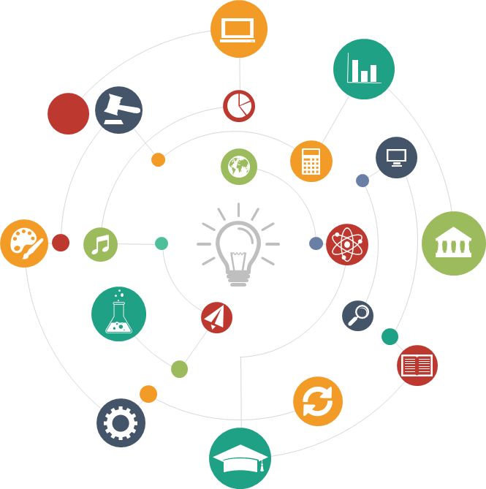

FaceBook Public Data Analysis
In-class project progress
Wenbo Sun
Jianan Wen
Zixuan Xu
March 14th

Slide 2
Why Social Media
12M
3M
5M
9M
4M
FaceBook as one of the most popular social media, have millions users sharing information
them of their lives every day.
What information can we know from that?
How much can we know them by these information published on social media? In other word, what kind of person the user is?

Slide 3
Problem Statement
Facebook Personal information capture, analysis, classification by using machine learning.
By grabbing the information posted by the user on the FB home page, it includes the text, pictures, the time when the information was released, and the associated user and other aspects to complete the machine learning. Realize the program's initial understanding of a homepage and be able to make effective and accurate predictions.
Date Set
We will have a web scraper to get those raw data from Facebook. Then we will use various big data analyses tools and technique to generate our own dataset.
Facebook only allows the extraction of information published on user’s own home page, or content published on public accounts. In this case we can’t deal with personal account.

Slide 4
Process Diagram
4.Extract Keywords
Analysis
Get a total of ten keywords in three categories: Location, Emotion, Common Keywords.
3.Download and remove pics after processing
Convert URLs to corresponding parameters via GoogleVisionAPI and classify them. Retain useful information and filter out verbose content.
Download images one by one for analysis and then delete them.
2.Category
The information fetched from the homepage is divided into three categories: 1.text information, 2.time of posting information, and 3.image link(url).
1.Facebook data crawling
FB only allows the extraction of information published on its home page, or content published on public accounts. Unable to get private account information. Using graphAPI to finish crawling.

Slide 5
Our Target
How to create a preliminary impression of a homepage？
Likes, Social circle
Daily/work schedule
Career, Title
Concerned field
Offer a Reward

Slide 6

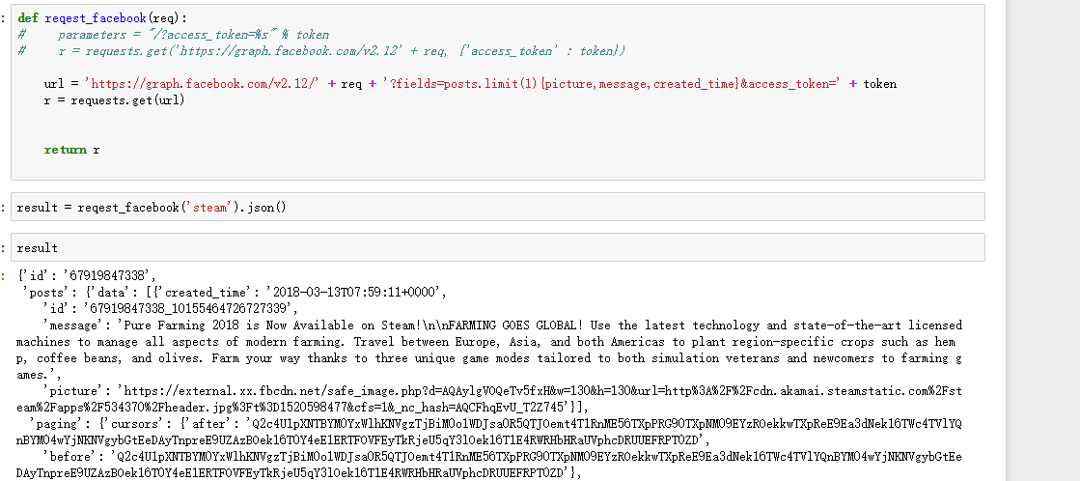
Project Progress
Using FacebookAPI to achieve data capture and save them into csv files.

Slide 7

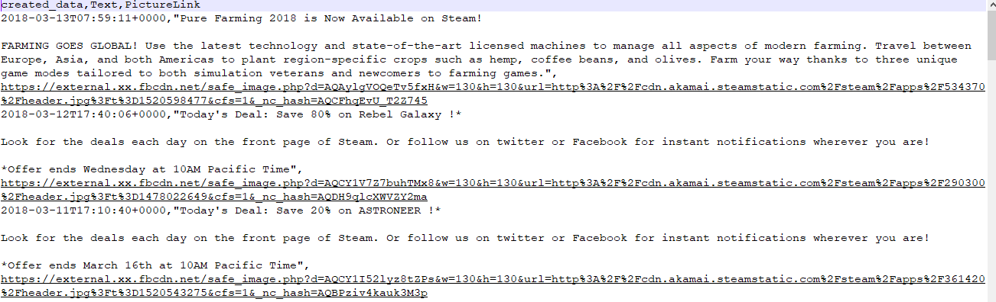
Project Progress
Using FacebookAPI to achieve data capture and save them into csv files.

Slide 8

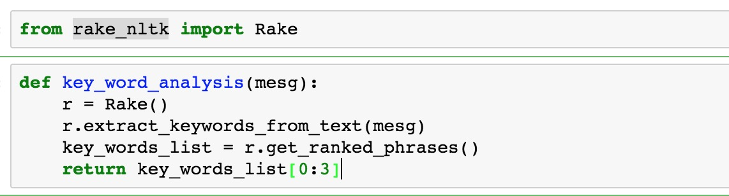
Project Progress
Key words crawling

Slide 9
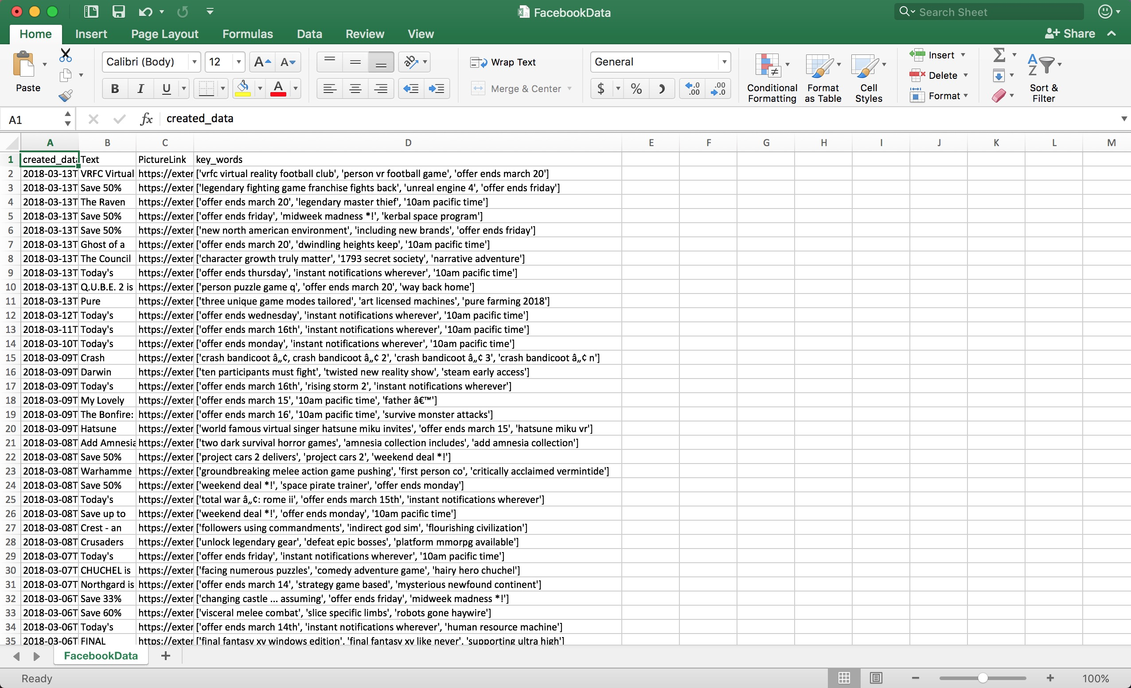

Slide 10

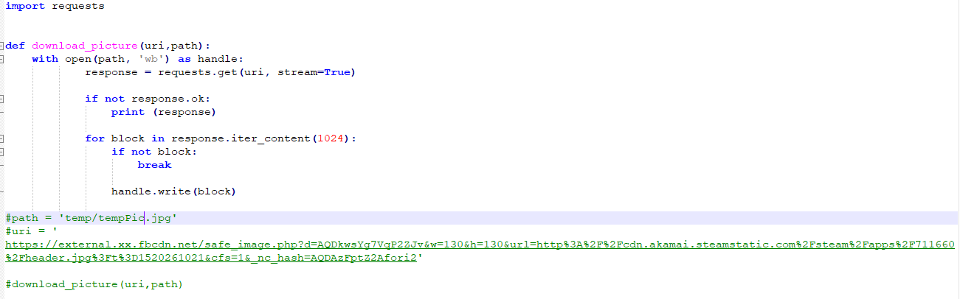
Project Progress
download picture(url format)， then delete after analysis.

Slide 11

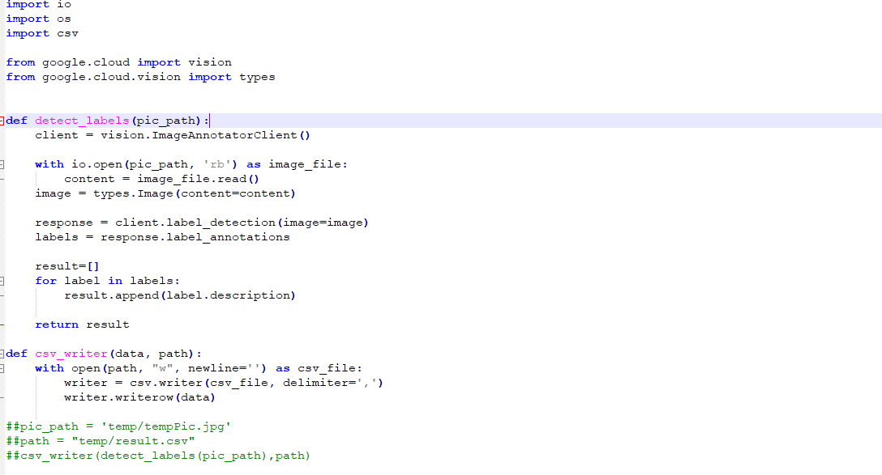
Project Progress
Using GoogleVisionAPI to analysis picture(url format)， then delete after analysis.

Slide 12


Project Progress
Using GoogleVisionAPI to download picture(url format)， then delete after analysis.

Slide 13
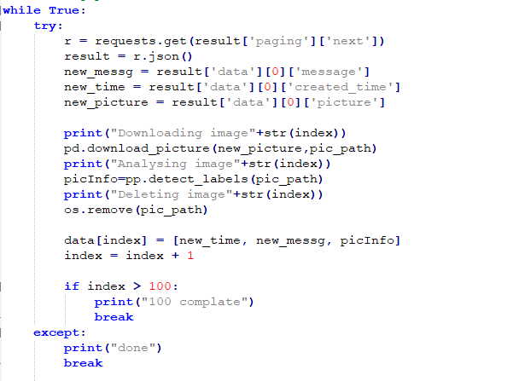
Project Progress
Saving the corresponding facebook account and analysis result into csv file.

Slide 14
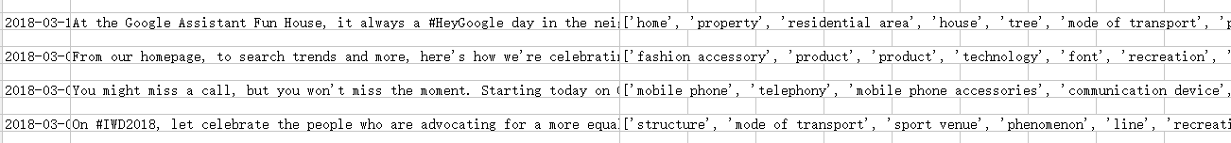
Project Progress
Saving the corresponding facebook account and analysis result into csv file.

Slide 15
Facebook(account) with result data in a csv file.

Slide 16

Thank you!

