Slide 1
Hibernate
An Object-Relational mapping framework
for object persistence

Slide 2
What Hibernate Does
Object - Relational mapping
Transparent persistence & retrieval of objects
Persistence of associations and collections
Guaranteed uniqueness of an object (within a session)

Slide 3
Hibernate Features
O-R mapping using ordinary JavaBeans
Can set attributes using private fields or private setter methods
Lazy instantiation of collections (configurable)
Polymorphic queries, object-oriented query language
Cascading persist & retrieve for associations, including collections and many-to-many
Transaction management with rollback
Can integrate with other container-provided services

Slide 4
Application Architecture
User Interface
UI event
data xfer object
Application Logic
data request
domain object
Domain Objects
DAO
SessionFactory
Hibernate API
domain object
Hibernate
hibernate.cfg.xml
JDBC API
ResultSet, etc.
*.hbm.xml class mappings
Foundation Classes
JDBC

Slide 5
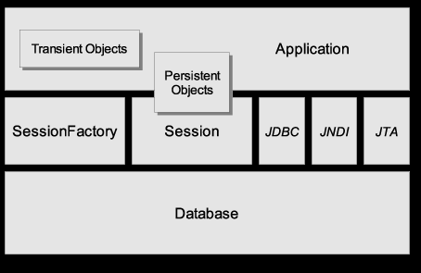
Another View
Source: Hibernate Reference Manual (online)

Slide 6

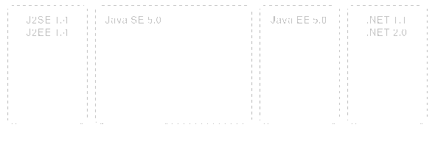
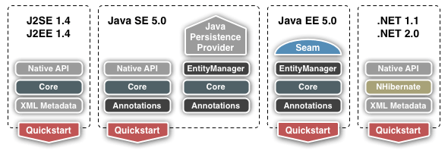
Where to Get Hibernate
http://www.hibernate.org
Local copy:
http://se.cpe.ku.ac.th/download/hibernate

Slide 7
Make XML file,Scan,Transaction to Database:
@Configuration @ComponentScan(basePackages="com.niit.basic") @EnableTransactionManagement

Slide 8
Initialize Session Factory:
@Bean(name="sessionFactory")
@Autowired
public LocalSessionFactoryBean sessionFactory() { LocalSessionFactoryBean sessionFactory = new LocalSessionFactoryBean(); sessionFactory.setDataSource(dataSource()); sessionFactory.setPackagesToScan("com.niit.basic.model"); sessionFactory.setHibernateProperties(hibernateProperties()); return sessionFactory; }

Slide 9
Property:
private Properties hibernateProperties() { Properties properties=new Properties(); properties.setProperty("hibernate.show_sql","true"); properties.setProperty("hibernate.dialect", "org.hibernate.dialect.H2Dialect"); properties.setProperty("hibernate.hbm2ddl.auto","update"); return properties; }

Slide 10
DataSource:
@Bean(name="dataSource")
public DataSource dataSource() { DriverManagerDataSource dataSource = new DriverManagerDataSource(); dataSource.setDriverClassName("org.h2.Driver"); dataSource.setUrl("jdbc:h2:tcp://localhost/~/test"); dataSource.setUsername("sa"); dataSource.setPassword(""); return dataSource; }

Slide 11
Transaction:
@Bean(name="transactionManager")
@Autowired
public HibernateTransactionManager transactionManager(SessionFactory sessionFactory) { HibernateTransactionManager hibernateTransactionManager= new HibernateTransactionManager(); hibernateTransactionManager.setSessionFactory(sessionFactory); return hibernateTransactionManager; }

