Slide 1
RapTAT
Rapid Text Annotation Tool
An Automated Clinical Annotation tool

Slide 2
What is an Annotation?
The process used humans to classify data by associating it with
a common concept or meaning is called annotation.
Text Annotation is the process of marking up relevant text
with meaningful concepts with application/domain specific meanings.
Why do we need to do it?
The main reason for annotation is to have relevant text within documents
tagged with concepts that can be interpreted by humans implicitly
or by software tools like RapTAT

Slide 3
Human Vs. Machine
Humans manually annotating and analyzing large amounts of data
Advantages
Human ability to detect context and ambiguity
Disadvantages
Expensive
Time intensive task
Error prone due to annotator level of familiarity and training in the domain/ field
Machine Supported Annotation
Advantages
Tools help to annotate large amounts of data
Faster than humans
Less expensive
Disadvantages
Amount of training required for the tool to be able to achieve high performance
Ambiguity of concepts must be identified and handled by the tool correctly.
Identification of new concepts that can be added to the schema/ontology.
Notes:
Humans can detect differences in word usage, context and ambiguity in the text.
This is why we use Human annotations as the Gold Standard

Slide 4
Machine annotation systems can be classified into 2 primary categories
Pattern based systems
Pattern Discovery and Rule-based pattern recognition
Examples:
GATE (General Architecture for Text Engineering) - JAPE Pattern recognition tool
YTex - DocumentAnalyser tool
Machine learning based systems
Statistical methods to predict the occurrence of text within the documents
Probability
Induction
Notes:
GATE, YTEX -Expand and explain

Slide 5
Why do we need RapTAT for Annotating Documents?
RapTAT can handle large amounts of data
Real time performance
Adaptability to any domain
High efficiency and accuracy
Ease of use
Works as a plugin to assist with annotation tools such as
Knowtator/Protégé, GATE, UIMA
EHOST
Notes:
Ehost-Annotation tool developed by informatics team in Uty of Utah and VA slc

Slide 6
More about RapTAT…
RapTAT uses a multi-strategic approach combining both
Pattern based (GATE –Open NLP) & Machine learning approaches –(Bayesian algorithms) to harness the advantages offered by both systems
RapTAT learns through human annotated training data with labeled phrases
Higher the number of training documents, higher is the performance close to 98% F-measure with at least 1000 training documents

Slide 7
Performance Analysis
Input
CSV Files containing Phrases and Concepts
Bootstrap Analysis
Random sample with replacement taken of all documents in corpus (2,860 docs)
Scored true positives (TP), false positives (FP), and false negatives (NP) after 1000
iterations
Overall Performance
F Measure: 0.95 – 0.97

Slide 8
Annotating with RapTAT
1. Training the Machine Learning Algorithm in RapTAT
2. Evaluating the System
3. Performance Measurement and continued training to reach
desired level of proficiency
4. Independent Annotations on free text

Slide 9
Training the RapTAT Machine Annotation Tool
Input and output formats
CSV, Text and XML
Algorithms
Naïve Bayes Algorithm
Non-Naïve Bayes Algorithm
Creation of a Solution file
Identifying probable concepts for a given phrase within a file containing free text using statistical algorithms. This solution file can be used for annotation by RapTAT or by GATE /UIMA pipeline for matching phrases to concepts

Slide 10
Machine Annotation by RapTAT
Compatible Input formats
CSV
Text documents
Loading the solution file
Annotation by RapTAT
Export of RapTAT annotations
Export (output) formats include
Knowtator XML
EHost XML
CSV
UIMA

Slide 11
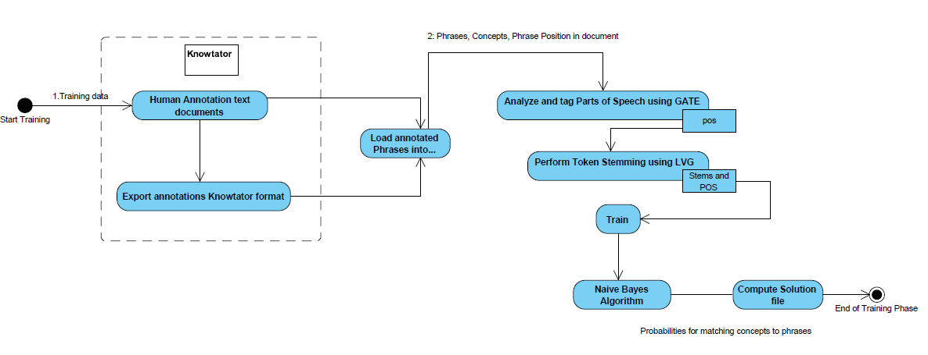
Process Flow for Training RapTAT

Slide 12
Tagging Parts of Speech
OpenNLP
Sentence Splitter
Tokenizer
Phrase Chunker
Input text: “The vitrectomy was performed.“
OpenNLP Output: AnnotationImpl: id=144; type=Token; features={source=openNLP,
string=performed, category=VBN, chunk=I-VP}; start=NodeImpl: id=257; offset=769;
end=NodeImpl: id=258; offset=778

Slide 13
Stemming using LVG
“..The vitrectomy was performed.”
AnnotationImpl: id=144; type=Token; features={source=openNLP, string=performed, category=VBN, chunk=I-VP}; start=NodeImpl: id=257; offset=769; end=NodeImpl: id=258; offset=778
TokenWord: performed VBN
PosCandidates: (POS to LVG)
4|32
64|32
1024|1
Lexical Variants generated by LVG:
perform|1024|1|perform
perform|1024|262144|perform
perform|1024|1024|perform
performed|1024|32|perform
performed|1024|64|perform

Slide 14
Parts of speech (POS) tags that are tagged by the OpenNLP pos tagger are a combination of LVG Category and Inflections for any given token. The mappings show different combinations in order to find the correct stem for a word.
Inflectional variants→
Category | 1 base | 2 comparative | 4 superlative | 8 plural | 16 pres participle | 32 past | 64 past participle | 128 pres3S | 256 positive | 512 singular | 1024 infinitive | 262144 Pres1p23p | 1048576 Past1s3s
Adj | JJ | JJR | JJS |  |  |  |  |  | JJ
adv | RB,RP,WRB | RBR | RBS |  |  |  |  |  | RB
aux | VB |  |  |  |  | VBN |  | VBZ |  |  |  | VBP | VBD
compl
conj | CC,IN
det | DT,IN,JJ,WDT,PDT
modal | MD,VB |  |  |  |  | MD, VBN
noun | NN,NNP, NNS,NPS |  |  | NNS |  |  |  |  |  |  | NNP
prep | IN, TO
pron | WPS,WP,PRP$, PRP, WP$,PRPR$,PP
verb | VBP,VB,MD, VBN |  | VBD |  | VBG | VBN, VBD | VBN | VBZ |  |  | VB

Slide 15
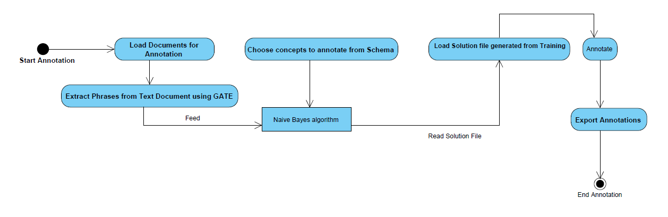
Process flow for Annotating with RapTAT
Compatible Input format-CSV, Text
Loading the solution file
Annotation by RapTAT
Export of RapTAT annotations

Slide 16
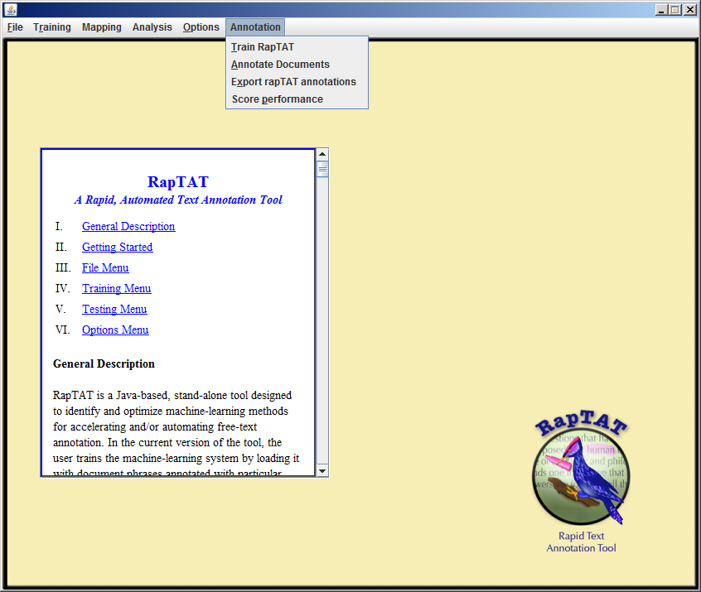
RapTAT User Interface

Slide 17
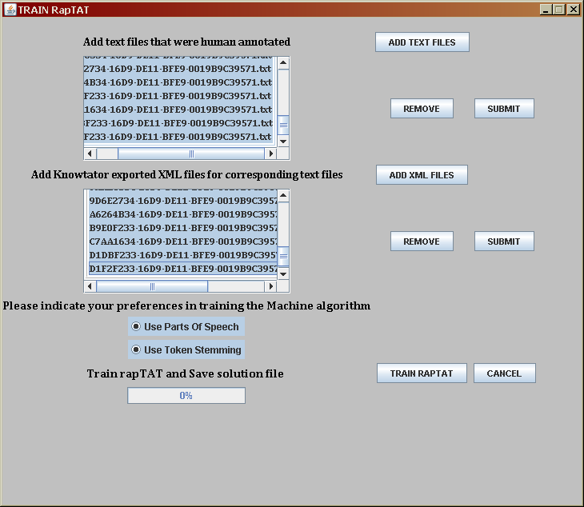
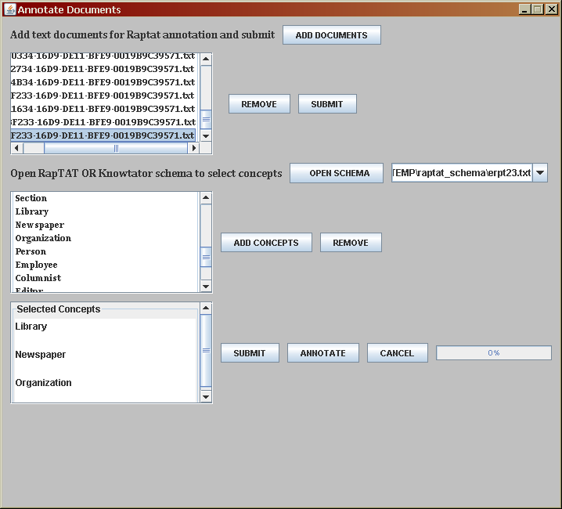
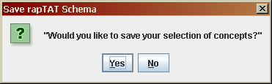

Slide 18
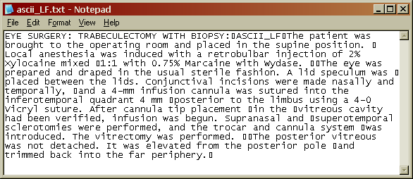
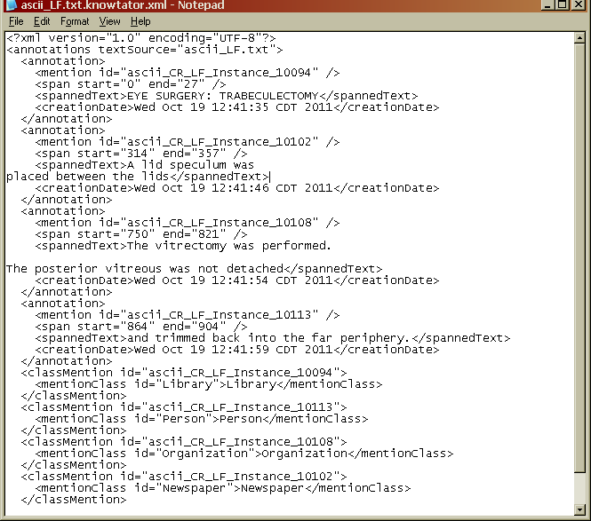
RapTAT Input files

Slide 19
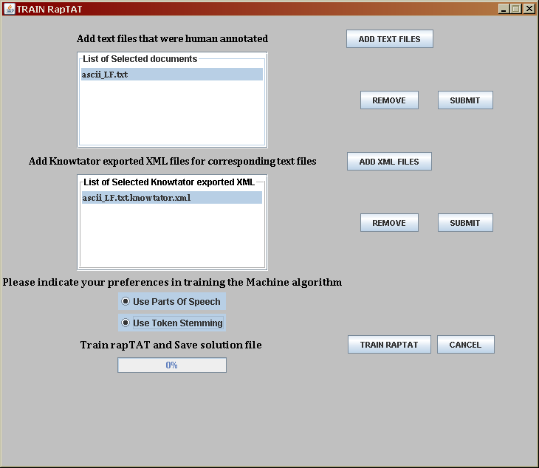
RapTAT in action..
Training data:
Raw Text and Knowtator XML file
After passing through NLP pipeline
EYE|NNP|eye|0|3 SURGERY|NNP|surgery|4|11 TRABECULECTOMY|NN|trabeculectomy|13|27
A|DT|a|314|315 lid|NN|lid|316|319 specul|NN|specul|320|326 um|NN|um|326|328 was|VBD|be|329|332 placed|VBN|place|334|340 between|IN|between|341|348 the|DT|the|349|352 lids|NNS|lid|353|357
The|DT|the|750|753 vitrectomy|NN|vitrectomy|754|764 was|VBD|be|765|768 performed|VBN|perform|769|778 The|DT|the|782|785 posterior|JJ|posterior|786|795 vitreous|JJ|vitreous|796|804 was|VBD|be|805|808 not|RB|not|809|812 detached|VBN|detach|813|821
and|CC|and|864|867 trimmed|VBD|trim|868|875 back|RB|back|876|880 into|IN|into|881|885 the|DT|the|886|889 far|JJ|far|890|893 periphery|NN|periphery|894|903
Trained Solution

Slide 20
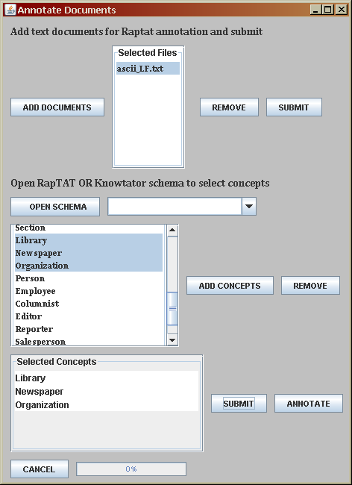
RapTAT Annotation Process
Input file for annotation: Medical notes
Load trained solution file: .Soln bin file
Load OpenNLP Extracted Phrases:
The patient
was brought
to the operating room placed in the supine position
Local anesthesia
was induced with a retrobulbar injection
of 2 % Xylocaine mixed 1:1
with 0.75 % Marcaine with Wydase The eye was prepared draped in the usual sterile fashion incisions were made
nasally and temporally
a 4-mm infusion cannula
Annotations done by RapTAT
to Organization
in Organization
with Newspaper
in Organization
between Organization
nasally and temporally Newspaper
into Organization
to Organization
using Newspaper
in Organization
were performed Organization
Phrases Identified by OpenNLP
Concepts tagged by RapTAT

Slide 21
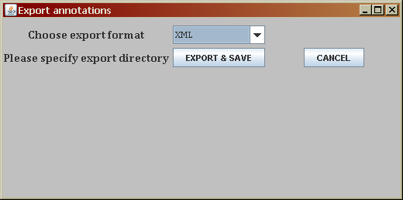
Annotations exported in Knowtator XML
<?xml version="1.0" encoding="UTF-8"?>
<annotations textSource="ascii_LF.txt">
- <annotation>
<mention id="RAPTAT_INSTANCE_47499348755" />
<annotator id="RAPTAT" />
<span start="683" end="697" />
<spannedText>were performed</spannedText>
</annotation>
- <classMention id="RAPTAT_INSTANCE_47499348755">
<mentionClass id="Organization">Organization</mentionClass>
</classMention>

Slide 22
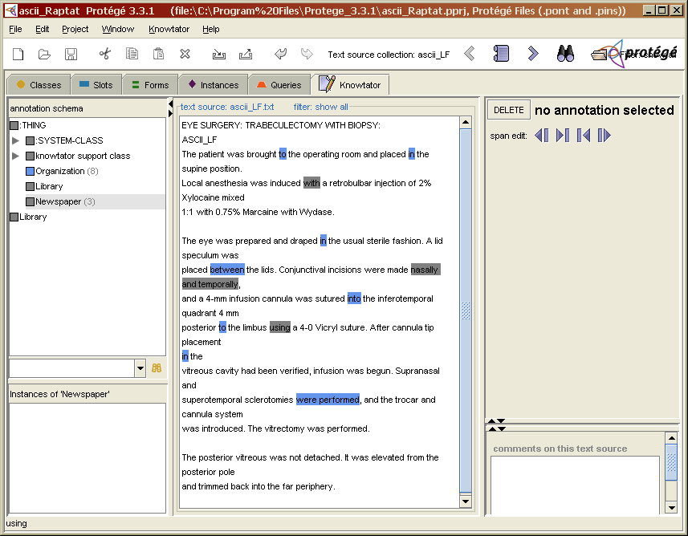
RapTAT annotations displayed in Protégé/Knowtator

Slide 23
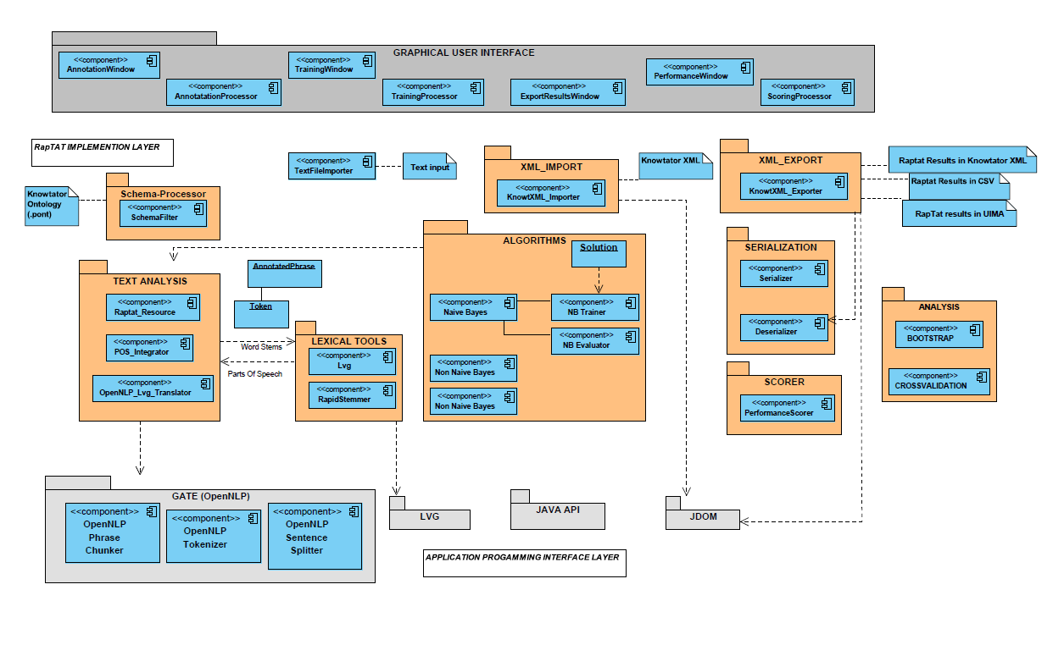
RapTAT Architecture (NLP Pipeline and Machine Learning)

Slide 24
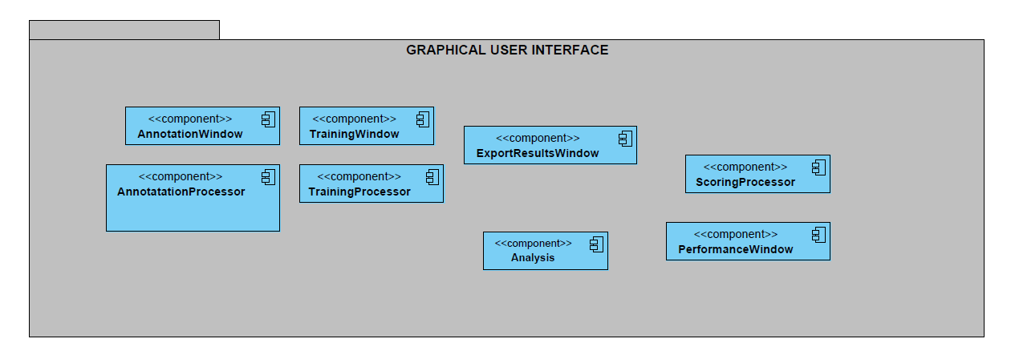
Application GUI Layer

Slide 25
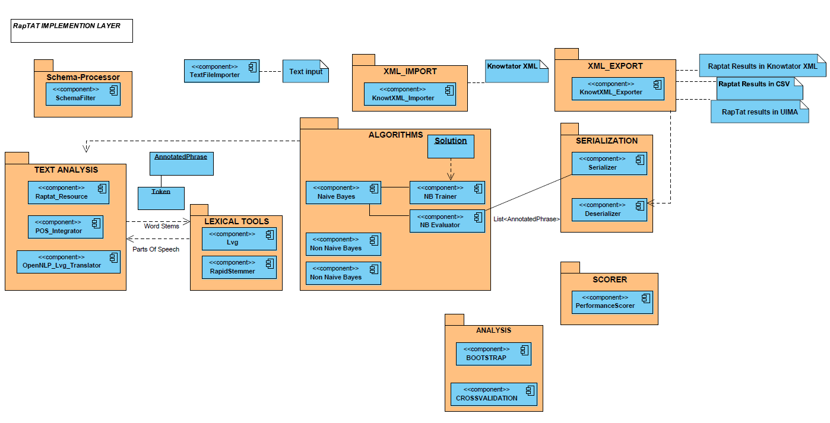
RapTAT Layer

Slide 26
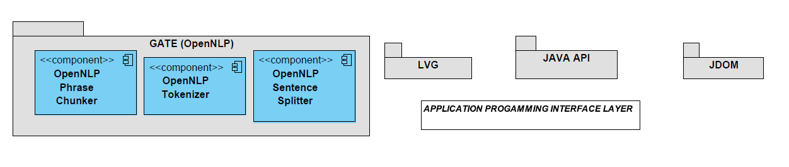
Application Programming Interface Layer

Slide 27
Ongoing & Future Development
RapTAT integration into Ehost NLP annotation tool
Implementation of Decision Tree Machine learning algorithm
Training on and Annotating on PTSD documents
Integration of RapTAT with a variety of Open source NLP systems
including Ytex, cTAKES and Hitex

Slide 28
Acknowledgements
Michael Matheny
Theodore Speroff
Steven Brown
Dario Giuse
Glenn T Gobbel
Ruth Reeves
Lalit Nookala
Funding
VA Informatics Fellowship (Gobbel)
Vanderbilt Dept. of Biomedical Informatics
VA HSR&D CHIR Center Grant (Samore)
VA HSR&D CDP-09-387 (Matheny)

