Slide 1
Ubisoldiers
Ubiquitous Game of Strategy and Collectible Cards

Slide 2
Smart Space
UbiSoldiers is based in the World Map. Its main focus it the city of Brasilia, where it will be tested, but the mechanics support the entire world map.

Slide 3
Devices
UbiSoldiers is intended to be played on smartphones and tablets. All design decisions aim to improve the player's experience on those devices. But it could be played on any device which does provide the necessary resources: a localization provider (such as GPS), and any other resource which would eventually be used by the SPDT plugins: Wifi, camera, etc.

Slide 4
Resources
UbiSoldiers requires a localization provider (such as GPS). The game cannot be player without it. This is the main requirement, but the use of additional SPDT plugins may impose further restrictions, such as the availability of a Wifi connection, camera, etc.

Slide 5
Services
Through the SPDT plugin architecture, all available services are accessed through an unified, and very simple, interface. Each interactions with the physical environment is abstract to a single number, which is applied to the SPDT. As consequence, the only necessary services is the provision of a number which accurately represents a real-world resource.
There is only one limitation for the services: each real-world entity must be mapped to a unidimensional scale, where greater numbers always represent "better", and lower numbers always represent "worse". There can be no subjectivity.

Slide 6
Application
Story
Concepts
Mechanics

Slide 7
Story
The world is at War. Elite squads of paramilitary forces are fighting for power! Gather your forces and crush everyone who stands in your way. Only you can claim to bring peace through war, and ascend as a true Hypocrite!

Slide 8
Concepts
Searches
Items
Soldiers
Weapons
Armor
Army
Squad
Battle

Slide 9
SPDT
Item | Probability
Command Sergeant Major | 0,08%
L86LSQW | 0,08%
Sergeant Major | 0,40%
Model 1887 | 0,40%
Barret | 0,40%
Sergeant First Class | 2,39%
First Sergeant | 2,39%
Master Sergeant | 2,39%
MP5 | 2,39%
M60E4 | 2,39%
KSG12 | 2,39%
SPAS12 | 2,39%
Titanium Kevlar | 2,39%
Corporal | 3,98%
Sergeant | 3,98%
Staff Sergeant | 3,98%
FAD | 3,98%
P90 | 3,98%
MP7 | 3,98%
KGS12 | 3,98%
L118A | 3,98%
Striker | 3,98%
Reinforced Kevlar | 3,98%
M16A4 | 7,96%
M4A1 | 7,96%
G36C | 7,96%
MK14 | 7,96%
USAS12 | 7,96%

Slide 10
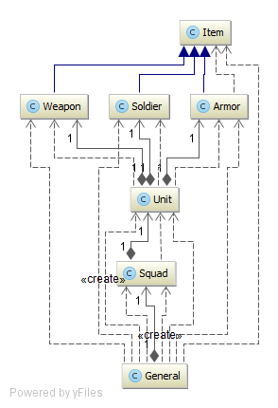
Data Classes

Slide 11
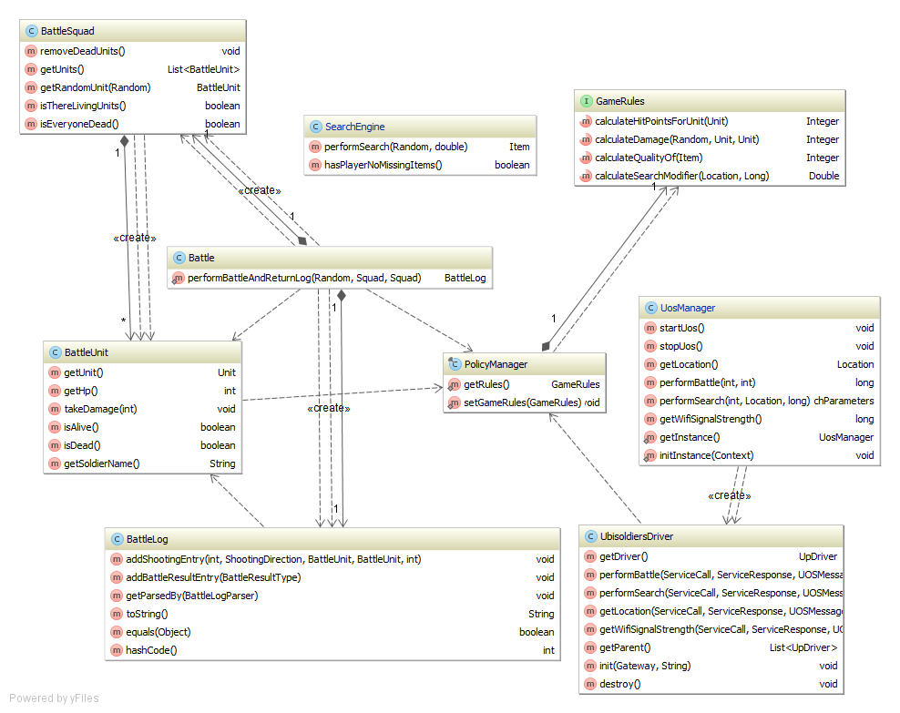
Business Classes

Slide 12
Dúvidas

