Slide 1
Automotive Cyber Security
Andi Otea
May 2018

Slide 2

Automotive Cyber Security Content
Modern Car
Automotive Cyber-Security overview
Aims of Security
Layered Security Concept
Secure Download
Secure Boot
Secure Communication
Secure Diagnostics

Slide 3
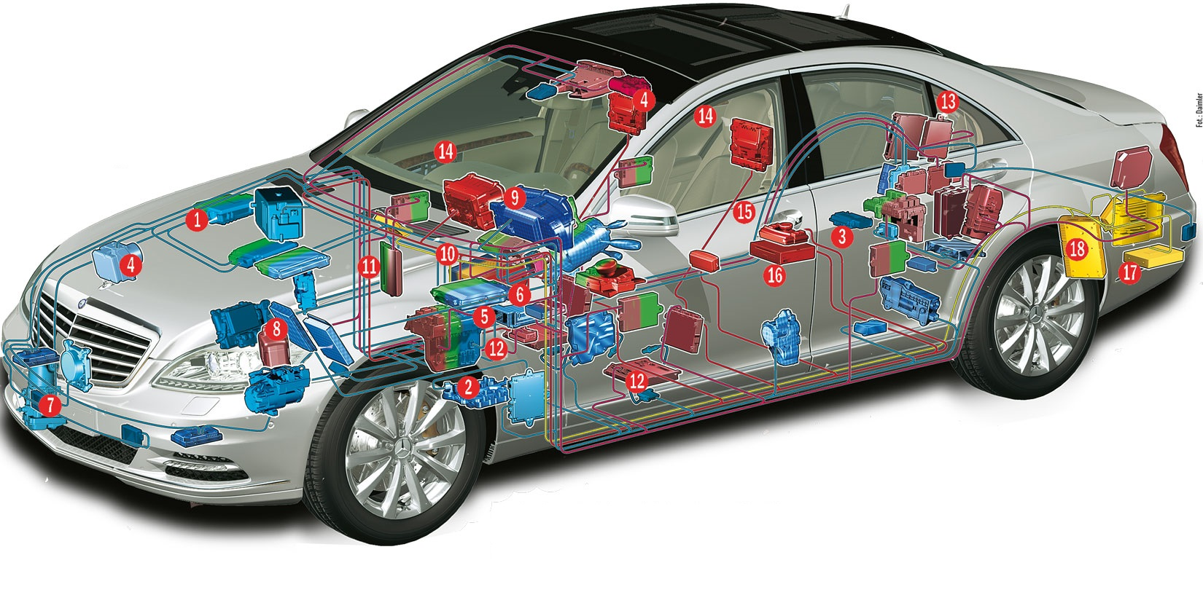
Automotive Cyber Security Modern cars are complex

Slide 4


Automotive Cyber Security Automotive Cyber Security overview
“Remember to lock your car” is no longer sufficient advice to protect your vehicle
Computer attacks are now a clear and present danger for car users, dealers, manufacturers, and suppliers

Slide 5
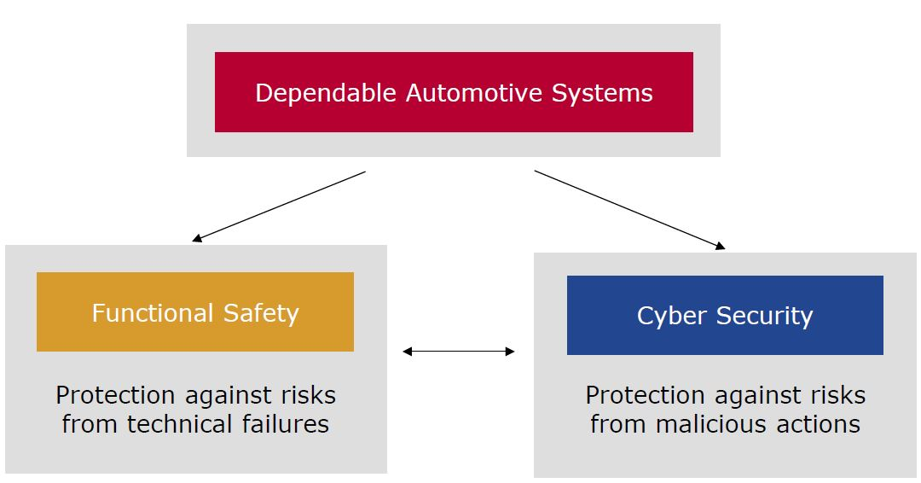
Automotive Cyber Security Automotive Security & Safety
Computer security joins reliability and safety as a cornerstone for consumer confidence and continued success in the automotive industry

Slide 6
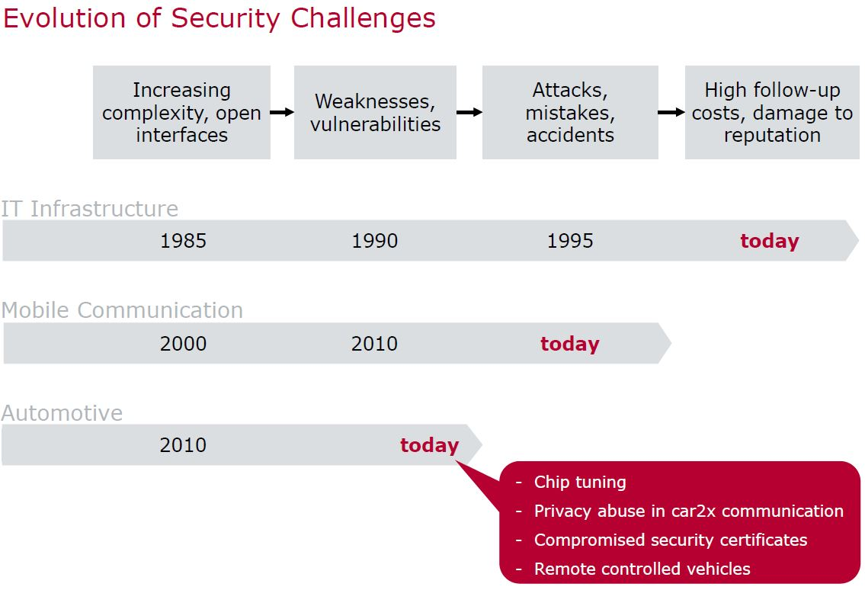
Automotive Cyber Security Evolution of Security Challenges

Slide 7
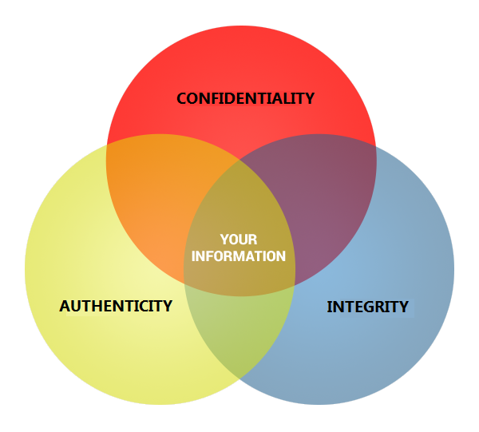
Automotive Cyber Security Aims of Security

Slide 8
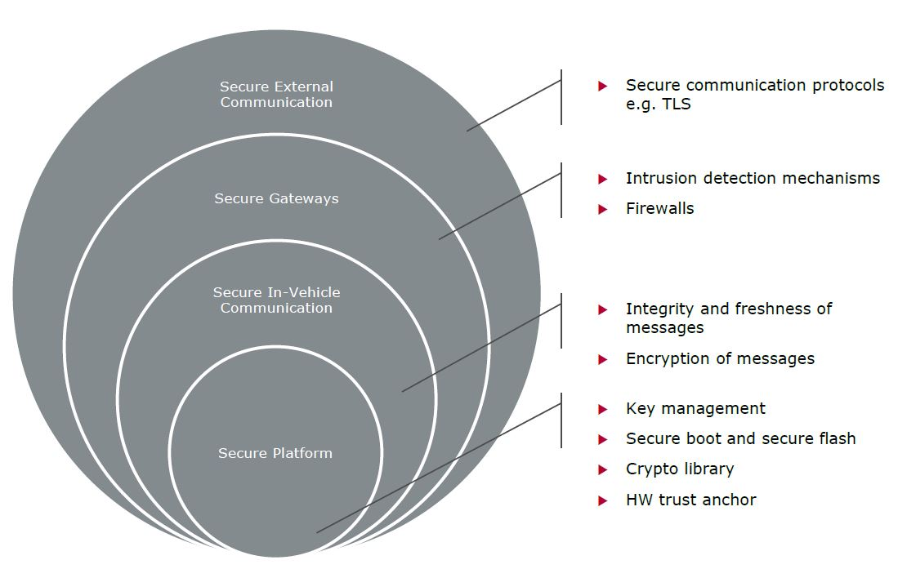
Automotive Cyber Security Layered Security Concept

Slide 9

Automotive Cyber Security Secure Download
Security Goal: Confidentiality, Authenticity and Integrity of Software and System Data
It shall be ensured that SW is downloaded to the ECU in a secured way, i.e.:
the download image cannot be investigated while transmitted to the ECU
the download image has not been created/modified by an unauthorized party
the download image has been correctly flashed to the ECU without any errors

Slide 10
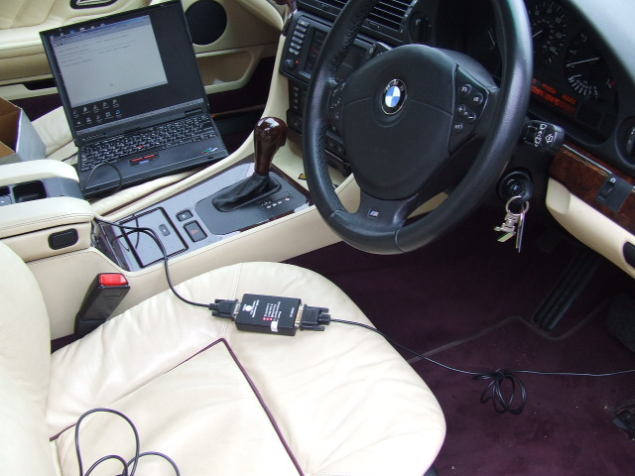
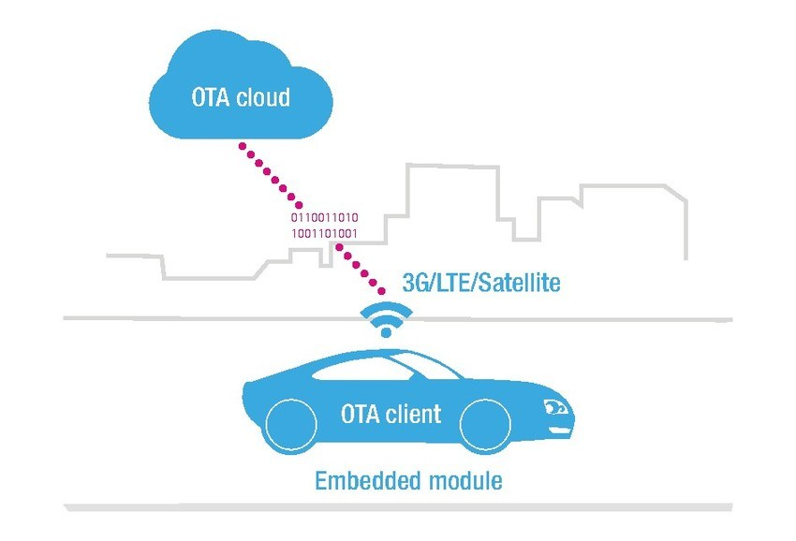
Automotive Cyber Security Secure Download
Classic Software update – tester connected directly to the car
Over the Air (OTA) update – software update received wirelessly
Secure Transfer: Send Software update Encrypted
Authenticity check: recalculate the Hash on the received Software and compare it with a “Reference Hash”

Slide 11

Automotive Cyber Security Secure Boot
Security Goal: Authenticity and Integrity of Software
It shall be ensured that only SW with proven authenticity & integrity is executed:
that has not been created/modified by an unauthorized party
that has been correctly flashed to the ECU without any errors
To provide Secure Boot functionality the ECU must be equipped with a HSM (hardware security module) that acts as a trust anchor

Slide 12
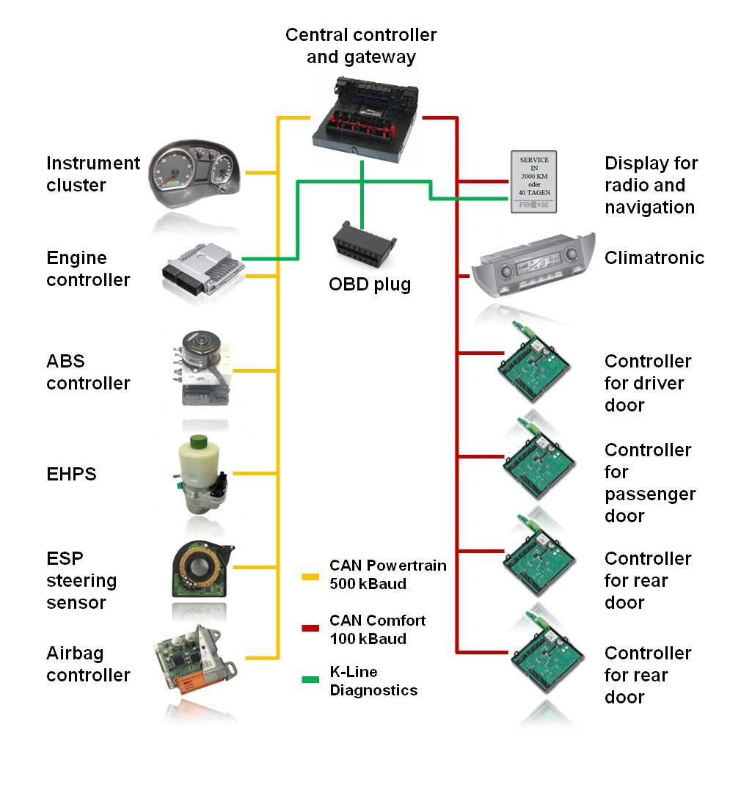
Automotive Cyber Security Secure Communication

Slide 13
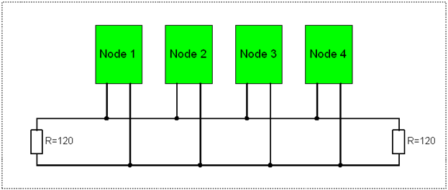
Automotive Cyber Security Secure Communication
Security Goal: Authenticity and Integrity of onboard-communication
It shall be ensured that messages transferred over onboard communication busses:
cannot be manipulated during transmission
cannot be recorded and transmitted later again (replay attack)
e.g. by an attacker without detection by the receiver of the message

Slide 14
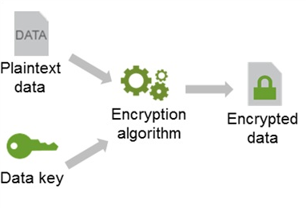
Automotive Cyber Security Criptographic Hash function
It is a mathematical algorithm that maps data of arbitrary size to a bit string of a fixed size
Is designed to be a one-way function (a function infeasible to invert)
Usecases: digital signatures and Message Authentication Codes (MACs)
A key is a piece of information (a parameter) that determines the functional output of a cryptographic algorithm

Slide 15
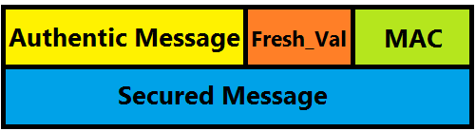
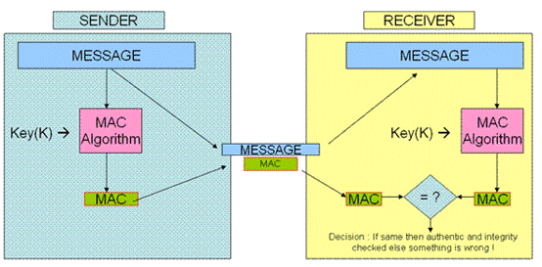
Automotive Cyber Security Key-Hashed MAC

Slide 16
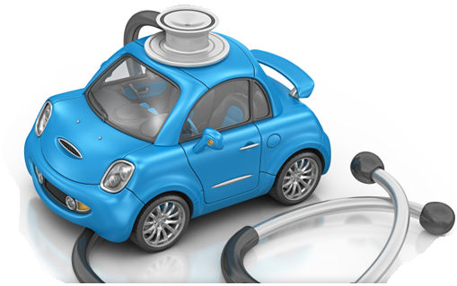
Automotive Cyber Security Secure Diagnostics
Modern care has multiple ECUs with complex software
There is need for interacting with the car
Parameter changes
Check errors
This should be done only by authorized persons, in a secure way

Slide 17

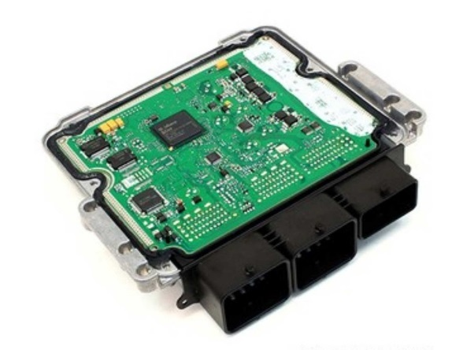
Automotive Cyber Security Secure Diagnostics
Usage of standard Security Access Service($27)
Tester (Client) request access and receives from ECU (Server) a “Seed”
Tester calculates a password (based on “Seed” and a diagnosis secret Key)
The ECU calculate its own password (in the same way)
Tester sends the password to ECU, and if passwords match access is granted
Access Req
Send Seed
Send Password

Slide 18

Automotive Cyber Security Thank You!

