Slide 1

CYCLISTIC
INSIGHTS ABOUT RIDING PATTERNS
By – Gobind Puri

Slide 2
OUTLI NE
Key topics for discussion
Background
Objective
Key Insights
Recommendations

Slide 3
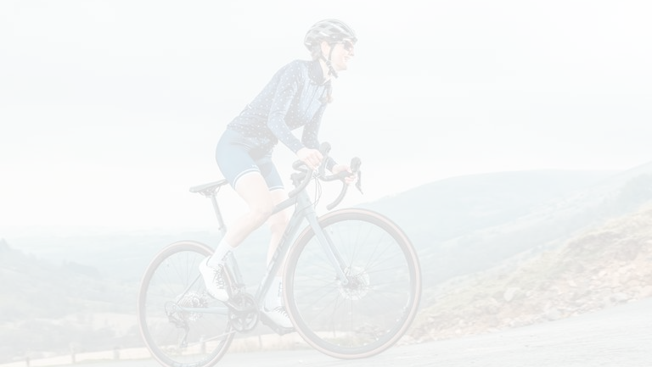
BACKGROUND
Cyclistic is providing bike sharing services through:
Single-ride passes Full day passes Annual membership
Customers opting for first two options are referred to as casuals.
Customers opting for third option are referred to as members

Slide 4


OBJECTIVE
To derive key insights from riding patterns of casual riders and members.
To deliver recommendations based on insights derived.

Slide 5
KEY
INSIGHTS

Slide 6
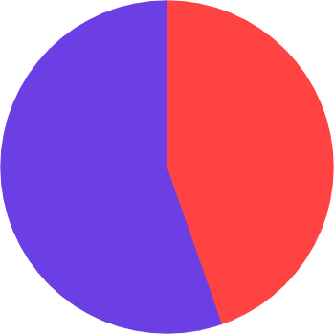
RIDES BREAKUP
No. of rides by user category
Rides taken by members are
slighly higher than that by casual riders
55%
45%

Slide 7
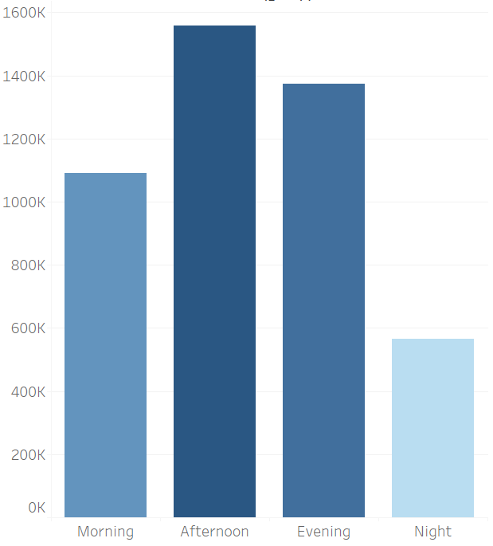
HOUR-WISE BREAKUP
No. of rides by day hours
Afternoon hours are the busiest.
Night hours witness 74% lesser rides than peak hours.

Slide 8
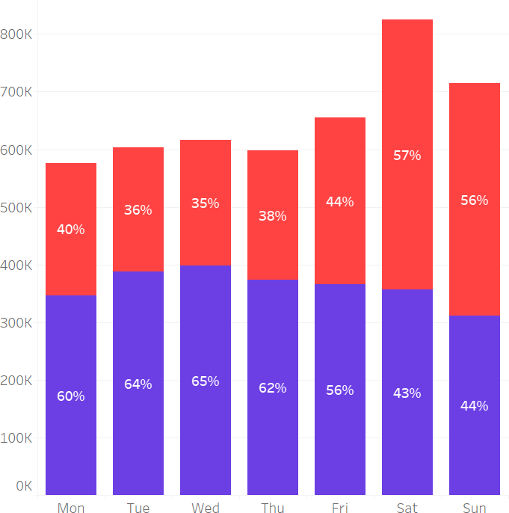
DAY-WISE BREAKUP
No. of rides by weekdays
Most rides happen on Saturday.
Casual Members
People ride 26% more on weekends as compared to weekdays.
Casual riders outweigh members on weekends

Slide 9
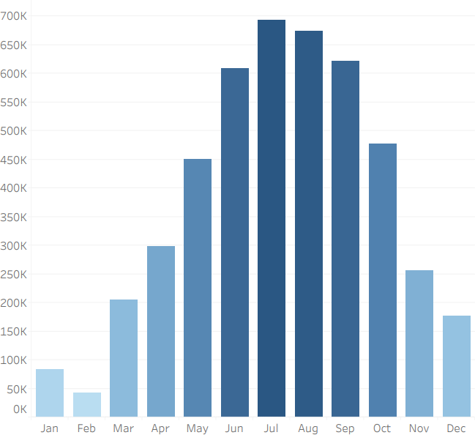
MONTH-WISE BREAKUP
No. of rides by Months
July, August and September
are peak months.
People ride least in January, Feburary and December.

Slide 10

DOES WEATHER AFFECT ?
No. of rides by weather
People tend to ride 80% less in colder months.
516 K
2.6 M

Slide 11
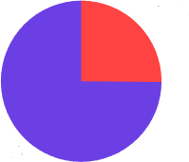
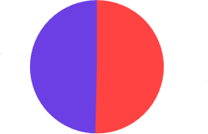

Cold Months
Proportion of rides by Rider type
Hot Months
25%
75%
49% 51%
Members ride 3 times more as compared to Casual riders
Casual riders are slightly
outnumbered.

Slide 12

HOW LONG I S A RI DE?
Proportion of rides by time duration
Over 2 hr
1 %
1 hr-2 hr
4 %
85% of rides finished under 30 minutes.
Under 1 0 min
43 %
1 0 min-30 min
42 %
Only 5% of rides go over 1 hour.
30 min-1 hr
10 %

Slide 13

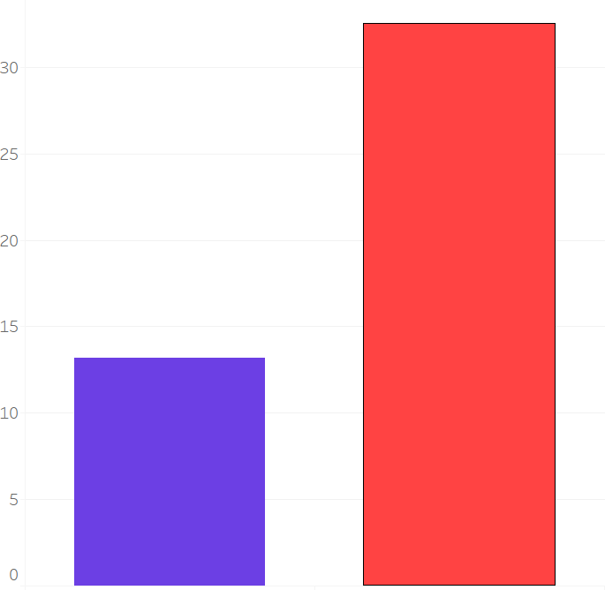

RIDE DURATION BREAKUP
Average ride duration in minutes
Casual riders tend to ride
20 minutes more than members.
Casual Members
33
Minutes
13
Minutes

Slide 14

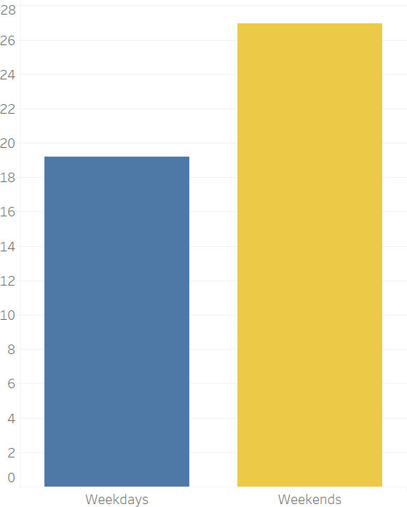
WEEKDAYS VS. WEEKENDS
Average ride duration in minutes
There is a 42% increase in ride duration during weekends
27
Minutes
19
Minutes

Slide 15
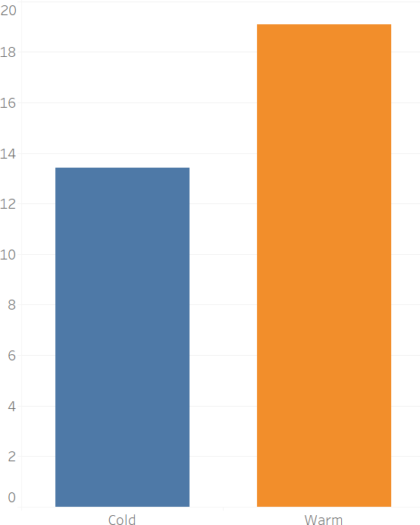
WEATHER AFFECT
Average ride duration in minutes
An increase of 46% in ride duration is seen during warm months.
19
Minutes
13
Minutes

Slide 16


RECOMMENDATIONS
Aggressive marketing during colder months.
Extra coupons and discount
Make annual membership seem cheaper
More priority to members during peak times
Introduce weekly and monthly passes.
Reconsider single ride passes

Slide 17
Marketing Strategy
Events and Influential Marketing: Conduct some events for healthy life style and relation with daily cycling. This might lead to increase in annual membership.
Attractive Pricing: Price annual membership in such a way that it seems to be cheaper.
Facilities: Extra facilities such as quick access to cycle that to of preferred type of customer who subscribe to annual model.

