Slide 1

Implementing an AI Travel Agent with LangGraph
Human-Aware, Stateful Agents Using Persistent Memory and Multiple LLMs
By Hammad Qaiser - 2021191

Slide 2
Why LangGraph Works for Real-World Agents
Directed Node Graph
LLMs, tools, and human inputs as nodes
Shared State
State flows across graph nodes for context
Persistent Memory
Enables full pause and resume cycles
Production Ready
Observability and modular architecture

Slide 3


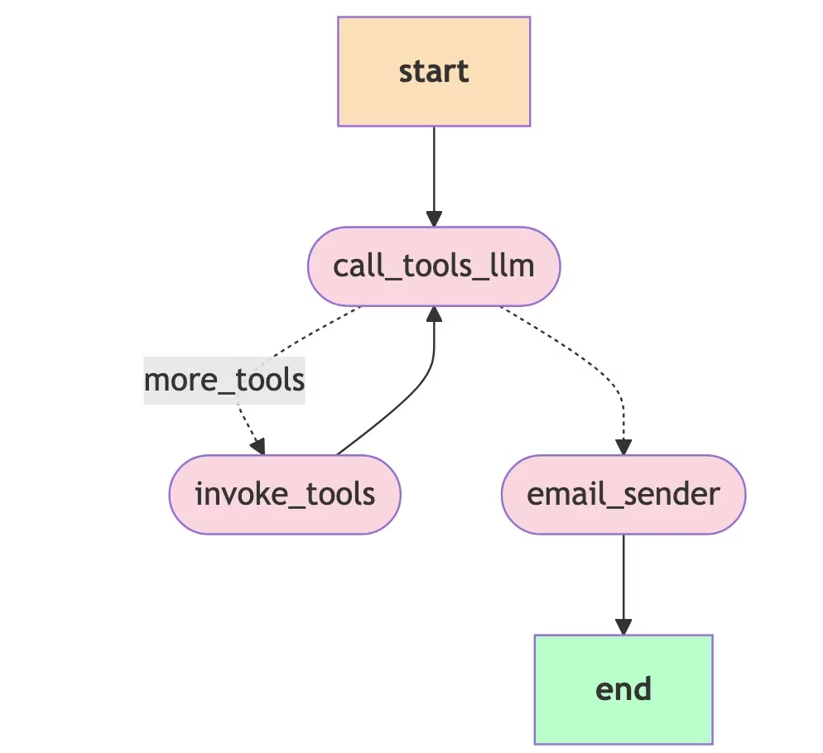



LangGraph Agent Workflow
Start
The workflow begins when the AI agent receives a task or input.
call_tools_llm:
The main language model (LLM) is called to interpret the task and decide which actions or tools to use next.
more_tools:
The agent can loop back to re-evaluate and call the language model again if additional tools or steps are needed.
Final Step
After completing required actions, the agent moves to a final step to complete the task, such as sending a notification or producing a result.

Slide 4

Real-World Agents Need Real-World Architecture
LangGraph solves state, control flow, human-in-loop needs
Agent becomes reliable, transparent, flexible
Ready for production and scalable deployments

Slide 5
Literature Review
Current Tools
Capabilities
Gaps Identified
Rule-based Systems
Basic travel assistance with fixed rules and limited scope
Lack flexibility and natural language understanding
GPT-4, GPT-4o (LLMs)
Advanced natural language processing, contextual understanding, content generation
Single LLM approach can be inefficient for complex workflows
LangGraph
Multi-LLM orchestration, persistent memory, modular workflows, human-in-the-loop support
Limited adoption and examples in travel domain
LangChain
Integration of multiple LLMs and tools, workflow management
Requires advanced setup; not tailored specifically for travel
API Integrations (SerpAPI, Flight APIs, etc.)
Access to live external data like flight schedules, weather, locations
Integration complexity; data inconsistency across sources
Human-in-the-Loop Systems
Allows user intervention at critical decision points
Can cause delays; requires smooth UX design

Slide 6
Memory That Survives Across Sessions
Persistent State Management
Code
MemorySaver checkpoints agent state
memory = MemorySaver()
self.graph = builder.compile(checkpointer=memory, interrupt_before=['email_sender'])
Pause/resume with thread_id per session
Supports Postgres, MongoDB, Redis
# Create a new thread ID
thread_id = str(uuid.uuid4())
st.session_state.thread_id = thread_id
# Create a message from the user input
messages = [HumanMessage(content=user_input)]
config = {'configurable': {'thread_id': thread_id}}
# Invoke the agent
result = st.session_state.agent.graph.invoke({'messages': messages}, config=config)

Slide 7
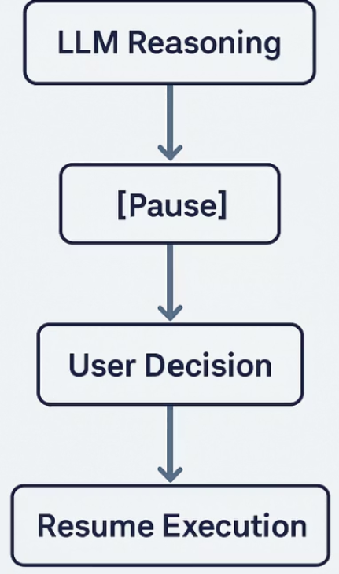
Pause for Approval - Human in the loop
How It Works in LangGraph:
Execution is paused before specific nodes using: interrupt_before=['decision_node']
The system waits for human input, then resumes from the same point using the saved state.
Implementation Details:
Persistent state via MemorySaver ensures accurate resume after human input.
Thread-specific context (thread_id) keeps multi-user sessions isolated and consistent.

Slide 8

Custom LangGraph Agent: LLMs + Tools Working in Sync
LLMs Used:
Tools Integrated:
Why this works:
🔹 gpt-4o — high-context reasoning, used for HTML email formatting and final outputs.
🔸 SerpAPI — fetch real-time flight, hotel, and location data.
LLMs and tools are dynamically routed based on the agent’s internal state.
🔸 LangGraph API — manage execution flow, invoke graphs with thread_id context.
LangGraph coordinates tool → LLM → human → output workflows seamlessly.

Slide 9
Tracing Agent Behavior with LangSmith
Enable Tracing
Benefits
Step-by-step graph execution introspection
LANGCHAIN_API_KEY=<your_key>
LANGCHAIN_TRACING_V2=true
LANGCHAIN_PROJECT=ai-travel-agent
Improves debugging and optimization
Production-ready monitoring

Slide 10
Demo

