Slide 1
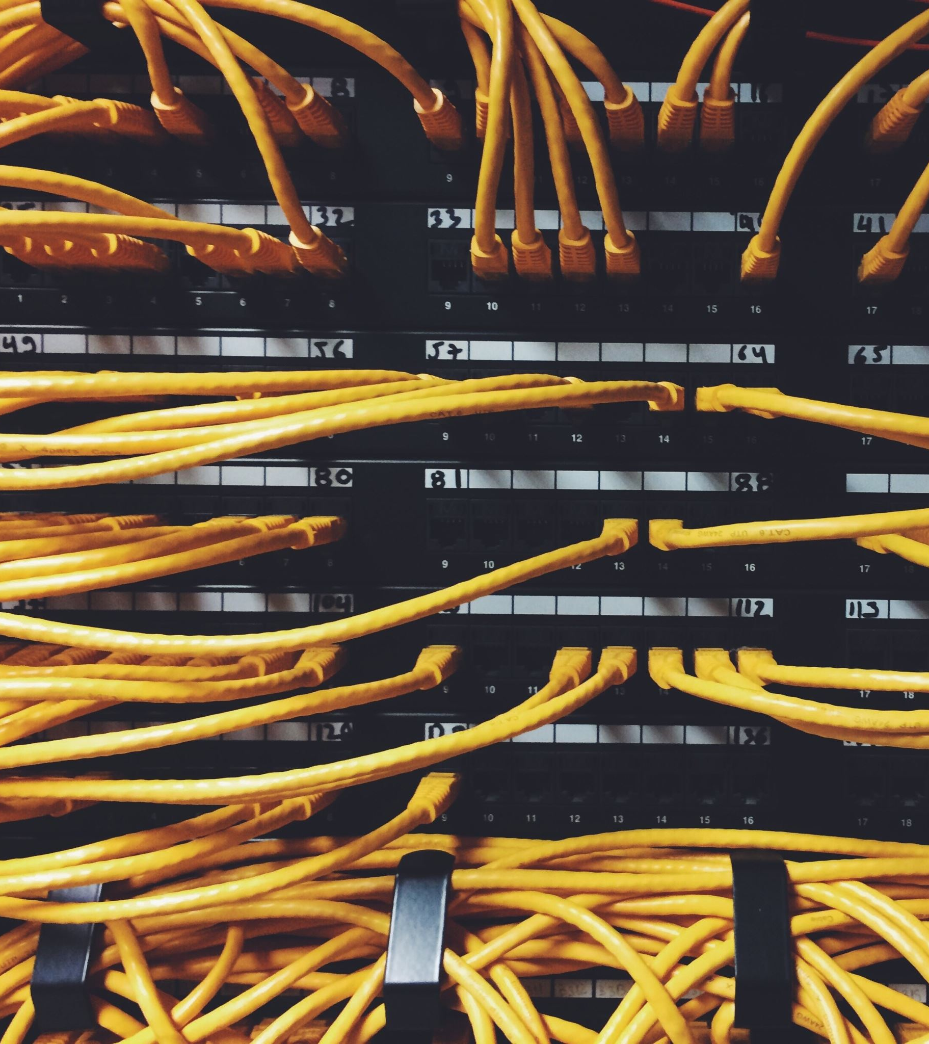
Nortek Presentation
By Gabriel Ocaga
Wed 20th March 2025

Slide 2
Nortek Presentation
Contents
RTU Software Development
Cable Validator Requirements
Cable Validator Test Cases

Slide 3

Rtu Software development
Help prove hardware.
A prioritized backlog of features. All features should be traceable to a test case.
Test against requirements, user stories and standards.
Board Bring Up Support
Feature Development
Testing
Board bring-up support to prove new hardware.
Support electronics engineers with base level software to test hardware interfaces and clocks.
Define software requirements.
Sources:
Requirements document.
User stories.
Standards e.g. cyber security, safety, Grid standards.
Design high-level architecture and detailed design e.g. State charts, flow charts, UML diagrams.
Plan work with the team in JIRA.
Implement features with an agile mindset.
e.g. with demonstrable software every 2 weeks within the team, and 1 month to the Management.
SW Release Management.
Release in phases e.g.
v1.0.0 – primary features
V1.2.0 – secondary features
V1.3.0 – tertiary features
Testing
User acceptance testing.
Regression tests after each release.
All bugs and issues will be resolved at this stage.
4
5
1
3
2

Slide 4
RTU SOFTWARE MILESTONES
30
30
31
29
April
APRIL
July
AUG
Board Bring-up
PROJECT PLAN
3 SW Releases
TESTING
Base Software for Electronics engineers to prove hardware.
A prioritized back-log.
Work allocated per engineer.
3x Demonstratable SW Releases to Product Owner and Management.
Software is ready to be released to the production line.

Slide 5
CABLE VALIDATOR
REQUIREMENTS
R1 - The cable validator should check for point-to-point continuity for up to 8 channels over digital I/Os within 400ms.
R2 - The cable validator should allow the user to select the number of channels to be tested.
R3 - The cable validator should notify the user or test-system when a break in continuity or an incorrect test-fixture setup is detected.
R4 - The cable validator should notify the user or test-system when the test is started and completed.
R5 - The cable validator should allow the user or test-system to start the test.
R6 - The cable validator should allow the user or test-system stop the test promptly.
R7 - The cable validator should allow the user to log the tests completed via a serial interface or to an onboard non-volatile memory.

Slide 6
CABLE VALIDATOR
TEST CASES
T1 - The cable validator should perform the test and return result in 400ms +/- 50ms
Given that the user has connected the cable assembly fixture
And has selected the number of channels to be tested.
When they send a command/push a button to start the continuity test.
Then the cable validator will notify that the test has started.
And should return a test result e.g. PASS or FAIL within 400ms +/- 50ms.
And with timestamps of start and end times in UTC time.

Slide 7
CABLE VALIDATOR
TEST CASES
T6 - The cable validator should allow the user to stop the test.
Given that the user has connected the cable assembly fixture
And has selected the number of channels to be tested
And has started the continuity test
When they send a command/push a button to stop the continuity test
Then the cable validator should terminate the test within in 200ms +/- 50ms
And notify the user that the test has stopped with time stamps of start and finish in UTC time

Slide 8
CABLE VALIDATOR
TEST CASES
T7 - The cable validator should allow the user to log the tests completed.
Given that the user has completed a test OR a series of tests
And that the cable validator has not been switched off
When the user sends a command/pushes a button to log tests
Then the cable validator will send the test results to the test-system via a serial interface

Slide 9
End
QUESTIONS?

