Slide 1
zVWS and zSSL
Topics in SSL on z/VM
Rick Troth
Velocity Software
<rickt@velocitysoftware.com>
http://www.velocitysoftware.com/
VM and Linux Workshop 2013
IUPUI
Notes:
> Sent: Friday, April 13, 2012 12:59 PM
> Subject: VM and SSL -or- the Public Life of a Private Key
> Proposed Session Title: VM and SSL -or- the Public Life of a Private Key Your
> What is with these public keys?
> Are they different from private keys or just immodest?
> And bring your Certs (with Retsyn) because we'll talk about certs.
>
> This session will begin with the basics of public/private key encryption and
> then walk through the basics of generating a "server certificate".
> The objective is to dispel fear and reduce confusion about using SSL on VM.

Slide 2
Disclaimer
The content of this presentation is informational only and is not intended to be an endorsement by Velocity Software.
(ie: I am speaking only for myself.) The reader or attendee
is responsible for his/her own use of the concepts and examples presented herein.
In other words: Your mileage may vary. “It Depends.”
Results not typical. Actual mileage will probably be less.
Use only as directed. Do not fold, spindle, or mutilate. Not to be taken on an empty stomach. Refrigerate after opening.
In all cases, “If you can't measure it, I'm just not interested.”

Slide 3
Agenda
Crypto Concepts
SSL Basics
PKI Overview
Server Certificates – zSSL and VM SSL
Client Certificates – zSSL
Tools and Services
Related Topics
Notes:
Crypto Concepts
+ symmetric, asymmetric, combined
+ Authenticating the other party
+ Securing the session or transaction
SSL Evolution, HTTPS = HTTP + SSL
SSL records
SSL handshake
encrypted session
PKI Overview
+ X.509 data
+ self-signed cert
+ PEM encoding
+ CA-signed cert
Server Certificates
+ Overview using zSSL
+ Overview using VM SSL
Client Certificates (zSSL only)
Tools and Services
Related Topics: SSH, PGP/GPG, DNSSEC

Slide 4
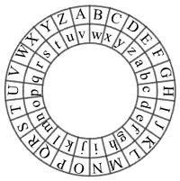
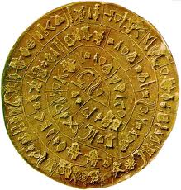
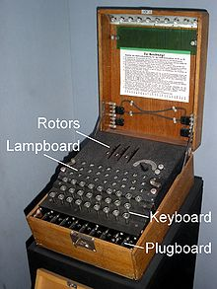
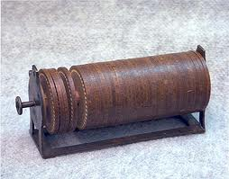
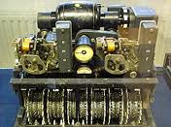
Symmetric Crypto
Early ciphers
  Caesar
  Jefferson
  Enigma, Lorenz
Passwords
One-time use
Notes:
Traditional ciphers use a single “key” or password. Typically, the act of encryption is simply reversed on the receiving end (using the same key or shared secret).
Caesar cipher formally is called a “shift cipher”.
The “key” is the shift.

Slide 5
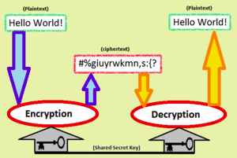
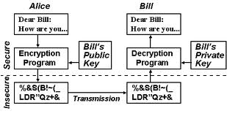
Asymmetric Crypto
What if someone
got the password?
Rivest, Shamir, Adleman
involves a public key and a private key
hence … asymmetric
http://en.wikipedia.org/wiki/
Public-key_cryptography
Notes:
Asymmetric keys are mathematically matched so that having one does not reveal the other and that a message or other information can be encrypted with one and only decrypted with the other. Neat trick, eh?
Asymmetric keys allow “crypt with public” and “decrypt with secret”, but also allow “sign with secret” and “validate with public”. So you not only get strongly private communication but also a confirmation of the sender.
http://en.wikipedia.org/wiki/RSA_%28algorithm%29
“Clifford Cocks, an English mathematician working for the UK intelligence agency GCHQ, described an equivalent system in an internal document in 1973, but given the relatively expensive computers needed to implement it at the time, it was mostly considered a curiosity and, as far as is publicly known, was never deployed. His discovery, however, was not revealed until 1998 due to its top-secret classification, and Rivest, Shamir, and Adleman devised RSA independently of Cocks' work.”

Slide 6
Encryption plus Authentication
Encrypt with public key (of recipient)
Decrypt with secret key
Sign with secret key
Verify with public key (of sender)
Notes:
Most useful when each party has their own “key pair”. Each party must have the public key of the other party. The distinction becomes more clear with PGP/GPG. Usually buried in tools and techniques in the SSL/TLS world.
Encrypting is handled with public keys, while decrypting is handled with private keys. If you want to encrypt something to me, then you need my public key. After using my public key to encrypt your message, I then use my private key to decrypt it. If public keys decrypted messages, imagine how many people could decrypt your private message. :)
Signing, however, is the other way around, handled with private keys. Verification is done using the public key(s). If I sign a document (this mail for example), then I did so with something only I have, my private key. Then, you can download my public key from a keyserver, and verify that the signature is valid.

Slide 7
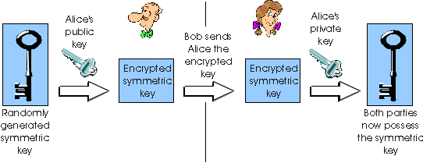
Combo Crypto
Random “session key” symmetric (single)
Encrypt that with asymmetric (dual)
Encrypt payload with session key
Send asym-encrypted session key
and sym-encrypted payload
Notes:
*****
Asymmetric key cryptography is “heavy” compared to symmetric algorithms. Bright idea: do the bulk of the crypto with symmetric and then wrap that key in asymmetric.
http://img.docstoccdn.com/thumb/orig/44342439.png
*****

Slide 8
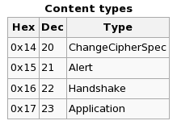
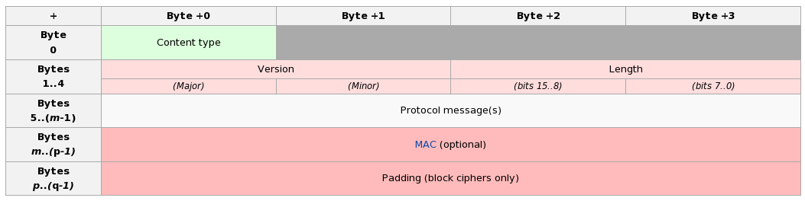
Transport Layer Security
Handshake authenticates
SSL provides a “channel”
Compare to SSH
Contrast with PGP/GPG (data at rest)
Notes:
Secure channel must be re-established for each web transaction.
(But there is a resume concept to short-cut some of the burden.)
The handshake is the heavy lifting in SSL/TLS. Once the session is established, the data flows smoothly.
SSL/TLS has only four record types.
SSL/TLS “handshake” then has roughly a dozen sub-types.
(Alert has three dozen enumerated conditions, some fatal, some not.)
“SSL False Start” (c/o Google) reduces latency.

Slide 9
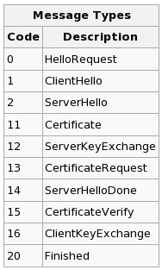
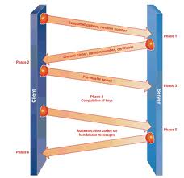
SSL Handshake
Authenticate the server
Establish a secure channel
Uses existing network
Does not protect “data at rest”
Notes:
Lessons in Trust from the web hoaxes ... a "veneer of veracity"
But what did Mom and Dad teach you? "Don't talk to strangers.".
Wheeler: institutional specific tokens
The SSL/TLS “handshake” is the heavy lifting. If you can avoid re-do then you get a boost in transactional performance. There is a restart/resume, and zSSL supports it.

Slide 10

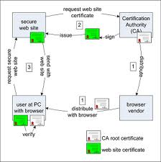



Public Key Infrastructure
CA certificate(s) pre-loaded
WS admin requests assertion
CA signs WS request
WS admin loads that
….....
Browser hits WS,
compares signature chain
Browser/WS agree on
session keys
Notes:
NOTE: session keys are symmetric. Single key crypto is used for session traffic. The session keys are passed securely (using asymmetric crypto) but are then used to wrap payload in faster logic. Works.
Web site (admin) generates a server key and a certificate request. WS admin submits the request to a CA (certificate authority). CA produces a signed certificate (usually for a fee) and returns that. WS admin loads the signed cert.
Browser gets server cert during handshake, compares signature chain, pass/fail. Server proves ownership by hashed data signed with secret (asym) key.
SSLShopper lists several CA to perform assertion.
NOTE: cert authorities (CAs) sign with asymmetric keys and hash functions
If a CA is compromised, the PKI may be poisoned.
If an algorithm is cracked, certifications using it become unreliable.

Slide 11
Got zVWS? Then install zSSL
Insallation process for zSSL
automatically generates a key pair
and creates a self-signed server certificate.
Also creates a certificate request
which you can submit to your CA of choice.

Slide 12
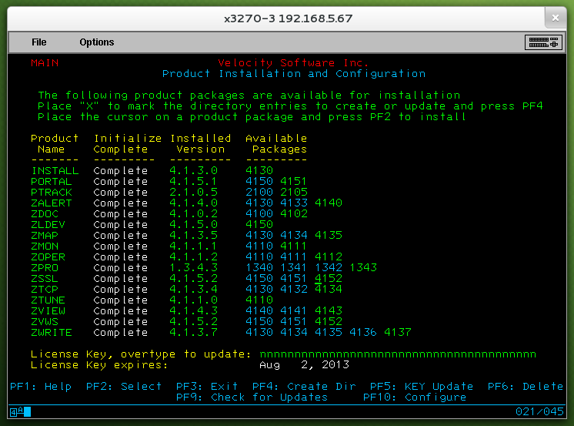
VSIMAINT – install zSSL

Slide 13
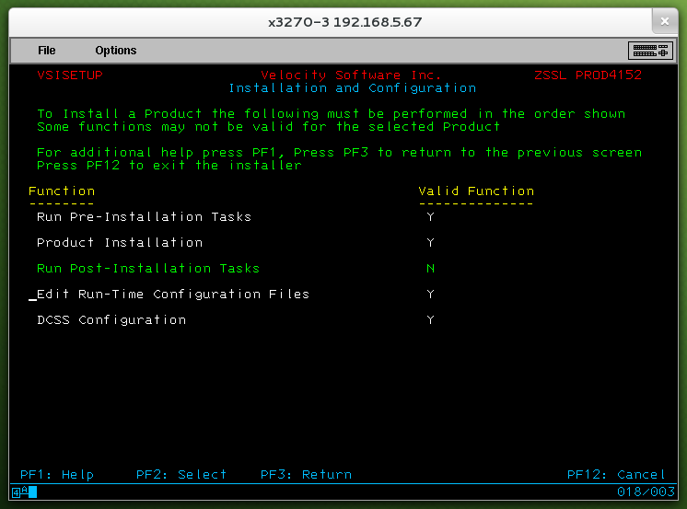
VSIMAINT – configure zSSL
Notes:
*****
zSSL creates an alternate web server set:
run HTTP or HTTPS or both.
*****

Slide 14
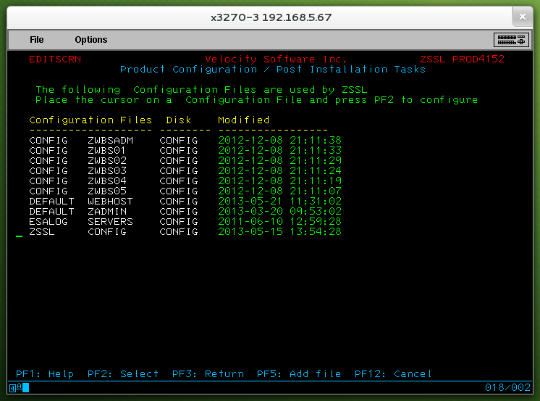
VSIMAINT – configure zSSL
Notes:
*****
ZSSLCERT KEYP ← RSA key pair
ZSSLCERT X509CERT ← self-signed cert
ZSSLCERT CRQ ← certificate request
*****

Slide 15
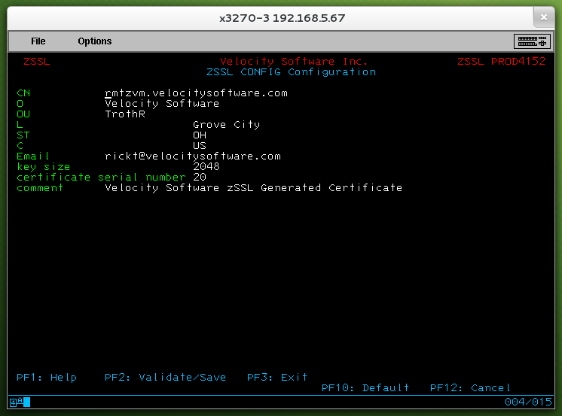
VSIMAINT – X.509 data
Notes:
*****
ZSSLCERT KEYP ← RSA key pair
ZSSLCERT X509CERT ← self-signed cert
ZSSLCERT CRQ ← certificate request
*****

Slide 16
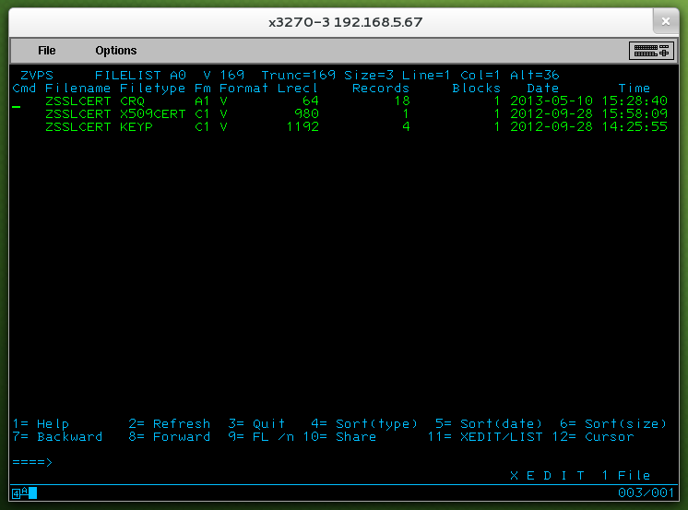
VSIMAINT – keys, cert, req
Notes:
*****
ZSSLCERT KEYP ← RSA key pair
ZSSLCERT X509CERT ← self-signed cert
ZSSLCERT CRQ ← certificate request
*****

Slide 17
Got zVWS? Then install zSSL
It's that easy!
Self-signed certificate is immediately ready.
Certificate request is available too.
Submit it to your CA of choice, if needed.

Slide 18
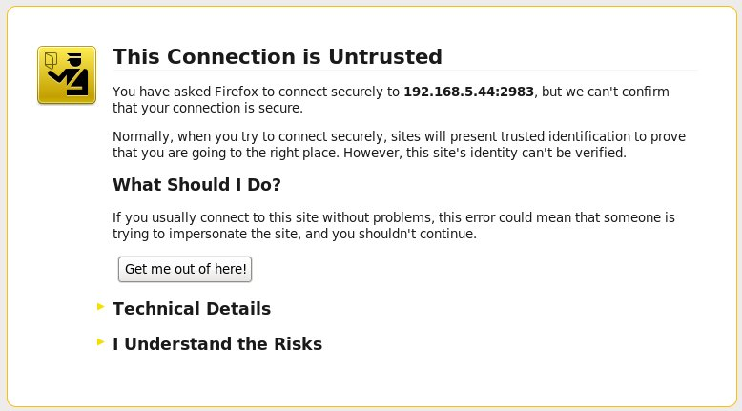
Server with Self-Signed Cert
Notes:
Your web browser should alert you if it cannot verify the certificate of an SSL-protected site. (Some will simply refuse to connect at all.) If you really know that you're hitting the right site, you can “manually assert” its validity.
This is STANDARD PROCEDURE for test installations. It is also common for many non-PKI sites. (User education is required.)

Slide 19
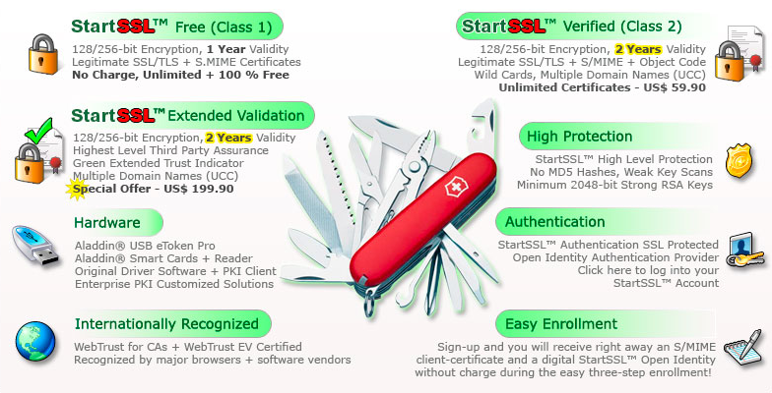
Certificate Authorities – StartSSL
https://www.startssl.com/

Slide 20
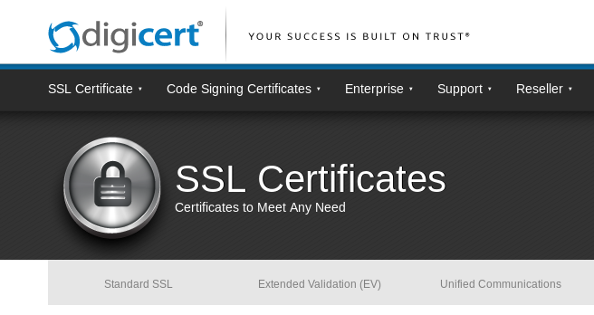
Certificate Authorities – DigiCert
http://www.digicert.com/ssl-certificate.htm

Slide 21
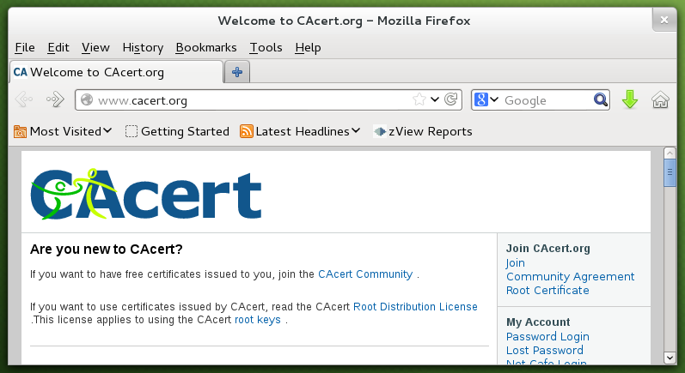
Certificate Authorities – CACert
http://www.cacert.org/

Slide 22
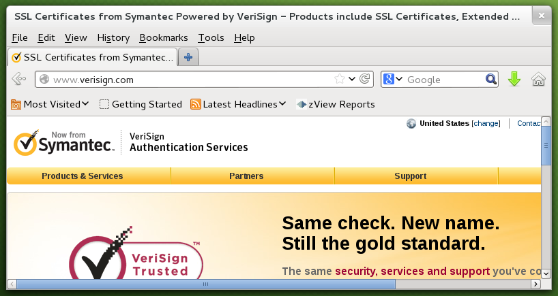
Certificate Authorities – VeriSign
http://www.verisign.com/

Slide 23
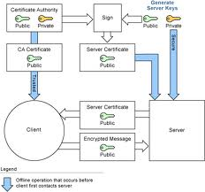
VM SSL Key Management
Set up GSKADMIN and wire it into the stack
Sign onto GSKADMIN
Use 'gskkyman' command
Notes:
NOTE: BFS and OpenVM represent excellent work by the VM development lab. Integration with other LE utilities is substantial. (Programs compiled for USS often run un-changed on OpenVM.) This is good stuff!!
Traditional VMers need to embrace BFS and OpenVM.
Typical Linux folk need to recognize OpenVM as a non-Linux, but still legitimate, implementation of Unix. Lin/Win/Unix folk need to recognize BFS as a legitimate byte oriented filesystem operationally equivalent to any VFS or Fuse capable FS.

Slide 24
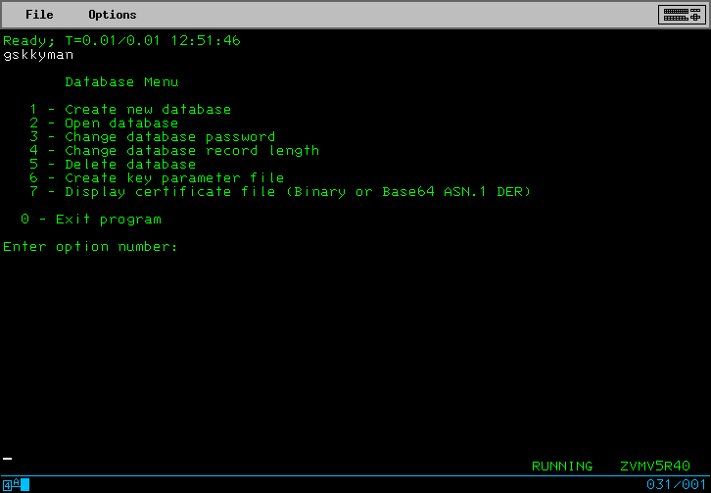
VM SSL Key Management
Notes:
VM SSL uses a “database” for keys and certificates.
It's a little more complicated than using flat files.

Slide 25
VM SSL Key Management
Create a key database ...
  Option 1
  Filename “Database.kdb”
  3700 days = 10 years, 6 weeks
  Default record size
Fix file access ...
openvm permit /etc/gskadm/Database.kdb rw- r-- ---
openvm permit /etc/gskadm/Database.sth rw- r-- ---
Notes:
BFS files are easily copied to/from traditional CMS space.
Do not be intimidated.
Remember to adjust file access (when you exit the GSKKYMAN program) so that the stack (actually SSLSERV) will be able to read use the files.
Realize that your CA will probably NOT extend validity to ten years.

Slide 26
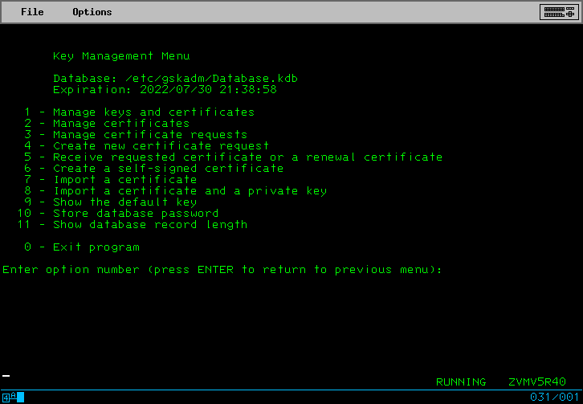
VM SSL Key Management
Notes:
After creating a new database or opening an existing database, you should get this menu.

Slide 27
VM SSL Key Management
Create a self-signed certificate ...
  Option 6
  Option 7, server cert with 4096-bit RSA key
  Option 3, SHA-256 signature digest
  Enter a label, UPPER CASE
  Enter X.509 stuff
Apply that label to a “secured” TCP port
Notes:
Use at least 2048 bits key size.
http://www.phildev.net/ssl/creating_ca.html
Note that as of January 1, 2011,
Microsoft will remove all CAs with keys of size 1024-bits or smaller
from their browsers and OSes.

Slide 28
VM SSL Key Management
Create new certificate request ...
  Option 4
  Option 3, cert with 4096-bit RSA key
  Enter filename
  Enter a label, UPPER CASE again
  Enter X.509 stuff
File is PEM encoded; send to your CA
Notes:
Remember that your CA will probably NOT extend validity to ten years.

Slide 29
Client Certificates
To use client certificates, or devices like common access cards, install a “CA bundle”.
CABUNDLE CRT ← in CONFIG directory
Notes:
*****
By default, zSSL does not use client certificates.
Enable client certificate operation by the presence of a CABUNDLE CRT file.
*****

Slide 30
CA Bundle file
a collection of “signing certificates”
Copy ca-bundle.crt (eg: from Apache)
Create by hand (PEM encoded)
Create from example
Sample CA bundle can be found at:
http://curl.haxx.se/ca/cacert.pem
Notes:
*****
a collection of “signing certificates” from certificate authorities (CAs)
It can contain free-form PKI text.
It must contain signing certificates.
The file can contain any number of CA certificates.
*****

Slide 31
Client Certificates
CGI variables
SSL_CLIENT_S_DN, SSL_CLIENT_I_DN,
SSL_CLIENT_M_VERSION, SSL_CLIENT_M_SERIAL,
SSL_CLIENT_V_START, SSL_CLIENT_V_END,
SSL_CLIENT_A_KEY, and SSL_CLIENT_A_SIG
Notes:
*****
The CGI variables
SSL_CLIENT_S_DN and SSL_CLIENT_I_DN
present the “subject distinguished name”
and “issuer distinguished name” respectively.
These are available after a 'sysvars' command in your CGI scripts.
*****

Slide 32
Crypto Concepts – Trust Models
Peer-to-Peer
  PGP style
Third Party / Centralized
  PKI style
Manual Assertion
  Self-signed certificates
Question: which works best for your business?

Slide 33
Crypto Concepts – Proper Tools
SSL and TLS (PKI)
  originally for HTTPS, now many protocols
  third party trust
  X.509 certificates
SSH
  variable trust models
  keys
PGP/GPG
  peer-to-peer trust
  keys

Slide 34
SSH
'ssh-keygen' command
  Generates pub (“.pub”) and sec, two files
Append pub to “authorized_keys” file
of target user(s) on target system(s)

Slide 35
PGP/GPG
Generate a key pair
gpg --gen-key
Export your pub key, sign others
gpg --armor --export
gpg --sign-key other-user's-key
Import signed keys and signatures
gpg --import
Notes:
http://groups.google.com/group/linux.debian.devel/browse_thread/thread/79aa76221d18eaea/29796cf5b7d25bd6?hl=en&q=key-sign#29796cf5b7d25bd6
"You should never sign a key for somebody else you haven't met personally."
http://www.debian.org/events/keysigning

Slide 36
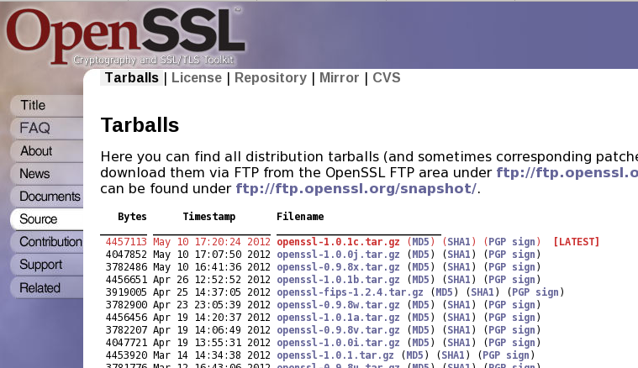
Validating Stuff
Notes:
Many downloadable files are signed PGP style.
If you have (and trust) the key of the signer, you can (and should) validate the signature. It is an extra step, but for security-sensitive items, it is worth the effort.
This also works under zVWS, the signature is plain text, usually with filetype ASC or SIG.

Slide 37
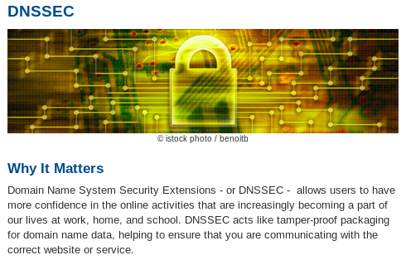
DNSSEC
Domain Name System Security Extensions
Crypto Signing of Internet Domain Data
Notes:
http://datatracker.ietf.org/doc/draft-ietf-dane-protocol/
DANE: DNS-Based Authentication of Named Entities
Alternative to traditional CAs
Requires DNSSEC
*****

Slide 38
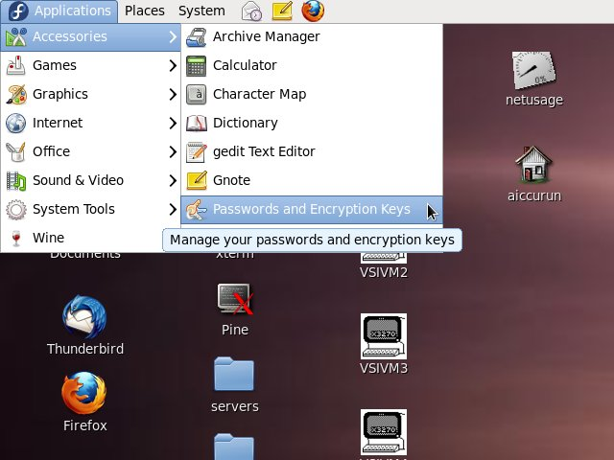
Key Management – Seahorse
Notes:
I discovered that Seahorse was installed by default on Fedora 14.

Slide 39
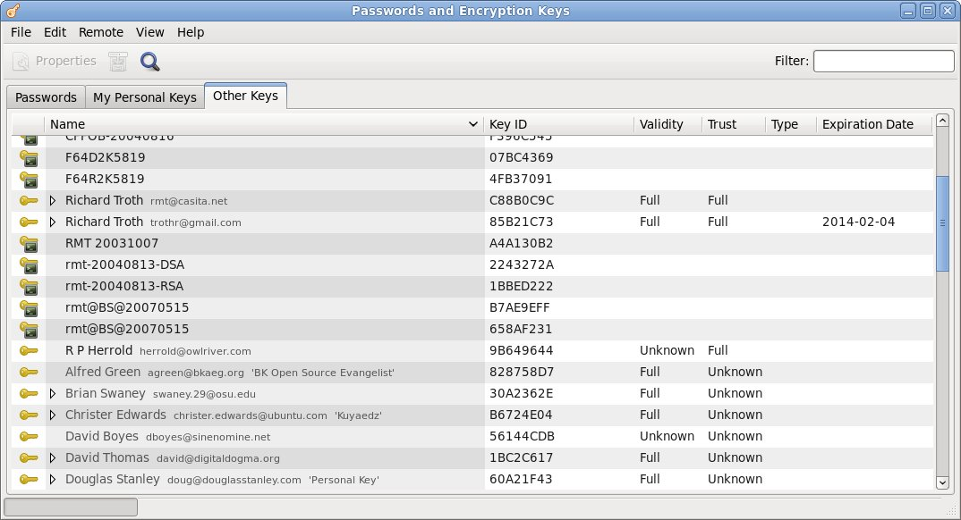
Key Management – Seahorse
Notes:
Seahorse handles PGP/GPG keys, SSH keys, and apparently also your local Unix/Linux password.

Slide 40
Terms and Tools to Learn
Certificates identified by SDN,
“subject distinguished name”
X.509 verbiage abounds
Need overview of BFS files (for VM SSL)
  x /etc/gskadm/mycert.crq (nam bfs

Slide 41
What is a “subject”?
What is the “subject”?
  That which is “signed” by an “authority”
What is the “authority”?
  That which cryptographically signs the “subject”

Slide 42
Entropy
maximum entropy, minimum energy
maximum entropy, minimum “order”
Entropy ==> Randomness
Strong encryption
requires reliable randomness
Notes:
“everything is entropying” -- Steve Martin
Reliable randomness seems intensely ironic.

Slide 43
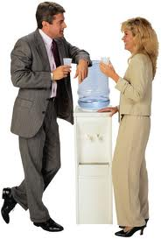
Water Cooler Leaks
Human factors remain the biggest risk
  Easy passwords
  Gullible to scams
  Easy-click assertion
  Profiled for info
  Unsecured hardware
  Lost hardware
Notes:
... watch out for water cooler leaks.
PGP trust model is “better”, but more difficult to establish.
PGP trust model suggests a security elite. (my term)
Perhaps a dispersed security elite can salt the industry.

Slide 44

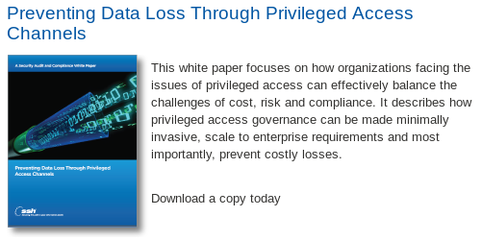
Back Channels?

Slide 45
Security Audit
A security auditor for our servers has demanded the following within two weeks:
  A list of current usernames and plain-text passwords for all user accounts on all servers
  A list of all password changes for the past six months, again in plain-text
  A list of "every file added to the server from remote devices" in the past six months
  The public and private keys of any SSH keys
  An email sent to him every time a user changes their password, containing the plain text password
We're running Red Hat Linux 5/6 and CentOS 5 boxes with LDAP authentication.
Notes:
When the auditor is an idiot.
http://www.techques.com/question/2-293217/Our-security-auditor-is-an-idiot.-How-do-I-give-him-the-information-he-wants
*** EOF ***

Slide 46
Summary
You need SSL
Apply SSL carefully
Understand the concepts
Be prepared:
SSL is a moving target!

