Slide 1
SEC & Big Ten College Football Analytics Dashboard
Matt Kurtz
MSBA-692 Data Engineering
Final Project Presentation

Slide 2
Business Problem & Data Source
Problem:
• College football data is fragmented across sources.
• Comparing SEC and Big Ten teams is time-consuming.
Data Source:
• CollegeFootballData API
• 2024 Team Records Endpoint
• Team Name, Conference, Wins, Losses

Slide 3
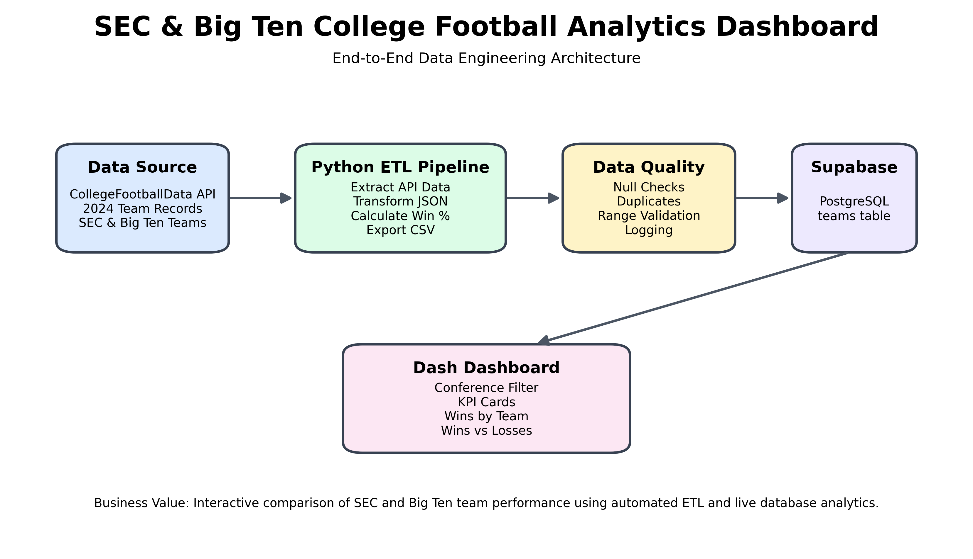
Architecture Overview

Slide 4
ETL Pipeline & Data Quality
Extract
• API requests using Python Requests
Transform
• Pandas data cleaning
• Conference filtering
• Win percentage calculation
Load
• Supabase PostgreSQL
Validation
• Null checks
• Duplicate detection
• Range validation
• Logging & error handling

Slide 5
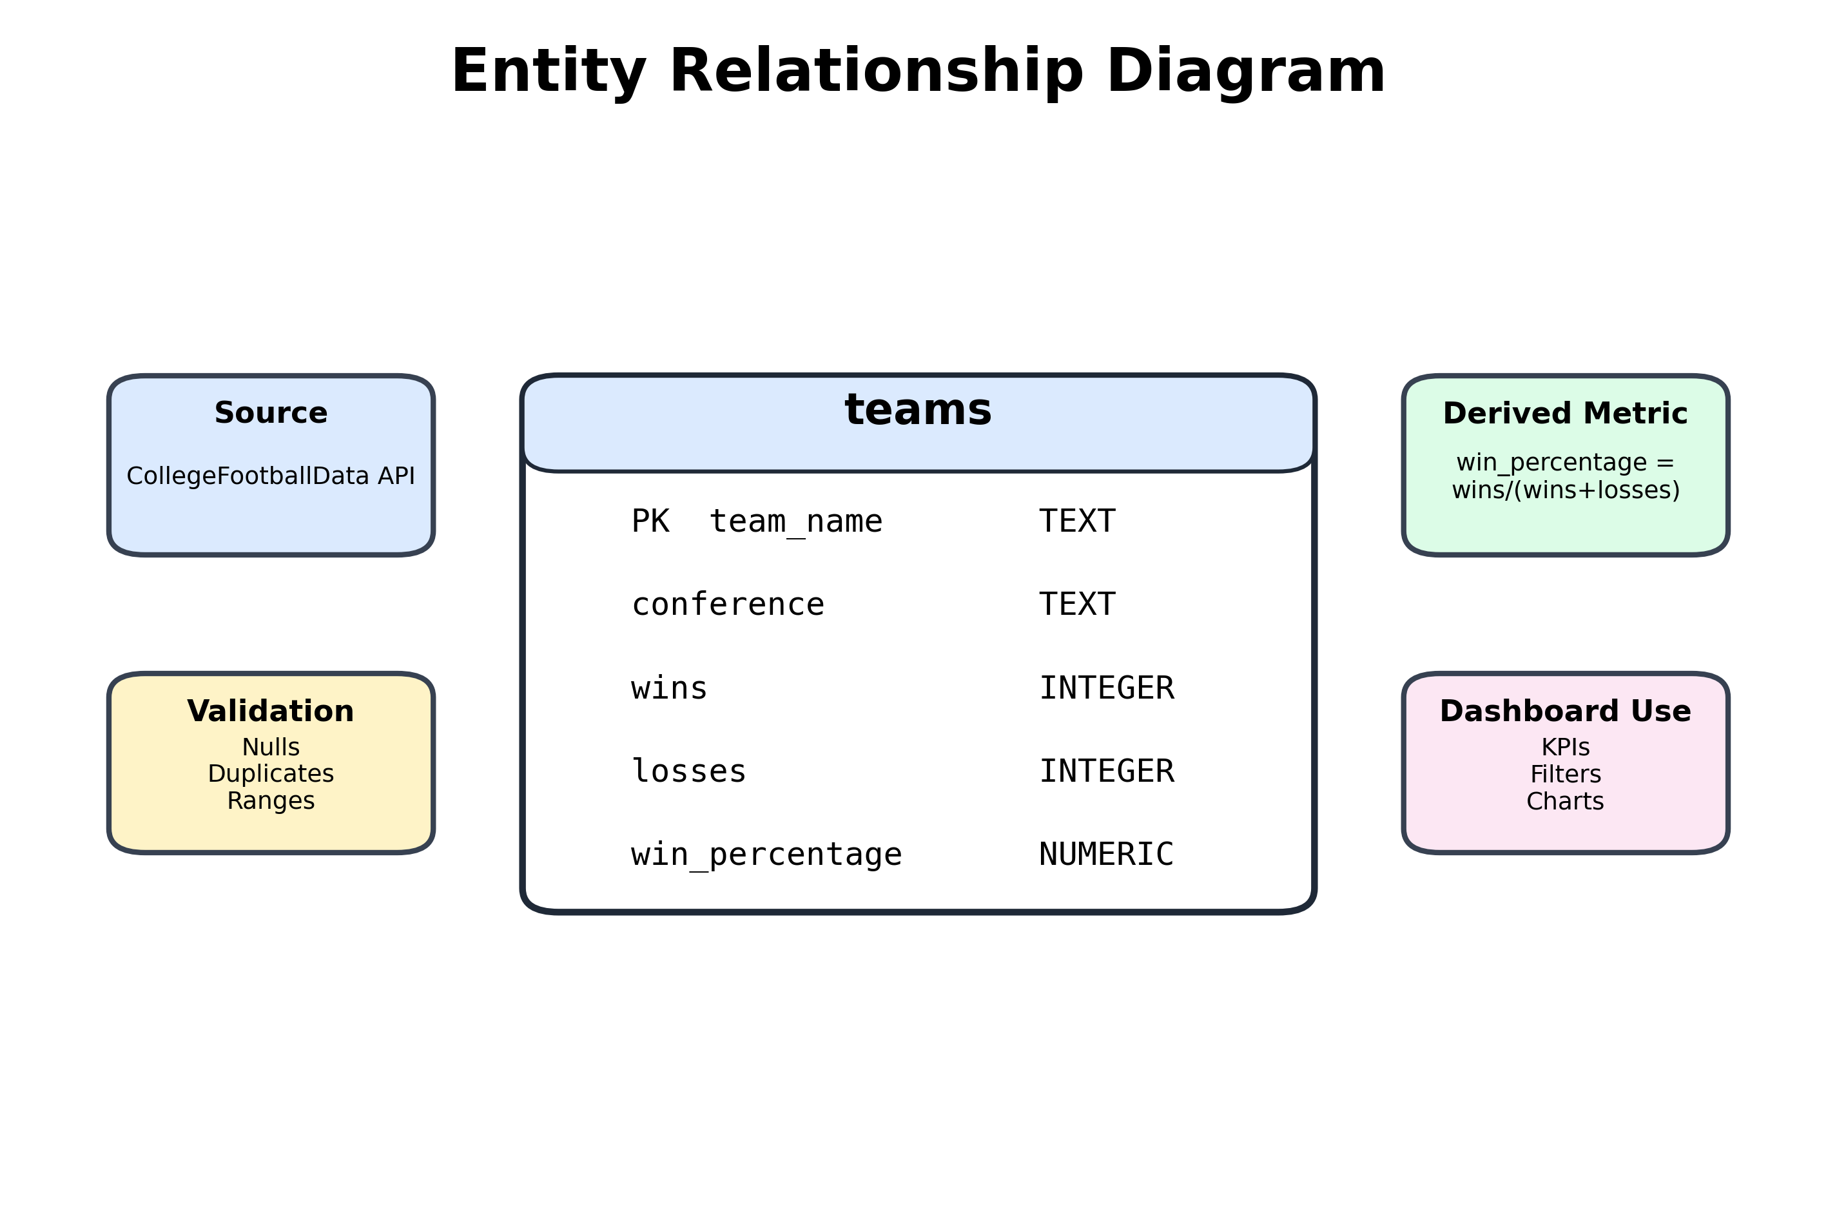
Database Schema

Slide 6
Dashboard Features
Interactive Components:
• Conference Filter (SEC / Big Ten / All)
• Total Teams KPI
• Average Win Percentage KPI
• Wins by Team Bar Chart
• Wins vs. Losses Scatter Plot

Slide 7
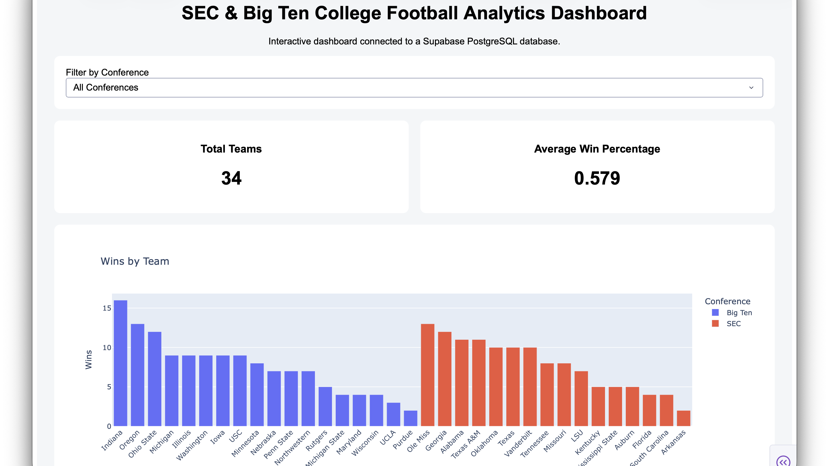

Slide 8
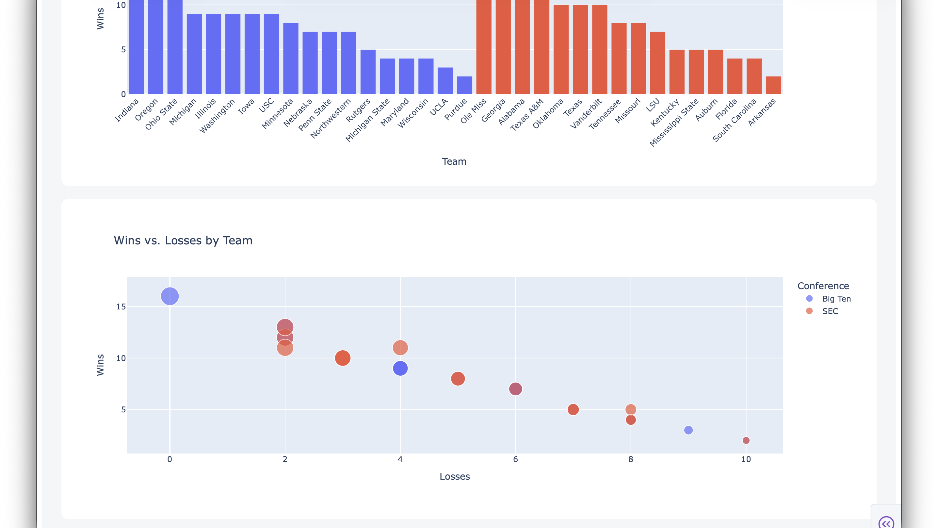

Slide 9
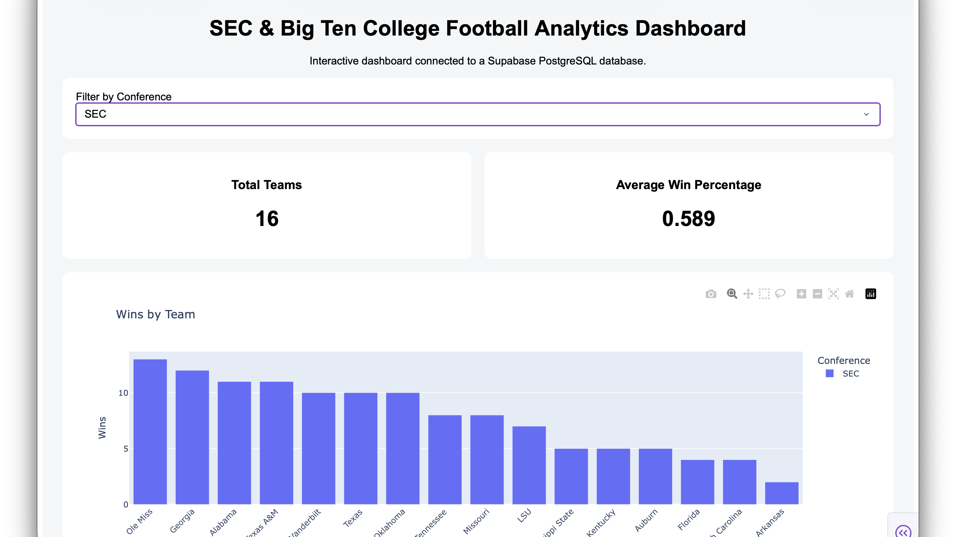

Slide 10
Insights, Challenges & Lessons Learned
Key Insights:
• Win percentage is a stronger comparison metric than wins alone.
• Interactive filtering improves conference-level analysis.
Challenges:
• API transformation
• Database integration
• Incremental loading
Lessons Learned:
• Data quality engineering is critical.
• End-to-end ETL enables reliable analytics.

