Slide 1



Slide 2

Coming Soon!
Nagapandu Potti, Shantanu Kande, Aman Singh,
Rakesh Dammalapati, Jithendra Yella, Akshitha Ainapuri

Slide 3
Why goChron?
1000+ Student Organizations at UF hosting wide array of events. Not so easy to keep track all of them!
Important Administrative deadlines. Don’t miss out!
Personal Events ( Public/Private/Closed ). Giving control to the user with filters/abstraction while creating the events!
All at a glance in One CALENDAR!
On a better GUI and with enhanced features such as subscription to events, suggestions on what to attend, alerts to remind you, notifications when an event that interests you is added, showing currently trending events and sync option with third party calendars!

Slide 4
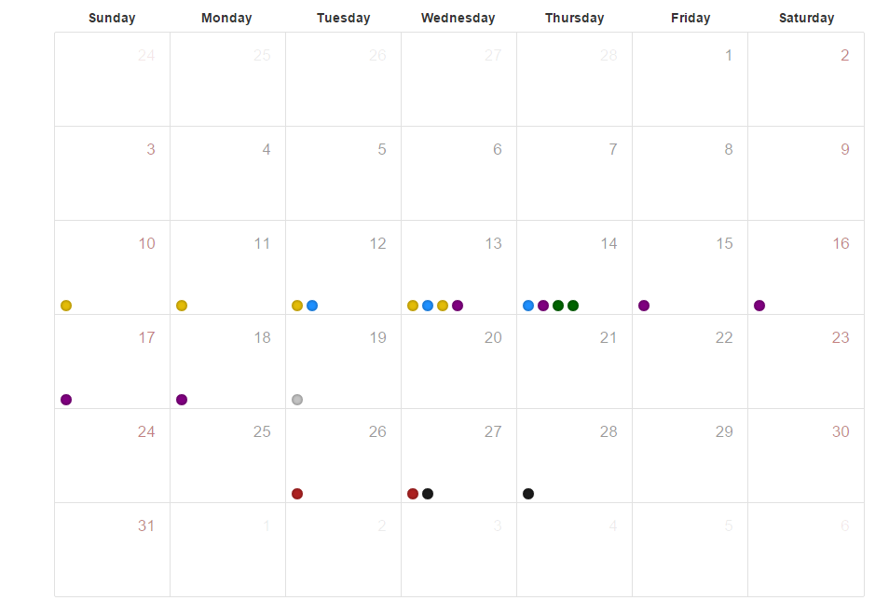

User Interface!

Slide 5
How to implement it ?
Project Link
https://github.com/gochron/gochron
Technologies
Ruby on Rails (Web Development framework)
Ruby (backend code)
MongoDB (Database NoSQL)
Redis (In-memory caching)
Elastic search (Full text search)
jQuery, Javascript (front end)
HTML/CSS (front end)
Twitter Bootstrap (front end)

Slide 6
View
/landing page
Landing page gives the user a holistic idea about the website.
/signup
Basic user details
Subscribe for events of specific types/clubs/orgs in sign up and settings
All students are subscribed to calendar.ufl.edu events by default
/index
Calendar view in the form of tiles
Right panel for listing events (Filtering tabs: subscribed - default, all) in chronological order
Search bar (searches for events by title)/Advanced Search(Category,Date)
Currently trending events
Alerts (register for alerts based on interests)
/view after user clicks on a tile
List out events (Filtering tabs: subscribed - default, all)

Slide 7
Thank You!

