Slide 1



Mitchel Pawirodinomo
November 6th 2016
Jonathan Tobi
Agon Emanuel
“Code Till Yuh Drop”
Timothy Pocorni
Simon Noerdjan

Slide 2
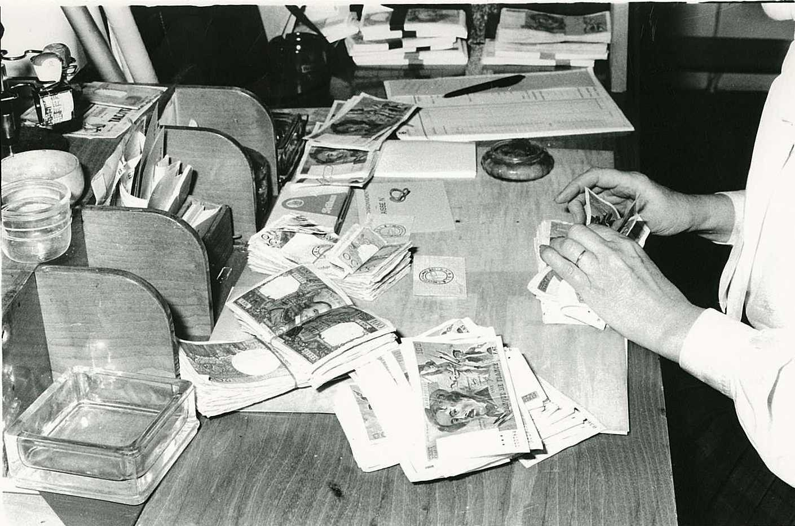
Situation
Going to the post office takes a lot of effort for most
Danger of getting robbed
Wait in line
Maybe the money didn’t even arrive for you that day
Relatives can make great use of your payment long after you are gone
Post offices get targeted bij thieves

Slide 3

Need
Receive payment quick and easy
Be able to pay for goods and services
Doesn’t want to carry money everywhere
Maybe let groceries be done for them

Slide 4
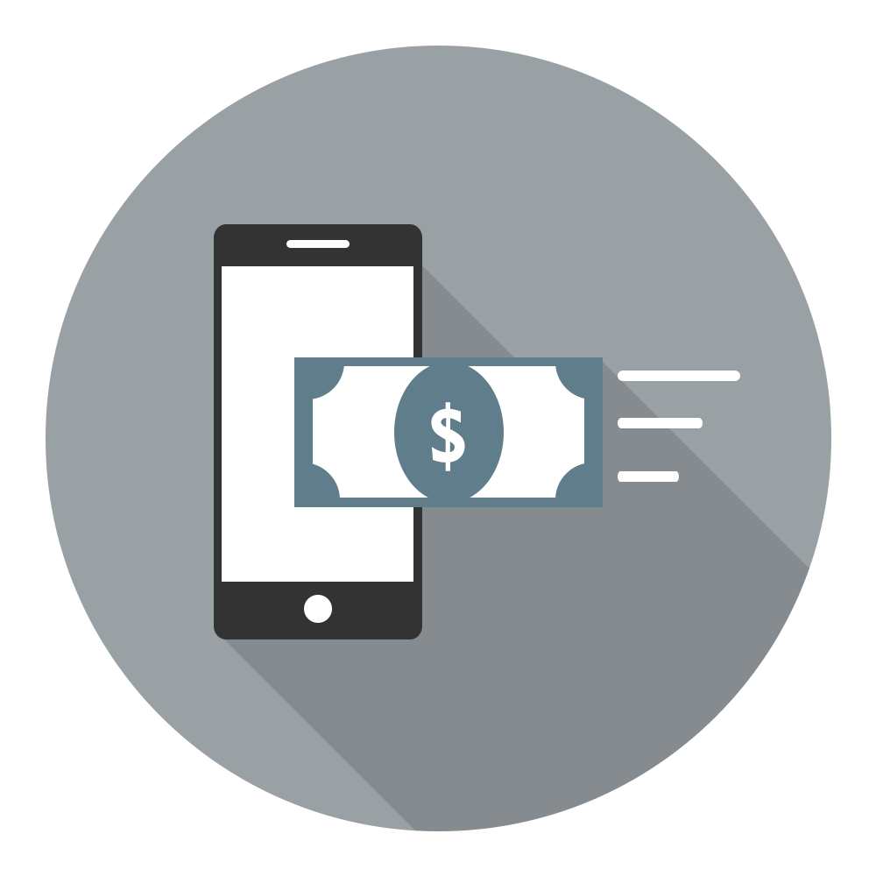
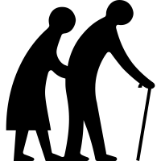


Eliminates going to the post office
Eliminates the danger of getting robbed
Eliminates waiting in line
Not a big deal if money arrives a day later, because it won’t
Relatives cannot misuse the system
Invoice interaction between merchants/ services and users
Ez payment from organization to user
Ez-Pay

Slide 5
“In 2007, Kenyans began to adopt a system called M-Pesa and today it is used by over 17 million Kenyans, over two-thirds of the adult population
“There are now 1,400 supermarkets in the Netherlands with registers that don’t accept cash.”
Qouted from bbc.com – The truth about the death of cash

Slide 6
Systems for moving cash around, not to replace it

Slide 7
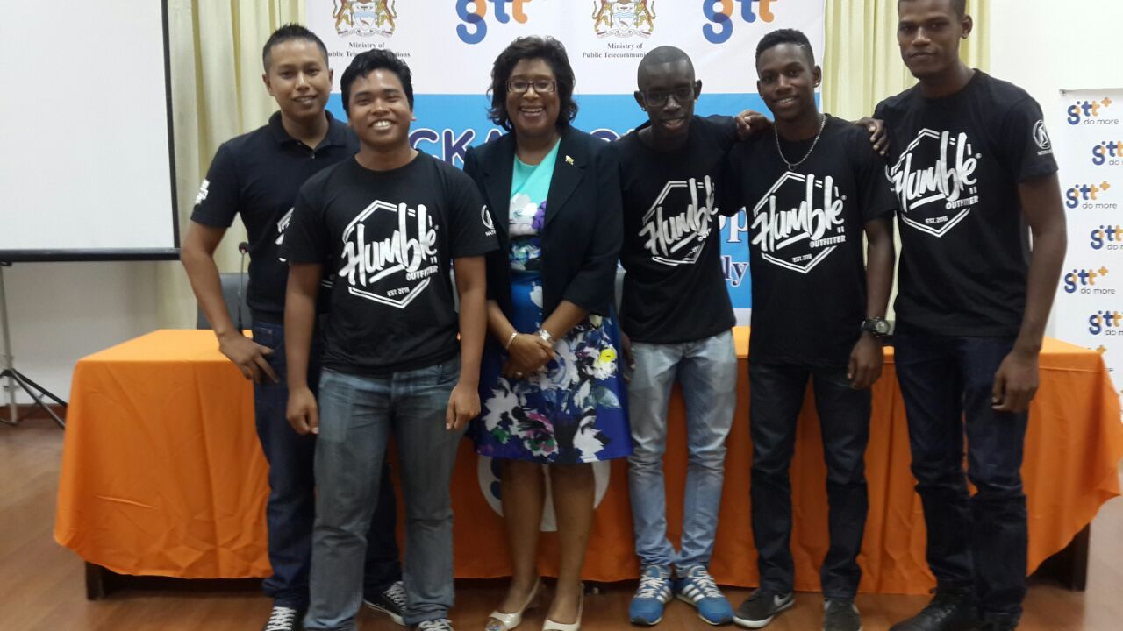
Thank you for having us
We surely had a GREAT time

