Slide 1

Crane
Cloud Resource Analytics and Economics
Powered by Tencent Cloud

Slide 2

Crane Overview
Crane (FinOps Crane) is an opensource project which manages cloud resources on Kubernetes stack, it is inspired by FinOps concepts.
The goal of Crane is to provide an one-stop shop to help Kubernetes users to save cloud cost with a rich set of functionalities

Slide 3
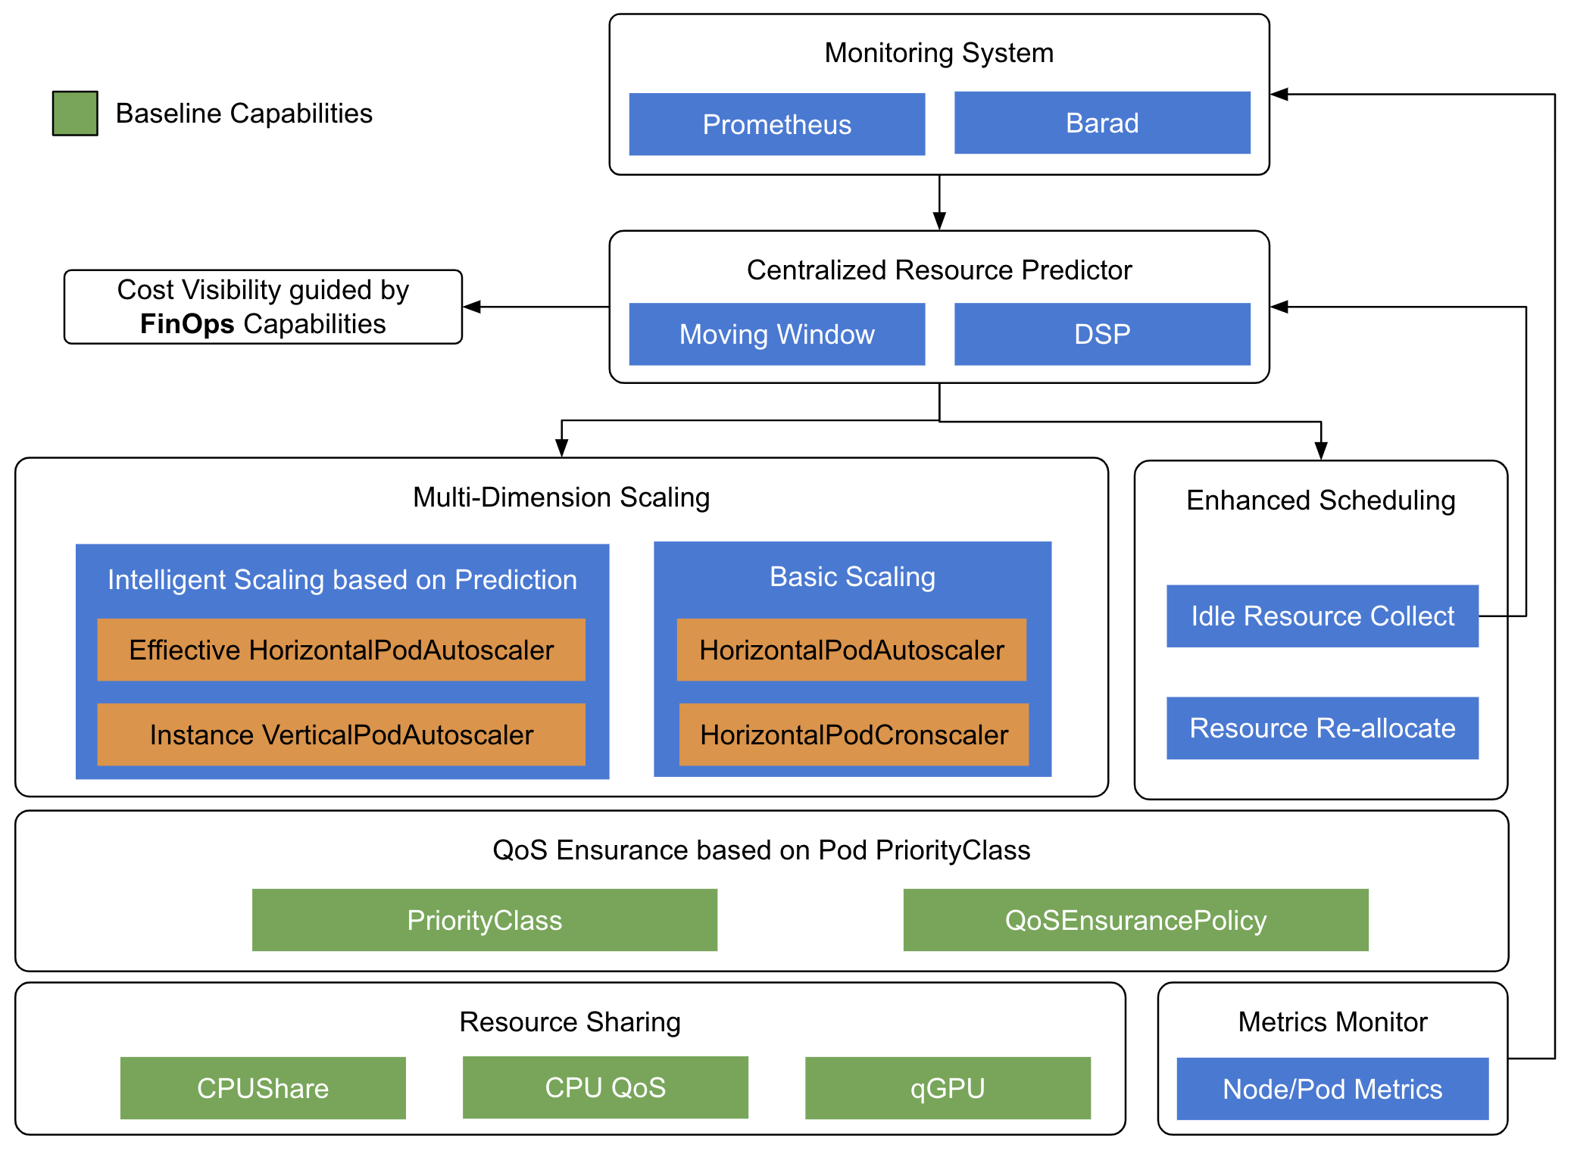
Crane Architecture
Prediction is the King
Support various prediciton algorithems
Optimize Usage with Cloud Native techs
Resource reallocation
Cost virtualization
Effective horizontal & vertical autoscaling
Enhanced QoS
Distruption detection & task aviodance
Crane Architecture

Slide 4
apiVersion: prediction.crane.io/v1alpha1
kind: TimeSeriesPrediction
metadata:
name: 192.168.56.166
namespace: default
spec:
period: 30s
mode: instant
metricPredictionConfigs:
- metricName: node_cpu_usage
percentile:
sampleInterval: "10s"
minSampleWeight: "1.0"
histogram:
maxValue: "100000.0"
epsilon: "1e-10"
halfLife: "12h"
bucketSize: "0"
firstBucketSize: "40"
bucketSizeGrowthRatio: "1.5"
apiVersion: prediction.crane.io/v1alpha1
kind: TimeSeriesPrediction
metadata:
name: podgroup-pred-test
namespace: default
spec:
predictionWindow: 30s
mode: instant
labelSelector:
matchExpressions:
- key: app
operator: In
values:
- dep-1-100m-500mib
metricPredictionConfigs:
- metricName: pod_cpu_usage
percentile:
sampleInterval: "10s"
minSampleWeight: "1.0"
histogram:
maxValue: "100000.0"
epsilon: "1e-10"
halfLife: "12h"
bucketSize: "0"
firstBucketSize: "40"
bucketSizeGrowthRatio: "1.5"
Prediction
Declaritive Prediction
Node prediction
Pod group prediction
Multiple Prediction Algorithems
Digital signal process
Moving windows

Slide 5
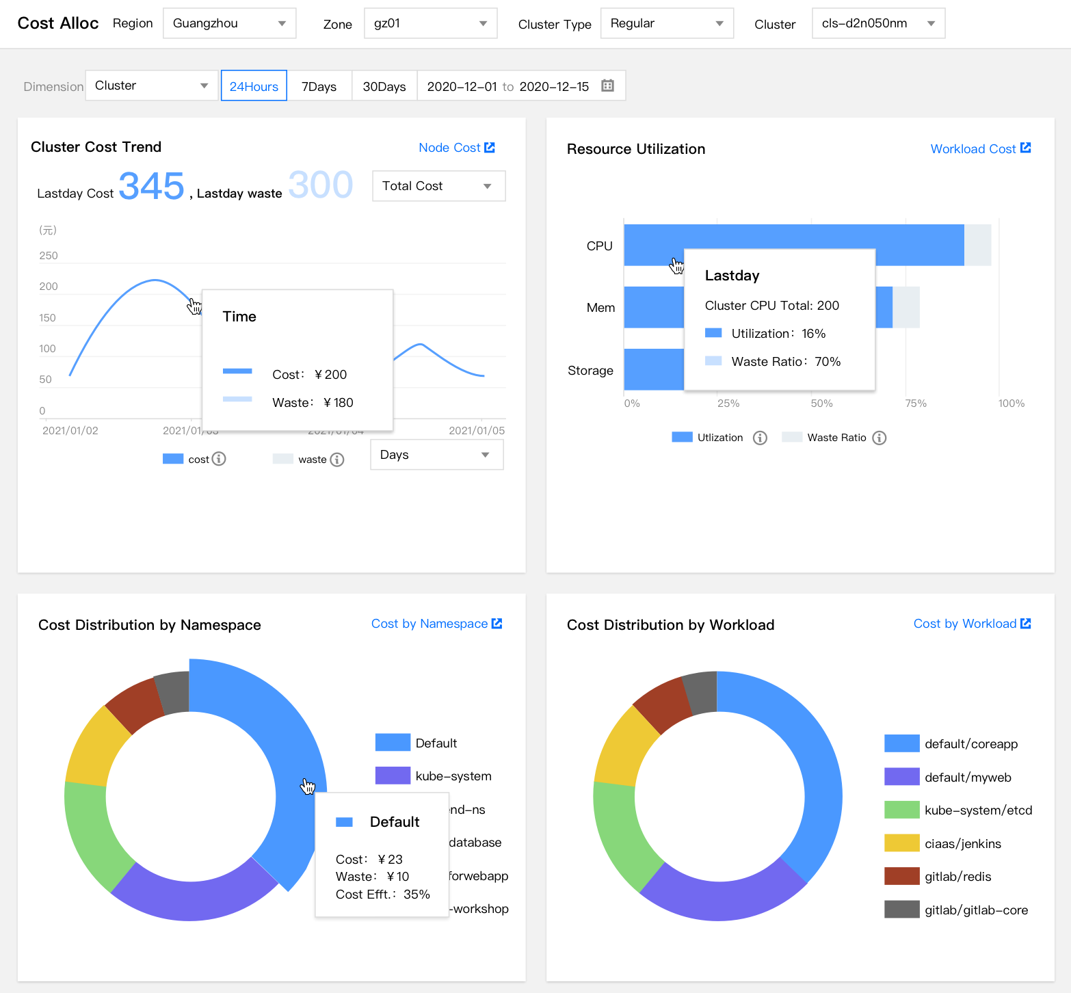
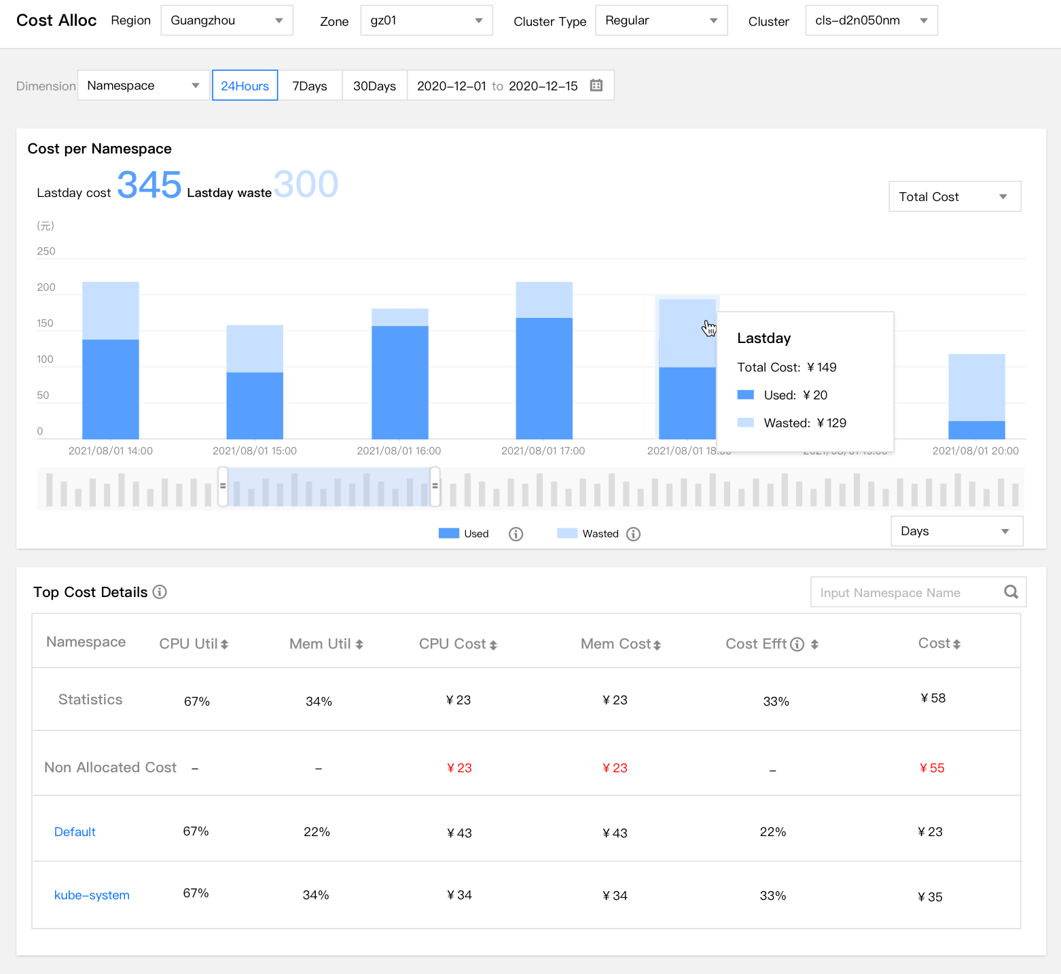
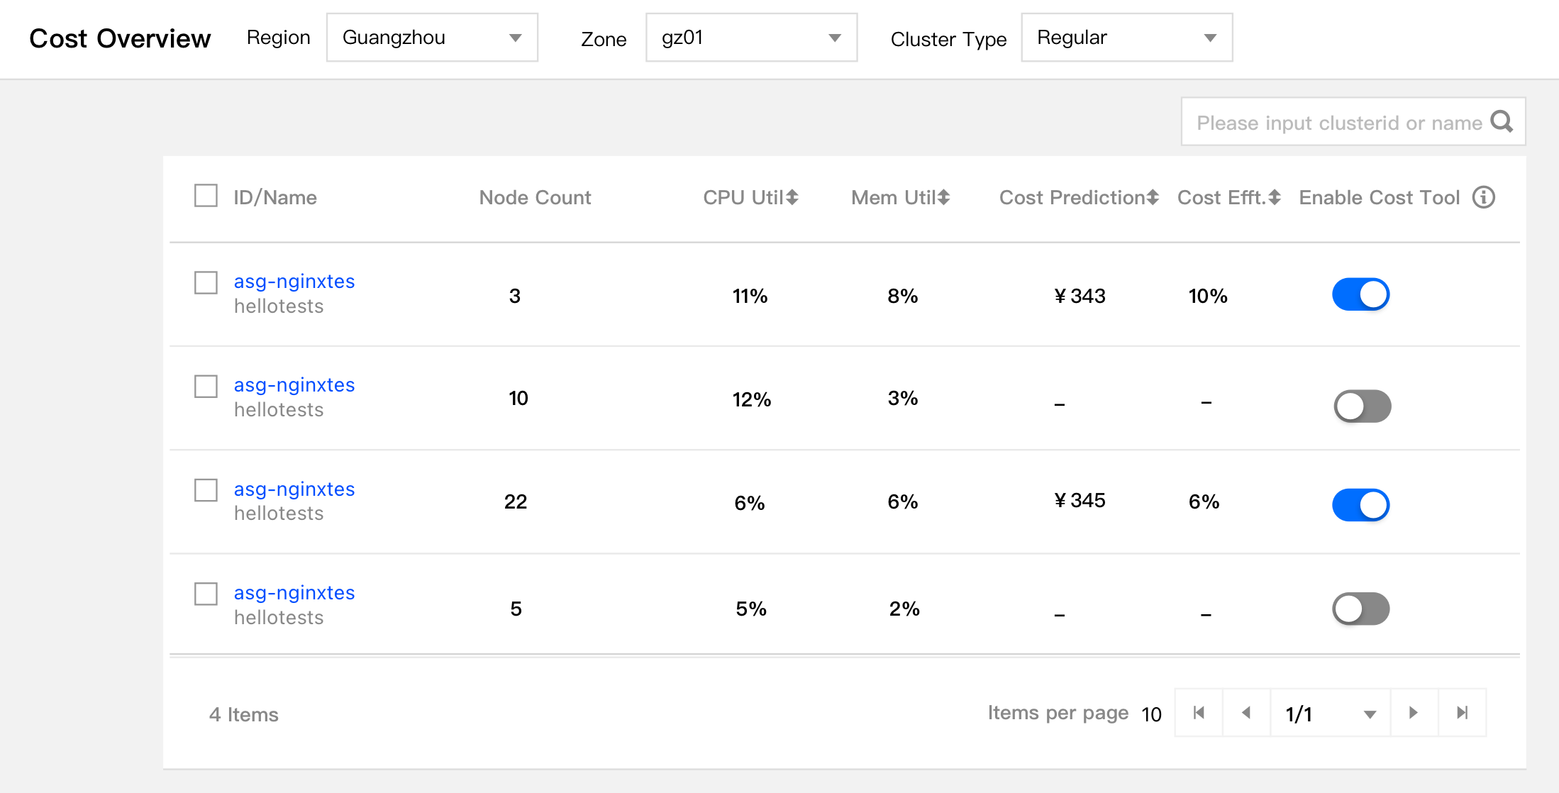
Cost Virtualization
Cost Virtualization
Usage & trends based on prediction result
Cost vs. waste based on billing API
Aggregated by cluster/namespace/label

Slide 6
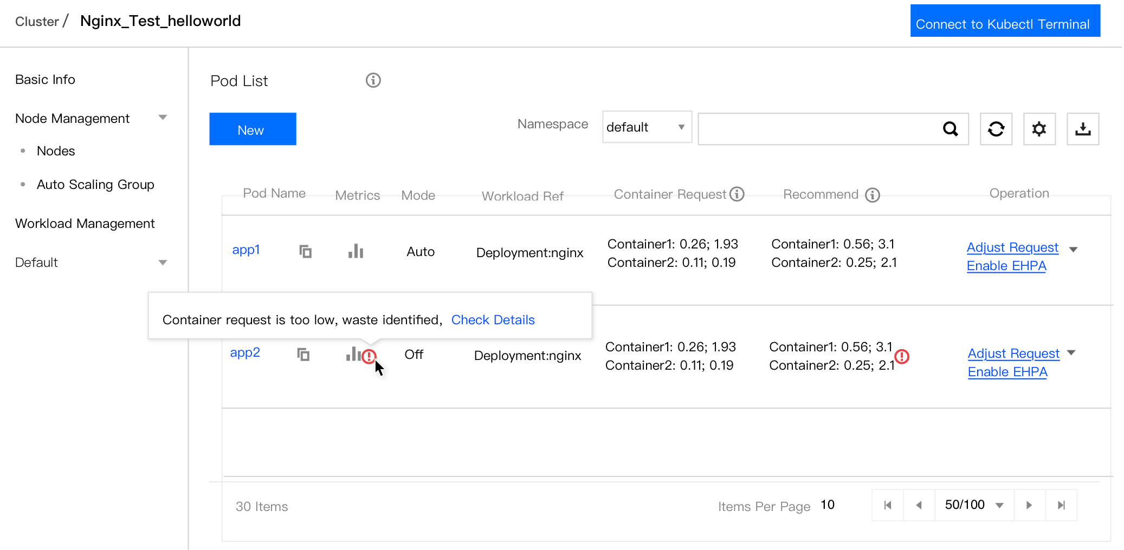
Cost Optimization
Request Recommendation
Suggestion to resize container request
Driven by workload prediction result
Effective HPA
Driven by workload prediction result
Manipulating native HPA with intelligencies
Instance VPA
Idle resources are reallocated based on node prediction result

Slide 7
QoS
apiVersion: ensurance.crane.io/v1alpha1
kind: NodeQOSEnsurancePolicy
metadata:
name: "waterline1"
labels:
app: "system"
spec:
nodeQualityProbe:
initialDelaySeconds: 10
timeoutSeconds: 10
nodeLocalGet:
localCacheTTLSeconds: 60
objectiveEnsurances:
- name: "cpu_usage"
reachedThreshold: 2
restoredThreshold: 2
actionName: "evict"
metricRule:
metric:
name: "cpu_total_usage"
target:
type: "Value"
value: 6000
Distruption Dection
apiVersion: ensurance.crane.io/v1alpha1
kind: AvoidanceAction
metadata:
name: evict
labels:
app: system
spec:
schedulingCoolDown: 300
eviction:
deletionGracePeriodSeconds: 30
description: "evict the pod"
Node metrics detection
Workload SLI detection
Task Avoidance
Scheduling disable
cgroup throttle
evict
Github Repo: https://github.com/gocrane/crane

