Slide 1

COMPANY

Slide 2
COME AS YOU ARE
BLOODY GOTCHA STORE
MEMBERS:
Pérez Zapata Javier
Duran Gonzales Michel Ernesto
Menor de Jesús Samuel
Lozano Gutiérrez Andrea
Meneses Montes José Pascual

Slide 3
OBJECTIVE
The members of the company bloody gotcha have as objective to carry out all the requirements of the approach of the problem, just as each member complies with their contributions and apply their knowledge in the position that was granted.
The business objective is that our brand be made known through our application and web page. We also seek to have our work applied in our lives and to generate jobs and implementation requests.
For this, each member is committed to give the best of their knowledge to be applied and executed in each one's work.

Slide 4
POLICIES
• The information displayed on our site is personal and unique so it can not be used by others.
• The images shown are edits and may be different from the set product.
• Information regarding the purchase (products, payments, shipping and billing information) will be made with the consent of the customer.
• The company is responsible if (the product was bought in poor condition).
• No refunds for incompatibility.
• For reasons of internal control, pages may not be seen on the last days of each month.
• Staff are prohibited from changing information on the page or application without prior authorization.
• The staff will have to consult with the boss for the implementation of updates.
• Staff will have the right to leave suggestions or complaints to help improve the company.
• Staff can change leaders if they do not exercise leadership.

Slide 5
Values:
In our company the values that mainly characterize us are:
Punctuality: Respect the arrival and departure times of workers, but especially with our customers.
Quality: Our services and products are of total excellence.
Originality: We like to innovate, make changes and create new products.
Teamwork: It is the integration of each of the company members into a work group with a positive attitude, it is elementary the participation of all employees in the various areas of the company.
These are the main values that we handle in our company, they are fundamental for us, since based on these our company performs in a favorable way.

Slide 6
Organization chart.
BIG CHEESE Empresa
Javier Pérez Zapata
Data base administrator
Andrea Lozano Gutierrez
software developer.
Pascual Meneses Montes
administrator
Michel Ernesto Duran Gonzalez
coordinator
Samuel Menor de Jesus

Slide 7
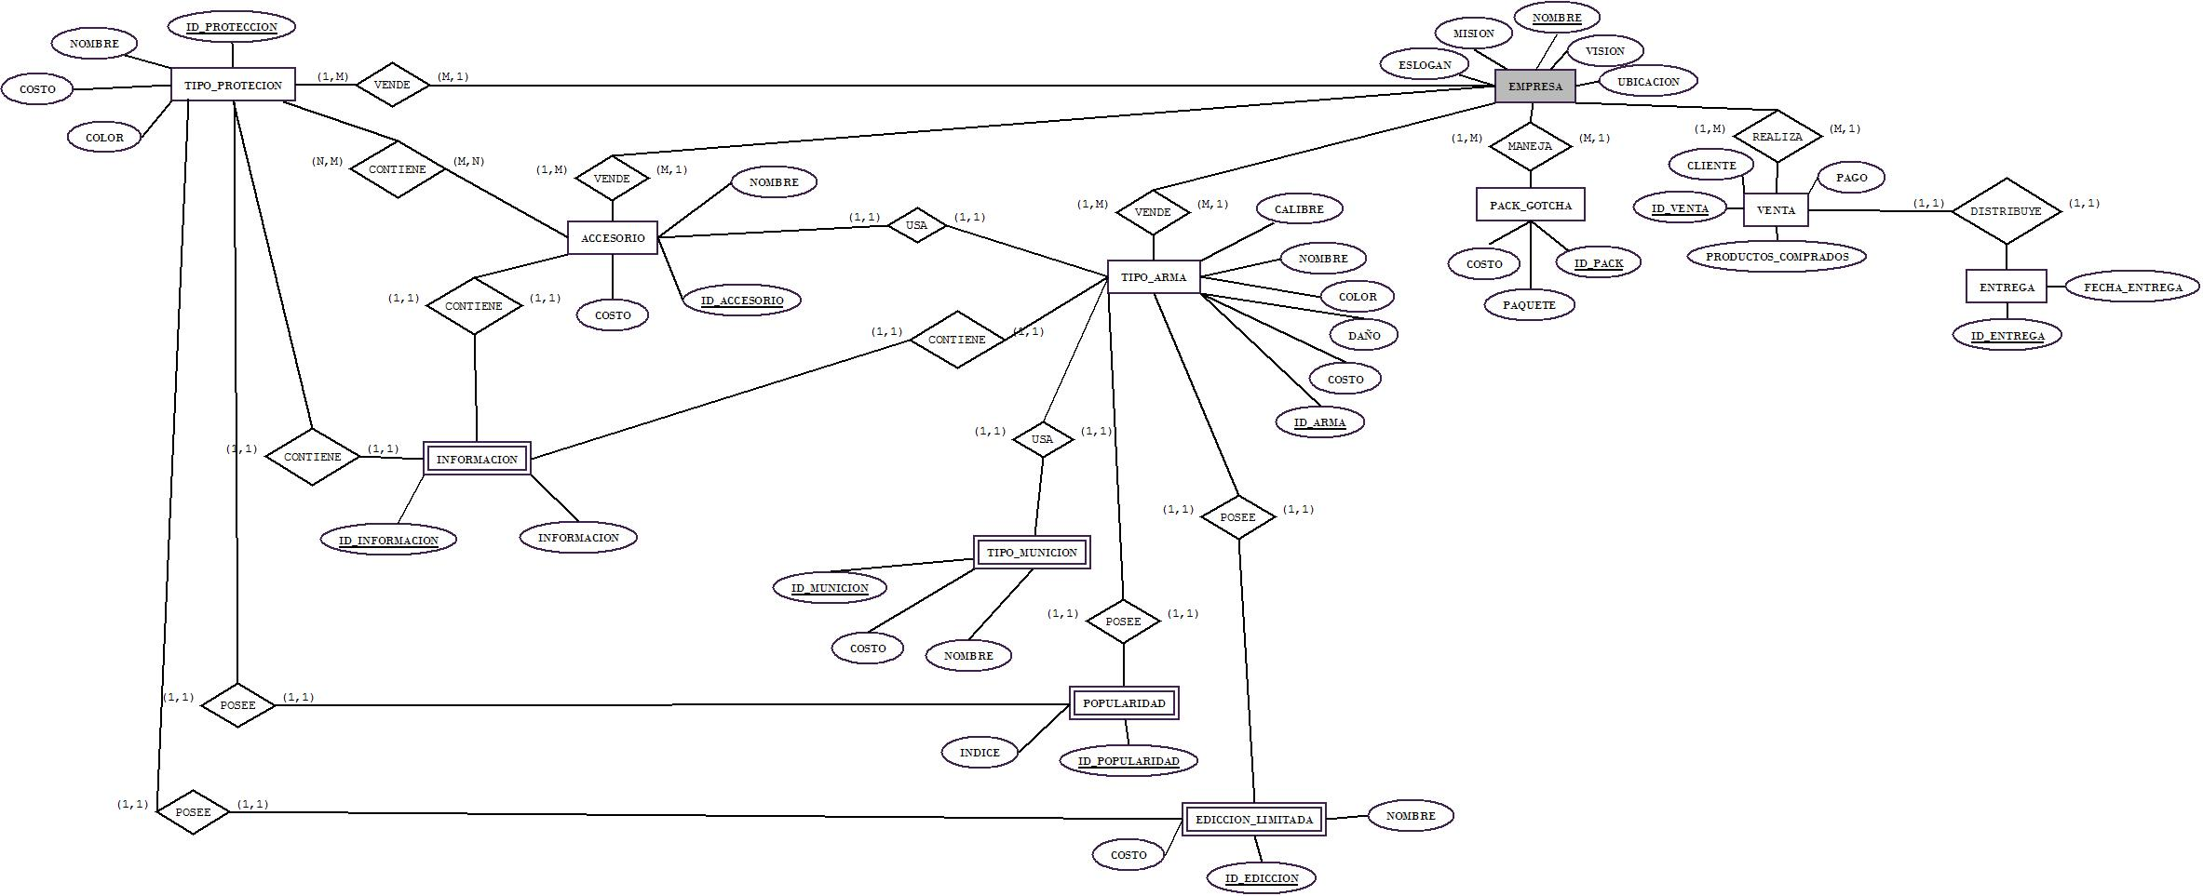
DIAGRAM

Slide 8
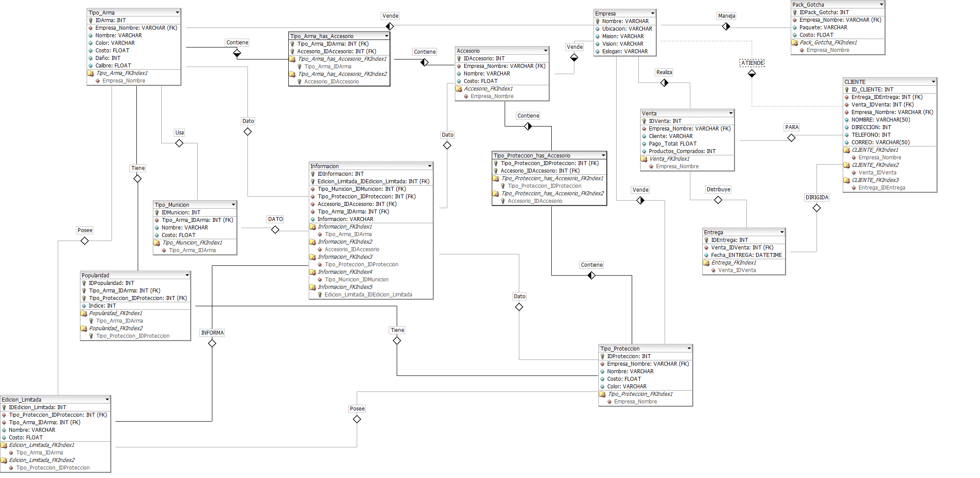
RELATIONAL MODEL

