Slide 1

Science
Year 5+6
Lesson 3 –
Tuesday 26th January , 02:30pm

Slide 2
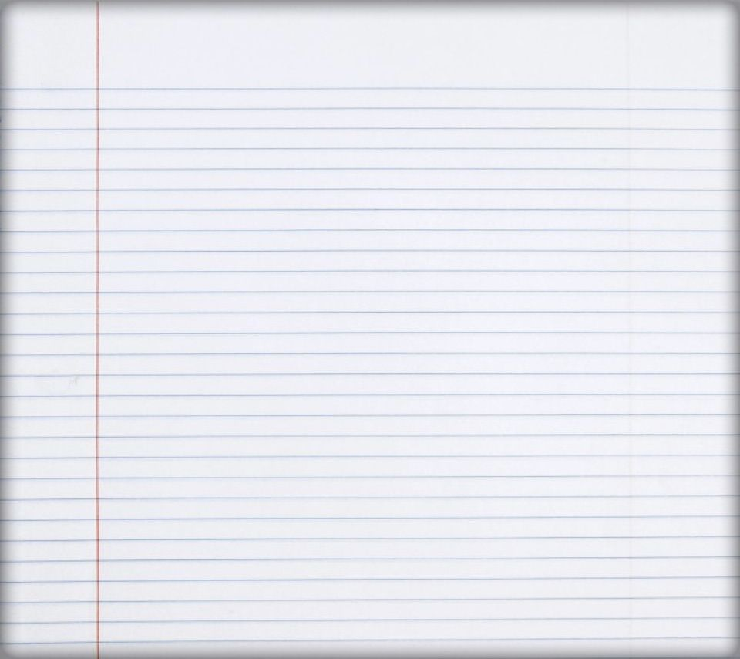
Tuesday 14th April 2020
Science
L.O.
Understand that some solid substances dissolve in a liquid (solvent) to form a solution
Understand that the solution formed contains particles of both the solute (solid) and
the solvent (liquid) .

Slide 3
Activity 1
Today you are going to be learning about how some solids will dissolve in liquids to form a solution
Think about what might happen if you add the following solids to some water
Salt
Sand
Flour
Sugar
If you are working at home you could try each of these, how will you know if the solid dissolves?
Write a simple description of what happened in each or take a photograph.
Look at this video https://www.bbc.co.uk/bitesize/clips/zx7w2hv
Where do you think the solid particles are going to if they dissolve?

Slide 4
Activity 2
We are going to investigate how much salt will dissolve in a given amount of water.
What equipment are you going to need here are some ideas:
Clear plastic beaker or similar
Salt (table salt) or sugar if no salt available
A teaspoon for measuring the salt/sugar
Another teaspoon or something to stir with
What to do:
Think about the following:
How will you measure the amount of salt/sugar you are adding?
How will you know if all the salt/sugar has dissolved?
How will you make sure it’s a fair test? (Think about the amount of water/stirring etc.)
Write up what you did and what you found out if you have time you could compare sugar and salt to see if some substances dissolve more than others.

