Slide 1
Introduction to DevOps
From Coders to Happy Users

Slide 2
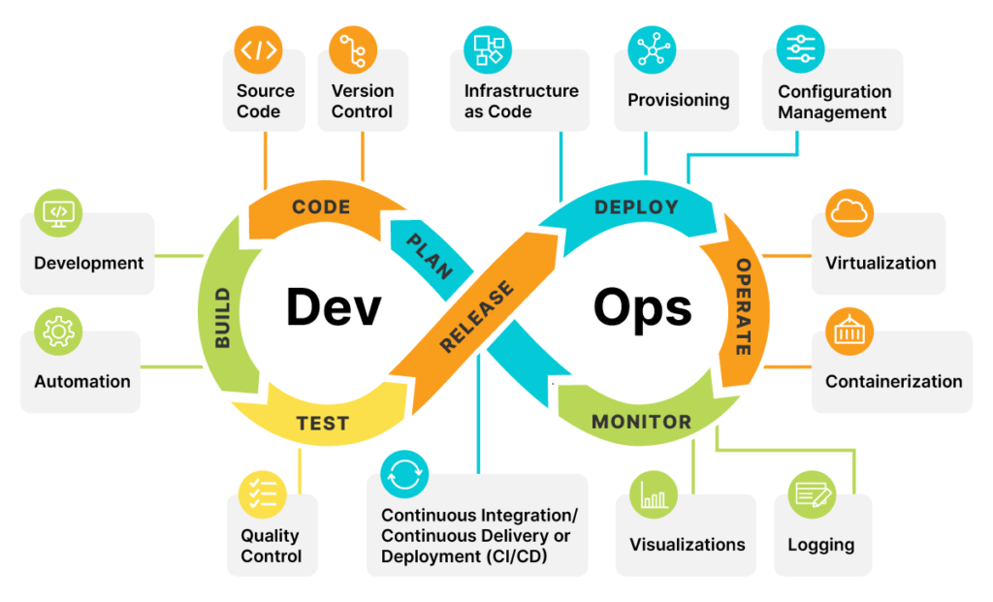
Development Operations (DevOps)

Slide 3
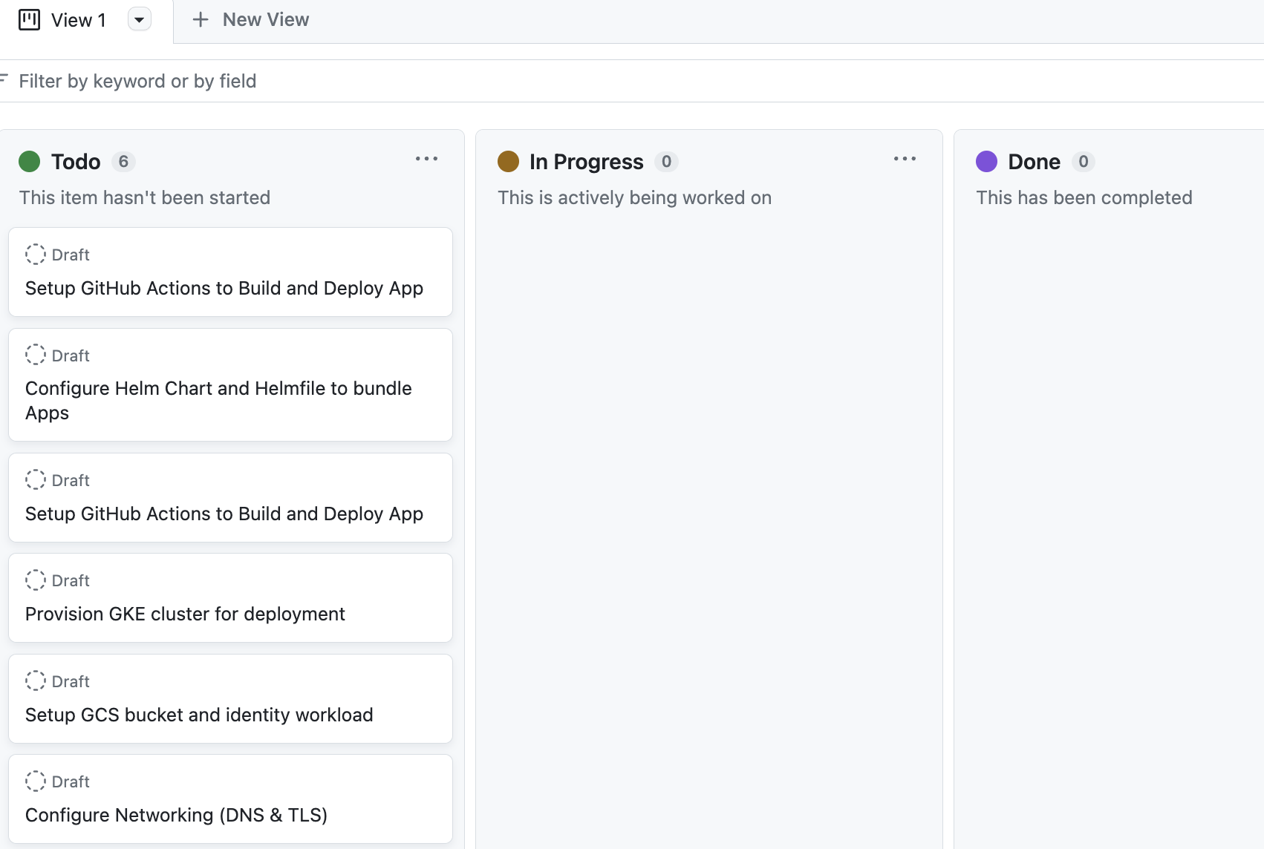
Plan
Notes:
Tools like Jira can be used in planning

Slide 4
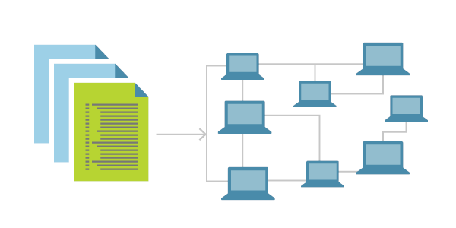
Code
Notes:
This is where tools like IaC comes in.

Slide 5
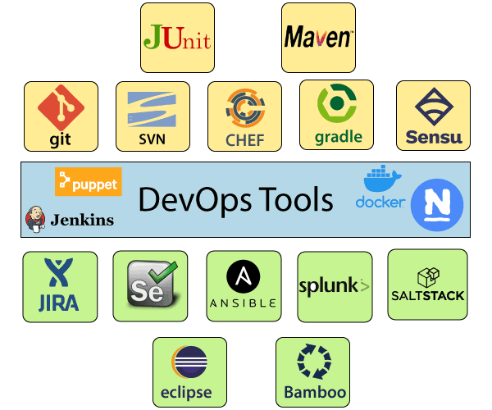
Build

Slide 6
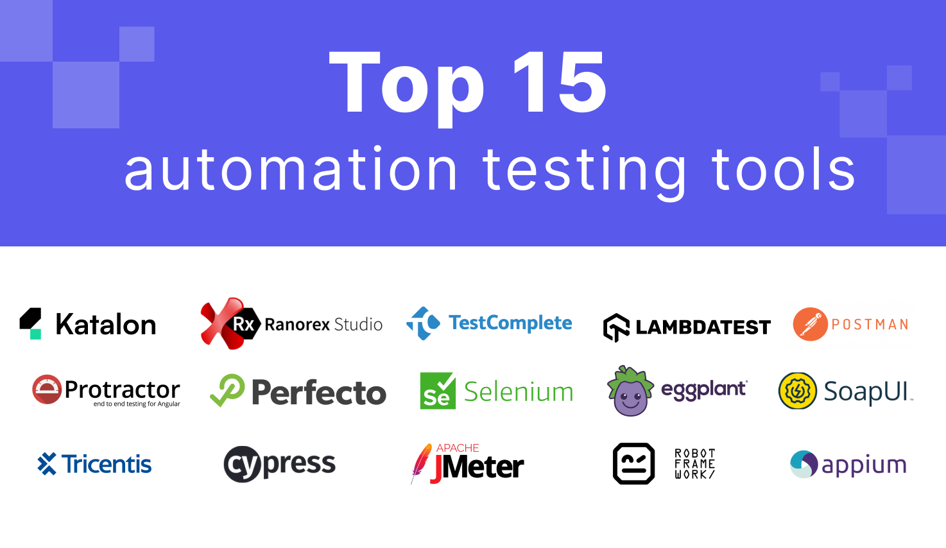
Test

Slide 7
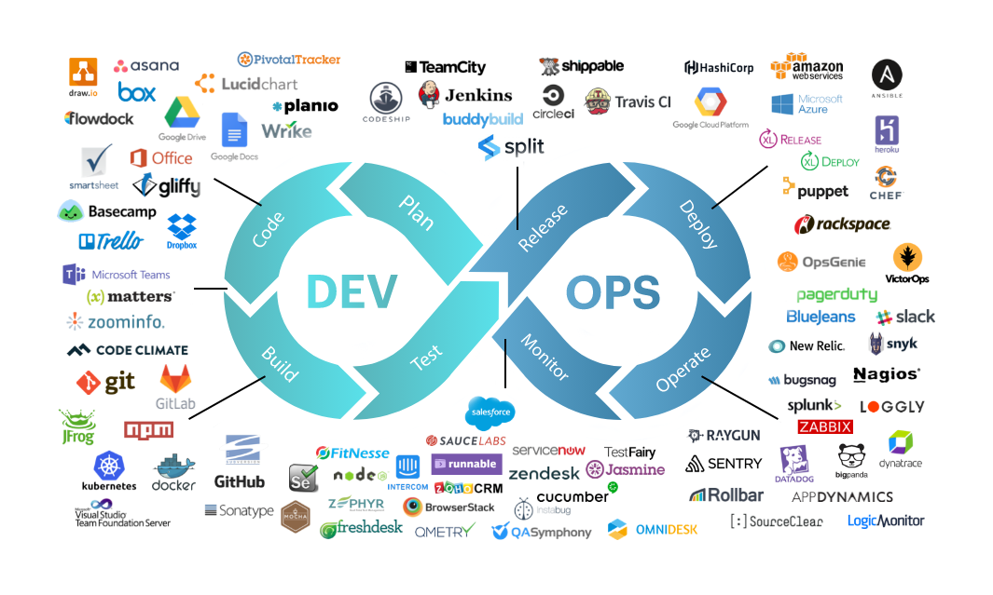
Deploy

Slide 8
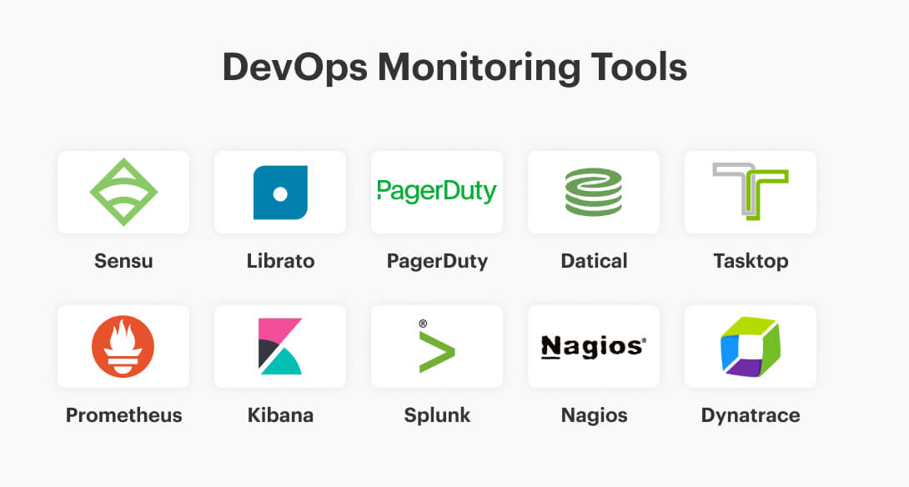
Monitor

Slide 9
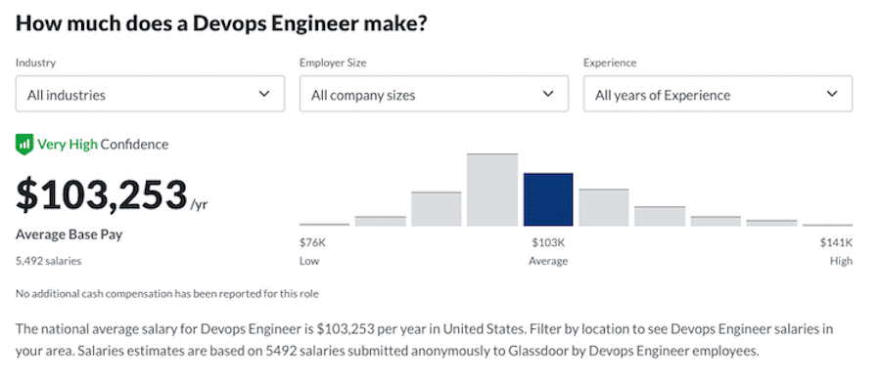
Some Inspiration

Slide 10
DevOps Practices
Continuous integration (CI): This practice brings configuration management tools together with other test and development tools to track how much of the code being developed is ready for production. It involves rapid feedback between testing and development to quickly identify and resolve code issues. Continuous deployment (CD): This practice automates the release of new or changed code into production. A company doing continuous deployment might release code or feature changes several times per day. The use of container technologies, such as Docker and Kubernetes, can enable continuous deployment by helping to maintain consistency of the code across different deployment platforms and environments.

Slide 11
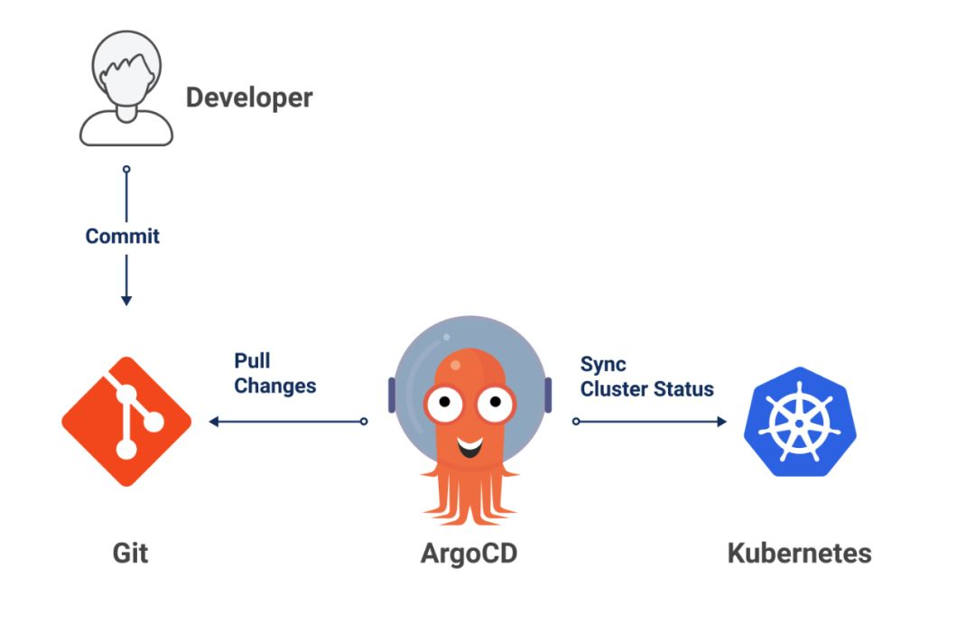
GitOps

Slide 12
FAQs
What’s the Development and DevOps?
What is the difference between cloud computing and devops?

