Slide 1
Horoscope: Resource Based Scheduling of Queries in Distributed Databases
David Dietrich
Tzu-Yang (Ben) Yu
Yiyao Liu

Slide 2
Roadmap
Problem and Motivation
Design
Implementation
Experiment
Conclusion & Future Work

Slide 3
Motivation
In a distributed database, the computing capacity of servers may vary
Different hardware
Different workload
Partial hardware failure
Network congestion
Typically, a query is assigned to the closest replica

Slide 4
Goal
Examine how different server conditions affect query performance
Heterogeneous hardware
Workload
Network condition
Explore an efficient way to schedule queries based on server conditions
Allocate work based on node conditions
Mitigate hotspots
Better performance
Feasible for any database

Slide 5
Design
Client
Master
Node A
Node K
Node N
Client sends query
Master collects resource information from nodes
Master sends query based upon resource usage
Master returns query result

Slide 6
Implementation
Resource Monitor*
On each node server
Measures the resource usage
CPU Usage
Memory
Process list
Central job director (CJD):
On central master server
Collect resource usage information
Schedule and assign jobs to nodes

Slide 7
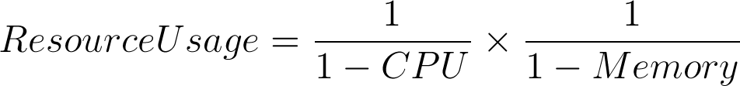
Implementation
Client
Master
CJD
24.7
7.3
89.5
Node A
Node K
Node N
Resource Monitor
Resource Monitor
Resource Monitor
*

Slide 8
Experimental Methodology
Apache Cassandra
Distributed key-value database
Compare performance with and without our scheduler
Implemented the scheduler in Cassandra
Yahoo! Cloud Service Benchmark (YCSB)
Generates data and queries for benchmarking

Slide 9
Experimental setup
Read-heavy workload
Ran on 10 machine cluster
150GB of generated data
Hash partitioned
Replication factor = 3
Read Consistency = ONE
Results averaged over 5 executions

Slide 10
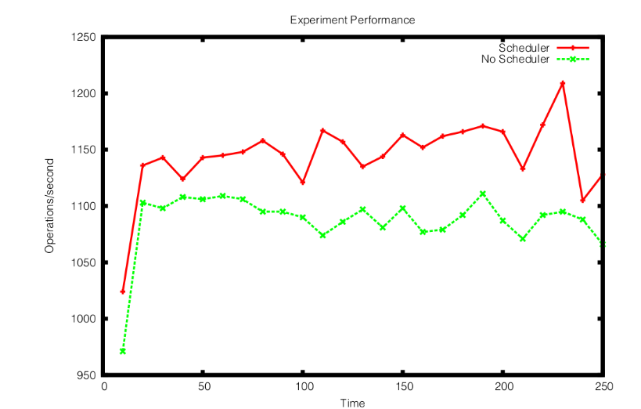
Experimental Results

Slide 11
Experimental Results
Our scheduling algorithm provides a small improvement to the default scheduler
Average improvement = 151 operations/second
The operations/second difference is not as drastic as we had hoped

Slide 12
Resource Usage
How does the resource usage actually correspond to the time to execute a query?
Collected:
Time to execute a query
CPU usage
Memory usage

Slide 13
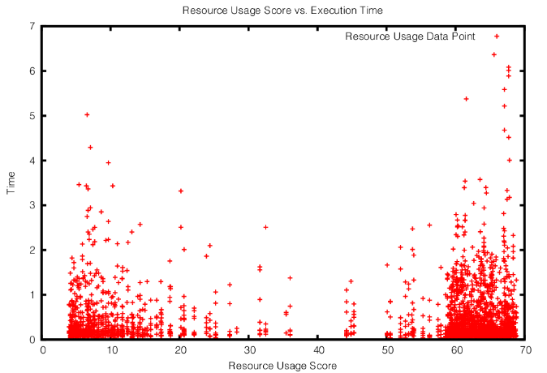
Resource usage experimental result

Slide 14
Limitations
Limited test environment
Only 10 servers in our cluster
Simplistic workload
Queries are small, so CPU & Memory usage has little effect
Unable to congest the network manually
All servers are collocated on the same rack, so network is never congested
Disk information wasn’t considered
We did not take hard disk accesses into account

Slide 15
Conclusion
Horoscope has slightly better performance than the ordinary scheduling algorithm
Scheduling queries based upon only CPU and memory usage seems to be insufficient
Other factors: bandwidth usage and disk time

Slide 16
Future Work
Consider disk usage & network condition
Find a more accurate formula for calculating resource usage score
Test with more complex queries
Test with different kinds of databases
Other key-value databases
Distributed relational databases

