Slide 1
MCV-M3: Image Classification (week 5)
Jonatan Poveda, Martí Cobos

Slide 2
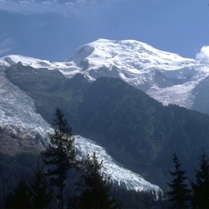
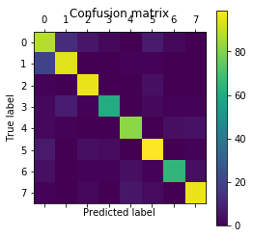
Image Classification Pipeline
Non-Deep learning approach
Feature Extraction
Global image representation
Classify Image
Evaluate Code Performance
SIFT descriptor
BoVW framework
SVM classifier
Compute metrics using ground truth information
Input Images and Labels
Deep learning approach
Neural Network
Evaluate Code Performance
Neural networks
(VGG-16, CNN)
Compute metrics using ground truth information
Input Images and Labels

Slide 3
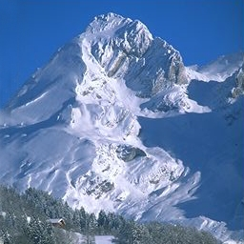
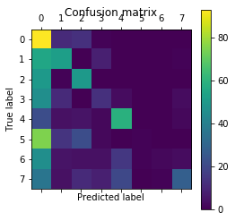
Week 1: Image Classification Pipeline
Train Database
Feature Extraction
Save Features
Classifier Training
Classification model
SIFT descriptor
Save Features to test several Classifiers
K-NN
Input Images and Labels
Test Database
Feature Extraction
Classify Image
Evaluate Code Performance
Feature extraction (SIFT) and classification
Compute metrics using ground truth
Input Images and Labels

Slide 4
Week 1: Implement performance evaluation measures and experimental protocols
Performance evaluation metrics:
Evaluator class has been implemented to assess code performance after assessing test images. Implementation based on sklearn.metrics class.
Code performance metrics implemented:
Confusion matrix: Great for visualize similar classes on the feature space in use.
Accuracy; Metric used to assess correct classifications vs entire dataset
Precision & Recall
F-score: Metric used to assess overall classifier performance
Image Classification algorithm evaluated on every code iteration

Slide 5
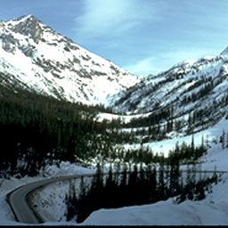
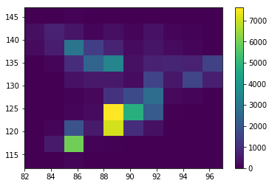
Week 1: Global description of the image
Color Histogram
A global feature descriptor based on the image color histogram has been implemented. Luv color space used for color histogram.
Number of descriptors per image = (number of bins)^2
The following flowchart summarizes the process to obtain the color histogram descriptor:
Convert image to Luv
Compute 2D histogram of u, v
Convert matrix to 1D array
Input Images

Slide 6

Week 1: Classifiers testing
A Classifier builder has been implemented to select between the following classifiers:
K-NN
Random Forest
Gaussian & Bernoulli Bayesian Classifier
SVM
A custom implementation of the logistic regression classifier has been implemented with the following features:
Convergence detection
Selectable maximum number of iterations
Lasso regularization with selectable lambda parameter
One vs All multiclass classification
The following equation defines the cost function of the gradient descent algorithm implemented:

Slide 7
Week 2: Image Classification Pipeline
Train Database
Feature Extraction
Vocabulary Learning
Global image representation
Classifier Training
Classification model
SIFT descriptor
k-means clustering
BoVW framework
SVM classifier
Input Images and Labels
Test Database
Feature Extraction
Global image representation
Classify Image
Evaluate Code Performance
SIFT descriptor
BoVW framework
SVM classifier
Compute metrics using ground truth information
Input Images and Labels

Slide 8
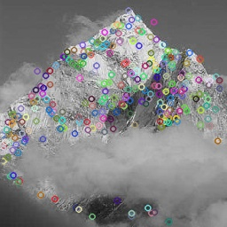
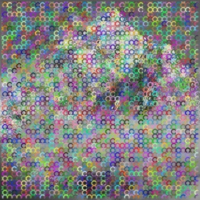
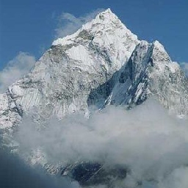
Week 2: Implement dense SIFT
Dense SIFT:
Normal SIFT implementation computes features on corner detections. (See right image).
Dense SIFT implemented by selecting key points uniformly spaced on the image. Python implementation using cv2.FeatureDetector_create("Dense") function
Use standard SIFT descriptor to obtain the features on the selected key points.
Dense SIFT improves accuracy from .66 to .79 (cross-validation average).
Standard SIFT:
Keypoints uniform definition
SIFT descriptor computation
Image classification
Input Images

Slide 9
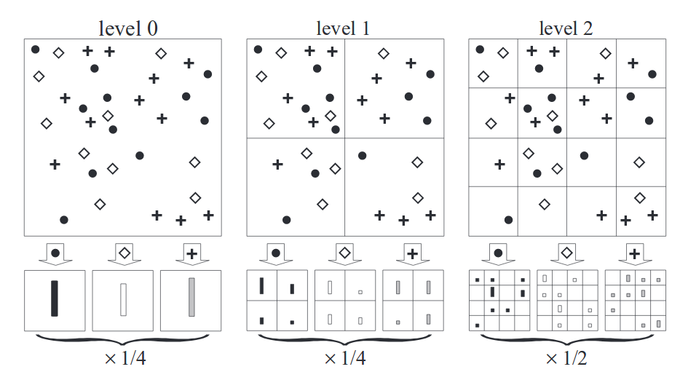
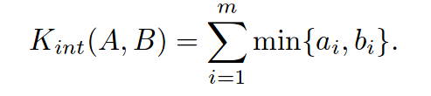
Week 2: Spatial Pyramid and Histogram Intersection kernel
Spatial pyramids
Histogram Intersection
Results
Pixel based | Accuracy | Precision | Recall | F1-score | time[s]
Method 1 | .793 | .799 | .793 | .796 | 579.2
Method 2 | .844 | .853 | .844 | .849 | 1104.3
Method 1: Dense SIFT + SVM (RBF kernel)
Method 2: Dense SIFT + Spatial Pyramids + SVM (histogram intersection kernel)

Slide 10
Weeks 3-5: Image Classification Pipeline
Implement a Multi Layer perceptron
Neural Network
Evaluate Code Performance
Neural Network
Compute metrics using ground truth information
Input Images and Labels

Slide 11
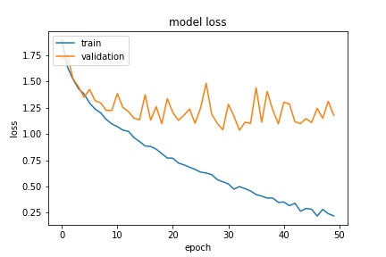
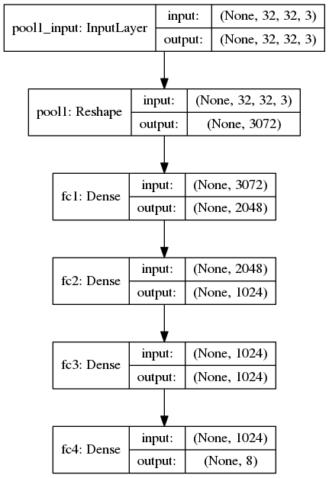
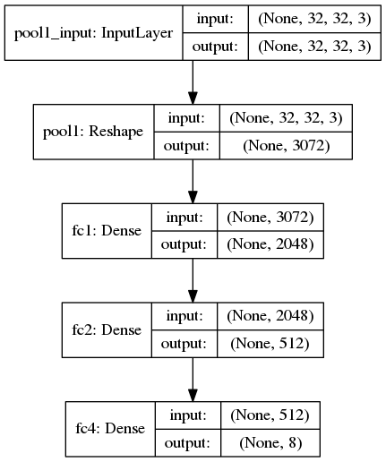
Week 3: Add/change layers in the network topology
Several topologies have been tested by adding and changing layers on the base network architecture. The best topologies are shown below. Full evaluation results shown on slide 8
Model loss: there is no loss train convergence with 50 epochs. The architecture of the model should be modified

Slide 12
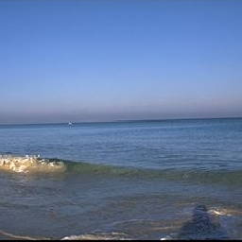

Week 3: Given an image, get the output of a given layer
MLP Topology
MLP output is difficult to interpret using only fully connected layers.
Output image
Input image
Reshape array to 32x32 image

Slide 13
Week 3: Extract a single feature from an input and apply to SVM
Procedure to apply SVM to the MLP output
Train multi layer perceptron with train images
Get the image output from the last hidden layer
Cross-validate SVM with output values to find best SVM kernel and parameters (best kernel: linear)
Train SVM with train images
Predict test images and evaluate classifiers
Evaluation results on test images:
SVM results are slightly better than end to end MLP
Image based | Accuracy | Precision | Recall | F1-score | time[s]
MLP | .640 | .640 | .657 | .646 | 1122.0
SVM | .660 | .674 | .667 | .670 | 1141.8
SVM

Slide 14
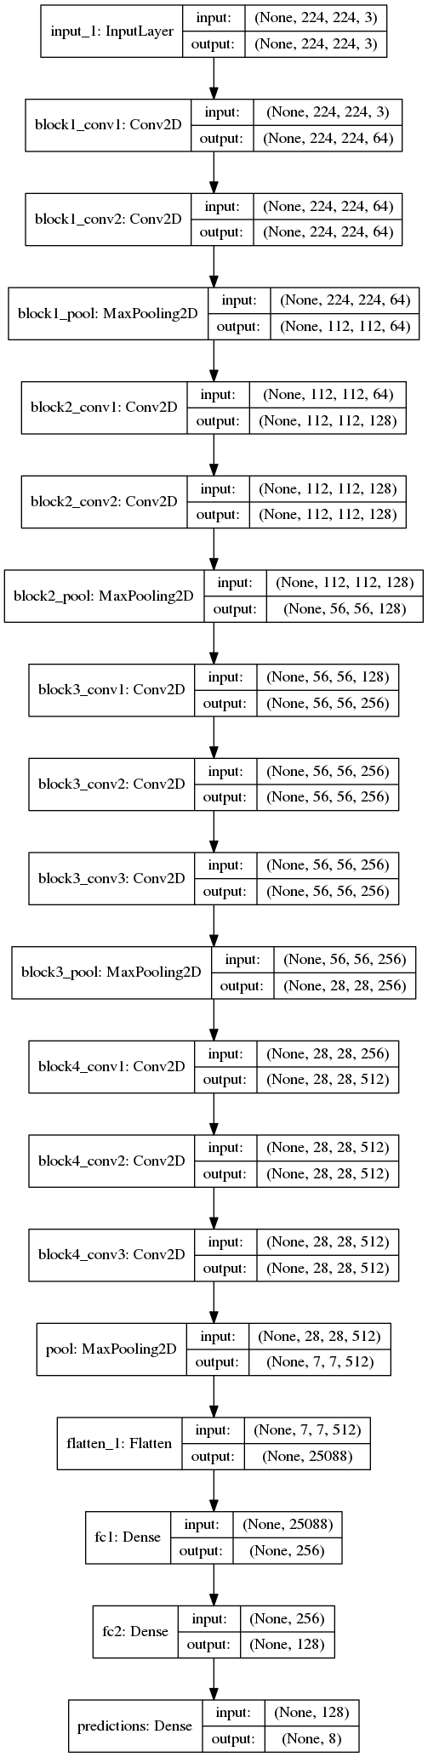
Week 4: Set a new model from a layer below VGG16-block4 including at least a fully connected layer + a prediction layer
The last convolutional blocks of VGG 16 is eliminated. A pooling layer to reduce the number of outputs from the convolutional blocks, two fully connected layers and a softmax layer are added at the end of the third block as shown on right image.
The neural network is trained in 2 stages:
1st stage: Freeze layers until the end of block 3, and train the new fully connected layers.
2nd stage: Unfreeze all layers to train all the CNN.
The learning rate on the 2nd training stage is reduced in order to avoid accuracy drop when changing the pre-trained layers.
Pooling layer to reduce output from conv blocks
Fully connected layers in decreasing number of nodes
Prediction layer

Slide 15
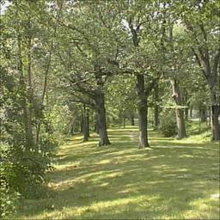
Week 4: Introduce and evaluate the usage of data augmentation
In order to increase the number of train images, using a base of only 400 real images, data augmentation has been implemented. The following techniques have been implemented:
Random rotation (±15º)
Random width shift (90%)
Random zoom (30%)
Random horizontal flip
Filling with reflection
Rotation
Original image
Zoom
Results on test image set:
Flip
Image based | Accuracy | Precision | Recall | F1-score | time[s]
Normal | .747 | .780 | .729 | .784 | 323.9
With data augmentation | .674 | .639 | .716 | .642 | 539.7

Slide 16
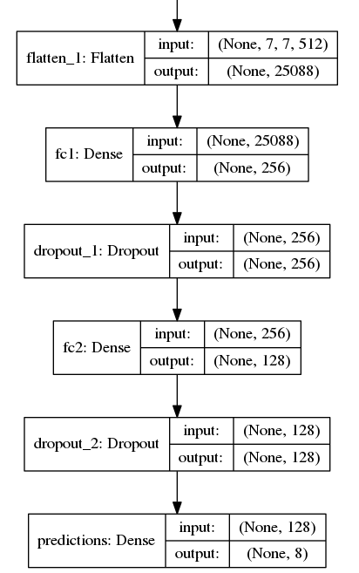
Week 4: Introduce and evaluate the usage of a dropout layer
A dropout layer is added after the last 2 fully connected layers:
Results on test image set:
Image based | Accuracy | Precision | Recall | F1-score | time[s]
With data augmentation | .674 | .639 | .716 | .642 | 539.7
Dropout Added | .489 | .465 | .403 | .461 | 521.6

Slide 17
Week 4: Apply random search on per model hyperparameters
We had troubles in order to adapt the initial CNN. By the time those issues were fixed, we could not perform a large random search of the hyperparameters due to a lack of time.
The following parameters were added to the random search:
Batch size (possible values: 16, 32, 64)
Fully connected layer 1 size (possible values: 512, 1024, 2048, 4096)
Fully connected layer 2 size (possible values: 128, 256, 512, 1024)
(We didn't try to search over the Adadelta optimize parameters because it was discouraged by Keras library)
Best results were achieved with a batch size of 32 and the size of the fully connected layers set to 1024. Evaluation results over the training set are shown on the following table:
Image based | Accuracy | Precision | Recall | F1-score | time[s]
Best random search results | .557 | .467 | .580 | .466 | 292
Note: Random search did not improve previous due to lack of time to implement a more exhaustive search

Slide 18
Week 5: Test/Validation split
Test image set provided has been splitted in a new test and a validation dataset with a 60% of images moved to validation set:
Old Test Image Set
Coast
Forest
Highway
60%
60%
60%
40%
40%
40%
Validation Image Set
New Test Image Set
Coast
Forest
Highway
Coast
Forest
Highway
During CNN training, the validation is used to tune the hyper-parameters. Afterwards, the image classification algorithm performance is assessed with test image set.

Slide 19
Week 5: Custom model
We build some models from scratch, smaller than VGG16 due to we need only to classify over 8-classes instead of 100-classes.
A Bayesian Optimization was implemented to find the best hyper-parameters:
3 different architectures were evaluated
3 image sizes (64x64, 128x128 and 256x256 [original]) as a input
a batch size of 128 images, ~300 iterations per epoch
Adadelta as the optimizer with recomm. parameters (lr=1, rho=.95)
a categorical cross-entropy as a loss function
accuracy as the metric to maximize
only 20 epochs of training

Slide 20
Week 5: Custom model
Arch-1 is based on two conv. layers and a pooling with three fc layers with one dropout before the layer of predictions.
Arch-2 is a modification of Arch-1 that reduces and number of parameters by adding a pooling layer after each conv., in that way we expect to keep the most representative filters and adds a bit of location invariance. It also has a dropout after each fc layer to enforce filters definition.
Arch-3 is a modification of Arch-2 with twice filters in the conv. layers, expecting to retrieve more features both low-level and high-level ones.

Slide 21
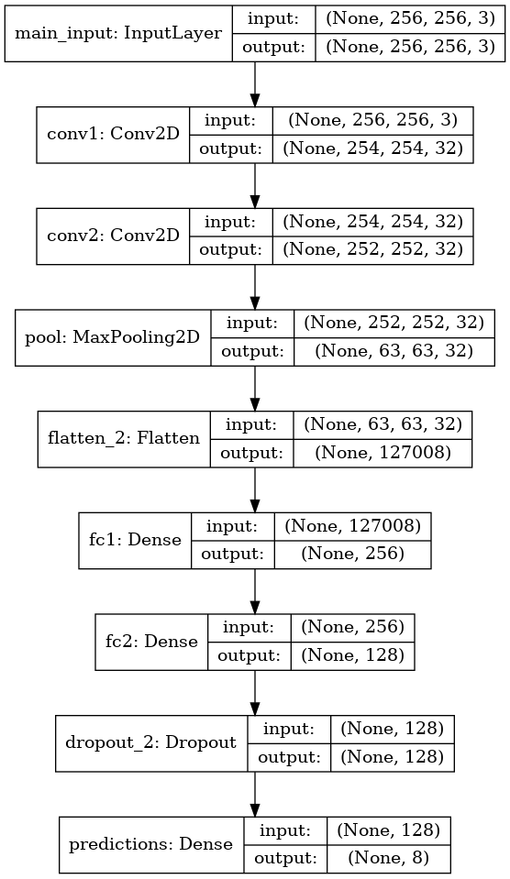
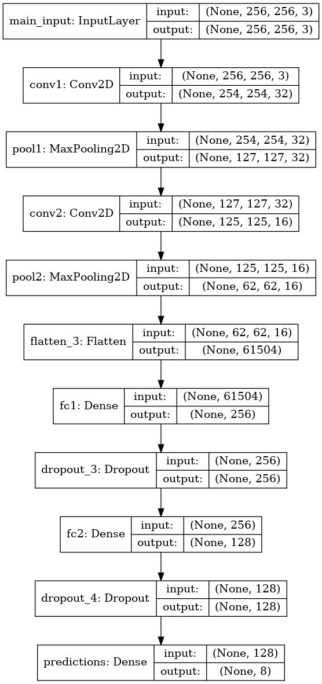
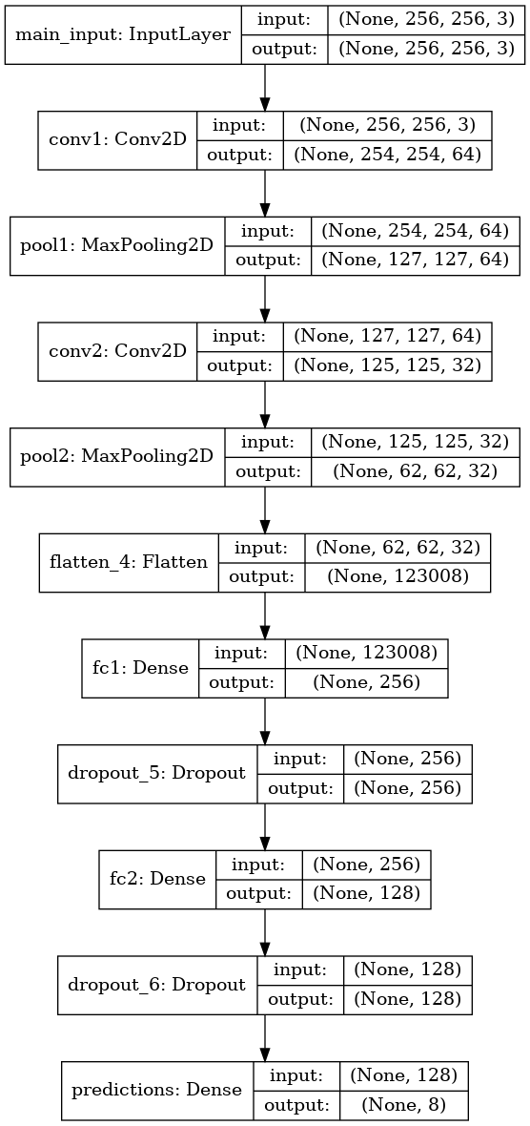
Week 5: Evaluated architectures
Arch-1 Arch-2 Arch-3

Slide 22
Week 5: Custom model
Comparison
Image based | Accuracy | Precision | Recall | F1-score | # Param | time[s]
M3-I64-E50 | .853 | .867 | .846 | .856 | 1.66 M | 2917
M3-I64-E20 | .831 | .844 | .827 | .836 | 1.66 M | 1222
M3-I256-E50 | .831 | .837 | .830 | .834 | 31.54 M | 2932
M3-I128-E50 | .825 | .834 | .826 | .830 | 7.43 M | 4862
M2-I64-E50 | .818 | .831 | .816 | .823 | 0.84 M | 5023
M2-I128-E20 | .821 | .829 | .818 | .823 | 3.72 M | 2158
M2-I128-E50 | .816 | .831 | .810 | .820 | 3.73 M | 5367
M1-128-E20 | .806 | .813 | .804 | .809 | 7.91 M | 2060
M1-I256-E20 | .796 | .809 | .797 | .802 | 32.59 M | 5257
Note: M{x}-I{y}-E{z} is the code for model {x} with an input image of {y}x{y} with {z} epochs

Slide 23
Classification performance evaluation (on test images)
Image based | Accuracy | Precision | Recall | F1-score | time[s]
Week 1 | .265 | .274 | .267 | .270 | 1.17
Week 2 | .844 | .853 | .844 | .849 | 1104
Week 3 | .660 | .674 | .667 | .670 | 2142
Week 4 | .747 | .780 | .729 | .784 | 324
Week 5 | .853 | .867 | .846 | .856 | 2917
Algorithm performance evaluated on test images using the following architectures (best results from every week):
Week 1: ColorHist (32 bins) + SVM (C=1)
Week 2: dense SIFT + k-means + spatial pyramids + SVM (histogram intersection kernel)
Week 3: 3 hidden layer multi layer perceptron + SVM (task 4)
Week 4: VGG 16 block4+4-pool+4096fc+1024fc
Week 5: CNN M3-I64-E50

Slide 24
Conclusions
BoVW is a good starting point for solving the classification problem due the low number of images. However, deep learning has a lot of potential and can achieve human accuracy.
Applying deep learning can boost the performance of the classification. However more hyper-parameters (optimizer, initializer, architecture) should be taking into account to select the best model. In addition, the duration of the training phase is significantly higher, without GPU acceleration this process wouldn’t have been possible in a reasonable time.
Best results achieved using the CNN’s architecture 3 using an image size of 64x64x3.
Counter-intuitively, a bigger image size seems to worse the results. Apart from increase a lot the number of parameters to train.
Adding an extra pooling and an extra dropout improve the results
Pixel based | Accuracy | Precision | Recall | F1-score | time[s]
Arch-{N} | .853 | .867 | .846 | .856 | 2917

Slide 25
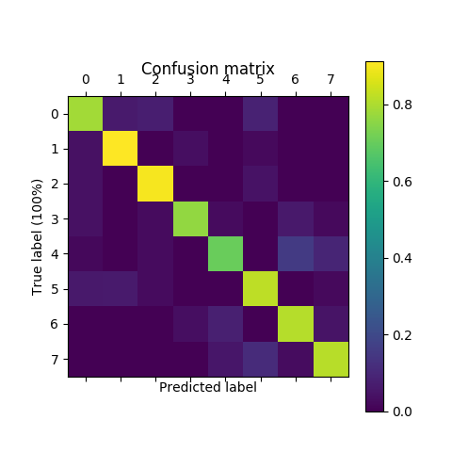
Future work, (using DL)
Best method Confusion Matrix plot
Collect more training data
Increase the number of epochs to further analyse the models and get a better working point
Increase the search in hyper-p. space to find better ones
Implement visualization to extract some info and fine-tune the NN
Base our model in other well-known NN like Inception
Give a try to the Capsule Networks which are based on CNNs
Maybe other types of NNs…

