Slide 1
Statistics with Python

Slide 2
Agenda
Regression Models
Statistical Assumptions for SLR
Gauss Markov theorem
Properties of Fitted Line
Residual Plots
Regression Model Accuracy Metrics – R², R²_{Adj} , AIC, BIC, CP and more
Regression Vs. Classification
Bivariate Linear Regression with Stats Model Example
Logistic Regression

Slide 3
Regression Model
The statistical model for simple linear regression is a straight line model of the form
We expect that different values of X will produce different mean response. In particular we have that for each value of X, the possible values of Y follow a distribution whose mean is
Method of Least Squares used to estimate the coefficients (Minimize RSS)

Slide 4
Statistical Assumptions for SLR
Classical Assumptions
  Regression is linear in parameters
  Error term has zero population mean
  Error term is not correlated with X’s
  Not serial correlation
  No heteroskedasticity
  No perfect multicolinearity
  Error term is normally distributed

Slide 5
Gauss-Markov Theorem
The least-squares estimates are BLUE (Best Linear, Unbiased Estimators).
Of all the possible linear, unbiased estimators of β0 and β1 the least squares estimates have the smallest variance.
The Gauss-Markov theorem states that if your linear regression model satisfies the first six classical assumptions, then ordinary least squares (OLS) regression produces unbiased estimates that have the smallest variance of all possible linear estimators.

Slide 6
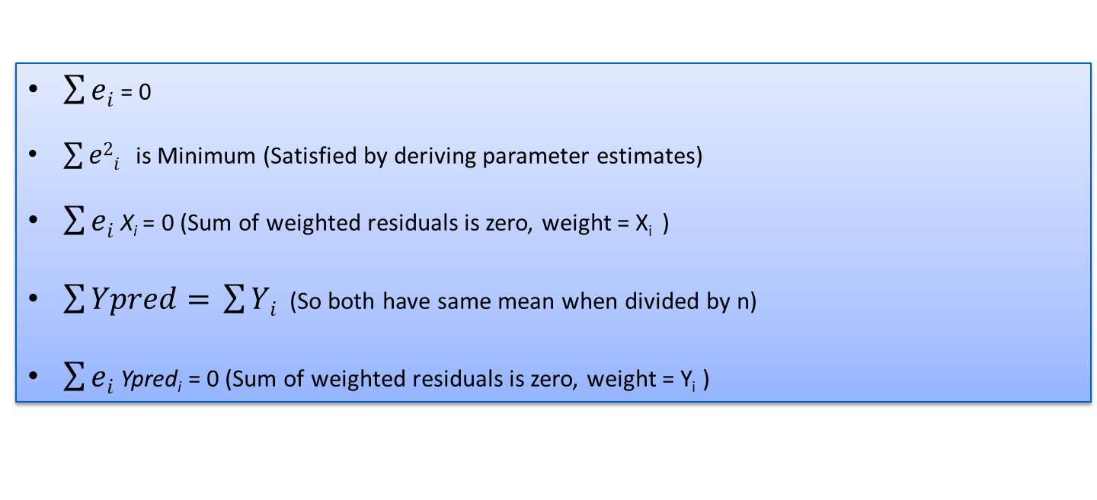
Properties of Fitted Line
$\sum{ei}$ = 0
$\sum{e2i}$ is Minimum (Satisfied by deriving parameter estimates)
$\sum{ei}$ X_{i} = 0 (Sum of weighted residuals is zero, weight = X_{i} )
$\sum{Ypred= }$ $\sum{Yi}$ (So both have same mean when divided by n)
$\sum{ei}$ Ypred_{i} = 0 (Sum of weighted residuals is zero, weight = Y_{i} )

Slide 7
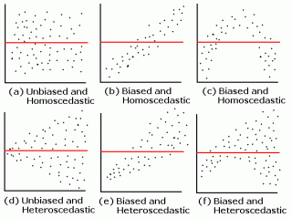
Residual Plots
A residual plot is a graph that shows the residuals on the vertical axis and the independent variable on the horizontal axis. If the points in a residual plot are randomly dispersed around the horizontal axis, a linear regression model is appropriate for the data; otherwise, a non-linear model is more appropriate.

Slide 8
Regression Model Accuracy Metrics
Adjusted R-squared
AIC: It adds a penalty that increases the error when including additional terms. The lower the AIC, the better the model
AICc is a version of AIC corrected for small sample sizes.
BIC (or Bayesian information criteria) is a variant of AIC with a stronger penalty for including additional variables to the model
Mallows Cp: A variant of AIC developed by Colin Mallows.
Generally, the most commonly used metrics, for measuring regression model quality and for comparing models, are: Adjusted R2, AIC, BIC and Cp.

Slide 9
Bivariate Regression - Example
Stock Market Prediction using two macro-economic variables – Interest Rate and Unemployment Rate
Year | Month | Interest_Rate | Unemployment_Rate | Stock_Index_Price
2017 | 12 | 2.75 | 5.3 | 1364
2017 | 11 | 2.5 | 5.3 | 1394
2017 | 10 | 2.5 | 5.3 | 1357
2017 | 9 | 2.5 | 5.4 | 1293
2017 | 8 | 2.5 | 5.6 | 1256

Slide 10
Regression Vs. Classification
Supervised Learning
Unsupervised Learning
classification | clustering
regression | dimension reduction
Discrete
Continuous

Slide 11
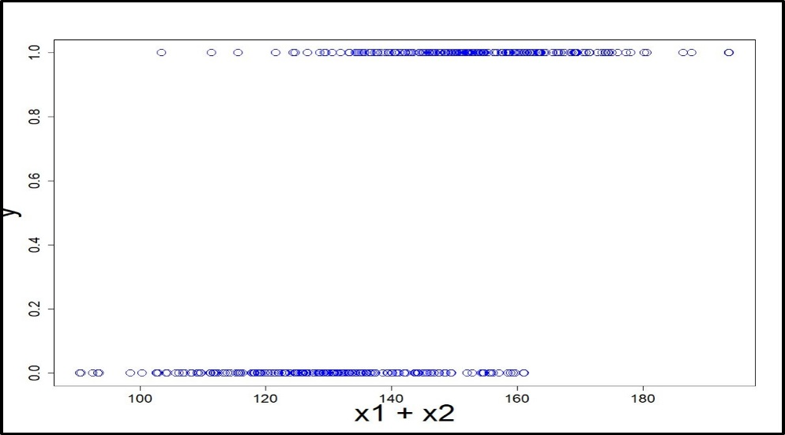
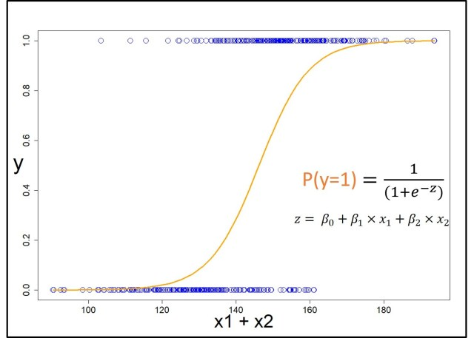
Logistic Regression
Regression used to fit a curve to data in which the dependent variable is binary, or dichotomous

Slide 12
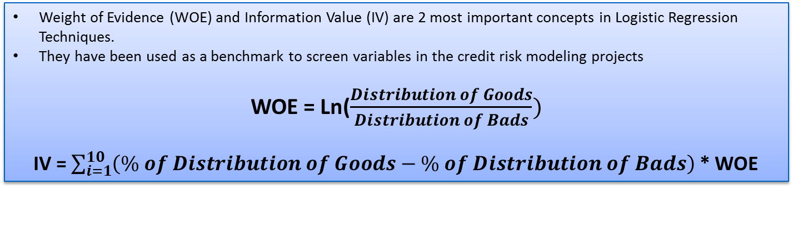
WOE & IV
Weight of Evidence (WOE) and Information Value (IV) are 2 most important concepts in Logistic Regression Techniques.
They have been used as a benchmark to screen variables in the credit risk modeling projects
WOE = Ln($\frac{Distribution of Goods}{Distribution of Bads})$
IV = $\sum_{i=1}^{10}{\left(\% of Distribution of Goods−\% of Distribution of Bads\right)}$ * WOE
Information Value | Predictive Power
< 0.02 | useless for prediction
0.02 to 0.1 | Weak predictor
0.1 to 0.3 | Medium predictor
0.3 to 0.5 | Strong predictor
>0.5 | Suspicious or too good to be true

Slide 13
WOE & IV
Age Group | Total Number of Loans | Number of Interesting | Numbef of Uninteresting | % Interesting | Distibution Interesting (DI) | Distibution Uninteresting (DU) | WOE | DU - DI | (DU - DI)* WOE
19-39 | 2290 | 259 | 2031 | 11.3% | 0.497 | 0.508 | 0.021 | 0.011 | 0.0002
40-87 | 2231 | 262 | 1969 | 11.7% | 0.503 | 0.492 | -0.021 | -0.011 | 0.0002
Total | 4521 | 521 | 4000 | Information Value --> |  |  |  |  | 0.0005
Education Group | Total Number of Loans | Number of Interesting | Numbef of Uninteresting | % Interesting | Distibution Interesting (DI) | Distibution Uninteresting (DU) | WOE | DU - DI | (DU - DI)* WOE
tertiary | 1350 | 193 | 1157 | 14.3% | 0.370 | 0.289 | -0.247 | -0.081 | 0.0201
secondary | 2306 | 245 | 2061 | 10.6% | 0.470 | 0.515 | 0.091 | 0.045 | 0.0041
unknown | 187 | 19 | 168 | 10.2% | 0.036 | 0.042 | 0.141 | 0.006 | 0.0008
primary | 678 | 64 | 614 | 9.4% | 0.123 | 0.154 | 0.223 | 0.031 | 0.0068
Total | 4521 | 521 | 4000 | Information Value --> |  |  |  |  | 0.0318
Marital Status | Total Number of Loans | Number of Interesting | Numbef of Uninteresting | % Interesting | Distibution Interesting (DI) | Distibution Uninteresting (DU) | WOE | DU - DI | (DU - DI)* WOE
divorced | 528 | 77 | 451 | 14.6% | 0.148 | 0.113 | -0.271 | -0.035 | 0.0095
single | 1196 | 167 | 1029 | 14.0% | 0.321 | 0.257 | -0.220 | -0.063 | 0.0139
married | 2797 | 277 | 2520 | 9.9% | 0.532 | 0.630 | 0.170 | 0.098 | 0.0167
Total | 4521 | 521 | 4000 | Information Value --> |  |  |  |  | 0.0401

Slide 14
INFORMATION VALUE (IV)
Predictive Power | VAR_NAME | IV
Strong | duration | 1.6515
 | poutcome | 0.4619
 | month | 0.3795
Mediun | contact | 0.2478
 | pdays | 0.2033
 | previous | 0.1771
 | job | 0.1325
 | housing | 0.1066
Week | balance | 0.0762
 | loan | 0.0608
 | marital | 0.0401
 | education | 0.0318
 | campaign | 0.0233
Useless | day | 0.0046
 | age | 0.0005
 | default | 0.0000

Slide 15
VARIABLE SELECTION
Variable | IV | RF | Chi_Square | RFE | final_score
duration | 1 | 1 | 1 | 1 | 4
balance | 0 | 1 | 1 | 1 | 3
contact | 1 | 0 | 1 | 1 | 3
pdays | 1 | 0 | 1 | 1 | 3
previous | 1 | 0 | 1 | 1 | 3
age | 0 | 1 | 0 | 1 | 2
day | 0 | 1 | 0 | 1 | 2
housing | 1 | 0 | 0 | 1 | 2
month | 0 | 1 | 0 | 1 | 2
campaign | 0 | 0 | 0 | 1 | 1
default | 0 | 0 | 0 | 1 | 1
education | 0 | 0 | 0 | 1 | 1
job | 0 | 0 | 0 | 1 | 1
loan | 0 | 0 | 0 | 1 | 1
marital | 0 | 0 | 0 | 1 | 1
poutcome | 0 | 0 | 0 | 1 | 1
IV: Information Value
RF: Random Forest Classifier
Chi_Square: Univariate Model
RFE: Recursive Feature Elemination
PS: VIFs has been checked before variable finalization. More details in code

Slide 16
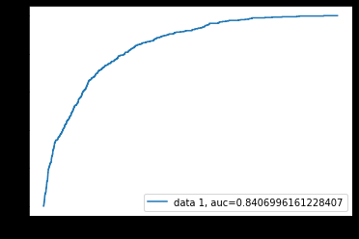
LOGISTIC REGRESSION
Model Iteration 1
Predicted
 | 0 | 1
0 | 3939 | 61
1 | 426 | 95
Actual
Accuracy | 0.89
Recall | 0.18
Precision | 0.60
F1 Score | 0.28

Slide 17
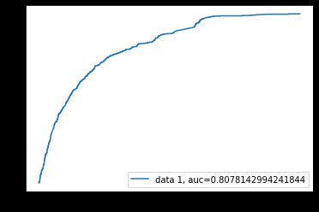
LOGISTIC REGRESSION
Model Iteration 2
Predicted
 | 0 | 1
0 | 3965 | 35
1 | 492 | 29
Actual
Accuracy | 0.88
Recall | 0.06
Precision | 0.45
F1 Score | 0.099

Slide 18

LOGISTIC REGRESSION
Model Iteration 3
Predicted
 | 0 | 1
0 | 3967 | 33
1 | 496 | 25
Actual
Accuracy | 0.88
Recall | 0.05
Precision | 0.42
F1 Score | 0.08

Slide 19
LOGISTIC REGRESSION
Model Execution in Python – Session102_Logistic_Regression.ipnyb

