Slide 1
ML Algorithms, ML with Python

Slide 2
LOGISTIC REGRESSION
Logistic Regression is a technique we apply to a class of problems where we need to predict whether the result is “class1”, “class2”, or “class 3” and so-on.
Start with Binary Classification:
  Results are calculated as to 1 or 0.
  So if assume A is the output, A = P(Y =1|X), and Xϵ R, w, b ϵ R, and A ϵ [0,1]
In Linear Regression, we have seen that we predict “A” using the following function
  A = wX + b. We learned the values of the parameters w and b, using Gradient Descent
Can we use this model for Linear Regression? - No, value is bound between 0 and 1
A=Sigmoid(z), where z=wX +b
W and b can be calculated same way as did in Linear Regression i.e. minimize cost function

Slide 3
LOGISTIC REGRESSION
Demo on real data
Data :- Bank data
  Information: The data is related with direct marketing campaigns of one of the European banking institution. The marketing campaigns were based on phone calls. Often, more than one contact to the same client was required, in order to access if the product (bank term deposit) would be (or not) subscribed.
  Objective: Identify the set of customer who has high likelihood to subscribe the product
  Dependent or Response Variable
    target: 1-Subscribe , 0-Not Subscribe
  Independent Variables:
    age (numeric)
    job : type of job: "student", "blue-collar","self-employed","retired","technician","services“, "admin.","unknown","unemployed","management","housemaid","entrepreneur"
    marital : marital status - "married","divorced","single“
    Education : "unknown","secondary","primary","tertiary“
    default: has credit in default? (binary: "yes","no")
    balance: average yearly balance, in euros

Slide 4
LOGISTIC REGRESSION
    age (numeric)
    job : type of job: "student", "blue-collar","self-employed","retired","technician","services“, "admin.","unknown","unemployed","management","housemaid","entrepreneur"
    marital : marital status - "married","divorced","single“
    Education : "unknown","secondary","primary","tertiary“
    default: has credit in default? (binary: "yes","no")
    balance: average yearly balance, in euros
    housing: has housing loan? (binary: "yes","no")
    loan: has personal loan? (binary: "yes","no")
    contact: contact communication type (categorical: "unknown","telephone","cellular")
    day: last contact day of the month (numeric)
    month: last contact month of year (categorical: "jan", "feb", "mar", ..., "nov", "dec")
    duration: last contact duration, in seconds (numeric)
    campaign: number of contacts performed during this campaign and for this client (numeric, includes last contact)
    pdays: number of days that passed by after the client was last contacted from a previous campaign (numeric, -1 means client was not previously contacted)
    previous: number of contacts performed before this campaign and for this client (numeric)
    poutcome: outcome of the previous marketing campaign (categorical: "unknown","other","failure","success")

Slide 5
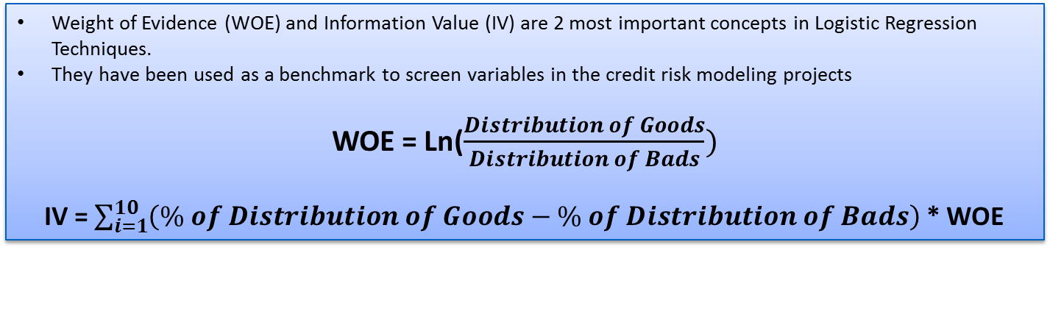
WOE & IV
Weight of Evidence (WOE) and Information Value (IV) are 2 most important concepts in Logistic Regression Techniques.
They have been used as a benchmark to screen variables in the credit risk modeling projects
WOE = Ln($\frac{Distribution of Goods}{Distribution of Bads})$
IV = $\sum_{i=1}^{10}{\left(\% of Distribution of Goods−\% of Distribution of Bads\right)}$ * WOE
Information Value | Predictive Power
< 0.02 | useless for prediction
0.02 to 0.1 | Weak predictor
0.1 to 0.3 | Medium predictor
0.3 to 0.5 | Strong predictor
>0.5 | Suspicious or too good to be true

Slide 6
WOE & IV
Occupation | Total Number of Loans | Number of Interesting | Numbef of Uninteresting | % Interesting | Distibution Interesting (DI) | Distibution Uninteresting (DU) | WOE | DU - DI | (DU - DI)* WOE
retired | 230 | 54 | 176 | 23.5% | 0.104 | 0.044 | -0.857 | -0.060 | 0.0511
student | 84 | 19 | 65 | 22.6% | 0.036 | 0.016 | -0.808 | -0.020 | 0.0163
unknown | 38 | 7 | 31 | 18.4% | 0.013 | 0.008 | -0.550 | -0.006 | 0.0031
management | 969 | 131 | 838 | 13.5% | 0.251 | 0.210 | -0.182 | -0.042 | 0.0077
housemaid | 112 | 14 | 98 | 12.5% | 0.027 | 0.025 | -0.092 | -0.002 | 0.0002
admin. | 478 | 58 | 420 | 12.1% | 0.111 | 0.105 | -0.058 | -0.006 | 0.0004
self-employed | 183 | 20 | 163 | 10.9% | 0.038 | 0.041 | 0.060 | 0.002 | 0.0001
technician | 768 | 83 | 685 | 10.8% | 0.159 | 0.171 | 0.072 | 0.012 | 0.0009
unemployed | 128 | 13 | 115 | 10.2% | 0.025 | 0.029 | 0.142 | 0.004 | 0.0005
services | 417 | 38 | 379 | 9.1% | 0.073 | 0.095 | 0.262 | 0.022 | 0.0057
entrepreneur | 168 | 15 | 153 | 8.9% | 0.029 | 0.038 | 0.284 | 0.009 | 0.0027
blue-collar | 946 | 69 | 877 | 7.3% | 0.132 | 0.219 | 0.504 | 0.087 | 0.0438
Total | 4521 | 521 | 4000 | Information Value --> |  |  |  |  | 0.1325

Slide 7
Coarse Classing
Occupation Group | Total Number of Loans | Number of Interesting | Numbef of Uninteresting | % Interesting | Distibution Interesting (DI) | Distibution Uninteresting (DU) | WOE | DU - DI | (DU - DI)* WOE
retired | 230 | 54 | 176 | 23.5% | 0.104 | 0.044 | -0.857 | -0.060 | 0.0511
student | 84 | 19 | 65 | 22.6% | 0.036 | 0.016 | -0.808 | -0.020 | 0.0163
unknown | 38 | 7 | 31 | 18.4% | 0.013 | 0.008 | -0.550 | -0.006 | 0.0031
management | 969 | 131 | 838 | 13.5% | 0.251 | 0.210 | -0.182 | -0.042 | 0.0077
housemaid | 112 | 14 | 98 | 12.5% | 0.027 | 0.025 | -0.092 | -0.002 | 0.0002
admin. | 478 | 58 | 420 | 12.1% | 0.111 | 0.105 | -0.058 | -0.006 | 0.0004
self-employed | 183 | 20 | 163 | 10.9% | 0.038 | 0.041 | 0.060 | 0.002 | 0.0001
technician | 768 | 83 | 685 | 10.8% | 0.159 | 0.171 | 0.072 | 0.012 | 0.0009
unemployed | 128 | 13 | 115 | 10.2% | 0.025 | 0.029 | 0.142 | 0.004 | 0.0005
services | 417 | 38 | 379 | 9.1% | 0.073 | 0.095 | 0.262 | 0.022 | 0.0057
entrepreneur | 168 | 15 | 153 | 8.9% | 0.029 | 0.038 | 0.284 | 0.009 | 0.0027
blue-collar | 946 | 69 | 877 | 7.3% | 0.132 | 0.219 | 0.504 | 0.087 | 0.0438
Total | 4521 | 521 | 4000 | Information Value --> |  |  |  |  | 0.1325

Slide 8
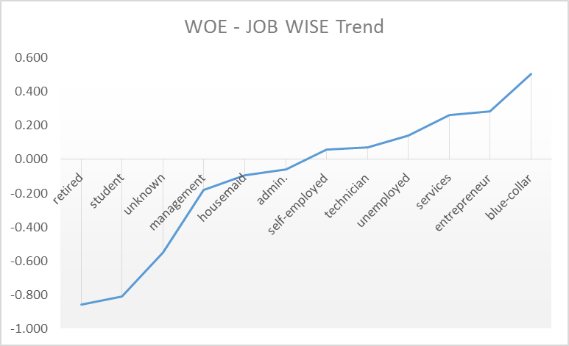
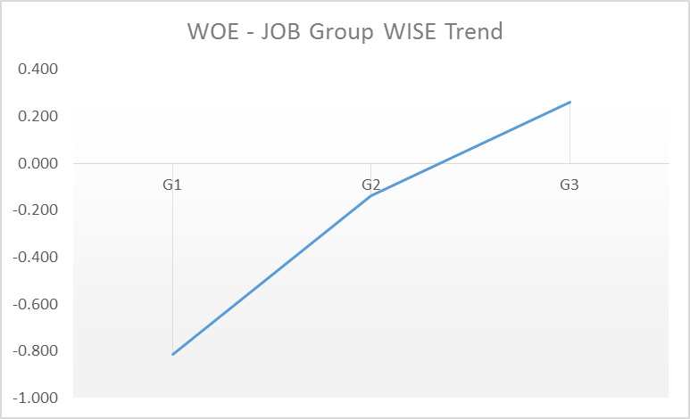
Coarse Classing
Occupation Group | Total Number of Loans | Number of Interesting | Numbef of Uninteresting | % Interesting | Distibution Interesting (DI) | Distibution Uninteresting (DU) | WOE | DU - DI | (DU - DI)* WOE
G1 | 352 | 80 | 272 | 22.7% | 0.154 | 0.068 | -0.815 | -0.086 | 0.0697
G2 | 1559 | 203 | 1356 | 13.0% | 0.390 | 0.339 | -0.139 | -0.051 | 0.0070
G3 | 2610 | 238 | 2372 | 9.1% | 0.457 | 0.593 | 0.261 | 0.136 | 0.0355
Total | 4521 | 521 | 4000 | Information Value --> |  |  |  |  | 0.1123

Slide 9
WOE & IV
Age Group | Total Number of Loans | Number of Interesting | Numbef of Uninteresting | % Interesting | Distibution Interesting (DI) | Distibution Uninteresting (DU) | WOE | DU - DI | (DU - DI)* WOE
19-39 | 2290 | 259 | 2031 | 11.3% | 0.497 | 0.508 | 0.021 | 0.011 | 0.0002
40-87 | 2231 | 262 | 1969 | 11.7% | 0.503 | 0.492 | -0.021 | -0.011 | 0.0002
Total | 4521 | 521 | 4000 | Information Value --> |  |  |  |  | 0.0005
Education Group | Total Number of Loans | Number of Interesting | Numbef of Uninteresting | % Interesting | Distibution Interesting (DI) | Distibution Uninteresting (DU) | WOE | DU - DI | (DU - DI)* WOE
tertiary | 1350 | 193 | 1157 | 14.3% | 0.370 | 0.289 | -0.247 | -0.081 | 0.0201
secondary | 2306 | 245 | 2061 | 10.6% | 0.470 | 0.515 | 0.091 | 0.045 | 0.0041
unknown | 187 | 19 | 168 | 10.2% | 0.036 | 0.042 | 0.141 | 0.006 | 0.0008
primary | 678 | 64 | 614 | 9.4% | 0.123 | 0.154 | 0.223 | 0.031 | 0.0068
Total | 4521 | 521 | 4000 | Information Value --> |  |  |  |  | 0.0318
Mariatl Status | Total Number of Loans | Number of Interesting | Numbef of Uninteresting | % Interesting | Distibution Interesting (DI) | Distibution Uninteresting (DU) | WOE | DU - DI | (DU - DI)* WOE
divorced | 528 | 77 | 451 | 14.6% | 0.148 | 0.113 | -0.271 | -0.035 | 0.0095
single | 1196 | 167 | 1029 | 14.0% | 0.321 | 0.257 | -0.220 | -0.063 | 0.0139
married | 2797 | 277 | 2520 | 9.9% | 0.532 | 0.630 | 0.170 | 0.098 | 0.0167
Total | 4521 | 521 | 4000 | Information Value --> |  |  |  |  | 0.0401

Slide 10
INFORMATION VALUE (IV)
Predictive Power | VAR_NAME | IV
Strong | duration | 1.6515
 | poutcome | 0.4619
 | month | 0.3795
Mediun | contact | 0.2478
 | pdays | 0.2033
 | previous | 0.1771
 | job | 0.1325
 | housing | 0.1066
Week | balance | 0.0762
 | loan | 0.0608
 | marital | 0.0401
 | education | 0.0318
 | campaign | 0.0233
Useless | day | 0.0046
 | age | 0.0005
 | default | 0.0000

Slide 11
VARIABLE SELECTION
Variable | IV | RF | Chi_Square | RFE | final_score
duration | 1 | 1 | 1 | 1 | 4
balance | 0 | 1 | 1 | 1 | 3
contact | 1 | 0 | 1 | 1 | 3
pdays | 1 | 0 | 1 | 1 | 3
previous | 1 | 0 | 1 | 1 | 3
age | 0 | 1 | 0 | 1 | 2
day | 0 | 1 | 0 | 1 | 2
housing | 1 | 0 | 0 | 1 | 2
month | 0 | 1 | 0 | 1 | 2
campaign | 0 | 0 | 0 | 1 | 1
default | 0 | 0 | 0 | 1 | 1
education | 0 | 0 | 0 | 1 | 1
job | 0 | 0 | 0 | 1 | 1
loan | 0 | 0 | 0 | 1 | 1
marital | 0 | 0 | 0 | 1 | 1
poutcome | 0 | 0 | 0 | 1 | 1
IV: Information Value
RF: Random Forest Classifier
Chi_Square: Univariate Model
RFE: Recursive Feature Elemination
PS: VIFs has been checked before variable finalization. More details in code

Slide 12
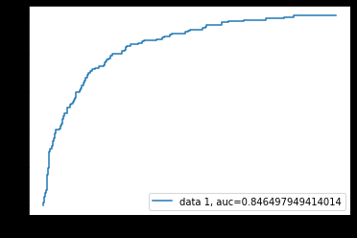
Model Performance
Confusion matrix
ROC Curve
Predicted Class
 | 1 | 0
1 | 973 | 20
0 | 104 | 34
Actual Class
Accuracy: 0.89

Slide 13
LOGISTIC REGRESSION
Model Execution in Python - BankData_Analysis_Logistic_Regression.ipnyb

Slide 14
DECISION TREE
A flow-chart-like tree structure
Internal node denotes a test on an attribute
Branch represents an outcome of the test
Leaf nodes represent class labels or class distribution
Split the records based on an attribute test that optimizes certain criterion.
Many Algorithms - CART, CHAID, C4.5/C5, ID3

Slide 15
DECISION TREE
Algorithm | Splitting Criteria | Type of Features | Missing Values
ID3 (Iterative Dichotomiser) | Information Gain | handles only categorical feature | ID3 does not work when data contains missing values
C4.5/C5 | Gain Ratio | handles both categorical and numerical feature | C4.5 works even when data contains missing values
CART (Classification & Regression Tree) | Twoing criteria/Gini value | handles both categorical and numerical feature | CART works even when data contains missing values
CHAID (Chi-square Automatic Interaction Detection) | Chi-square test based on p-value significance | handles both categorical and numerical feature | Deals with missing values present in the data

Slide 16
DECISION TREE
categorical
categorical
continuous
class
MarSt
Single, Divorced
Married
NO
Refund
Yes
No
NO
TaxInc
< 80K
> 80K
NO
YES
There could be more than one tree that fits the same data!

Slide 17
DECISION TREE
Important Components of Decision Tree
  SPLITTING DECISION (Gini Value, Entropy, Information Gain, Gain Ratio)
  STOPPING DECISION
  ASIGNMENT DECISION
  DECISION RULE EXTRACTION

Slide 18
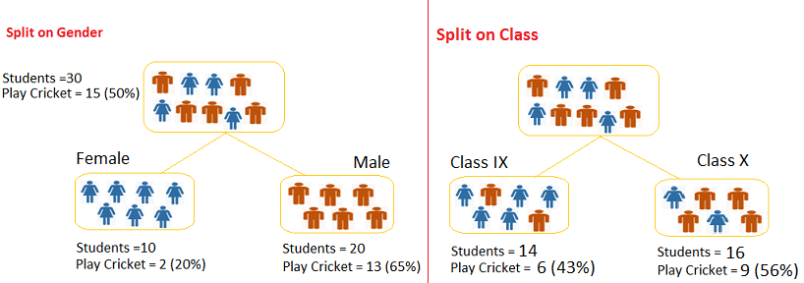
DECISION TREE
SPLITTING DECISION
  Gini Value:
The Gini index is very easy to calculate and used in the CART algorithm
Higher the value of Gini higher the homogeneity.
Calculate Gini for sub-nodes, using formula sum of square of probability for success and failure (p²+q²).
Calculate Gini for split using weighted Gini score of each node of that split
Referring to example where we want to segregate the students based on target variable ( playing cricket or not ). There are 2 input variables –
Split on Gender:
Gini for sub-node Female = (0.2)*(0.2)+(0.8)*(0.8)=0.68
Gini for sub-node Male = (0.65)*(0.65)+(0.35)*(0.35)=0.55
Weighted Gini for Split Gender = (10/30)*0.68+(20/30)*0.55 = 0.59
Similar for Split on Class:
Gini for sub-node Class IX = (0.43)*(0.43)+(0.57)*(0.57)=0.51
Gini for sub-node Class X = (0.56)*(0.56)+(0.44)*(0.44)=0.51
Weighted Gini for Split Class = (14/30)*0.51+(16/30)*0.51 = 0.51
Above, you can see that Gini score for Split on Gender is higher than Split on Class, hence, the node split will take place on Gender.

Slide 19
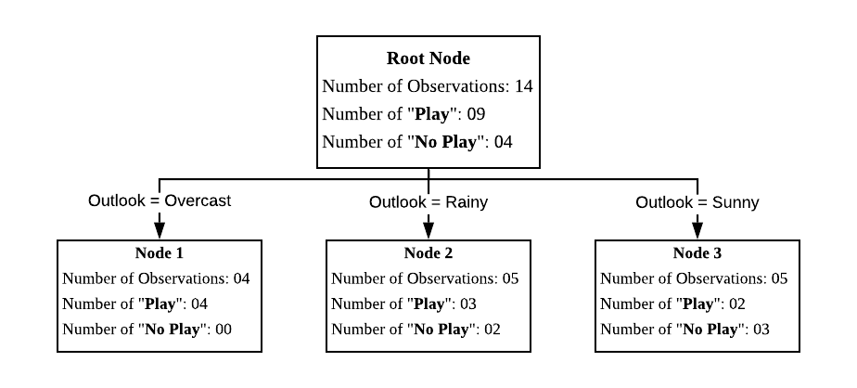
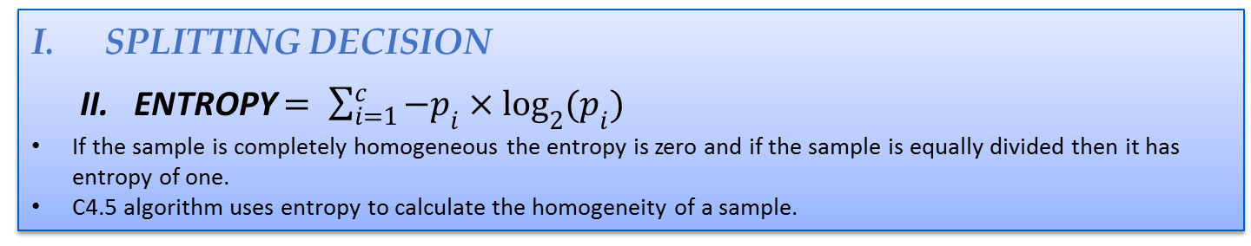
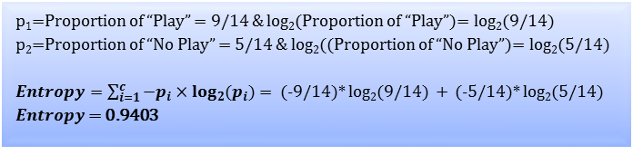
DECISION TREE
SPLITTING DECISION
  II. ENTROPY $= \sum_{i=1}^{c}{−p_{i}×\log_{2}{{(p}_{i})}}$
If the sample is completely homogeneous the entropy is zero and if the sample is equally divided then it has entropy of one.
C4.5 algorithm uses entropy to calculate the homogeneity of a sample.
Entropy calculation for root node:
Root Node
Number of Observations = 14
Number of Yes’s (1s): 09
Number of No’s (0s): 05
p₁=Proportion of “Play” = 9/14 & log₂(Proportion of “Play”)= log₂(9/14)
p₂=Proportion of “No Play” = 5/14 & log₂((Proportion of “No Play”)= log₂(5/14)
$Entropy=\sum_{i=1}^{c}{−p_{i}×\log_{2}{{(p}_{i})}}$ = (-9/14)* log₂(9/14) + (-5/14)* log₂(5/14)
$Entropy$ = 0.9403

Slide 20
DECISION TREE
Model Execution in Python - BankData_Analysis_DecisionTree.ipnyb

Slide 21
RANDOM FOREST
Random forests is a supervised learning algorithm. It can be used both for classification and regression.
Random forests has a variety of applications, such as recommendation engines, image classification and feature selection.
How does the algorithm work?
  Select random samples from a given dataset.
  Construct a decision tree for each sample and get a prediction result from each decision tree.
  For classification, it select the most occurred output as the final prediction
  For regression, it selects the average of all outputs.
The model is difficult to interpret compared to a decision tree, where you can easily make a decision by following the path in the tree.

Slide 22
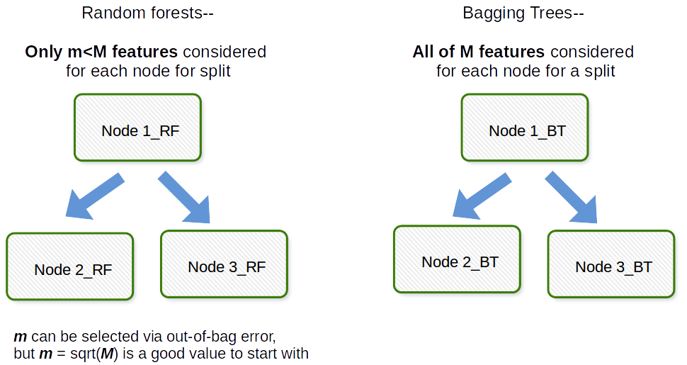
RANDOM FOREST vs BAGGING
The fundamental difference is that in Random forests, only a subset of features are selected at random out of the total and the best split feature from the subset is used to split each node in a tree, unlike in bagging where all features are considered for splitting a node.
Bagging comprises 2 steps – bootstrap and aggregation

Slide 23
Decision Tree Data
ID | Outlook | Temperature | Humidity | Play
1 | sunny | hot | high | No Play
2 | sunny | hot | high | No Play
3 | overcast | hot | high | Play
4 | rainy | mild | high | YesPlay
5 | rainy | cool | normal | YesPlay
6 | rainy | cool | normal | No Play
7 | overcast | cool | normal | YesPlay
8 | sunny | mild | high | No Play
9 | sunny | cool | normal | YesPlay
10 | rainy | mild | normal | YesPlay
11 | sunny | mild | normal | YesPlay
12 | overcast | mild | high | YesPlay
13 | overcast | hot | normal | YesPlay
14 | rainy | mild | high | No Play

Slide 24
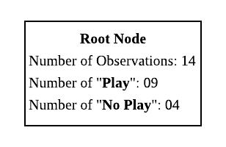
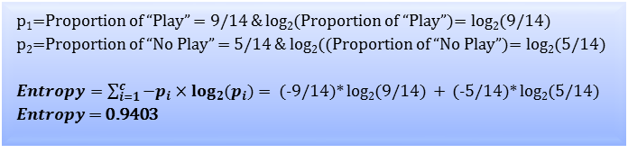
C4.5
Root Node
Root Node
Number of Observations = 14
Number of Yes’s (1s): 09
Number of No’s (0s): 05
p₁=Proportion of “Play” = 9/14 & log₂(Proportion of “Play”)= log₂(9/14)
p₂=Proportion of “No Play” = 5/14 & log₂((Proportion of “No Play”)= log₂(5/14)
$Entropy=\sum_{i=1}^{c}{−p_{i}×\log_{2}{{(p}_{i})}}$ = (-9/14)* log₂(9/14) + (-5/14)* log₂(5/14)
$Entropy$ = 0.9403

Slide 25
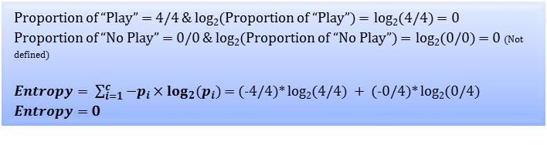
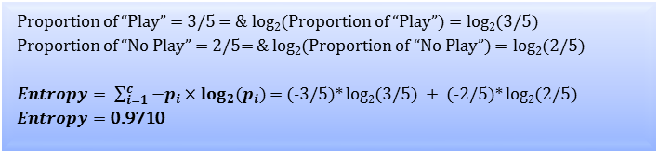
C4.5
Choice of first splitting variables
Outlook = overcast
Number of Observations = 04
Number of Yes’s (1s): 04
Number of No’s (0s): 00
Proportion of “Play” = 4/4 & log₂(Proportion of “Play”) = log₂(4/4) = 0
Proportion of “No Play” = 0/0 & log₂(Proportion of “No Play”) = log₂(0/0) = 0 (Not defined)
$Entropy= \sum_{i=1}^{c}{−p_{i}×\log_{2}{{(p}_{i})}}$ = (-4/4)* log₂(4/4) + (-0/4)* log₂(0/4)
$Entropy=$ 0
Outlook = rainy
Number of Observations = 05
Number of Yes’s (1s): 03
Number of No’s (0s): 02
Proportion of “Play” = 3/5 = & log₂(Proportion of “Play”) = log₂(3/5)
Proportion of “No Play” = 2/5= & log₂(Proportion of “No Play”) = log₂(2/5)
$Entropy= \sum_{i=1}^{c}{−p_{i}×\log_{2}{{(p}_{i})}}$ = (-3/5)* log₂(3/5) + (-2/5)* log₂(2/5)
$Entropy=$ 0.9710
Outlook Node Value (A) | Parent Node Obs. (B) | Node Obs. (C) | Weight = C ÷ B (D) | Entropy (E)*
Sunny | 14 | 5 | 5 ÷ 14 = 0.3571 | 0.9710
Overcast | 14 | 4 | 4 ÷ 14 = 0.2857 | 0.0
Rainy | 14 | 5 | 5 ÷ 14 = 0.3571 | 0.9710
Expected Entropy = Weight*Entropy = 0.3571*0.9710 + 0.2857*0 + 0.3571*0.9710 = 0.6935
Information Gain = 0.2467

Slide 26
C4.5
Choice of first splitting variables
Outlook = overcast
Number of Observations = 04
Number of Yes’s (1s): 04
Number of No’s (0s): 00
Proportion of “Play” = 4/4 & log₂(Proportion of “Play”) = log₂(4/4) = 0
Proportion of “No Play” = 0/0 & log₂(Proportion of “No Play”) = log₂(0/0) = 0 (Not defined)
$Entropy= \sum_{i=1}^{c}{−p_{i}×\log_{2}{{(p}_{i})}}$ = (-4/4)* log₂(4/4) + (-0/4)* log₂(0/4)
$Entropy=$ 0
Outlook = rainy
Number of Observations = 05
Number of Yes’s (1s): 03
Number of No’s (0s): 02
Proportion of “Play” = 3/5 = & log₂(Proportion of “Play”) = log₂(3/5)
Proportion of “No Play” = 2/5= & log₂(Proportion of “No Play”) = log₂(2/5)
$Entropy= \sum_{i=1}^{c}{−p_{i}×\log_{2}{{(p}_{i})}}$ = (-3/5)* log₂(3/5) + (-2/5)* log₂(2/5)
$Entropy=$ 0.9710
Outlook Node Value (A) | Parent Node Obs. (B) | Node Obs. (C) | Weight = C ÷ B (D) | Entropy (E)*
Sunny | 14 | 5 | 5 ÷ 14 = 0.3571 | 0.9710
Overcast | 14 | 4 | 4 ÷ 14 = 0.2857 | 0.0
Rainy | 14 | 5 | 5 ÷ 14 = 0.3571 | 0.9710
Expected Entropy = Weight*Entropy = 0.3571*0.9710 + 0.2857*0 + 0.3571*0.9710 = 0.6935
Information Gain = 0.2467

Slide 27
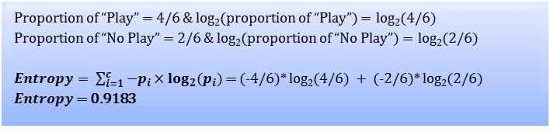
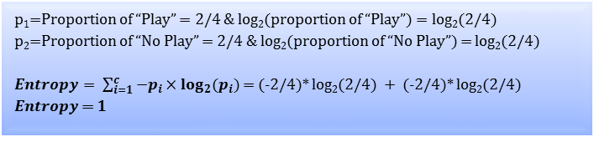
C4.5
Choice of first splitting variables
Temperature = hot
Number of Observations = 04
Number of Play’s (1s): 02
Number of No Play’s (0s): 02
p₁=Proportion of “Play” = 2/4 & log₂(proportion of “Play”) = log₂(2/4)
p₂=Proportion of “No Play” = 2/4 & log₂(proportion of “No Play”) = log₂(2/4)
$Entropy= \sum_{i=1}^{c}{−p_{i}×\log_{2}{{(p}_{i})}}$ = (-2/4)* log₂(2/4) + (-2/4)* log₂(2/4)
$Entropy$ = 1
Temperature = mild
Number of Observations = 06
Number of Play’s (1s): 04
Number of No Play’s (0s): 02
Proportion of “Play” = 4/6 & log₂(proportion of “Play”) = log₂(4/6)
Proportion of “No Play” = 2/6 & log₂(proportion of “No Play”) = log₂(2/6)
$Entropy= \sum_{i=1}^{c}{−p_{i}×\log_{2}{{(p}_{i})}}$ = (-4/6)* log₂(4/6) + (-2/6)* log₂(2/6)
$Entropy$ = 0.9183
Temperature Node Value (A) | Parent Node Obs. (B) | Node Obs. (C) | Weight = C ÷ B (D) | Entropy (E)
hot | 14 | 4 | 4 ÷ 14 = 0.2857 | 1.0
Mild | 14 | 6 | 6 ÷ 14 = 0.4286 | 0.9183
Cool | 14 | 4 | 4 ÷ 14 = 0.2857 | 0.8113
Expected Entropy = Weight*Entropy = 0.2857*1 + 0.4286*0.9183 + 0.2857*0.8113= 0.9111
Information Gain = 0.0292

Slide 28
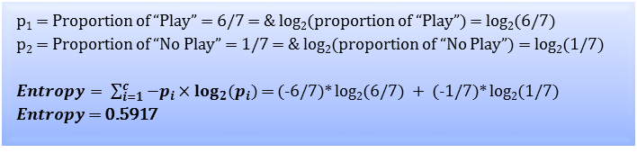
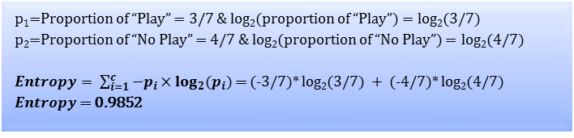
C4.5
Choice of first splitting variables
Humidity = high
Number of Observations = 07
Number of Yes’s (1s): 03
Number of No’s (0s): 04
p₁=Proportion of “Play” = 3/7 & log₂(proportion of “Play”) = log₂(3/7)
p₂=Proportion of “No Play” = 4/7 & log₂(proportion of “No Play”) = log₂(4/7)
$Entropy= \sum_{i=1}^{c}{−p_{i}×\log_{2}{{(p}_{i})}}$ = (-3/7)* log₂(3/7) + (-4/7)* log₂(4/7)
$Entropy$ = 0.9852
Humidity = normal
Number of Observations = 07
Number of Play’s (1s): 06
Number of No Play’s (0s): 01
p₁ = Proportion of “Play” = 6/7 = & log₂(proportion of “Play”) = log₂(6/7)
p₂ = Proportion of “No Play” = 1/7 = & log₂(proportion of “No Play”) = log₂(1/7)
$Entropy= \sum_{i=1}^{c}{−p_{i}×\log_{2}{{(p}_{i})}}$ = (-6/7)* log₂(6/7) + (-1/7)* log₂(1/7)
$Entropy$ = 0.5917
Humidity Node Value (A) | Parent Node Obs. (B) | Node Obs. (C) | Weight = C ÷ B (D) | Entropy (E)
high | 14 | 7 | 7 ÷ 14 = 0.50 | 0.9852
normal | 14 | 7 | 7 ÷ 14 = 0.50 | 0.5917
Expected Entropy = Weight*Entropy 0.50*0.9852 + 0.50*0.5917= 0.9111
Information Gain = 0.1518

Slide 29
C4.5
Deciding variable for splitting
Variable Name | Information Gain
Outlook | 0.2467
Temperature | 0.0292
Humidity | 0.1518

Slide 30
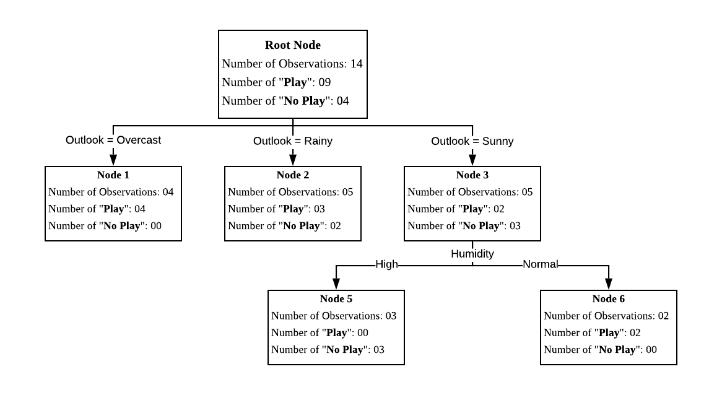
C4.5
Outlook = Sunny
Variable Name | Information Gain
Temperature | 0.5710
Humidity | 0.9710

Slide 31
C4.5
Rule # | Node # | Decision Rule
Rule 1 | Node 1 | If Outlook = ”Overcast” then Golf = “Play”
Rule 2 | Node 2 | If Outlook = ”rainy” then Golf = “Play”
Rule 3 | Node 5 | If Outlook = ”sunny” and Humidity = “high” then Golf = “No Play”
Rule 4 | Node 6 | If Outlook = ”sunny” and Humidity = “normal” then Golf = “Play”

