Slide 1

Knowledge Graph-Based Metaphor Representation
Tushar Godbole
MIS No.: 111903115
Under the guidance of
Dr. Y. V. Haribhakta

Slide 2
Introduction – Metaphors
Metaphor: figure of speech – one thing is described implicitly by referring to another
Detection and interpretation of metaphor is a major challenge in NLP
Project closely follows the work of Peng et al.¹, who use knowledge graphs to represent metaphors
1 Ciyuan Peng, Dang Thinh Vu, and Jason J Jung. Knowledge graph-based metaphor representation for literature understanding. Digital Scholarship in the Humanities, 36(3):698–711, 2021.

Slide 3
Introduction – Knowledge Graphs
Knowledge graph (KG): directed graph containing entities and the relationships between them
Knowledge graph embedding: representing the components of a KG using low-dimensional vectors while preserving its inherent structure

Slide 4
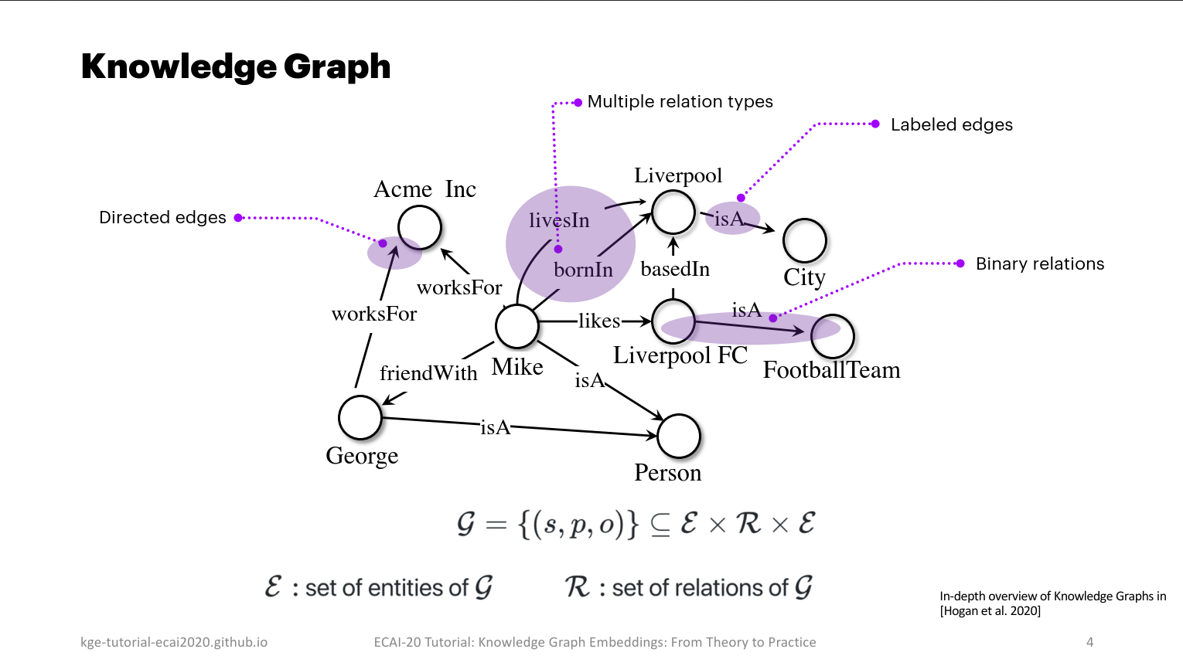
Introduction – Knowledge Graphs
Examples of information represented in this graph
Mike is a person
Mike lives in Liverpool
Mike works for Acme Inc.
Liverpool is a city

Slide 5
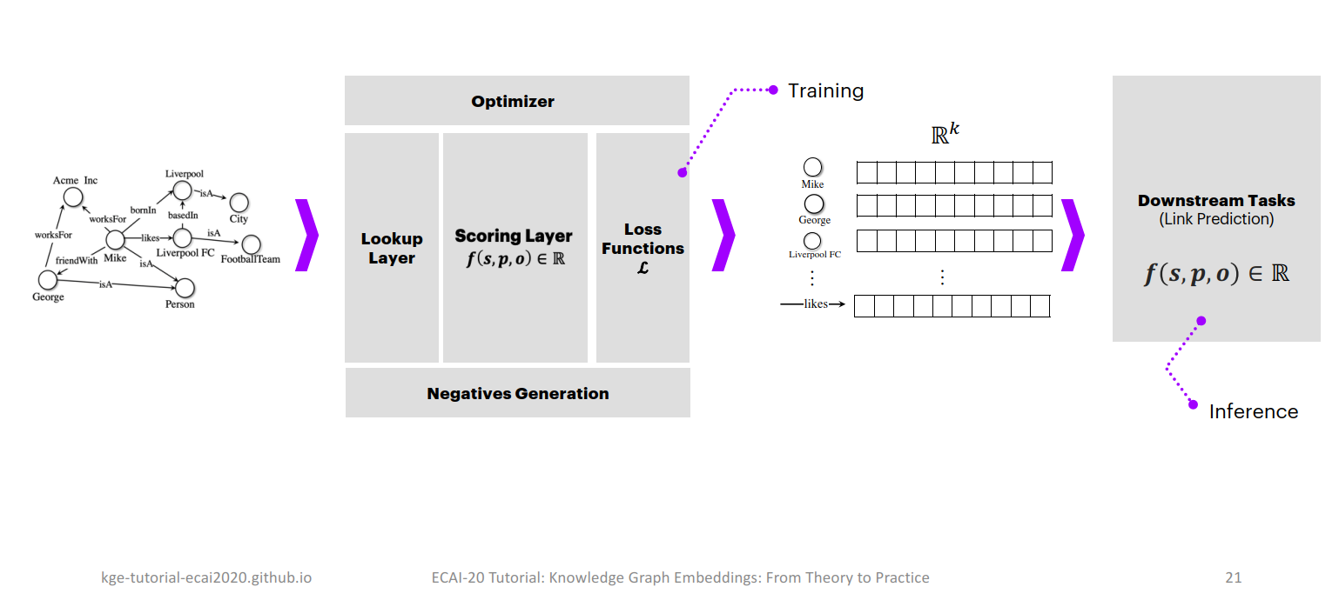
Introduction – Generic Knowledge Graph Embedding Block Diagram

Slide 6
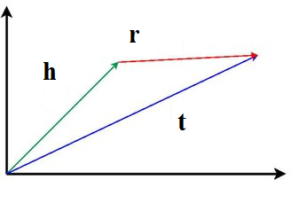

Introduction – TransE
TransE: It proposes to force the embeddings to satisfy a simple vector sum equation in each fact in which they appear: h + r = t.

Slide 7
Literature Review
Word-sense disambiguation and figurative language
Similarity-based Word Sense Disambiguation (Karov and Edelman, 1998):
Automatic disambiguation of word sense using text corpus and machine-readable dictionary
Active Learning for the Identification of Nonliteral Language (Birke and Sarkar, 2007)
Recognition of nonliteral language reduced to WSD problem
Karov and Edelman’s algorithm is used

Slide 8
Literature Review (contd.)
Reviews of existing work:
A Survey of Figurative Language and its Computational Detection in Online Social Networks (Abulaish et al., 2020):
brief history of figurative language studies
overview of feature extraction techniques and detection approaches
Models of Metaphor in NLP (Shutova, 2010):
Review of existing computational methods of metaphor

Slide 9
Literature Review (contd.)
Metaphors:
Knowledge graph-based metaphor representation for literature understanding (Peng et al., 2021):
Use KG to represent metaphors. Common adjectives of nouns are their relation.
Hunting Elusive Metaphors Using Lexical Resources (Krishnakmaran and Zhu, 2007):
Identification of 3 types of live metaphors involving nouns.
Uses WordNet and bigram counts.
A Knowledge Graph Embedding Approach for Metaphor Processing (Song et al., 2020):
Represent metaphors as triples (target, attribute, source), modelled as fact triples in a KG.
Use simile recognition and concept-attribute collocations.
Automatic Metaphor Interpretation as a Paraphrasing Task (Shutova, 2010):
Metaphorical expressions paraphrased literally. Uses automatically induced selectional preferences.

Slide 10
Problem Statement
Problem statement:
Study the knowledge graph embedding approach to metaphor representation.
Objectives:
To study the effectiveness of knowledge graph as a form of metaphor representation
To study knowledge graph embedding techniques
To predict the metaphor relations between noun pairs using knowledge graph embedding techniques

Slide 11
System Requirement Specification
The code for this project is written using Google Colaboratory.
The NLTK and Pandas libraries need to be imported in the notebooks.
Ampligraph 2.0.0 is used for knowledge graph embedding
Gephi is used to visualise the knowledge graph

Slide 12
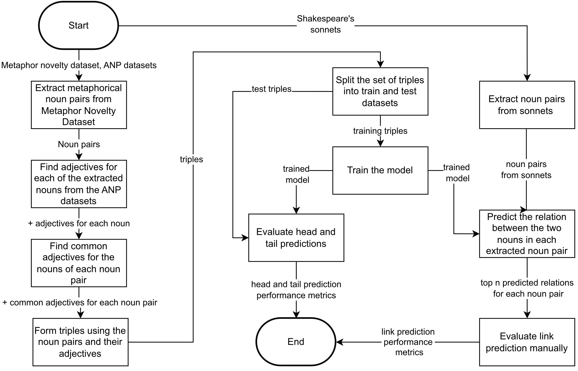
End-to-end process diagram for KG construction, KGE and model evaluation

Slide 13
Pseudocode and implementation
for word_pair in Metaphor_Novelty_Dataset:
lemmatised_word_pair = lemmatise(word_pair)
if words in lemmatised_word_pair are nouns:
noun_pair = lemmatised_word_pair
if noun_pair is metaphoric:
/* ANP(noun_pair) is the set of
adjectives common to the noun
pair */
adjs = ANP(noun_pair)
// noun_pair == (head, tail)
for adj in adjs:
write(head,adj,tail) to dataset

Slide 14
Pseudocode and implementation (contd.)
KG = DirectedGraph(triples from dataset)
split(triples from dataset) into train and test datasets
model = create_model(TransE, hyperparameters)
train(model, training_dataset)
noun_pairs = extract_noun_pairs(sonnets)
head_predictions(model, test_dataset)
tail_predictions(model, test_dataset)
link_predictions(model, noun_pairs)

Slide 15
Pseudocode and implementation (contd.)
head_predictions(model, test_dataset):
neg_triples = corrupt(test_dataset, H)
rank_and_evaluate(test_dataset against neg_triples)
tail_predictions(model, test_dataset):
neg_triples = corrupt(test_dataset, T)
rank_and_evaluate(test_dataset against neg_triples)
link_predictions(model, noun_pairs):
for noun_pair in noun_pairs:
top = top_predictions(noun_pair, 10)
Manually rank and evaluate link predictions

Slide 16
Results (Head and Tail prediction)
The model is evaluated for head and tail prediction for a test set of 528 triples.
Metric | Head | Tail
Mean rank | 109.6894 | 107.6572
Mean reciprocal rank | 0.2142 | 0.2194
Hits@1 | 0.19% | 0.19%
Hits@3 | 39.20% | 39.20%
Hits@5 | 47.16% | 47.16%
Hits@10 | 55.87% | 58.52%

Slide 17
Results (Link Prediction)
Link prediction metrics considering only the top 10 predictions using the metaphorical noun pairs from Shakespeare’s sonnets and the training dataset.
Metric | Value
Mean rank | 3.9130
Mean reciprocal rank | 0.4705
Hits@1 | 30.43%
Hits@3 | 47.83%
Hits@5 | 73.91%

Slide 18
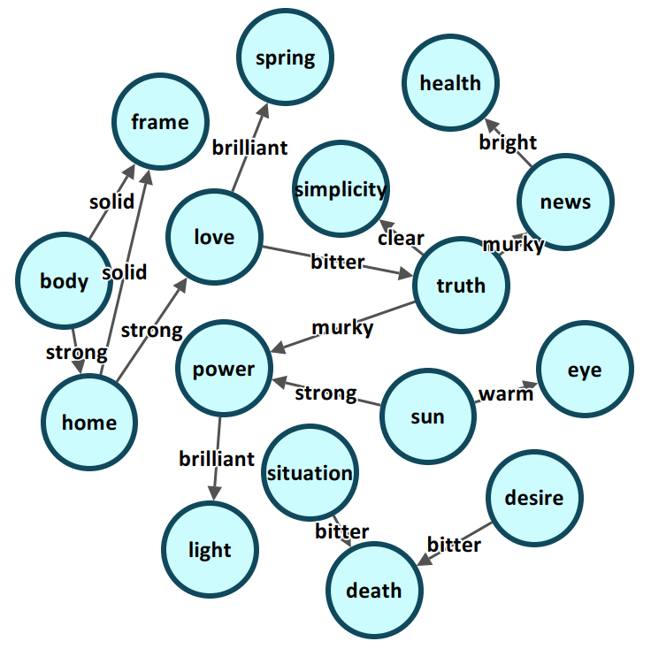
Link predictions

Slide 19
Conclusion
Metaphors can be represented by knowledge graphs
Knowledge graph embedding techniques can be used to predict metaphor relations between noun pairs
Dataset used was small in size
Larger datasets with better quality may improve results
Idea of common adjectives as the relation between entities works reasonably well for metaphors of the form SUBJECT IS-A OBJECT but not for others

Slide 20
Future scope
Create a large, cleaned dataset containing metaphorically related noun pairs.
Create a large, cleaned dataset containing ANPs.
Repeat the experiment using the cleaned datasets to check the performance.
Try other knowledge graph embedding models.

Slide 21
References
Yael Karov and Shimon Edelman. Similarity-based word sense disambiguation. Computational linguistics, 24(1):41–59, 1998.
Julia Birke and Anoop Sarkar. Active learning for the identification of nonliteral language. In Proceedings of the Workshop on Computational Approaches to Figurative Language, pages 21–28, 2007
Ekaterina Shutova. Models of metaphor in NLP. In Proceedings of the 48th annual meeting of the association for computational linguistics, pages 688–697, 2010.
Muhammad Abulaish, Ashraf Kamal, and Mohammed J Zaki. A survey of figurative language and its computational detection in online social networks. ACM Transactions on the Web (TWEB), 14(1):1–52, 2020.
Ekaterina Shutova. Automatic metaphor interpretation as a paraphrasing task. In Human Language Technologies: The 2010 Annual Conference of the North American Chapter of the Association for Computational Linguistics, pages 1029–1037, 2010.

Slide 22
References (contd.)
Saisuresh Krishnakumaran and Xiaojin Zhu. Hunting elusive metaphors using lexical resources. In Proceedings of the Workshop on Computational approaches to Figurative Language, pages 13–20, 2007.
Ciyuan Peng, Dang Thinh Vu, and Jason J Jung. Knowledge graph-based metaphor representation for literature understanding. Digital Scholarship in the Humanities, 36(3):698–711, 2021.
Wei Song, Jingjin Guo, Ruiji Fu, Ting Liu, and Lizhen Liu. A knowledge graph embedding approach for metaphor processing. IEEE/ACM Transactions on Audio, Speech, and Language Processing, 29:406–420, 2020.
Natalie Parde and Rodney Nielsen. A corpus of metaphor novelty scores for syntactically-related word pairs. In Proceedings of the Eleventh International Conference on Language Resources and Evaluation (LREC 2018), 2018.
Damian Borth, Rongrong Ji, Tao Chen, Thomas Breuel, and Shih-Fu Chang. Large-scale visual sentiment ontology and detectors using adjective noun pairs. In Proceedings of the 21st ACM international conference on Multimedia, pages 223–232, 2013.

Slide 23
References (contd.)
E Dario Gutierrez, Ekaterina Shutova, Tyler Marghetis, and Benjamin Bergen. Literal and metaphorical senses in compositional distributional semantic models. In Proceedings of the 54th Annual Meeting of the Association for Computational Linguistics (Volume 1: Long Papers), pages 183–193, 2016.
Yuri Bizzoni, Stergios Chatzikyriakidis, and Mehdi Ghanimifard. “Deep” learning: Detecting metaphoricity in adjective-noun pairs. In Proceedings of the Workshop on Stylistic Variation, pages 43–52, 2017.
https://en.wikipedia.org/wiki/Literal and figurative language
https://towardsdatascience.com/summary-of-translate-model-for-knowledge-graph-embedding-29042be64273
https://www.ibm.com/topics/knowledge-graph
https://towardsdatascience.com/introduction-to-knowledge-graph-embedding-with-dgl-ke-77ace6fb60ef, 2020
https://en.wikipedia.org/wiki/Knowledge graph

Slide 24
References (contd.)
https://en.wikipedia.org/wiki/Knowledge graph embedding
https://web.stanford.edu/~vinayc/kg/notes/What is a Knowledge Graph.html
https://aws-dglke.readthedocs.io/en/latest/kg.html
https://stackoverflow.com/questions/44382254/nltk-single-word-part-of-speech-tagging
https://universaldependencies.org/u/pos/
http://www.vismet.org/metcor/manual/index.php
http://www.vismet.org/metcor/about.html
https://www.ee.columbia.edu/ln/dvmm/vso/download/vso.html
https://en.wikipedia.org/wiki/Norm (mathematics)
https://stats.stackexchange.com/questions/181620/what-is-the-meaning-of-super-script-2-subscript-2-within-the-context-of-norms

Slide 25
References (contd.)
https://docs.ampligraph.org/en/latest/
https://github.com/Accenture/AmpliGraph/
https://kge4nlp-coling22.github.io/
https://kge-tutorial-ecai2020.github.io/
Luca Costabello, Sumit Pai, Chan Le Van, Rory McGrath, Nick McCarthy, and Pedro Tabacof. AmpliGraph: a Library for Representation Learning on Knowledge Graphs, March 2019.
Antoine Bordes, Nicolas Usunier, Alberto Garcia-Duran, Jason Weston, and Oksana Yakhnenko. Translating embeddings for modeling multi-relational data. Advances in neural information processing systems, 26, 2013.

Slide 26
Thank You

Slide 27
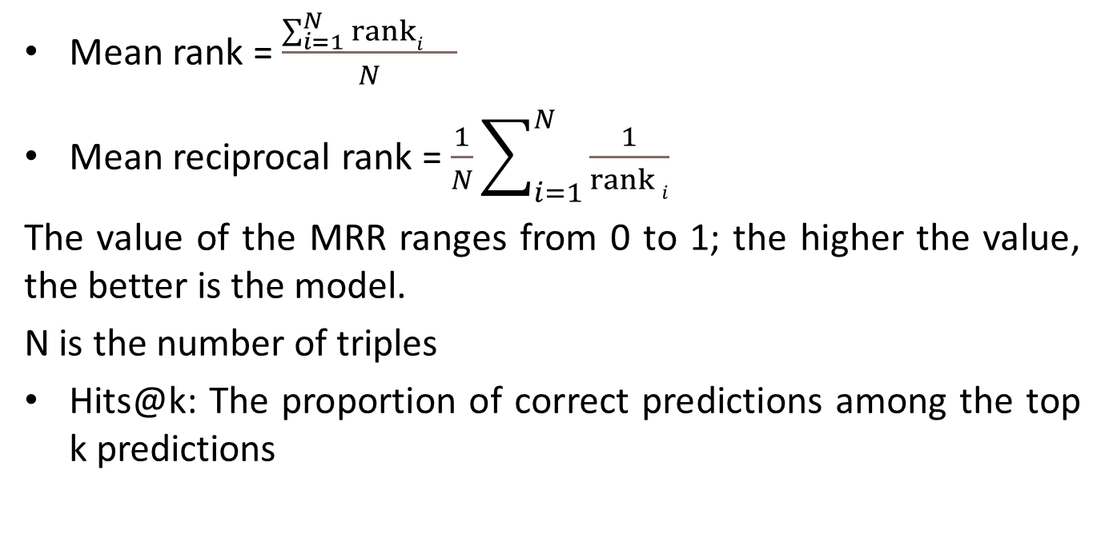
Evaluation metrics
Mean rank = $\frac{\sum_{i=1}^{N}{\operatorname{ranki}{}}}{N}$
Mean reciprocal rank = $\frac{1}{N}\sum_{i=1}^{N}{\frac{1}{\operatorname{rank}{i}}}$
The value of the MRR ranges from 0 to 1; the higher the value, the better is the model.
N is the number of triples
Hits@k: The proportion of correct predictions among the top k predictions

Slide 28
Hyperparameters and more
The Adam optimiser was used.
5 negatives were used for corrupting each triple during training.
The embeddings are 300-dimensional vectors.
A batch size of 16 with 10 epochs was used for training

Slide 29
Abstract
A metaphor is a figure of speech which is very commonly used in natural language. Metaphor processing involves identifying and interpreting them and presents challenges to automatic natural language processing. This project is a study of the knowledge graph embedding approach to noun-pair metaphor representation. A knowledge graph is a directed graph containing entities and the relations between them. Knowledge graph embedding involves representing the entities and relations of a knowledge graph in the form of low-dimensional vectors to simplify processing while preserving the structure and meaning of the knowledge graph.

Slide 30
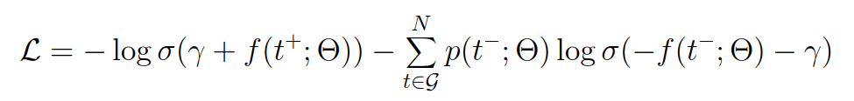
Loss function
Self-adversarial loss is used in this project

