Slide 1
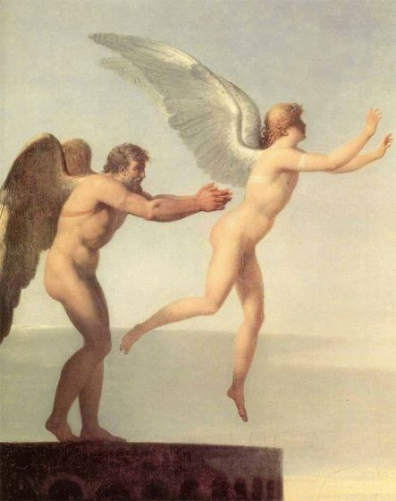
Project Icarus
HCI/ComS 575x
Iowa State University
Kevin Godby, Jesse Lane & Ethan Slattery
April 26, 2006

Slide 2
Project Icarus Overview
Flight simulation
  Similar flight dynamics to that of a bird
  Virtual environment with obstacles
Data Flow
  User input
    Capture with webcam and IR pendants
    Calculate arm positions
  Flight Dynamics
    Receive arm position vectors
    Calculate forward and upward velocities

Slide 3
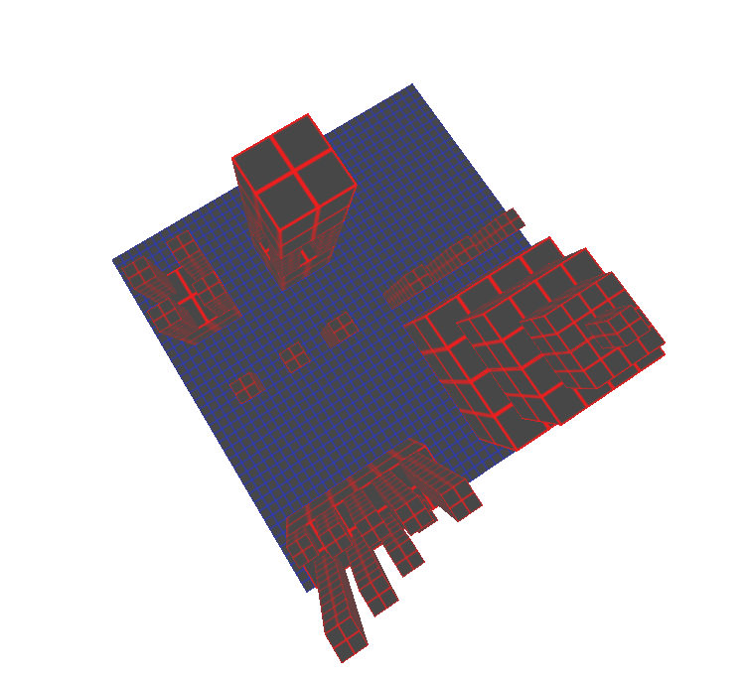
Project Icarus Motivation
Easily and intuitively move around in a 3D environment
Possible demo application
Cool factor
  The dream of flight!
  Cave
No bulky control input

Slide 4
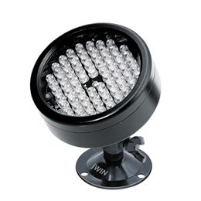
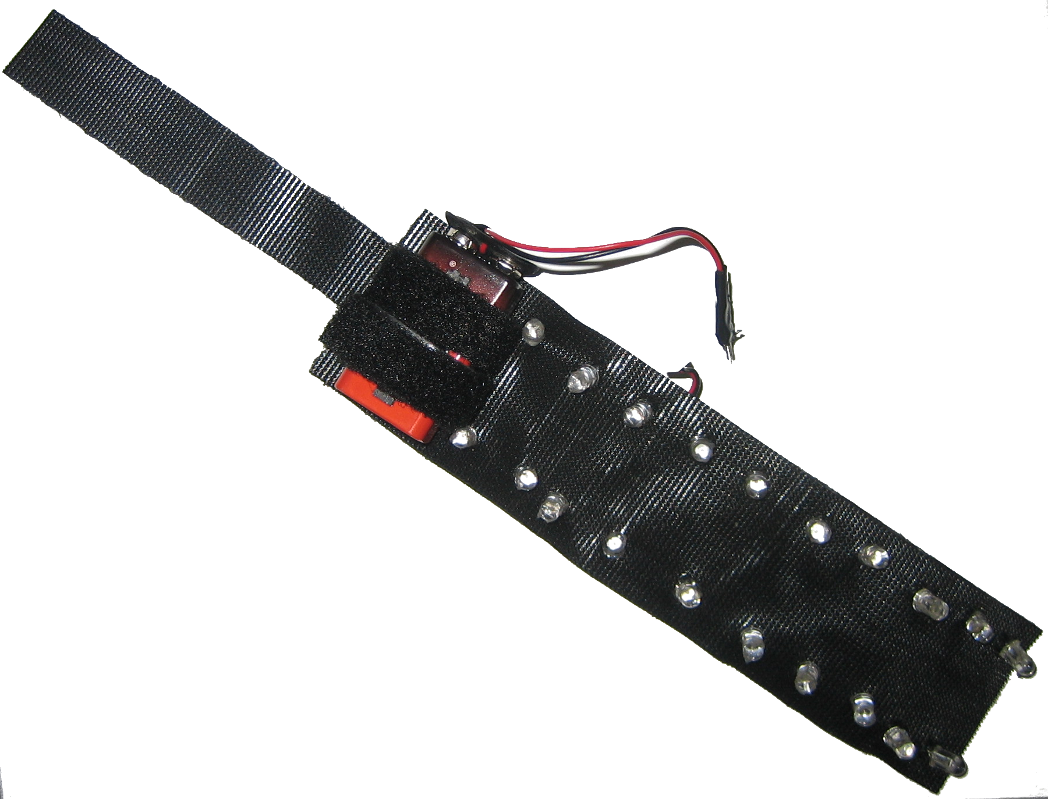
IR Illumination
External Source
  Lamp Illumination
  Not enough light intensity, $$$
Wearable Source
  Two bracelets, one back pendant
  Camera with IR pass filter

