Slide 1
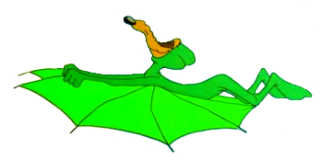
Flight Kinematics

Slide 2
Toolset
VRJuggler
  So that multiple display types, including the CAVE, can be used
Open Scene Graph
  Open source scene graph built on top of OpenGL
OPAL (Open Physics Abstraction Layer)
  Open source physics engine built on top of ODE (Open Dynamics Engine)

