Slide 1

AI-Driven Campus Placement Platform
A centralized, intelligent system that automates placement registration, analyzes resumes using AI and NLP, and matches students to the right opportunities — reducing manual effort and increasing placement success.
FINAL YEAR ACADEMIC PROJECT
AI · NLP · PLACEMENT AUTOMATION
GEDDAM JYOTHI PRAKASH
323129512014

Slide 2

The Problem: Manual Placement Is Broken
Time-Consuming Screening
Placement officers manually review hundreds of resumes per drive, causing delays and inconsistent evaluations.
Poor Student-Job Matching
Students apply to unsuitable roles due to lack of personalized guidance, lowering placement success rates.
Fragmented Communication
No centralized system for tracking applications, deadlines, or recruitment updates in real time.
Zero Data Insights
Colleges lack analytics to measure placement performance or make data-driven decisions.

Slide 3
Project Objectives
This platform is designed to modernize campus recruitment by combining automation, AI intelligence, and real-time data.
1
Automate Registration & Eligibility
Streamline student sign-up and verify eligibility criteria automatically.
2
AI-Powered Resume Analysis
Extract skills, qualifications, and experience using NLP for objective screening.
3
Intelligent Profile Matching
Match student profiles to company requirements with high accuracy.
4
Personalized Job Recommendations
Suggest roles based on skills, academics, interests, and eligibility.
5
Real-Time Notifications
Alert students to drives, interviews, and deadlines instantly.
6
Analytics & Reporting
Generate placement reports, dashboards, and company-wise statistics.

Slide 4
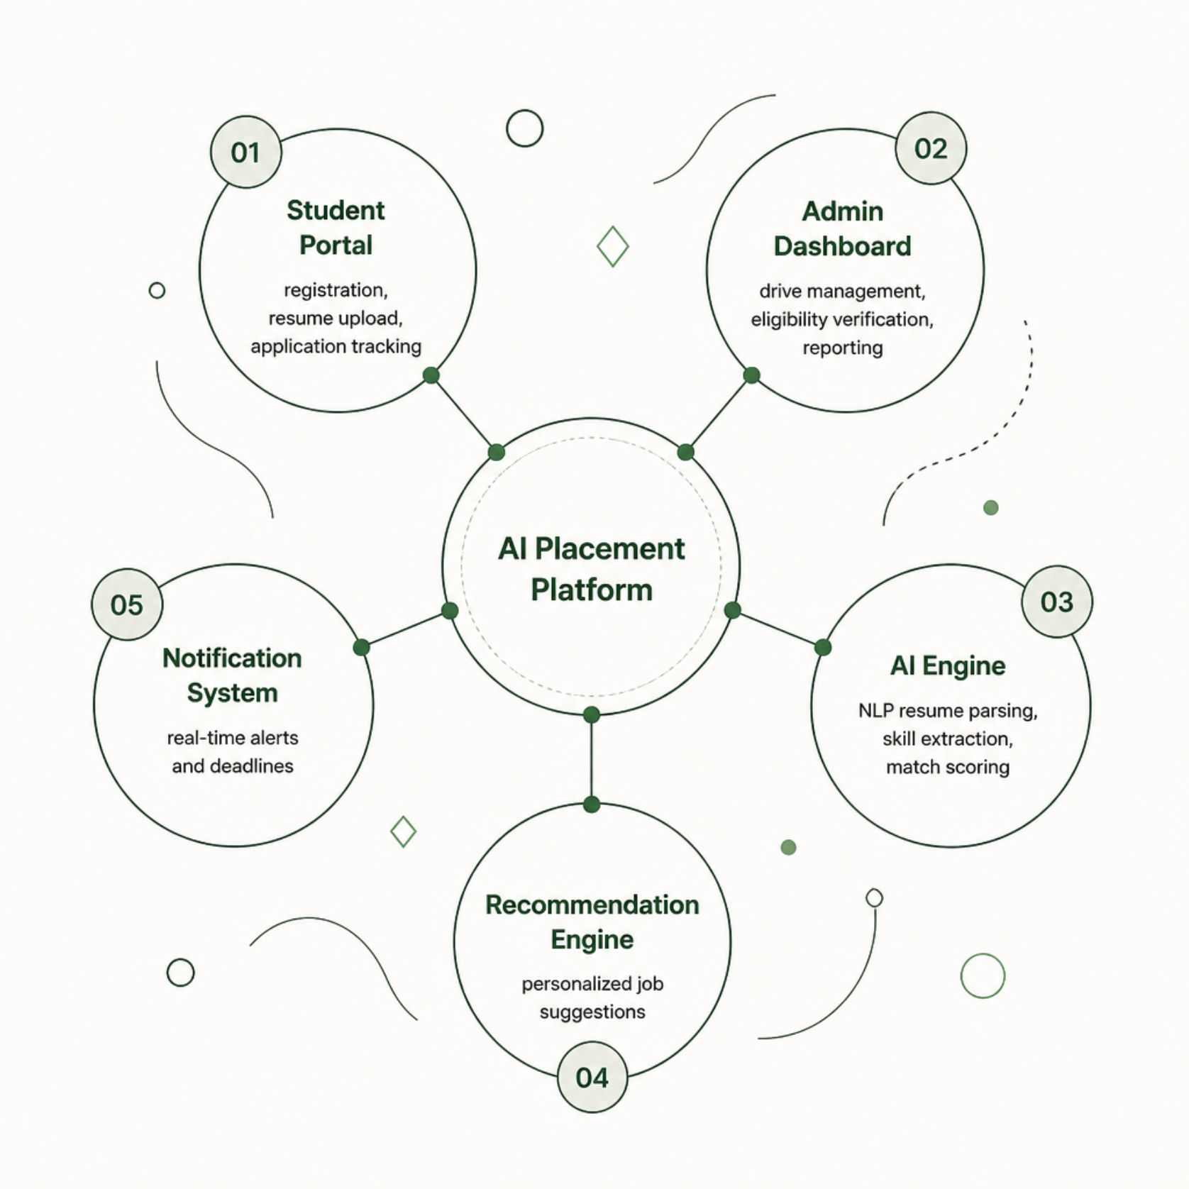
Proposed Solution at a Glance
The platform is a unified, AI-powered ecosystem connecting students, placement officers, and recruiters — replacing manual processes with intelligent automation.
Student Portal: Profile management, resume upload, application tracking
Admin Dashboard: Drive management, eligibility verification, reporting
AI Engine: NLP resume parsing, skill extraction, match scoring
Recommendation Engine: Personalized job suggestions per student profile
Notification System: Real-time alerts for all stakeholders

Slide 5
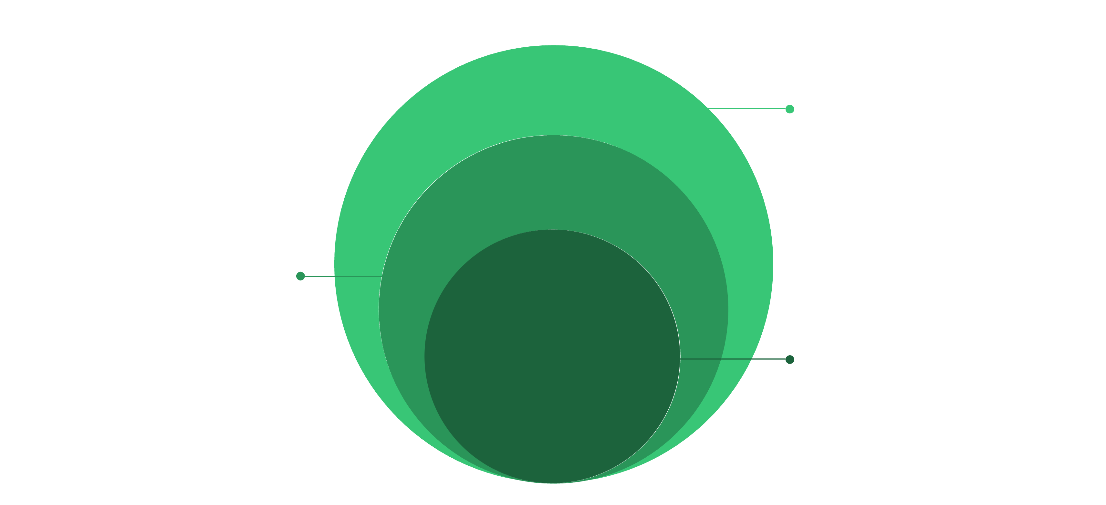
System Architecture
A three-tier architecture ensures modularity, scalability, and clean separation of concerns across the platform.
Database
PostgreSQL/MongoDB for data, Redis cache for performance
Backend
REST API, AI/NLP, recommendation and notification services
Frontend
React/Angular web app with responsive UI and portals
The architecture supports independent scaling of the AI engine and recommendation services, ensuring high performance during peak placement seasons.

Slide 6
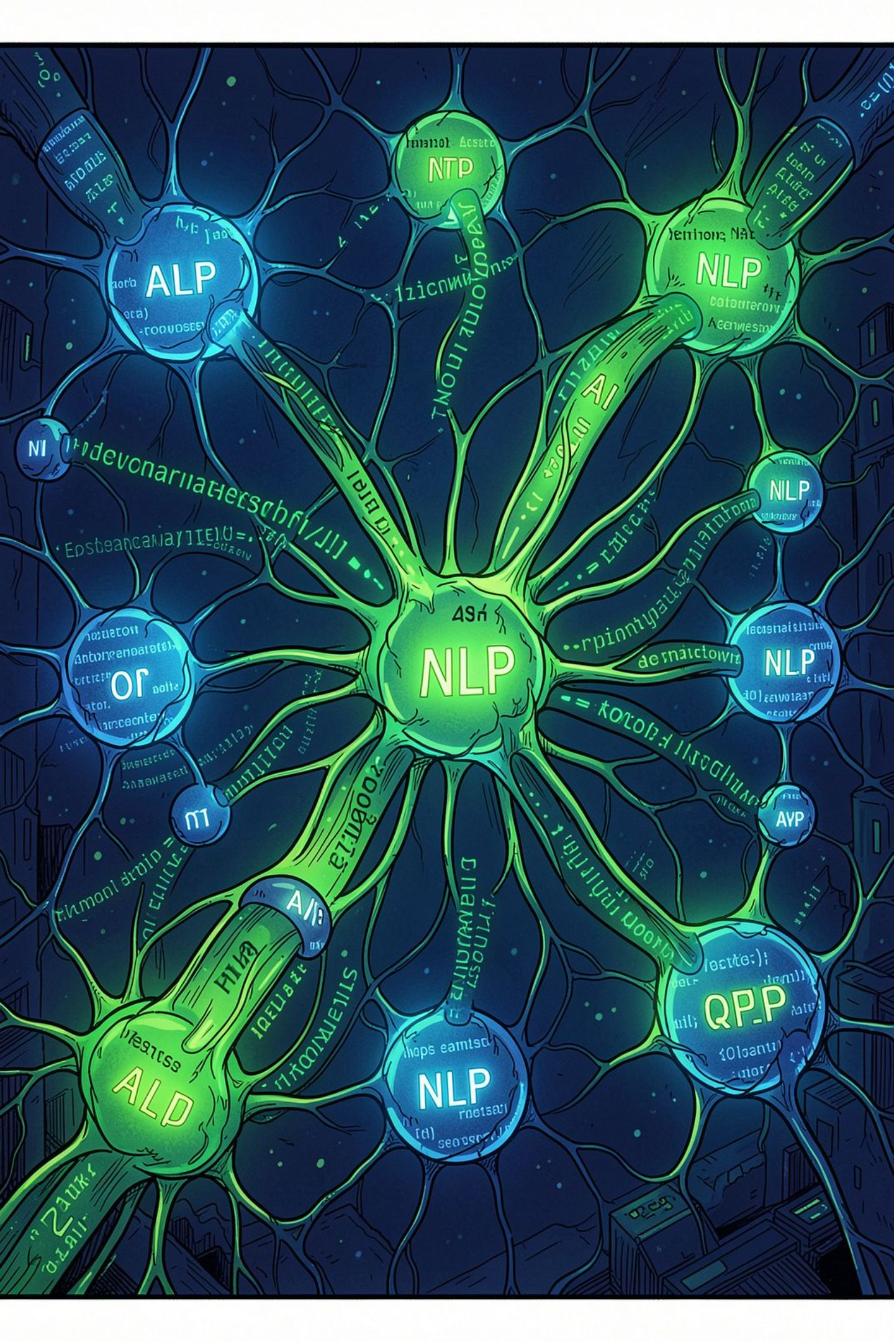
AI & NLP Integration
Resume Parsing
NLP models extract structured data — name, education, skills, certifications — from uploaded resumes in any format.
Skill Extraction
Named Entity Recognition (NER) identifies technical and soft skills, mapping them to standardized taxonomies.
Profile Matching
Cosine similarity and semantic embeddings score student-company fit, ranking candidates by compatibility.
Eligibility Verification
AI cross-checks CGPA, attendance, and backlogs against company criteria, auto-approving or flagging applicants.

Slide 7
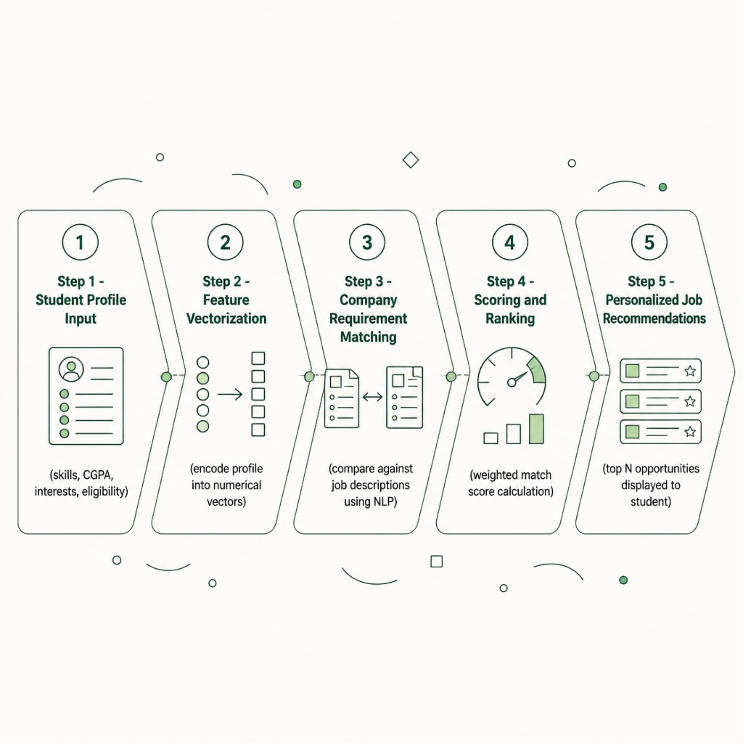

Recommendation Engine Workflow
The recommendation engine uses a hybrid approach — combining content-based filtering (skills, academics) with collaborative filtering (peer placement patterns) to deliver personalized, accurate job suggestions.
Recommendations update dynamically as students add new skills or complete certifications.

Slide 8

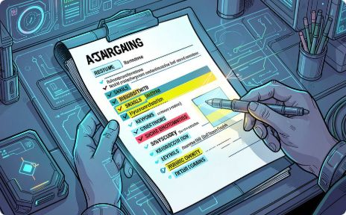


Core Platform Modules
Registration & Profile
Resume Analyzer
Job Recommender
Analytics Dashboard
Students create profiles, upload resumes, and register for drives with automated eligibility checks.
AI extracts and scores resume content, providing students with feedback to improve their profiles.
Personalized job cards ranked by match score, with one-click apply and status tracking.
Real-time placement metrics, company-wise stats, and student performance reports for officers.

Slide 9
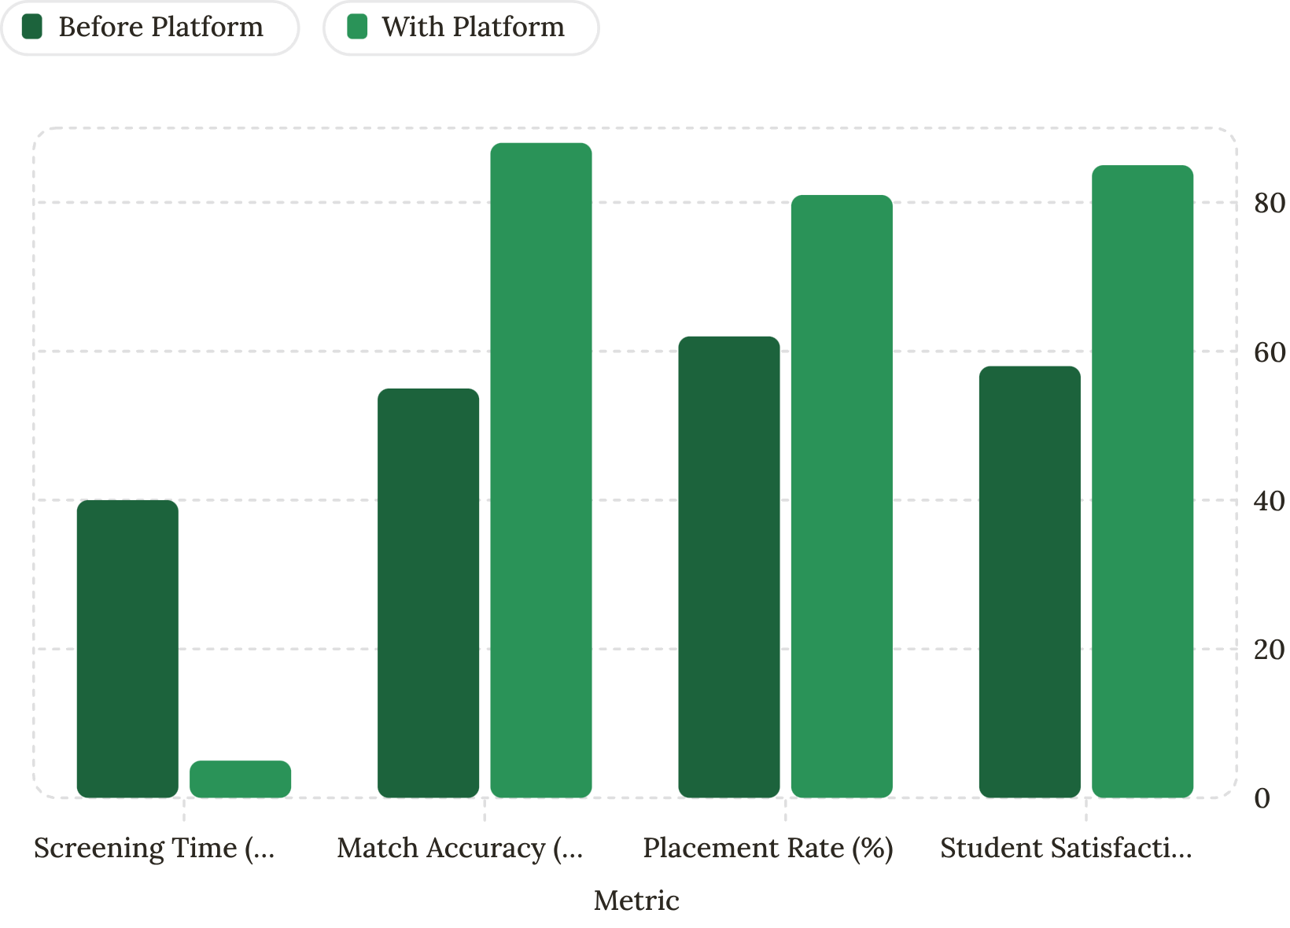
Analytics, Security & Scalability
Placement Analytics
Security & Scalability
Authentication: JWT-based sessions with role-based access control
Data Encryption: AES-256 for stored data, TLS 1.3 in transit
Scalability: Cloud-native deployment with horizontal scaling via Docker/Kubernetes
Compliance: GDPR-ready data handling and audit logging

Slide 10


Expected Outcomes & Conclusion
🎯 Higher Placement Rates
Accurate AI matching increases successful student-company placements significantly.
⚡ 8× Faster Screening
Automated NLP parsing reduces resume review time from hours to minutes.
📊 Data-Driven Decisions
Real-time dashboards empower officers to optimize recruitment strategies.
🔒 Secure & Scalable
Enterprise-grade security and cloud architecture support thousands of concurrent users.
This platform transforms campus placement from a manual, error-prone process into an intelligent, data-driven ecosystem — benefiting students, colleges, and recruiters alike.

