Slide 1
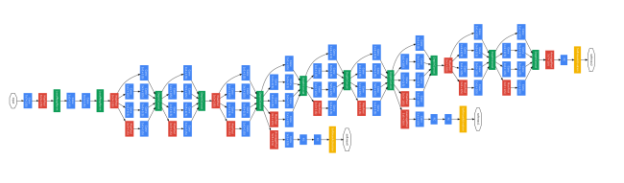
Convolutional neural networks in fifteen slides

Slide 2
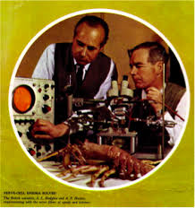
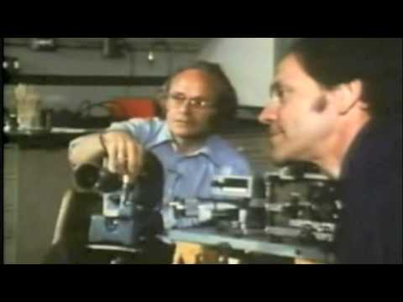
Two Experiments
Huxley-Hodgkin experiment
Hubel-wiesel

Slide 3
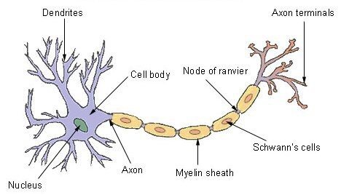
Hodgkin and Huxley experiment
Human brain is made of 100 billion neurons
Each neuron simply computes a function based on a small amount of potential applied to it.
The neuron simply computes some kind of majority voting function based on the potentials given to it

Slide 4
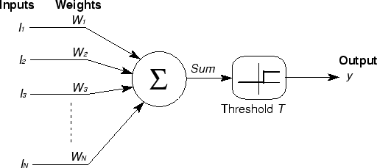

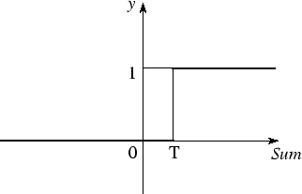
Modelling neurons
McCulloch-Pitts Model of Neuron
Mathematically it computes a step function over the sum of potentials of the input to neurons and their weights.

Slide 5
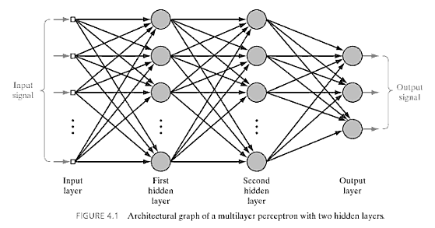
Feedworward neural networks
An array of large number of mcullagh-pitts neurons
All functions that have a similar function are named as “layers”

Slide 6
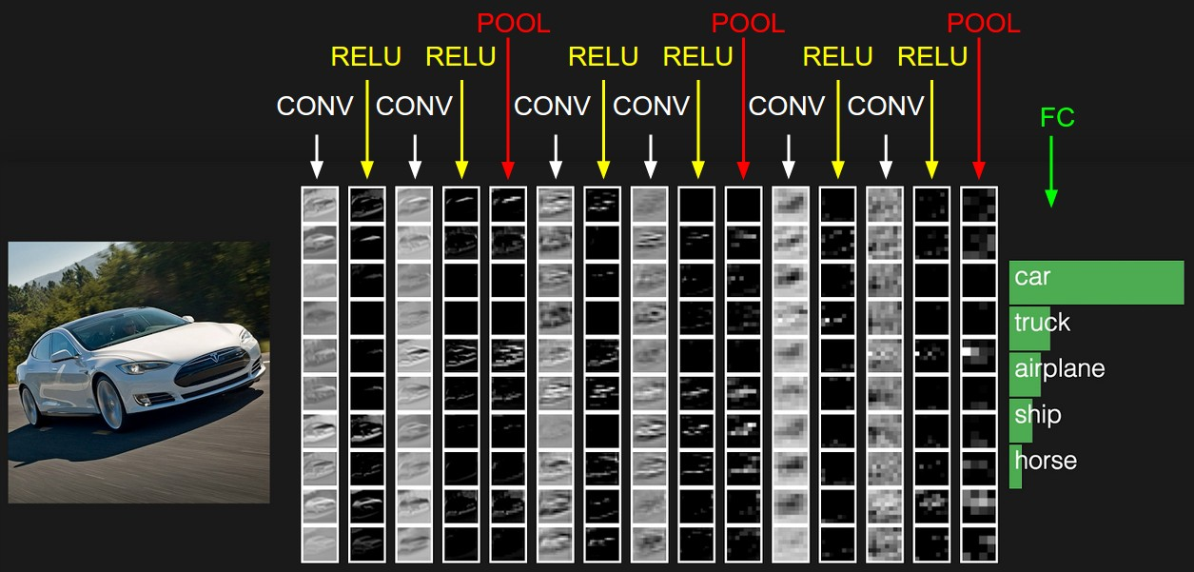
Training neural networks
The only algorithm for this is the most sought “Back propagation algorithm”
Put it simply it is a way of adjusting the “weights” of individual neurons

Slide 7
Update rules..
“Loss” is the amount of discrepancy between the output we require from the neural network to the value we got.
We compute the “Partial derivative ” of loss with respect to the weight and call this “Gradient”
The weight of the neuron is updated by subtracting the the value of gradient from the actual value of weight

Slide 8
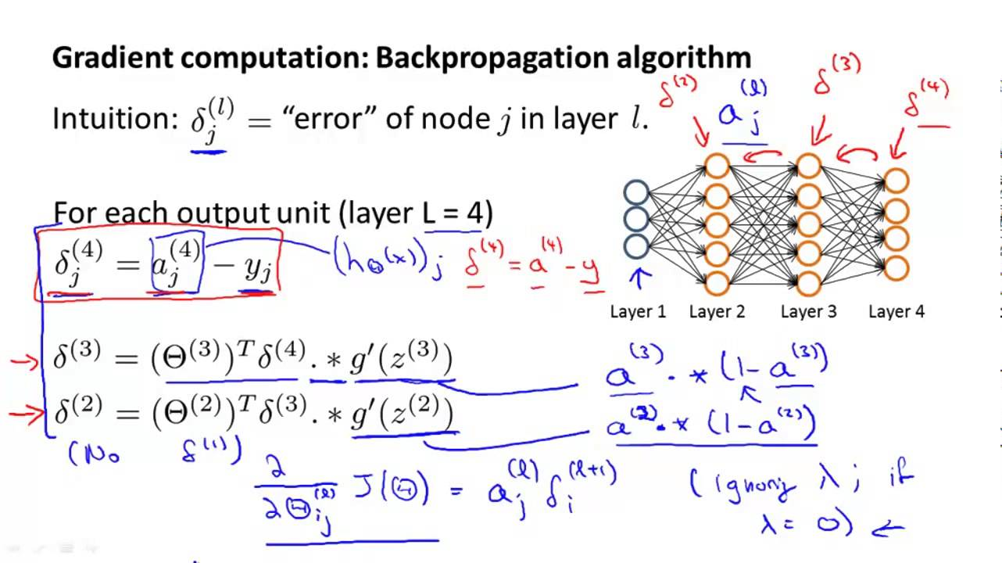
Back propagation in equations

Slide 9
Problem with these type of neural networks
Lots and lots of parameters “weight values” to be changed during training.
If you want to construct a neural network model something like this:-
Considering Atleast ~1000^2 weights for each layer and 20 layers implies 20*1000*1000 weights to change for each iteration , if you want to train on a dataset of ~10000 images it with “your” computer
It would take forever

Slide 10
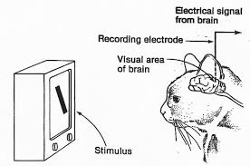
The solution:- convolutional layers
Instead of connecting all the neurons from the previous layer , only connect some fixed region of neurons
This thing is justified by Hubel-wiesel and their brave cats

Slide 11
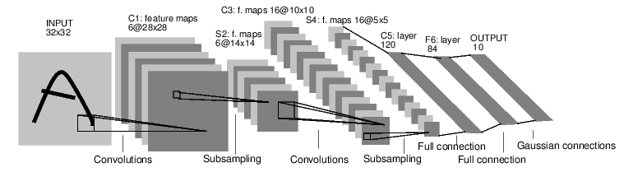
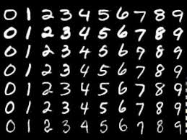
Convolutional neural networks
This is a model called by “Lenet” introduced by yannlecun.
This model if trained correctly achieves an unprecedented accuracy of 99.x% on MNIST database(a huge database of handwritten numbers).

Slide 12
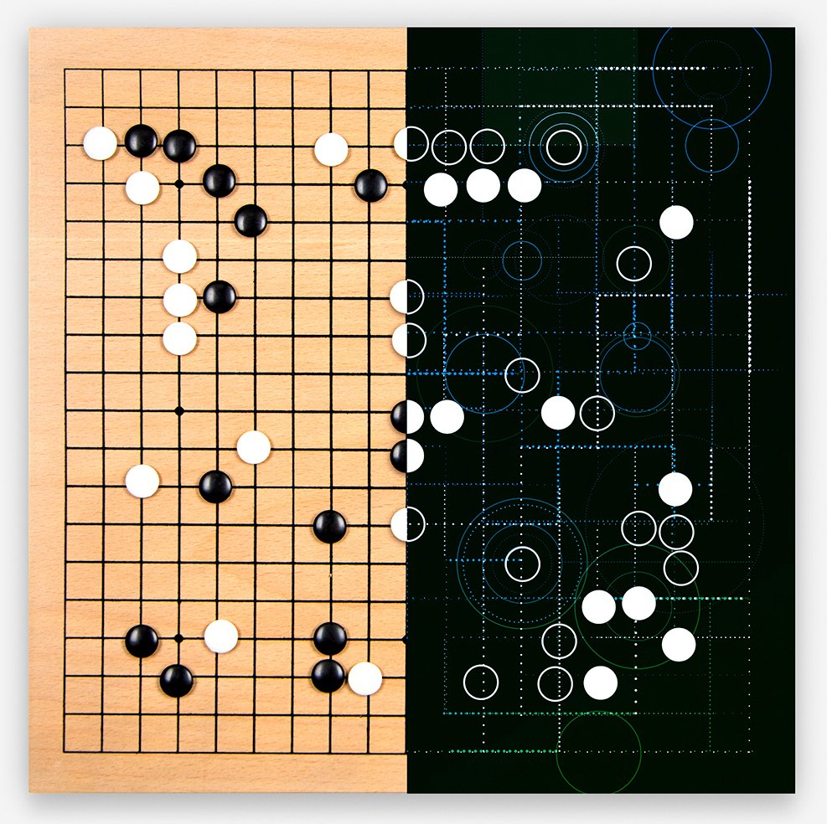
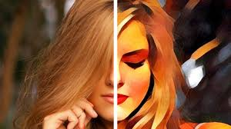
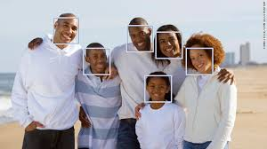
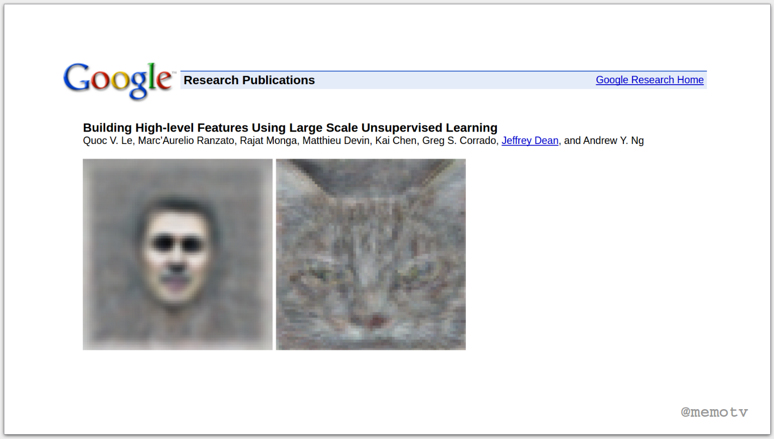
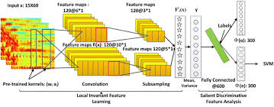
Some places where you encounter convolutional neural networks

Slide 13





Implementing convolutional neural networks
Trust me you cant!
Use OpenSource libraries if you want to.
Almost every “big” company has one.

Slide 14
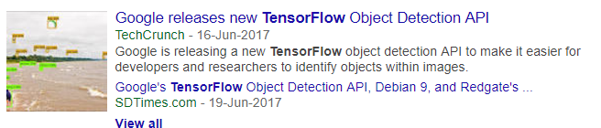

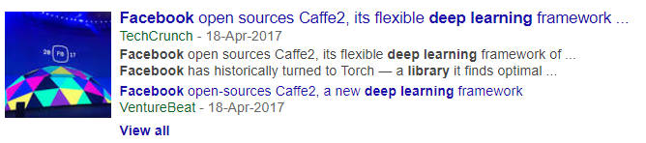

As expected….

Slide 15
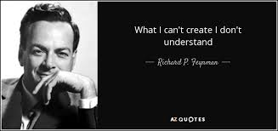
In the next session
An in depth explanation of various convolutional neural network models.
A Hands on demonstration of dense image captioning/how prisma filters work

Slide 16
References
Cs231n course 2016 version (16 lectures ,3 assignments) by Andrej karpathy
karpathy.github.io/ Andrej karpathy’s blog

