Slide 1
Concurrent Ruby Application Servers

Slide 2
Agenda
- Who? (2)
- Concurrency? (10)
- What we have? (15)
- App servers? (15)
- Q? (3)

Slide 3
Who?

Slide 4
* Programmer at Cardinal Blue
* Use Ruby from 2006
* Interested in programming languages and functional programming (e.g. Haskell)

Slide 5
* Programmer at Cardinal Blue
* Use Ruby from 2006
* Interested in programming languages and functional programming (e.g. Haskell)
* Also concurrency recently

Slide 6

PicCollage

Slide 7
PicCollage
in 7 days
* ~3.1k requests per minute
* Average response time: ~135 ms
* Average concurrent requests per process: ~7
* Total processes: 18
* Above data observed from NewRelic
* App server: Zbatery with EventMachine and thread pool on Heroku Cedar stack

Slide 8
Recent gems
* jellyfish - Pico web framework for building API-centric web applications
* rib - Ruby-Interactive-ruBy -- Yet another interactive Ruby shell
* rest-core - Modular Ruby clients interface for REST APIs
* rest-more - Various REST clients such as Facebook and Twitter built with rest-core

Slide 9
Special Thanks
ihower, ET Blue and Cardinal Blue

Slide 10
Concurrency?

Slide 11
Caveats: There are a ton of details which would make exceptions to what I am going to say, and given that I am still quite new in this area and since I don't want to make this talk sound quite complicated or chaotic, all conclusions are overly simplified. So please keep in mind that everything I said might not be perfectly true.
Caveats:
* No disk I/O
* No pipelined requests
* No chunked encoding
* No web sockets
* No ...
To make things simpler for now.
For example, when I am talking about I/O operations, heavy disk I/O operations are excluded. When I am talking about HTTP requests, pipelined requests, chunked encoding and web sockets are all excluded. Those are the exceptions we'll need to address separately.
I/O operations
HTTP requests
network I/O
disk I/O
pipelined requests
chunked encoding
web sockets
Notes:
test
u did it ^o^

Slide 12
Caution: it's not faster for a user

Slide 13
10 moms can't produce
1 child in 1 month

Slide 14
10 moms can produce
10 children in 10 month
that said, we cannot speed up

Slide 15
in a perfect world, we might have a process for each task. in reality, we don't have that much money (or resource on the earth)
(assuming you have much more clients than cores)
Resource matters

Slide 16
in a perfect world, we might have a process for each task. in reality, we don't have that much money (or resource on the earth)
(assuming you have much more clients than cores)
Resource matters
We might not always have
enough processors

Slide 17
in a perfect world, we might have a process for each task. in reality, we don't have that much money (or resource on the earth)
(assuming you have much more clients than cores)
Resource matters
We might not always have
enough processors
We need multitasking

Slide 18
Imagine 15 children have to be context switched amongst 10 moms

Slide 19
Multitasking is not free

Slide 20
If your program context switches, then actually it runs slower

Slide 21
But it's more fair for users

Slide 22

[Image for a long long long line up]

Slide 23
It's more fair if they are all served equally in terms of waiting time

Slide 24
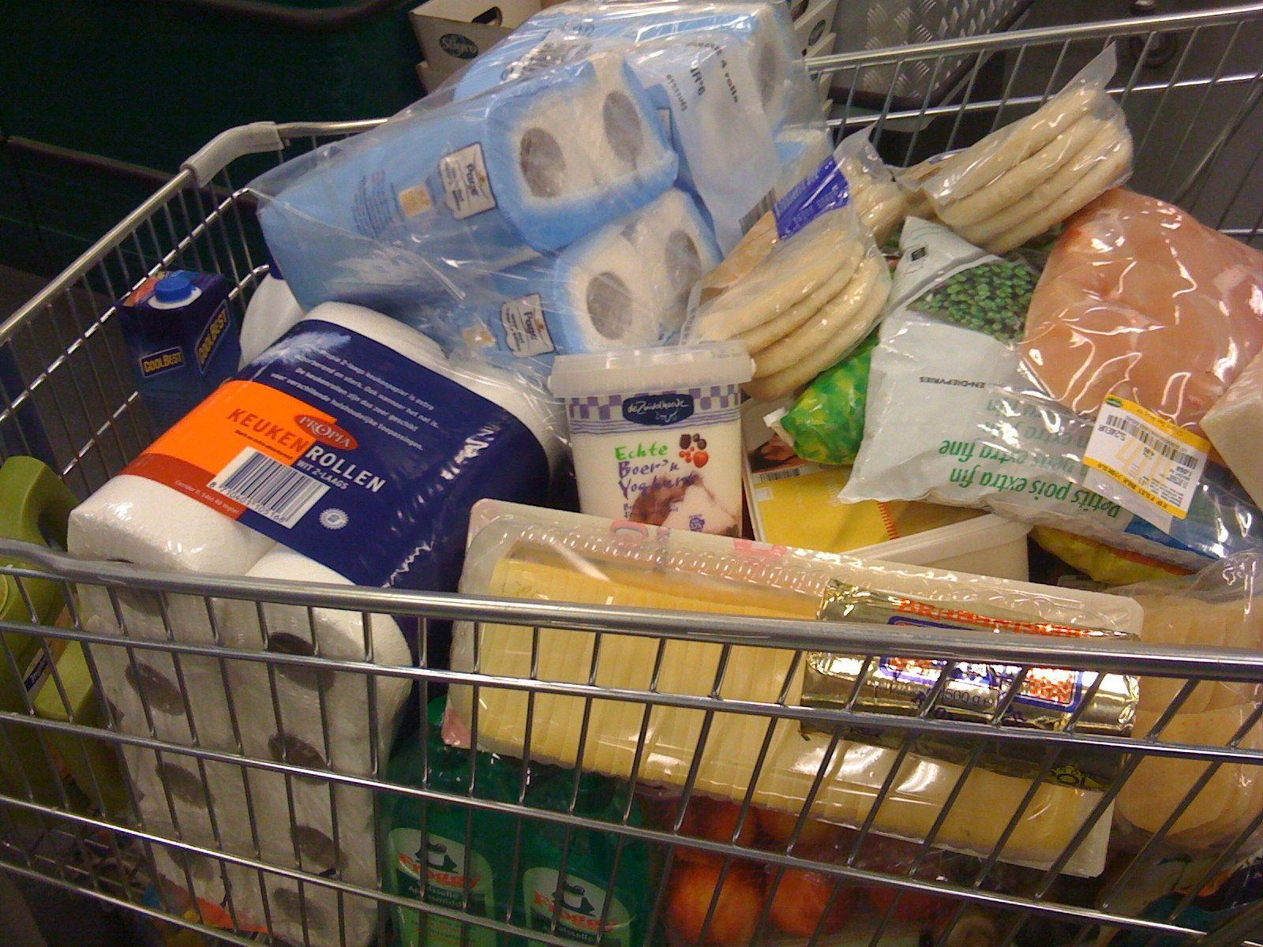
[Image for someone buying a lot of things]

Slide 25
I just want a drink!

Slide 26
to illustrate the overall running time:

Slide 27
User ID
sequential
#05
waiting
#04
processing
#03
#02
Time
context switching
#01
User ID
concurrent
#05
waiting
#04
#03
processing
#02
Time
context switching
#01

Slide 28
User ID
sequential
running time
of server
#05
waiting and processing time
of users
#04
#03
#02
Time
#01
User ID
concurrent
#05
#04
#03
#02
Time
#01

Slide 29
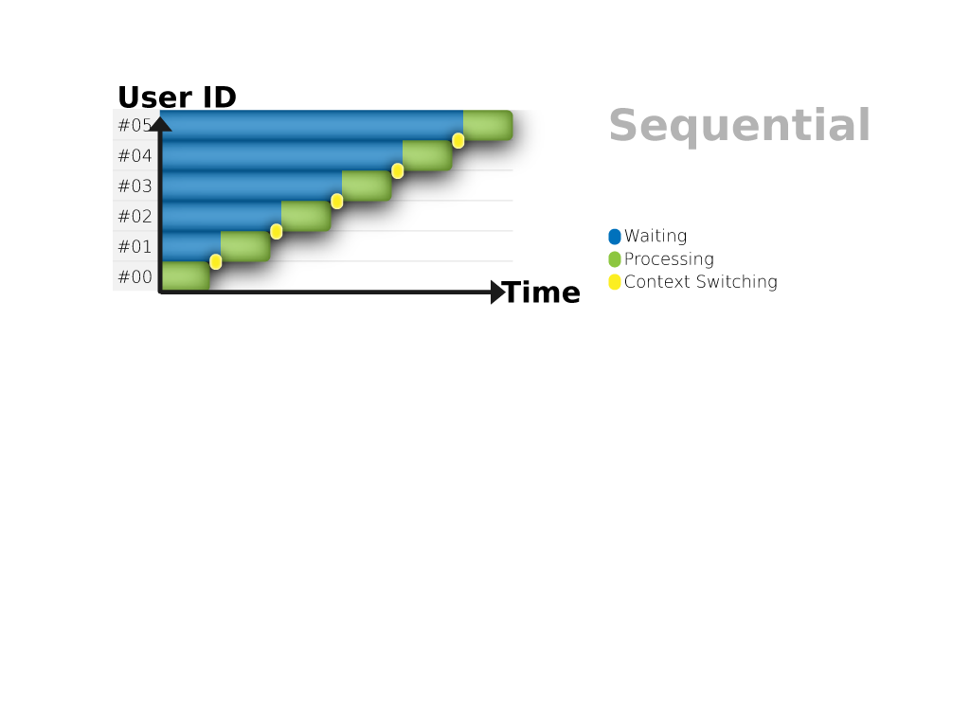
cpu bound operation, one thread (mom)

Slide 30
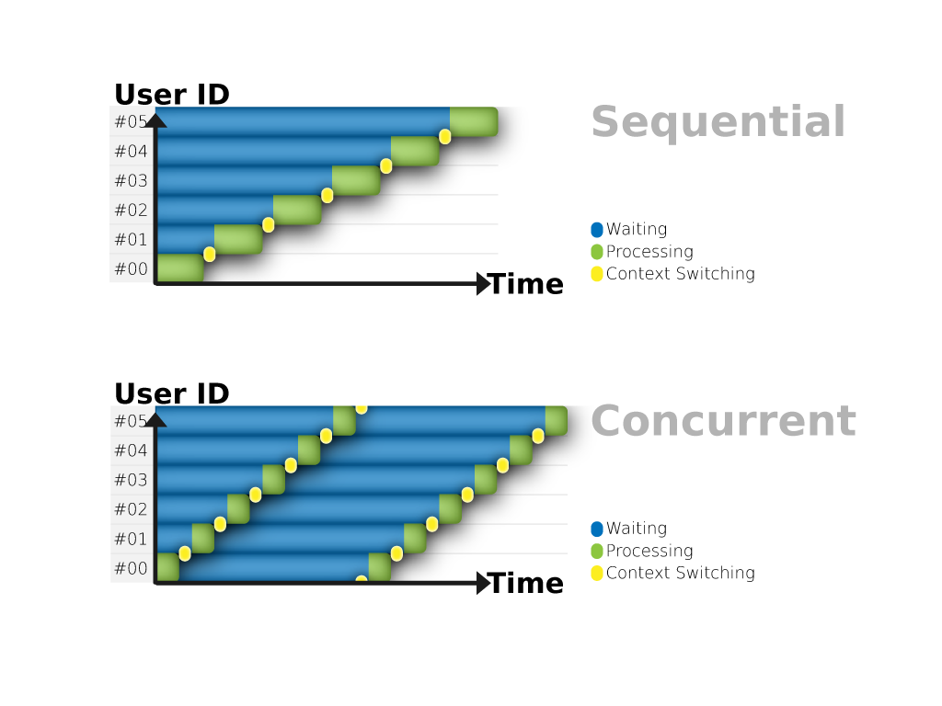

Slide 31
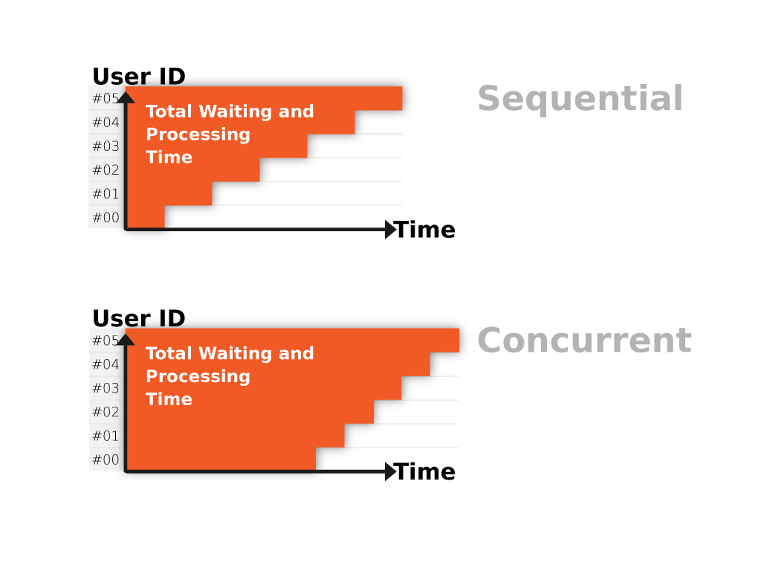

Slide 32
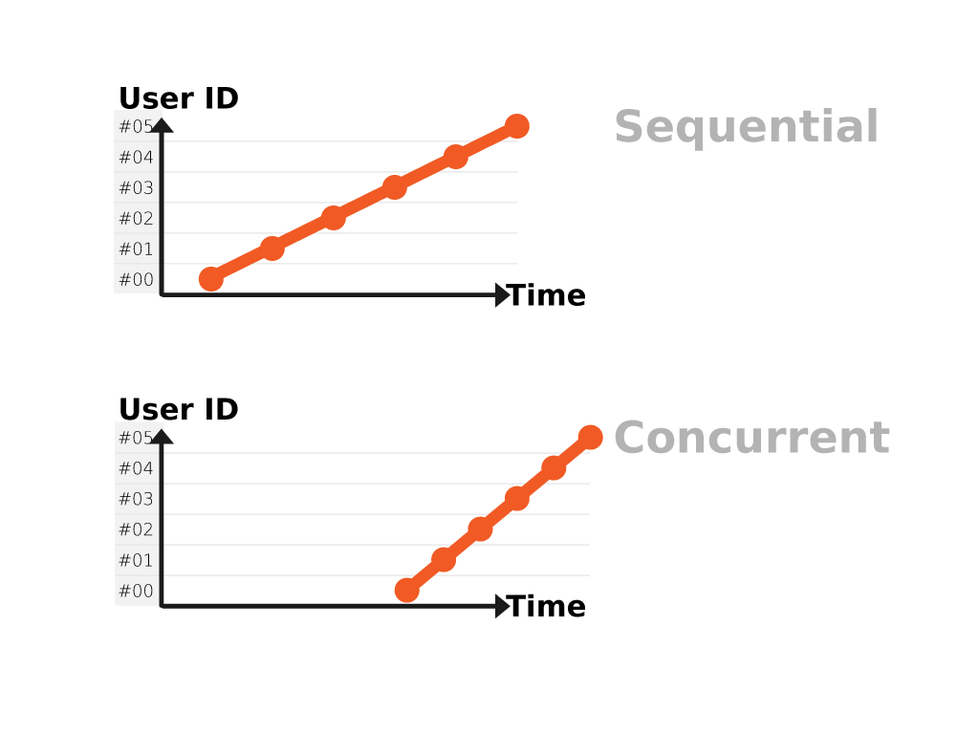

Slide 33
Scalable != Fast

Slide 34
Scalable != Fast
Scalable == Less complaining

Slide 35
Rails is not fast

Slide 36
Rails is not fast
Rails might be scalable

Slide 37
so when do we want concurrency?

Slide 38
以上 FREEZE *o*

Slide 39
When context switching cost is much cheaper than a single task

Slide 40
When context switching cost is much cheaper than a single task
or if you have much more cores than your clients (= no context switching)

Slide 41
If context switching cost is at about 1 second

Slide 42
It's much cheaper than 10 months, so it might be worth it

Slide 43
But if context switching cost is at about 5 months, then it might not be worth it

Slide 44
sequential
#05
#04
#03
#02
#01
concurrent
#05
#04
#03
#02
#01

Slide 45
Do kernel threads
context switch fast?

Slide 46
Do user threads context switch fast?

Slide 47
Do fibers............. context switch fast?

Slide 48
a ton of different concurrency models then invented

Slide 49
each of them has different strengths to deal with different tasks

Slide 50
also trade off, trading with the ease of programming and efficiency

Slide 51
data dependency -- two patterns of composite tasks

Slide 52
- linear data dependency
- mixed data dependency

Slide 53
order
wait food
wait drink
eat
drink
order_food -> eat
order_tea -> drink

Slide 54
order
wait food
wait spices
mix
eat
[order_food, order_spices] -> add_spices -> eat

Slide 55
order
order
wait food
wait drink
wait food
wait spices
eat
drink
mix
eat

Slide 56
two types of tasks:
CPU bound tasks
I/O bound tasks

Slide 57
prepare to share a photo
prepare to merge photos
share to facebook
share to flickr
load from facebook
load from flickr
save result
save result
merge photos
save result

Slide 58
CPU
CPU
prepare to share a photo
prepare to merge photos
IO
IO
IO
IO
share to facebook
share to flickr
load from facebook
load from flickr
CPU
save result
save result
CPU
CPU
merge photos
CPU
save result
CPU

Slide 59
what we have

Slide 60
we don't only talk about performance, we also talk about interface, since we human write programs the easy way, but not the hard way

Slide 61
it would be good if the interface we're using is orthogonal to its implementation

Slide 62
there are two advantages for this:

Slide 63
a) we don't have to change our code if the implementation is changed. (that said, we can also switch implementation to see how they work differently)

Slide 64
b) we don't need to really know the implementation detail in order to use this interface

Slide 65
linear data dependency
this is an easy one

Slide 66
interface -- callback
order_food{ |food|
eat(food)
}
order_tea{ |tea|
drink(tea)
}

Slide 67
this might be bad, blocking drink while ordering food
it is possible to address this blocking issue by doing some static analysis, and then we would know that drink(order_tea) doesn't depend on eat(order_food), that is we can make sure that eat(order_food) won't introduce any side-effect, like changing satisfaction points which drink(order_tea) might be depending on (or the random seed, to name a few concrete examples), so on so forth.
then we could make those operations run in parallels. but it would be hard even in a static typing program, not even to mention ruby which is so dynamic, that we cannot know a lot of thing unless we really run it, since that's the nature of dynamic programs.
so -- we cannot have this perfect interface for now, except... umm... in haskell, probably, which we need to control every single side-effect, so we might be able to tell whether they are dependant or not. but i believe even in haskell, this cannot be easily done either. let's see if we can reach that point given another decade.
callbacks are still ideal here since it forces you to explicitly telling the dependency,
then the program could know they could be run in a concurrent way.
eat(order_food)
drink(order_tea)
but what if we could control side-effect and do static analysis?
not going to happen on ruby though

Slide 68
mixed data dependency
here comes the dragon

Slide 69
if the interface we only have is callbacks...

Slide 70
we don't want to do this:
# order_food is blocking order_spices
order_food{ |food|
order_spices{ |spices|
eat(add_spices(spices, food))
}
}

Slide 71
we don't really want to do this either, but we have no choices if what we only have is callback and we want order_food and order_spices to run in a concurrent way
food, spices = nil
order_food{ |arrived_food|
food = arrived_food
start_eating(food, spices) if food && spices
}
order_spices{ |arrived_spices|
spices = arrived_spices
start_eating(food, spices) if food && spices
}
##
def start_eating food, spices
superfood = add_spices(spices, food)
eat(superfood)
end

Slide 72
ideally, we could do this with futures
food = order_food
spices = order_spices
superfood = add_spices(spices, food)
eat(superfood)
# or one liner
eat(add_spices(order_spices, order_food))

Slide 73
but by how?

Slide 74
implementation

Slide 75
forget about data dependency for now, let's focus on implementation for a single task

Slide 76
basically we have two main choices:

Slide 77
a) threads with synchronous (blocking) interface
this could be used for either CPU bound or IO bound operations

Slide 78
b) reactor with asynchronous (callback) interface
this could only be used on I/O bound operations, since it is a

Slide 79
if order_food is I/O bound
so it could be done in either a thread or with a reactor

Slide 80
the implementation -- how we define order_food with a thread
def order_food
Thread.new{
food = order_food_blocking
yield(food)
}
end

Slide 81
the implementation -- as for with a reactor...
# i know this looks stupid, but the actual implementation is quite dependant on which reactor we would want to use, so i omit them here; while we have universal threading interface.... threads were invented much more earlier, we have more agreements on it
def order_food
make_request('order_food'){ |food|
yield(food)
}
end

Slide 82
the implementation -- how we define order_food with a reactor
def order_food
buf = []
reactor = Thread.current[:reactor]
sock = TCPSocket.new('example.com', 80)
request = "GET / HTTP/1.0\r\n\r\n"
reactor.write sock, request do
reactor.read sock do |response|
if response
buf << response
else
yield(buf.join)
ennnnd
https://github.com/godfat/ruby-server-exp/blob/master/sample/reactor.rb

Slide 83
if order_food is CPU bound

Slide 84
the implementation -- how we define order_food with a thread
def order_food
Thread.new{
food = order_food_blocking
yield(food)
}
end

Slide 85
yes, exactly the same
how about reactor?

Slide 86
sorry, you can't do that with a reactor.
use a thread instead.

Slide 87
CPU: thread
(sockets and pipes) I/O: reactor
disk I/O: thread
see libev and libeio

Slide 88
back to mixed data dependency

Slide 89
if we could have some other interface than callbacks...

Slide 90
we can do it with threads easily
food, spices = nil
t0 = Thread.new{ food = order_food }
t1 = Thread.new{ spices = order_spices }
t0.join
t1.join
superfood = add_spices(spices, food)
eat(superfood)

Slide 91
what if we still want callbacks, since then we can pick either threads or reactors as the implementation detail?

Slide 92
can we do better?

Slide 93
can we do better?
YES!

Slide 94
instead of writing this...
food, spices = nil
order_food{ |arrived_food|
food = arrived_food
start_eating(food, spices) if food && spices
}
order_spices{ |arrived_spices|
spices = arrived_spices
start_eating(food, spices) if food && spices
}
##
def start_eating food, spices
superfood = add_spices(spices, food)
eat(superfood)
end

Slide 95
we could use threads or fibers to remove the need for defining another callback (i.e. start_eating)

Slide 96
instead of writing this...
food, spices = nil
order_food{ |arrived_food|
food = arrived_food
start_eating(food, spices) if food && spices
}
order_spices{ |arrived_spices|
spices = arrived_spices
start_eating(food, spices) if food && spices
}
##
def start_eating food, spices
superfood = add_spices(spices, food)
eat(superfood)
end

Slide 97
instead of writing this...
food, spices = nil
order_food{ |arrived_food|
food = arrived_food
start_eating(food, spices) if food && spices
}
order_spices{ |arrived_spices|
spices = arrived_spices
start_eating(food, spices) if food && spices
}
##
def start_eating food, spices
superfood = add_spices(spices, food)
eat(superfood)
end

Slide 98
Turn threads callback back to synchronized like using join
condv = ConditionVariable.new
mutex = Mutex.new
food, spices = nil
order_food{ |arrived_food|
food = arrived_food
condv.signal if food && spices
}
order_spices{ |arrived_spices|
spices = arrived_spices
condv.signal if food && spices
}
##
mutex.synchronize{ condv.wait(mutex) }
superfood = add_spices(spices, food)
eat(superfood)

Slide 99
Turn reactor callback to synchronized style
fiber = Fiber.current
food, spices = nil
order_food{ |arrived_food|
food = arrived_food
fiber.resume if food && spices
}
order_spices{ |arrived_spices|
spices = arrived_spices
fiber.resume if food && spices
}
##
Fiber.yield
superfood = add_spices(spices, food)
eat(superfood)

Slide 100
threads or fibers?

Slide 101
threads if your request is wrapped inside a thread (e.g. thread pool strategy)

Slide 102
fibers if your request is wrapped inside a fiber (e.g. reactor + fibers)

Slide 103
we're using eventmachine + thread pool with thread synchronization

Slide 104
we used to run fibers, but it didn't work well with other libraries
e.g. activerecord's connection pool didn't respect fibers, only threads

Slide 105
also, using fibers we're running a risk where we might block the event loop somehow we don't know

Slide 106
so using threads is easier if you consider thread-safety is easier than fiber-safety + potential risk of blocking the reactor

Slide 107
and we can even go one step further...

Slide 108
...into the futures!

Slide 109
this is also a demonstration that some interfaces are only available to some implementations

Slide 110
ideally, we could do this with futures
food = order_food
spices = order_spices
superfood = add_spices(spices, food)
eat(superfood)
# or one liner
eat(add_spices(order_spices, order_food))

Slide 111
who got futures?
but the detail is beyond this talk, so i won't talk about the detail here. you can see rest-core which supports this out-of-the-box if you're interested, or you can also check celluloid which i haven't checked in much detail but i believe they are sharing some concepts, and i might try to use it to implement rest-core some other days
* rest-core for HTTP futures
* celluloid for general futures
* also check celluloid-io for replacing eventmachine
http://en.wikipedia.org/wiki/Futures_and_promises
https://github.com/cardinalblue/rest-core
https://github.com/celluloid/celluloid

Slide 112
a more complex (real world) example: (picture)
* update friend list from facebook
* get photo list from facebook
* download 3 photos from the list
* detect the dimension of the 3 photos
* merge above photos
* upload to facebook
this example shows a mix model of type Fork and type Diamond

Slide 113
and how do we do that in a web application? we'll need to do the above example in a concurrent way. i.e. (last picture * 3)

Slide 114
application servers

Slide 115
Again: we don't talk about chunked encoding and web sockets or so for now; simply plain old HTTP 1.0

Slide 116
two types of concurrency
- network concurrency
- application concurrency

Slide 117
client
client
client
buffering requests, I/O bound
http server (reverse proxy or load balancer)
take Nginx for the example
buffering responses, I/O bound
processing requests, application dependant, might be I/O bound might be CPU bound and might have mixed form
app server
app server
app server

Slide 118
sockets I/O bound tasks would be ideal for an event loop to process them efficiently
nginx, eventmachine, libev, nodejs, etc.

Slide 119
however, CPU bound tasks should be handled in real hardware core (e.g. kernel process/thread)
unicorn uses pre-forked workers, thin uses clusters (launch multiple processes), puma uses threads; while rainbows could do anything above and more. you can even use zbatery to avoid forking (such as saving memory, or make it work more like puma)

Slide 120
we can abstract the http server (reverse proxy) easily, since it only needs to do one thing and do it well (unix philosophy)
that is, using an event loop to buffer the requests

Slide 121
however, different application does different things, one strategy might work well for one application but not the other

Slide 122
we could have an universal concurrency model which could do averagely good, but not perfect for say, *your* application

Slide 123
that is why rainbows provides all possible concurrency models for you to choose from

Slide 124
what if we want to make external requests to outside world? (e.g. facebook)
it's I/O bound, and could be the most significant bottleneck, much slower than your favorite database

Slide 125
before we jump into the detail...
let's see some concurrent popular ruby application servers

Slide 126
thin, puma, unicorn family

Slide 127
client
client
client
buffering requests, I/O bound
http server (reverse proxy or load balancer)
take Nginx for the example
buffering responses, I/O bound
processing requests, application dependant, might be I/O bound might be CPU bound and might have mixed form
app server
app server
app server

Slide 128
default thin: eventmachine (event loop) for buffering requests; no application concurrency
you can run thin cluster for application concurrency

Slide 129
client
client
client
buffering requests, I/O bound
http server (reverse proxy or load balancer)
take Nginx for the example
buffering responses, I/O bound
eventmachine
eventmachine
eventmachine
thin
app server
app server
app server

Slide 130
threaded thin: eventmachine (event loop) for buffering requests; thread pool to serve requests
you can of course run cluster for this

Slide 131
client
client
client
buffering requests, I/O bound
http server (reverse proxy or load balancer)
take Nginx for the example
buffering responses, I/O bound
eventmachine
eventmachine
eventmachine
threaded thin
app server
app server
app server
app server
app server
app server
app server
app server
app server

Slide 132
puma: thread pool
zbatery + ThreadPool = puma

Slide 133
client
client
client
buffering requests, I/O bound
http server (reverse proxy or load balancer)
take Nginx for the example
buffering responses, I/O bound
app server
app server
app server
app server
app server
app server
puma -- threads
app server
app server
app server

Slide 134
unicorn: no network concurrency; worker process application concurrency

Slide 135
client
client
client
Unicron doesn't have any I/O concurrency, relying on Nginx to buffer the requests. Unicorn has workers (processes) concurrency, dealing with CPU bound tasks
buffering requests, I/O bound
http server (reverse proxy or load balancer)
take Nginx for the example
buffering responses, I/O bound
app server
app server
app server
app server
app server
app server
unicorn -- forked processes
app server
app server
app server

Slide 136
rainbows: another concurrency model + unicorn

Slide 137
zbatery: rainbows with single unicorn (no fork)
saving memories

Slide 138
zbatery + EventMachine = default thin
rainbows + eventmachine = cluster default thin

Slide 139
zbatery + EventMachine + TryDefer (thread pool) = threaded thin

Slide 140
each model has its strength to deal with different task

Slide 141
remember? threads for cpu operations, reactor for i/o operations

Slide 142
what if we want to resize images, encode videos?
it's of course CPU bound, and should be handled in a real core/CPU

Slide 143
what if we want to do both? what if we first request facebook, and then encode video, or vice versa?
or we need to request facebook and encode videos and request facebook again?

Slide 144
the reactor could be used for http concurrency and also making external requests

Slide 145

USE EVERYTHING

Slide 146
ultimate solution
for what i can think of right now

Slide 147
rainbows + eventmachine + thread pool + futures!

Slide 148
client
client
client
Unicron doesn't have any I/O concurrency, relying on Nginx to buffer the requests. Unicorn has workers (processes) concurrency, dealing with CPU bound tasks
buffering requests, I/O bound
http server (reverse proxy or load balancer)
take Nginx for the example
buffering responses, I/O bound
app server
app server
app server
app server
app server
app server
unicorn -- forked processes
app server
app server
app server

Slide 149
and how do we do that in a web application? we'll need to do the above example in a concurrent way. i.e. (last picture * 3)

Slide 150
network
interface
application
based on other architecture
thin (default)
eventmachine
Rack
N/A
thin (threaded)
eventmachine
thread pool
puma
thread pool
zbatery
unicorn
N/A
worker processes
rainbows
worker processes + depends on configurations
unicorn
zbatery
depends on configurations
rainbows
unicorn (no fork)
passenger
I/O threads
process pool
nginx
SCGI?
libev + libeio
process/thread pool
goliath
eventmachine
wrapped rack
async I/O

Slide 151
conclusion: your choice

Slide 152
are u sure what your application will do?
No
Yes
are ur colleagues sure?
Yes
No
you need concurrent app servers - [ 42 ] event-driven (CEER?) + thread pool.
supported by:
1.Thin
2.Rainbows
3.Zbattery (for Heroku)
is ur boss sure?
No
Yes
srly?
No
Yes
will computation time be short?
No
you need concurrent app servers - event-driven (CEER?) + fiber.
supported by (but need some adjustments):
1.Thin
2.Rainbows
3.Zbattery (for Heroku)
Yes
do u have extraordinary coding skills?
No
Yes
do u need "diamond type" operations?
Yes
do u need a lot of IO bound operations?
No
Yes
you need concurrent app servers - pure event-driven (CEER?).
supported by:
1.Thin
2.Rainbows
3.Zbattery (for Heroku)
No
You don't really need a concurrent app server. Unicorn + Nginx would work fine

Slide 153
Q?

Slide 154
EXTRA
some free talk

Slide 155
Reinvent the wheel, not the car

Slide 156
fdata = RC::Facebook.new.get('me')
tdata = RC::Twitter.new.get('me')
t0 = Thread.new{ merge_photos fdata, tdata }
t1 = Thread.new{ mix_photos fdata, tdata }
t0.join; t1.join
merge_final_photo
Thread.new{ do_some_fancy_stuffs }
RC::Facebook.new.post('me', final) # non-blocking
RC::Twitter.new.post('me', final).tap{} # blocking

Slide 157
network concurrency VS
application concurrency
network concurrency = buffering client request
nginx could do this well
we need reactor pattern, event loop, or whatever you call it
it's a full I/O issue
application concurrency = do the real business
might be I/O bound or CPU bound, it depends on your business. they are two different things

Slide 158
default thin server = event loop network concurrency + no application concurrency
threaded thin server = event loop network concurrency + threaded application concurrency
if you have nginx in front, then there's no much point for an event loop, or is there?
do you make external network request?
if so, then it matters. if not, then it doesn't matter

Slide 159
ruby people, please learn about threads
don't easily trust the hype
be conscious
trust the old good things
threads are old...
it's not that hard
threads are hard, if you don't try to understand it
cores are growing, threads would be more and more important in the future. threading is not simply a technique, it's a concept... which we have to overcome in the end, don't be afraid of it

Slide 160
thin = zbatery + eventmachine
thin clusters = rainbows + eventmachine
puma = zbatery + thread pool

Slide 161
bonus content? not sure if i would have time to talk about this, since it would be the toughest content
application concurrency

Slide 162
（把上一張的圖中的食物替換回 I/O & CPU）

Slide 163
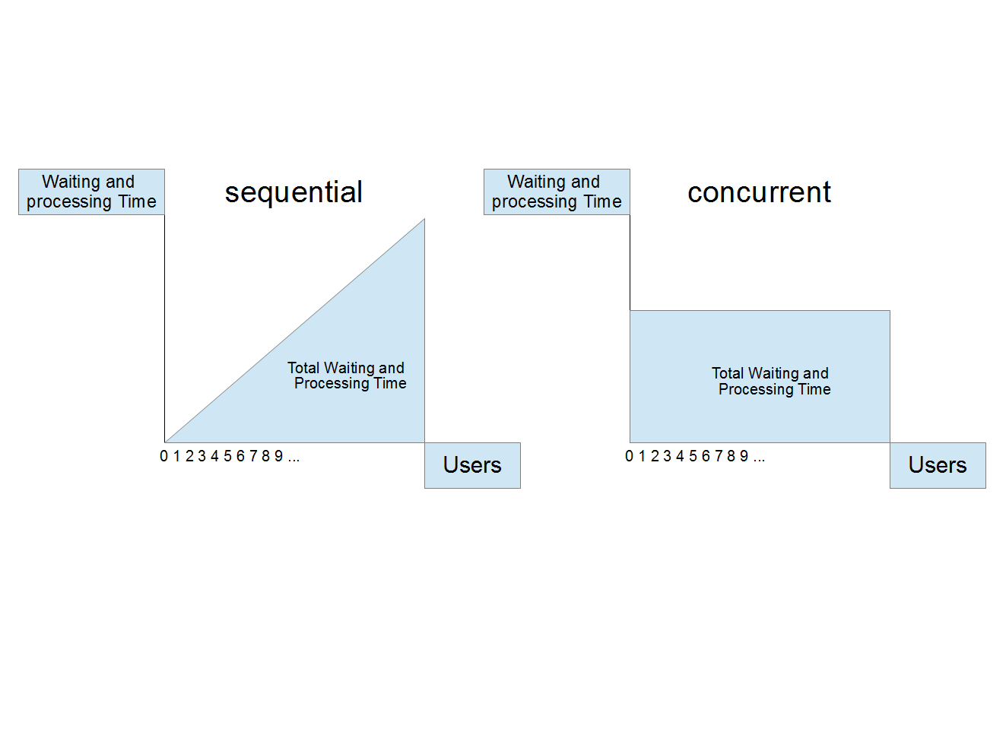
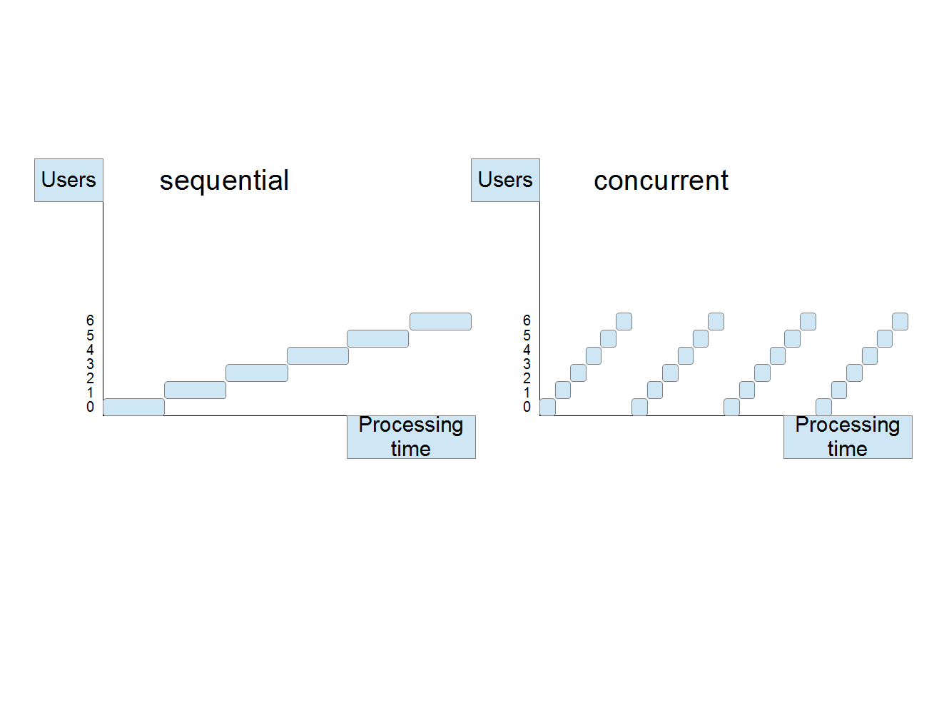
considering one mom (thread/process)
child (client) id
child (client) id
context switching time
^^^^^ less overall time ^^^^^ more overall time
^^^^^ less overall time ^^^^^ more overall time

Slide 164
considering one mom (thread/process)
Waiting and
processing Time
sequential
Waiting and
processing Time
concurrent
Total Waiting and
Processing Time
Total Waiting and
Processing Time
0 1 2 3 4 5
child (client) id
0 1 2 3 4 5
child (client) id
^^^^^ less overall time ^^^^^ more overall time

Slide 165
considering one mom (thread/process)
child (client) id
sequential
child (client) id
concurrent
waiting
5
4
3
2
1
0
5
4
3
2
1
0
processing
context switching
Time
context switching time
processing Time
^^^^^ less overall time ^^^^^ more overall time

Slide 166
（使用前&使用後(1)）
（圖一：總等待時間，用了 concurrency 以後圖中的面積反而會變大）
X: 個別 client
Y: 等待時間

Slide 167
（使用前&使用後(2)）
（圖二：甘特圖，執行不同使用者的 request 的時候，用了 concurrency 會讓單一使用者的處理時間變的不連續）
X: 時間
Y: 個別client

Slide 168
（可以用 Concurrency 處理的問題類型，Data Dependency）
（圖一，叉子型：等待兩個不同來源的資料，各自獨立，先到的就先處理 (food + drink)，像是用手機同時分享照片到FB跟Twitter）
（圖二，鑽石型：兩個來源的資料都等到了才能處理(food + spices)，像是抓FB跟Flickr的照片來合成一張Collage）

Slide 169
fork shaped
tasks (eat, drink) depend on independent tasks (order_food, order_tea)
this is ideal for parallels computing (if we're not enforcing task resolution ordering), and it is quite easy to solve for whatever methods
order_food -> eat
order_tea -> drink

Slide 170
diamond shaped
task (add_spices) depends on multiple independent tasks (order_food, order_spices)
[order_food, order_spices] -> add_spices -> eat

Slide 171
if we're not using concurrency, all clients would need to wait for a different period of time, and some unfortunate users might need to wait for a long long time, since (s)he needs to wait for all the preceding users had done their requests.
we don't want that, we want all users wait for the same time, eliminate unfortunate users, making our program "fair". 公平正義

Slide 172
but making our program run concurrently, would actually make our program run slower, in terms of overall processing time. that's the trade of 公平正義. 公平正義的政府效率比較差

Slide 173
Why Concurrency
（解釋 concurrency 這個東西其實並不會讓處理速度變快，相反的還會變慢，只是他可以避免某個特定使用者等超久的情況出現。）
（所以...的情況適合採用 concurrency，但...的情況就不適合 concurrency）

Slide 174
（接下來幾張秀code：鑽石型的實做方式）
1. synchronized I/O + thread
2. asynchronized I/O + callback
3. asynchronized I/O + callback + thread (coroutine)

Slide 175
synchronized CPU - 依序執行
asynchronized CPU - threads 輪流執行
synchronized I/O - 依序
asynchronized I/O -

Slide 176
a simple reactor
class Reactor
def run
until read_socks.empty? &&
write_socks.empty?
rs, ws = IO.select(read_socks, write_socks,
[], 0.05)
read_data(rs) if rs
write_data(ws) if ws
ennnd

Slide 177
a simple reactor
class Reactor
def read sock, &callback
read_socks << sock
read_calls[sock.object_id] = callback
end
def write sock, data, &callback
write_socks << sock
write_pairs[sock.object_id] = [data, callback]
ennd

Slide 178
a simple reactor
class Reactor
def read_data rs
rs.each do |r|
begin
read_calls[r.object_id].call(r.read_nonblock(8192))
rescue Errno::EAGAIN, ::IO::WaitReadable
rescue Errno::ECONNRESET, EOFError
read_socks.delete(r)
ennnd

Slide 179
a simple reactor
class Reactor
def write_data ws
ws.each do |w|
data, callback = write_pairs[w.object_id]
begin
data.slice!(0, w.write_nonblock(data))
raise EOFError if data.empty?
rescue ::IO::WaitWritable
rescue EOFError
write_pairs.delete(w.object_id)
write_socks.delete(w)
callback.call(w)
ennnd

Slide 180
it doesn't seem to be a good pattern

Slide 181
but it's so ugly and tedious!
what if we want 42 kinds of different spices?
yes, yes, i know nodejs guys have some solution for this, but why invent a new method while the old good synchronous programming does do the job elegantly? you can also consider that as a DSL for synchronous programming

Slide 182
let's see how to make your code synchronous
there are two approaches, depending on the architecture, you can use either threads or fibers to do that.
but note that fibers only work in an event loop (or say single threaded asynchronous programming)

Slide 183
still looks ugly? we can go further with futures.
it can make your code exactly the same as synchronous one, but actually running asynchronous underneath.

Slide 184
（賣藥時間）
using rest-core to make concurrent requests with futures
maybe try to use celluloid to implement futures in the futures? that way, we can have a more consistent way to deal with either I/O or CPU bound operations.
i shouldn't create my own futures -- there's no futures for me (?)

Slide 185
confused?
implementation
synchronized
asynchronized
interface
O
O
thread
X
O
reactor
reactor
+ fiber
O
X
+futures
reactor
+ fiber
O
O

