Slide 1


Health, simplified.
A founder story · Georgy Varghese
Notes:
Hi, I'm Georgy, the founder of SuperState.

Slide 2

OUR MISSION
We make health simple
in a world that makes
it complicated.
02
Notes:
We're building a modern health and wellness brand with a simple mission: to make health simpler, more transparent, and more exciting.
The idea for SuperState came from my own journey with health. As I learned more about nutrition and supplements, I realised that while there was so much information available, it was surprisingly difficult to figure out what was actually useful, what was worth investing in, and what I could trust. That's ultimately why I'm building SuperState.

Slide 3
WHERE IT STARTED
I wanted to get healthier.
I ended up with more
questions than answers.
Georgy Varghese, Founder
03
Notes:
For me, this started with wanting to improve my own health: weight management, skin health, recovery and overall performance. I started learning about nutrition, ingredients and supplements.
But the more I researched, the more questions I had. Every product seemed to have a different promise. It became difficult to separate useful evidence from marketing.
If I was finding this confusing despite actively researching it, how difficult must it be for someone who simply wants to take better care of themselves?

Slide 4
THE PROBLEM
People don’t lack interest
in their health.
They lack a simple,
reliable way to decide.
04
Notes:
I don't think consumers lack interest in their health. I think they lack a simple, reliable way to make informed decisions.

Slide 5
THREE GAPS
01
02
03
Awareness.
Trust.
Uncertainty.
“Which needs actually
matter to me?”
“Can I believe
this label?”
“Is it even
working?”
05
Notes:
I think there are three major challenges in the supplement space.
Awareness: people want to improve their health, but may not understand which nutritional needs matter to them or where supplements fit.
Trust: products make impressive claims, but it isn't easy to verify ingredient quality, dosage, sourcing, or the evidence behind those claims.
Uncertainty: the benefits of many supplements are gradual and vary from person to person, so people are left wondering whether a product is actually helping them.

Slide 6
HOW THE CATEGORY WORKS TODAY
Big on the front.
Pixie dust inside.
Tiny doses · cheapest forms · hidden blends · fine print
06
Notes:
A lot of the category relies on 'pixie dusting': a pinch of a fancy ingredient, just enough to print it big on the front, the cheapest forms of ingredients, and real amounts hidden inside proprietary blends. They're not betting on customers being foolish. They're betting on them being busy.

Slide 7
OUR APPROACH
We do the homework,
so you don’t have to.
Every dose on the label
Honest about evidence
Built to be enjoyed
07
Notes:
I believe brands should take responsibility for making this process easier, rather than expecting every customer to become an expert in nutrition. That's the job SuperState takes on.

Slide 8
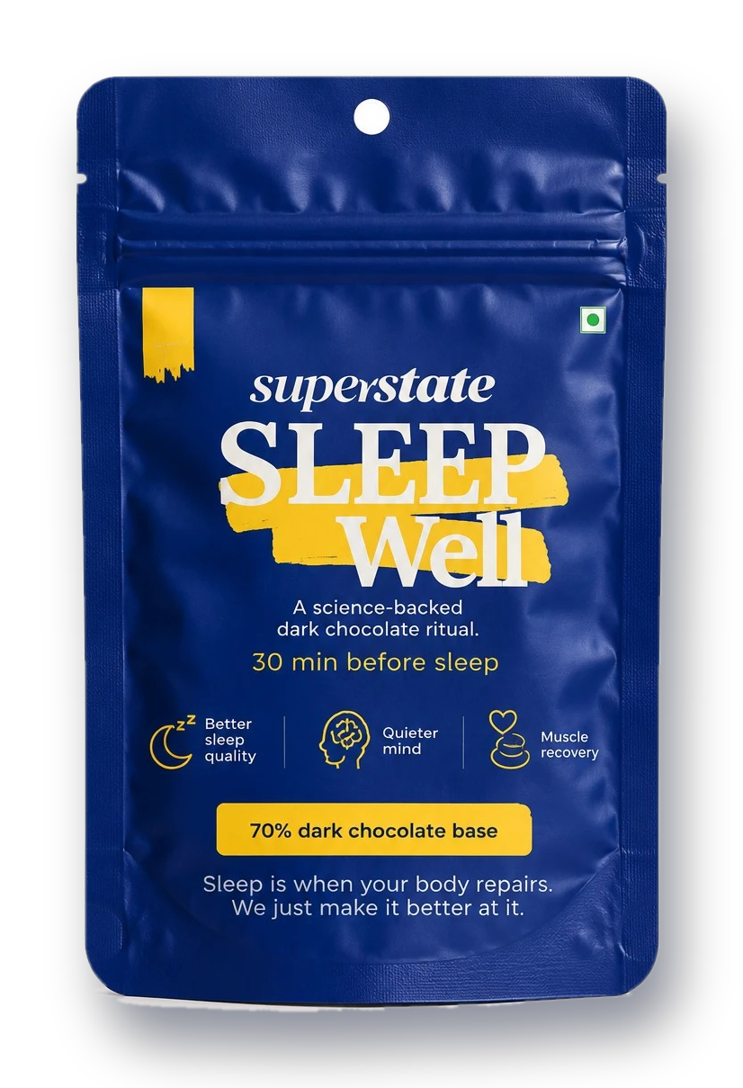
OUR FIRST PRODUCT
Sleep Well.
Coffee, but for sleep.
A warm dark chocolate drink
for your evenings. No melatonin.
08
Notes:
Our first product is Sleep Well, a ready-to-mix sleep supplement in a dark chocolate format.
We chose sleep because it's fundamental to how we feel and function every day. It plays an important role in recovery, focus and overall well-being, yet building a consistent night-time routine isn't always easy.

Slide 9
WHAT’S INSIDE
7 ingredients.
0 hidden doses.
3,000 mg
Organic raw cacao
500 mg
Tart cherry extract
3,000 mg
Glycine
200 mg
L-theanine
2,000 mg
Magnesium L-threonate
50 mg
Apigenin
1,000 mg
Magnesium bisglycinate
Per sachet · no proprietary blends · no melatonin · food product, not a medicine
09
Notes:
Every ingredient and every dose is on the label: organic raw cacao, glycine, two forms of magnesium, tart cherry, L-theanine and apigenin. No proprietary blends, and no melatonin.

Slide 10
YOUR 10 PM RITUAL
9:30 pm
9:31 pm
9:35 pm
10:00 pm
Rip.
Stir.
Sip.
Sleep.
Not another pill to remember.
A ritual to look forward to.
10
Notes:
Instead of creating another supplement you have to remember to take, we wanted it to be a simple, enjoyable ritual at the end of the day. You mix it with hot water, enjoy it like a warm chocolate drink, and make it part of your night-time routine.
This is about more than the format. It's about making functional nutrition fit more naturally into people's lives.

Slide 11
OUR DIFFERENCE
Transparency
beyond the label.
Every dose on the pack
Live
Batch-specific quality reports
Building
Honest about what the evidence shows
Next
11
Notes:
Creating an enjoyable product is only one part of it. The bigger question is: how do we give people more confidence in what they're buying?
We want customers to understand what goes into our products, why each ingredient is included, where it comes from, and what evidence supports its use. Our ambition is to make quality-testing information accessible, including batch-specific reports where appropriate.
And we're careful about the difference between research on individual ingredients and evidence for a finished formulation. Over time, where appropriate, we want to test our finished formulations and communicate the findings honestly, including the limitations. Transparency shouldn't be just a marketing message.

Slide 12
MEASURING WHAT MATTERS
Better questions than
“did you like it?”
Sleep diaries, customer feedback and sleep-tracker data,
kept honestly separate from proven science.
12
Notes:
In a category where benefits are gradual and experiences vary, we want to ask more meaningful questions than whether someone simply likes a product.
For Sleep Well, we could look at sleep diaries, customer feedback, and data from sleep-tracking devices. These measures alone can't prove a supplement caused an improvement, so we'll keep customer observations separate from scientifically established results.
The goal is a model where product development, quality verification and customer feedback inform one another.

Slide 13
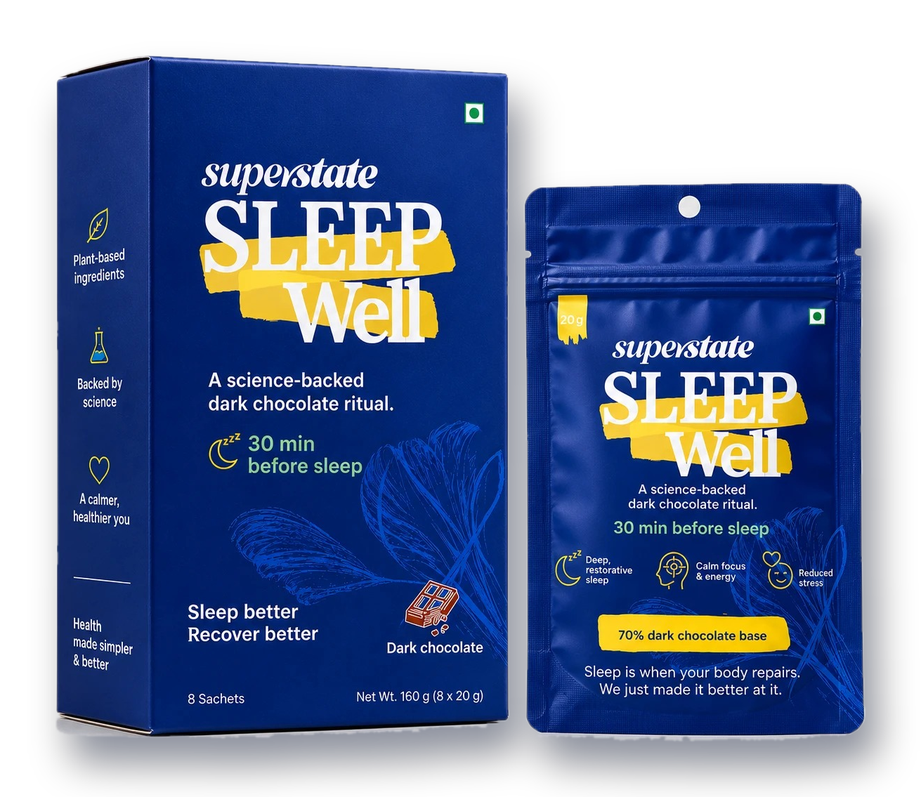
EARLY SIGNAL
Batch 01
sold out.
Faster than we planned.
Batch 02 is shipping now.
13
Notes:
Our first batch sold out faster than we planned. We took notes, improved the product, and Batch 02 is shipping now.

Slide 14
THE LONG GAME
Sleep Well is just
the beginning.
More everyday health needs. The same four principles:
Quality
Transparency
Evidence
Better experience
14
Notes:
Sleep Well is just the beginning. Our long-term vision is a broader health and wellness brand that addresses different everyday health needs, with the same principles at the centre of every product: quality, transparency, evidence, and a better consumer experience.
I don't expect us to solve every problem in the supplement industry overnight. We're at the beginning of this journey, and we have a lot to learn and prove. That's exactly why I want to build SuperState around these principles from the start.

Slide 15
“I want to help people
feel more confident
about the choices they
make for their health.”
Georgy Varghese, Founder
superstate.in · support@superstate.in
Instagram @superstate.in
Notes:
At the end of the day, SuperState is personal for me. I know what it's like to want to improve your health, look for answers, and end up with more questions than you started with. I want to help change that experience.
We're starting with Sleep Well, but the bigger goal is to make health simpler, more transparent, and more enjoyable for the long term. That's the vision behind SuperState, and that's what we're working toward.

