Slide 1
★ ★ ★ ★ ★
The Restaurant with
5-Star Reviews
and Empty Tables
A hospitality paradox — and what the ratings never told us
Saffron & Sage | 12 outlets | FY 2025
Storytelling with Data · Final Group Presentation · August 2026
Notes:
Open cold, no preamble. 'Our client has never been better reviewed. And it has never been emptier.' Hold two seconds. Then: over the next ten minutes we will show you why the best-rated year in this chain's history was also the year it quietly lost a third of its regulars — and why its own dashboard could not see it happening.

Slide 2
THE STAKEHOLDER
Meet Ananya Rao, COO of Saffron & Sage
A 12-outlet casual-dining chain across Chennai, Bengaluru, Hyderabad and Kochi. In her January board review she will be asked one question she cannot currently answer: why is the best-rated year in company history also its worst year for footfall?
12
▤
Outlets
₹
₹94 Cr
BUSINESS PROBLEM
FY25 revenue
Footfall is falling 23% a year while satisfaction metrics improve. Ananya does not know which lever to pull — and every month of delay costs revenue she cannot win back.
★
4.68★
Her decision by 31 January: where to commit a ₹1.2 crore turnaround budget.
Google rating
▼
-23%
Footfall
Notes:
Anchor the audience in a person, not a dataset. Ananya is the stakeholder every recommendation later in this deck is addressed to. Note the four tiles on the right: three of them look like a healthy business. Only the last one doesn't. That tension is the whole presentation.

Slide 3
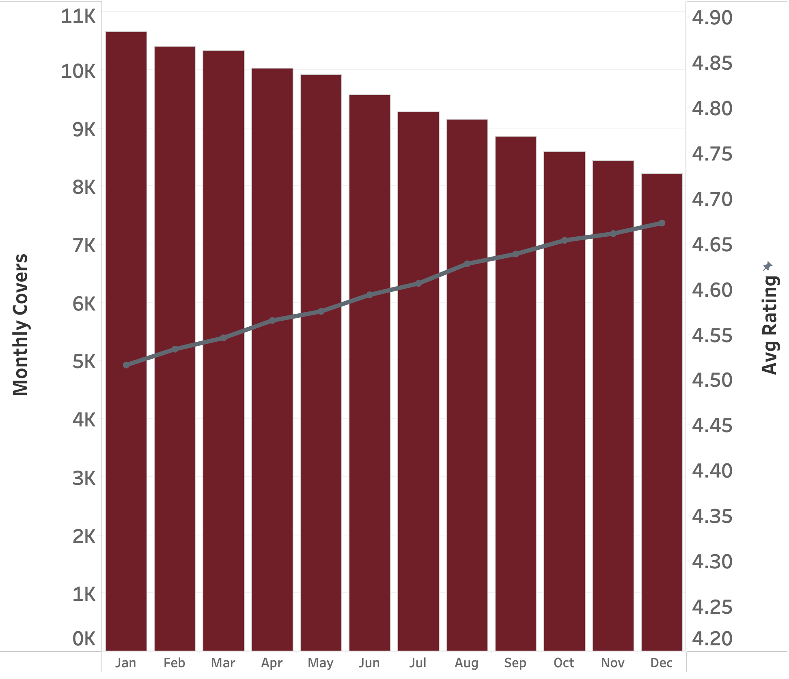
THE PARADOX
The rating went up. The room emptied out.
-23%
covers, Jan → Dec
14,200 → 10,950
+0.16★
rating, Jan → Dec
4.52 → 4.68
Twelve months. Two lines. They should move together — they move apart.
Notes:
Chart choice: bars for a volume measure, line for a rate measure, dual axis because the units are not comparable. The amber line is the only warm accent on the chart — the eye goes to the divergence, which is the point. If satisfaction genuinely drove return visits, these two series could not diverge for twelve consecutive months.

Slide 4
HOW WE INTERROGATED IT
Four questions we put to the data
1
Is the decline real, or an artefact of how covers are counted?
Validated against POS bill counts, not door sensors.
2
Is it explained by any external factor?
Price, competition, location, seasonality — tested one by one.
3
Who exactly is missing — new guests or returning ones?
Decomposed every cover by guest visit history.
4
Does our satisfaction metric actually measure satisfaction?
Traced every review back to the visit that produced it.
Notes:
These four questions are the spine of the talk. Q1 and Q2 are elimination. Q3 is where the story turns. Q4 is the reveal. Say explicitly: we expected the answer to live in question two — it did not.

Slide 5
EXPLORATION
Four suspects. All of them plausible.
Every one of these is the answer a management consultant would reach for first. We tested each against the data before we allowed ourselves a new hypothesis.
₹
◎
◈
◷
SUSPECT 01
SUSPECT 02
SUSPECT 03
SUSPECT 04
Pricing
Competition
Location
Seasonality
We raised menu prices and priced ourselves out.
New restaurants opened around our outlets.
A few weak outlets are dragging the chain down.
This is a normal annual cycle, not a decline.
Spoiler: all four are innocent.
Notes:
Deliberate detective framing — it buys the audience's patience through two slides of elimination. Do not rush this slide; naming the obvious suspects out loud is what makes the audience trust the reveal later, because they will have thought of these themselves.

Slide 6
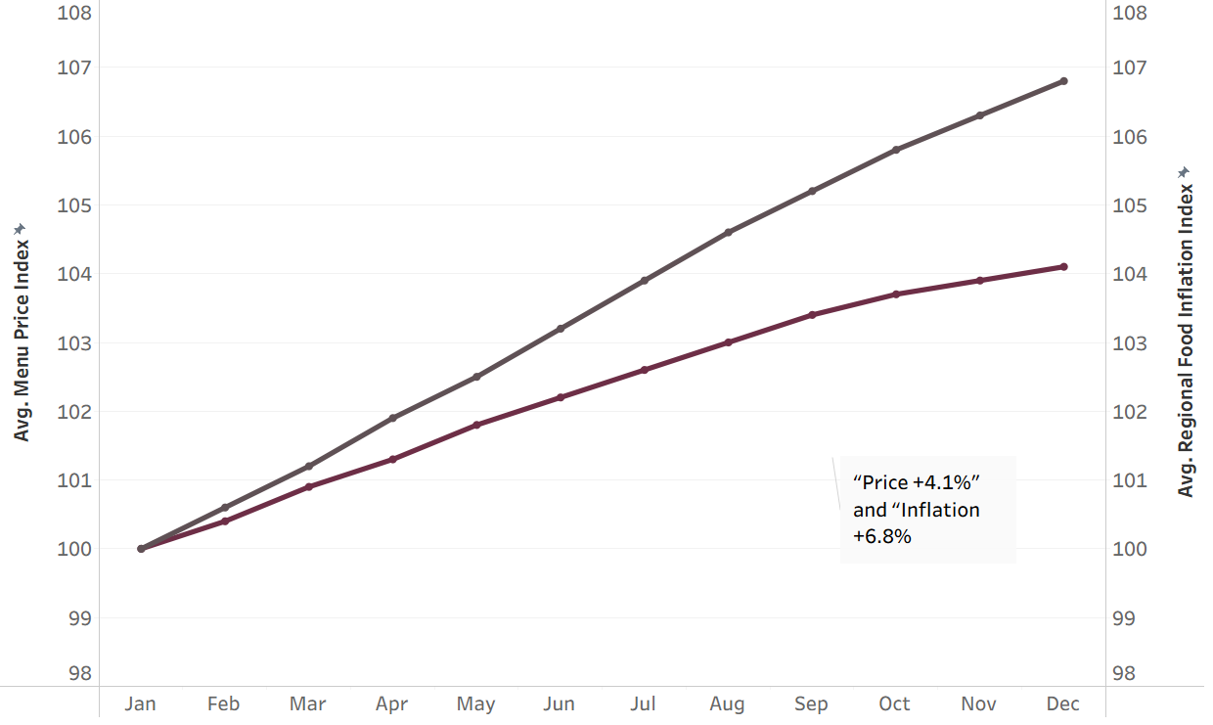
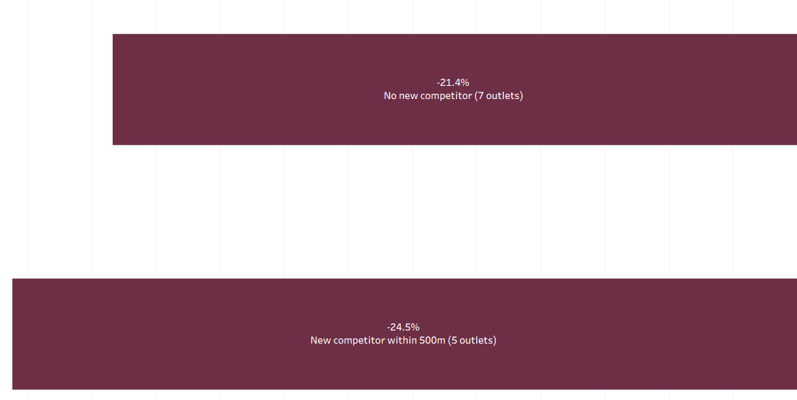
ELIMINATION 1 AND 2
Not price. Not competition.
SUSPECT 01 - PRICING
SUSPECT 02 - COMPETITION
We raised prices 4.1% while the market rise by 6.8%. IN real terms, Saffron and Sage got cheaper.
Outlets with a new rival next door declines 24.1%. Outlets with no rivals declined 22%. A 2-point gap explains almost nothing.
Both suspects released. The decline is happening everywhere, to everyone, regardless of price or rivals
Notes:
Chart choice: bars for a volume measure, line for a rate measure, dual axis because the units are not comparable. The amber line is the only warm accent on the chart — the eye goes to the divergence, which is the point. If satisfaction genuinely drove return visits, these two series could not diverge for twelve consecutive months.

Slide 7
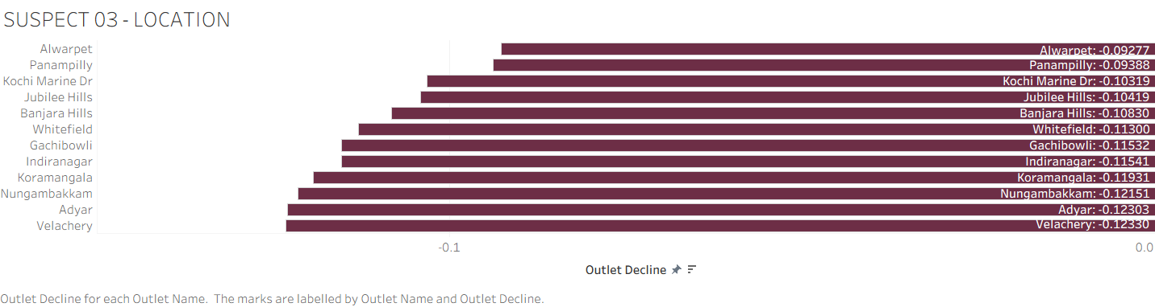
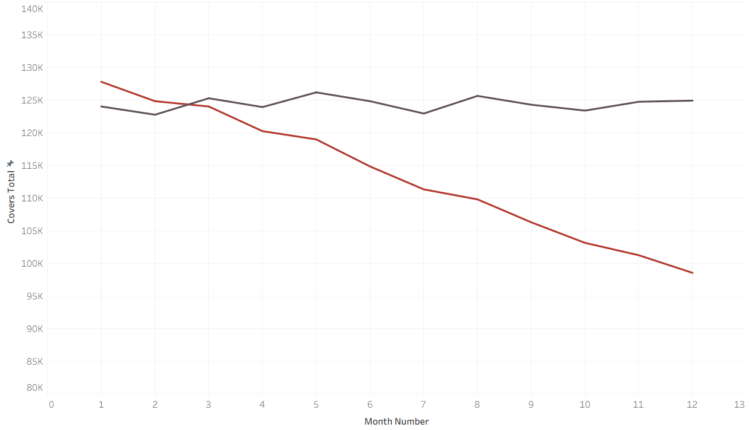
ELIMINATION 3 AND 4
Not location. Not the season.
SUSPECT 03 - LOCATION
SUSPECT 04 - SEASONALITY
All 12 outlets fell, in a tight band from -18% to -27% there is no weak outlet story here, this is systemic
Same months, same festivals, same monsoon. 2024 held flat. 2025 slides away from it every single month.
Four suspects. Four alibis. Which means we had been asking the wrong question
Notes:
Chart choice: bars for a volume measure, line for a rate measure, dual axis because the units are not comparable. The amber line is the only warm accent on the chart — the eye goes to the divergence, which is the point. If satisfaction genuinely drove return visits, these two series could not diverge for twelve consecutive months.

Slide 8
THE TURN
We kept asking
why people stopped coming.
We should have asked
who was still there to leave a review.
So we stopped analysing covers, and started analysing reviewers.
Notes:
Slow down. This is the only slide with no data on it, and that is intentional — the audience needs one beat to reset before the reveal. Deliver the two sentences as a contrast pair, with a full pause between them.

Slide 9
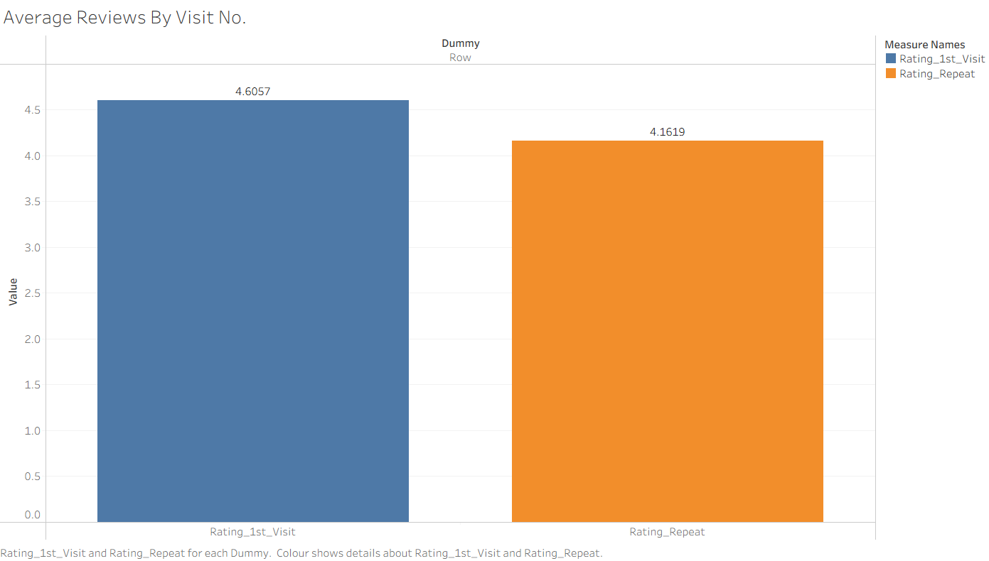
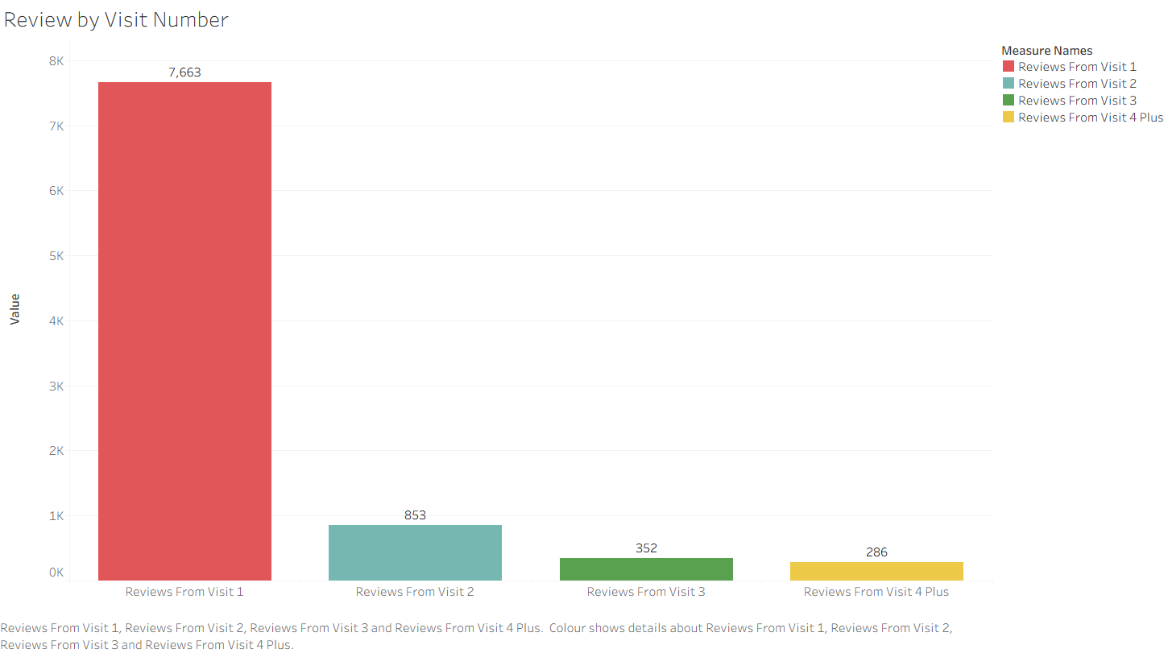
REVEAL · 1 OF 3
86% of our five-star reviews come from first-time guests
Share of reviews, by which visit produced them
Average stars given, by the same visit number
The rating is not a measure of how good we are. It is a measure of how good our first impression is — and the people best placed to judge us are the ones least likely to be counted.
Notes:
Two charts, one argument: first-timers write nearly all the reviews AND they give the highest scores. The deep berry bar marks the dominant segment on both charts so the eye connects them without a legend. Loyal guests rate us 3.61. We have almost no record of it because they have stopped writing, and then they stop coming.

Slide 10
REVEAL · 2 OF 3
Acquisition is fine. Retention is collapsing.
±1%
change in new
guests all year
-52%
change in returning
guests all year
Every rupee of marketing is working. The front door is fine. It is the back door nobody was watching.
Returning guests fell from 44% of covers in January to 28% in December.
Notes:
This is the smoking gun. Stacked columns, deliberately: the total height is the number the board already knows, and splitting it shows the entire loss sits in one segment. The pale segment barely moves. In the live dashboard this chart filters by city and daypart — the pattern holds in all four cities.

Slide 11
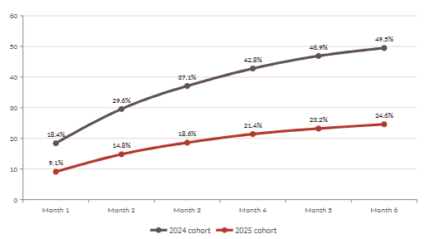
REVEAL · 3 OF 3
Guests we won this year come back half as often
49.5% - 24.6%
Six-month return date
2024 vs 2025
340/-
spent to acquire each guest
810/- vs 610/-
a repeat guest’s bill vs a first timer’s
% of a first visit cohort that has made a second visit, by months elapsed
Notes:
This is the smoking gun. Stacked columns, deliberately: the total height is the number the board already knows, and splitting it shows the entire loss sits in one segment. The pale segment barely moves. In the live dashboard this chart filters by city and daypart — the pattern holds in all four cities.

Slide 12
WHY NOBODY SAW IT
We were reading the bullet holes on the planes that came back
In 1943 the Allies armoured their bombers where returning planes were most damaged. Abraham Wald pointed out the flaw: the planes hit elsewhere never came back to be measured. Our rating system has the same blind spot.
94,940
guests dined with us in FY25
4,762 wrote a review
5.0% of guests — and they set the 4.68★
A star rating can only ever be written by someone who is still willing to come back and write it.
67,489 never came back
71% of guests — and they said nothing
Churn is silent by construction. There is no one-star review for the meal you simply never returned for.
The metric on the boardroom wall is built from the 5% least likely to be disappointed.
Notes:
The Wald analogy is the non-data storytelling layer the brief asks for. Keep it to twenty seconds — the audience gets it fast, and the panel on the right does the quantitative work. If asked in Q&A: yes, this is survivorship bias, and it is structural, not a sampling error we can fix by collecting more reviews.

Slide 13
SO WHAT
What the silence has already cost
₹3.16 Cr
3,250
₹1.1 Cr
annualised revenue lost
repeat covers lost per month
spent re-acquiring guests
at December's repeat-visit run rate
versus January 2025
we had already won once
And the compounding problem:
Every month the rating rises, the case for changing anything gets weaker. The metric is not merely failing to detect the problem — it is actively arguing against fixing it.
₹1.2 crore of turnaround budget is currently earmarked for acquisition campaigns and a menu price review — both aimed at suspects the data has already cleared.
Notes:
This slide converts the analysis into money, which is what the stakeholder will act on. The final line is the bridge to the recommendation: the budget is about to be spent on the wrong door.

Slide 14
RECOMMENDATION
Move the ₹1.2 Cr from the front door to the back
Measure the churn you cannot see
OWNER
SUCCESS METRIC
TIMELINE
BUDGET
1
Replace the star rating as the headline KPI with 90-day Repeat Visit Rate, reported by outlet every month. Trigger an exit survey to any guest 60 days silent.
Head of Insights
90-day RVR live, all 12 outlets
Weeks 1–4
₹15 L
Win back the 67,489
OWNER
SUCCESS METRIC
TIMELINE
BUDGET
2
Targeted return offer to lapsed guests, sequenced by past spend. These guests already know us — they cost nothing to persuade and spend ₹810 when they come.
CMO
12% of lapsed guests reactivated
Weeks 3–12
₹65 L
Fix the second visit, not the first
OWNER
SUCCESS METRIC
TIMELINE
BUDGET
3
Recipe and service audit on the dishes rated below 4.0 by repeat guests, plus a named-guest recognition flow for third visits onward.
COO / Exec Chef
Month-6 return rate above 40%
Weeks 4–20
₹40 L
Notes:
Every recommendation carries an owner, a measure, a timeline and a rupee figure — that is what turns an insight into a decision. Note the sequencing logic: recommendation 1 makes the problem visible, 2 recovers revenue this quarter, 3 fixes the underlying cause.

Slide 15
THE ASK
Ananya, change the number
on the boardroom wall.
The 4.68★ is real. It is also the most flattering, least useful number this company owns. Retire it as a headline metric at the January board review and put 90-day Repeat Visit Rate in its place — starting with the twelve outlets, this quarter.
TODAY
FROM JANUARY
4.68 ★
24.6% → 40%
measures our first impression
90-day repeat visit rate — measures whether we deserved them
Because the guests who love you write reviews. The guests you lost just stop showing up.
Notes:
Close on the ask, not on a summary. The two panels give the board a single before-and-after decision. Final line is the callback to the title — deliver it and stop talking. Then hand to Q&A.

