Slide 1
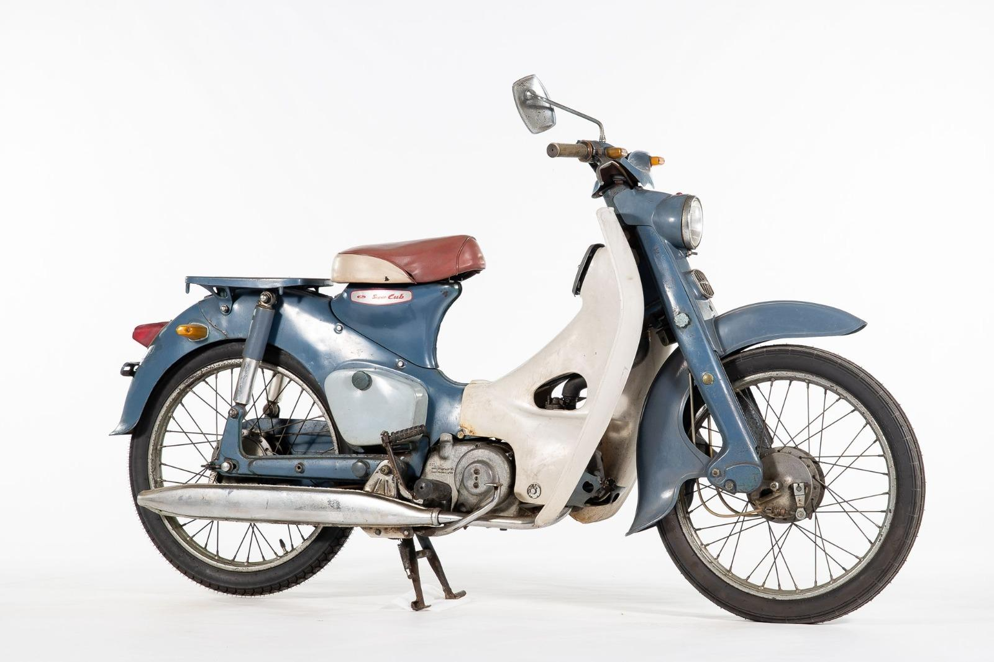
HONDA (A) - STRATEGIC MANAGEMENT CASE
PHOTO
1958 Honda Super Cub C100
(Wikimedia Commons / Honda Global)
Honda's U.S. Market Entry
What went into Honda's success in its U.S. market-entry strategy?
A strategic-management analysis of how Honda repositioned motorcycles in America (1959-1975) through underserved-segment targeting, manufacturing scale, and cultural repositioning.
Submitted By - Group 4 | Section - 2
Naman FT272022
Ojasvi FT261010R
Harshraj FT272017
Tanya FT272073
Tanmay FT272069
Pushkar FT272056

Slide 2
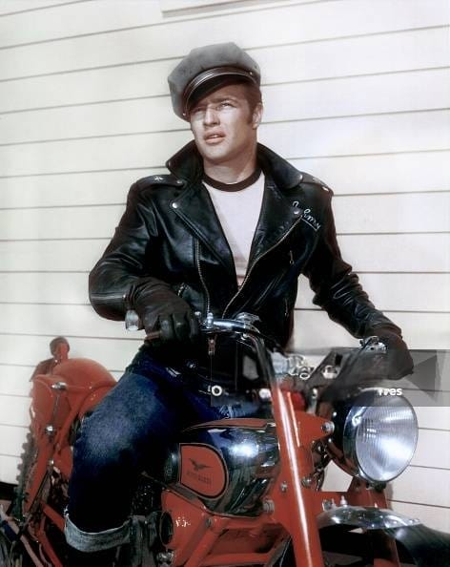
The Honda Foundation: Innovation and Scale
Founded in 1946 by Soichiro Honda, the Honda Technical Research Institute anchored a technology-led strategy focused on reliable internal-combustion engines.
By 1951 Honda had a superior 4-stroke design and became a fully integrated producer of engines, frames and parts, controlling quality end-to-end.
1958: market research revealed an untapped segment wanting a small, unintimidating bike. Honda built the 50cc Super Cub, step-through frame, one-hand controls and gambled on a 30,000-unit/month plant, 10× the demand at the time.
By 1959 Honda was the world's largest motorcycle producer by sales ($55M), producing 285,000 units that year.
Core philosophy
Innovation, affordability and expansion through scale, a multi-product line, product-innovation leadership, and mass-production economics.

Slide 3
Honda's Global Strategic Approach
Innovation-driven development
Heavy R&D funded ~18-month concept-to-market cycles and a 'cold storage' of designs far faster than Western rivals.
Experience-curve cost leadership
High volume drove costs down a steep experience curve (76–88% slopes), enabling continual real price cuts while staying profitable.
Multi-segment product line
A full range from lightweight commuters to large bikes ensured broad coverage and a strong selling-and-distribution system.
Market share over short-term profit
Objectives set in share and volume terms, defended at all costs; plans aimed at long-term payoff.
U.S. Market Context: The 1950s Landscape
Dominated by Harley-Davidson and British makers (Triumph, BSA) selling large, expensive leisure/sport machines at $1,000–$1,500
Strong cultural barrier: motorcycling linked to gang and 'bad-boy' imagery reinforced by the 1953 film The Wild One (Marlon Brando)
Incumbents dismissed small bikes. Harley-Davidson's president: Motorcycles are 'sports vehicles, not transportation vehicles.
That blind spot left a wide-open gap: affordable, lightweight, easy-to-ride commuter motorcycles for ordinary people

Slide 4
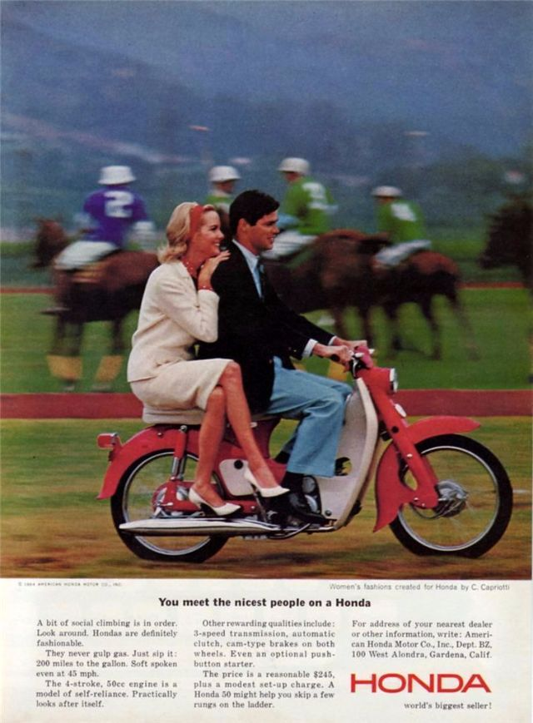
Honda's U.S. Market-Entry Strategy
Subsidiary-led entry (1959)
Established American Honda Motor Co. instead of using importers keeping direct control of distribution, service and branding.
Targeted an underserved segment
Small, lightweight bikes (from 50cc) retailing under $250 vs. $1,000+ for Harley/Triumph; ~5 hp vs. 2.5 hp for the Sears lightweight.
Distinctive product design
Step-through unisex frame, automatic clutch, electric starter and easy handling appealed to first-time and non-traditional riders.
Region-by-region rollout + dealers
Began on the West Coast, moving east over 4 - 5 years; grew from 125 dealers (1961) to ~2,000 by the mid-1970s, with strong after-sales support.
Brand repositioning
'You meet the nicest people on a Honda' broke the biker-gang stereotype and targeted middle-class families, backed by heavy advertising.

Slide 5
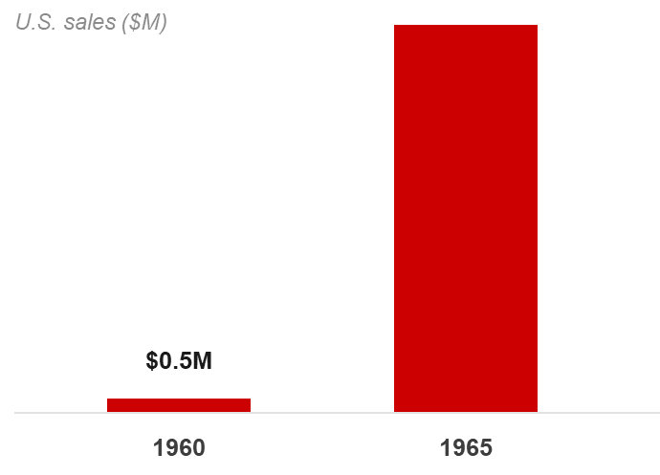
Honda's Remarkable U.S. Success
$0.5M → $77M
~43%
~2,000
U.S. sales, 1960 to 1965
Honda's U.S. market share by 1974
U.S. dealers by the mid-1970s
By 1966 Honda led the Japanese makers who together held 85% of the U.S. market.
Created entirely new demand among non-traditional riders like students, women, professionals and repositioned motorcycling as mainstream leisure.
After winning small bikes, Honda moved upmarket (CB450, CB750) competing with established brands at lower prices.
BCG's verdict: success came from productivity, not cheap labour. Honda's value-added per employee was up to 4× Western rivals'.

Slide 6
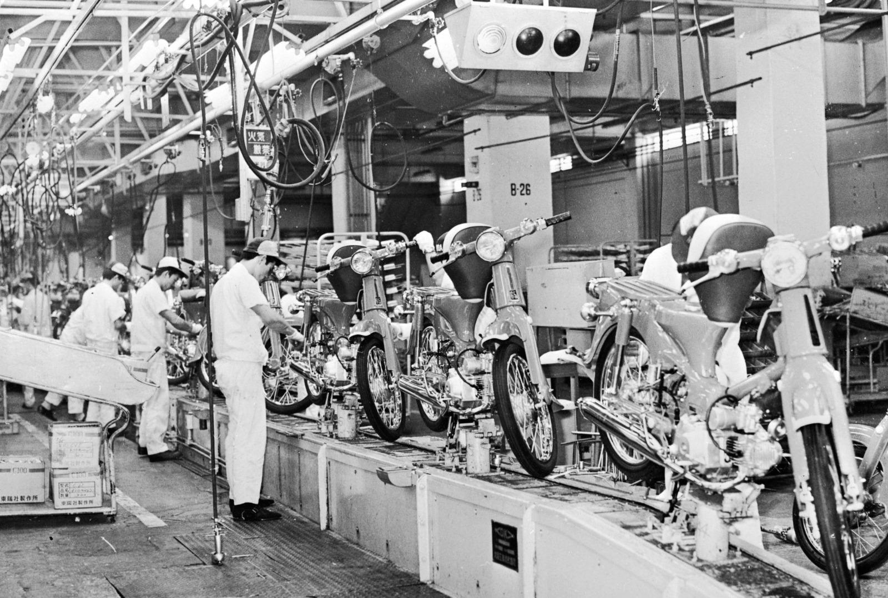
Key Takeaways: The Honda Success Formula
Strategic insight
Honda found an underserved segment and paired it with cultural repositioning to create new demand instead of attacking incumbents head-on.
Execution excellence
Direct subsidiary control, region-by-region rollout, heavy advertising and the largest U.S. dealer network delivered superior value and support.
Resource advantage
Hard-to-imitate strengths in R&D, experience-curve cost leadership, branding and a share-first culture created sustainable advantage.
The enduring lesson: align internal strengths with an overlooked market opportunity, challenge industry assumptions, and prioritise long-term market position over immediate profit.

