Slide 1
Building Android apps
2843-201710_MCS4993_M:Topics in MA/CS
2843-201710_MCS5993_M:Topics in Computer Science

Slide 2
Agenda
Introductions
Syllabus
Books
Project
Hello World Android app
Java Test reminder

Slide 3
Introductions
Godfrey Nolan, B.E., MSc.
President of RIIS LLC, mobile development company based in Troy, MI
Originally from Dublin, Ireland
Author 5 books
Decompiling Java, Decompiling Android, Android Best Practices, Bulletproof Android, Agile Android
Currently working on Agile Swift and Android Design Patterns

Slide 4
What should you know at the end of this course
How to use Android Studio
How to write 5-10 simple android apps.
How to push your code to github.
Know where to put passwords and API keys in an app
How to write unit tests
How to write user interface tests
How to build and test a project in Jenkins
Know how to measure code coverage
Know the difference between unit testing and test driven development

Slide 5
Course Schedule
Date | Topic | Date | Topic
8/23/16 | Introduction, Hello World | 9/22/16 | Fragments
8/26/16 | Basic Java test | 9/27/16 | Action Bars & Navigation Menus
8/30/16 | Activities and Intents | 9/29/16 | Action Bars & Navigation Menus
9/1/16 | Activities and Intents | 10/4/16 | SQLite databases
9/6/16 | Android Activity Lifecycle | 10/6/16 | SQLite databases
9/8/16 | User Interface | 10/11/16 | AsyncTask
9/13/16 | User Interface | 10/13/16 | AsyncTask
9/15/16 | List Views and Adapters | 10/18/16 | Under the hood
9/20/16 | List Views and Adapters | 10/18/16 | Under the hood

Slide 6
Course Schedule
Date | Topic | Date | Topic
10/25/16 | Material Design | 11/24/16 | No Class
10/27/16 | Material Design | 11/29/16 | Continuous Integration
11/1/16 | Project Demo | 12/1/16 | Test Driven Development
11/3/16 | Mid Term Written Test | 12/6/16 | Test Driven Development
11/8/16 | Unit Testing | 12/8/16 | Final Project Demo
11/10/16 | Unit Testing | 12/13/16 | Final Written Exam
11/15/16 | User Interface Testing
11/17/16 | User Interface Testing
11/22/16 | Continuous Integration

Slide 7


Books

Slide 8
Projects
To Do List
Calculator
IoT Home app
COPD app
Drone app
Google Cardboard app
Comparing Crops app
Secure app
Salesforce app
EMR Integration app
Push notifications app
Quickblox app

Slide 9
Hello World Android app
Set up development environment
Build a basic app
Run the app in the Android emulator
Change the app

Slide 10
Hello World Android app
Set up development environment
Install Java JDK (not the JRE)
http://www.oracle.com/technetwork/java/javase/downloads/index.html
Install Android Studio
https://developer.android.com/studio/index.html

Slide 11
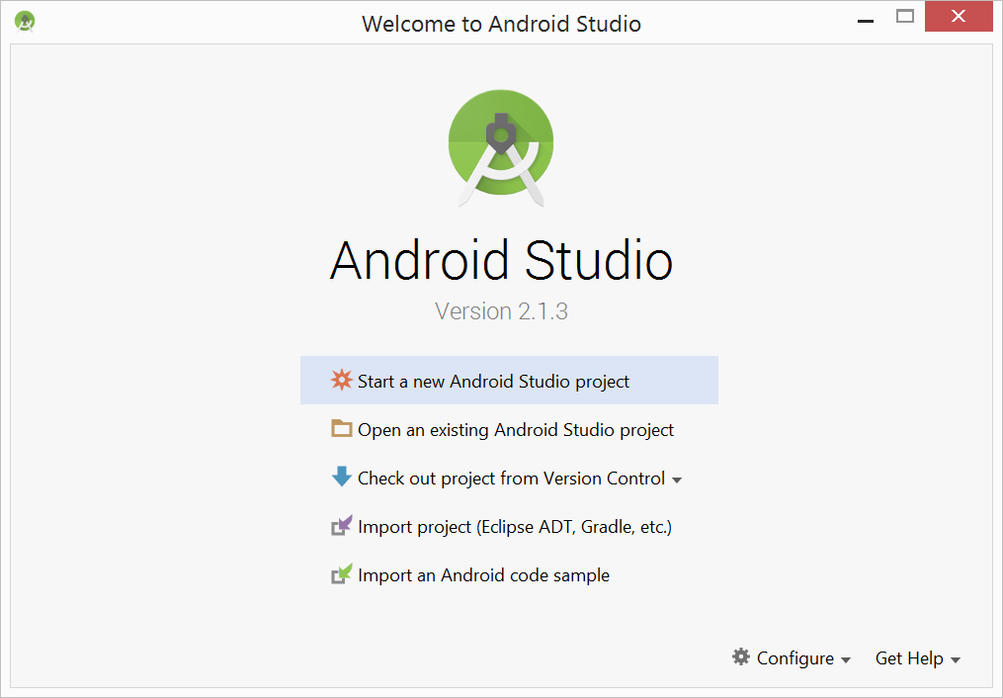
Hello World Android app
Build a basic app

Slide 12
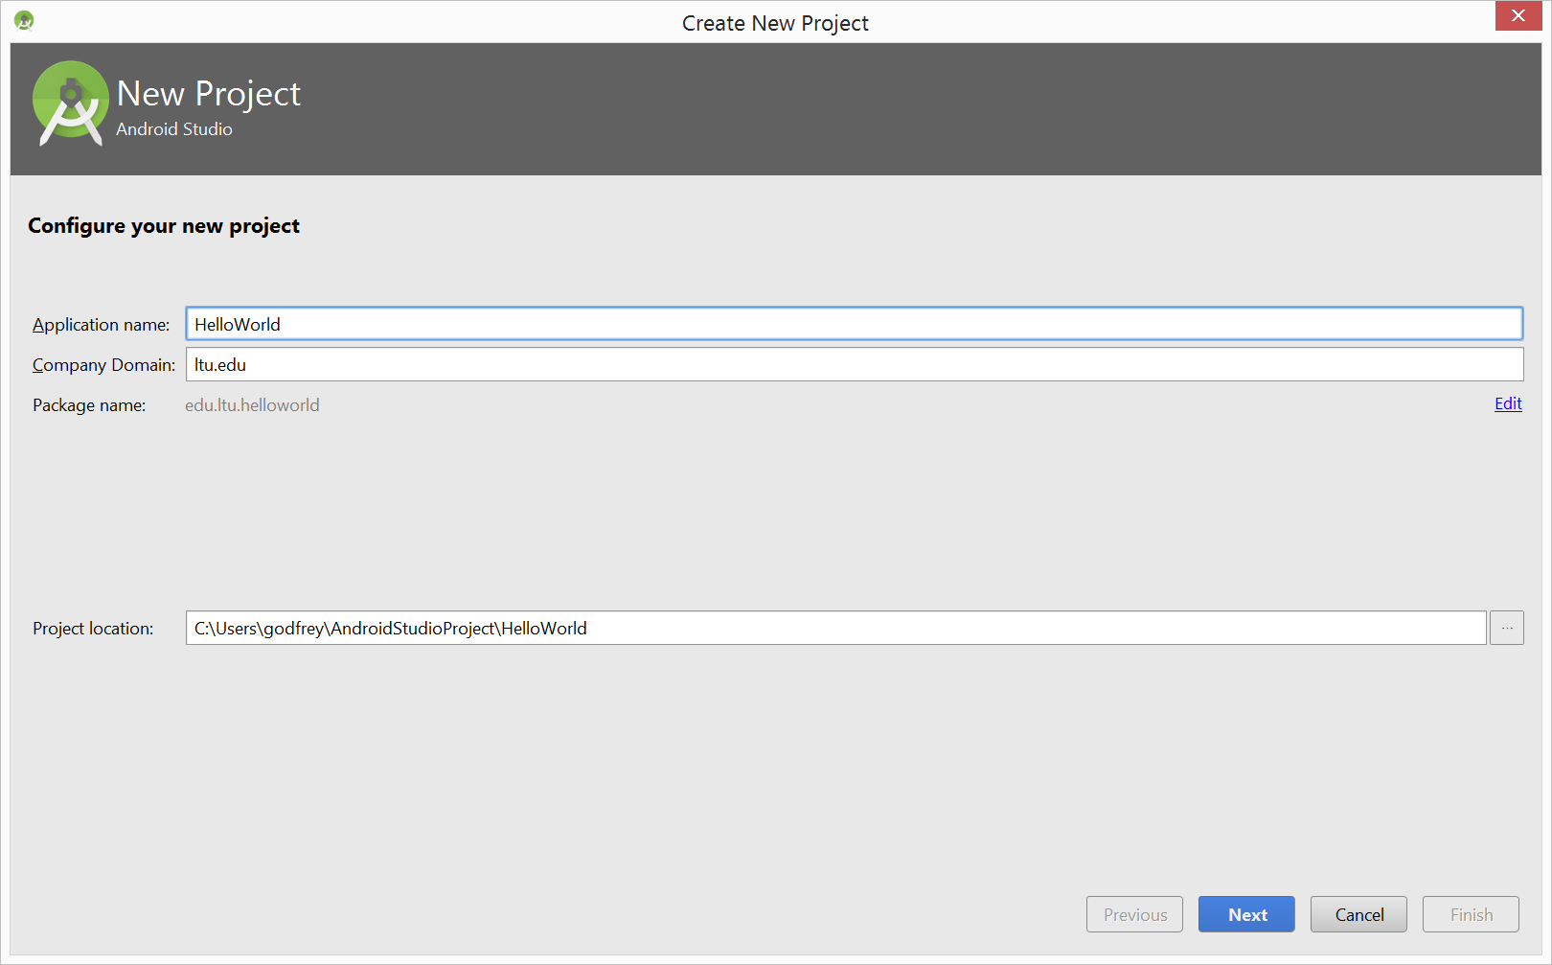
Hello World Android app
Build a basic app

Slide 13
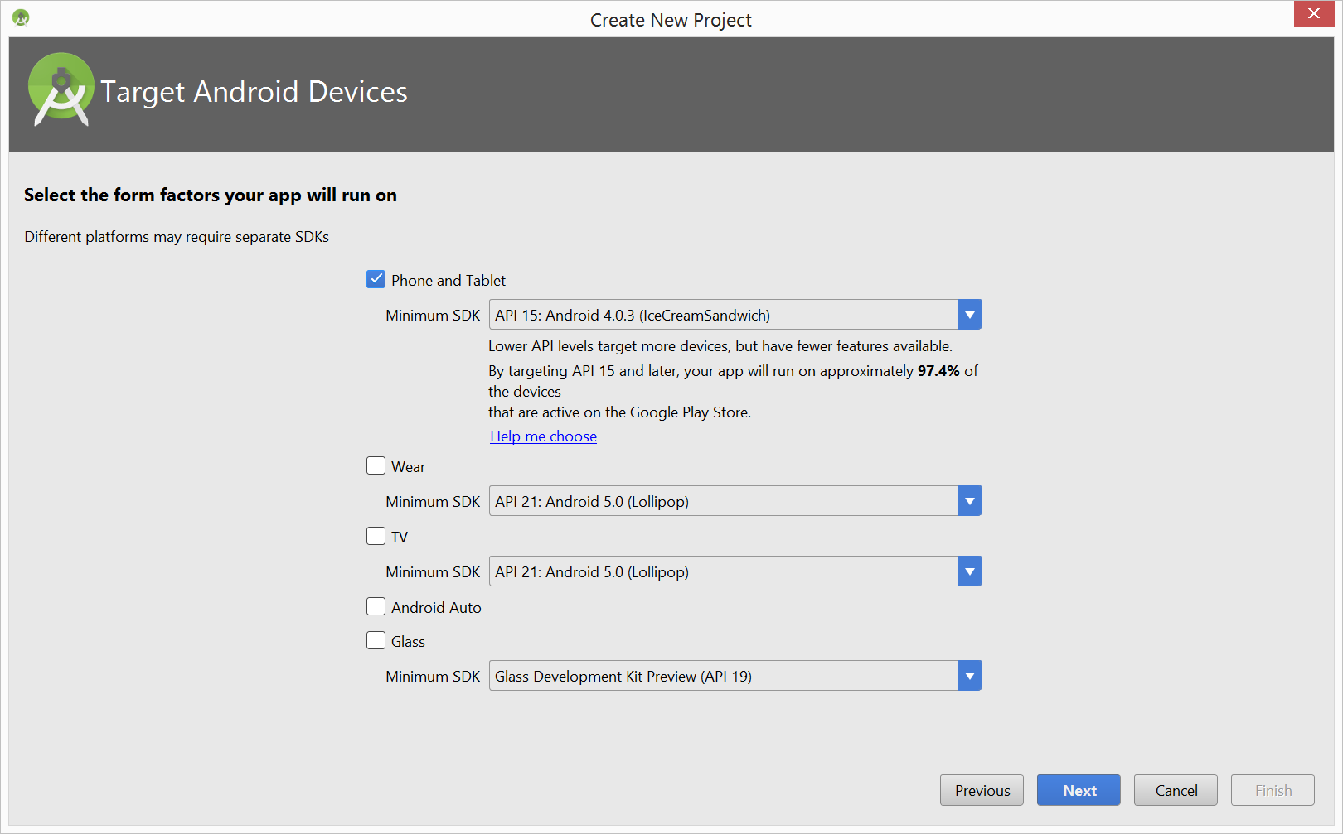
Hello World Android app
Build a basic app

Slide 14
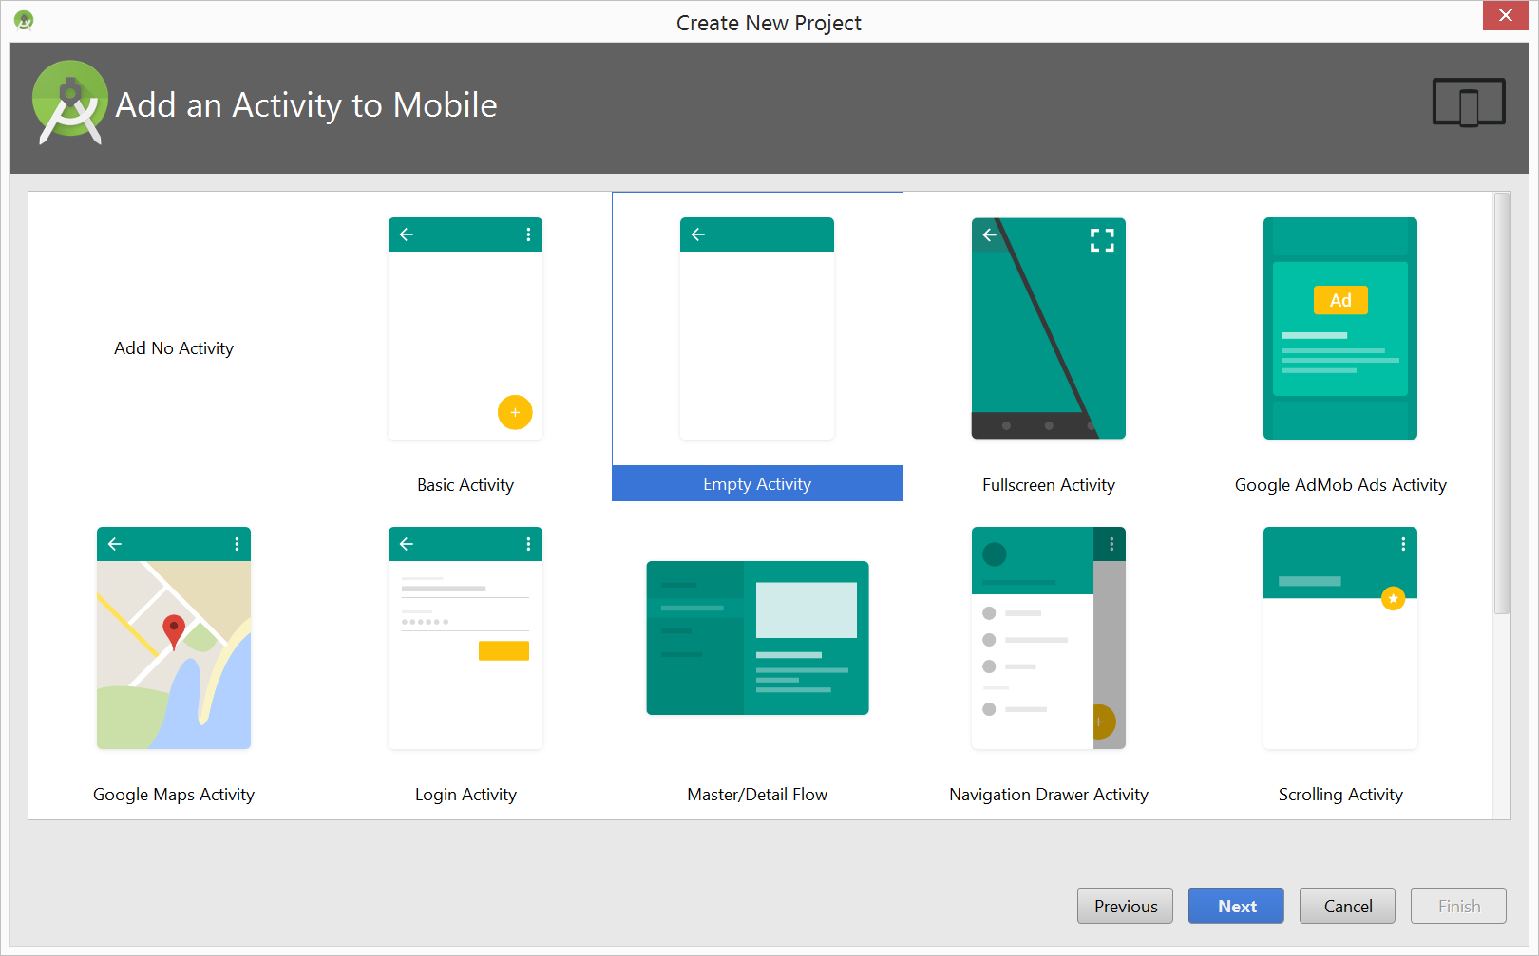
Hello World Android app
Build a basic app

Slide 15
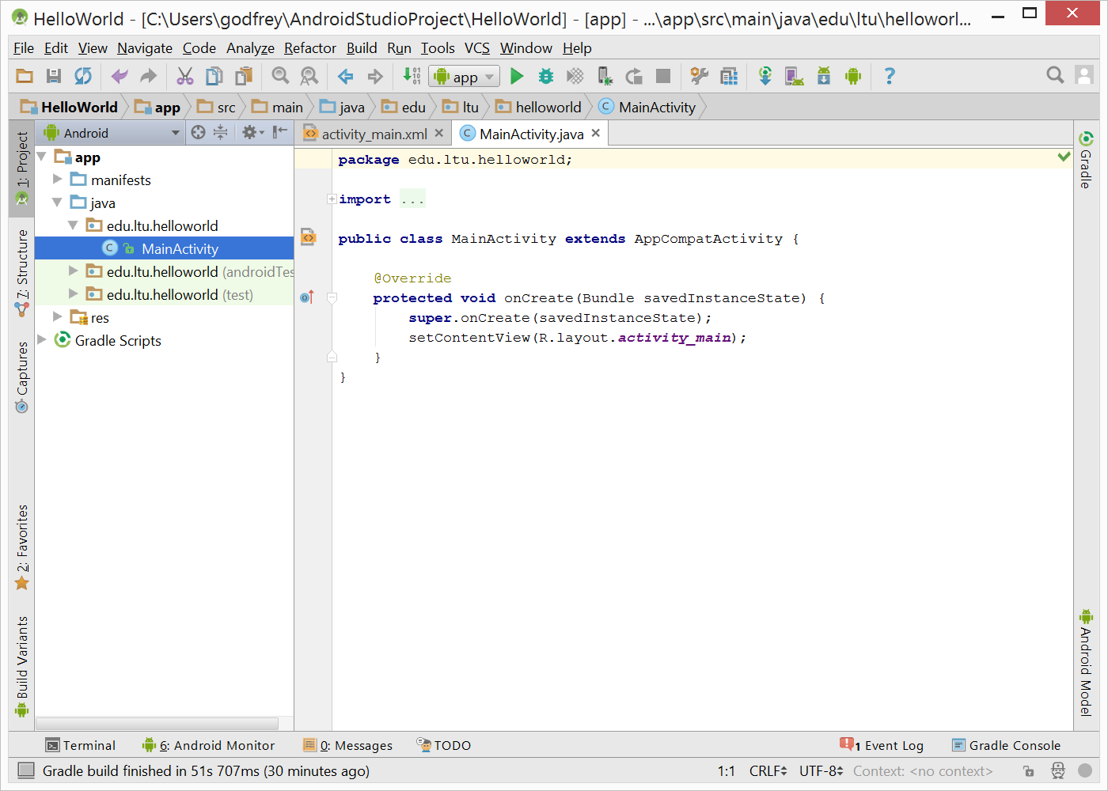
Hello World Android app
Build a basic app
Notes:
Show directory

Slide 16
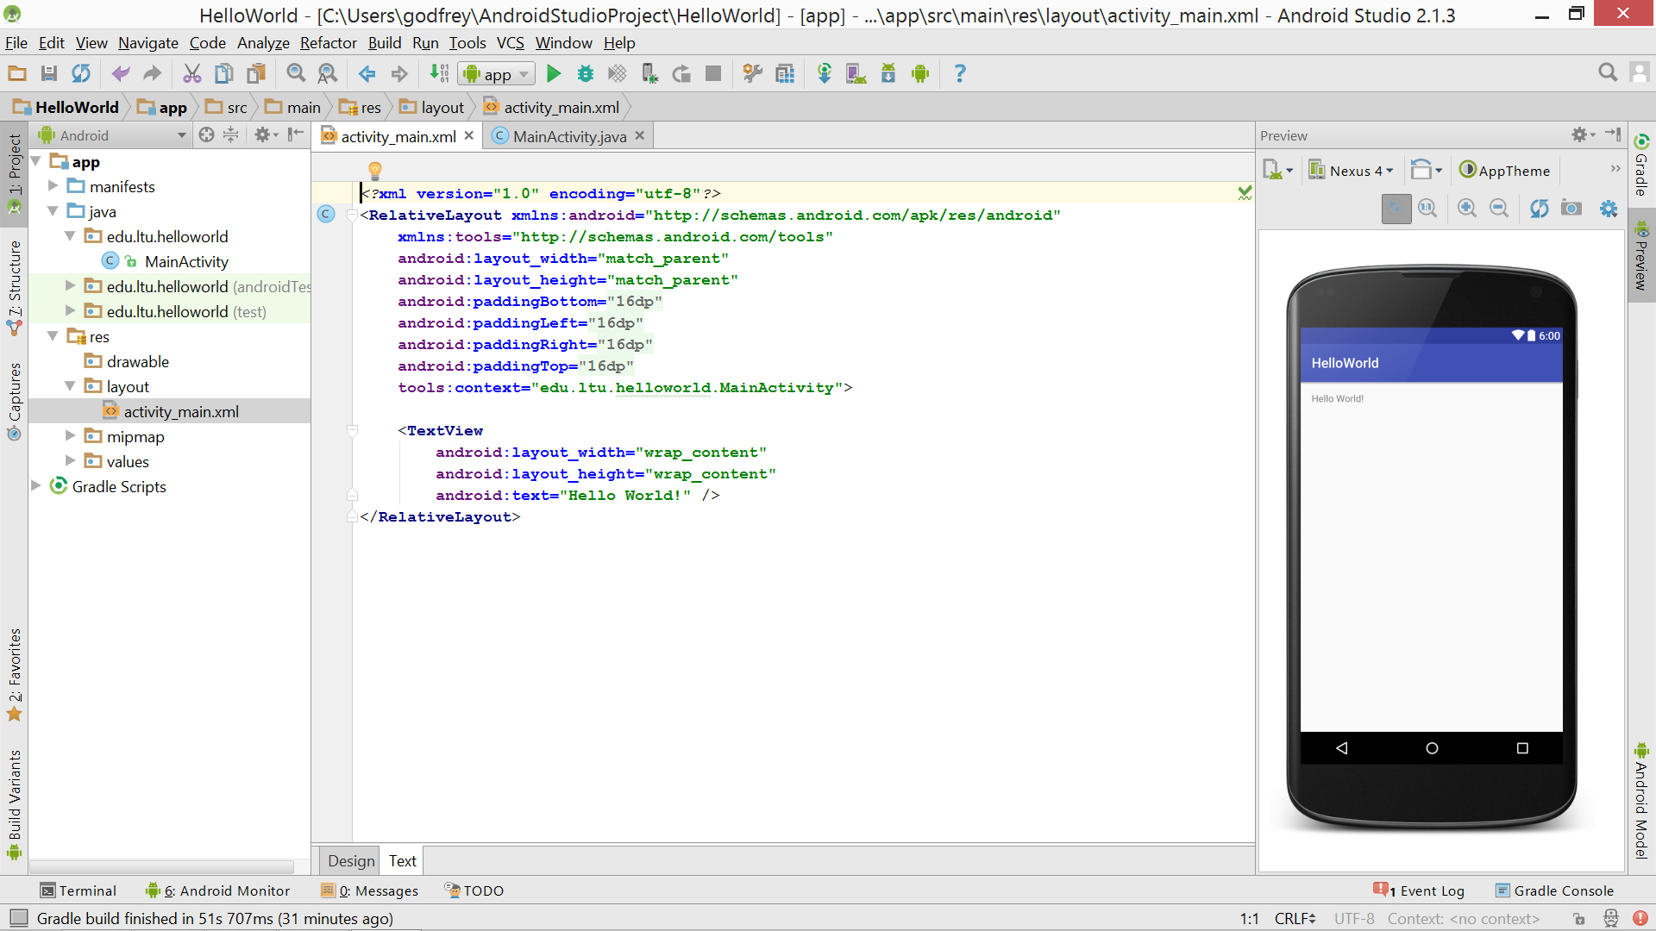
Hello World Android app
Build a basic app

Slide 17
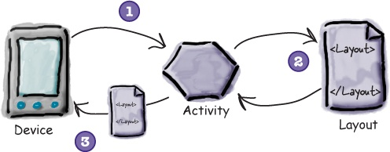
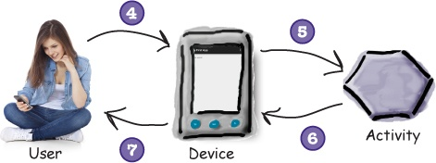
Layouts define how the user interface is presented.
Activities define actions.
The device launches your app and creates an activity object.
The activity object specifies a layout.
The activity tells Android to display the layout on screen.
The user interacts with the layout that’s displayed on the device.
The activity responds to these interactions by running application code.
The activity updates the display...
...which the user sees on the device.

Slide 18
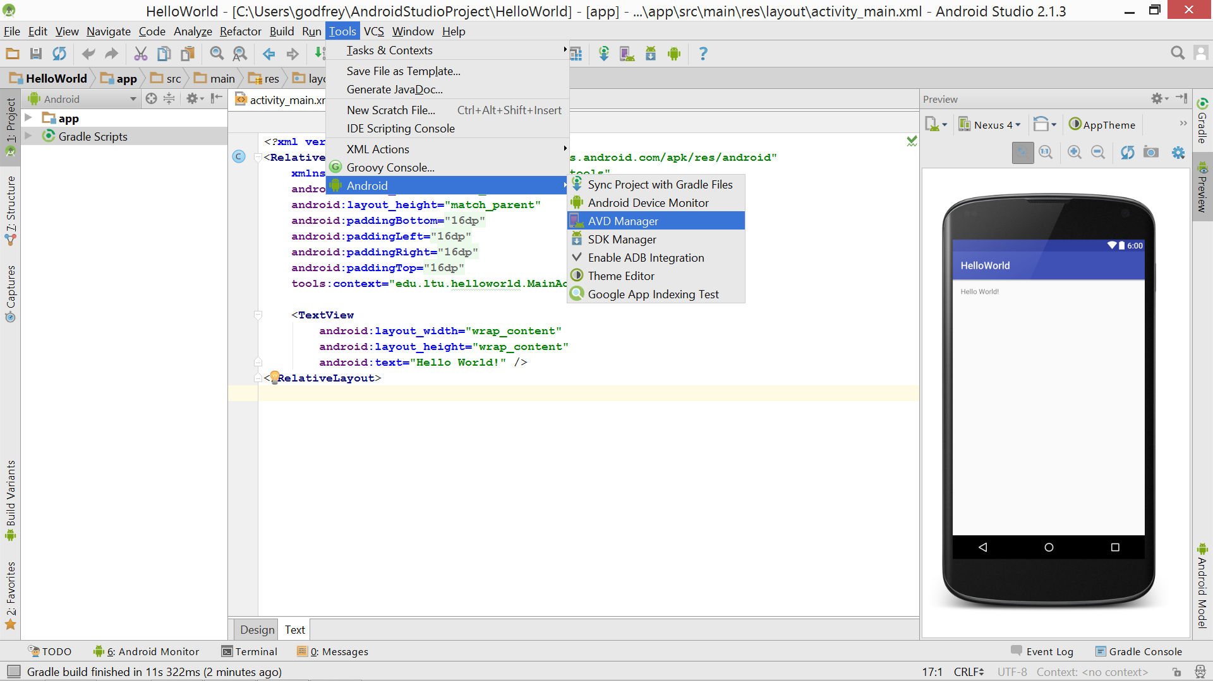
Hello World Android app
Run the app in the Android emulator

Slide 19
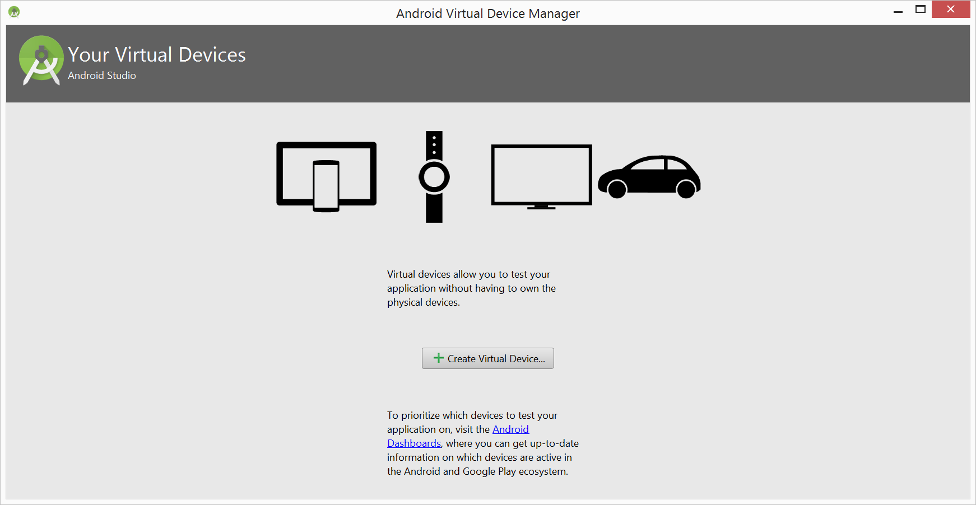
Hello World Android app
Run the app in the Android emulator

Slide 20
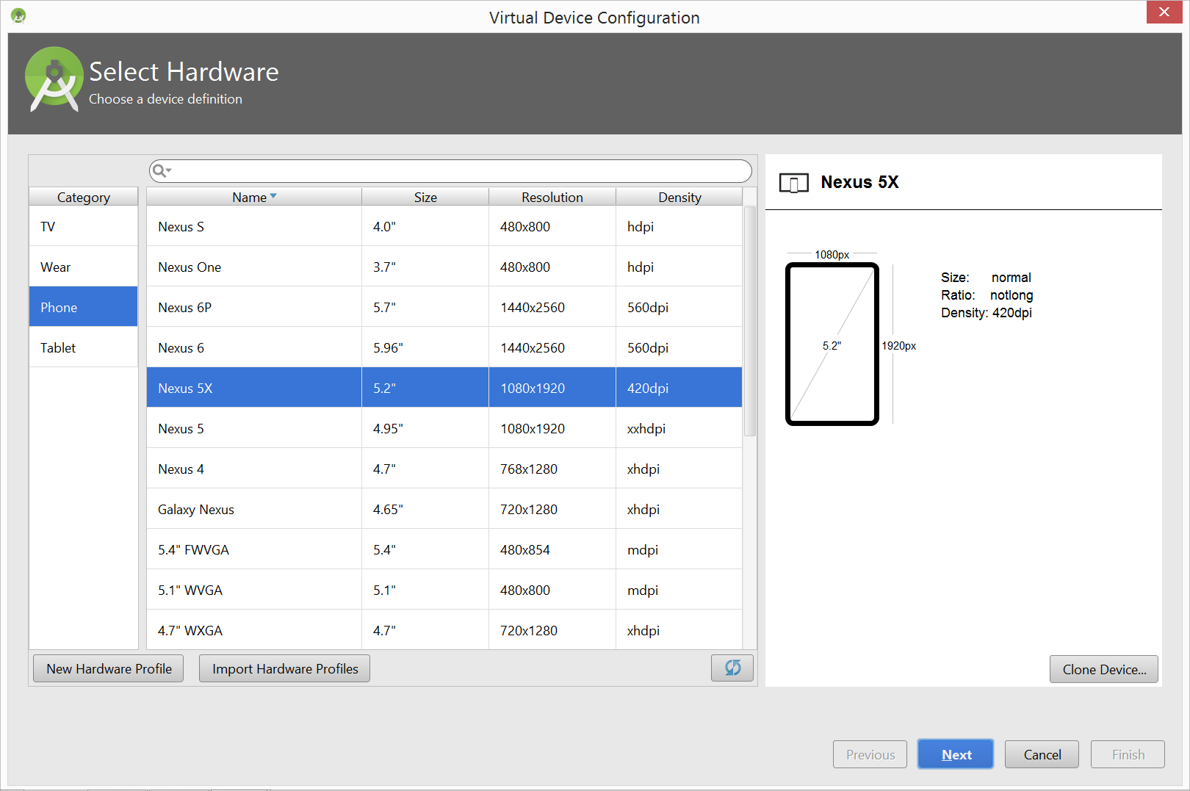
Hello World Android app
Run the app in the Android emulator

Slide 21
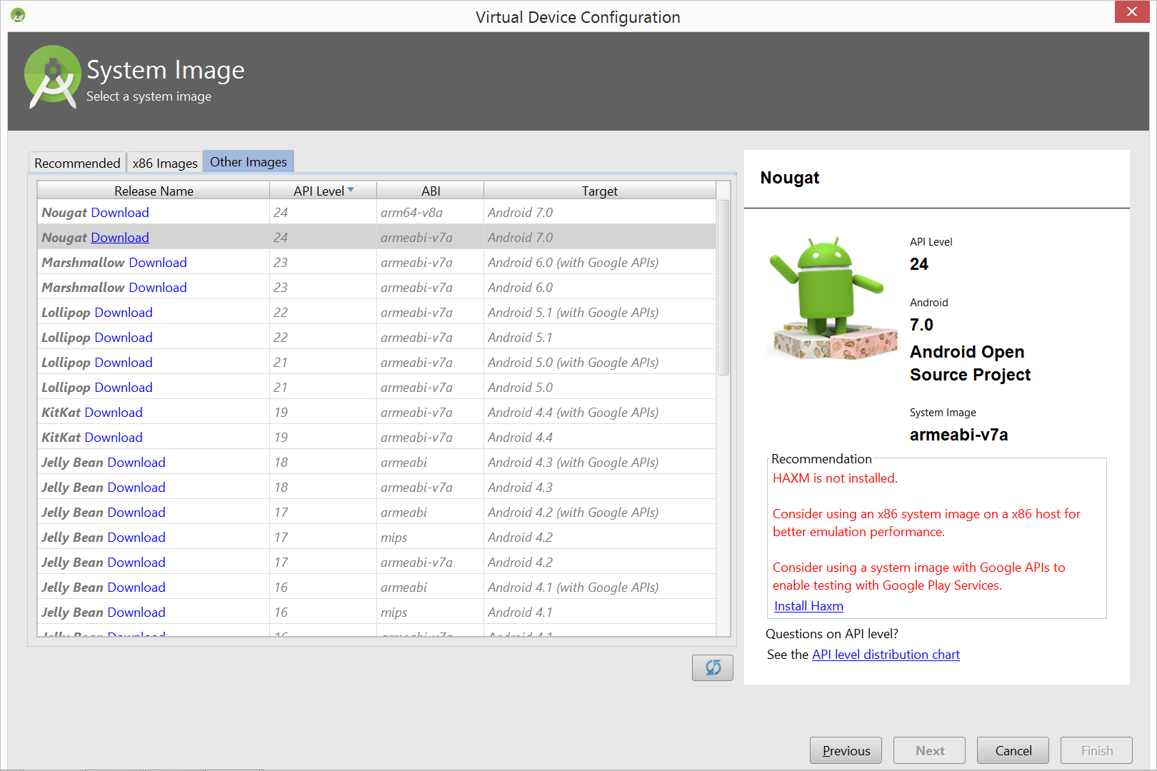
Hello World Android app
Run the app in the Android emulator

Slide 22
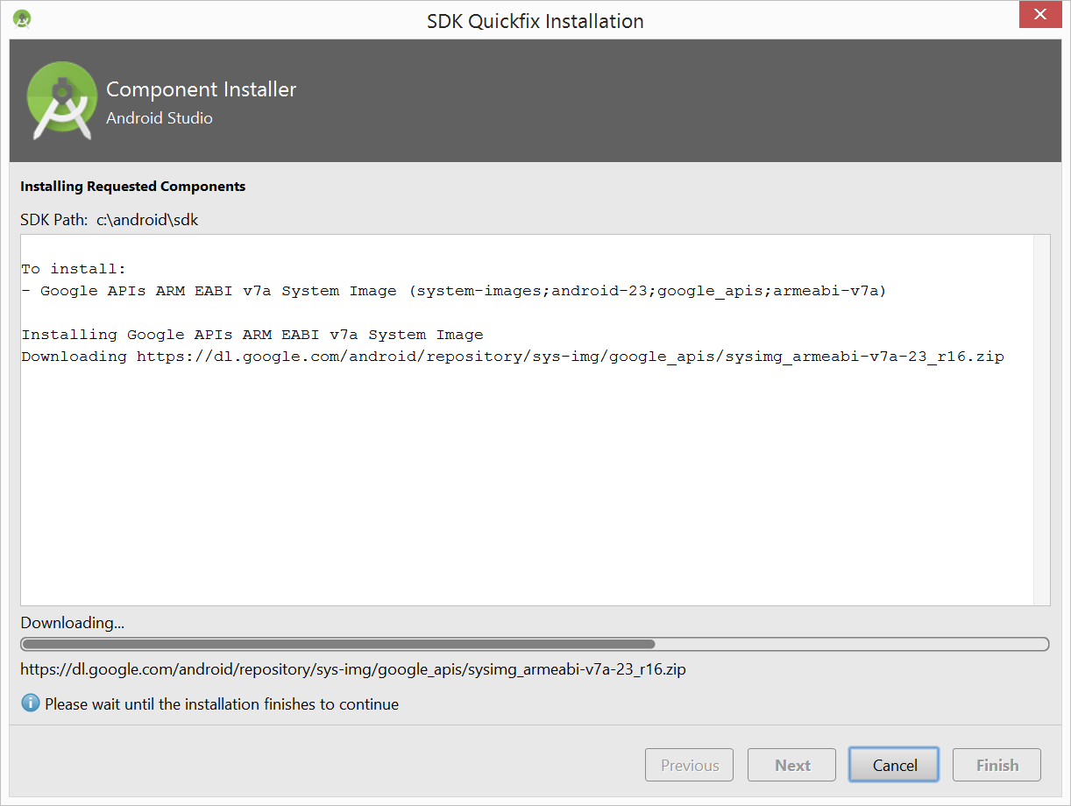
Hello World Android app
Run the app in the Android emulator

Slide 23
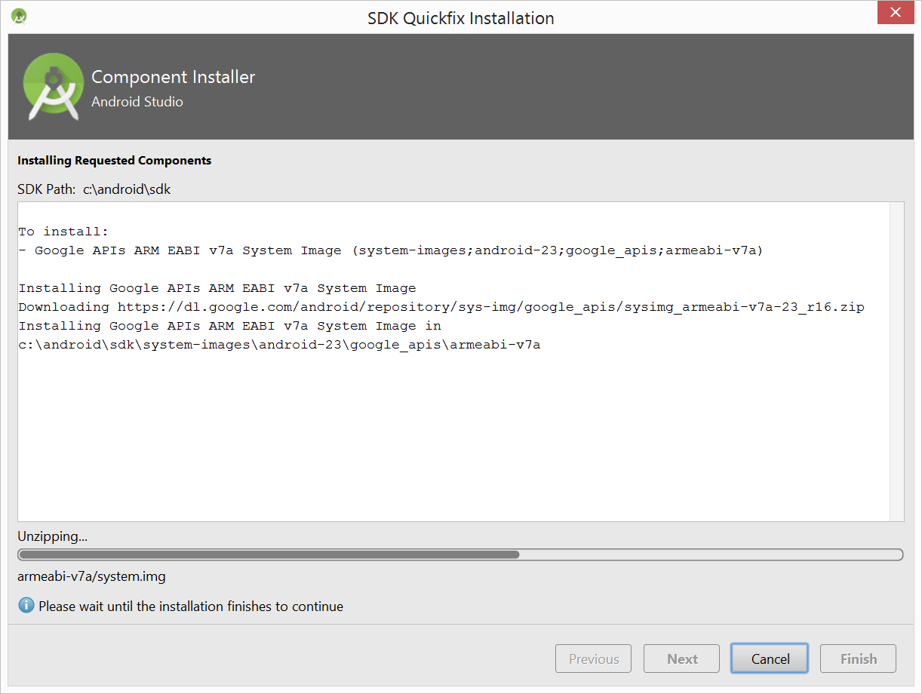
Hello World Android app
Run the app in the Android emulator

Slide 24
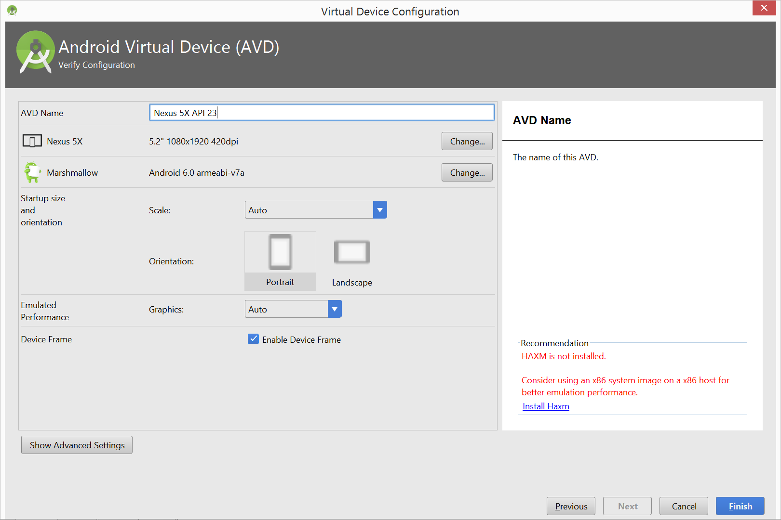
Hello World Android app
Run the app in the Android emulator

Slide 25
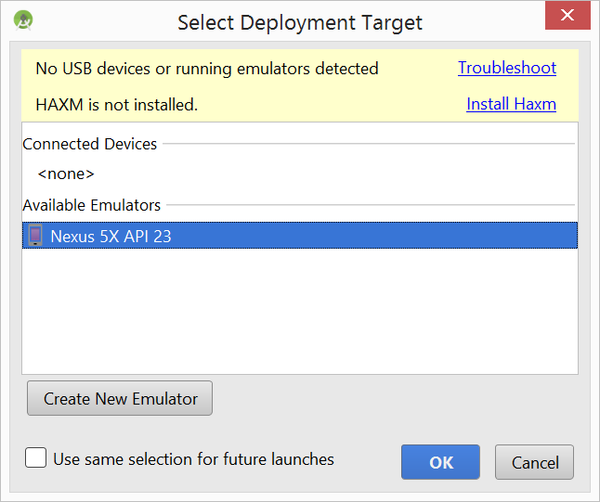
Hello World Android app
Run the app in the Android emulator
Run->Run ‘App’

Slide 26
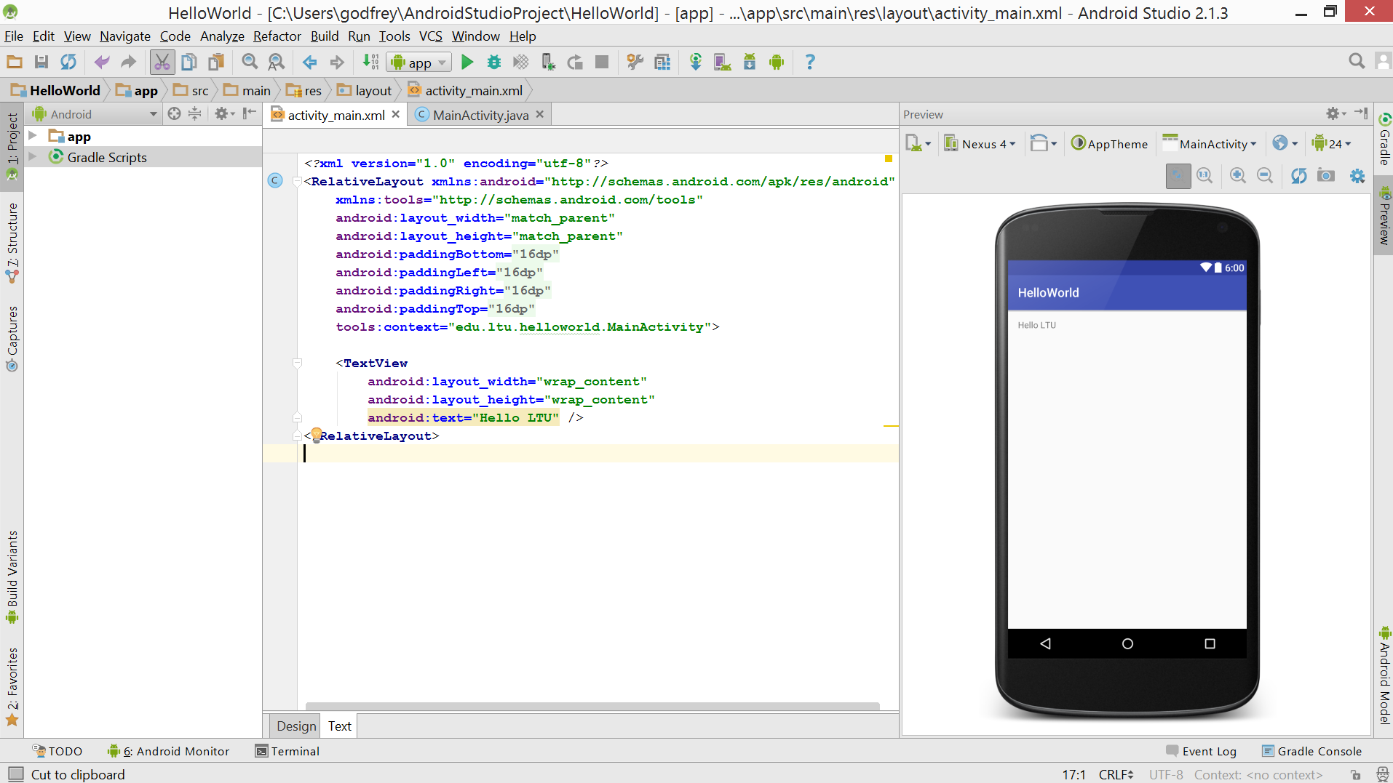
Hello World Android app
Change the text
Run->Run ‘App’

Slide 27
Reminder
Java test next class
Assignment for next Tuesday – create HelloWorld app / change text

Slide 28
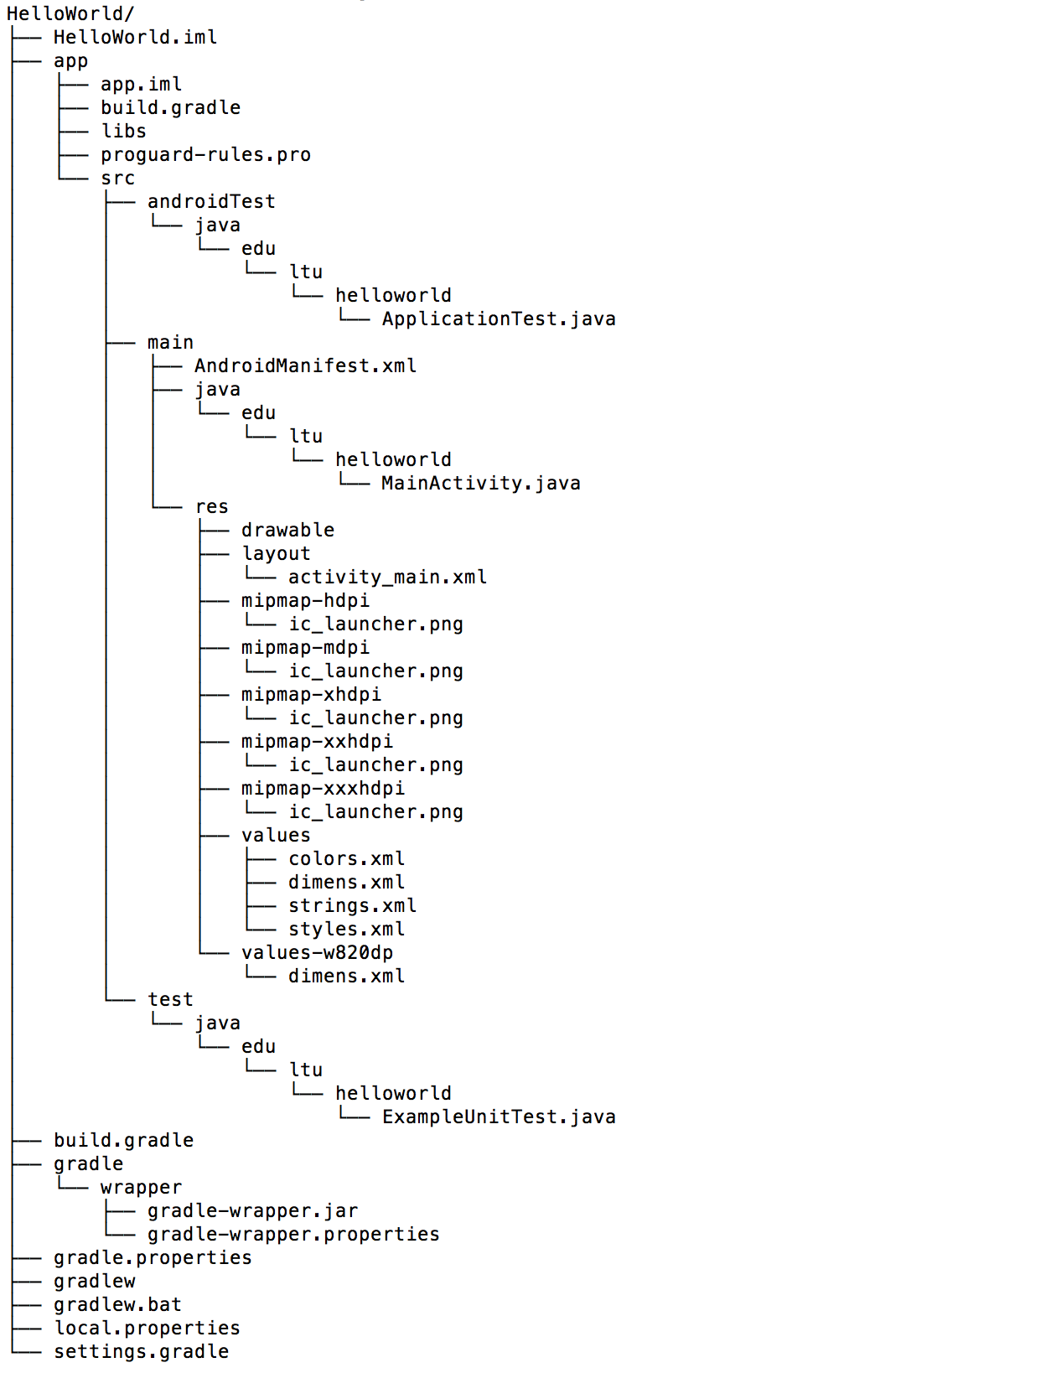
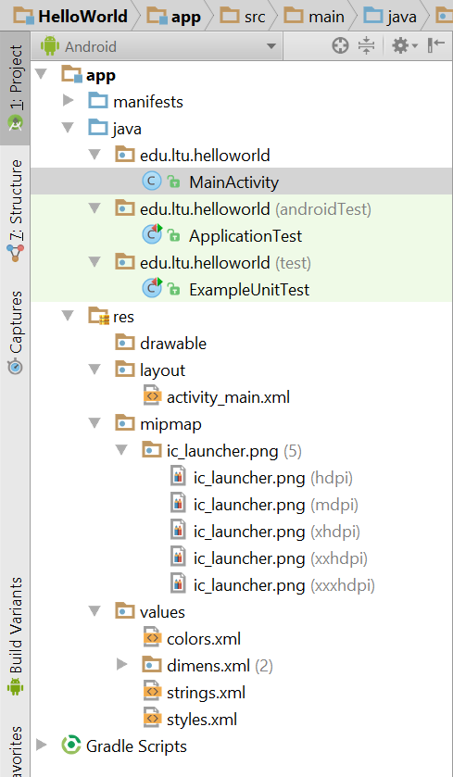
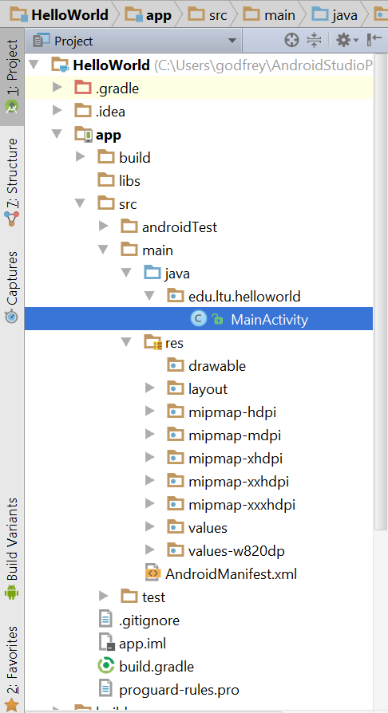
Project files

Slide 29
apply plugin: 'com.android.application'
android {
compileSdkVersion 24
buildToolsVersion "24.0.1"
defaultConfig {
applicationId "edu.ltu.helloworld"
minSdkVersion 15
targetSdkVersion 24
versionCode 1
versionName "1.0"
}
buildTypes {
release {
minifyEnabled false
proguardFiles getDefaultProguardFile('proguard-android.txt'), 'proguard-rules.pro'
}
}
}
dependencies {
compile fileTree(dir: 'libs', include: ['*.jar'])
testCompile 'junit:junit:4.12'
compile 'com.android.support:appcompat-v7:24.2.0'
}

Slide 30
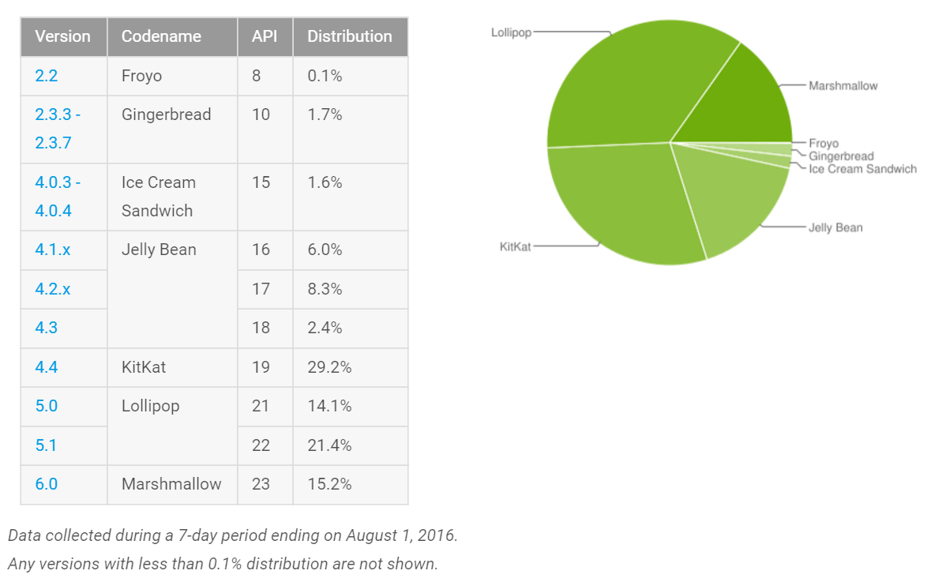

Slide 31
