Slide 1
Building Android apps – Week 12b
2843-201710_MCS4993_M:Topics in MA/CS
2843-201710_MCS5993_M:Topics in Computer Science

Slide 2
Agenda
Design Patterns
Unit Testing 101

Slide 3
What is Your Goal?
Scalable
Add new features quickly
Maintainable
No spaghetti code
Don’t cross the streams
Testable
Easy to unit test

Slide 4
Why?
Easier to add new features
Easier to understand
Easier to police
Make our life easier
Make Unit Testing easier

Slide 5
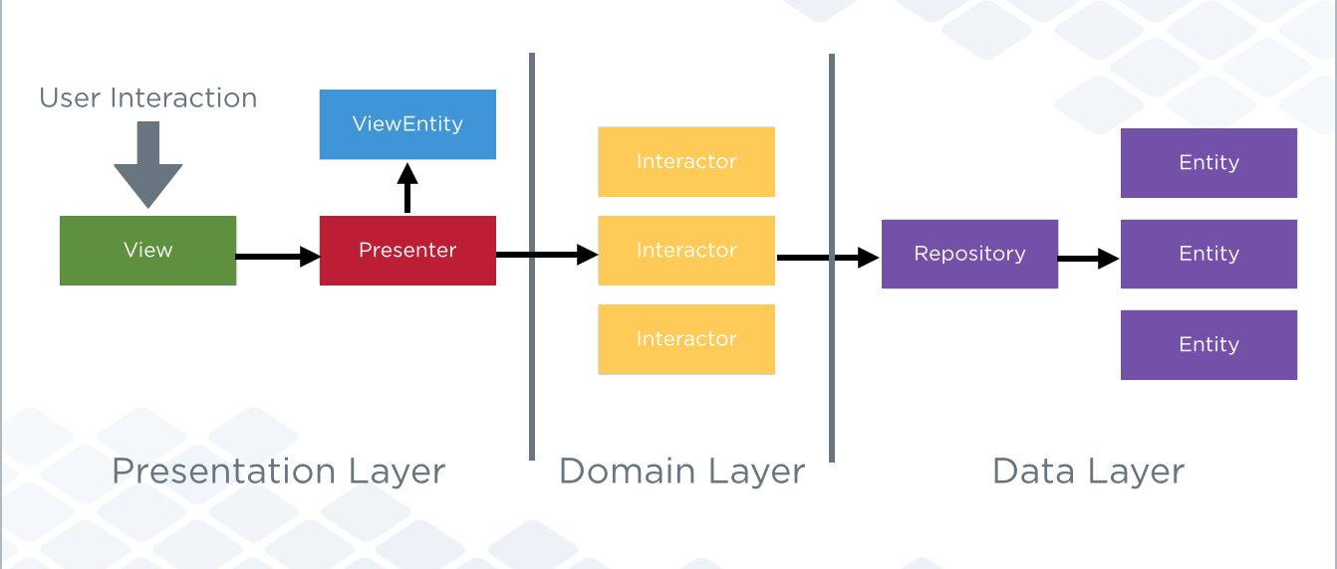
Clean
Notes:
Entities
Entities are business objects, functions or data structures, that are responsible for all the non application specific business rules.
So for example bank account
This means that if you have multiple applications that share the same domain (business) objects, the entities should not need to change in order to be usable by all of them.
Interactors or Use Cases
Interactors represent the layer for application specific business rules.
So for example transferring money, paying a bill etc.
So what happens if you want to add change add a new bank account to your app, do you need to rewrite everything
Or what if you want to add PayPal as a payment option?

Slide 6
Clean
Independent of Frameworks
Testable
Independent of UI
Independent of Database
Independent of any External Agency
Decoupled

Slide 7
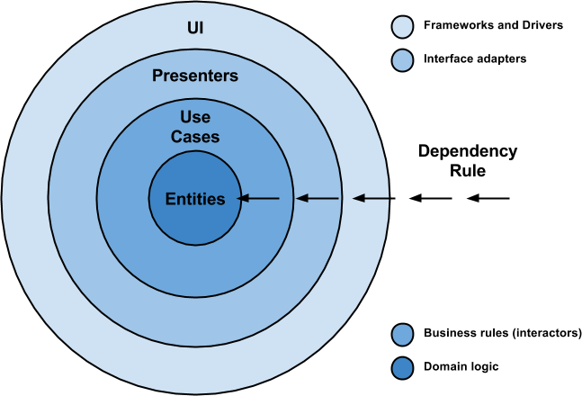
Notes:
Here is some vocabulary that is relevant for getting familiar and understanding this approach in a better way:
Entities: These are the business objects of the application.
Use Cases: These use cases orchestrate the flow of data to and from the entities. Are also called Interactors.
Interface Adapters: This set of adapters convert data from the format most convenient for the use cases and entities. Presenters and Controllers belong here.
Frameworks and Drivers: This is where all the details go: UI, tools, frameworks, etc.

Slide 8
Dependency Rule
“source code dependencies can only point inwards and nothing in an inner circle can know anything at all about something in an outer circle.”

Slide 9
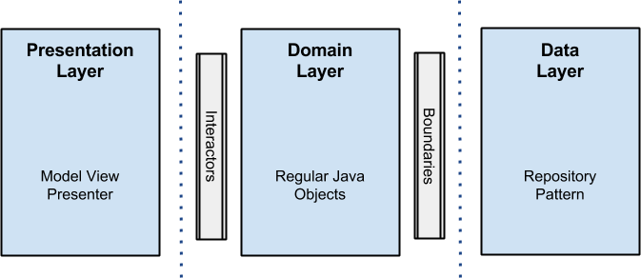
Notes:
The objective is the separation of concerns by keeping the business rules not knowing anything at all about the outside world, thus, they can can be tested without any dependency to any external element.
To achieve this, my proposal is about breaking up the project into 3 different layers, in which each one has its own purpose and works separately from the others.

Slide 10
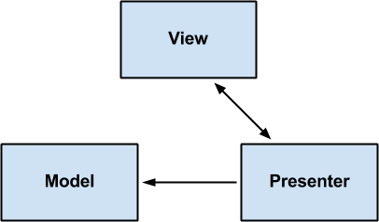
Presentation Layer
Notes:
Is here, where the logic related with views and animations happens. It uses no more than aModel View Presenter (MVP from now on), but you can use any other pattern like MVC or MVVM. I will not get into details on it, but here fragments and activities are only views, there is no logic inside them other than UI logic, and this is where all the rendering stuff takes place. Presenters in this layer are composed with interactors (use cases) that perform the job in a new thread outside the android UI thread, and come back using a callback with the data that will be rendered in the view.

Slide 11
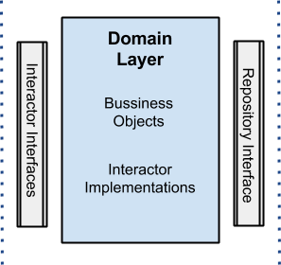
Domain Layer
Notes:
Business rules here: all the logic happens in this layer. Regarding the android project, you will see all the interactors (use cases) implementations here as well. This layer is a pure java module without any android dependencies. All the external components use interfaces when connecting to the business objects.

Slide 12
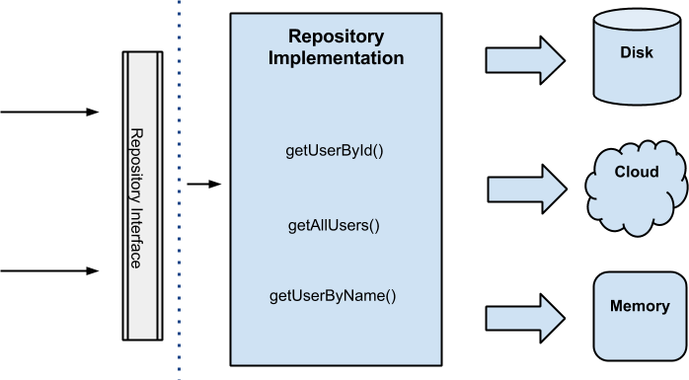
Data Layer
Notes:
All data needed for the application comes from this layer through a UserRepository implementation (the interface is in the domain layer) that uses a Repository Pattern with a strategy that, through a factory, picks different data sources depending on certain conditions. For instance, when getting a user by id, the disk cache data source will be selected if the user already exists in cache, otherwise the cloud will be queried to retrieve the data and later save it to the disk cache. The idea behind all this is that the data origin is transparent for the client, which does not care if the data is coming from memory, disk or the cloud, the only truth is that the data will arrive and will be got.

Slide 13
Simple Example
“Greet the user with a message when the app starts where that message is stored in the database.”
the presentation package
the storage package
the domain package
Notes:
https://medium.com/@dmilicic/a-detailed-guide-on-developing-android-apps-using-the-clean-architecture-pattern-d38d71e94029#.cvw2vjcr2

Slide 14
Summary of calls
MainActivity
->MainPresenter
-> WelcomingInteractor
-> WelcomeMessageRepository
-> WelcomingInteractor
-> MainPresenter
-> MainActivity

Slide 15
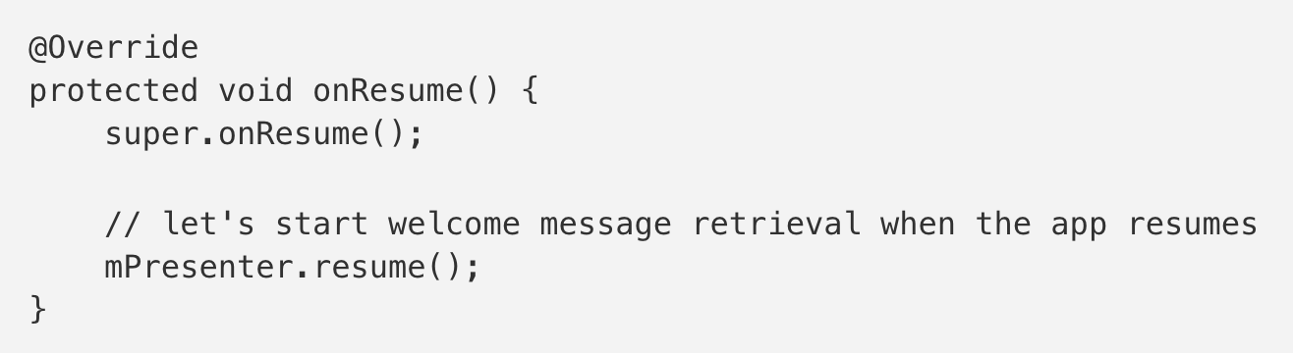
MainActivity
Notes:
So how and where do we start the Interactor when an app resumes? Everything that is not strictly view related should go into the Presenter class. This helps achieve separation of concerns and prevents the Activity classes from getting bloated. This includes all code working with Interactors.
In our MainActivity class we override the onResume() method:
All Presenter objects implement the resume() method when they extendBasePresenter.

Slide 16
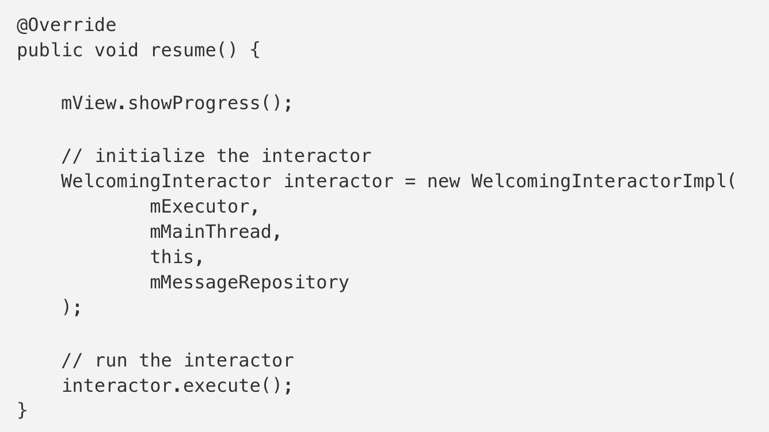
MainPresenter
Notes:
We start the Interactor inside the MainPresenter class in the resume()method:
The execute() method will just execute the run() method of theWelcomingInteractorImpl in a background thread.
The run() method can be seen in the Writing a new Interactor section.

Slide 17
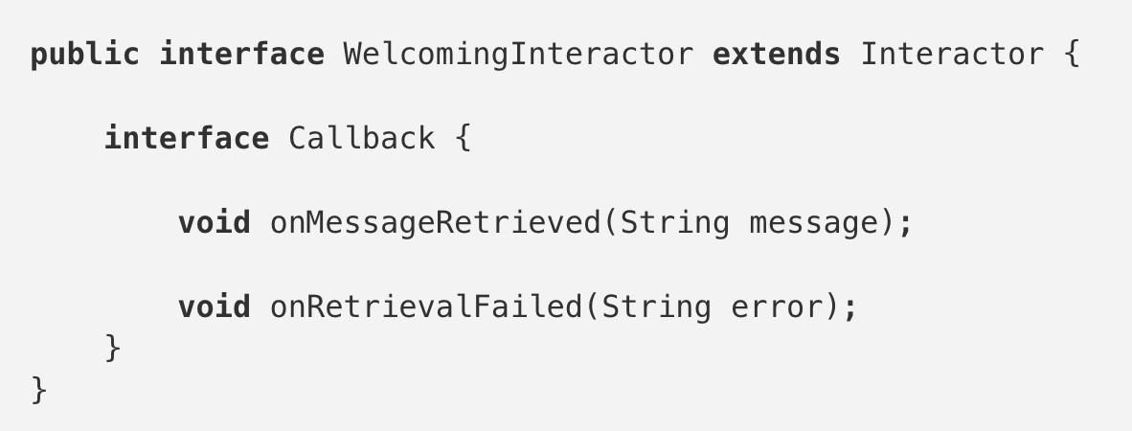
Writing a new Interactor
Notes:
All Interactors are run in the background thread so there shouldn’t be any impact on UI performance.
Let’s create a new Interactor with a warm name of WelcomingInteractor.
The Callback is responsible for talking to the UI on the main thread, we put it into this Interactor’s interface so we don’t have to name it a WelcomingInteractorCallback — to distinguish it from other callbacks.

Slide 18
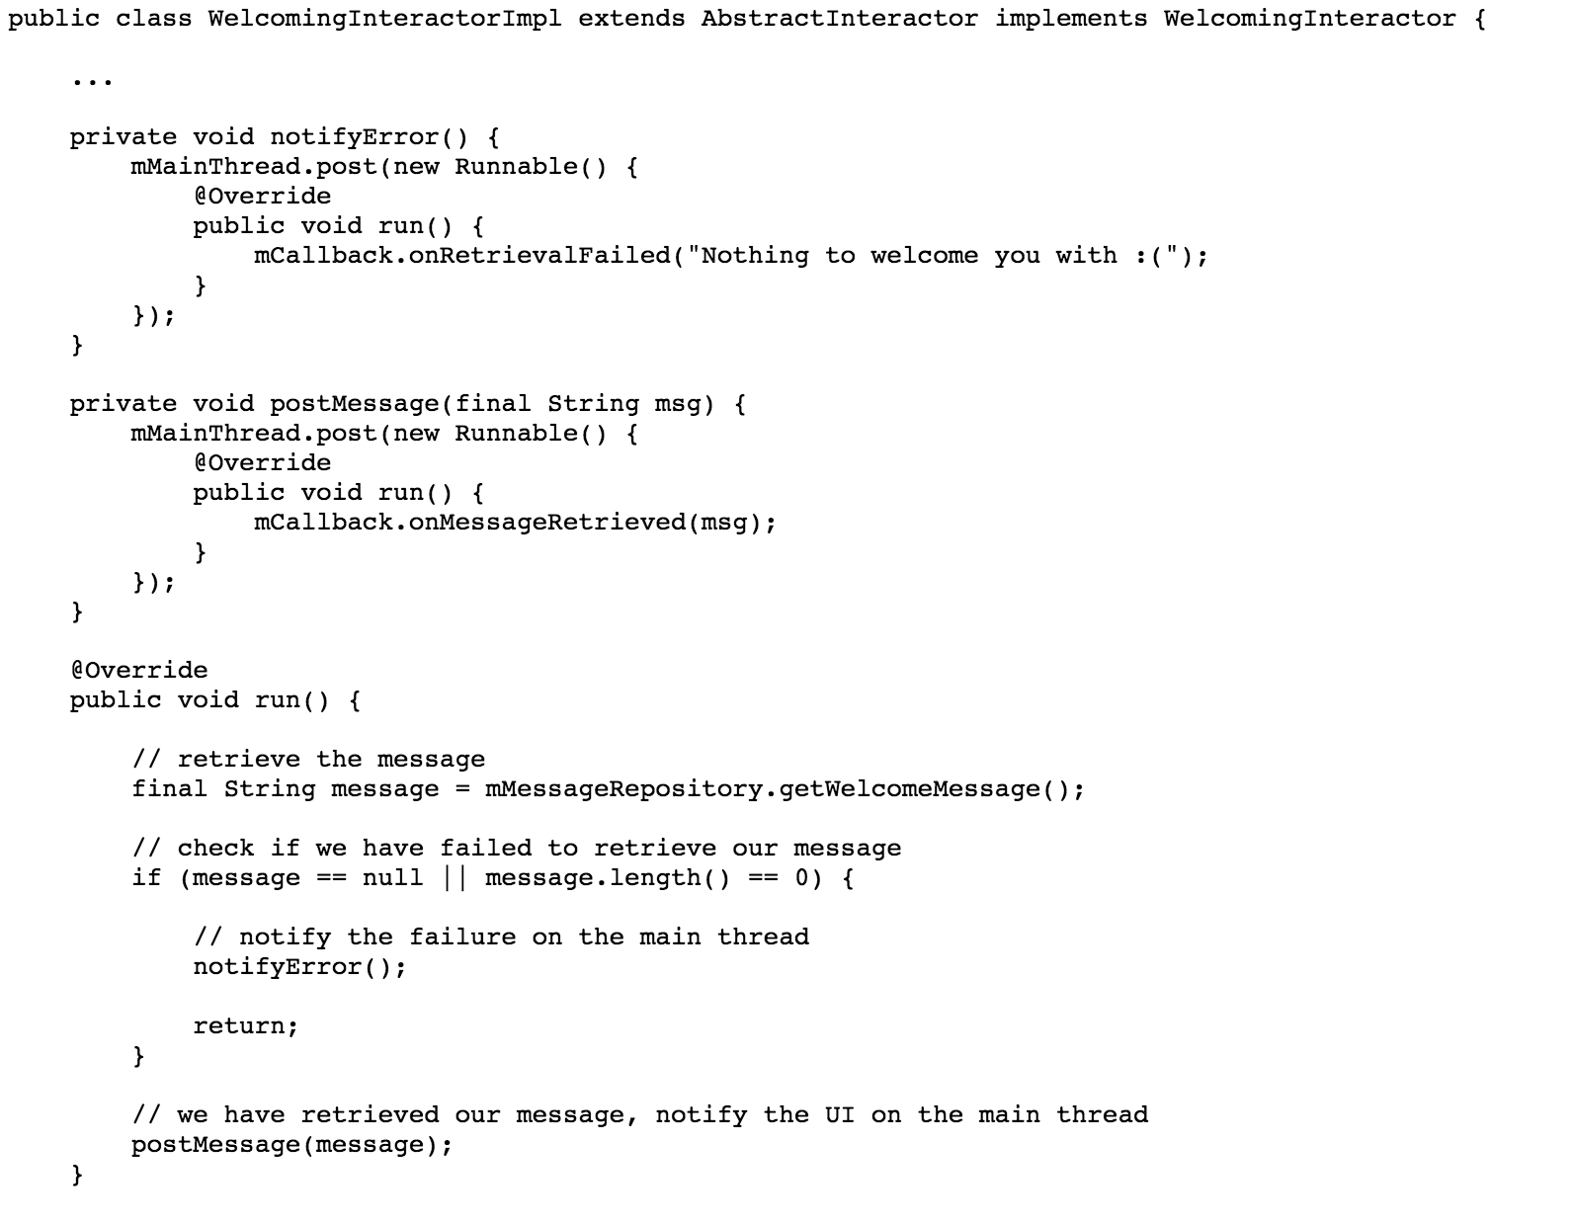
Notes:
Here’s the implementation of the code.
This just attempts to retrieve the message and sends the message or the error to the UI to display it. We notify the UI using our Callback which is actually going to be our Presenter. That is the crux of our business logic. Everything else we need to do is framework dependent.

Slide 19
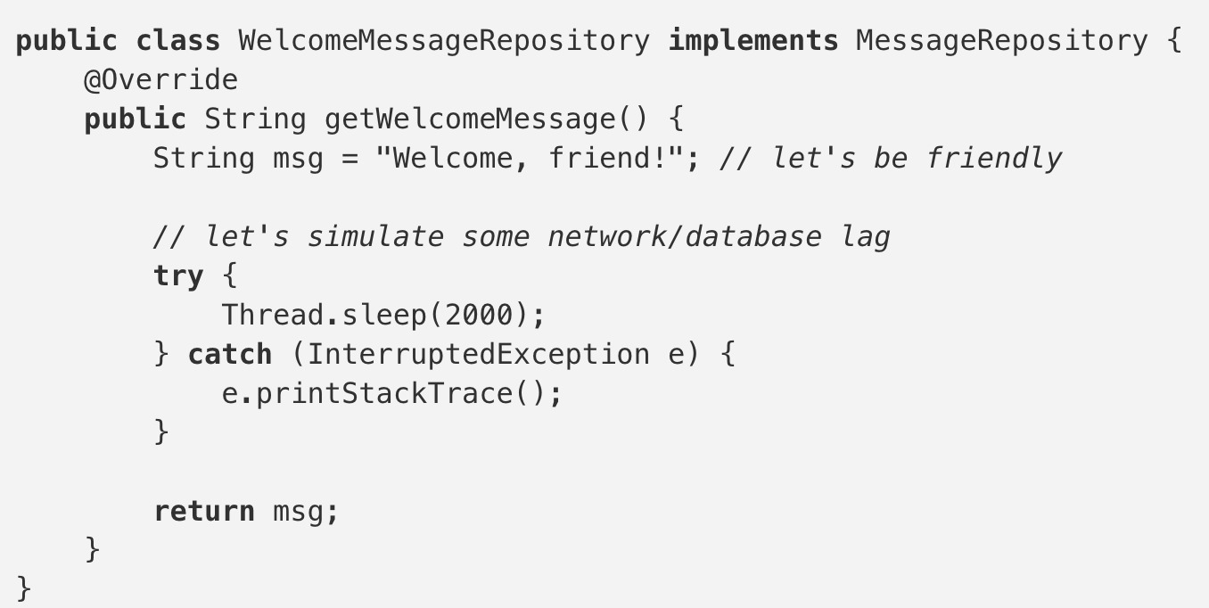
Storage

Slide 20
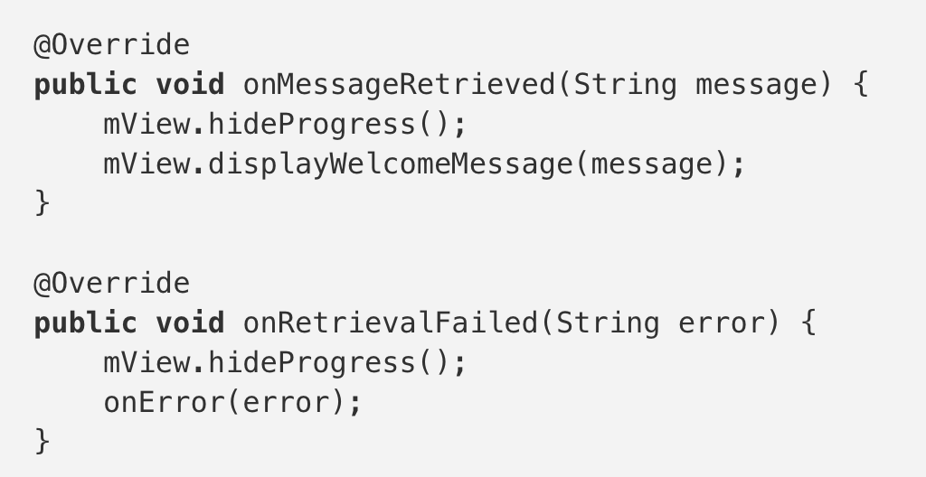
MainPresenter
Notes:
Presentation code belongs to the outer layer in Clean. It consists of framework dependent code to display the UI to the user. We will use theMainActivity class to display the welcome message to the user when the app resumes.
Let’s start by writing the interface of our Presenter and View. The only thing our view needs to do is to display the welcome message:

Slide 21
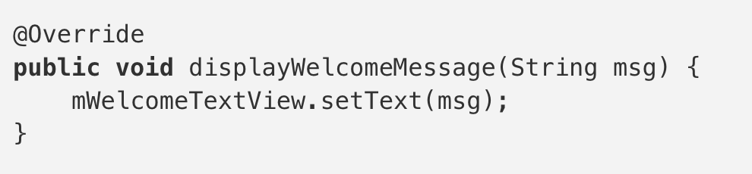
MainActivity

Slide 22
Summary of calls
MainActivity
->MainPresenter
-> WelcomingInteractor
-> WelcomeMessageRepository
-> WelcomingInteractor
-> MainPresenter
-> MainActivity

Slide 23
Summary of calls
Outer — Mid — Core — Outer — Core — Mid — Outer

Slide 24
Unit Testing 101
Hello World
Benefits
Android Testing Pyramid
Up and Running

Slide 25
Unit Testing 101
Catch more mistakes
Confidently make more changes
Built in regression testing
Extend the life of your codebase

Slide 26
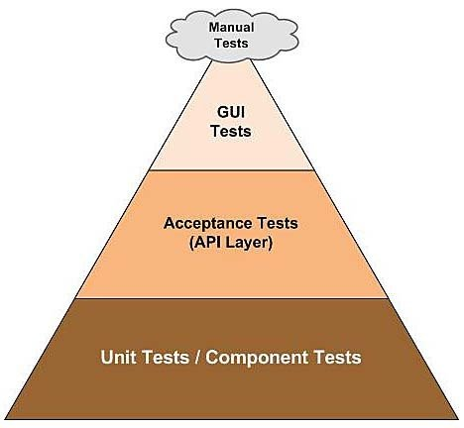

Slide 27
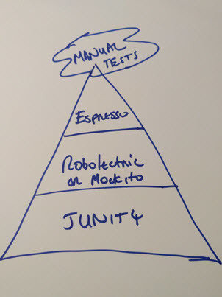

Slide 28
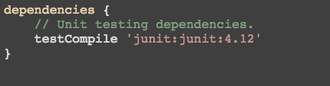

Slide 29
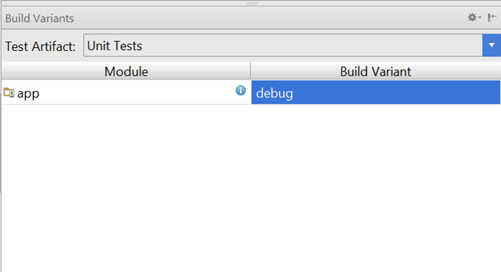

Slide 30
Unit Testing 101
Command line
Setup and Teardown
Grouping
Parameters
Assertions
Code Coverage

Slide 31
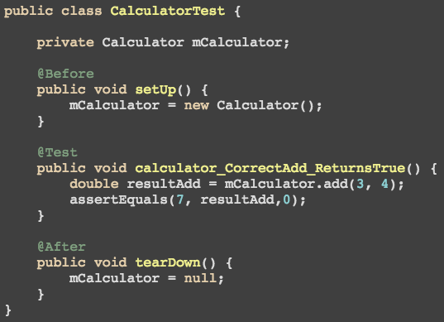

Slide 32
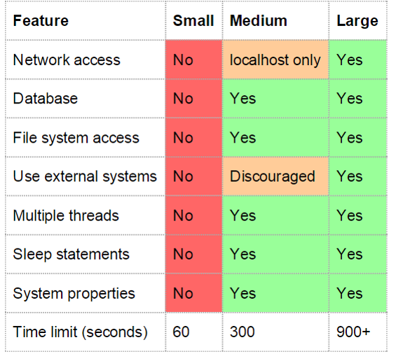
Notes:
Keep it small where ever possible

Slide 33
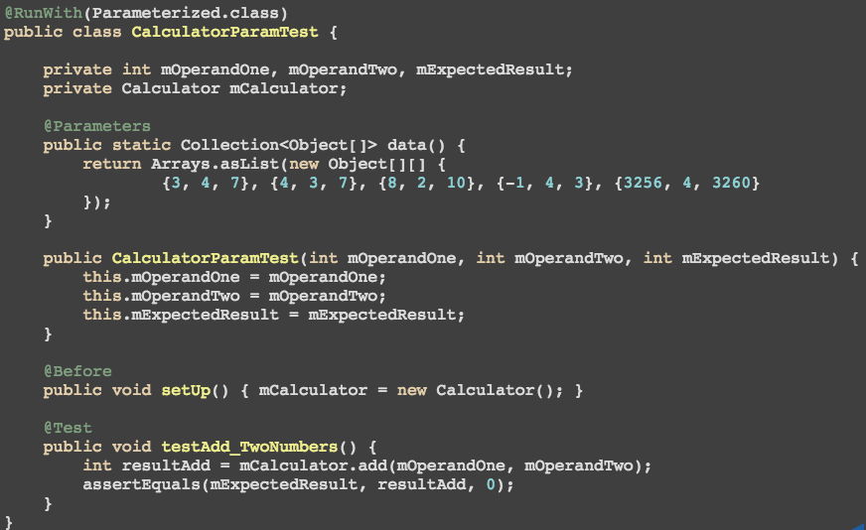
Notes:
Keep it small where ever possible

Slide 34
Assertions
assertEquals
assertTrue
assertFalse
assertNull
assertNotNull
assertSame
assertNotSame
assertThat
fail

Slide 35
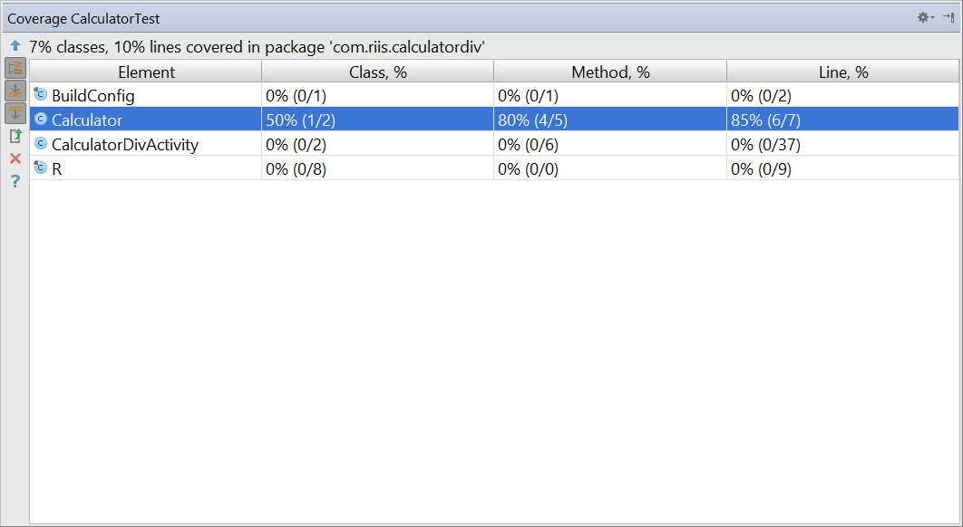

Slide 36
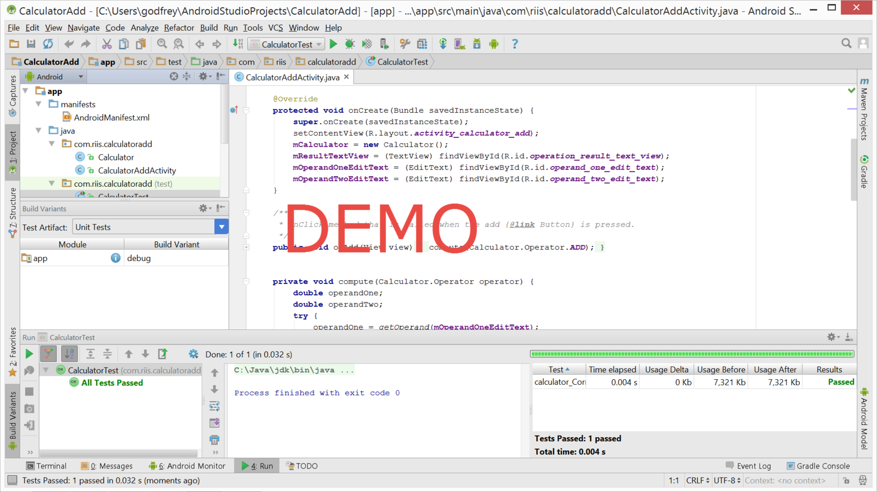
Notes:
https://github.com/godfreynolan/AgileAndroid

Slide 37
Tuesday
Unit Testing 201
Hamcrest
Mockito
Robolectric
Jenkins

