Slide 1
Building Android apps – Week 13b
2843-201710_MCS4993_M:Topics in MA/CS
2843-201710_MCS5993_M:Topics in Computer Science

Slide 2
Agenda
Chap3: Tools of the trade
Chap4: Mocking cont’d

Slide 3
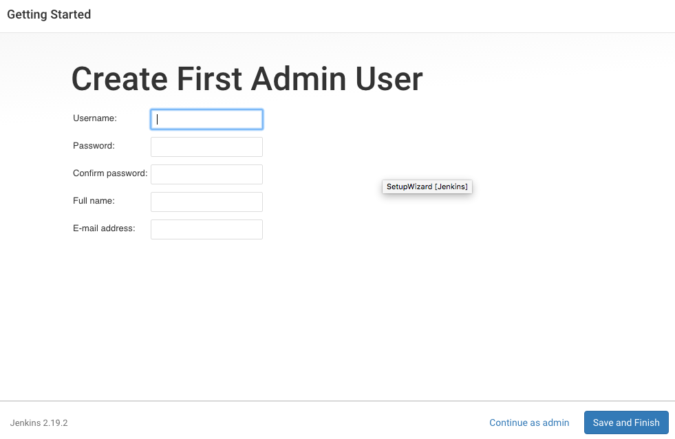
Jenkins

Slide 4
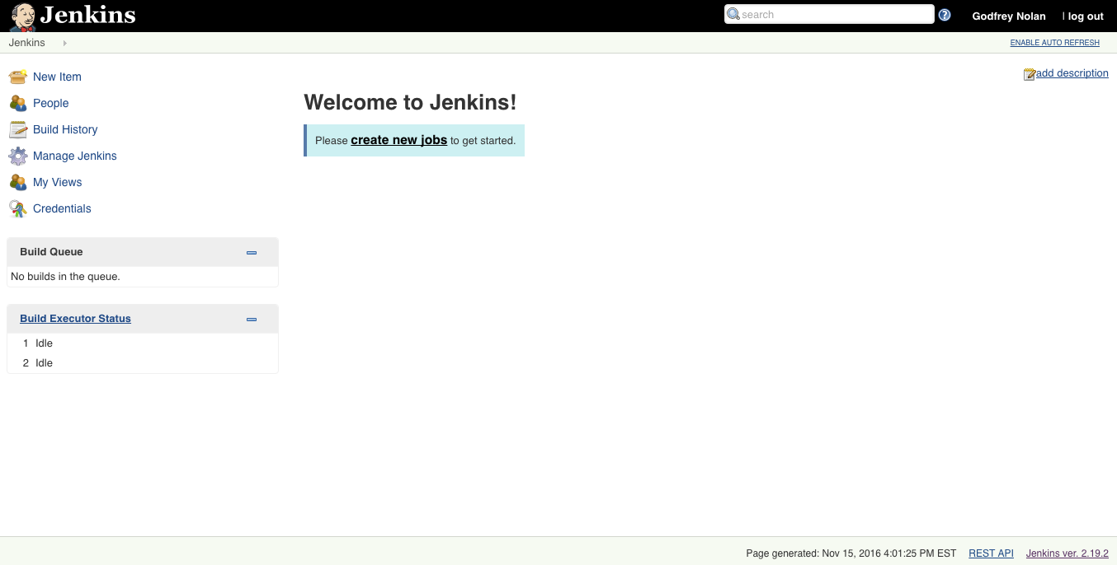
Jenkins

Slide 5
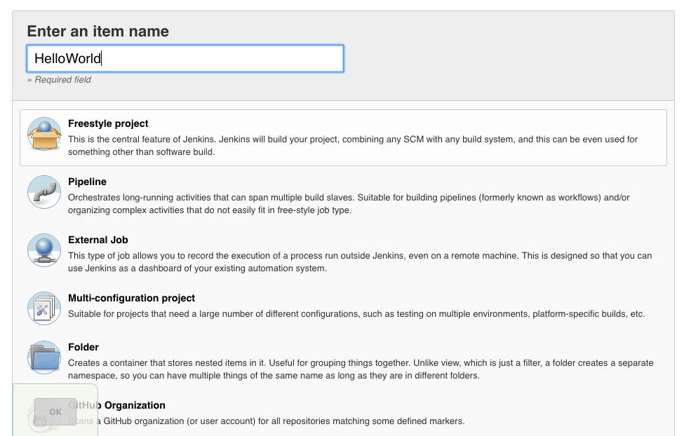
Jenkins

Slide 6
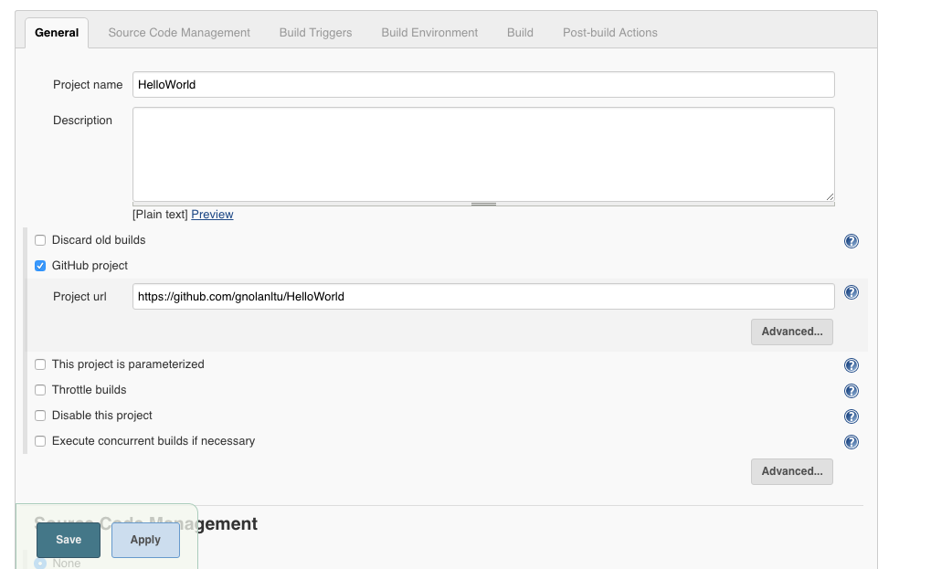
Jenkins

Slide 7
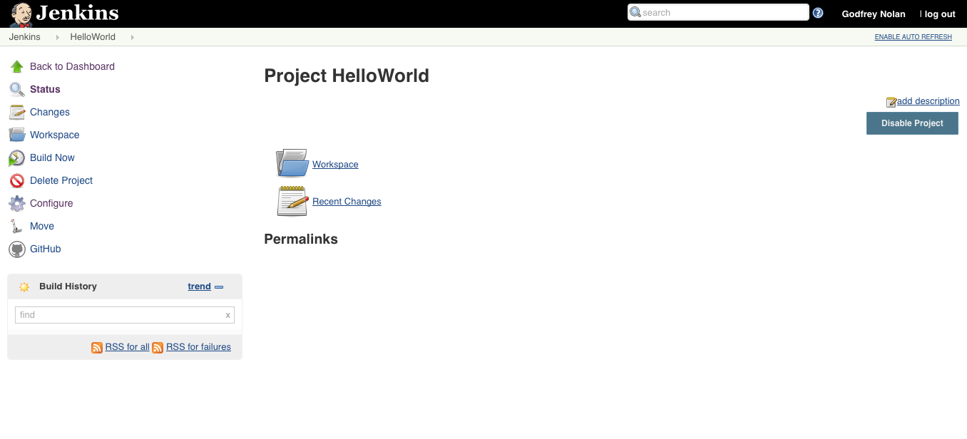
Jenkins

Slide 8
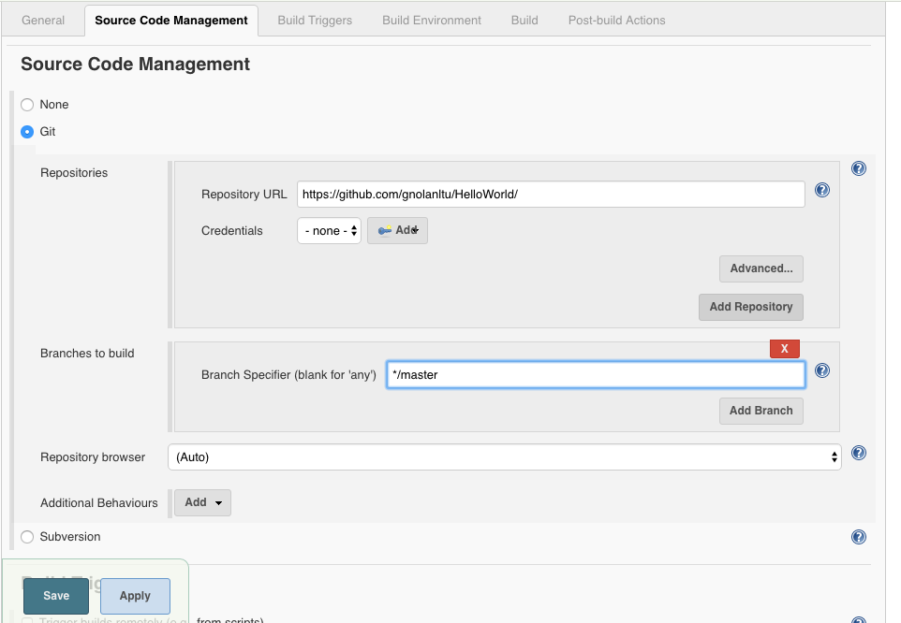
Jenkins
Notes:
Create a file in the root directory of your project called "local.properties"
Put only the following in the file: sdk.dir=/home/patience/android-studio/sdk

Slide 9
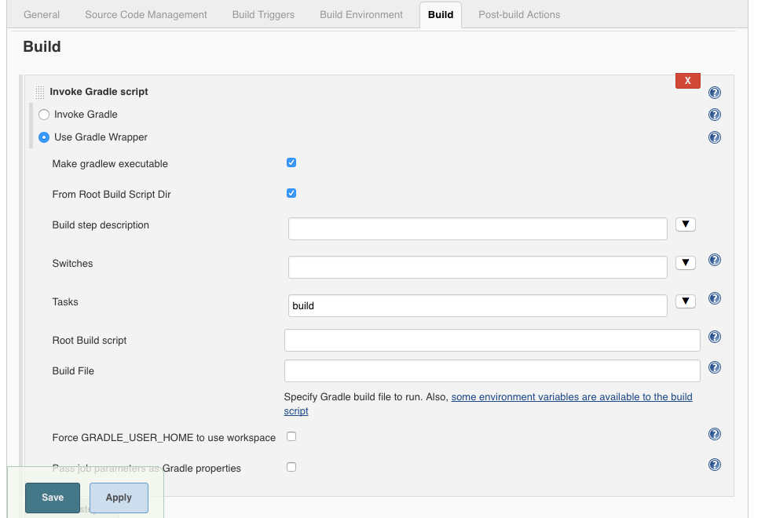
Jenkins
Notes:
Get it to run from your command line first

Slide 10
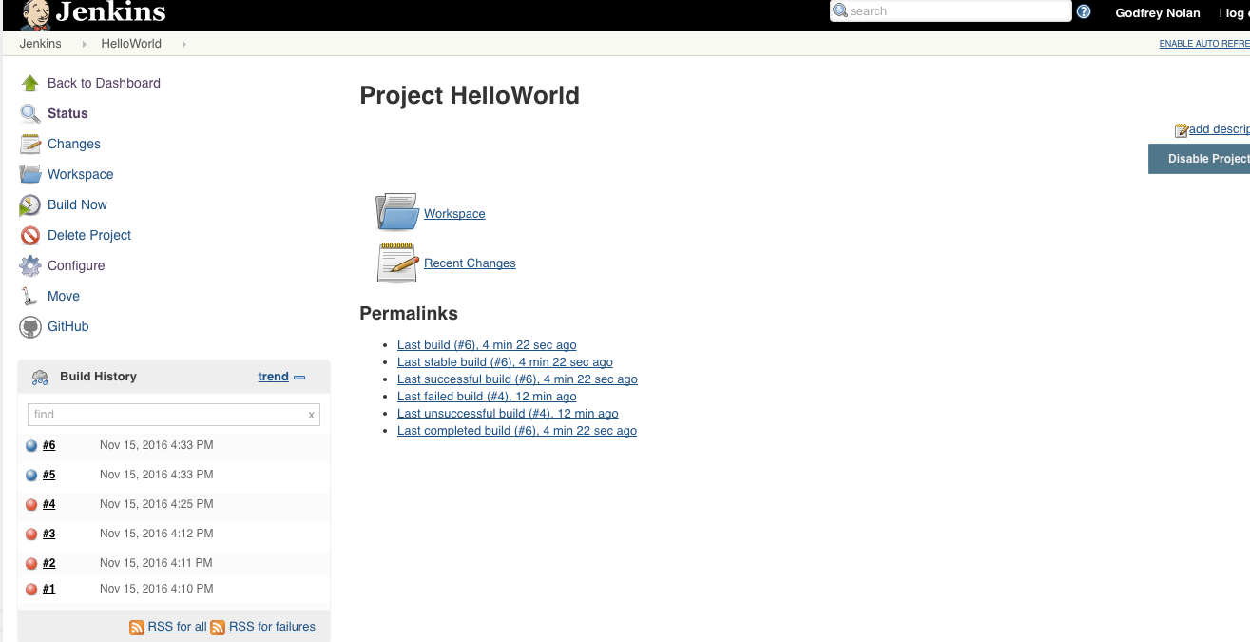
Jenkins

Slide 11
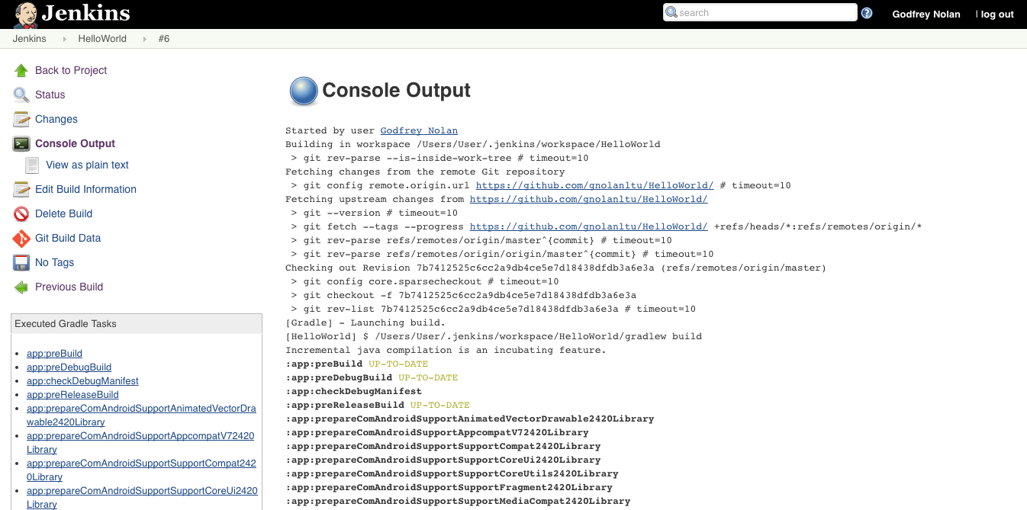
Jenkins

Slide 12
Mocking
Shared preferences
Settings
SQLite databases
Notes:
Already did web services so we’re good with any network traffic.

Slide 13
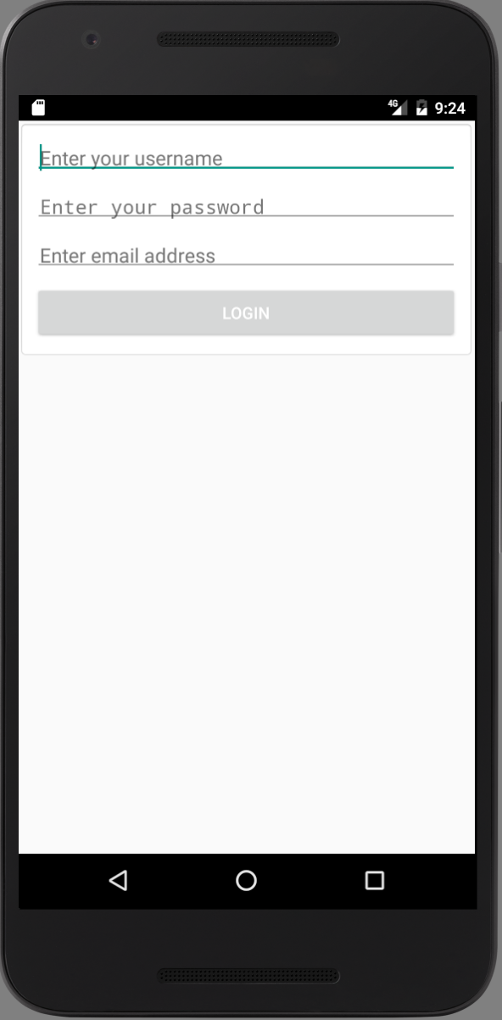
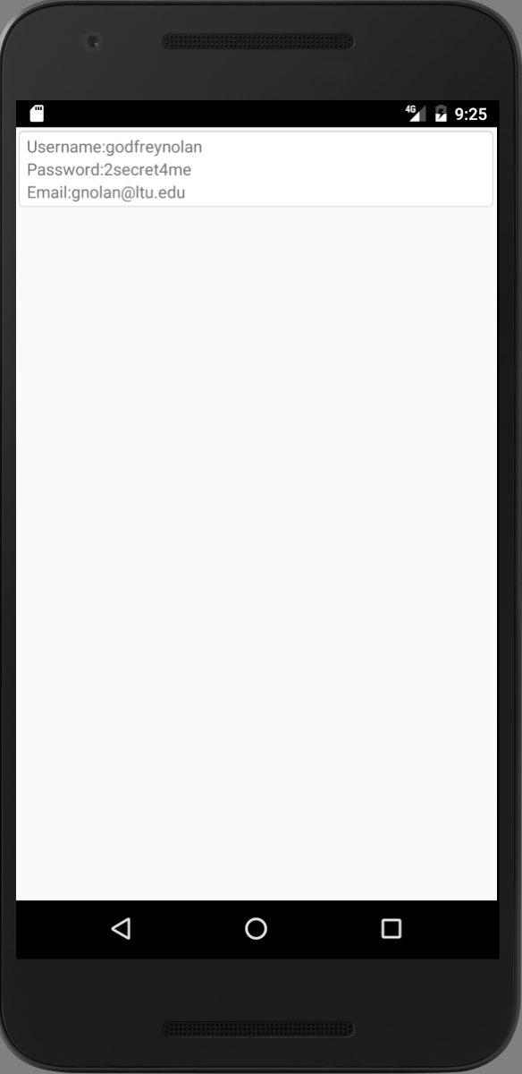
Shared Preferences
Notes:
Shared preferences are typically stored as xml files on the device in the /data/data/<name of your package> folder. Under normal circumstances, any testing that requires file system access means using an emulator, unless we use Mockito.
In our example, to show how this works, we’re going to use a simple login app. It doesn’t do much other than let you log in with a username, password, and e-mail address and then display the information on the second page (see Figure 4-1).

Slide 14
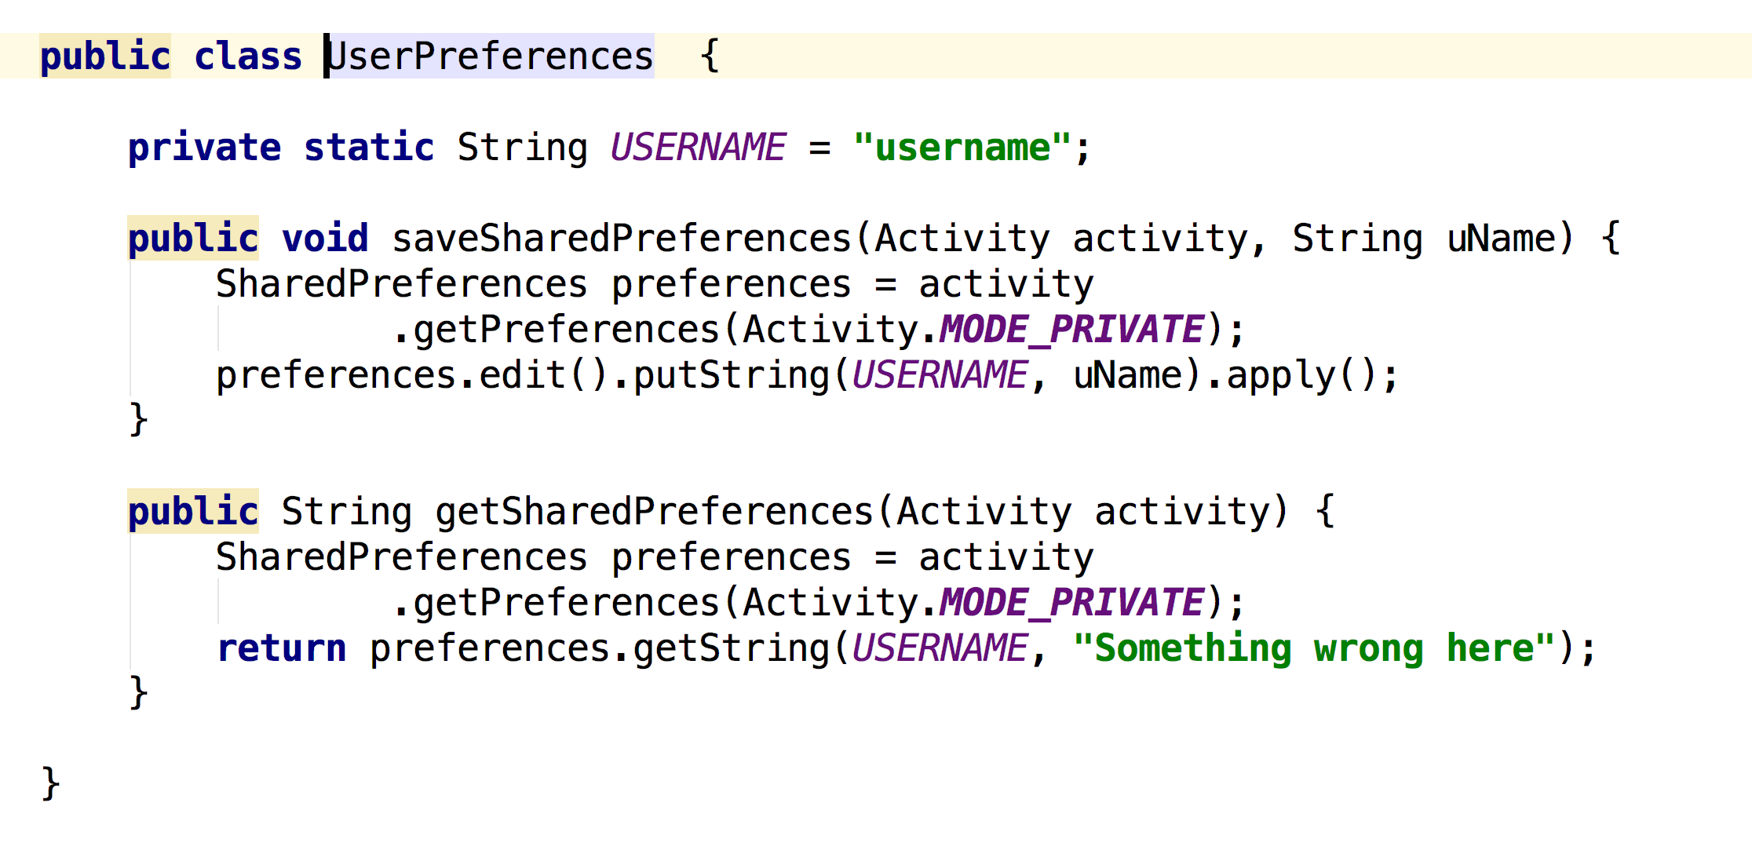
Shared Preferences
Notes:
In our fake app we want to show that the user has already registered,
so the first time the user logs in we’re going to write to the app’s shared preferences. Listing 4-1 shows the code for writing to the shared preferences file. The method takes an Activity and a string as its parameters.
Listing 4-2 shows the call to check to see the value stored in our shared preferences.

Slide 15
Shared preferences
Adb shell
Notes:
Run the app on the Android emulator and enter your login credentials. You can see what’s stored in the shared preferences, by running the adb shell command on the emulator (see Listing 4-3). It will also work on a rooted device.

Slide 16
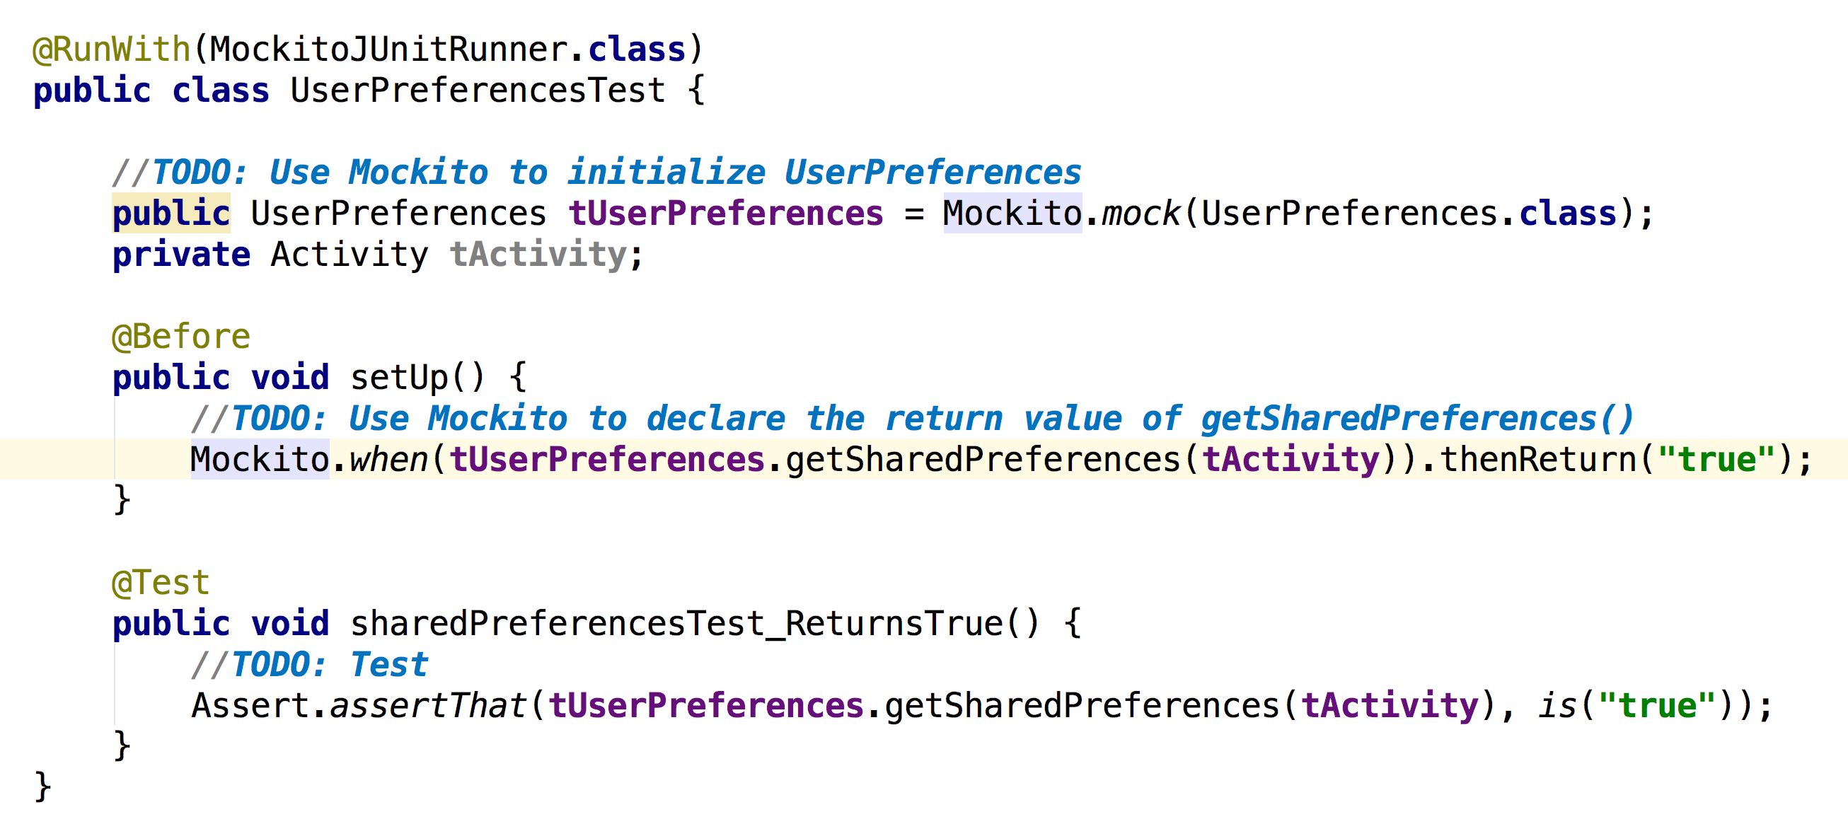
Shared Preferences
Notes:
Shared preferences is built into Android functionality, meaning that we don’t need to test it. In a real app we may want to test our code, assuming that the user is already registered when the app is under test. Listing 4-4 shows the mocked-out call for the getSharedPreferences method, sharedPreferencesTest_ReturnsTrue.
sharedPreferencesTest_ReturnsTrue always returns true so we can bypass the shared preferences and get on with what’s important in our testing. In this example we fix the shared preferences code so that it always returns true. Mainly because it never actually runs the shared preferences code. The setup block tells Mockito how you want it to behave, and the mocked version of that class will behave as it was instructed, always returning true.

Slide 17
Shared Preferences
https://github.com/gnolanltu/MockitoSharedPreferences
Notes:
Get them to download it and make it work

Slide 18
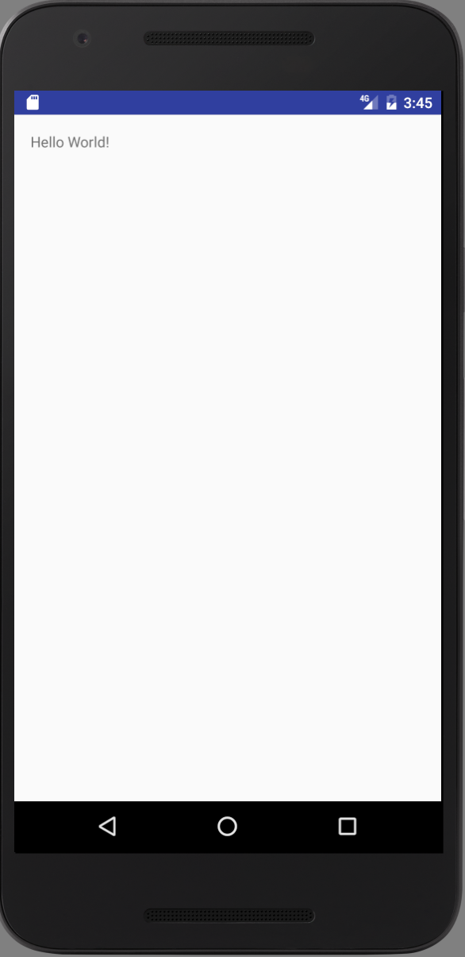
Settings
AudioHelper class
Notes:
If we want to avoid using the emulator for testing we need to fake any Java or built-in Android functionality. In most cases this is exactly what we’re looking for; as we’ve seen in the previous example, we’re not testing the shared preferences functionality or the date functionality. Similarly, we don’t want to test Android settings (such as the Audio Manager).

Slide 19
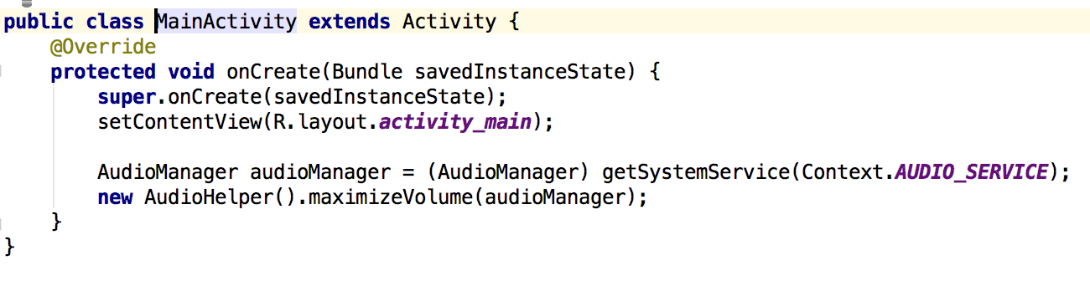
MainActivity

Slide 20
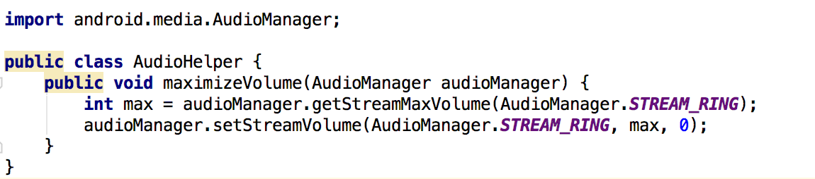
AudioHelper class
Notes:
Our AudioHelper code has a single method, maximizeVolume. Listing 4-9 shows our code to max out the volume.

Slide 21
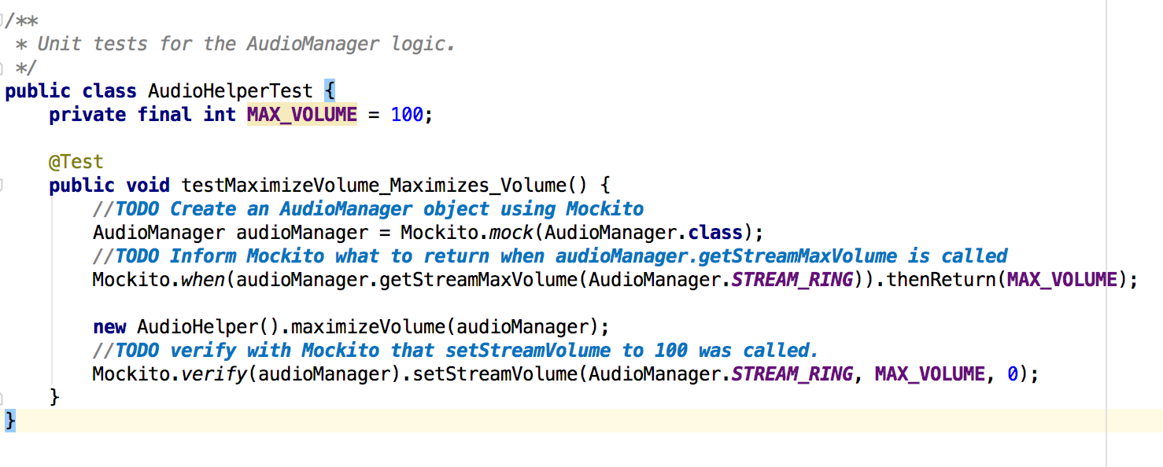
AudioHelperTest class
Notes:
We create the mock AudioManager object, and tell our test code to return the MaxVolume when we make the call and then we verify that the Mockito set the volume to our max when the call was made.
Run the demo

Slide 22
Settings
https://github.com/gnolanltu/MockitoSettings

Slide 23
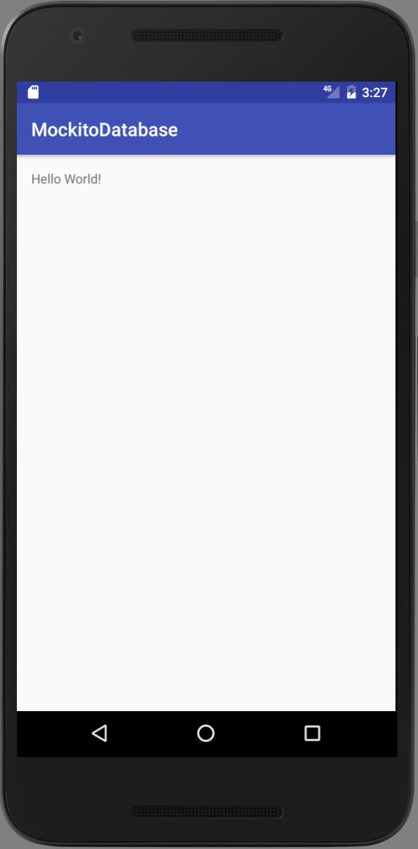
Databases
Notes:
Shared preferences are great for storing parameters, URLs (uniform resource locators), or API (application programming interface) keys to third-party libraries, but they are not so good for large amounts of tabular data. If you have a lot of spreadsheet-type data in Android that you want to keep on the phone, then it’s more common to use a SQLite database for storage as it’s free, lightweight, and does a great job with 10s to 1,000s of rows of data.
If you need to upgrade to bigger data sets, then you’re much more likely to store them on a back-end server than on the device itself.

Slide 24
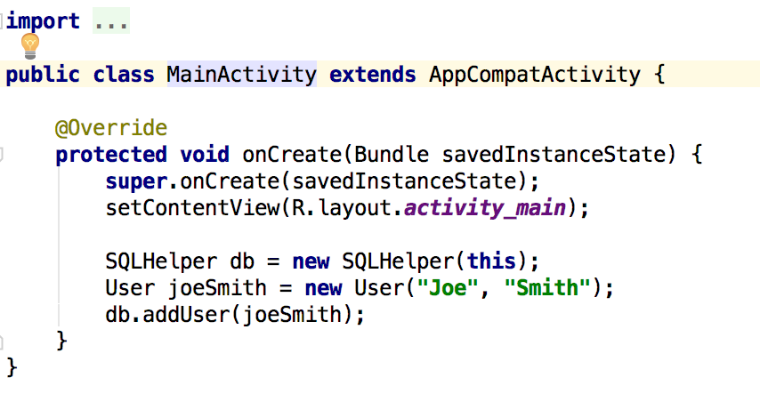
Databases

Slide 25
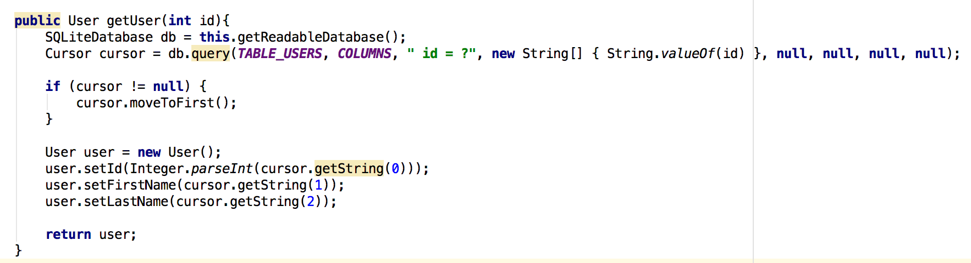
Databases

Slide 26
Databases
Adb shell

Slide 27
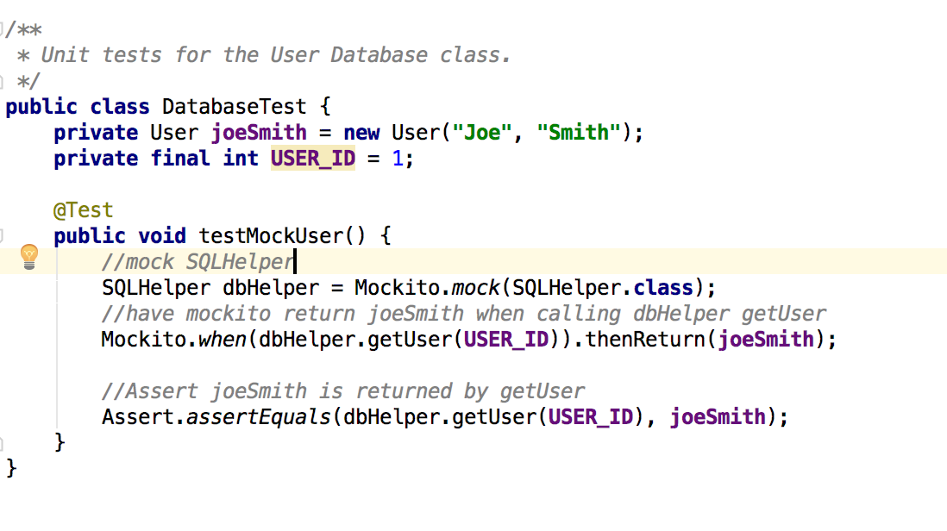
Databases – Mock getUser

Slide 28
Databases
https://github.com/gnolanltu/MockitoDatabase

Slide 29
Tuesday
User Interface Testing
Assignment
  To do list using sqlite
  Due Dec 1
Notes:
I’ll be gone 11/29 so I’ll record the class and you can do view it at home.

Slide 30
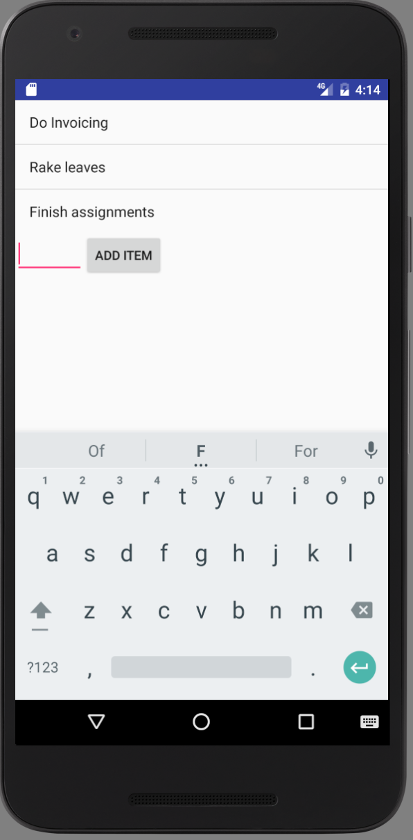
To Do List

Slide 31
To Do List Features
Create task
Read existing task
Delete existing task
Add Unit tests
Add Espresso tests
Notes:
Demo app

