Slide 1
Building Android apps – Week 15a
2843-201710_MCS4993_M:Topics in MA/CS
2843-201710_MCS5993_M:Topics in Computer Science

Slide 2
Agenda
Chap5: Espresso
Notes:
Android apps fail for a number of reasons other than simple logic errors. At its most basic, the app may not install correctly, or there may be a problem when you move from landscape to portrait and back again. Because of fragmentation, the layout might not work on any number of devices that you haven’t had the time to test it on, or it could hang if the network is down.
It’s just not possible to test for these conditions using unit testing. We’re going to have to use another testing tool to test our GUIs (graphical user interfaces) or activities. And, unfortunately, it also means we’re back to using devices and emulators to do our testing.

Slide 3
Espresso
What is it?
Recorded tests
Roll your own tests
Command line

Slide 4
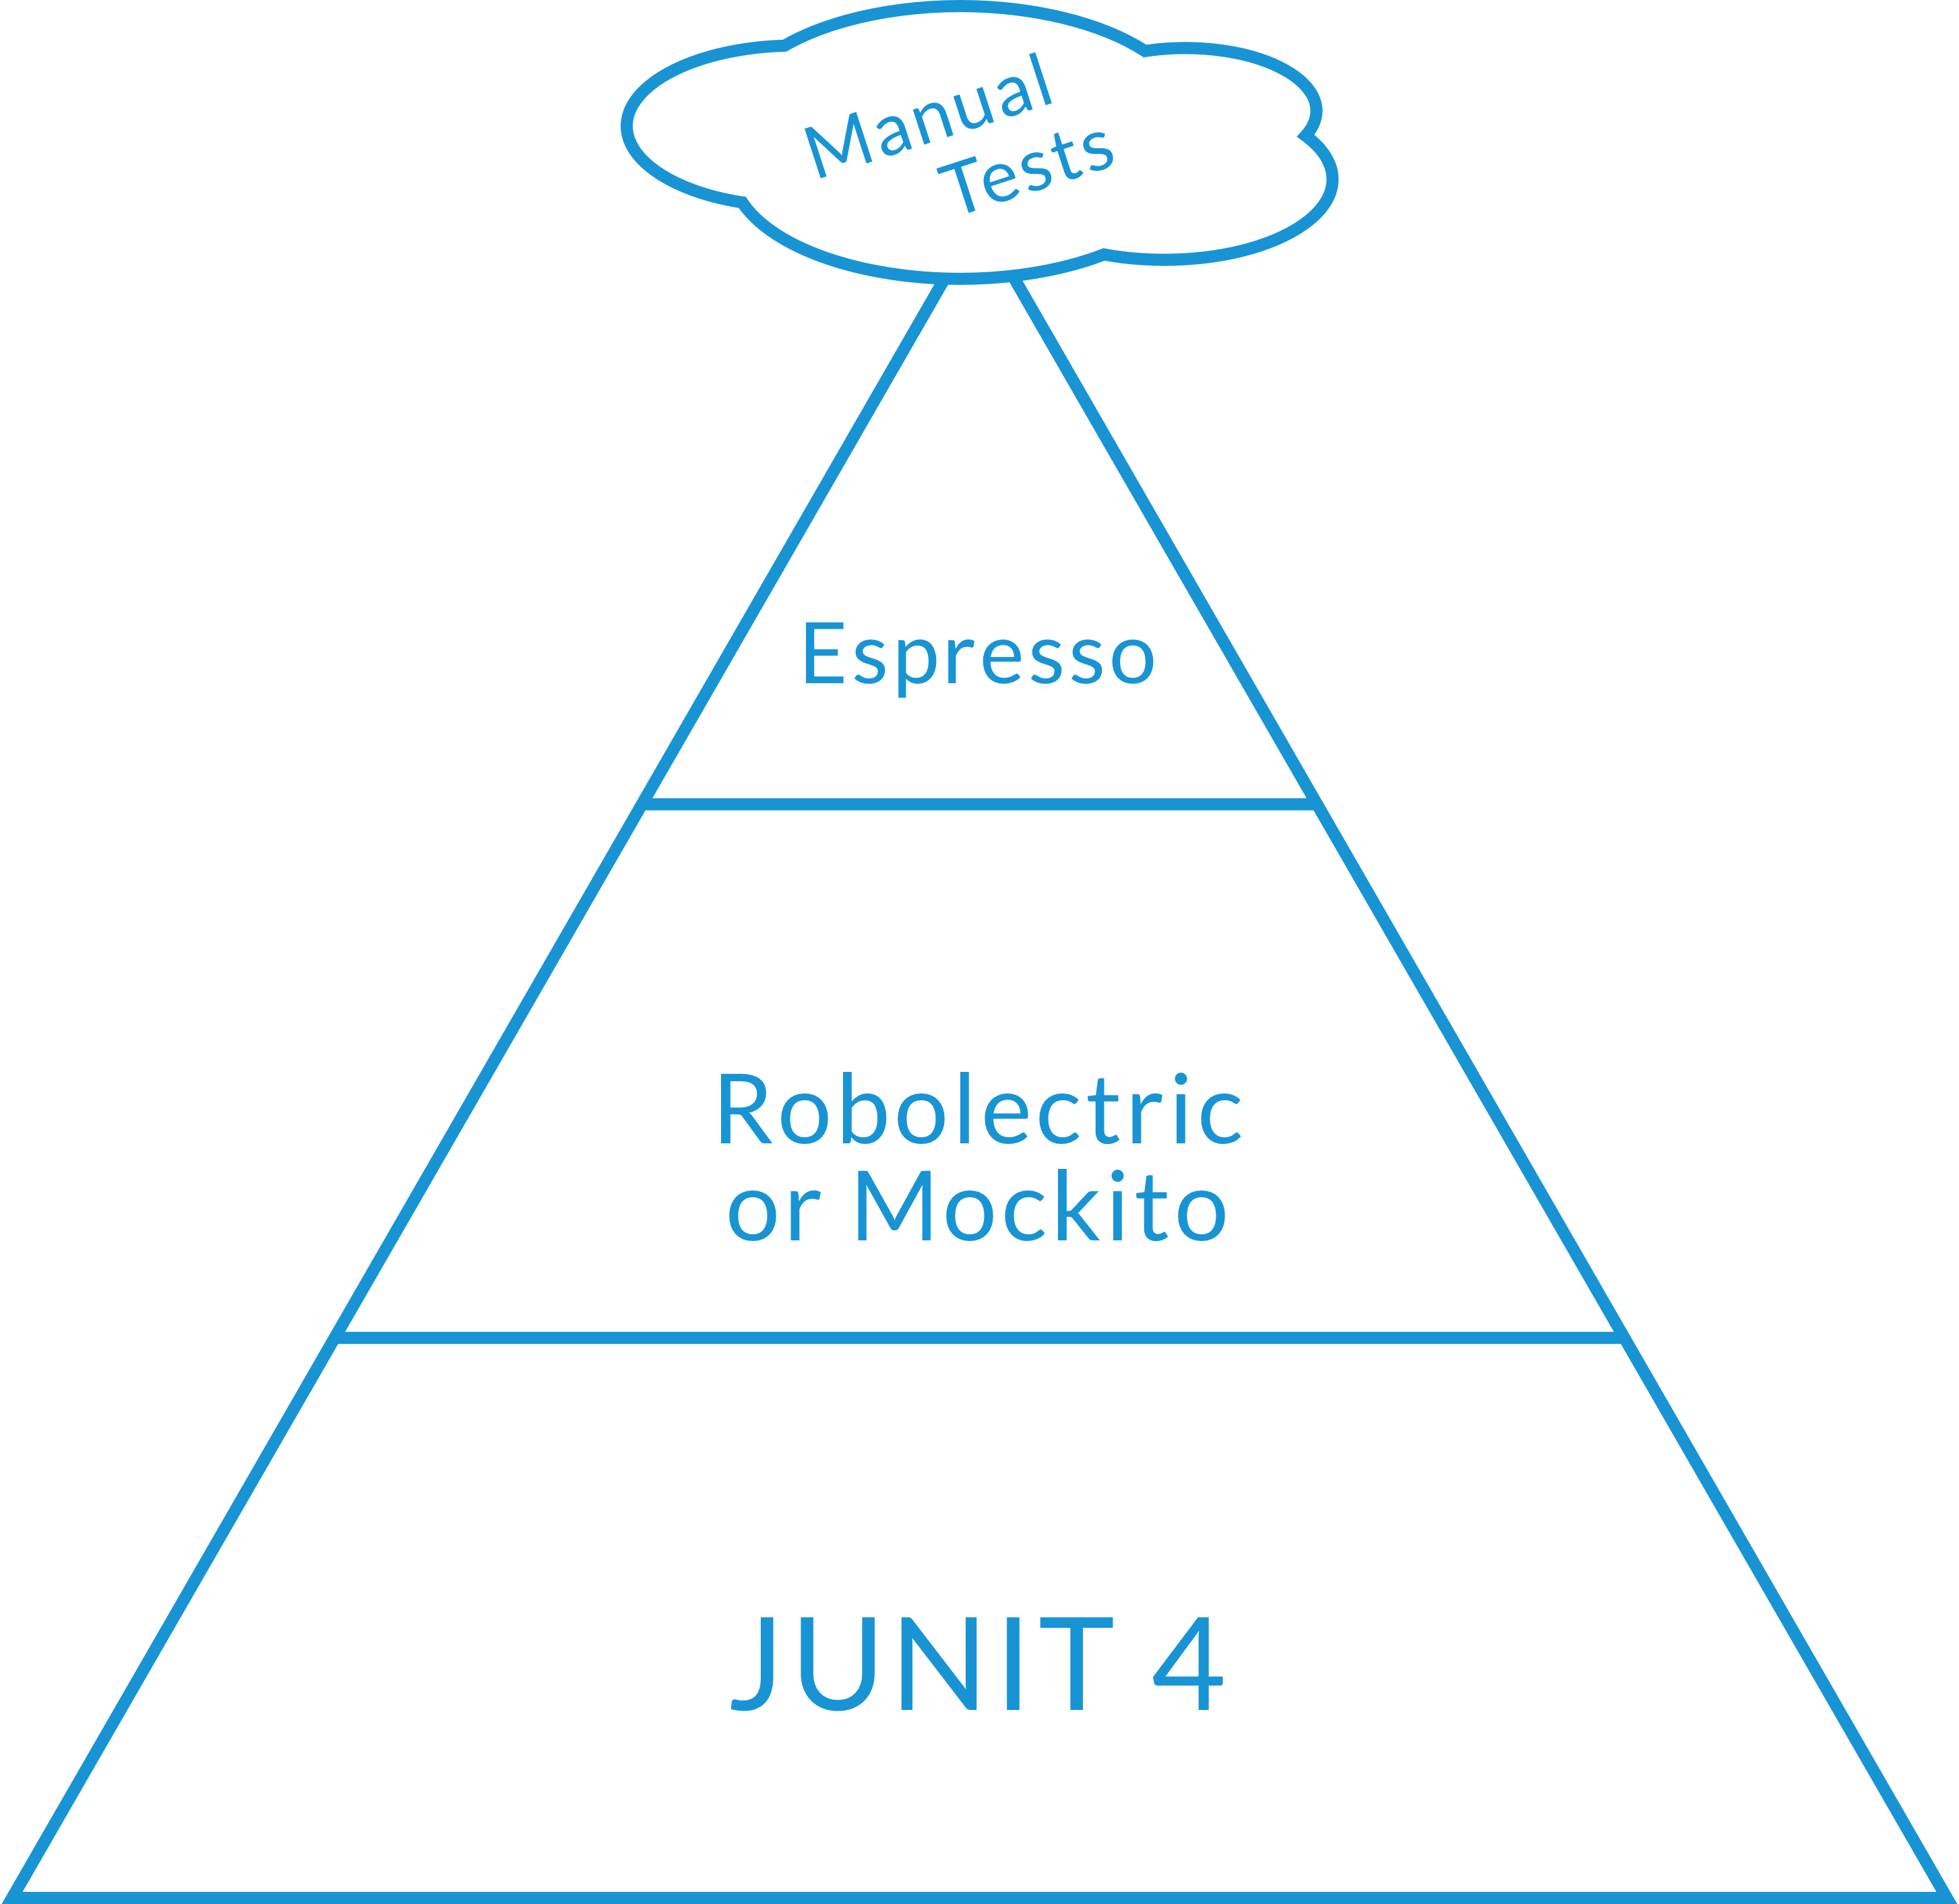
Espresso
Notes:
So how much Espresso should you do? We can see above that the vast majority of our tests should be unit tests and then unit tests using robolectric and mockito. Only then should we be looking at using Espresso. Finally you’ll see right at the top we should be looking at doing a very small amount of manual tests. It really shouldn’t be the main focus of our testing as they can’t be automated and they’re very expensive.

Slide 5
Espresso – What is it?
GUI Testing
Simple but effective
Brittle
Small changes can break lots of tests

Slide 6
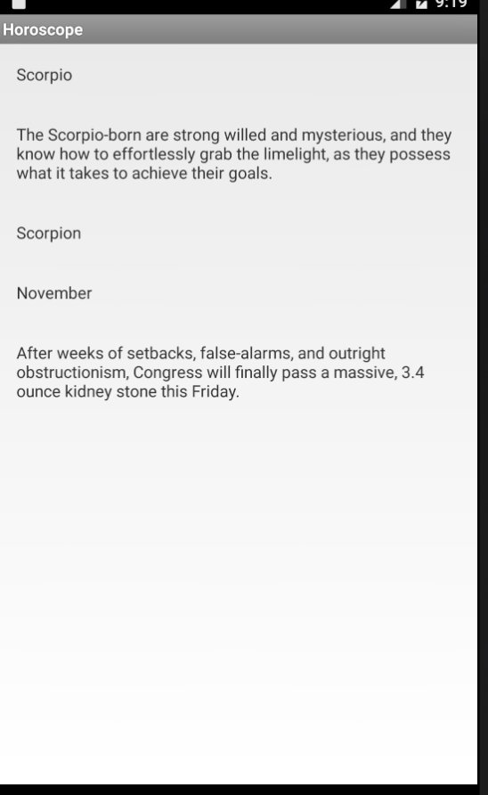
Espresso – What is it?
Notes:
Run the recorded session

Slide 7
Notes:
Why do we do it – because unit tests on their own won’t catch everything. You might think they can be unit tests are by definition silo’d tests
Integration tests using something like Espresso are needed to test the app end to end so that something doesn’t get missed.

Slide 8
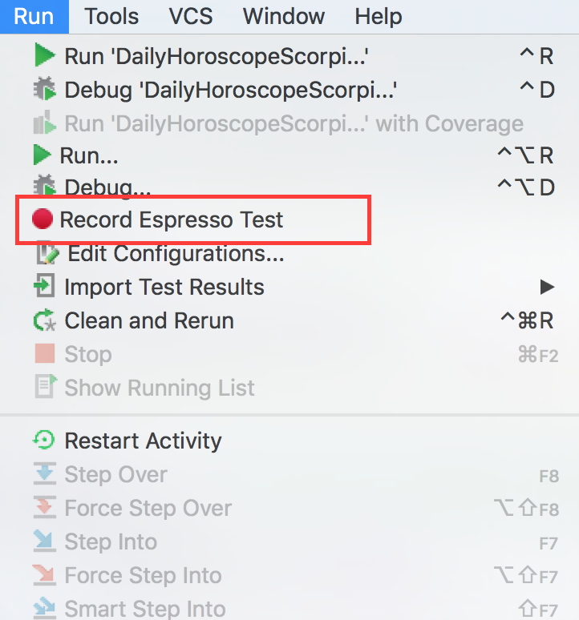
Espresso – Recording
Notes:
Show video

Slide 9
Espresso – Recording
Notes:
RECORD YOUR OWN TEST

Slide 10
Espresso – Roll your own
OnView
OnData

Slide 11
Espresso – Roll your own
dependencies { androidTestCompile 'com.android.support.test:runner:0.3' androidTestCompile 'com.android.support.test:rules:0.3' androidTestCompile "com.android.support.test.espresso:espresso-core:2.2" }
Notes:
The espresso dependency should already be in your build.gradle file

Slide 12
Espresso – Roll your own
onView(ViewMatcher) .perform(ViewAction) .check(ViewAssertion);
Notes:
Intead of JUnit or Hamcrest matchers and assertions, Espresso uses the OnView format. This has three parts, namely a ViewMatcher to find the element in the activity we’re testing, a ViewAction to perform the action (e.g., click) and finally a ViewAssertion to make sure the text matches and the test passes.

Slide 13
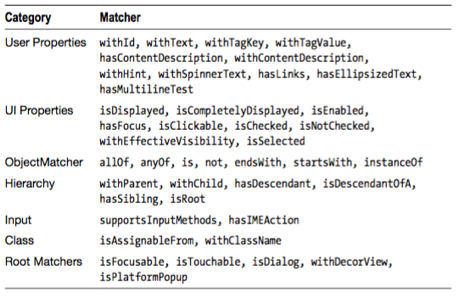
Espresso – ViewMatchers
Notes:
onView(withId(R.id.button))

Slide 14
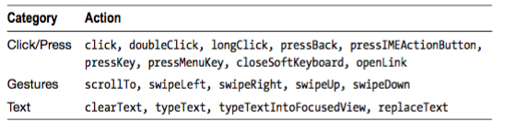
Espresso – ViewActions
Notes:
onView(withId(R.id.button))

Slide 15
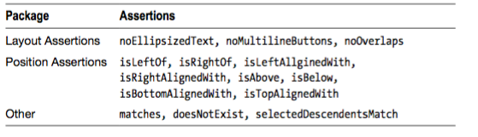
Espresso – ViewAssertions
Notes:
onView(withId(R.id.button))

Slide 16
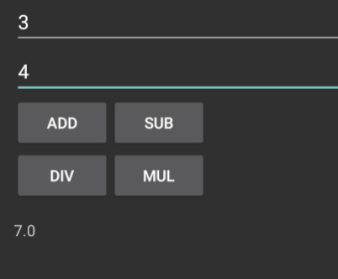
Espresso – Roll your own
public void testCalculatorAdd() {
onView(withId(R.id.operand_one_edit_text)).perform(typeText(THREE)); onView(withId(R.id.operand_two_edit_text)).perform(typeText(FOUR)); onView(withId(R.id.operation_add_btn)).perform(click()); onView(withId(R.id.operation_result_text_view)).check(matches(withText(RESULT)));
}
Notes:
Adds 3 + 4 to the Calculator and checks to see that the result is 7

Slide 17
Espresso – Download
Run the command
git clone https://github.com/godfreynolan/AgileAndroid/
Open the calculator app in Chapter 1
Run the Espresso test in the (androidTest) directory
Notes:
Download and try the code yourself

Slide 18
Espresso – Roll your own
OnView
OnData
Notes:
onView won’t be able to find the data when we’re using any AdapterViews such as ListView, GridView, or Spinner. For AdapterViews we have to use onData in conjunction with the onView to locate and test the item.

Slide 19
Espresso – Roll your own
onData(ObjectMatcher) .DataOptions .perform(ViewAction) .check(ViewAssertion)
Notes:
The onData format is as follows….
The DataOptions available are inAdapterView, atPosition, or onChildView.

Slide 20
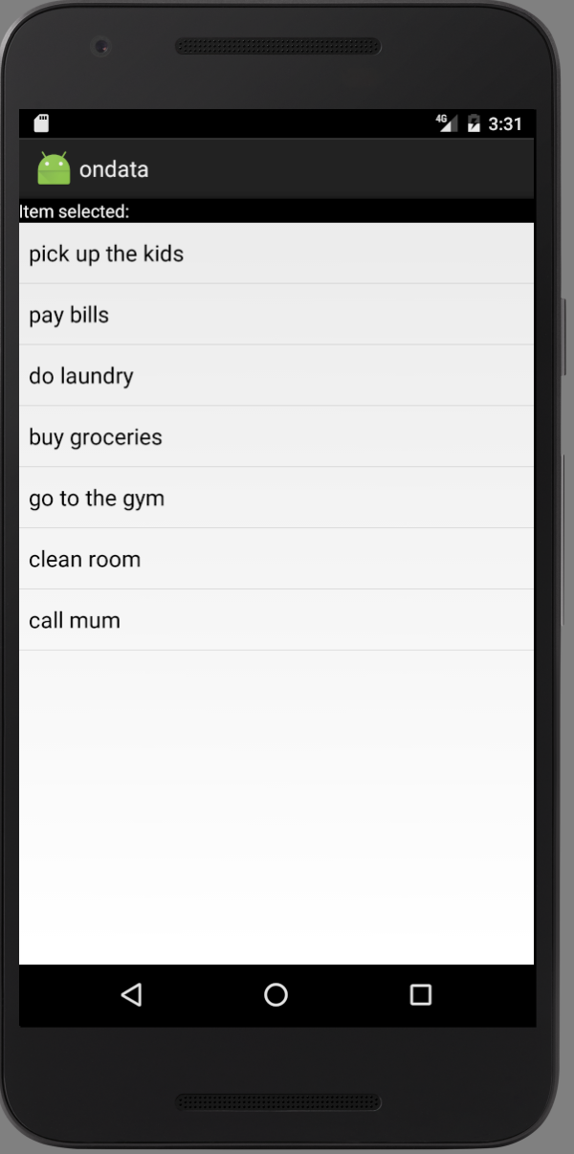
Espresso - onData

Slide 21
Espresso - onData
public void toDoListTest(){
onData(anything()) .inAdapterView(withId(R.id.list_of_todos)).atPosition(4) .perform(click());
onView(withId(R.id.txt_selected_item)) . check(matches(withText("go to the gym")));
}
Notes:
A simple test to make sure everything is working okay would be to pick something on the todo list, such as “go to the gym.” Listing 5-6 shows the Espresso code. We’re telling the test to look at position [4] in the AdapterView in the onData code and then passing that to the onView so that it can check that the text does indeed say “go to the gym.” Run the test once again using the emulator or on a device.

Slide 22
Espresso – Download
Go to Chapter 5 in Agile Android code
Open the onData project
Run the class in the (androidTest) directory

Slide 23
Assignment
Using your Zodiac code, record an espresso test to test functionality of your app
Notes:
Demo app

