Slide 1
Building Android apps – Week 15b
2843-201710_MCS4993_M:Topics in MA/CS
2843-201710_MCS5993_M:Topics in Computer Science

Slide 2
Agenda
Chap6: Test Driven Development
Assignment: Espresso test
Notes:
It wouldn’t be right if we didn’t make an effort to show test-driven development (TDD) in action. So, in this chapter we’re going to create an app from scratch using our TDD approach. Using TDD, we’re going to create a sample app for a daily horoscope. I’m not an astrology fanatic by any means, but it’s a simple enough app that will allow us to show our TDD techniques in action.

Slide 3
Test Driven Development
Unit testing vs TDD
Why TDD
Sample app

Slide 4
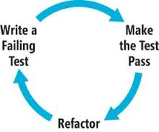
Test Driven Development
Write test first
See it fail
Write simplest possible solution to get test to pass
Refactor
Wash, Rinse, Repeat

Slide 5
Test Driven Development
Built in regression testing
Longer life for your codebase
YAGNI feature development
Red/Green/Refactor helps kill procrastination

Slide 6
TDD vs Unit Testing
You can't TDD w/o unit testing
TDD means writing the tests before the code
TDD is more painless than classic unit testing
You can unit test w/o TDD
Unit tests don't mandate when you write the tests
Unit tests are often written at the end of a coding cycle

Slide 7
Sample app
Display each star sign
Display information about each star sign
Display horoscope for star sign

Slide 8
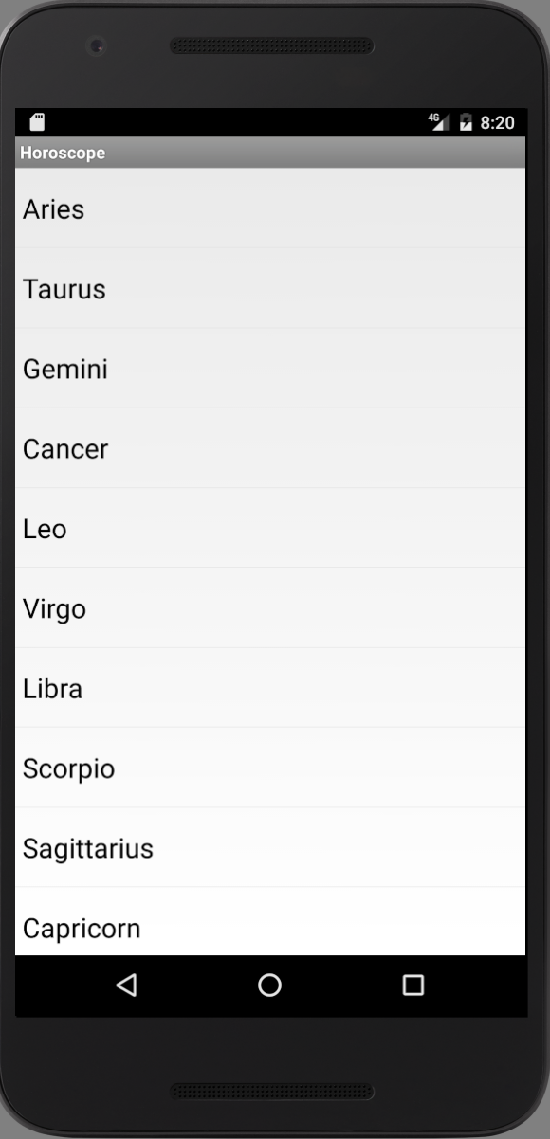
Feature 1

Slide 9
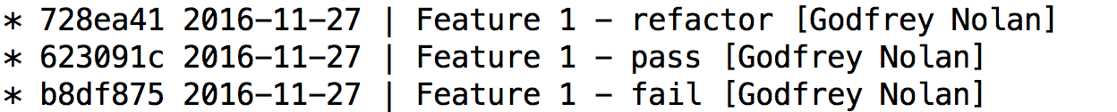
Feature 1
git clone https://github.com/godfreynolan/Zodiac
git hist alias
git checkout b8df875

Slide 10
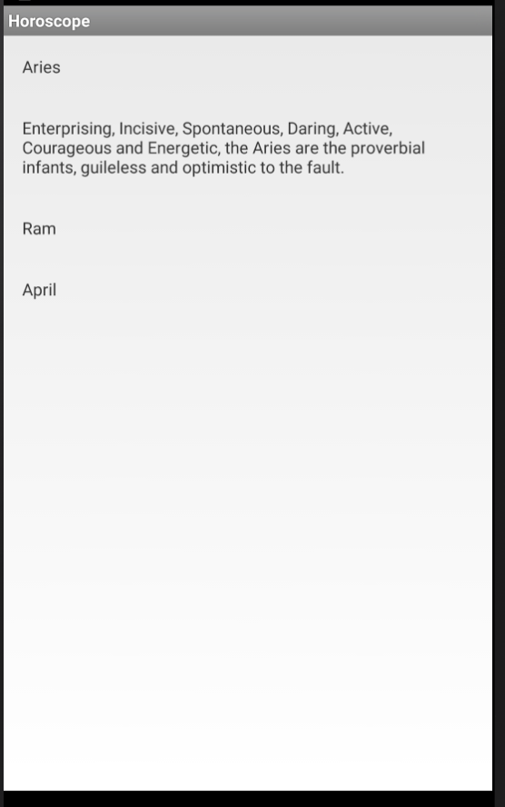
Feature 2

Slide 11
Feature 2

Slide 12
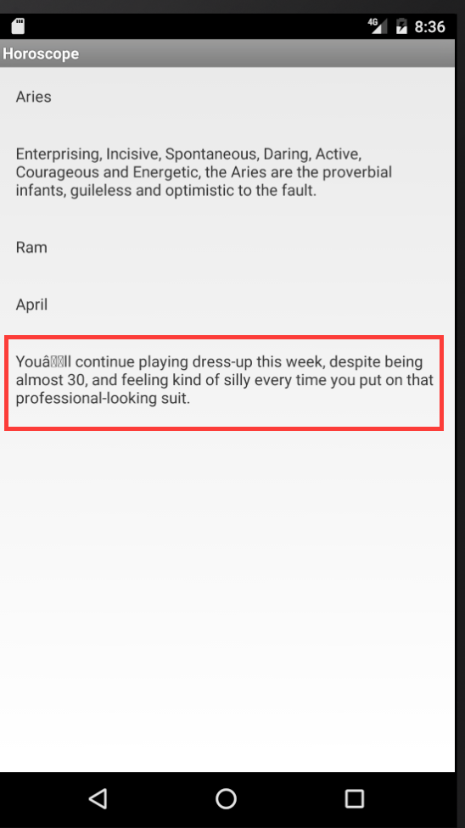
Feature 3

Slide 13
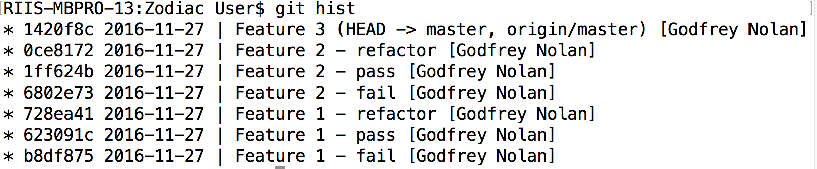
Feature 3
Notes:
SHOW the espresso assignment

Slide 14
TDD in a legacy environment
Introduce Continuous Integration to build code
Configure android projects for TDD
Add minimal unit tests based on existing tests, add to CI Show team how to create unit tests
Add testing code coverage metrics to CI, expect 5-10%
Add Espresso tests
Unit test new features or sprouts, mock existing objects
Wrap or ring fence existing code, remove unused code
Refactor wrapped code to get code coverage to 60-70% (New refactoring in Android Studio)

Slide 15
Assignment
Using your Zodiac code, make the display view use SQLite instead of the Zodiac.java class.

