Slide 1
Building Android apps – Week 16a
2843-201710_MCS4993_M:Topics in MA/CS
2843-201710_MCS5993_M:Topics in Computer Science

Slide 2
Agenda
Recap
Exam hints
Project Demo

Slide 3
Recap
Books
Head First Android Development
Agile Android

Slide 4
Recap
Hello World
Activities and Intents
Android Lifecycle
User Interface
List Views and Adapters
Fragments
Navigation Menus
SQLite databases
AsyncTask
Web Services
Under the hood
Material Design
Design Patterns
Testing
Continuous Integration
TDD

Slide 5
Recap – Basics that you need to know
Hello World
Activities and Intents
Android Lifecycle
User Interface
List Views and Adapters
Fragments
Navigation Menus
SQLite databases
AsyncTask
Web Services
Under the hood
Material Design
Design Patterns
Testing
Continuous Integration
TDD

Slide 6
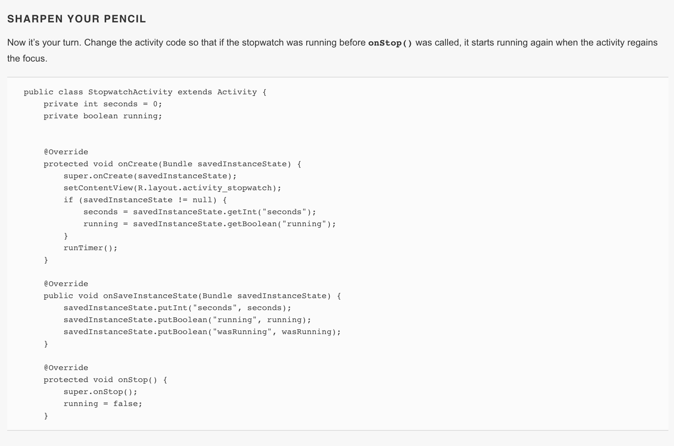
Sharpen your pencil
Notes:
There will be some sharpen your pencils in the exam. Nothing new it will be from the book.

Slide 7
Final Project Demo Rubric
Description | Points
Presentation | 10
Working Demo | 15
Features Implemented | 15
Difficulty | 10
Total | 50

Slide 8
Features - Chris
Allow a user to enter items and date/time they should be displayed
Allow user to modify items
o Modify text that will be displayed
o Modify title for notification
o Modify date/time
o Delete item
Notify user when they try to enter a date/time that has passed already
Allow user to attach images that will appear in the push notification
Allow user to open the app from a push notification
Push items as notification at specified time
Notes:
Fake bank app?

Slide 9
Features - Ian
TV Tracker
Display a list of "completed" TV series
Display a list of "watching" TV series
Display a list of "Plan to watch" TV series
Save/Load the user's TV series automatically in SQLite database
Display a list of settings to apply preferred sorting methods to lists

Slide 10
Features - Bino
The user shall measure and monitor steps.
The user shall record when COPD symptoms are triggered daily.
The users' step results and notes shall be sent to their physician for analysis.
If a test measurement indicates an emergency COPD health risk, the app shall notify the user when they should seek immediate medical attention and alert the physician of the users' condition.
Notes:
Changed to steps from breathing

Slide 11
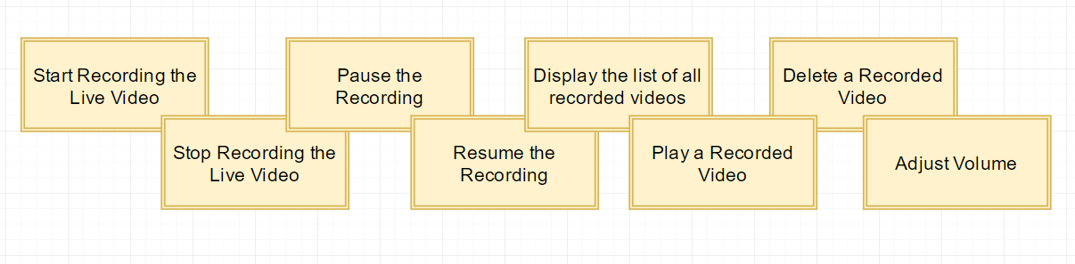
Features - Khalil

Slide 12
Continuing Android Education
https://www.udacity.com/course/designing-restful-apis--ud388
https://www.udacity.com/course/advanced-android-app-development--ud855

Slide 13
Continuing Education
Read, read, read
https://android-developers.blogspot.com/
http://nuzzel.com/josemontesdeoca/android-dev
Practice, practice, practice
Calculator app
ToDo list
Currency converter
Facebook Oauth app
FHIR Healthcare app
Horoscope app
https://github.com/Gazler/githug

