Slide 1
Building iOS Swift apps
5030-201720_MCS5993_M: 5030-Topics in Computer Science
5031-201720_MCS4993_M: 5031-Topics in MA/CS

Slide 2
Agenda
Introductions
Syllabus
Books
Project
Hello World Swift app

Slide 3
Introductions
Godfrey Nolan, B.E., MSc.
President of RIIS LLC, mobile development company based in Troy, MI
Originally from Dublin, Ireland
Author 6 books
Decompiling Java, Decompiling Android, Android Best Practices, Bulletproof Android, Agile Android, Agile Swift
Currently working on Android Design Patterns

Slide 4
What should you know at the end of this course
How to use Swift on Linux and Xcode
How to write 5-10 simple iOS apps.
How to push your code to bitbucket
Know how to secure your app
How to write unit tests
How to write user interface tests
How to build and test a project in Jenkins
Know how to measure code coverage
Know the difference between unit testing and test driven development

Slide 5
Course Schedule
Date | Topic | Date | Topic
1/10/17 | Hello World, BitBucket | 2/9/17 | NavigationController
1/12/17 | Installing Swift on Linux | 2/14/17 | TableViewController
1/17/17 | Constants, Types, Expressions | 2/16/17 | SplitViewController
1/19/17 | Constants, Types, Expressions | 2/21/17 | iOS Design Patterns
1/24/17 | Collections, Control, Functions | 2/23/17 | Network access
1/26/17 | Classes and Structs | 2/28/17 | Mid Term Project Demo
1/31/17 | Protocols and Extensions | 3/2/17 | Mid Term Exam
2/2/17 | XCode | 3/14/17 | Swift Under the Hood
2/7/17 | ViewController | 3/16/17 | Swift Under the Hood

Slide 6
Course Schedule
Date | Topic | Date | Topic
3/21/17 | UI Design | 4/20/17 | Test Driven Development
3/23/17 | UI Design | 4/25/17 | Test Driven Development
3/28/17 | Unit Testing | 4/27/17 | Final Project Demo
3/30/17 | Unit Testing | 5/2/17 | Final Written Exam
4/4/17 | Mocking | 4/20/17 | Test Driven Development
4/6/17 | User Interface Testing | 4/25/17 | Test Driven Development
4/11/17 | User Interface Testing
4/13/17 | Continuous Integration
4/18/17 | Continuous Integration

Slide 7
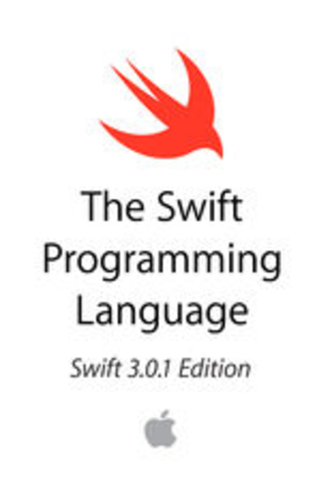
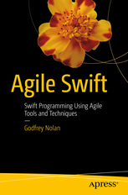
Books

Slide 8
Swift Apps
To Do List
Calculator
Horoscope app
Bands app
Crop app

Slide 9
Swift Projects
ETA Detroit
COPD app
Comparing Crops app
Secure app
Salesforce app
EMR Integration app
Push notifications app
Quickblox app

Slide 10
Hello World Swift app
Set up command line environment
Xcode Playgrounds
swift from the command line
In browser http://repl.it
Basic swift command
print("Hello, world!")

Slide 11
Hello World Swift app
User$ swift package init
Creating library package: HelloWorld
Creating Package.swift
Creating .gitignore
Creating Sources/
Creating Sources/HelloWorld.swift
Creating Tests/
Creating Tests/LinuxMain.swift
Creating Tests/HelloWorldTests/
Creating Tests/HelloWorldTests/HelloWorldTests.swift
User$ swift test

Slide 12
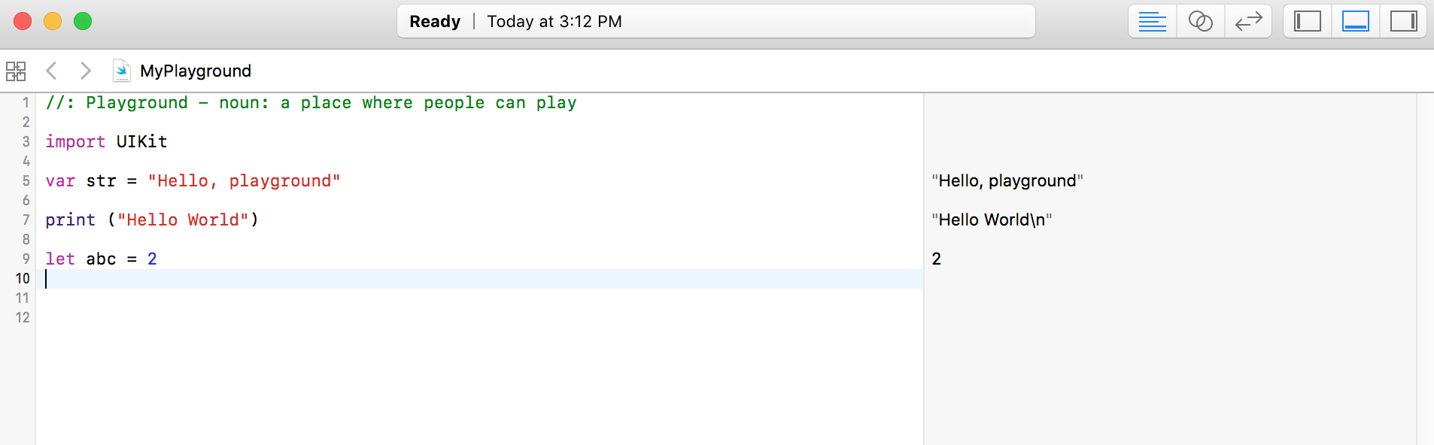
Xcode Playground
Notes:
https://developer.apple.com/go/?id=swift-tour

Slide 13
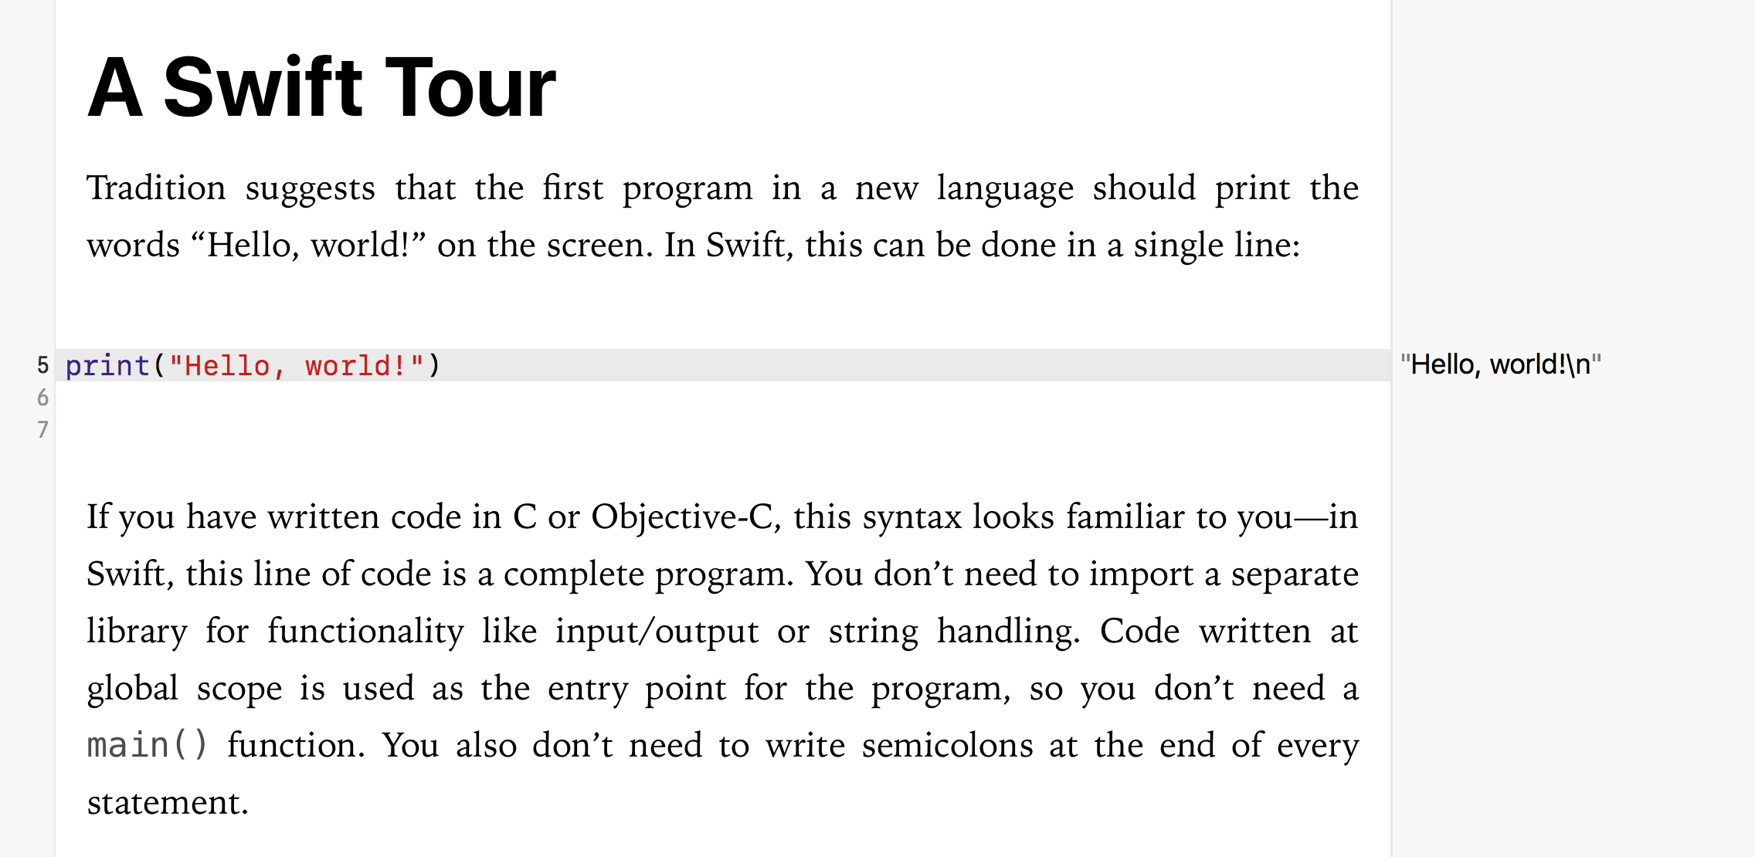
Xcode Playground - Basic tour
Notes:
https://developer.apple.com/go/?id=swift-tour

Slide 14
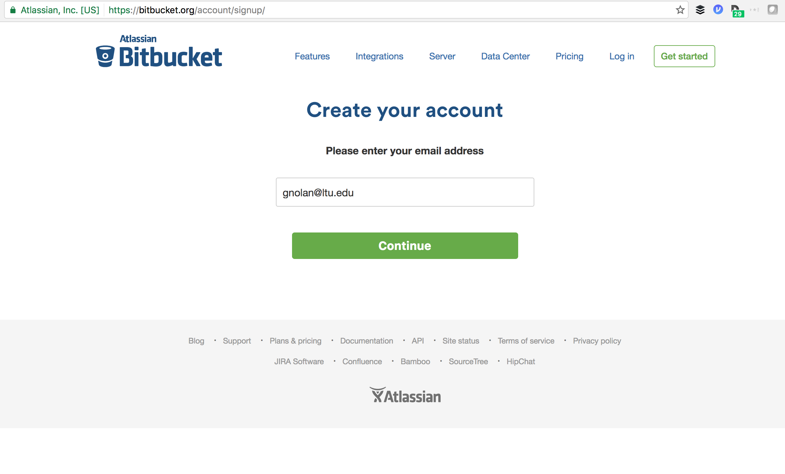

Slide 15
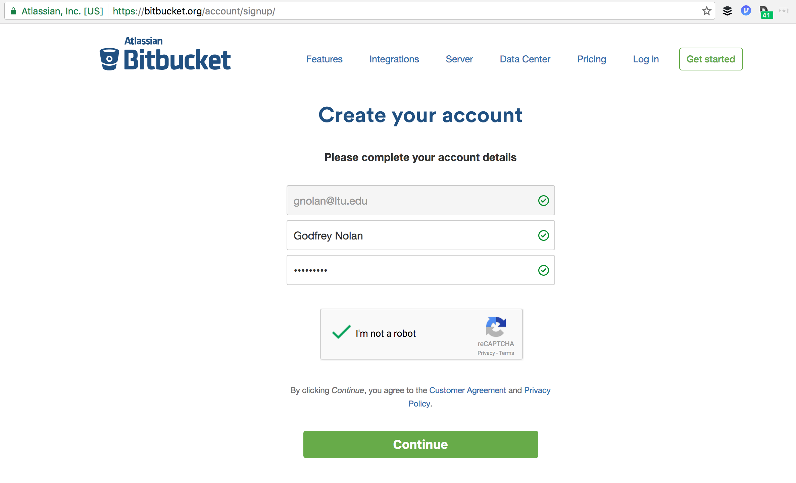

Slide 16
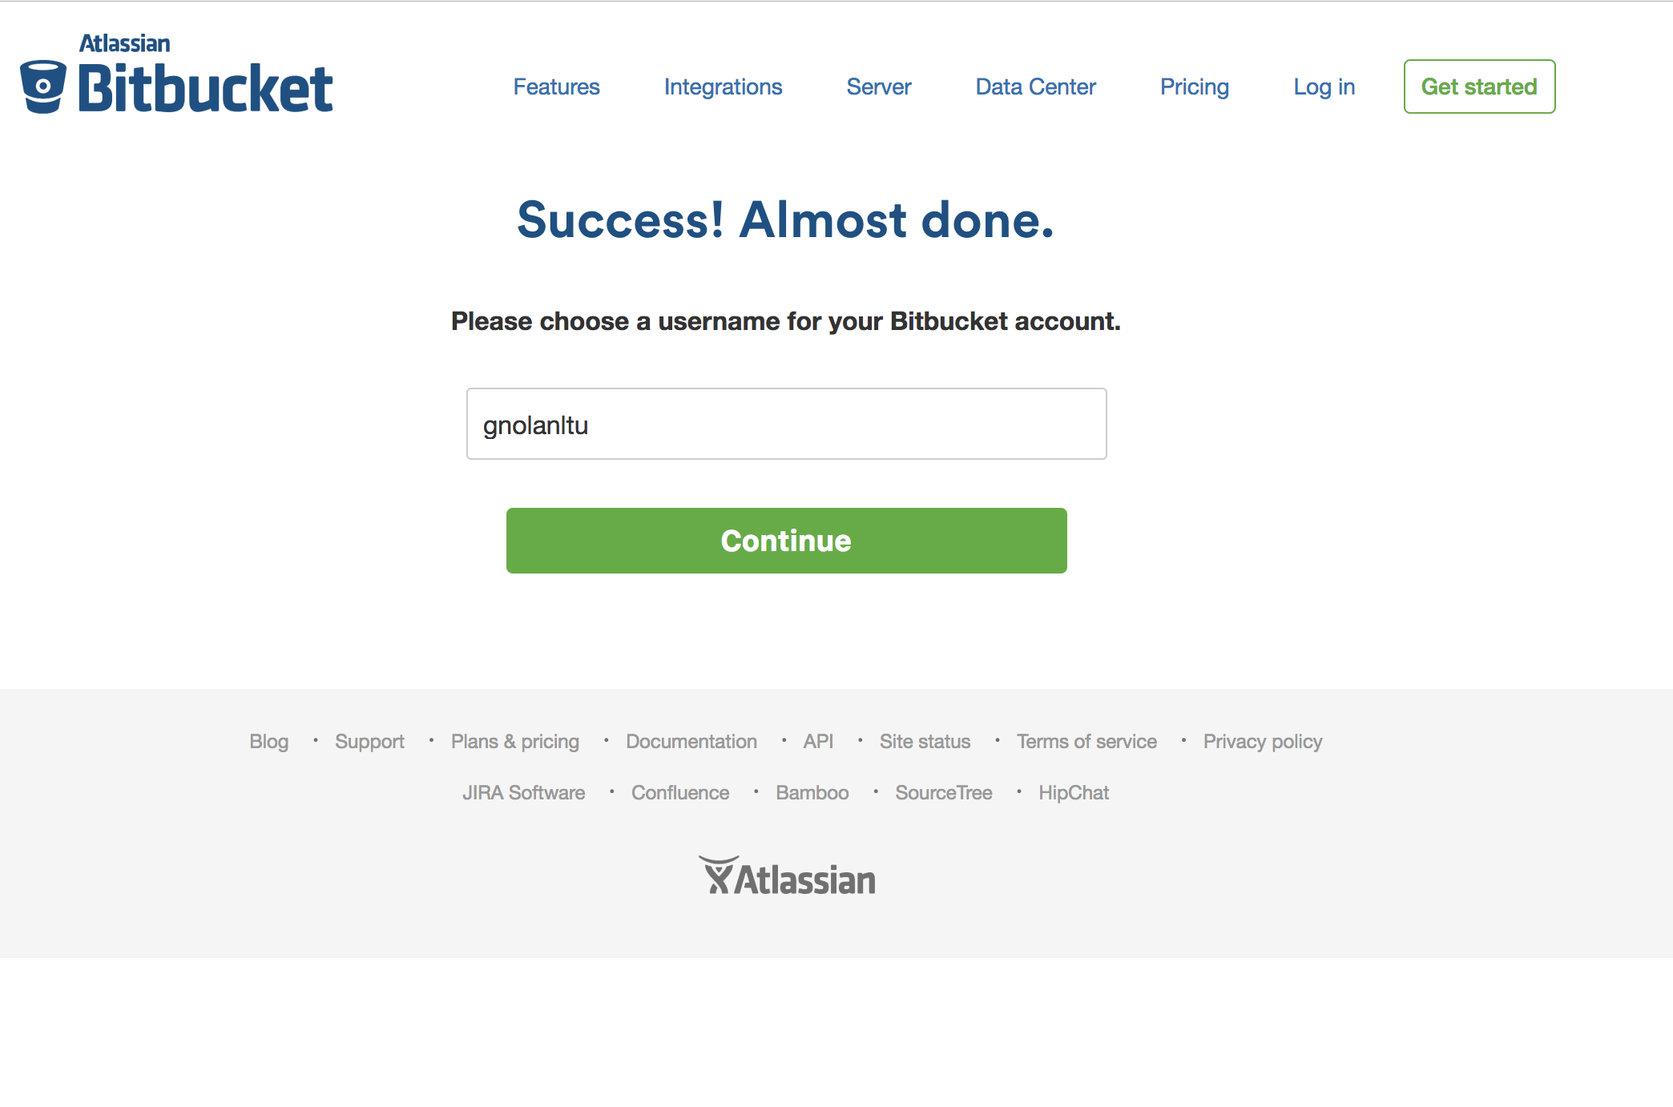

Slide 17
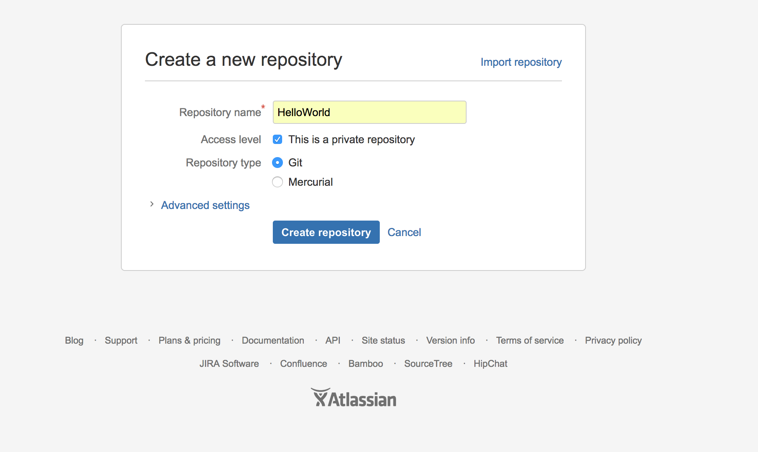

Slide 18
Git commands
git init
git add README.md
git commit -m "first commit"
git remote add origin https://bitbucket.com/godfreynolan/test.git
git push -u origin master

Slide 19
Thursday
Class will be recorded, posted online

