Slide 1
Building iOS Swift apps
5030-201720_MCS5993_M: 5030-Topics in Computer Science
5031-201720_MCS4993_M: 5031-Topics in MA/CS

Slide 2
Agenda
Chapter 5 from Nobledesktop book

Slide 3
Save your work
git add .
git commit –m “Chapter 4”
Notes:
Will probably just add the new images

Slide 4
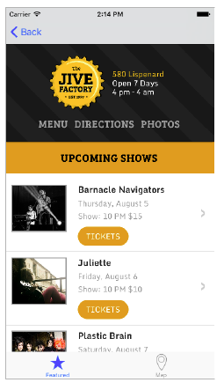
Link to External Webpage
Notes:
In this exercise, we will learn how to link to an external webpage

Slide 5
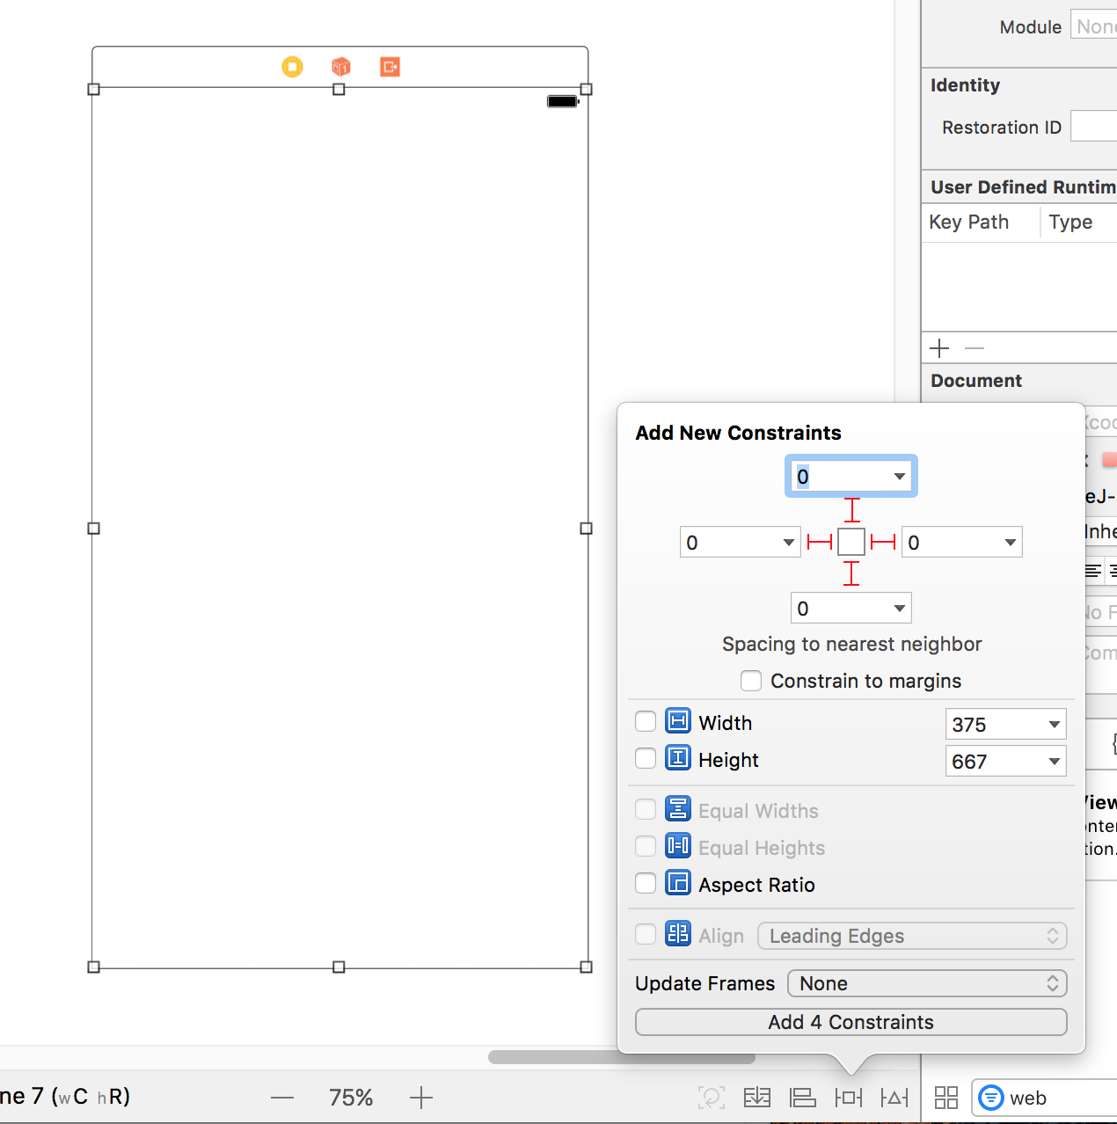
Link to External Webpage
Notes:
Creating the Web View Controller
We’re going to link to a webpage, so let’s make a view to display it.
1. In the Project Navigator, click on Main.storyboard.
2. Delete any text in the search bar at the bottom of the Object library .
3. From the Object library , drag View Controller onto the Editor below the Bands
Detail View Controller.
4. With the new View Controller selected, go to the Attributes inspector .
5. Set the Size menu to iPhone 4.7-inch.
6. Position the new view controller nicely below the Bands Detail View Controller.
7. In the search bar at the bottom of the Object library , type: web
8. Drag Web View onto the empty view controller in the Editor, then resize it so that it
fills the View.
We should use Auto Layout to make sure the Web View fills all screen sizes.
9. Make sure the Web View is still selected, then at the bottom right of the Editor, click
the Pin button .
10. In the options that pop up, UNcheck Constrain to margins.
11. At the top of the options pop up, under Add New Constraints, click all four
red lines.
12. At the bottom, click Add 4 Constraints.

Slide 6
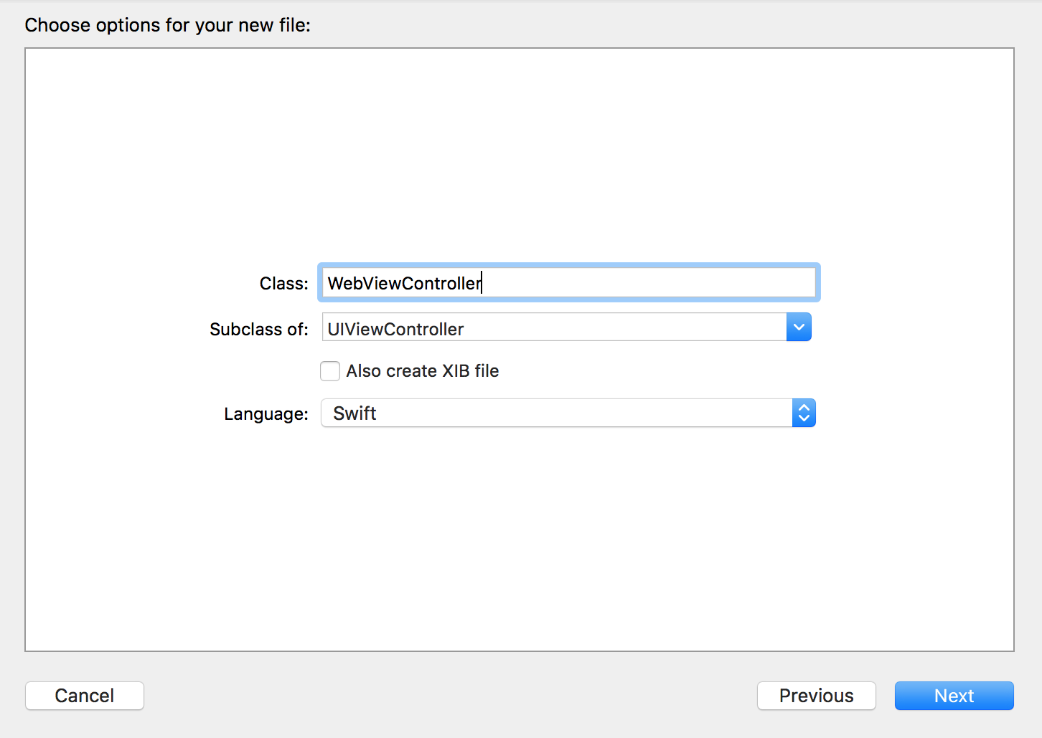
Link to External Webpage
Notes:
Creating a Class
As we have done in a previous exercise, we need to create a class for the Web View
Controller so we can add the code necessary to go to a webpage.
1. In the Project Navigator, select MapViewController.swift. (We want the file to be
added after this file, that’s why we had you select it.)
2. Hit Cmd–N to open a new file.
3. Double–click Cocoa Touch Class to choose it.
4. From the Subclass of menu, choose UIViewController (or start typing it and let
Xcode autocomplete it for you).
For the name of the Class, add Web at the start, so the Class ends up being
WebViewController.
NOTE: ViewController is the object we are currently using on the storyboard. By
making this class a subclass of the UIViewController, it will have all the functionality
it currently has, plus any additional functionality we add in the code to this new
WebViewController class.
6. Click Next.

Slide 7
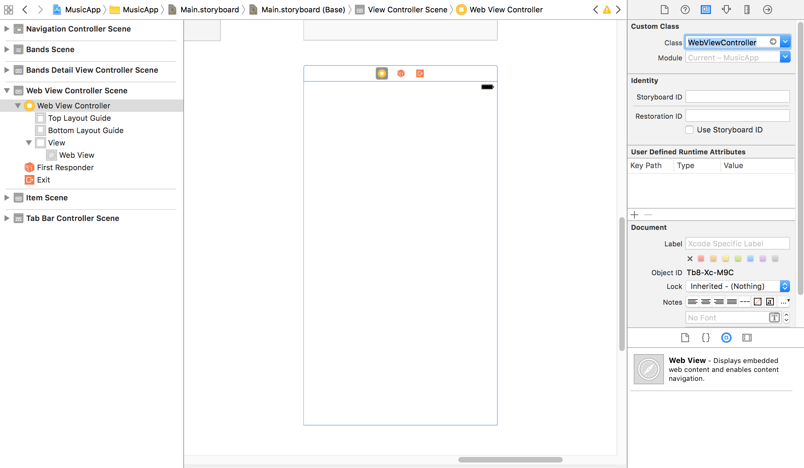
Link to External Webpage
Notes:
Notice a WebViewController.swift file has been added in the Project Navigator. Now
we need to link it to the view controller in the storyboard.
9. In the Project Navigator, click on Main.storyboard.
10. Select the View Controller with the Web View by clicking on its top bar. It will
become outlined in blue to indicate it’s selected.
11. In the Utilities area on the right, click on the Identity inspector tab .
12. Next to Class, type W and it should autocomplete to WebViewController. (If it
doesn’t autocomplete, just type it out.) Hit Return to apply it. Now it’s connected to
our new class.

Slide 8
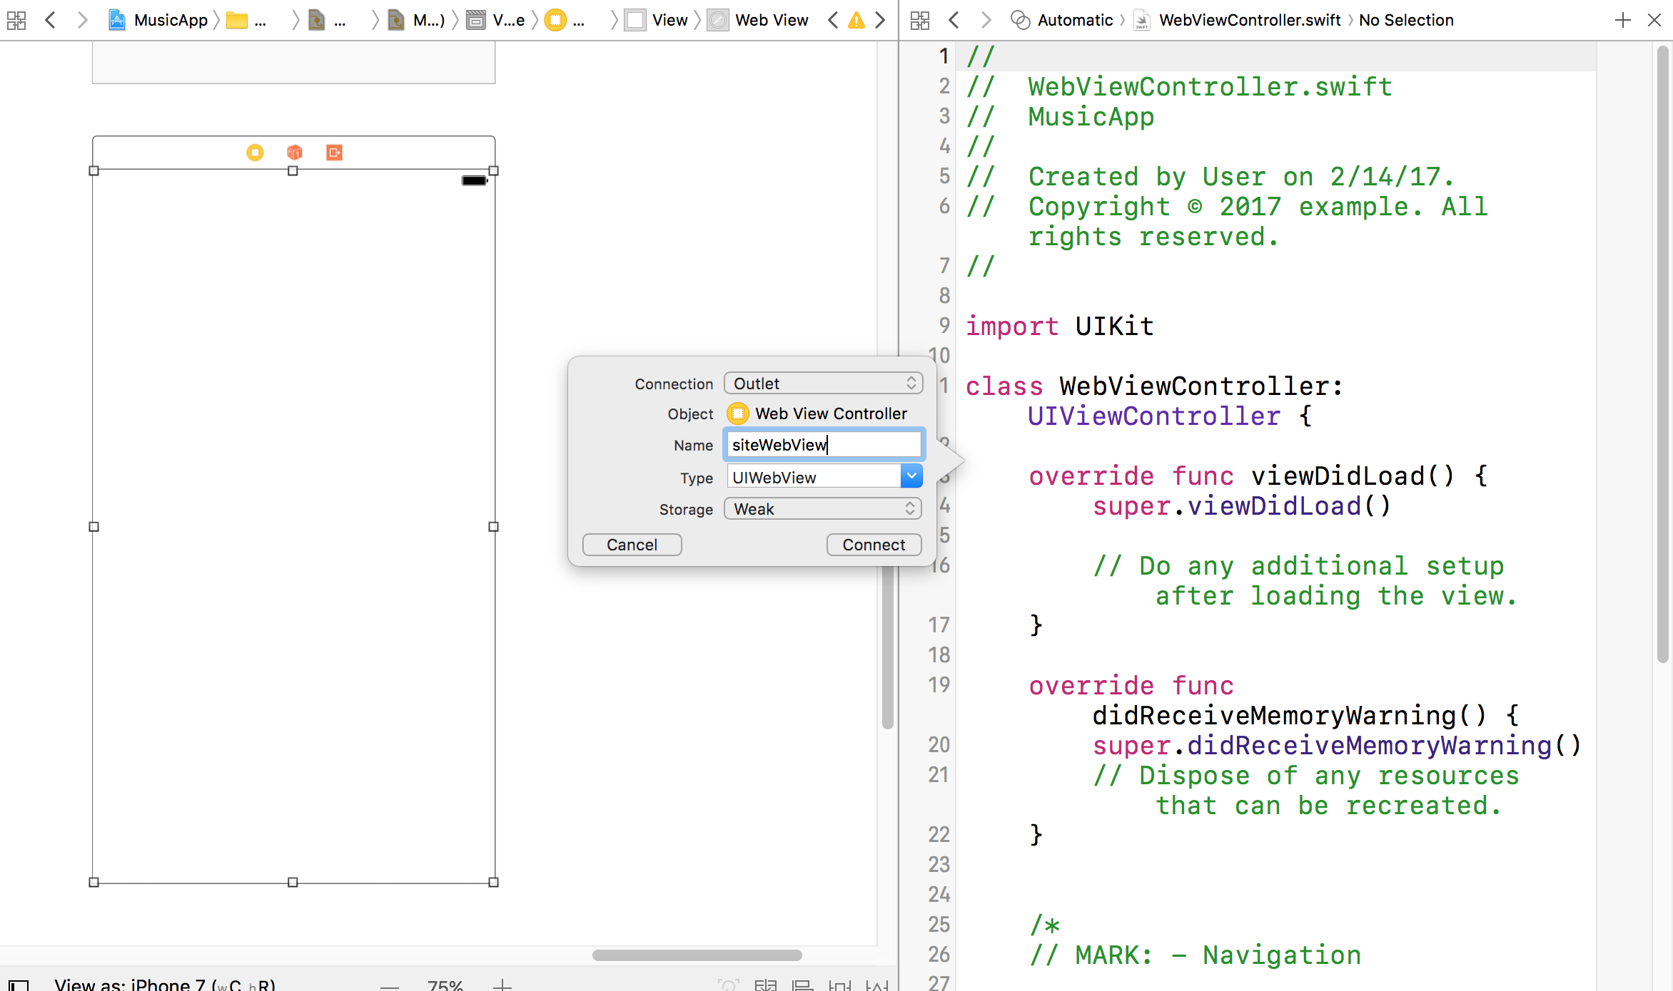
Notes:
If the Document Outline is open, click Hide Document Outline .
2. Click on the Assistant editor icon on the top right of the window.
3. You should now have the storyboard showing on the left and
WebViewController.swift on the right. If WebViewController.swift isn’t showing on
the right side, click the menu bar at the top of the file and choose it.
4. We are going to create an outlet for the UIWebView. Hold Ctrl and drag from the
Web View in the Editor to the WebViewController.swift file below the class
WebViewController: UIViewController line (around line 11).
5. Set the following:
• Connection: Outlet
• Name: siteWebView
• Type: UIWebView
• Storage: Weak
6. Click Connect.

Slide 9
Link to External Webpage
override func viewDidLoad() {
super.viewDidLoad()
// let jiveURL = NSURL(string: "http://www.thejivefactory.com")
let jiveURL = NSURL(string: "https://www.google.com")
// Do any additional setup after loading the view.
}
Notes:
Click on the Standard editor icon at the top right of the window.
9. In the Project Navigator, select WebViewController.swift.
10. Find the viewDidLoad method (around line 15). Here is where we’ll write the code
to go to the webpage. When this view controller loads up for the first time, we’re
going to create an external webpage.
11. First we need to define the URL for the webpage. Around line 18, add the following
bold code:
NOTE: This code creates an instance of an NSURL object and initializes it with the
web address. We now have a usable NSURL object for our webpage.

Slide 10
Link to External Webpage
override func viewDidLoad() {
super.viewDidLoad()
let jiveURL = NSURL(string: "https://www.google.com")
let myNSURLRequest = NSURLRequest(url: jiveURL! as URL)
siteWebView.loadRequest(myNSURLRequest as URLRequest)
}
Notes:
Next, we need to create an instance of an NSURLRequest object.
Add the following bold code:
Now that we have the request, we can tell the Web View outlet to use this request
object using the loadRequest method. Add the following bold code:
Save and run the code – unfortunately we can’t get to it so we need to add a button!

Slide 11
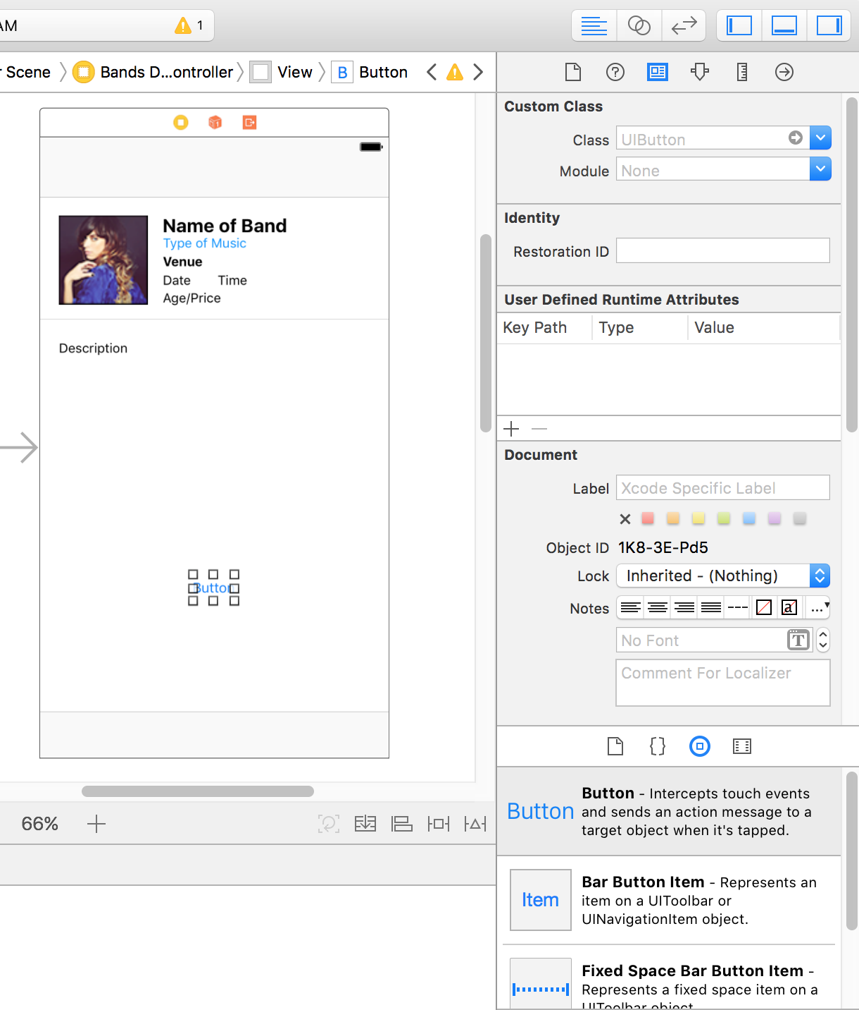
Notes:
Adding a Button
Now that we have programmed the web view to load the webpage, we need to add
a button to the Bands Detail View Controller that will transition users to this view.
1. In the Project Navigator click on Main.storyboard.
2. Make sure you can see the Bands Detail View Controller. It has the placeholder info
including Name of Band, Type of music, etc.
3. In the search bar at the bottom of the Object library , delete any existing text and
type: button
4. Drag a Button and drop it anywhere under the Description. We’ll position it in
a moment.

Slide 12
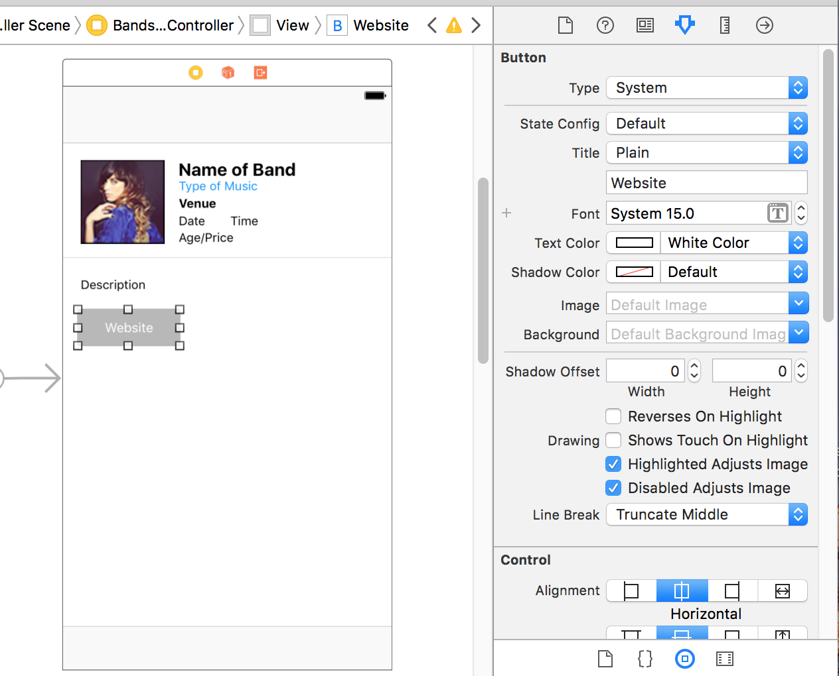
Notes:
Click on the Attributes inspector tab .
6. Scroll down to the View options and set Background to Light Gray Color (click the
arrows on the right side to open the options menu).
7. Under the Button options further up, set the following:
• Text Color: White Color
• Inset, Top and Bottom: 8
• Inset, Left and Right: 15
8. Double–click the Button in the Editor, change the text to Jive Factory Website and
hit Return to apply it.
9. Drag the button below Description, using their guides to align their left edges.

Slide 13
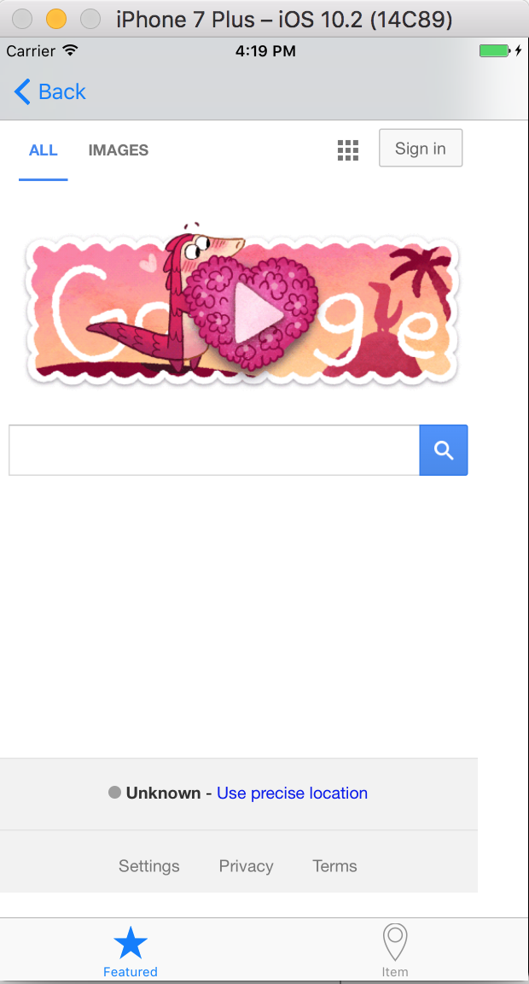
Notes:
10. We need to create a segue from the Bands Detail View Controller to the Web View
Controller. Hold Ctrl and drag from the Jive Factory Website button to the
Web View on the Web View Controller (which should be below it).
11. In the menu that appears, click on Push (deprecated).
12. Time for a preview. Set the active scheme to iPhone 6.
13. Click the Run button and click Stop if you get a warning.
14. When the Simulator finishes loading, click any of the band listings to go into the
detail view.
15. Click the Jive Factory Website button to open the Jive Factory website.

Slide 14
Save your work
git add .
git commit –m “Chapter 4”
Notes:
Will probably just add the new images

Slide 15
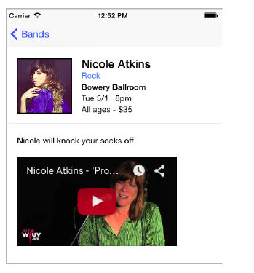
Notes:
Adding a Video
When a user taps the button in the Bands Detail View Controller, we want to load a
video of the band instead of taking users to the Jive Factory website.
1. In the Project Navigator, click on WebViewController.swift.
2. The new code we are adding is going to replace the current code we have linking to
the Jive Factory website. Let’s comment out those three lines of code. Select the
following code (around lines 18–20):
let jiveURL = NSURL(string: "http://www.thejivefactory.com")
let myNSURLRequest = NSURLRequest(URL: jiveURL!)
siteWebView.loadRequest(myNSURLRequest)
3. Press Cmd–/ to comment out the code.
4. First we need to create a new string to hold the YouTube embedded video HTML
code. After the code you just commented out, add the following bold code:
// let jiveURL = NSURL(string: "http://www.thejivefactory.com")
// let myNSURLRequest = NSURLRequest(URL: jiveURL!)
// siteWebView.loadRequest(myNSURLRequest)

Slide 16
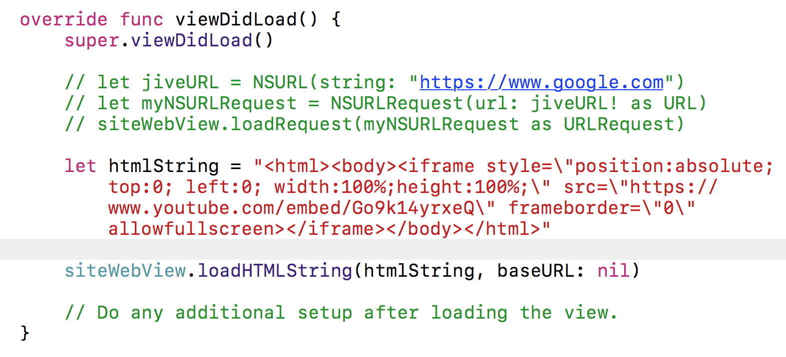
Notes:
let htmlString = "”
Open a web browser and go to: tinyurl.com/nicole-promised
6. Below the video and view count, click the Share link.
7. Below that, click the Embed tab. Under that, you should see some HTML code.
8. Below the code, click SHOW MORE.
9. UNcheck Show suggested videos when the video finishes.
10. Click into the HTML code and hit Cmd–A to select it all.
11. Press Cmd–C to copy it.
12. Close the web browser window.
13. Switch back to Xcode.
We’ve prepared some code for you in a file to make the video flexible (responsive).
Unfortunately YouTube doesn’t include this.
14. Go to File > Open (or hit Cmd–O).

Slide 17
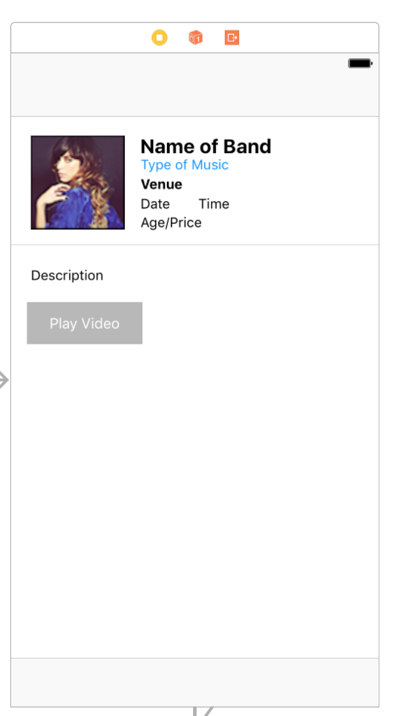
Notes:
29. In the Project Navigator, click on Main.storyboard.
30. Scroll over to the Bands Detail View Controller.
31. Double–click on the name of the Jive Factory Website button, change the name to
Play Video and hit Return. Don’t worry about the positioning for now.
32. Click the Run button.
NOTE: If you get a warning asking if you want to Stop “Jive Factory”, click Stop.
33. When the Simulator finishes loading, click one of the band listings.
34. Click the Play Video button.
35. You should see the Web View Controller now has a video preview. Click on it
to play.
36. After the video starts playing, click the Done button to go back to the Web
View Controller.

Slide 18
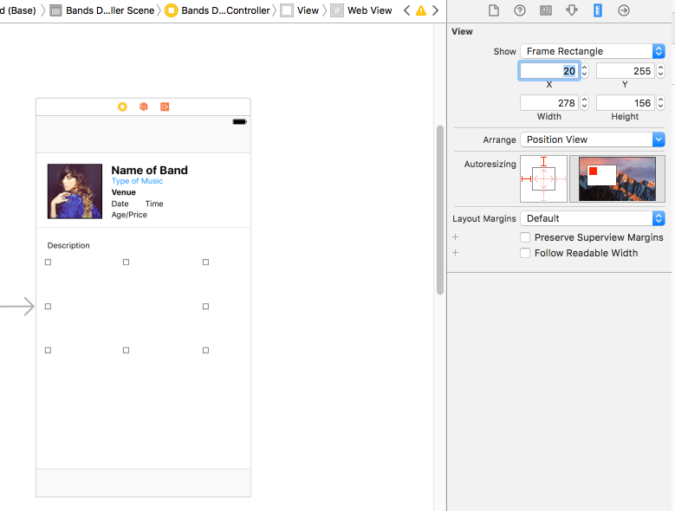
Notes:
Moving the Video to the Band Detail
Now that we think about it, it seems unnecessary to go to a whole other view to
play the video. Let’s add the video directly in the Bands Detail View Controller.
1. Switch back to Xcode.
2. Select the Play Video button on the Bands Detail View Controller and hit Delete.
3. In the search bar at the bottom of the Object library , delete any existing text and type: web
Drag Web View below the Description. Don’t worry about placement, we’ll set
that next.
5. With the Web View still selected in the Editor, in the Utilities area on the right, click
on the Size inspector tab .
6. In the Size inspector set the following:
• X: 20
• Y: 255
• Width: 278
• Height: 156

Slide 19
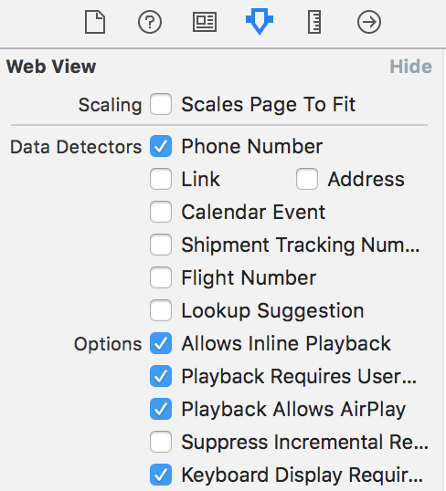
Notes:
Click on the Attributes inspector tab .
8. Next to the very first option, Scaling, make sure Scales Page To Fit is NOT checked.
The code we provided is responsive and adapts itself to different device sizes, so it
will size itself accordingly without the need for scaling!

Slide 20
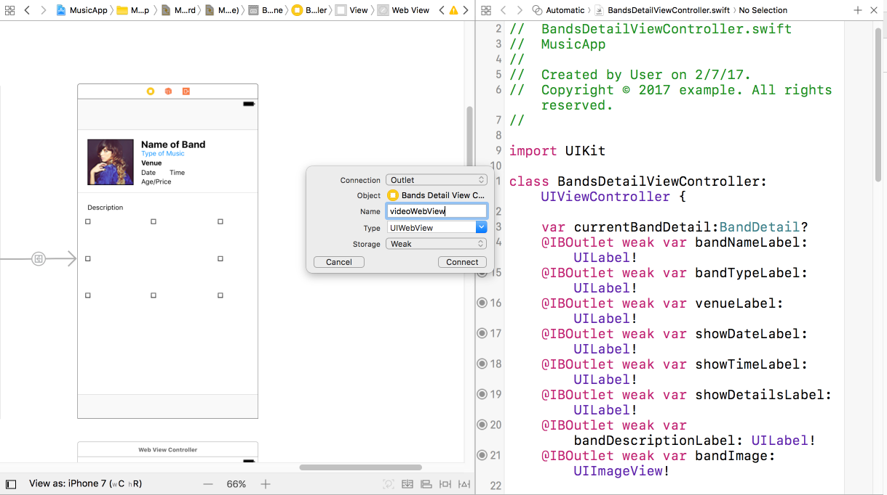
Notes:
Click on the Assistant editor icon in the top right of the window. We want to
see the storyboard showing on the left next to BandsDetailViewController.swift on
the right.
10. If BandsDetailViewController.swift isn’t showing on the right side, click the menu
bar at the top of the file and choose it.
11. We are going to create an outlet for the UIWebView on this page. Hold Ctrl and
drag from the Web View element in the Editor to the
BandsDetailViewController.swift file below the last property line (around line 22).
12. Set the following:
• Connection: Outlet
• Name: videoWebView
• Type: UIWebView
• Storage: Weak
13. Click Connect.

Slide 21
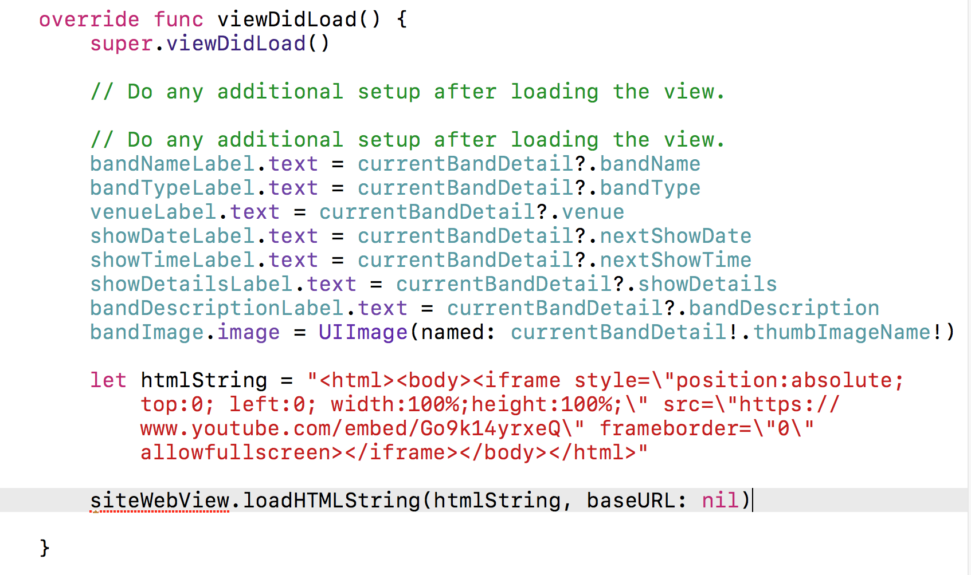
Notes:
14. Click on the Standard editor icon at the top right of the window.
15. Now we need to move the video code. We can copy and paste the code we already
have from the WebViewController.swift file. In the Project Navigator, click on
WebViewController.swift.
16. Select the embedded video code in the viewDidLoad method (around lines 22–24):
let htmlString = "<html><body><iframe style=\"position:absolute; top:0; left:
0; width:100%; height:100%;\" src=\"http://www.youtube.com/embed/Go9k14yrxeQ?
rel=0\" frameborder=\"0\" allowfullscreen></iframe></body></html>"
siteWebView.loadHTMLString(htmlString, baseURL: nil)
17. Hit Cmd–C to copy it.
18. Go to BandsDetailViewController.swift.
19. Find the viewDidLoad method (around line 24).
20. At the end of the method, paste the code you just copied:
bandImage.image = UIImage(named: currentBandDetail!.fullImageName!)
let htmlString = "<html><body><iframe style=\"position:absolute; top:0;
left:0; width:100%; height:100%;\" src=\"http://www.youtube.com/embed/
Go9k14yrxeQ?rel=0\" frameborder=\"0\" allowfullscreen></iframe></body></html>"
siteWebView.loadHTMLString(htmlString, baseURL: nil)
}

Slide 22
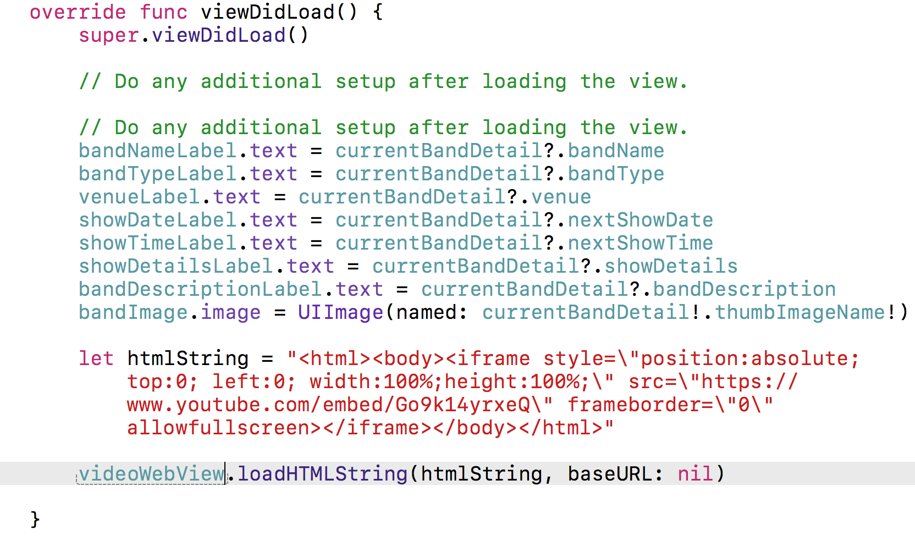
Notes:
14. Click on the Standard editor icon at the top right of the window.
15. Now we need to move the video code. We can copy and paste the code we already
have from the WebViewController.swift file. In the Project Navigator, click on
WebViewController.swift.
16. Select the embedded video code in the viewDidLoad method (around lines 22–24):
let htmlString = "<html><body><iframe style=\"position:absolute; top:0; left:
0; width:100%; height:100%;\" src=\"http://www.youtube.com/embed/Go9k14yrxeQ?
rel=0\" frameborder=\"0\" allowfullscreen></iframe></body></html>"
siteWebView.loadHTMLString(htmlString, baseURL: nil)
17. Hit Cmd–C to copy it.
18. Go to BandsDetailViewController.swift.
19. Find the viewDidLoad method (around line 24).
20. At the end of the method, paste the code you just copied:
bandImage.image = UIImage(named: currentBandDetail!.fullImageName!)
let htmlString = "<html><body><iframe style=\"position:absolute; top:0;
left:0; width:100%; height:100%;\" src=\"http://www.youtube.com/embed/
Go9k14yrxeQ?rel=0\" frameborder=\"0\" allowfullscreen></iframe></body></html>"
siteWebView.loadHTMLString(htmlString, baseURL: nil)
}

Slide 23
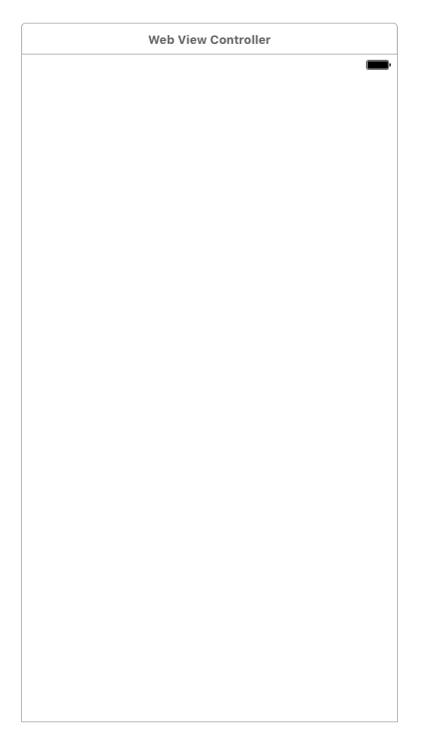
Notes:
2. Click the top of the Web View Controller to select it. (Be sure to get the controller
that’s below the Bands Detail View Controller, not the Web View!) The controller
should become outlined in blue.
3. Hit Delete to remove it.
4. Notice in the Project Navigator, we still have WebViewController.swift. Select it.
5. Hit Delete.
6. When asked about moving the files, click Move to Trash.
7. Hit Cmd–S to save.
8. Keep this file open. In the next exercise, we’ll add a different YouTube video for
each band.

Slide 24
Agenda
Chapter 5 and 6 from Nobledesktop book

