Slide 1
Building iOS Swift apps
5030-201720_MCS5993_M: 5030-Topics in Computer Science
5031-201720_MCS4993_M: 5031-Topics in MA/CS

Slide 2
Agenda
Chapter 5C, Appendix B from Nobledesktop book
Customizing the App for iPad
App Settings – Icons and Launch Images
Submitting to the app Store

Slide 3
Save your work
git add .
git commit –m “Chapter 5”
Notes:
Will probably just add the new images

Slide 4
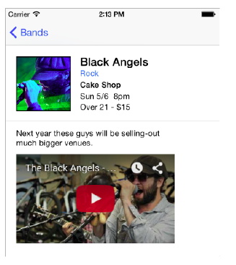
Setting the video for each band
Notes:
Will probably just add the new images

Slide 5
import UIKit
class BandDetail: NSObject {
var bandName:String? var bandType:String? var bandDescription:String? var fullImageName:String? var thumbImageName:String? var nextShowDate:String? var nextShowTime:String? var venue:String? var showDetails:String? var videoURL:String?
}
Notes:
If you remember from a previous exercise, the details for the four bands are
contained in objects of the BandDetail class we created. We want to pass along the
correct youtube.com video URL for each of these bands. First we need to add a new
property to our class to hold the video URL.

Slide 6
nicoleAtkinsBandDetail.videoURL = "http://www.youtube.com/embed/Go9k14yrxeQ?rel=0"
ambulanceLtdDetails.videoURL = "http://www.youtube.com/embed/l2uzjdxRVyw?rel=0"
sleepiesDetails.videoURL = "http://www.youtube.com/embed/npQNt3YDI5Q?rel=0"
blackAngelsDetails.videoURL = "http://www.youtube.com/embed/c-VEcHM-UVY?rel=0"
Notes:
Add to BandsTableViewController after the previous band information

Slide 7
let htmlString = "<html><body><iframe style=\"position:absolute; top:0; left:0; width:100%;height:100%;\" src=\"https://www.youtube.com/embed/Go9k14yrxeQ\" frameborder=\"0\" allowfullscreen></iframe></body></html>”
let htmlString = "<html><body><iframe style=\"position:absolute; top:0; left:0; width:100%;height:100%;\" src=\"\(currentBandDetail!.videoURL!)\" frameborder=\"0\" allowfullscreen></iframe></body></html>"
Notes:
Add to BandsTableViewController after the previous band information

Slide 8
Chapter 6
Making the App for the real world
Notes:
Up to this point, we have been constructing our app with static data. We did this so
we could more easily learn the basics of working on an iOS application without
having to stop and spend a lot of time talking about data. It’s served us well for now,
however in the real world it’s very unlikely that an app like this would have hardcoded
data in it. If it did, we’d have to go in and manually update the arrays that
store the bands’ data and re-submit to Apple each time we wanted to add or modify
the details of a band. The more realistic scenario is that all of the bands’ data would
be stored in the “Cloud” somewhere and get delivered to the application via a REST
API. The term REST API means that data would be returned via web calls to certain
URLs that would then be parsed/interpreted by the app. This is the way the majority
of the applications you are used to using on your mobile devices work.

Slide 9
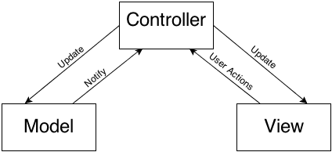
MVC
Notes:
Another new term that we are going to delve into is a concept called MVC which
stands for: Model, View, Controller. MVC is a software design pattern that is widely
used in mobile and web applications and in fact, iOS is based on using it. Up
until this point we have been dealing with View Controllers and their views
consistently, so we’re two-thirds of the way there. What we haven’t done is separate
our Data layer from our Controller layer. Right now our data is all mixed in.
The MVC concept is simple: The Controller talks to the Model and gets the data
needed. The Controller interprets the data and tells the View how to display it to the
user. In this way, the design, the application logic, and the data model are all kept in
their own neat little places and if any of the three need to be changed, it can be
done without breaking the rest of the application. It also makes it easier to work on
an app with more than 1 developer.

Slide 10
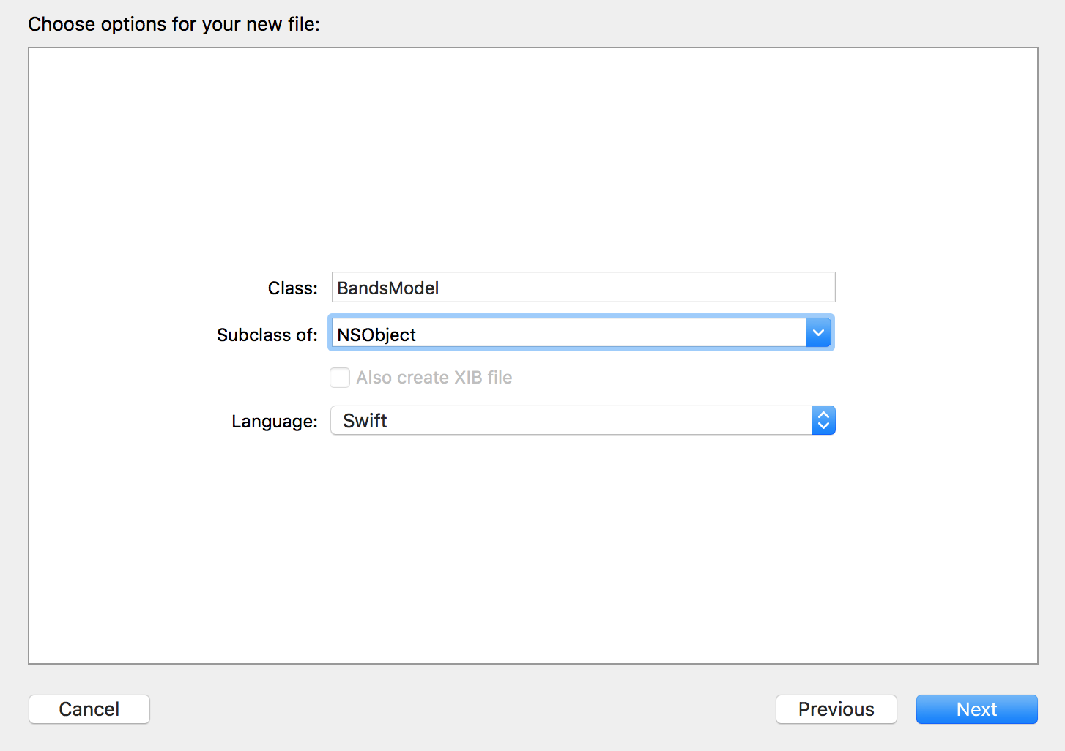
Notes:
Setting Up a Model
The first step in updating our application for the real world is setting up a model and
moving our data into it.
1. In the Project Navigator, select AppDelegate.swift. (We want the file to be added
after this file, that’s why we had you select it.)
2. Go to File > New > File or hit Cmd–N.
3. On the left, under iOS select Source.
4. Double–click on Cocoa Touch Class to choose it.
5. For Class type: BandsModel
6. From the Subclass of menu, choose NSObject (or start typing it and let Xcode
autocomplete it for you)
7. Make sure Language is set to Swift.
8. Click Next.
9. Make sure you are in the Jive Factory folder, and click Create.

Slide 11
class BandsModel: NSObject {
var bandDetails = [BandDetail]()
}
Notes:
In the Project Navigator, notice BandsModel.swift has been added. Now we have a
class we can work with.
11. The first thing we want to do is to put the bandDetails array into the BandsModel.
Open the BandsModel.swift class, if it isn’t already.
12. Add the following bold code into the BandsModel class:
class BandsModel: NSObject {
var bandDetails = [BandDetail]()
}

Slide 12
class BandsModel: NSObject {
var bandDetails = [BandDetail]()
func fetch() {
}
}
Notes:
Next we want to create a method in the BandsModel called parseData.
Add it just below the bandDetails property, as shown:

Slide 13
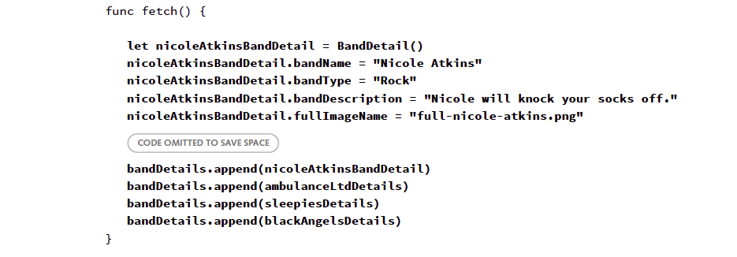
Notes:
14. Now we are going to take the code that sets up the bandDetails array from the
BandsTableViewController and paste it in the BandsModel class.
Go to BandsTableViewController.swift.
15. Select the code in the viewDidLoad method (around lines 21-72).
16. Cut (Cmd–X) the code.
17. Go back to BandsModel.swift.
Paste (Cmd–V) it all in the fetch method (around line 15). Your code should look
as follows:

Slide 14
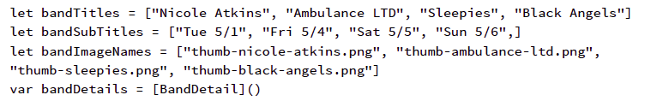
Notes:
Now let’s finish fixing up our BandsTableViewController class so that it can work with
our model. Go to BandsTableViewController.swift.
21. Find the four properties at the top of the file (around lines 13-16) and delete them:
let bandTitles = ["Nicole Atkins", "Ambulance LTD", "Sleepies", "Black Angels"]
let bandSubTitles = ["Tue 5/1", "Fri 5/4", "Sat 5/5", "Sun 5/6",]
let bandImageNames = ["thumb-nicole-atkins.png", "thumb-ambulance-ltd.png",
"thumb-sleepies.png", "thumb-black-angels.png"]
var bandDetails = [BandDetail]()

Slide 15
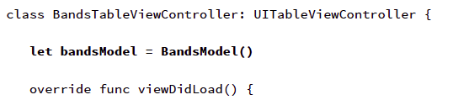
Notes:
Now we need to create an instance of the band model where the old properties once existed.
Add the following bold code:
class BandsTableViewController: UITableViewController {
let bandsModel = BandsModel()
override func viewDidLoad() {

Slide 16

Notes:
Now in the viewDidLoad method we want to call the model’s fetch method. What’s
going to happen here is that when this screen gets loaded, it will trigger the model
to parse the data so we can use it to build the table and display it to the user. Add
the following bold code (around line 18):

Slide 17
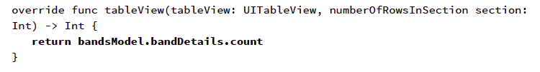
Notes:
We need to fix up our table a bit. You’ll remember from previous exercises that we’re
using the data from the arrays to populate the table while passing the data stored in
the bandDetail object to the details page. This actually isn’t a great method. A better
way is to have a single data source that is shared by the whole app.
Still in BandsTableViewController.swift, locate the numberOfRowsInSection method
(around line 34). Replace everything inside it with the bold code, changing its return
to the count from the bandDetails array in the model:

Slide 18
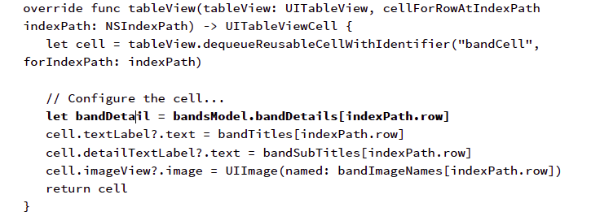
Notes:
In the cellForRowAtIndexPath method, we will configure the cell based on the model’s data. Add the bold code around line 42:
NOTE: Notice that the first thing we do is create an instance of the bandDetail object
from the information in the array. This allows us to neatly capture and grab the data
for later use.

Slide 19
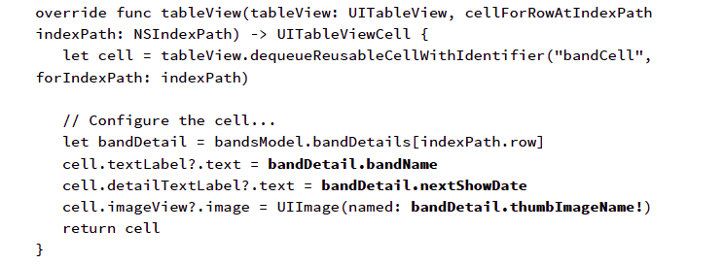
Notes:
In the cellForRowAtIndexPath method, we will configure the cell based on the model’s data. Add the bold code around line 42:
NOTE: Notice that the first thing we do is create an instance of the bandDetail object
from the information in the array. This allows us to neatly capture and grab the data
for later use.

Slide 20
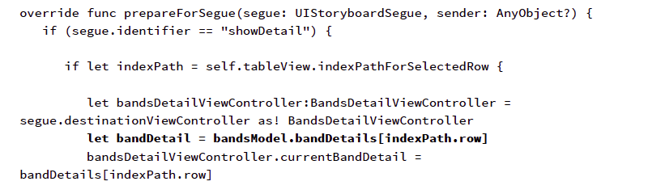
Notes:
Finally we need to go to the prepareForSegue method and update it to pass data
from the model. Add the bold code around line 99:

Slide 21
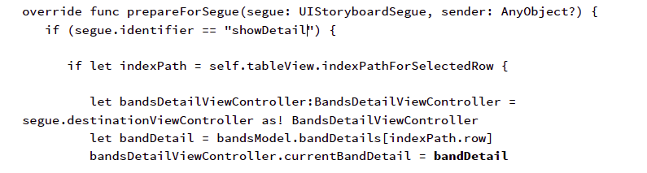
Notes:
Edit the code around line 98, as shown:
Click the Run button.
Go ahead and explore the app’s features to see the app is functioning fully, but now
its data is being supported by the model.

Slide 22
Firebase
Interact with a web service
Create a backend to store our data
Parse data from the cloud for display in our application
Notes:
Interact with a web service
Create a backend to store our data
Parse data from the cloud for display in our application

Slide 23
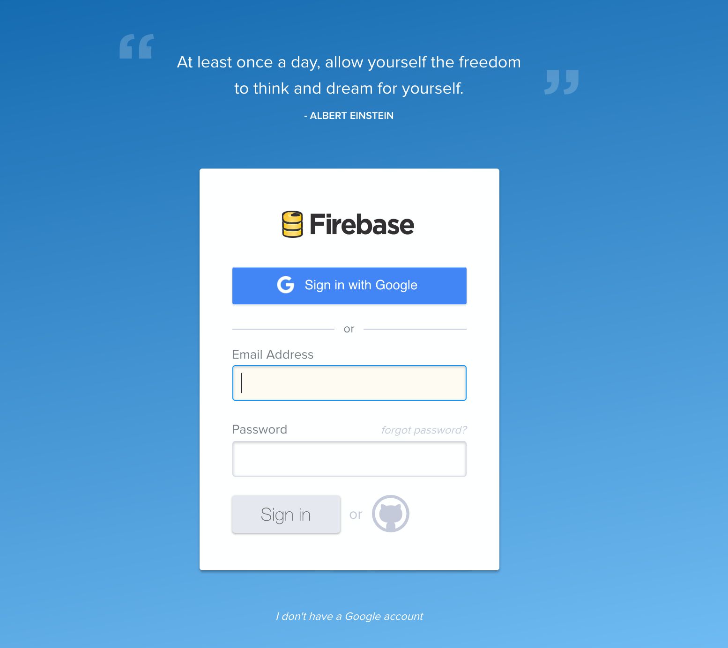
Firebase
Notes:
Always changing – but we can’t use Parse anymore

Slide 24
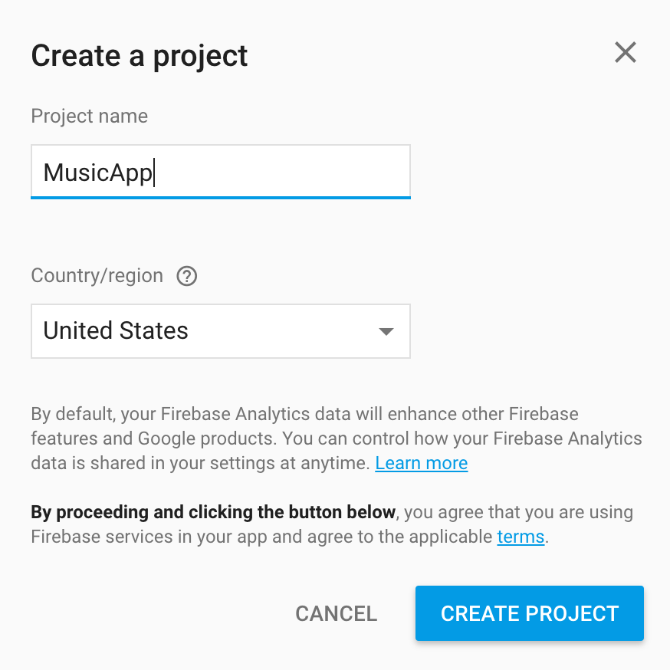
Firebase

Slide 25
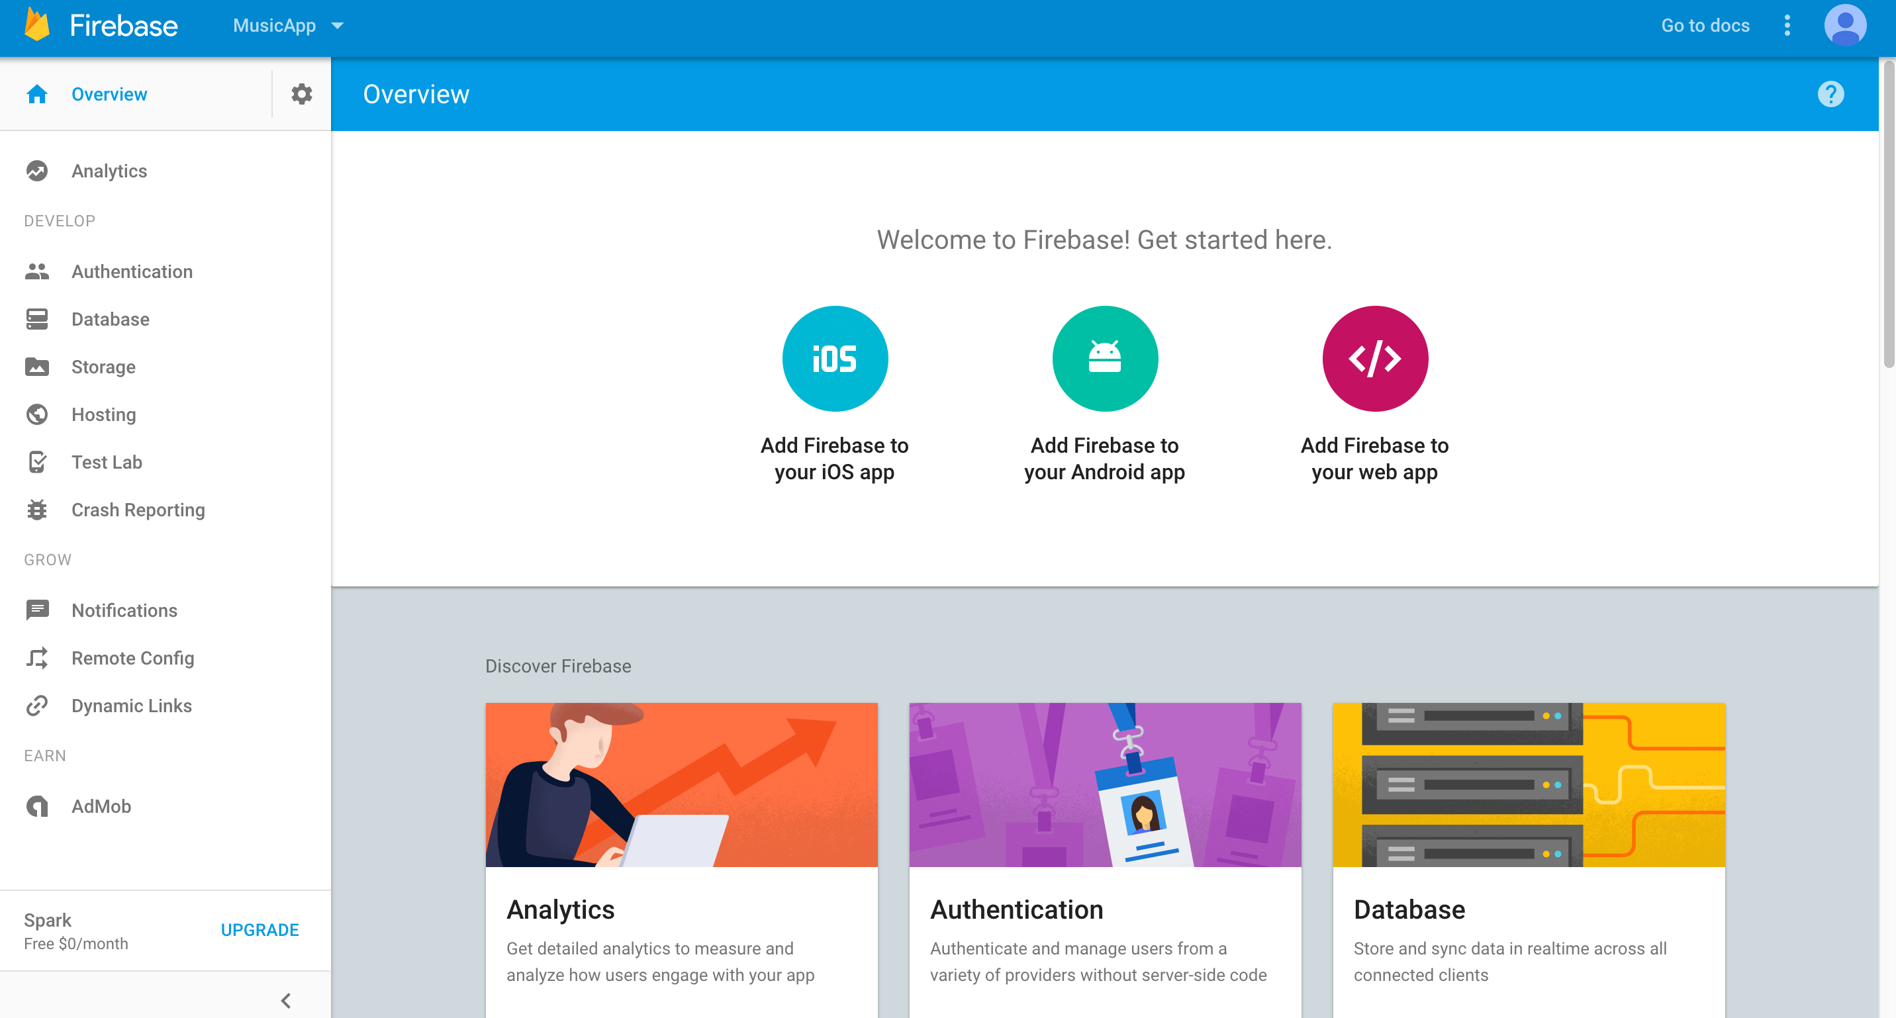
Firebase
Notes:
Adding Dependencies
Now we need to add the dependencies required by Firebase. Dependencies are
libraries of code that another library needs in order to run. Remember back to an
earlier exercise when we imported MapKit? That was a dependency that we added
to the project.
We will use a utility called CocoaPods, which allows developers to easily add libraries
and dependencies to projects. It is commonly the case that you may want to use one
library, but because it is dependent on other libraries, you’ll need to add
(and maintain) them as well in order for the one library to work. CocoaPods helps
simplify things for developers who want to install a library by maintaining any
additional dependencies.

Slide 26
Firebase
sudo gem install cocoapods
pod init
vi podfile

Slide 27
Podfile
pod 'Firebase/Core'
use_frameworks!
Notes:
pod 'Firebase', '>=2.5.0'
use_frameworks!

Slide 28
Podfile
>pod install
Close project and open xcworkspace file
Notes:
pod 'Firebase', '>=2.5.0'
use_frameworks!

Slide 29
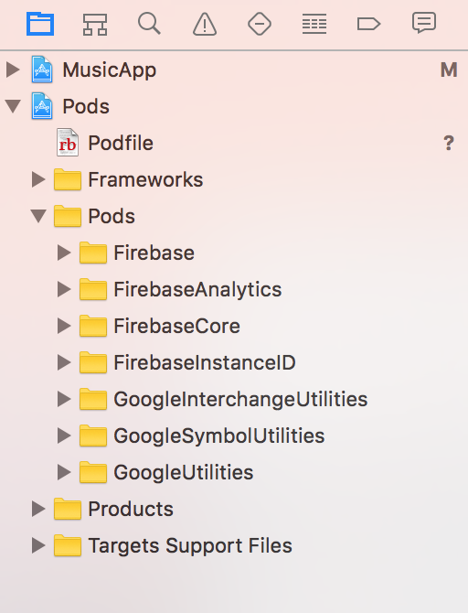
Notes:
pod 'Firebase', '>=2.5.0'
use_frameworks!

Slide 30
Agenda Tuesday
MVC Design Pattern
Connecting to REST API, Sqlite

