Slide 1
Building iOS Swift apps
5030-201720_MCS5993_M: 5030-Topics in Computer Science
5031-201720_MCS4993_M: 5031-Topics in MA/CS

Slide 2
Agenda
Chapter 6 from Nobledesktop book
Complete Firebase integration

Slide 3
Save your work
git add .
git commit –m “pods”

Slide 4
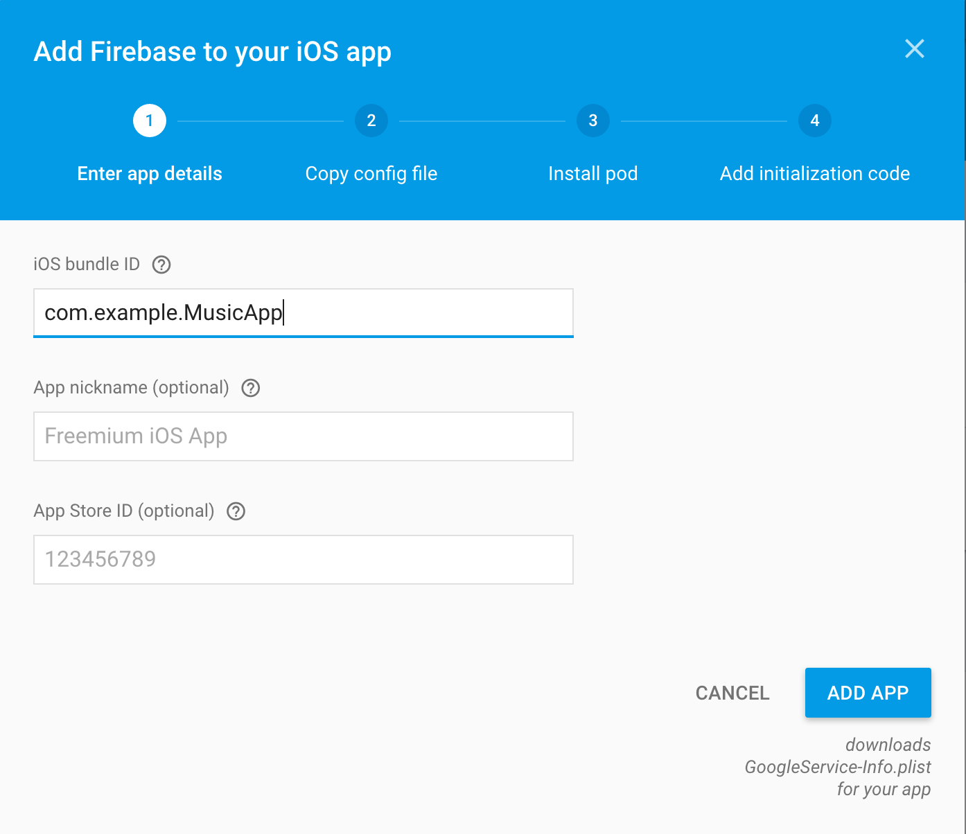

Slide 5
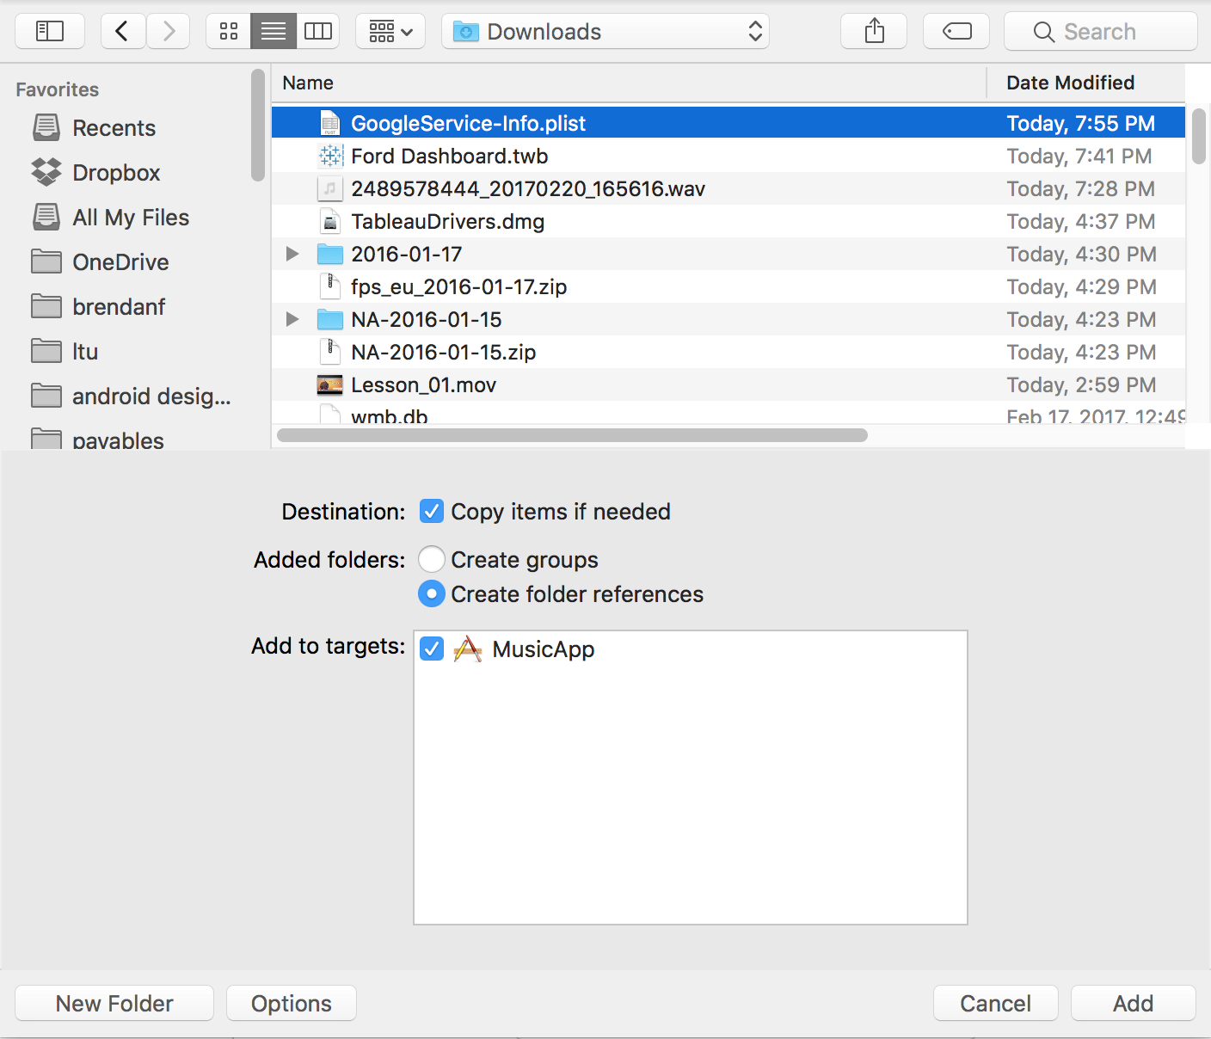

Slide 6
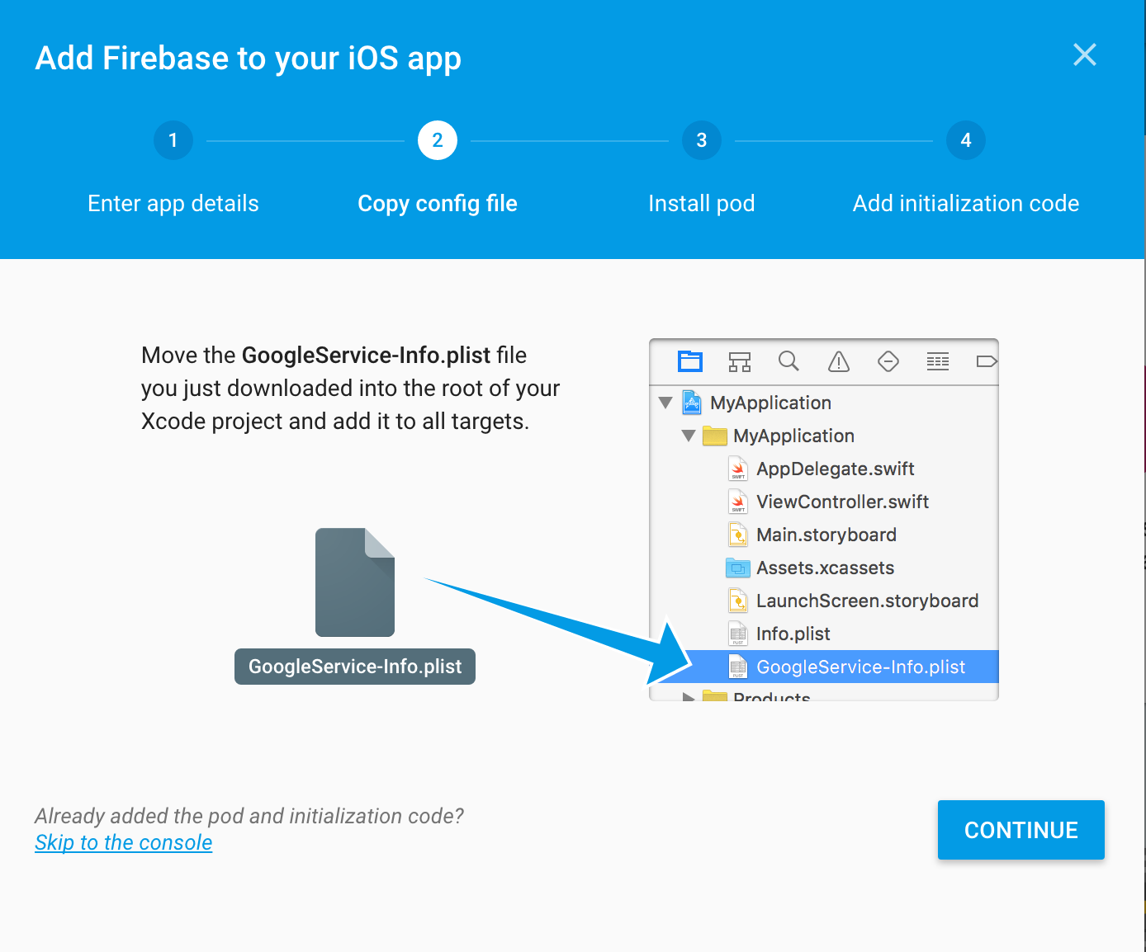

Slide 7
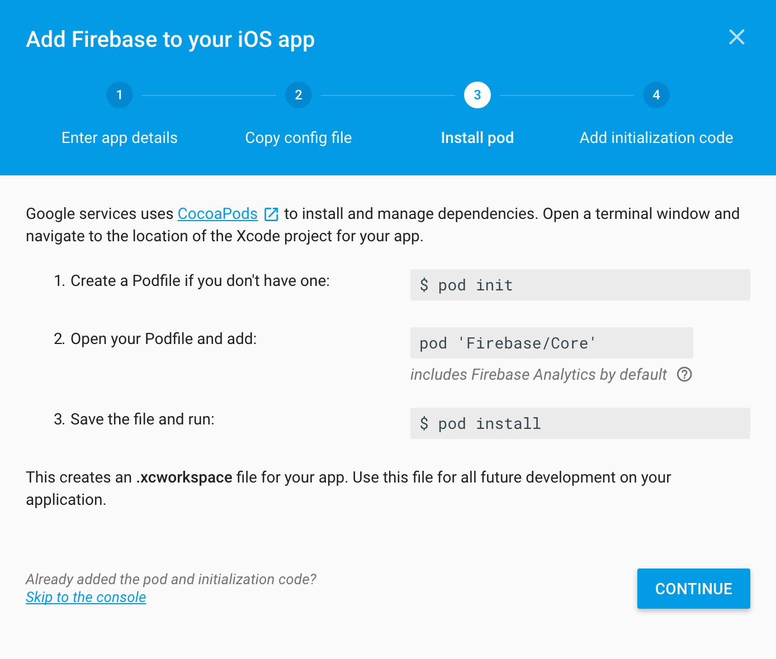

Slide 8
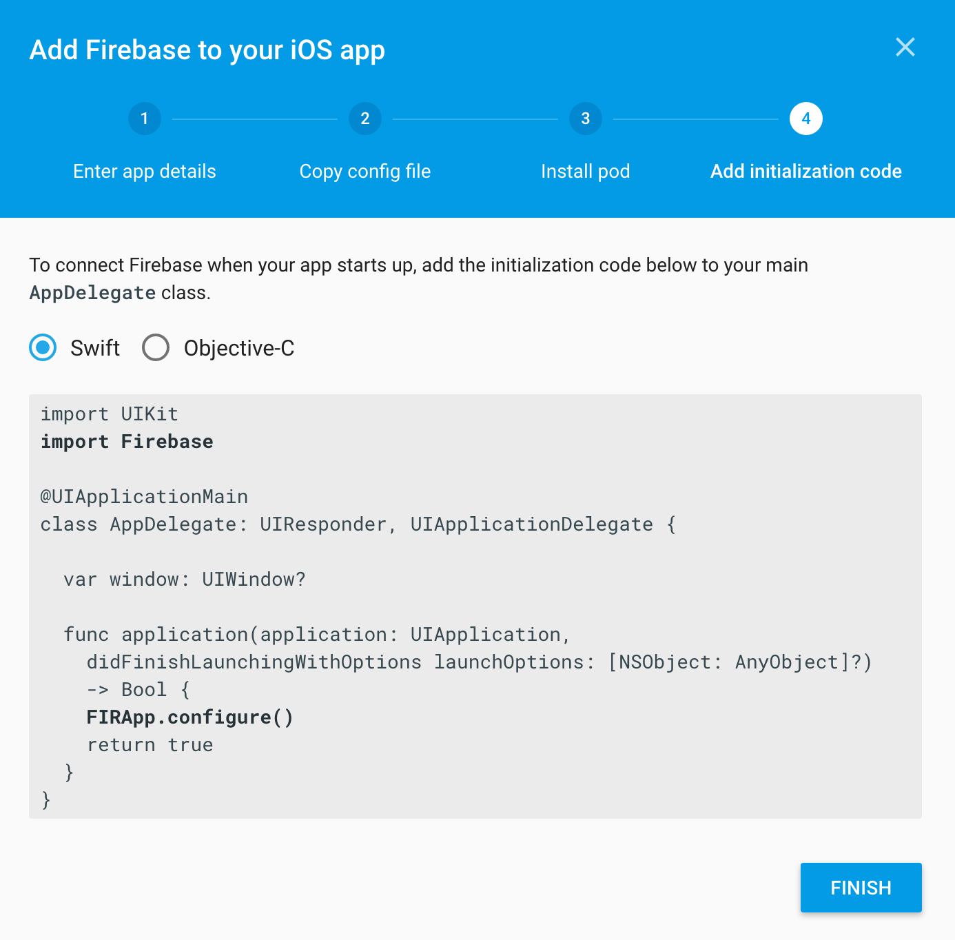

Slide 9
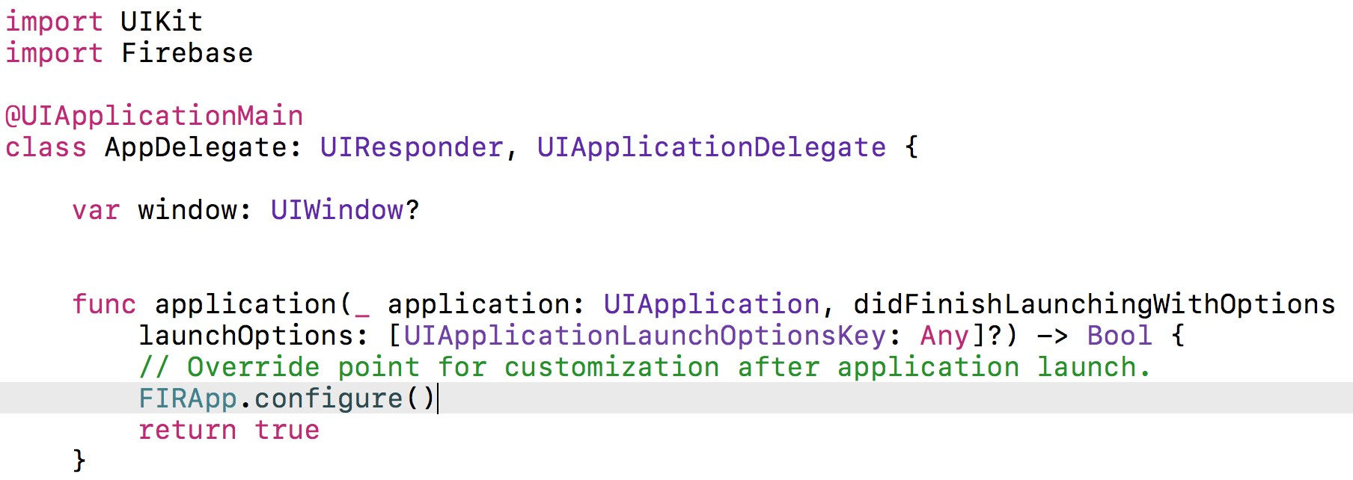

Slide 10
Firebase/Database
Add Firebase/Database to podfile
pod install
Close and reopen workspace

Slide 11
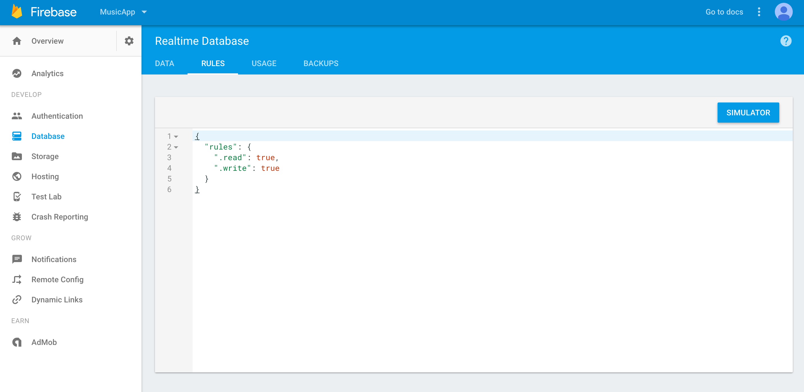
Notes:
Also, by default, the Firebase database requires user authentication for reading and writing. To change it, go to the Firebase dashboard in your browser and select the Database option on the left, followed by the RULES tab and set the rules as follows:
Then select the PUBLISH button to save your changes.

Slide 12
override func viewDidLoad() { super.viewDidLoad() bandsModel.fetch()
let myRootRef = FIRDatabase.database().reference()
// Write data to Firebase myRootRef.setValue("Do you have data? You'll love Firebase.")
myRootRef.observe(.value, with: { snapshot in print("\(snapshot.key) -> \(snapshot.value)") })
}
Notes:
Quick test that we’re all connected

Slide 13
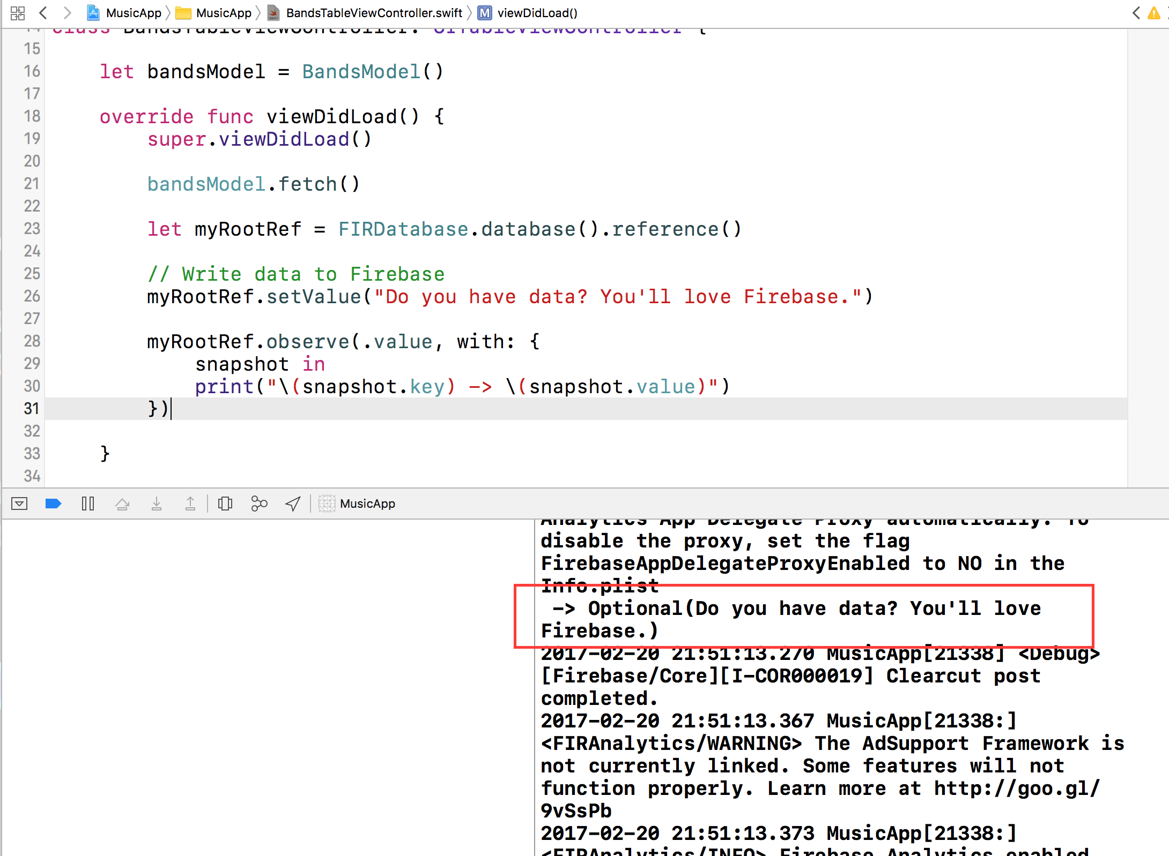
Notes:
Quick test that we’re all connected

Slide 14
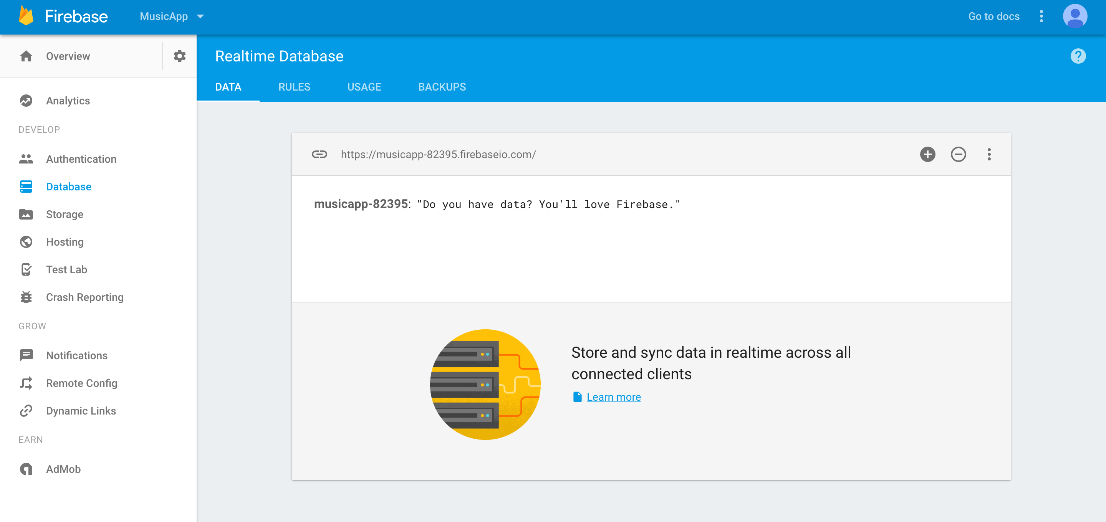
Notes:
Quick test that we’re all connected

Slide 15
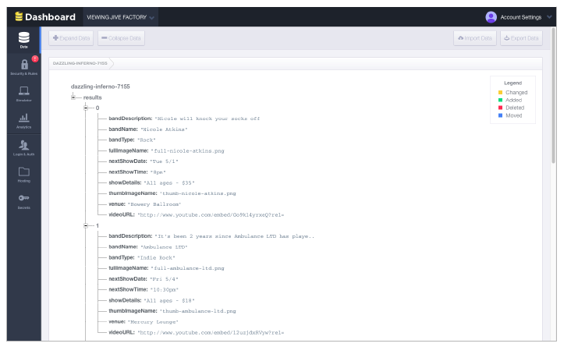
Notes:
In this exercise you’ll create a band database in Firebase and connect it to the app

Slide 16
Save your work
git add .
git commit –m “Connected Firebase”

Slide 17
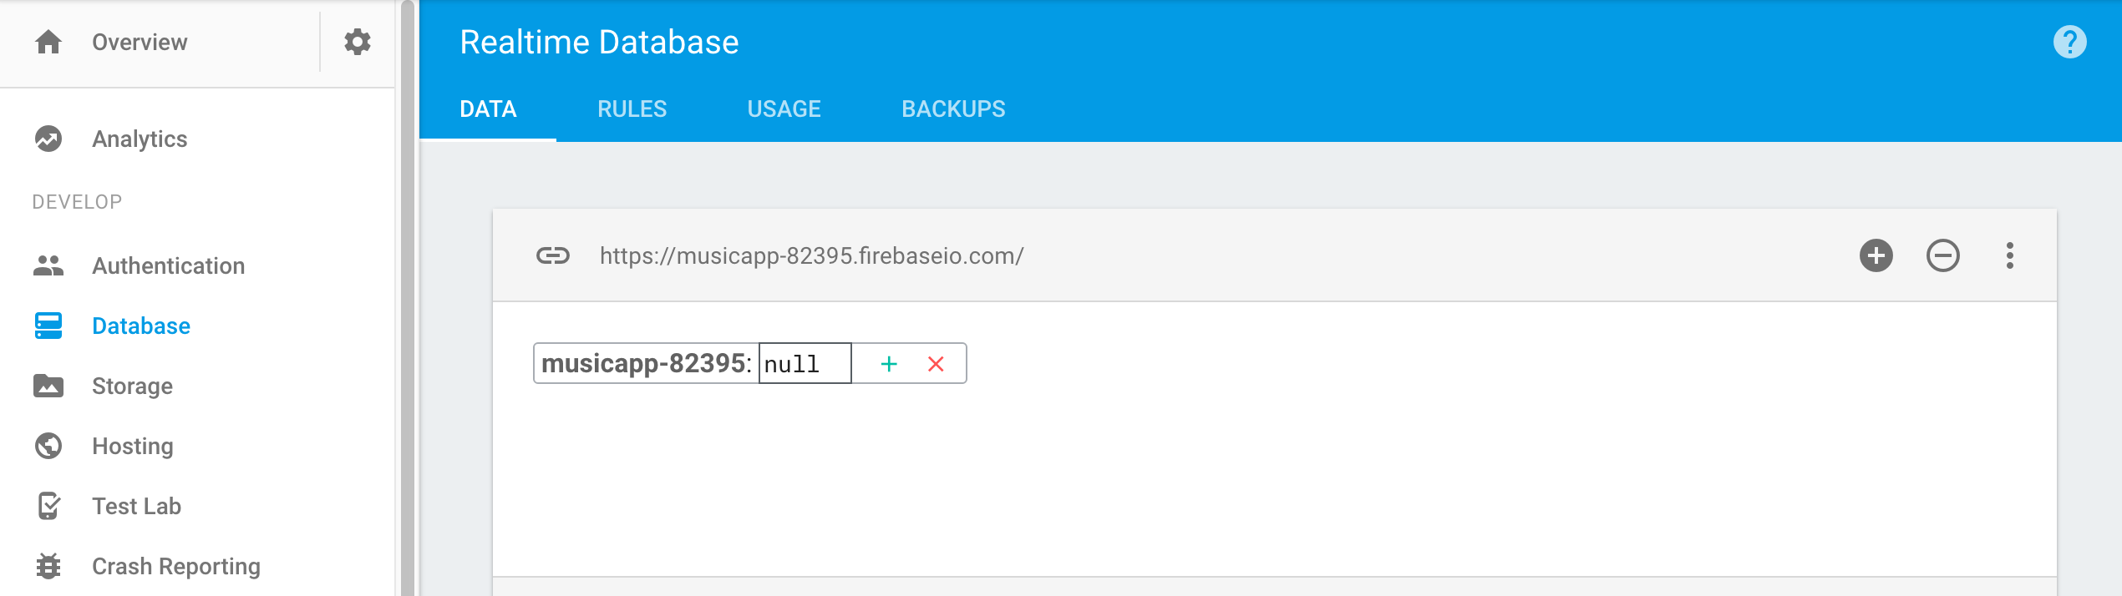
Notes:
If your user dashboard isn’t still open in your web browser, go to firebase.com/
account/ If you are not logged in, do so now.
2. Under the Jive Factory app, click Manage App.
3. Delete the data we just wrote
4. To add data to our database, hover over your app’s unique identifier and click the green + (plus) symbol next to it:

Slide 18
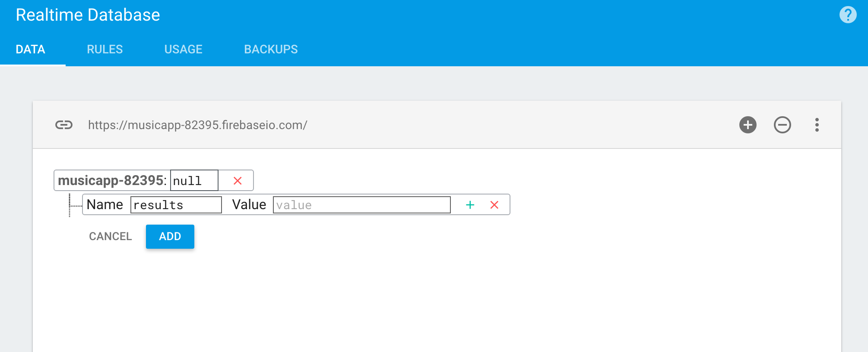
Notes:
Set the following in the text fields that appear:
name: results
value: Leave it blank
Now that we have a dataset available to us, let’s take a minute to learn a bit about it.
Databases are traditionally made up of tables. This is what Firebase presents to us in
its interface. In a table, each entry will be a row. The row we just added will act like
an array, as we did not give it a value. It will be the parent of all the data we want
to add.

Slide 19
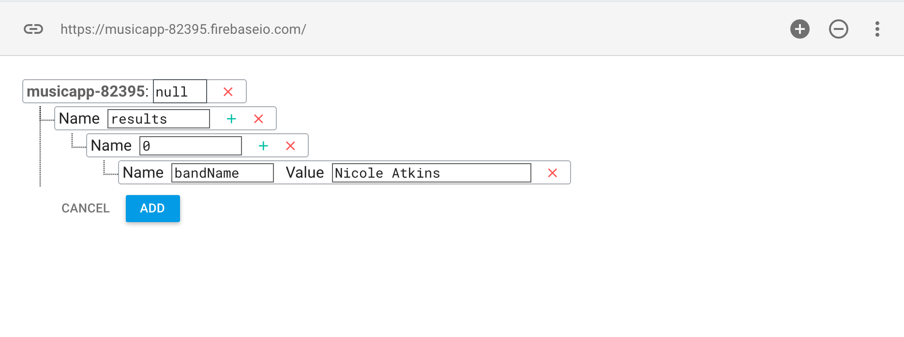
Notes:
5. Let’s create another array of data within the parent object. Click the plus next to
value to make another set of text fields appear.
6. Set name to 0 (indicating the zeroth index of an array). Leave value blank and click
the plus next to it.
NOTE: This ensures that each band will get its own row in the database (represented
by its own index in the array). We’ll only add one band’s data for now.
7. We next want to add columns within the array for all of Nicole Atkins’ band details.
In the next set of text fields, set the following and do NOT click the plus yet:
name: bandName
value: Nicole Atkins
Setting both a name and a value creates a key-value pair. In iOS, this is stored in a
collection of objects called a Dictionary. The name corresponds to a property in our
BandsModel, and the value is the one that corresponds to Nicole Atkins’ info.

Slide 20
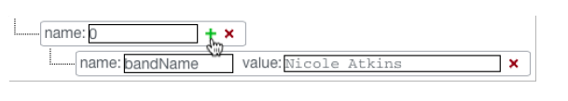
Notes:
To create a new column at the same array index, click the plus next to 0:

Slide 21
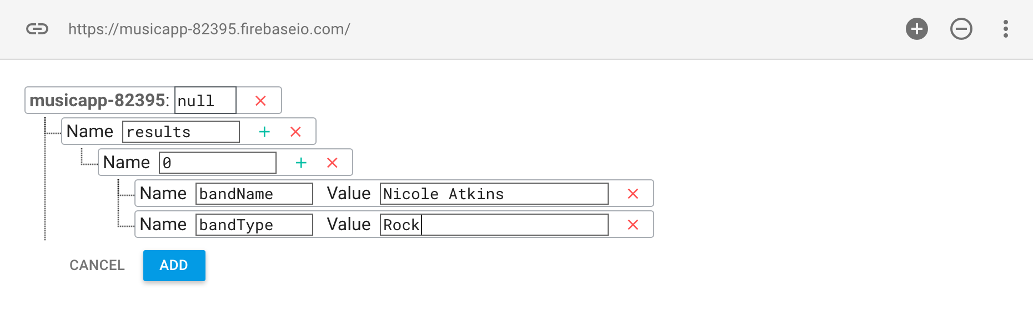
Notes:
In the new text fields, set name to bandType and value to Rock.
10. Once again, click the plus next to the 0 a couple of rows above.
11. It’s important that the names of the keys and values in the database match the
properties and values in our app exactly. Some of the values we’re about to add are
a real mouthful, so it’s a good idea to copy/paste them. Switch to Xcode.
12. In the Project Navigator , click on BandsModel.swift if it isn’t already open.

Slide 22
name | value
bandDescription | Nicole will knock your socks off.
fullImageName | full-nicole-atkins.png
thumbImageName | thumb-nicole-atkins.png
nextShowDate | Tue 5/1
nextShowTime | 8pm
venue | Bowery Ballroom
showDetails | All ages - $35
videoUrl | http://www.youtube.com/embed/Go9k14yrxeQ?rel=0
Notes:
In the new text fields, set name to bandType and value to Rock.
10. Once again, click the plus next to the 0 a couple of rows above.
11. It’s important that the names of the keys and values in the database match the
properties and values in our app exactly. Some of the values we’re about to add are
a real mouthful, so it’s a good idea to copy/paste them. Switch to Xcode.
12. In the Project Navigator , click on BandsModel.swift if it isn’t already open.
Copy the bandDescription value (Nicole will knock your socks off. minus the
quotation marks) around line 17, then switch back to your Firebase dashboard.

Slide 23
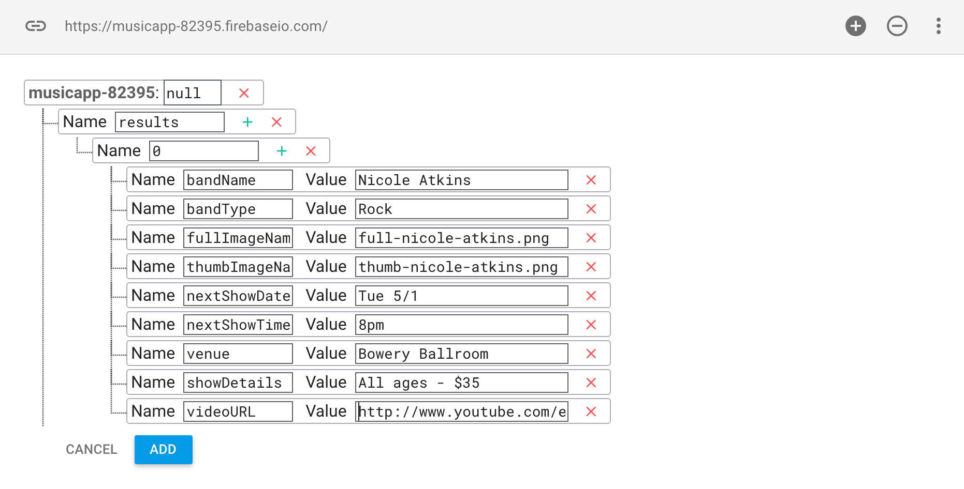
Notes:
14. Repeat the process from the previous steps to fill in the rest of the array with these
key-value pairs (feel free to switch back to BandsModel.swift in Xcode to copy the
data, then paste it in your Firebase dashboard):

Slide 24
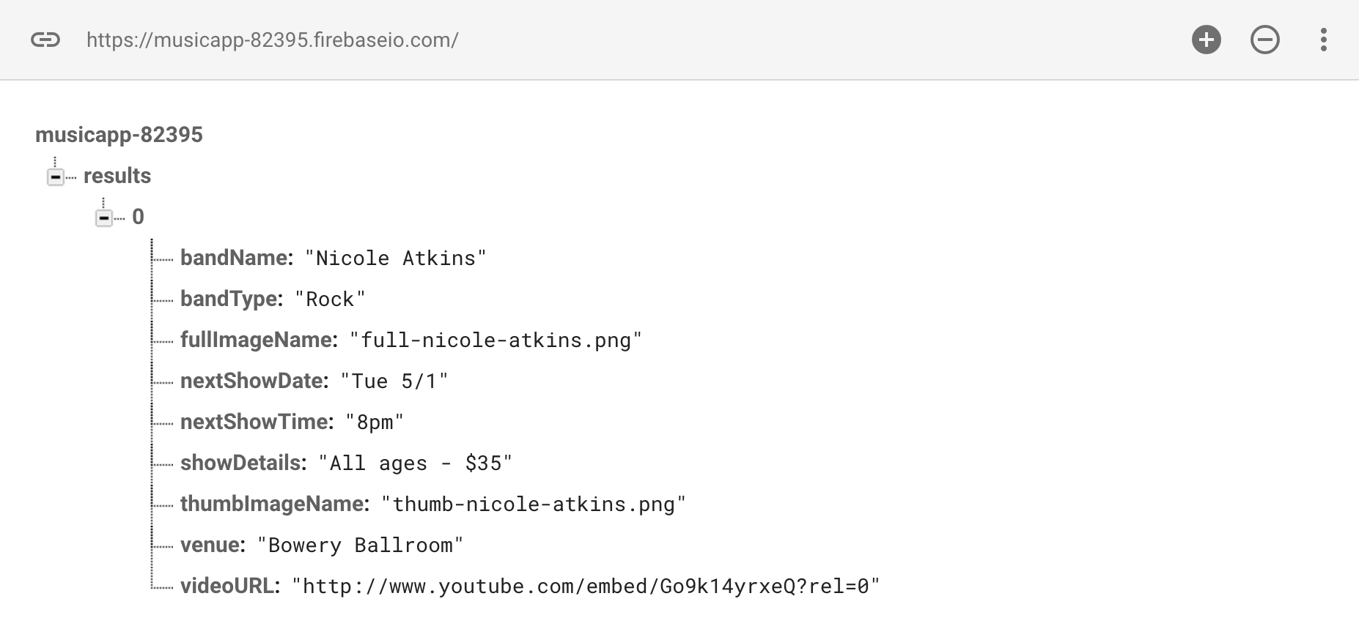
Notes:
Click Add and then you should see the following

Slide 25
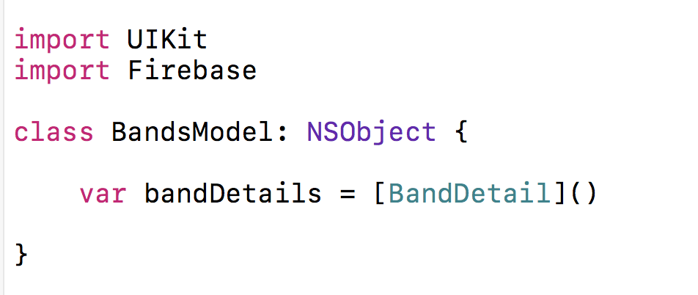
Notes:
Connecting the Model with Firebase
Now that we have a database populated with some data, we will need to update our
model to fetch and parse the data.
1. Switch to Xcode and in the Project Navigator open BandsModel.swift.
2. Around line 10, import Firebase by adding the bold code:
import Firebase
3. Around lines 14–67, select and delete the entire fetch() method as shown:

Slide 26
Notes:
Connecting the Model with Firebase
Now that we have a database populated with some data, we will need to update our
model to fetch and parse the data.
1. Switch to Xcode and in the Project Navigator open BandsModel.swift.
2. Around line 10, import Firebase by adding the bold code:
import Firebase
3. Around lines 14–67, select and delete the entire fetch() method as shown:

Slide 27
var bandDetails = [BandDetail]()
func fetch(complete:(Void)->Void){
}

Slide 28
var bandDetails = [BandDetail]()
func fetch(complete:(Void)->Void){
// Get a reference to my Firebase URL
let myRootRef = FIRDatabase.database().reference()
}
Notes:
The first thing we want to do is initialize the Firebase object by pointing it to your
app’s URL. Luckily the Firebase object is a designated initializer, which means we can
conveniently do so on one line. Add the following bold comment and code, being
sure to use your app’s unique identifier instead of dazzling-inferno-7155:
(see earlier example)

Slide 29
var bandDetails = [BandDetail]()
func fetch(complete:(Void)->Void){
// Get a reference to my Firebase URL
let myRootRef = FIRDatabase.database().reference()
// Attach a closure to read the data stored at the URL
myRootRef.observe(.value, with: {[weak self]
snapshot in })
}
Notes:
Now we need to add a closure so our app can read the data stored in the URL. As
shown below in bold, use Firebase’s observeEventType() method to set up an event
listener that can listen for any changes to our database:
The code we just added gets pinged automatically every time there’s new data in the
database. This is all we need to keep the app’s data up-to-date. Let’s take a moment
to learn how it works:
• We’re getting a snapshot passed back in the completion block. A snapshot is a
representation of the current data in a particular place in our database.
• There are a few different types of events Firebase can listen for. We set it up to
listen for .Value events, which fire anytime a snapshot changes.
• If you want to access properties of the main class within a closure, you need to use
self. That can create a memory management nightmare called a strong reference
cycle. We added a [weak self] block to make the BandsModel class’ properties a
weak reference within the closure, essentially avoiding that.

Slide 30
var bandDetails = [BandDetail]()
func fetch(complete:(Void)->Void){
// Get a reference to my Firebase URL
let myRootRef = FIRDatabase.database().reference()
// Attach a closure to read the data stored at the URL
myRootRef.observe(.value, with: {[weak self]
snapshot in
if let snapshots = snapshot.children.allObjects as? [FIRDataSnapshot] {
print(snapshot.value)
} })
}
Notes:
Around line 21, place the cursor between snapshot in and }) and add the following
bold block that returns a FDataSnapshot object (Firebase’s custom data type for a
snapshot) that contains our data:
Earlier in the exercise, we structured our data so the parent object (results) holds
arrays for each band. These nested arrays and the key-value pairs stored within them
are the children of snapshot, and we want all these child objects to get returned. To
see if this works, we’re going to print those contents to the log.

Slide 31
print(snapshot.value)
for snap in snapshots {
if let array = snap.value as? NSArray {
}
}
Notes:
Now that we have a constant that stores all the snapshot’s child objects, we want to
iterate through each array index. Add the following bold code:
Essentially what we’re doing here is using conditional binding to ensure that the child objects are of the NSArray data type.
This is because we might have other types of objects in our database. snap is helping us pull out each item from the array.
If the value of that snap is an array, it’ll get set to the array constant.

Slide 32
print(snapshot.value)
for snap in snapshots {
if let array = snap.value as? NSArray {
for dict in array {
if let object = dict as? Dictionary<String, AnyObject> {
}
}
}
}
Notes:
If you remember from earlier, the array with a key of 0 has multiple key-value pairs.
These are each entries in a Dictionary. Now that we’ve iterated through that array,
we need to iterate through its child dictionaries. To do that, add the bold code:
NOTE: dict is helping us pull out each item from the dictionary. We’re making sure
dict is actually a Dictionary with String objects for keys and values that are objects of
any data type (AnyObject). This is because we don’t know necessarily what the type
of the value is going to be. If it passes, we’ll continue on, and our dictionary data will
be set to the object constant.

Slide 33
if let object = dict as? Dictionary<String, AnyObject> {
let bandDetail = BandDetail()
bandDetail.bandName = object["bandName"] as? String
bandDetail.bandType = object["bandType"] as? String
bandDetail.bandDescription = object["bandDescription"] as? String
bandDetail.fullImageName = object["fullImageName"] as? String
bandDetail.thumbImageName = object["thumbImageName"] as? String
bandDetail.nextShowDate = object["nextShowDate"] as? String
bandDetail.nextShowTime = object["nextShowTime"] as? String
bandDetail.venue = object["venue"] as? String
bandDetail.showDetails = object["showDetails"] as? String
bandDetail.videoURL = object["videoURL"] as? String
}
Notes:
Scan the code. Notice that we’re creating an instance of the bandDetail object, then
assigning values to all of the properties in our bandDetail object. We are accessing
the values using the keys that we stored in our Firebase database (such as
bandName) and Firebase will give us the value associated with that key. We say as?
String, to coerce it into being a string.

Slide 34
bandDetail.videoURL = object["videoURL"] as? String
// A little memory management
if let strongSelf = self {
strongSelf.bandDetails.append(bandDetail)
}
}
Notes:
Let’s break down the memory management aspect of the code we just wrote:
• This code refers to the [weak self] block we added to the closure around line 20.
That previous code basically turned self into a weak reference within the closure,
preventing a strong reference cycle.
• Here we’re saying “if self doesn’t equal nil, then we’re creating a strong reference
to a version of self that will only live inside of the closure.”
• The weak self/strong self type design pattern we’re using here and in the block is
a very typical technique. It guarantees that the instance of self that we created up
in the [weak self] block doesn’t disappear, or we don’t try to access it because it
was released for some reason.
• strongSelf.bandDetails is a strongly referred to item within the closure, but it’s
weakly referred to in regard to the entire class. It should get you a nice reference
to your object.

Slide 35
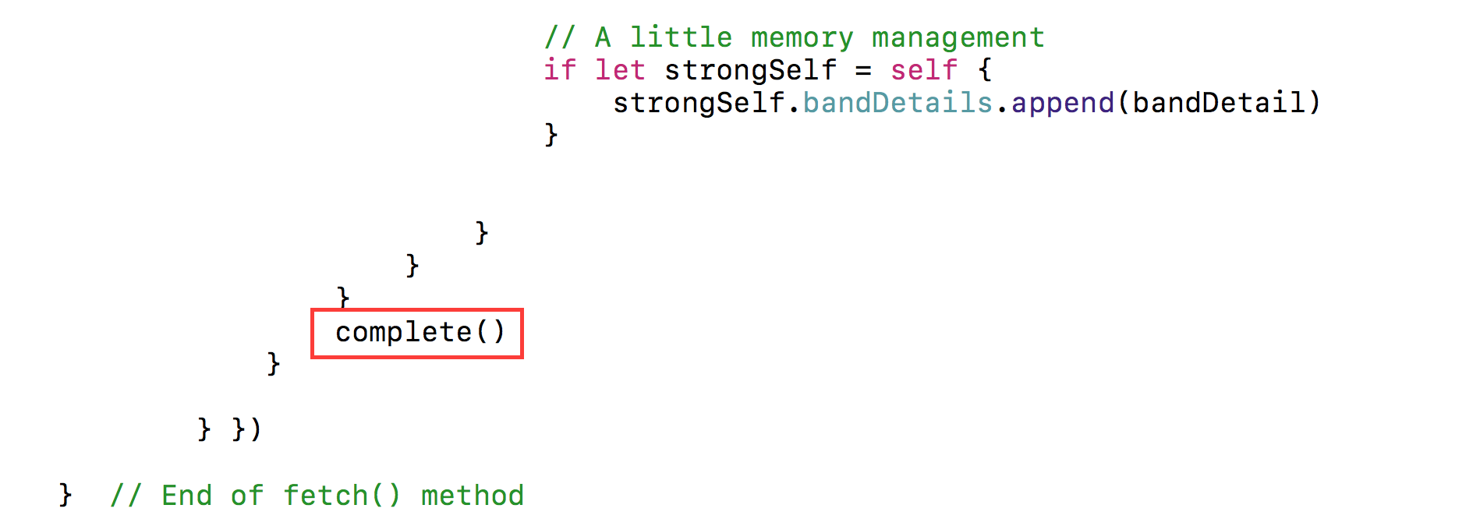
Notes:
Since Firebase’s observeEventType() function around line 20 executes
asynchronously, we need to use a completion block and not just a return. Around
line 50, add a complete() at the end of our method, outside of our loop:

Slide 36
override func viewDidLoad() {
super.viewDidLoad()
bandsModel.fetch {[weak self] (Void) -> Void in
if let strongSelf = self {
strongSelf.tableView.reloadData()
}
}
}
Notes:
Connecting the View Controller with the Model
Now that we have updated our model to work with our external data source, let’s
update our BandsViewController to work with the model.
1. In the Project Navigator , go to BandsTableViewController.swift.
2. In the viewDidLoad() around line 19, select the entire bandsModel.fetch() method
and delete it.
3. Type the following bold code:
override func viewDidLoad() {
super.viewDidLoad()
This method also has this weak self/strong self type design pattern. When this view
loads, we hit line 19 and call the fetch() method which talks to our model. Our
model then talks to Firebase, and when it is done, it calls complete(), which pings our
fetch() method, and tells the table view to reload. So let’s try it.

Slide 37
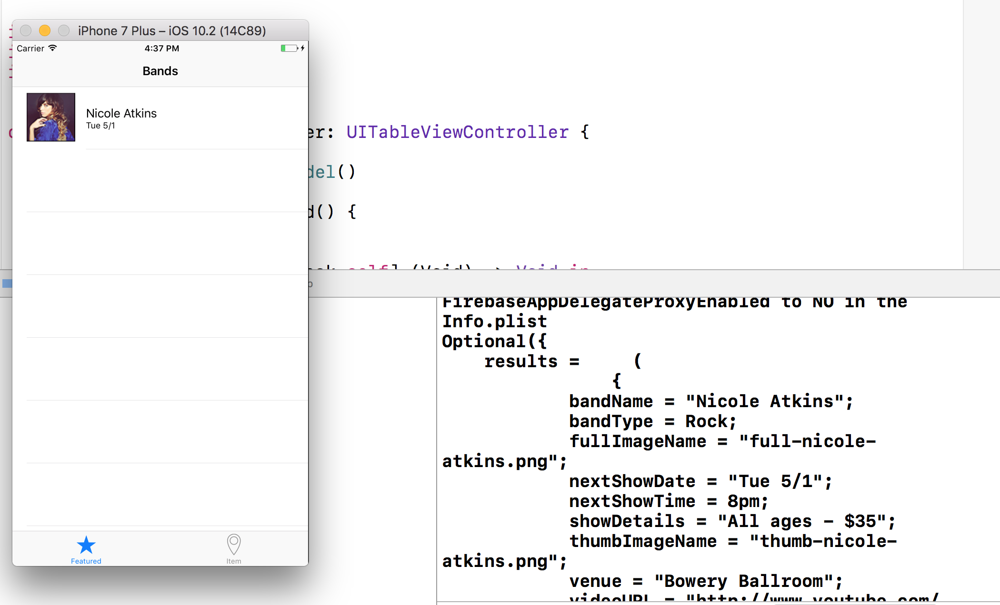
Notes:
For testing purposes, we added a print() function to our model. It should print out
the contents of our Firebase array. This helpful feedback will show up in the Debug
area at the bottom of the screen, so if it isn’t showing, go to the top and click Hide
or show the Debug area .
5. Click Run to fire up the simulator so we can test.
Nicole’s row on the table view should look the same as in previous exercises. That’s
because the data is still the same as when we had static data in our model. It’s just
coming from an external datasource on the Internet now.
6. Switch back to Xcode and find the log on the right side of the Debug area.
In our log file you should see the entire results array, which means the whole object
is there. This is our snapshot. All the code we added ensures that Firebase returns all
the objects from the child array and dictionary. Exactly what we want!

Slide 38
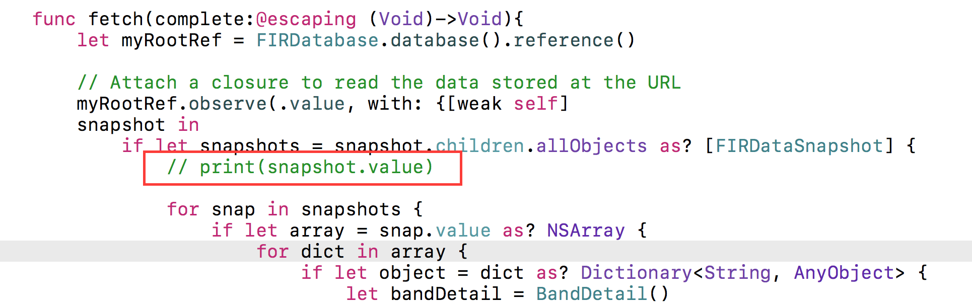
Notes:
Now that we know the code works, we no longer need the print() function. Still in
Xcode, switch to BandsModel.swift.
8. Around line 24, delete the following line of code:
print(snapshot.value)

Slide 39
Notes:
Now that we know the code works, we no longer need the print() function. Still in
Xcode, switch to BandsModel.swift.
8. Around line 24, delete the following line of code:
print(snapshot.value)

Slide 40
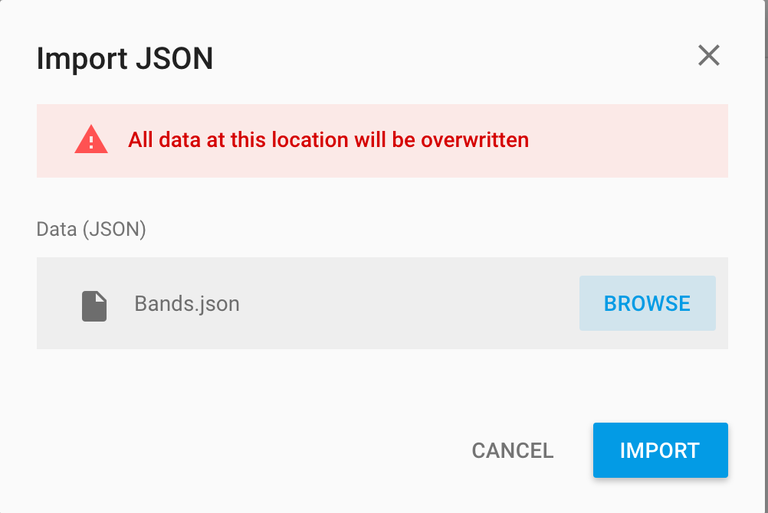
Import More Data
Notes:
Importing More Data
We need to add details for the other three bands. We had you hand-import Nicole’s
data so you could understand how the structure of a database works, and so you
could get your hands wet. But manually typing in data is tedious, and there’s a
better way.
JSON, short for JavaScript Object Notation, is a text format that can share data with
apps or sites written in any language. It is the current standard for data transfer via
REST APIs. Firebase allows us to import data directly from a JSON file.
The Firebase data we already have is structured just like JSON, which is organized as
one parent object (like our results array), followed by other arrays (which can have
key-value pairs nested within). This means that all it takes to get more data into our
app is simply to import our data in JSON format. Let’s check it out to make sure.
1. Return to Firebase in your browser, and in the Data Dashboard, click on the Import
Data button in the top right of the page.
2. In the dialog that pops up, click Choose File.
3. Navigate to Desktop > Class Files > yourname-iOS Dev Level 2 Class > Code
Snippets and double–click on Bands.json to select it.
4. With the file chosen, now click Import JSON.
IOS

Slide 41
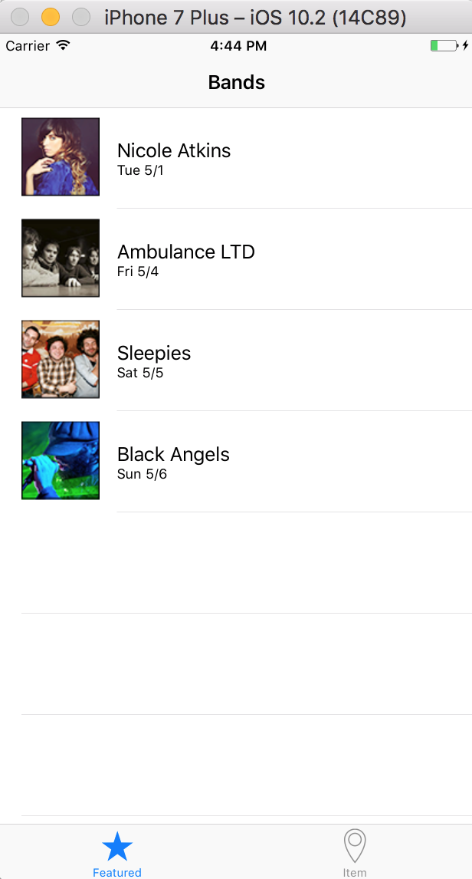
Import More Data
Notes:
You should be returned to the dashboard, where the new data will appear. Expand
the new arrays named 1, 2, and 3 to see key-value pairs for each new band.
6. Let’s see what the app looks like now. Return to Xcode.
7. Click Run to see the app now has all four bands included.
8. Great! Now we have a fully-functioning, real world app that is using an external
datasource. Take a few minutes to experiment with your data on Firebase

Slide 42
Agenda Tuesday
Customizing for the iPad
Icons & Launch Images

