Slide 1
Building iOS Swift apps
5030-201720_MCS5993_M: 5030-Topics in Computer Science
5031-201720_MCS4993_M: 5031-Topics in MA/CS

Slide 2
Agenda
Swift on Linux
Creating a docker image for Swift
Start swift within docker
Compiling a program
Package Manager and LinuxMain.swift files
Apple Card playing example

Slide 3
Swift on Linux
What is Swift on Linux
compiler
REPL
Standard Library
Core Libraries
Package Manager

Slide 4
Swift on Linux
What’s missing
Xcode
AppKit
UIKit
No Graphics

Slide 5
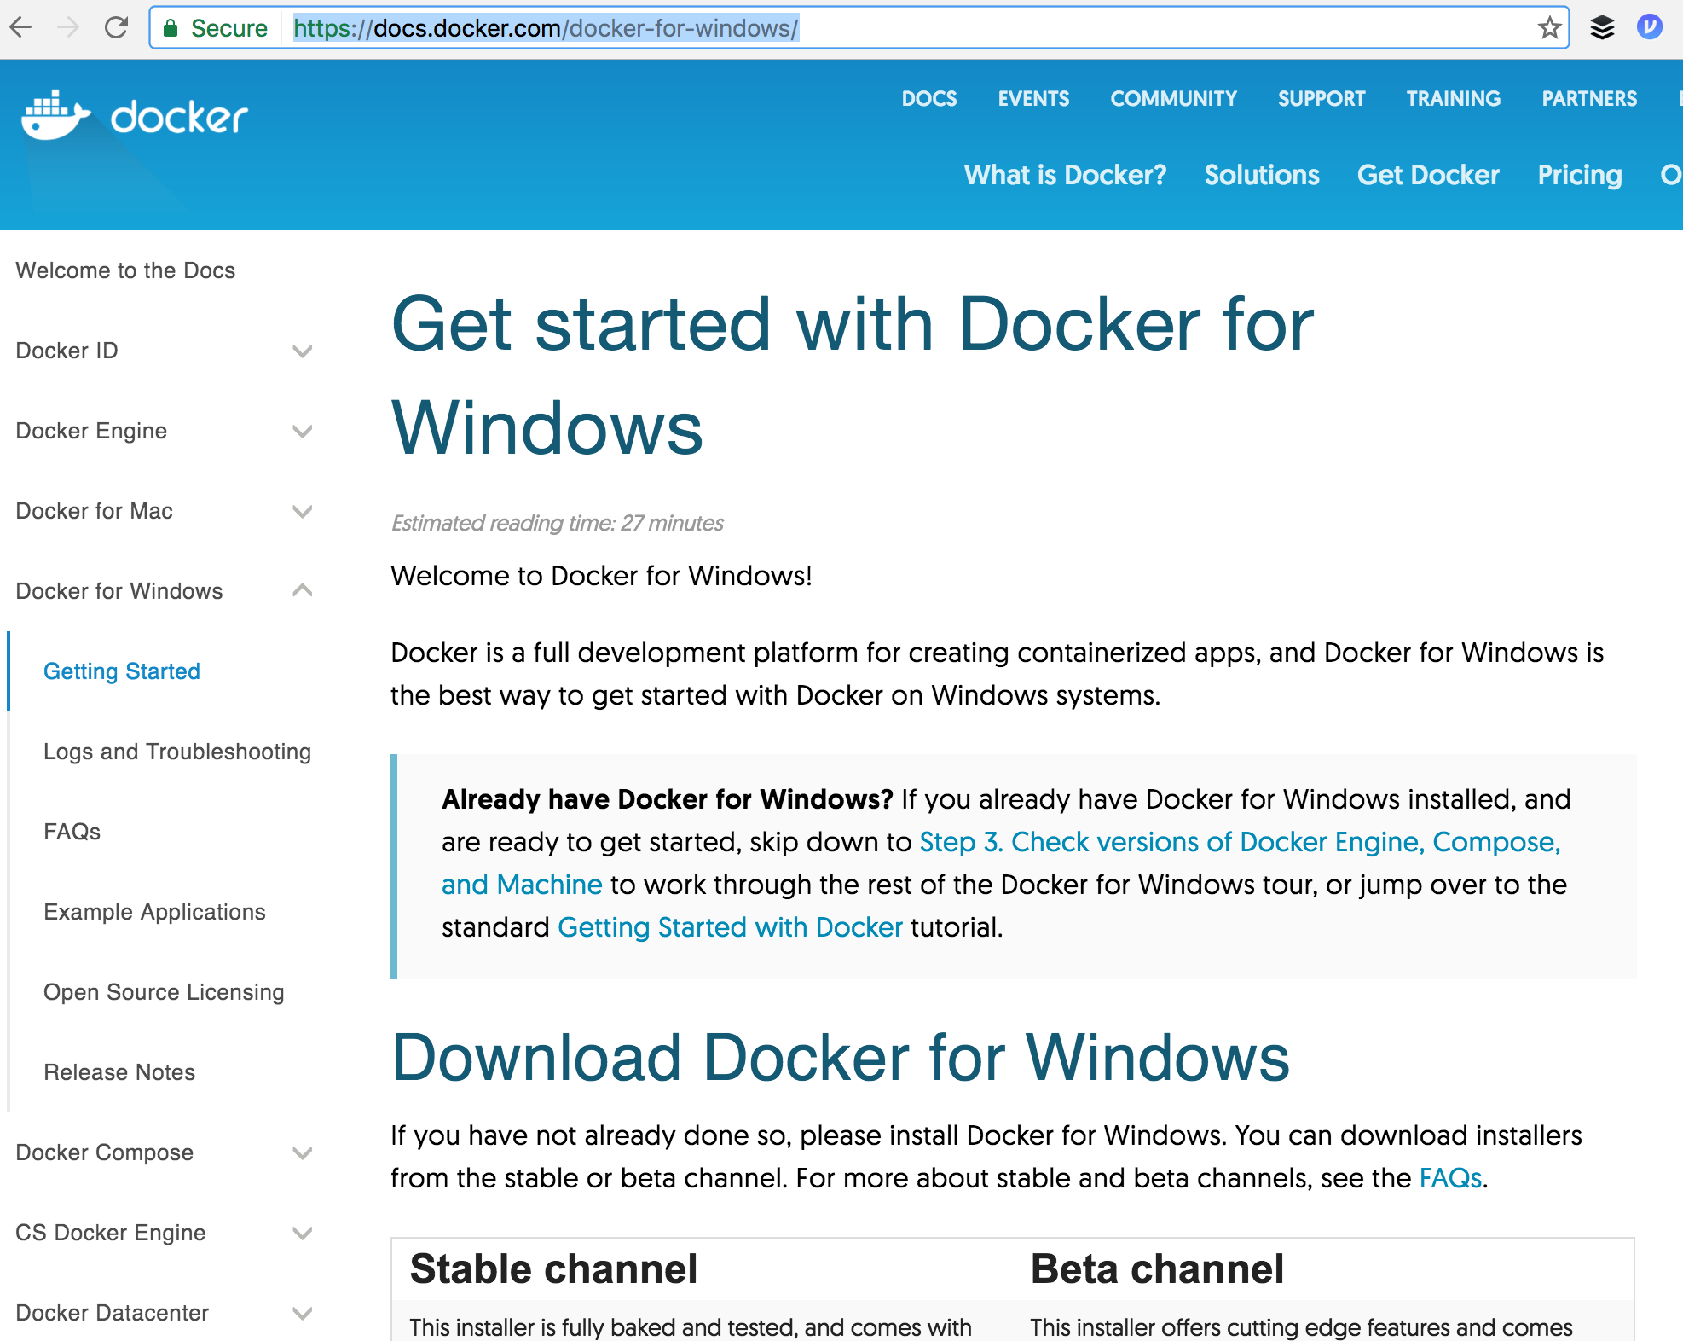
Docker image
Docker on windows
http://docs.docker.com/docker-for-windows
Download swiftfun
Do swift –version to show it’s working
Notes:
Docs.docker.com/docker-for-windows

Slide 6
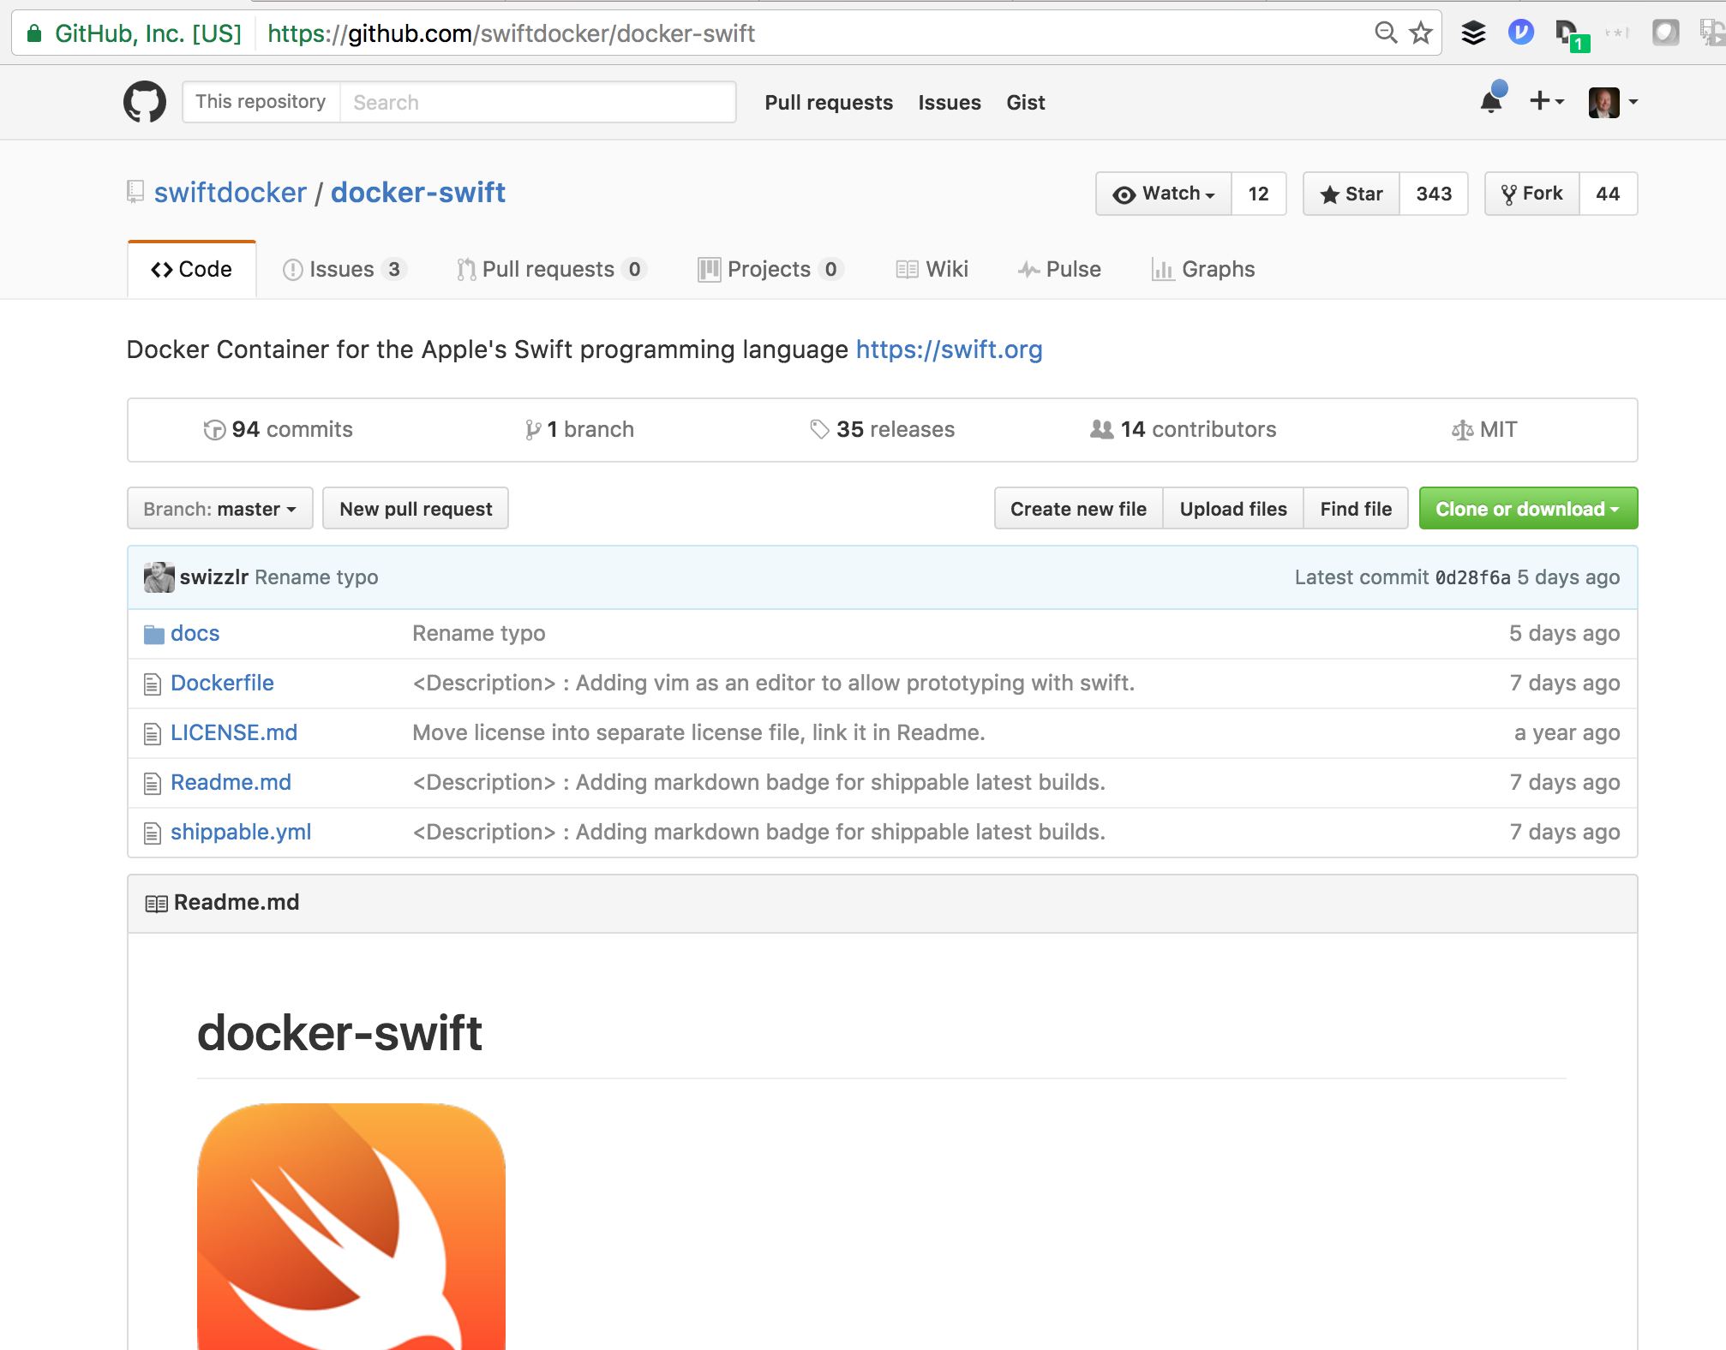
Docker image
Docker on windows
Download swiftfun
http://github.com/swiftdocker/docker-swift
docker pull swiftdocker/swift
docker run --privileged -i -t --name swiftfun swiftdocker/swift:latest /bin/bash
Do swift --version to show it’s working
Restart
docker start swiftfun
docker attach swiftfun
Notes:
Docs.docker.com/docker-for-windows

Slide 7
Helloworld
Create file to print (’Hello, World!”)
swiftc helloworld
./helloworld

Slide 8
Helloworld
swift package init --type executable
swiftc helloworld
./helloworld

Slide 9
Swift Package Init
Package manager file
LinuxMain.swift file for testing
Run swift package init
Download tree to view structure
apt-get update
agt-get install tree
apt-get install vim
Run tests

Slide 10
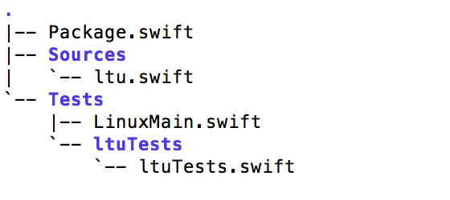
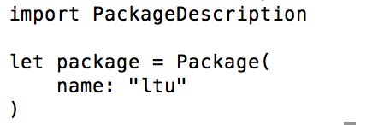
Package Manager
A package consists of Swift source files and a manifest file. The manifest file, called Package.swift, defines the package’s name and its contents using the PackageDescription module.

Slide 11
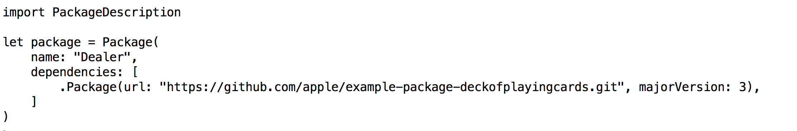
Package Manager
A package has one or more targets.
Each target specifies a product and may declare one or more dependencies.

Slide 12
Products
A target may build either a library or an executable as its product.
A library contains a module that can be imported by other Swift code.
An executable is a program that can be run by the operating system.

Slide 13
Dependencies
A target’s dependencies are modules that are required by code in the package.
A dependency consists of a relative or absolute URL to the source of the package and a set of requirements for the version of the package that can be used.

Slide 14
Deck of cards playing game
git clone https://github.com/apple/example-package-dealer.git
swift build
Run .build/debug/Dealer

Slide 15
Tuesday
Constants, Types and Expressions
No need for Xcode as yet.

