Slide 1
Building iOS Swift apps
5030-201720_MCS5993_M: 5030-Topics in Computer Science
5031-201720_MCS4993_M: 5031-Topics in MA/CS

Slide 2
Agenda
Unit Testing

Slide 3
Hello World Unit Test – swift package init
struct HelloWorld {
var text = "Hello, World!”
}
Notes:
swift package init

Slide 4
Hello World Unit Test – swift package init
import XCTest
@testable import HelloWorld
class HelloWorldTests: XCTestCase {
func testExample() {
XCTAssertEqual(HelloWorld().text, "Hello, World!")
}
}
Notes:
import XCTest
@testable import HelloWorld
class HelloWorldTests: XCTestCase {
func testExample() {
XCTAssertEqual(HelloWorld().text, "Hello, World!")
}
}

Slide 5
Unit Testing Benefits
Catch more mistakes
Confidently make more changes
Built in regression testing
Extend the life of your codebase

Slide 6
Unit Testing Benefits

Slide 7
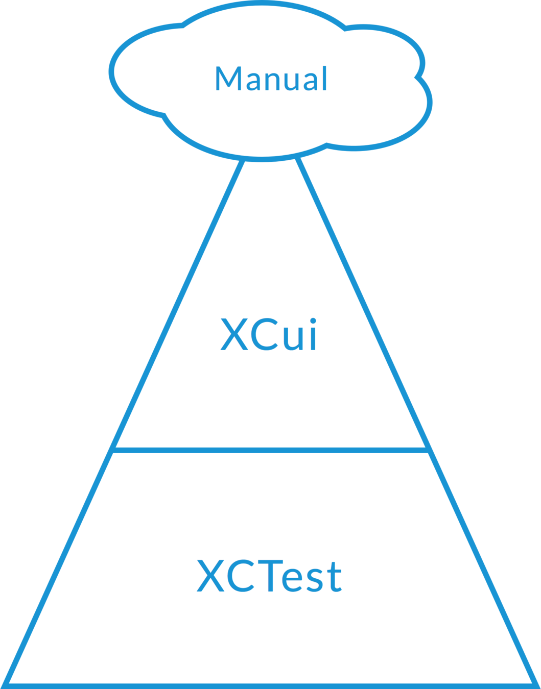
Unit Testing Benefits

Slide 8
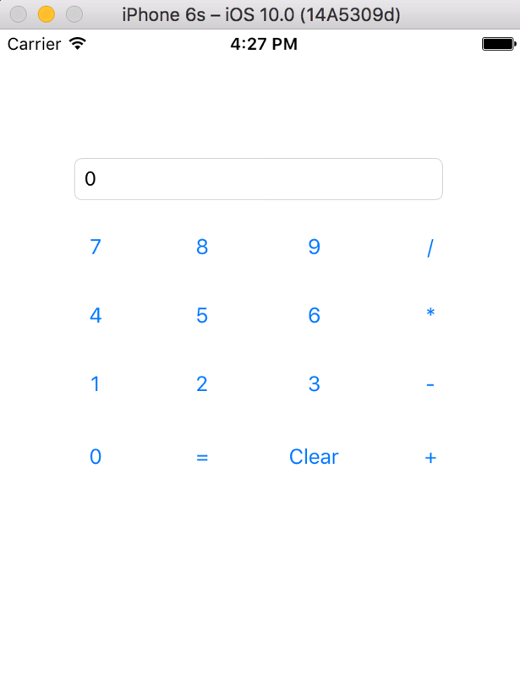
Unit Testing

Slide 9
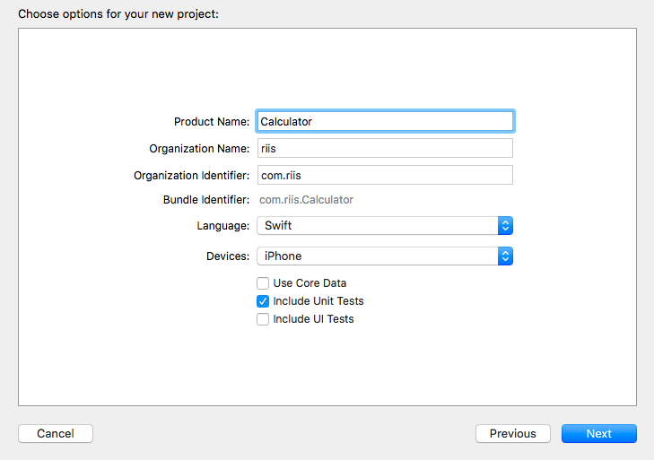
Unit Testing

Slide 10
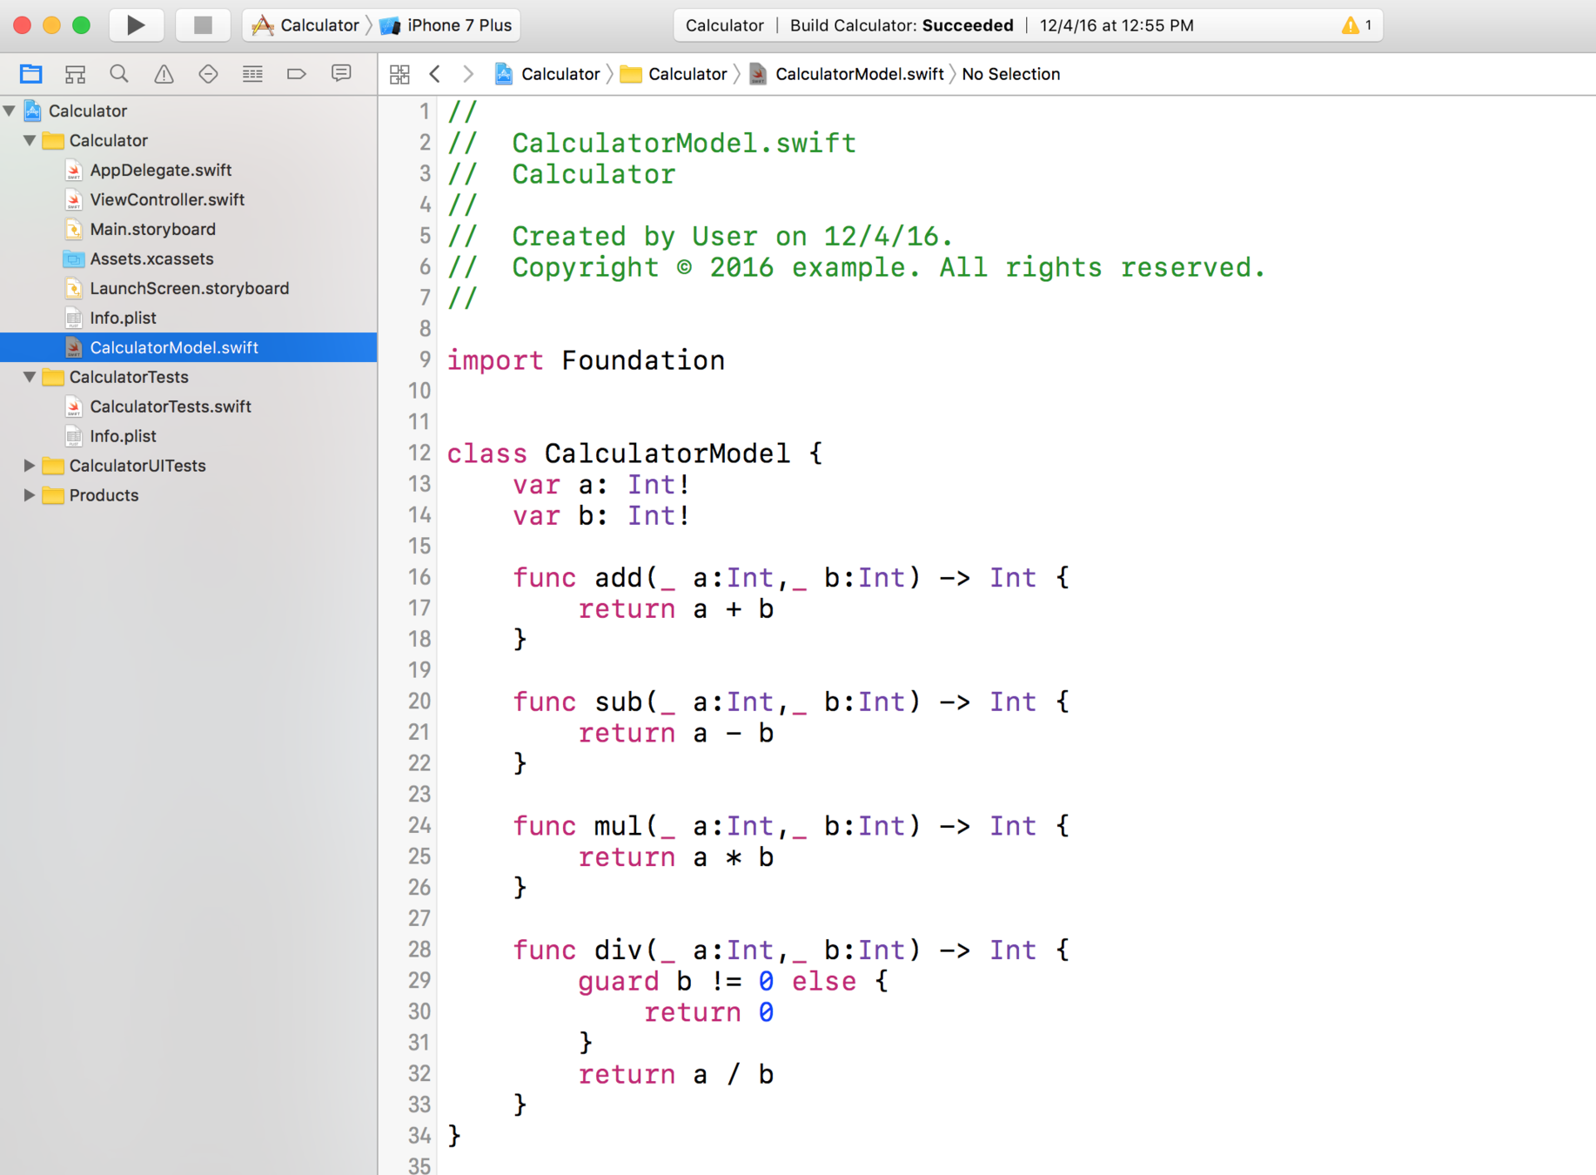
Unit Testing

Slide 11
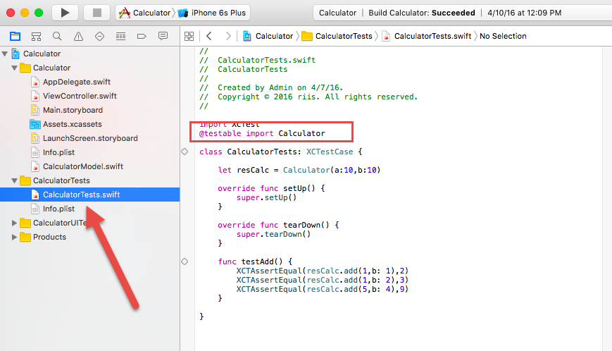
Unit Testing

Slide 12
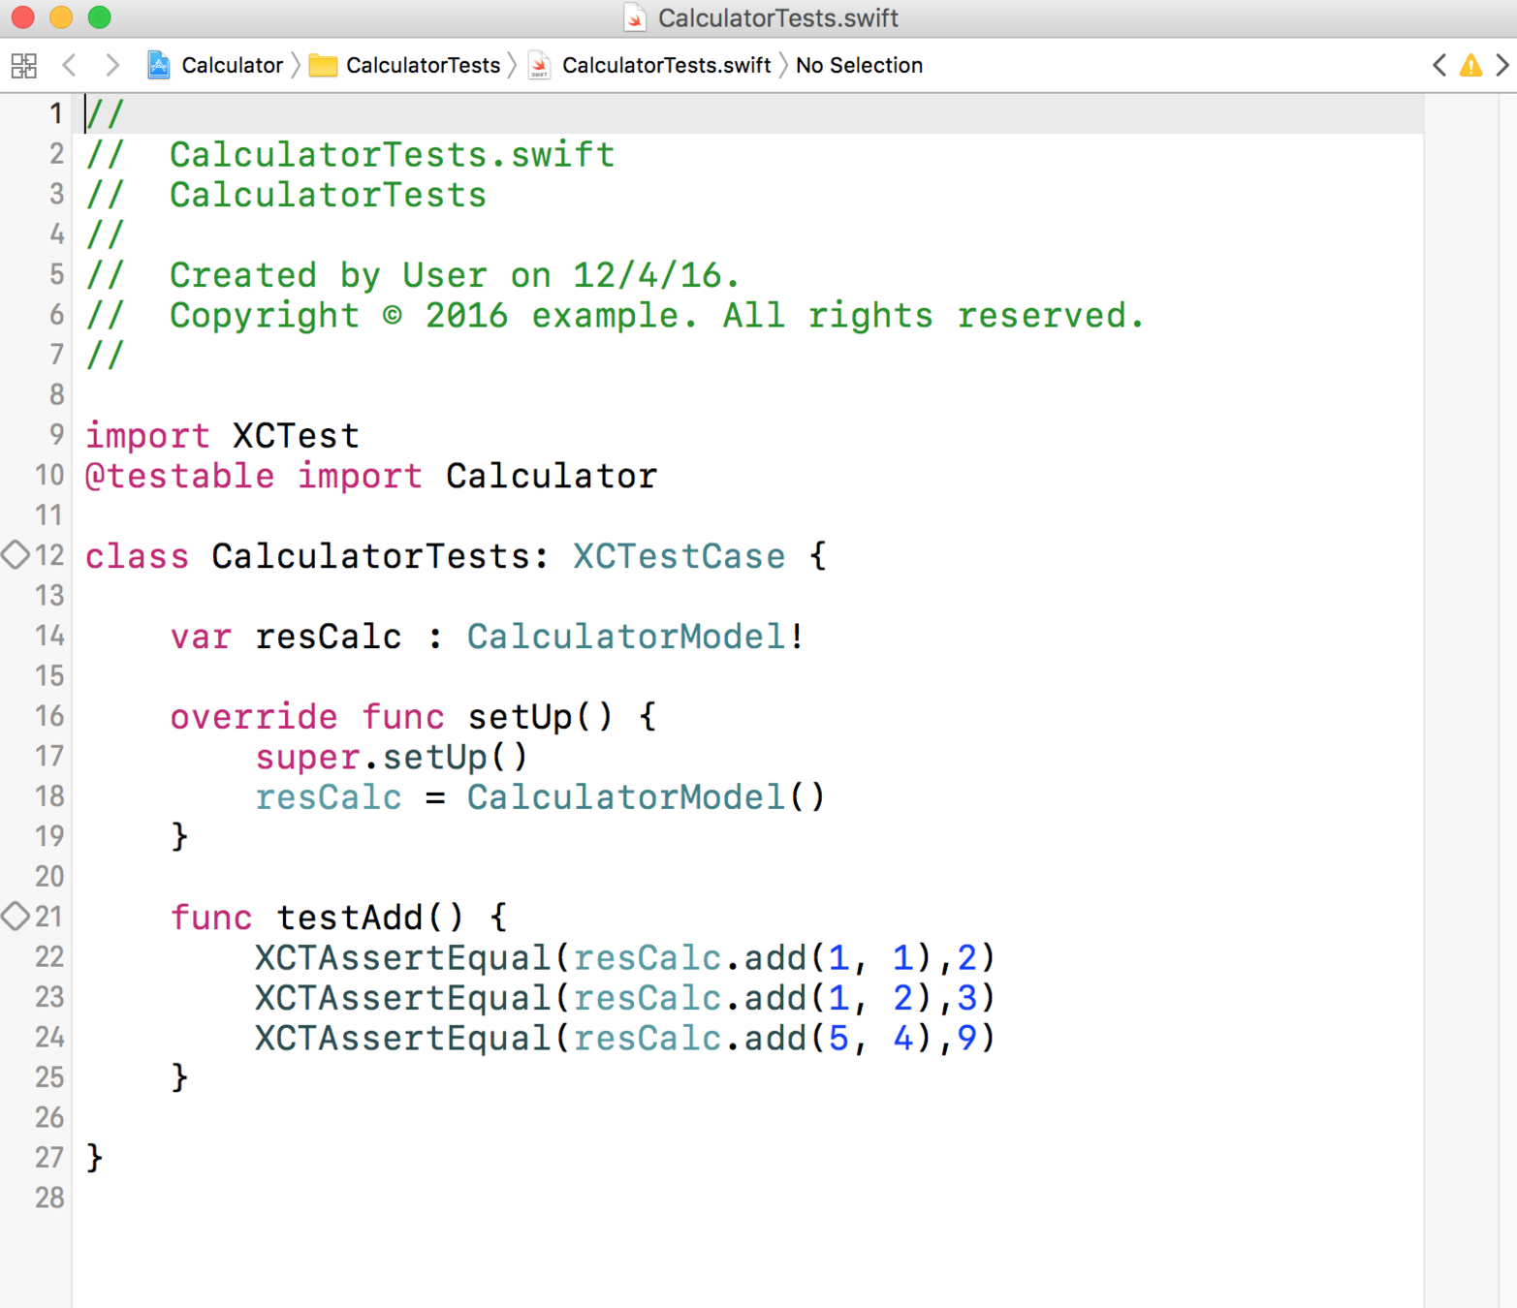
Unit Testing

Slide 13
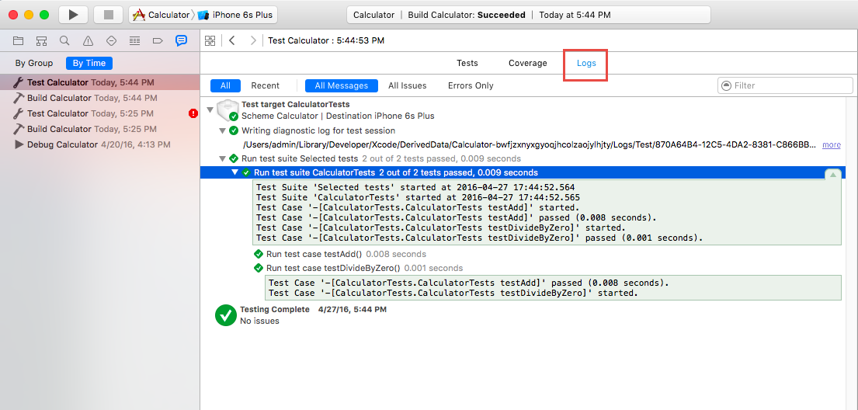
Unit Testing

Slide 14
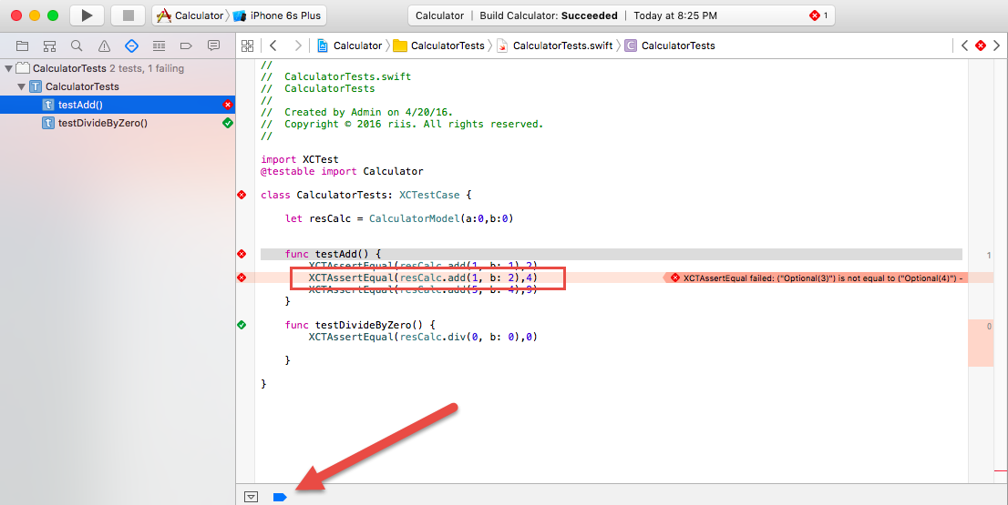
Unit Testing

Slide 15
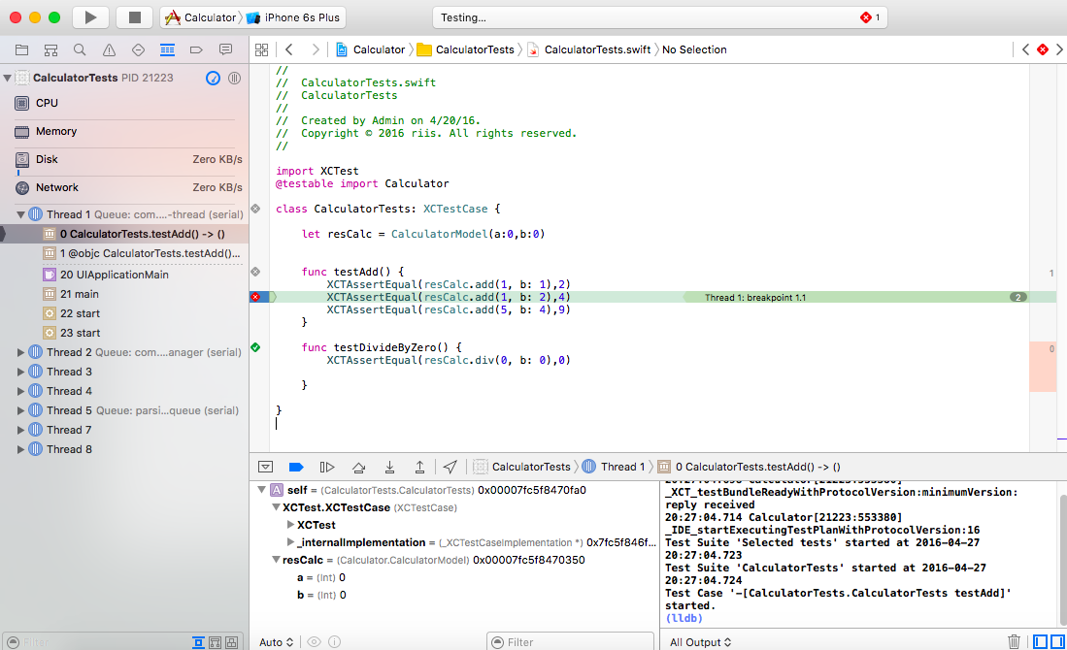
Unit Testing

Slide 16
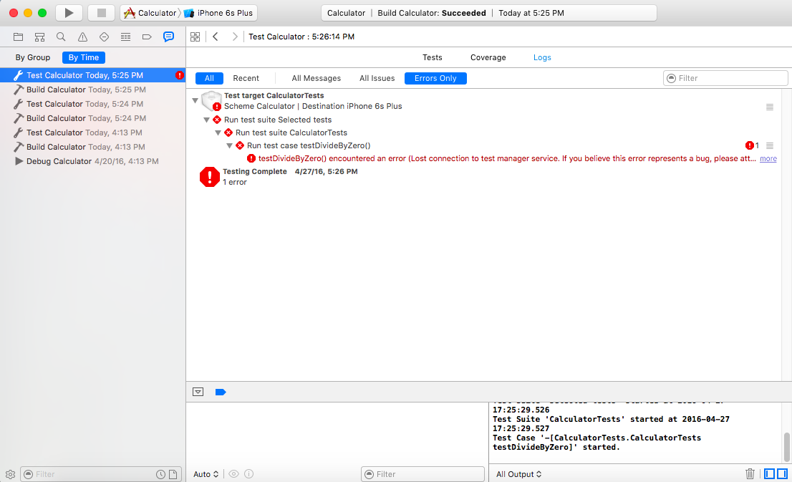
Unit Testing

Slide 17
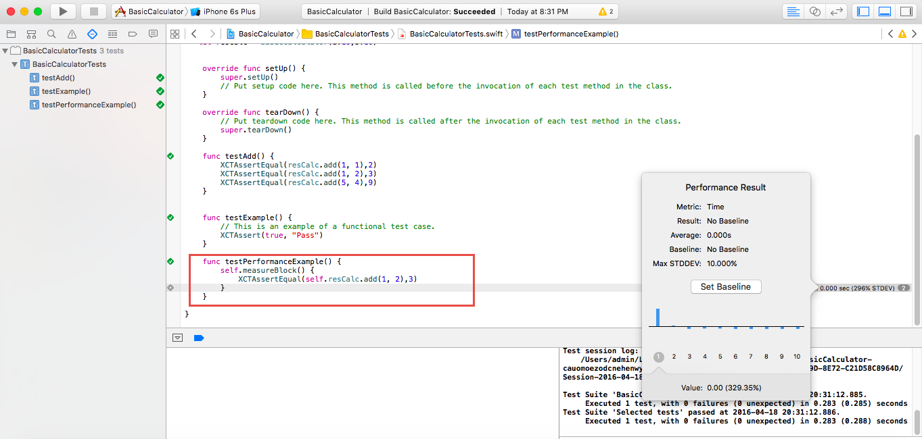
Unit Testing

Slide 18
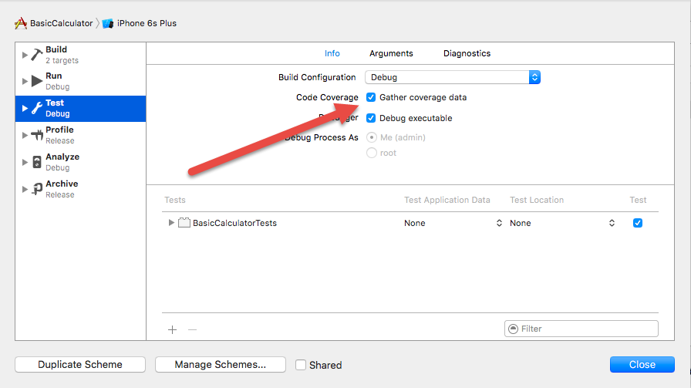
Unit Testing

Slide 19
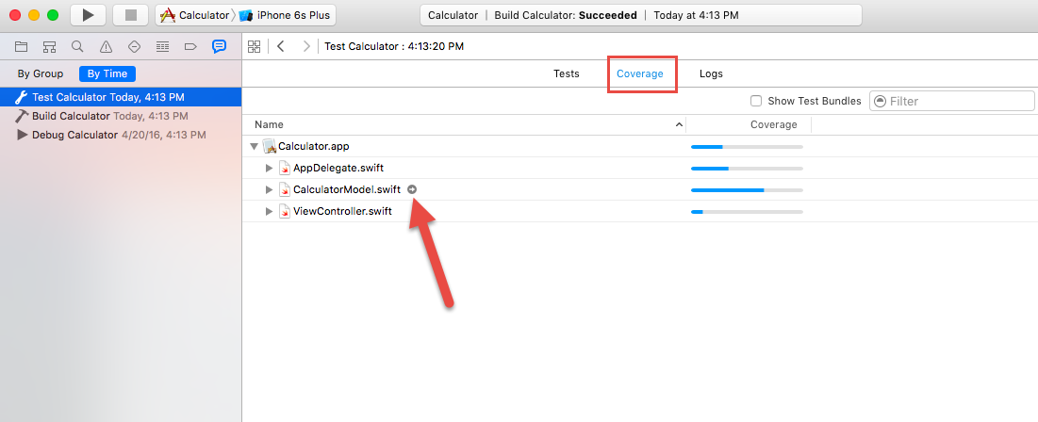
Unit Testing

Slide 20
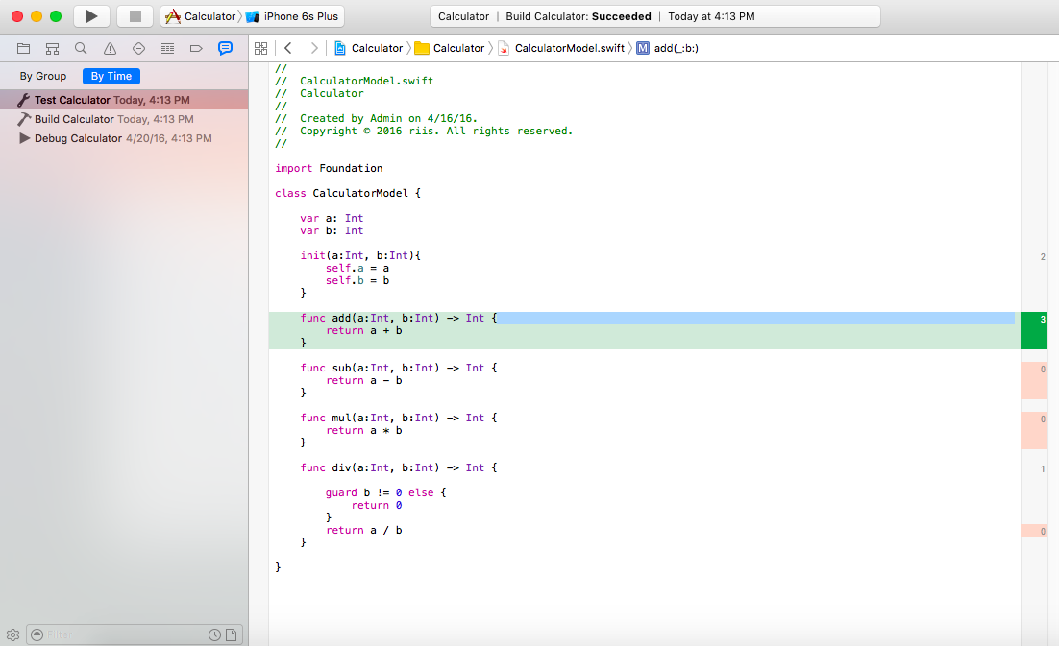
Unit Testing

Slide 21
Agenda
Unit Testing – Tools of the trade

