Slide 1
Building iOS Swift apps
5030-201720_MCS5993_M: 5030-Topics in Computer Science
5031-201720_MCS4993_M: 5031-Topics in MA/CS

Slide 2
Agenda
Continuous Integration III
Test Driven Development
Notes:
Show remarks in iTunesConnect

Slide 3
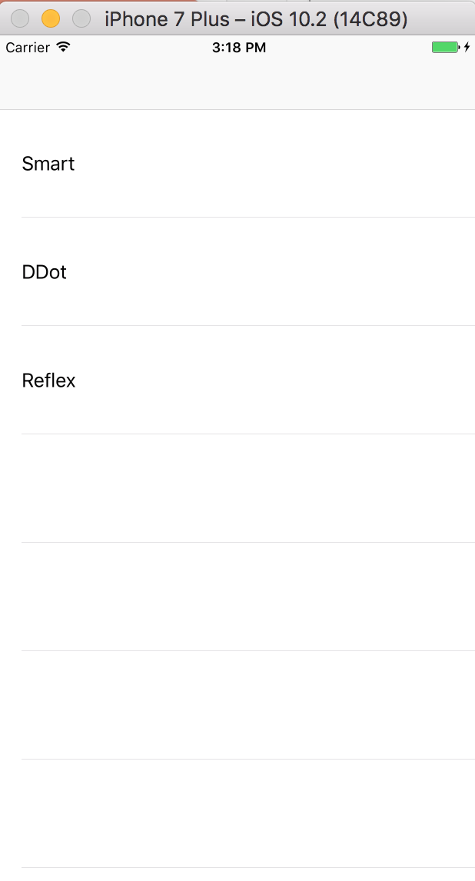
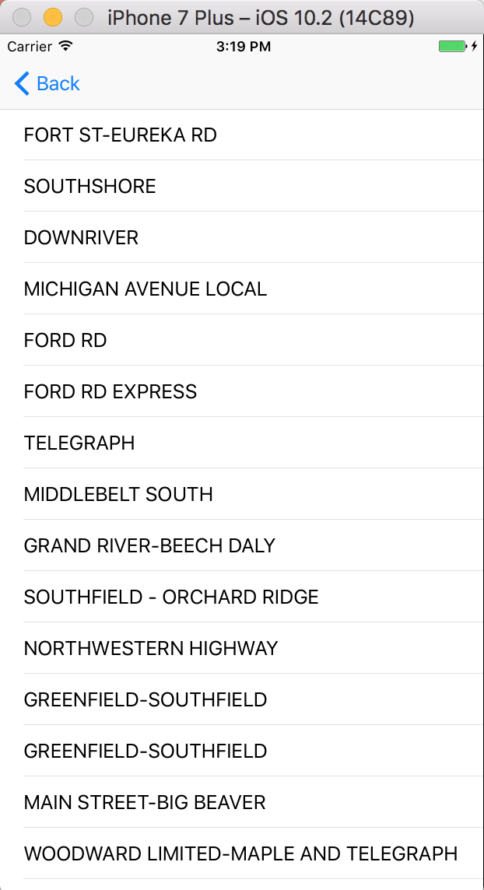
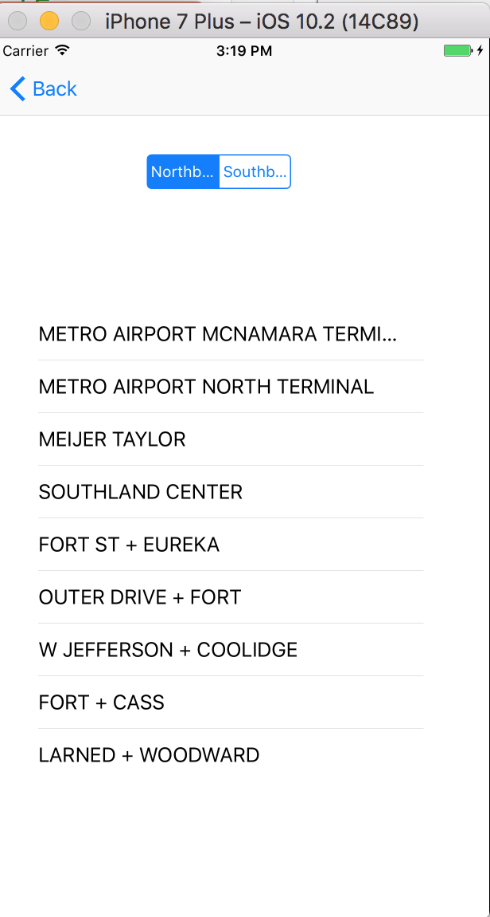
Sample app
Notes:
git clone http://github.com/dfreemanRIIS/ETAMock

Slide 4
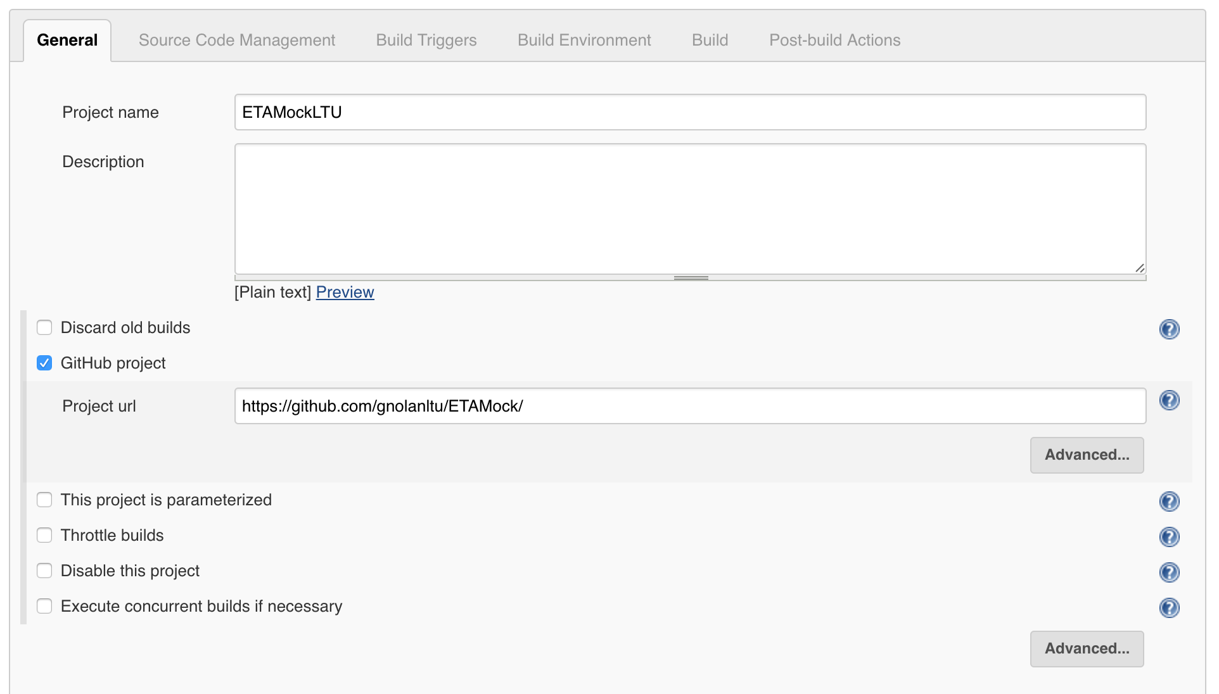
Jenkins

Slide 5
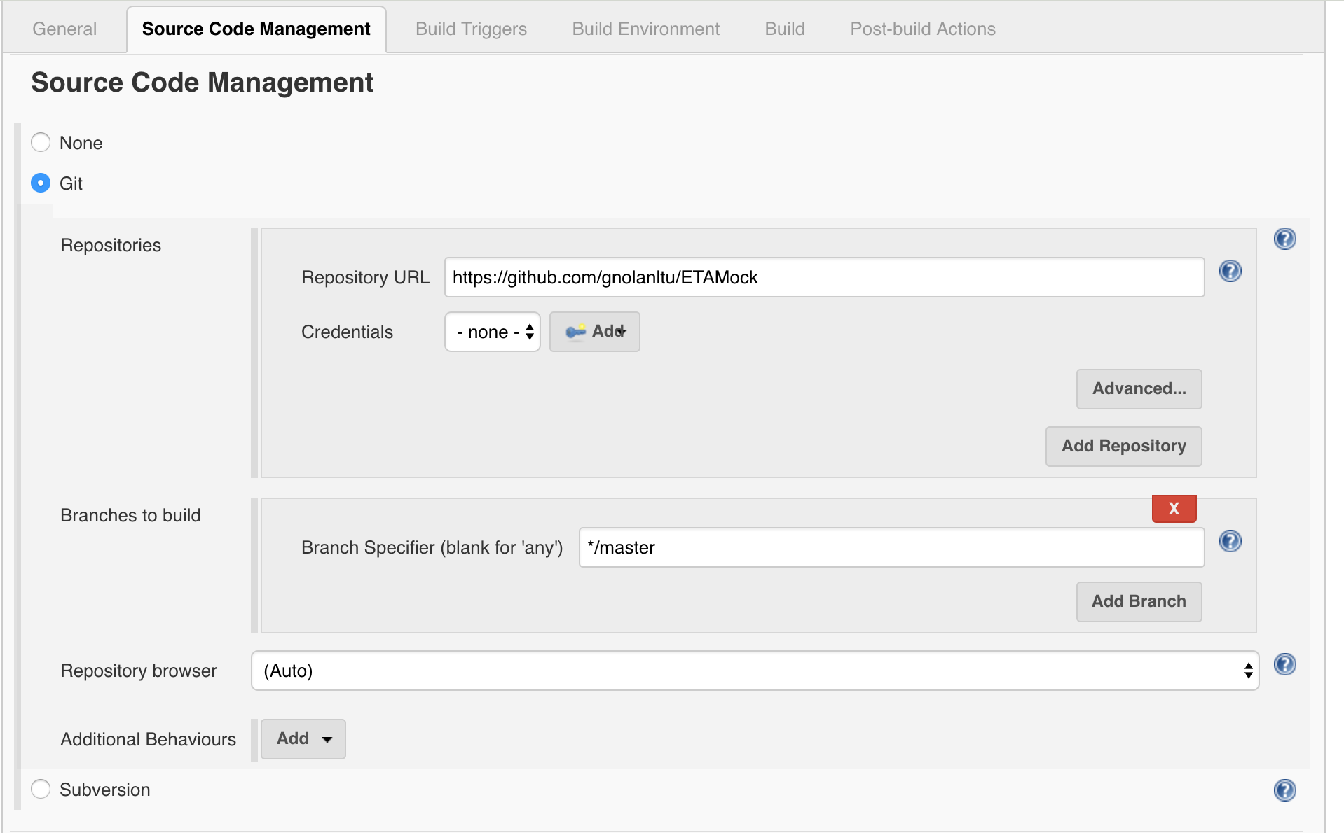
Jenkins

Slide 6
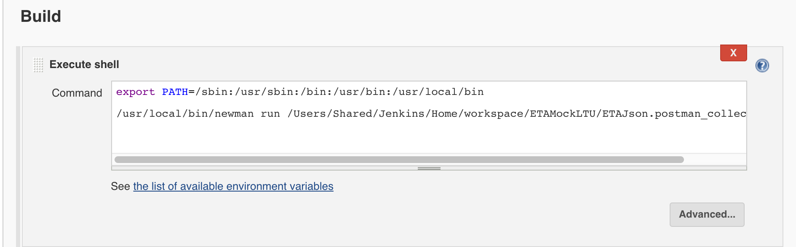
Jenkins

Slide 7
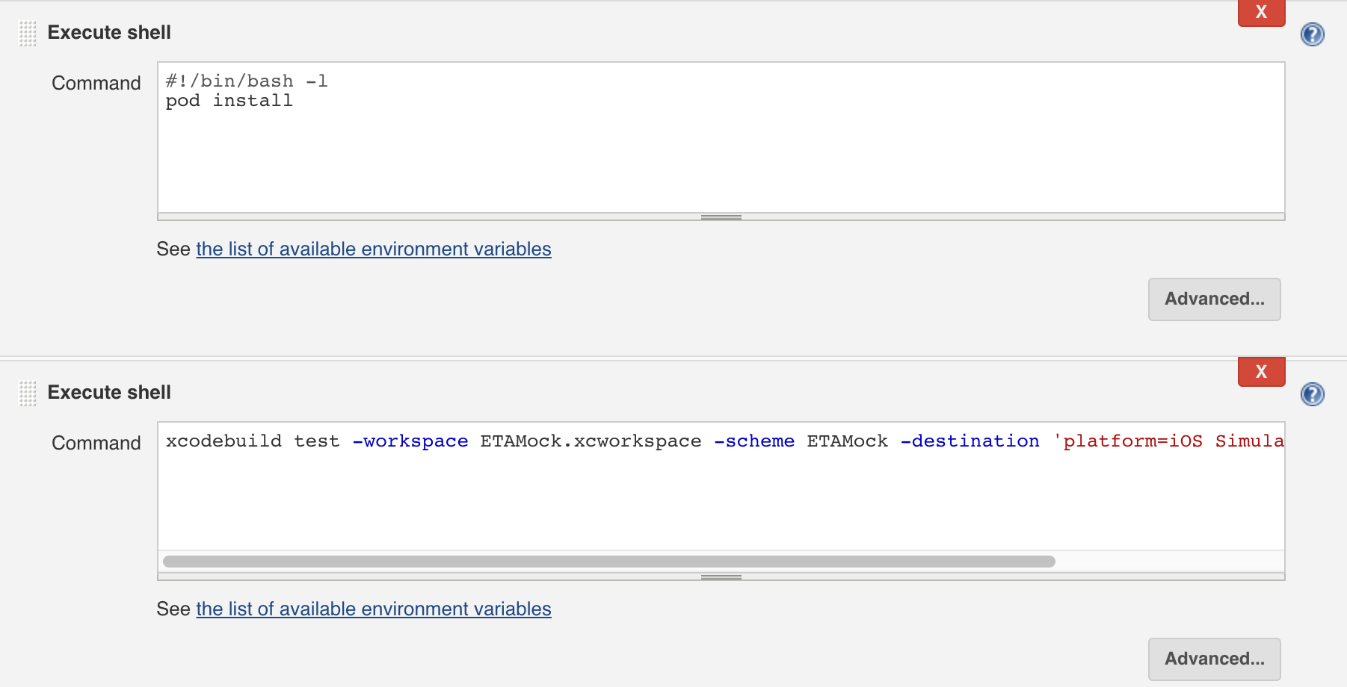
Jenkins

Slide 8
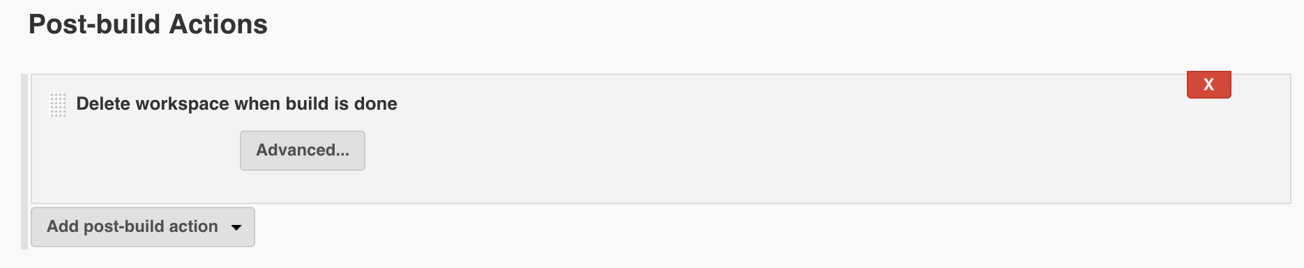
Jenkins

Slide 9
Commands
export PATH=/sbin:/usr/sbin:/bin:/usr/bin:/usr/local/bin/usr/local/bin/newman run /Users/Shared/Jenkins/Home/workspace/ETAMockLTU/ETAJson.postman_collection.json
#!/bin/bash –l pod install
xcodebuild test -workspace ETAMock.xcworkspace -scheme ETAMock -destination 'platform=iOS Simulator,name=iPhone 7 Plus'

Slide 10
Test Driven Development
Unit testing vs TDD
Why TDD
Sample app

Slide 11
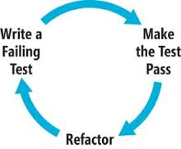
Test Driven Development
Write test first
See it fail
Write simplest possible solution to get test to pass
Refactor
Wash, Rinse, Repeat

Slide 12
Test Driven Development
Built in regression testing
Longer life for your codebase
YAGNI feature development
Red/Green/Refactor helps kill procrastination

Slide 13
TDD vs Unit Testing
You can't TDD w/o unit testing
TDD means writing the tests before the code
TDD is more painless than classic unit testing
You can unit test w/o TDD
Unit tests don't mandate when you write the tests
Unit tests are often written at the end of a coding cycle

Slide 14
Sample app
Display bus companies
Display bus routes
Display bus stops

Slide 15
Sample app
Notes:
Do this without any Interface Builder.
xcodebuild

Slide 16
Agenda Tuesday
Test Driven Development – TDD
Homework – Add Unit and UI Tests

