Slide 1
Building iOS Swift apps
5030-201720_MCS5993_M: 5030-Topics in Computer Science
5031-201720_MCS4993_M: 5031-Topics in MA/CS

Slide 2
Agenda
Start Swift on Linux
docker start swiftfun
docker attach swiftfun
Language basics
Variables, Constants, Strings and Operators

Slide 3
Swift feature | Description
Type inference | Swift can automatically deduce the type of the variable or constant, based on the initial value.
Generics | Generics allow us to write the code only once to perform identical tasks for different types of objects.
Collection mutability | Swift does not have separate objects for mutable or nonmutable containers. Instead, you define mutability by defining the container as a constant or variable.
Closure syntax | Closures are self-contained blocks of functionality that can be passed around and used in our code.
Optionals | Optionals define a variable that might not have a value.
Switch statement | The Switch statement has been drastically improved.
Multiple return types | Functions can have multiple return types using tuples.
Operator overloading | Classes can provide their own implementation of existing operators.
Enumerations with Associated values | In Swift, we can do a lot more than just defining a group of related values with enumerations.

Slide 4
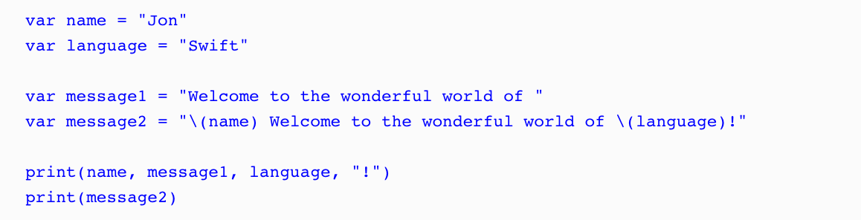
Hello World
vi main.swift
swiftc main.swift
./main

Slide 5
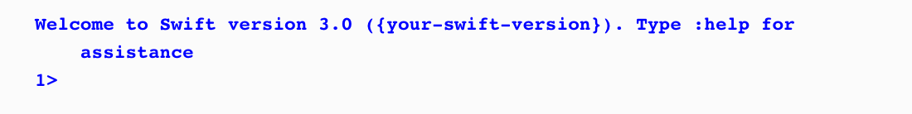
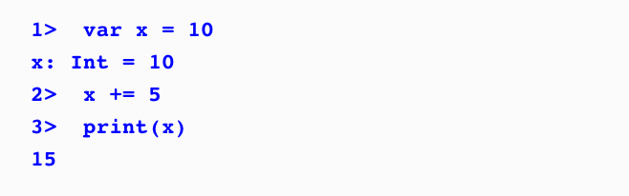

REPL

Slide 6

swiftc options

Slide 7
Constant and Variables
What variables and constants are
The difference between explicit and inferred typing
Explaining numeric, string, and boolean types
Defining optional types
Explaining how enumerations work in Swift
Explaining how Swift's operators work
Notes:
https://www.safaribooksonline.com/library/view/mastering-swift-3/9781786461414/ch02.html

Slide 8
Constant and Variables
An identifier must not contain any whitespace
An identifier must not contain any mathematical symbols
An identifier must not contain any arrows
An identifier must not contain private use or invalid Unicode characters
An identifier must not contain line- or box-drawing characters
An identifier must not start with a number, but it can contain numbers
If you use a Swift keyword as an identifier, surround it with back ticks
Notes:
https://www.safaribooksonline.com/library/view/mastering-swift-3/9781786461414/ch02.html

Slide 9
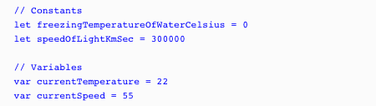

Constant and Variables
Notes:
Constants and variables must be defined prior to using them.
To define a constant, you use the keyword, let; to define a variable, you use the keyword, var.
We can declare multiple constants or variables in a single line by separating them with a comma.

Slide 10
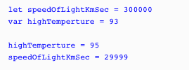
Constant and Variables
Notes:
This will error out, can’t change the speed of light as it’s a constant
Demo let speedOfLightKmSec = 300000 var highTemperture = 93 highTemperture = 95 speedOfLightKmSec = 29999

Slide 11
Type Safety
var integerVar = 10
integerVar = "My String"
error: cannot assign value of type 'String' to type 'Int' integerVar = "My String"
Notes:
This will also fail as Swift will figure out using Type inference that the integarVar is an integer.

Slide 12
Type Inference
var x = 3.14 // Double type
var y = "Hello" // String type
var z = true // Boolean type
print(type(of: x))
Notes:
Swift infers that the variable type is a double, string and boolean
You can also check the type using the print type command which will return???? ….. Double

Slide 13
Explicit Types
var pi : Float = 3.14
var x: Int
Notes:
there are times when we would like to explicitly define a variable's type by putting colon and then the type
We can’t just do var x as it won’t be able to infer or figure out the type, but var x : Int will work

Slide 14
Integers
Type | Minimum | Maximum
Int8 | −128 | 127
Int16 | −32,768 | 32,767
Int32 | −2,147,483,648 | 2,147,483,647
Int64 | −9,223,372,036,854,775,808 | 9,223,372,036,854,775,807
Int | −9,223,372,036,854,775,808 | 9,223,372,036,854,775,807
UInt8 | 0 | 255
UInt16 | 0 | 65,535
UInt32 | 0 | 4,294,967,295
UInt64 | 0 | 18,446,744,073,709,551,615
UInt | 0 | 18,446,744,073,709,551,615

Slide 15
Integers
print("UInt8 max \(UInt8.max)")
print("UInt8 min \(UInt8.min)")
Notes:
there are times when we would like to explicitly define a variable's type by putting colon and then the type
We can’t just do var x as it won’t be able to infer or figure out the type, but var x : Int will work

Slide 16
Integers
var a = 95
var b = 0b1011111
var c = 0o137
var d = 0x5f
let speedOfLightKmSec = 300_000
Notes:
Integers can also be represented as binary, octal, and hexadecimal numbers.
Swift also allows us to insert arbitrary underscores in our numeric literals for better readability

Slide 17
Floating Point
let f: Float = 0.111_111_111 + 0.222_222_222
let d: Double = 0.111_111_111 + 0.222_222_222
Notes:
Two types of Floating point, float and double.
RUN THE CODE

Slide 18
Floating Point
var a : Int = 3
var b : Double = 0.14
var c = a + b
var a : Int = 3
var b : Double = 0.14
var c = Double(a) + b
Notes:
To add an Int and a Double together, we need to convert the Int value into a Double value.
The following code shows how to this:

Slide 19
Boolean
let swiftIsCool = true
let swiftIsHard = false
var itIsWarm = false
var itIsRaining = true
Notes:
Boolean values are often referred to as logical values because they can be either true or false.
Swift has a built-in Boolean type that accepts one of the two built-in Boolean constants: true or false.
Boolean constants and variables can be defined as follows:

Slide 20
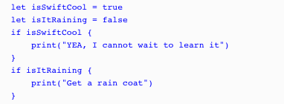
Boolean
Notes:
Which print commands will execute?

Slide 21
Strings
var stringOne = "Hello"
var stringTwo = " World"
Notes:
Define two strings

Slide 22

Strings
Notes:
Since a string is an ordered collection of characters, we can iterate through each character of a string. The following code shows how to do this:

Slide 23
Strings
var stringC = stringA + stringB
stringA += stringB
Notes:
We can concatenate strings
There are two ways to add one string to another string. We can concatenate them or include them inline. To concatenate two strings, we use the + or += operator. The following code shows how to concatenate two strings. The first example appends stringB to the end of stringA, and the results are put into a new stringC variable. The second example appends stringB directly to the end of stringA, without creating a new string:

Slide 24
Strings
var stringA = "Jon"
var stringB = "Hello \(stringA)"
Notes:
To include a string inline with another string, we use a special sequence of characters \( ).
The following code shows how to include a string inline with another string so it prints Hello Jon DEMO

Slide 25
Strings – Mutable vs Immutable
var x = "Hello"
let y = "HI" var
z = "World"
//This is valid, x is mutable
x += z
//This is invalid, y is not mutable.
y += z

Slide 26
Strings – Converting
var stringOne = "hElLo"
print("Lowercase String: " + stringOne.lowercased())
print("Uppercase String: " + stringOne.uppercased())
Lowercase String: hello
Uppercase String: HELLO

Slide 27
Strings – Comparison
var stringOne = "Hello Swift"
var stringTwo = ""
stringOne.isEmpty //false
stringTwo.isEmpty //true
stringOne == "hello swift" //false
stringOne == "Hello Swift" //true
stringOne.hasPrefix("Hello") //true
stringOne.hasSuffix("Hello") //false
Notes:
Swift provides four ways to compare a string; these are string equality, prefix equality, suffix equality, and isEmpty.

Slide 28
Strings – Replacing
var stringOne = "one,to,three,four"
print(stringOne.replacingOccurrences(of: "to", with: "two"))
Notes:
We can replace all the occurrences of a target string with another string using the stringByReplacingOccurrencesOfString()method.
The above prints one, two, three, four

Slide 29
Optional variables
var optionalString: String?
var nonoptionalString: String
var name: String?
name = "Jon"
if name != nil {
var newString = "Hello " + name!
}
Notes:
In Swift, an optional variable is a variable to which we are able to assign nil (no value).
Optional variables and constants are defined using a question mark (?). The following code shows how to define both an optional string variable and a non-optional string variable:
If we attempt to assign a nil to the nonoptionalString variable, we will receive an error.

Slide 30
Enumerations
enum Planets {
case Mercury case Venus case Earth case Mars case Jupiter case Saturn case Uranus case Neptune
}
var planetWeLiveOn = Planets.Earth var furthestPlanet = Planets.Neptune planetWeLiveOn = .Mars
Notes:
The values defined in an enumeration are considered to be the member values (or simply the members) of the enumeration.
We can then use the Planets enumeration, like this:
The types for the planetWeLiveOn and furthestPlanet variables are inferred when we initialize the variable with one of the member values of the Planets enumeration. Once the variable type is inferred, we can then assign a new value without the Planets prefix as shown here:

Slide 31
Enumerations
// Using the traditional == operator if planetWeLiveOn == .Earth { print("Earth it is") } // Using the switch statement switch planetWeLiveOn { case .Mercury: print("We live on Mercury, it is very hot!") case .Venus: print("We live on Venus, it is very hot!") case .Earth: print("We live on Earth, just right") case .Mars: print("We live on Mars, a little cold") default: print("Where do we live?") }
Notes:
We can compare an enumeration value using the traditional equals (==) operator or a switch statement.
The following example shows how to use the equals operator and the switch statement with an enum:

Slide 32
Enumerations
enum Devices: String {
case MusicPlayer = "iPod"
case Phone = "iPhone"
case Tablet = "iPad"
}
print("We are using an " + Devices.Tablet.rawValue)
Notes:
Enumerations can come prepopulated with raw values, which are required to be of the same type.
The following example shows how to define an enumeration with string values:

Slide 33
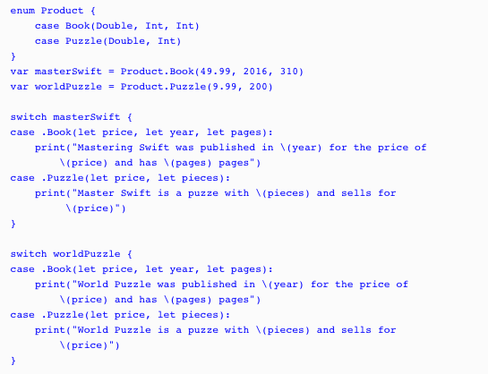
Enumerations
Notes:
In Swift, enumeration can also have associated values. Associated values allow us to store additional information along with member values
In the preceding example, we begin by defining a Product enumeration with two members-Book and Puzzle. The Book member has an associated value of Double, Int, and Int, and the Puzzle member has an associated value of Double, Int. We then create two products: masterSwift and worldPuzzle. We assign the masterSwift variable a value of Product.Book with the associated values of 49.99, 2016, 310. We then assign the worldPuzzle variable a value of Product.Puzzle with the associated values of 9.99, 200.
We can then check the Products enumeration using a switch statement, as we did in an earlier example. We extract the associated values within the switch statement. In this example, we extracted the associated values as constants with the let keyword, but you can also extract the associated values as variables with the var keyword.

Slide 34
Operators
Assignment
Comparison
Arithmetic
Remainder
Compound Assignment
Ternary
NOT
AND
OR
Notes:
Enumerations can come prepopulated with raw values, which are required to be of the same type.
The following example shows how to define an enumeration with string values:

Slide 35
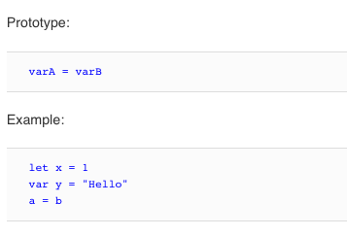
Assignment
Notes:
Enumerations can come prepopulated with raw values, which are required to be of the same type.
The following example shows how to define an enumeration with string values:

Slide 36
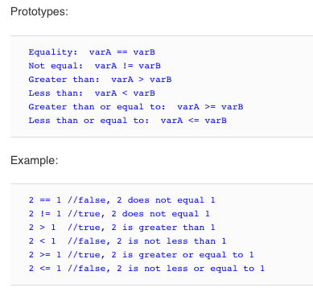
Comparison
Notes:
The comparison operator returns the true Boolean if the statement is true or the Boolean false if the statement is not true.

Slide 37
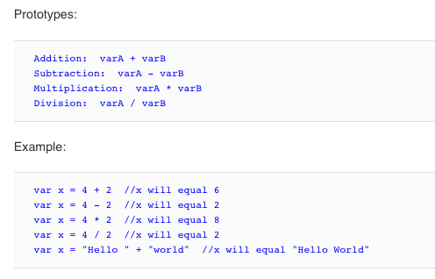
Arithmetic
Notes:
Four basic mathematical operations

Slide 38
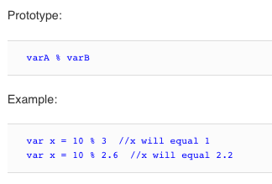
Remainder
Notes:
Four basic mathematical operations

Slide 39
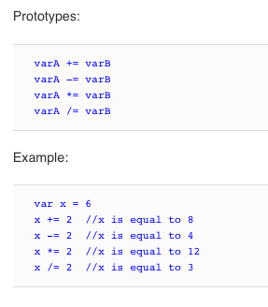
Compound Assignment
Notes:
Compound assignment operators combine an arithmetic operator with an assignment operator.

Slide 40
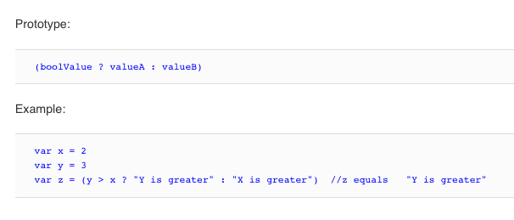
Ternary
Notes:
The ternary conditional operator assigns a value to a variable based on the evaluation of a comparison operator or Boolean value.

Slide 41
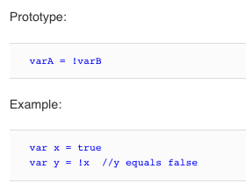
Logical NOT
Notes:
Inverts a Boolean value

Slide 42
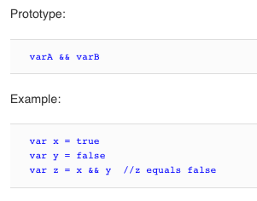
Logical AND
Notes:
The logical AND operator returns true if both operands are true. Otherwise, it returns false.

Slide 43
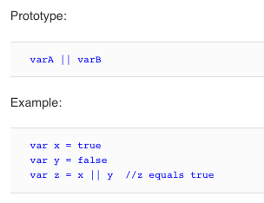
Logical OR
Notes:
The logical OR operator returns true if either of the operands is true.

Slide 44
Thursday
Collections (Arrays, Dictionaries, Sets), Tuples, Control Flow and Functions
No need for Xcode as yet.

