Slide 1
Building iOS Swift apps
5030-201720_MCS5993_M: 5030-Topics in Computer Science
5031-201720_MCS4993_M: 5031-Topics in MA/CS

Slide 2
Agenda
Classes and Structs

Slide 3
Properties
Stored Properties
Computed Properties
Notes:
A stored property is a constant or variable that is stored as part of an instance of a particular class or structure
In addition to stored properties, classes, structures, and enumerations can define computed properties, which do not actually store a value. Instead, they provide a getter and an optional setter to retrieve and set other properties and values indirectly.

Slide 4
Stored Properties
struct FixedLengthRange {
var firstValue: Int
let length: Int
}
var rangeOfThreeItems = FixedLengthRange(firstValue: 0, length: 3)
// the range represents integer values 0, 1, and 2
rangeOfThreeItems.firstValue = 6
// the range now represents integer values 6, 7, and 8
Notes:
Instances of FixedLengthRange have a variable stored property called firstValue and a constant stored property called length. In the example above, length is initialized when the new range is created and cannot be changed thereafter, because it is a constant property.

Slide 5
Computed Properties
struct EmployeeStruct { var firstName = "" var lastName = "" var salaryYear = 0.0 var salaryWeek: Double { get{ return self.salaryYear/52 } set (newSalaryWeek){ self.salaryYear = newSalaryWeek*52 } } }
Notes:
Instances of FixedLengthRange have a variable stored property called firstValue and a constant stored property called length. In the example above, length is initialized when the new range is created and cannot be changed thereafter, because it is a constant property.

Slide 6
struct EmployeeStruct { var firstName = "" var lastName = "" var salaryYear = 0.0 var salaryWeek: Double { get{ return self.salaryYear/52 } set (newSalaryWeek){ self.salaryYear = newSalaryWeek*52 } } } var f = EmployeeStruct(firstName: "Jon", lastName: "Hoffman", salaryYear: 39000)
print(f.salaryWeek) //prints 750.00 to the console
f.salaryWeek = 1000
print(f.salaryWeek) //prints 1000.00 to the console
print(f.salaryYear) //prints 52000.00 to the console
Notes:
The preceding example starts off by creating an instance of the EmployStruct structure with the salaryYear value being set to 39,000. Next, we print the value of the salaryWeek property to the console. This value is currently 750.00. We then set the salaryWeek property to 1000.00 and print out both the salaryWeek and salaryYear properties to the console. The values of the salaryWeek and salaryYear properties are now 1000.00 and 52000 respectively. As we can see, in this example, setting either the salaryWeek or salaryYear property changes the values returned by both.

Slide 7
Property observers
var salaryYear: Double = 0.0 { willSet(newSalary) { print("About to set salaryYear to \(newSalary)") } didSet { if salaryWeek > oldValue { print("\(firstName) got a raise") } else { print("\(firstName) did not get a raise") } } }
Notes:
Property observers observe and respond to changes in a property’s value.
Property observers are called every time a property’s value is set, even if the new value is the same as the property’s current value.
You have the option to define either or both of these observers on a property:
willSet is called just before the value is stored.
didSet is called immediately after the new value is stored.

Slide 8
struct EmployeeStruct { var firstName = "" var lastName = "" // var salaryYear = 0.0 var salaryYear: Double = 0.0 { willSet(newSalary) { print("About to set salaryYear to \(newSalary)") } didSet { if salaryYear > oldValue { print("\(firstName) got a raise") } else { print("\(firstName) did not get a raise") } } } var salaryWeek: Double { get{ return self.salaryYear/52 } set (newSalaryWeek){ self.salaryYear = newSalaryWeek*52 } } }

Slide 9
var f = EmployeeStruct(firstName: "Jon", lastName: "Hoffman", salaryYear: 39000)
print(f.salaryWeek)
f.salaryWeek = 1000
print(f.salaryWeek)
print(f.salaryYear)
750.0
About to set salaryYear to 52000.0
Jon got a raise
1000.0
52000.0
Notes:
The preceding example starts off by creating an instance of the EmployStruct structure with the salaryYear value being set to 39,000. Next, we print the value of the salaryWeek property to the console. This value is currently 750.00. We then set the salaryWeek property to 1000.00 and print out both the salaryWeek and salaryYear properties to the console. The values of the salaryWeek and salaryYear properties are now 1000.00 and 52000 respectively. As we can see, in this example, setting either the salaryWeek or salaryYear property changes the values returned by both.

Slide 10
Methods
func getFullName() -> String { return firstName + " " + lastName }
Notes:
Methods are functions that are associated with a class or structure. A method, like a function, will encapsulate the code for a specific task or functionality that is associated with the class or structure. The following code will return the full name of the employee by using the firstName and lastName properties:
We define this method exactly as we would define any function. A method is simply a function that is associated with a specific class or structure, and everything that we learned about functions in the previous chapters applies to methods. The getFullName() function can be added directly to the EmployeeClass class or EmployeeStruct structure without any modification.

Slide 11
public class EmployeeClass { var firstName = "" var lastName = "" var salaryYear = 0.0 var salaryWeek: Double { get{ return self.salaryYear/52 } set (newSalaryWeek) { self.salaryYear = newSalaryWeek*52 } }
func getFullName() -> String { return firstName + " " + lastName } }
Notes:
The getFullName() function can be added directly to the EmployeeClass class or EmployeeStruct structure without any modification.

Slide 12
Methods
var e = EmployeeClass()
e.firstName = "Jon" e.lastName = "Hoffman" e.salaryYear = 50000.00
print(e.getFullName()) //Jon Hoffman is printed to the console
Notes:
In the preceding example, we initialize an instance of both the EmployeeClass class. We populate the class with the same information and then use the getFullName()method to print the full name of the employee to the console. Jon Hoffman is printed to the console. You can do the same with the struct

Slide 13
Custom Initializers
init() { //Perform initialization here }
Notes:
Initializers are called when we initialize a new instance of a particular type (a class or structure).
The initialization process can include setting initial values for stored properties, verifying external resources are available, or setting up the UI properly. Initializers are generally used to ensure that the instance of the class or structure is properly initialized prior to first use. Initializers are special methods that are used to create a new instance of a type.

Slide 14
Custom Initializers
init() { self.firstName = "" self.lastName = "" self.salaryYear = 0.0 }
init(firstName: String, lastName: String) { self.firstName = firstName self.lastName = lastName self.salaryYear = 0.0 }
init(firstName: String, lastName: String, salaryYear: Double) { self.firstName = firstName self.lastName = lastName self.salaryYear = salaryYear }
Notes:
The first initializer, init(), when used, will set all of the stored properties to their default values. The second initializer, init(firstName: String, lastName: String), when used, will populate the firstName and lastName properties with the values of the arguments. The third initializer, init(firstName: String, lastName: String, salaryYear: Double), will populate all the properties with the values of the arguments.

Slide 15
Custom Initializers
var g = EmployeeClass()
var h = EmployeeStruct(firstName: "Me", lastName: "Moe")
var i = EmployeeClass(firstName: "Me", lastName: "Moe", salaryYear: 45000)
Notes:
The variable g uses the init() initializer to create an instance of the EmployeeClass class; therefore, all the properties of this EmployeeClass instance contain their default values.
The h variable uses the init(firstName: String, lastName: String) initializer to create an instance of the EmployeeStruct structure; therefore, the firstName property of the structure is set to Me and the lastName property is set to Moe, which are the two arguments passed into the initializer. The salaryYear property is still set to the default value of 0.0.
The i variable uses the init(firstName: String, lastName: String, salaryYear: Double) initializer to create an instance of the EmployeeClass class; therefore, the firstName property is set to Me, the lastName property is set to Moe, and the salaryYear is set to 45000.

Slide 16
Internal and external parameter names
init(employeeWithFirstName firstName: String, lastName: String, andSalary salaryYear: Double) { self.firstName = firstName self.lastName = lastName self.salaryYear = salaryYear }
var i = EmployeeClass(employeeWithFirstName: "Me", lastName: "Moe", andSalary: 45000)
Notes:
Just like functions, the parameters associated with an initializer can have separate internal and external names. Unlike functions, if we do not supply external parameter names for our parameters, Swift will automatically generate them for us. In the previous examples, we did not include external parameter names in the definition of the initializers, so Swift created them for us using the internal parameter name as the external parameter name.
If we wanted to supply our own parameter names, we would do so by putting the external function name before the internal function name, exactly as we do with any normal function. Let's look at how we would define our own external parameter names by redefining one of the initializers within our EmployeeClass class:

Slide 17
Failable Intializers
init?(firstName: String, lastName: String, salaryYear: Double) { self.firstName = firstName self.lastName = lastName self.salaryYear = salaryYear if self.salaryYear < 20000 { return nil } }
Notes:
A failable initializer is an initializer that may fail to initialize the resources needed for a class or a structure, thereby rendering the instance unusable.
In the previous example, we did not include a return statement within the initializer because Swift does not need to return the initialized instance; however, in a failable initializer, if the initialization fails, we will return nil. If the initializer successfully initializes the instance, we do not need to return anything. Therefore, in our example, if the yearly salary that is passed in is below $20,000 a year, we return nil, indicating that the initialization failed; otherwise, nothing will be returned

Slide 18
Failable Intializers
if let f = EmployeeClass(firstName: "Jon", lastName: "Hoffman", salaryYear: 19000) { print(f.getFullName()) } else { print("Failed to initialize") }
Notes:
In the previous example, we initialize the instance of the EmployeeClass class with a yearly salary greater than $20,000; therefore, the instance gets initialized correctly and the full name of Jon Hoffman is printed to the console. Now let's try to initialize an instance of the EmployeeClass class with a yearly salary less than $20,000 to see how it fails:

Slide 19
Access Levels
Public
Internal
Private
Fileprivate
Notes:
Public: This is the most visible access control level. It allows us to use the property, method, class, and so on anywhere we want to import the module. Basically, anything can use an item that has an access control level set to public. This level is primarily used by frameworks to expose the framework's public API.
Internal: This is the default access level. This access level allows us to use the property, method, class, and so on in the defining source as well as the module that the source is in (the application or framework). If this level is used in a framework, it lets other parts of the framework use the item but code outside the framework will be unable to access it.
Private: This is the least visible access control level. It only allows us to use the property, method, class, and so on in the source file that defines it.
Fileprivate: This access control allows access to the properties and methods from any code within the same source file that the item is defined in.

Slide 20
Access Levels
private struct EmployeeStruct {} public class EmployeeClass {} internal class EmployeeClass2 {} public var firstName = "Jon" internal var lastName = "Hoffman" private var salaryYear = 0.0 public func getFullName() -> String {} private func giveRaise(amount: Double) {}
Notes:
To define access levels, we place the name of the level before the definition of the entity. The following code shows examples of how we would add access levels to several entities:
There are some limitations with access controls, but these limitations are there to ensure that access levels in Swift follow a simple guiding principle-no entity can be defined in terms of another entity that has a lower (more restrictive) access level. What this means is that we cannot assign a higher (less restrictive) access level to an entity when it relies on another entity that has a lower (more restrictive) access level.

Slide 21
Class Inheritance
Derive class from another class
Single inheritance only
Classes can be derived from a parent or superclass, but a structure cannot.
Notes:
The concept of inheritance is a basic object-oriented development concept. Inheritance allows a class to be defined as having a certain set of characteristics and then other classes can be derived from that class. The derived class inherits all of the features of the class it is inheriting from (unless the derived class overrides those characteristics) and then usually adds additional characteristics of its own.
With inheritance, we can create what is known as a class hierarchy. In a class hierarchy, the class at the top of the hierarchy is known as the base class and the derived classes are known as subclasses. We are not limited to only creating subclasses from a base class; we can also create subclasses from other subclasses. The class that a subclass is derived from is known as the parent or superclass. In Swift, a class can have only one parent class. This is known as single inheritance.

Slide 22
Class Inheritance
class Plant { var height = 0.0 var age = 0 func growHeight(inches: Double) { self.height += inches; } }
Notes:
We will start off by defining a base class named Plant. The Plant class will have two properties, height and age. It will also have one method, growHeight(). The height property will represent the height of the plant, the age property will represent the age of the plant, and the growHeight() method will be used to increase the height of the plant. Here is how we would define the Plant class:

Slide 23
Class Inheritance
class Tree: Plant { private var limbs = 0
func limbGrow() { self.limbs += 1 }
func limbFall() { self.limbs -= 1 } }
Notes:
Now that we have our Plant base class, let's see how we can define a subclass of it. We will name this subclass Tree. The Tree class will inherit the age and height properties of the Plant class and add one additional property named limbs. It will also inherit the growHeight() method of the Plant class and add two additional methods: limbGrow(), where a new limb is grown, and limbFall(), where one of the limbs falls off the tree. Let's have a look at the following code:

Slide 24
Class Inheritance
var tree = Tree() tree.age = 5 tree.height = 4 tree.limbGrow() tree.limbGrow()
Notes:
The preceding example begins by creating an instance of the Tree class. We then set the age and height properties to 5 and 4, respectively, and add two limbs to the tree by calling the limbGrow() method twice.

Slide 25
Class Inheritance
class PineTree: Tree { var needles = 0 }
class OakTree: Tree { var leaves = 0 }
Notes:
We now have a base class named Plant that has a subclass named Tree. This means that the super (or parent) class of Tree is the Plant class. This also means that one of the subclasses (or child classes) of Plant is named Tree. There are, however, lots of different kinds of trees in the world. Let's create two subclasses from the Tree class. These subclasses will be the PineTree class and the OakTree class:

Slide 26
Class Inheritance

Slide 27
Class Inheritance
Overriding methods
Overriding properties
Preventing overrides
Notes:
It is important to keep in mind that, in Swift, a class can have multiple subclasses; however, a class can have only one superclass.
There are times when a subclass needs to provide its own implementation of a method or property that it inherited from its superclass.
This is known as overriding.

Slide 28
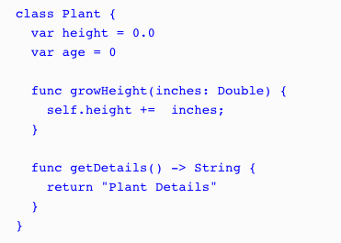
Overriding methods
Notes:
start by adding a getDetails()method to the Plant class that we will then override in the child classes. The following code shows how the new Plant class looks with the getDetails() method added:

Slide 29
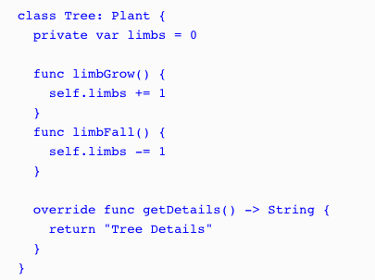
Overriding methods
Notes:
The thing to note here is that we do not use the override keyword in the Plant class because it is the first class to implement this method; however, we do include it in the Tree class since we are overriding the getDetails() method from the Plant class. Now, let's see what happens if we call the getDetails() method from an instance of the Plant and Tree classes:

Slide 30
Overriding Methods
var plant = Plant() var tree = Tree() print("Plant: \(plant.getDetails())") print("Tree: \(tree.getDetails())")
Notes:
What will they print?

Slide 31
Overriding Methods
var plant = Plant() var tree = Tree() print("Plant: \(plant.getDetails())") print("Tree: \(tree.getDetails())")
Plant: Plant Details Tree: Tree Details
Notes:
As we can see, the getDetails() method in the Tree subclass overrides the getDetails() method of its parent Plant class.
Inside the Tree class, we can still call the getDetails() method (or any overridden method, property, or subscript) of its superclass by using the super prefix. Let's see how we would call the getDetails() method of the Plant class from an instance of the Treeclass. We will begin by replacing the getDetails() method in the Plant class with the following method, which will generate a string containing the values of the height and ageproperties. Let's take a look at the following code:

Slide 32
class Plant {
var height: Double = 0.0
var age = 0
func growHeight(inches: Double) {
self.height += inches
}
func getDetails() -> String {
return "Height: \(self.height) age: \(self.age)"
}
}
Notes:
In the preceding code, we are changing the getDetails() method to return a string that contains the height and age of the plant. Now, let's replace the getDetails() method for the Tree class with the following method:

Slide 33
class Tree: Plant {
private var limbs = 0
func limbGrow() {
self.limbs += 1
}
func limbFall() {
self.limbs -= 1
}
override func getDetails() -> String {
return " \(super.getDetails()) Limbs: \(self.limbs)"
}
}

Slide 34
Overriding Methods
var tree = OakTree() tree.age = 5 tree.height = 4 tree.leaves = 50 tree.limbGrow() tree.limbGrow() print(tree.getDetails())
Notes:
When we call the getDetails() method of an instance of the OakTree class, it calls the getDetails() method of its superclass (the Tree class). The getDetails() method of the Tree class also calls the getDetails() method of its superclass (the Plant class). The getDetails() method of the Tree class will finally create a string instance that contains the height and age from the Plant class, the limbs from the Tree class, and the leaves from the OakTree class. Let's look at an example of this:

Slide 35
Overriding Methods
var tree = OakTree() tree.age = 5 tree.height = 4 tree.leaves = 50 tree.limbGrow() tree.limbGrow() print(tree.getDetails())
Height: 4.0 age: 5 limbs: 2 Leaves: 50

Slide 36
Overriding Properties
var description: String { get { return "Base class is Plant." } }
Notes:
Let's see how we would override a property by adding the following method to our Plantclass:
We can provide custom getter and setter to override any inherited property. When we override a property, we must provide the name and the type of property we are overriding, so the compiler can verify that one of the classes in the class hierarchy has a matching property to override. While overriding, properties are not as common as overriding methods; it is good for us to know how to do this when we need
The description property is a basic read-only property. This property returns the string, Base class is Plant. Now let's override this property by adding the following property to the Tree class:.

Slide 37
Overriding Properties
override var description: String { return "\(super.description) I am a Tree class." }
Notes:
Now let's override this property by adding the following property to the Tree class:
When we override a property, we use the same override keyword that we use when we override a method. The override keyword tells the compiler that we want to override a property, so the compiler can verify that another class in the class hierarchy contains a matching property to override. We then implement the property as we would any other property. Calling the description property of the tree would result in ……

Slide 38
Overriding Properties
override var description: String { return "\(super.description) I am a Tree class." }
Base class is Plant. I am a Tree class.
Notes:
Calling the description property of the tree would result in the Base class is Plant. I am a Tree class. string being returned.

Slide 39
Preventing Overrides
Use final keyword
final func growHeight(inches: Double) {
self.height += inches
}
Notes:
There are times when we want to prevent a subclass from overriding the properties and methods. There are also times when we want to prevent an entire class from being subclassed.
To prevent overrides or subclassing, we use the final keyword. To use the final keyword, we add it before the item's definition. Examples are final func, final var, and final class.
Any attempt to override an item marked final will throw a compile-time error.
RUN INHERITANCE PLAYGROUND EXAMPLES

Slide 40
Protocols
protocol MyProtocol { //protocol definition here }
Notes:
There are times when we would like to describe the implementation (methods, properties, and other requirements) of a class without actually providing the implementation. For this, we use protocols.
Protocols define a blueprint of methods, properties, and other requirements for a class or a structure. A class or a structure can then provide an implementation that conforms to those requirements. The class or structure that provides the implementation is said to conform to the protocol.
The syntax to define a protocol is very similar to how we define a class or a structure. The following example shows the syntax used to define a protocol:

Slide 41
Protocols
protocol MyProtocol { //protocol definition here }
class myClass: MyProtocol { //class implementation here }
Notes:
We state that a class or structure conforms to a particular protocol by placing the name of the protocol after the class or structure's name, separated by a colon. Here is an example of how we would state that a class conforms to the MyProtocol protocol:

Slide 42
Protocols
class MyClass: MyProtocol, AnotherProtocol, ThirdProtocol { // class implementation here }
Notes:
A class or a structure can conform to multiple protocols. We list the protocols that the class or structure conforms to by separating them with commas. The following example shows how we would state that our class conforms to multiple protocols:

Slide 43
Protocols
Class MyClass: MySuperClass, MyProtocol, MyProtocol2 { // Class implementation here }
Notes:
When we need a class to inherit from a superclass and implement a protocol, we list the superclass first, followed by the protocols. The following example illustrates this:

Slide 44
Protocols
Class MyClass: MySuperClass, MyProtocol, MyProtocol2 { // Class implementation here }
Notes:
When we need a class to inherit from a superclass and implement a protocol, we list the superclass first, followed by the protocols. The following example illustrates this:

Slide 45
Protocols - Properties
protocol FullName { var firstName: String {get set} var lastName: String {get set} }
Notes:
A protocol can require that the conforming class or structure provide certain properties with a specified name and type.
The protocol does not say if the property should be a stored or computed property because the implementation details are left up to the conforming class or structure.
When defining a property within a protocol, we must specify whether the property is a read-only or a read/write property by using the get and set keywords.
The FullName protocol defines two properties, which any class or structure that conforms to the protocol must implement. These are the firstName and lastName properties. Both these properties in the FullName protocol are read/write properties.

Slide 46
Protocols - Properties
protocol FullName { var firstName: String {get} var lastName: String {get set} }
Notes:
If we wanted to specify that the property is read-only, we would define it with only the get keyword, like this:

Slide 47
Protocols - Properties
class Scientist: FullName { var firstName = "" var lastName = "" }
Notes:
a Scientist class conforms to the FullName protocol:
If we had forgotten to include either the firstName or lastName property, we would have received a Scientist does not conform to protocol 'FullName' error message. We also need to make sure that the type of the property is the same. For example, if we changed the lastName definition in the Scientist class to var lastName = 42, we would also receive a Scientist does not conform to protocol 'FullName' error message because the protocol specifies that we must have a lastName property of the string type.

Slide 48
Protocols - Properties
class Scientist: FullName { var firstName = "" var lastName = "" }
Notes:
a Scientist class conforms to the FullName protocol:
If we had forgotten to include either the firstName or lastName property, we would have received a Scientist does not conform to protocol 'FullName' error message. We also need to make sure that the type of the property is the same. For example, if we changed the lastName definition in the Scientist class to var lastName = 42, we would also receive a Scientist does not conform to protocol 'FullName' error message because the protocol specifies that we must have a lastName property of the string type.

Slide 49
Protocols - Methods
protocol FullName { var firstName: String {get set} var lastName: String {get set}
func getFullName() -> String }
Notes:
A protocol can require that the conforming class or structure provide certain methods.
We define a method within a protocol exactly as we do within a normal class or structure, except without the curly braces or method body. Let's add a getFullName() method to our FullName protocol and Scientist class.
The following example shows how the FullName protocol would look with the getFullName() method added:

Slide 50
Protocols - Methods
class Scientist: FullName { var firstName = "" var lastName = "" var field = “”
func getFullName() -> String { return "\(firstName) \(lastName) studies \(field)" } }
Notes:
Now, we will need to add a getFullName() method to our Scientist class so that it will properly conform to the FullName protocol:

Slide 51
Protocols - Methods
struct FootballPlayer: FullName {
var firstName = "” var lastName = "” var number = 0
func getFullName() -> String { return "\(firstName) \(lastName) has the number \(number)” } }
Notes:
Structures can conform to Swift protocols exactly as classes do. The following example shows how we can create a FootballPlayer structure that conforms to the FullNameprotocol:
When a class or structure conforms to a Swift protocol, we can be sure that it has implemented the required properties and methods. This can be very useful when we want to ensure that certain properties or methods are implemented over various classes,
Protocols are also very useful when we want to decouple our code from requiring specific classes or structures. The following code shows how we would decouple our code using the FullName protocol, the Scientist class, and the FootballPlayer structure that we have already built:

Slide 52
Protocols - Methods
var scientist = Scientist() scientist.firstName = "Kara” scientist.lastName = "Hoffman” scientist.field = "Physics"
var player = FootballPlayer(); player.firstName = "Dan” player.lastName = "Marino” player.number = 13
var person: FullName person = scientist; print(person.getFullName()) person = player print(player.getFullName())
Notes:
In the preceding code, we begin by creating an instance of the Scientist class and the FootballPlayer structure. We then create a person variable that is of the FullName(protocol) type and set it to the scientist instance that we just created. We then call the getFullName() method to retrieve our description. This will print out the Kara Hoffman studies Physics message to the console.
We then set the person variable equal to the player instance and call the getFullName() method again. This will print out the Dan Marino has the number 13message to the console.
As we can see, the person variable does not care what the actual implementation class or structure is. Since we defined the person variable to be of the FullName type, we can set the person variable to an instance of any class or structure that conforms to the FullNameprotocol.
WHAT WILL IT PRINT??

Slide 53
var scientist = Scientist() scientist.firstName = "Kara” scientist.lastName = "Hoffman” scientist.field = "Physics"
var player = FootballPlayer(); player.firstName = "Dan” player.lastName = "Marino” player.number = 13
var person: FullName person = scientist; print(person.getFullName()) person = player print(player.getFullName())
Kara Hoffman studies Physics Dan Marino has the number 13
Notes:
RUN PROTOCOL CODE – COPY AND PASTE INTO PLAYGROUND

Slide 54
Extensions
extension String { //add new functionality here }
Notes:
With extensions, we can add new properties, methods, initializers, and subscripts, or make an existing class or structure conform to a protocol.
extensions cannot override the existing functionality.
To define an extension, we use the extension keyword, followed by the type that we are extending. The following example shows how we would create an extension that extends the string class:

Slide 55
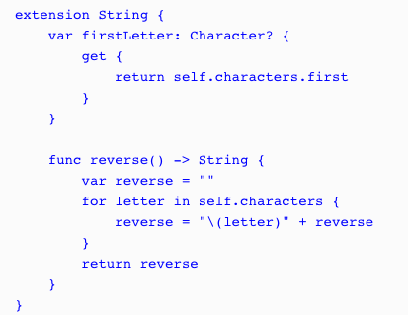
Extensions
Notes:
Let's see how extensions work by adding a reverse() method and a firstLetter property to Swift's standard string class:
When we extend an existing class or structure, we define properties, methods, initializers, and subscripts in exactly the same way as we would normally define them in a standard class or structure. In the string extension example, we see that we define the reverse()method and the firstLetter property exactly as we would define them in a normal class.

Slide 56
Extensions
var myString = "Learning Swift is fun"
print(myString.reverse())
print(myString.firstLetter)
Notes:
Extensions are very useful for adding additional functionality to classes and structures from external frameworks, even for Apple's frameworks, as demonstrated in the examples.
It is preferred to use extensions to add additional functionality to classes from external frameworks rather than subclassing because it allows us to use the classes provided by the frameworks throughout our code.
RUN EXTENSIONS CODE – CUT AND PASTE INTO PLAYGROUND

Slide 57
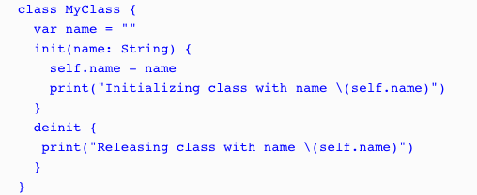
Memory management
Notes:
Let’s look at how ARC works.
This class is very similar to our previous MyClass class, except that we add a deinitializer that is called just before an instance of the class is destroyed and removed from memory.
This deinitializer prints out a message to the console that lets us know that the instance of the class is about to be removed.

Slide 58
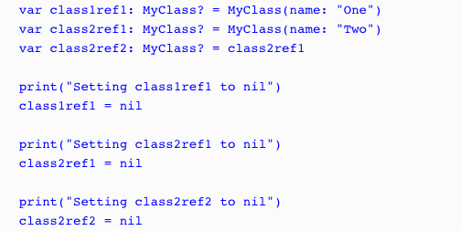
Memory management
Notes:
Now, let's look at the code that shows how ARC creates and destroys instances of a class:
In the example, we begin by creating two instances of the MyClass class named class1ref1 (which stands for class 1 reference 1) and class2ref1 (which stands for class 2 reference 1). We then create a second reference to class2ref1 named class2ref2. Now, in order to see how ARC works, we need to begin setting the references to nil. We start out by setting class1ref1 to nil. Since there is only one reference to class1ref1, the deinitializer will be called. Once the deinitializer completes its task, in our case, it prints a message to the console letting us know that the instance of the class has been destroyed and the memory has been released.
We then set the class2ref1 to nil, but a second reference to this class (class2ref2) prevents ARC from destroying the instance so that the deinitializer is not called. Finally, we set class2ref2 to nil, which allows ARC to destroy this instance of the MyClass class.

Slide 59
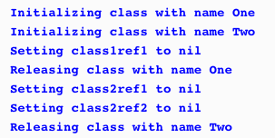
Memory management
Notes:
If we run this code, we will see the following output, which illustrates how ARC works:
From the example, it seems that ARC handles memory management very well. However, it is possible to write code that will prevent ARC from working properly.

Slide 60
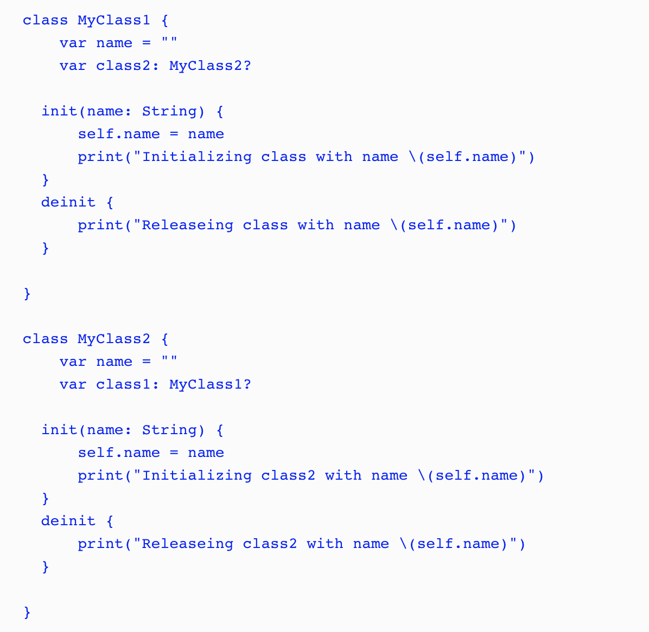
Memory management
Notes:
A strong reference cycle is where the instances of two classes hold a strong reference to each other, preventing ARC from releasing either instance. Strong reference cycles are a lot easier to understand with an example, so let's create one. In this project, we start off by creating two classes named MyClass1 and MyClass2 with the following code:

Slide 61
Memory management
Notes:
A strong reference cycle is where the instances of two classes hold a strong reference to each other, preventing ARC from releasing either instance. Strong reference cycles are a lot easier to understand with an example, so let's create one. In this project, we start off by creating two classes named MyClass1 and MyClass2 with the following code: As we can see from the code, MyClass1 contains an instance of MyClass2; therefore, the instance of MyClass2 cannot be released until MyClass1 is destroyed. We can also see from the code that MyClass2 contains an instance of MyClass1; therefore, the instance of MyClass1 cannot be released until MyClass2 is destroyed. This creates a cycle of dependency in which neither instance can be destroyed until the other one is destroyed. Let's see how this works by running the following code:

Slide 62
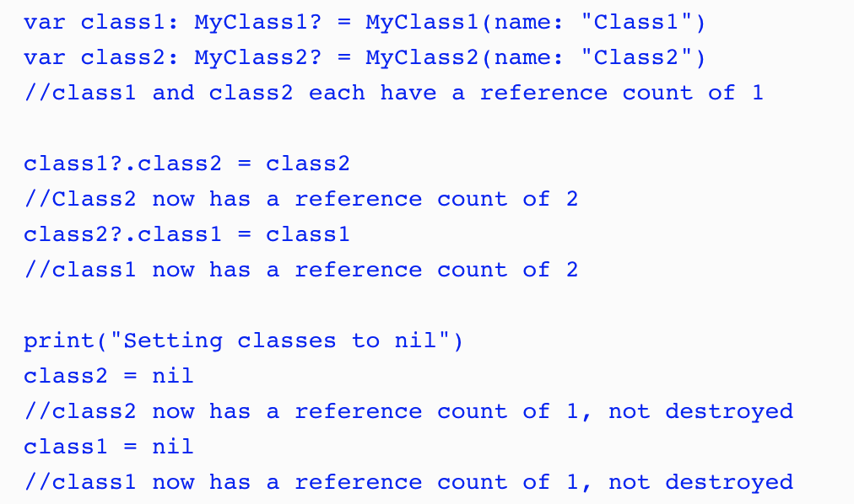
Memory management
Notes:
As we can see from the comments in the example, the reference counter for each instance never reaches zero; therefore, ARC cannot destroy the instances, thereby creating a memory leak. A memory leak is where an application continues to use memory but does not properly release it. This can eventually cause an application to crash.
To resolve a strong reference cycle, we need to prevent one of the classes from keeping a strong hold on the instance of the other class, thereby allowing ARC to destroy them both. Swift provides two ways of doing this, by letting us define the properties as either a weak reference or an unowned reference.
The difference between a weak reference and an unowned reference is that the instance which a weak reference refers to can be nil, whereas the instance that an unowned reference is referring to cannot be nil. This means that when we use a weak reference, the property must be an optional property since it can be nil. Let's see how we would use unowned and weak references to resolve a strong reference cycle. Let's start by looking at the unowned reference technique.

Slide 63
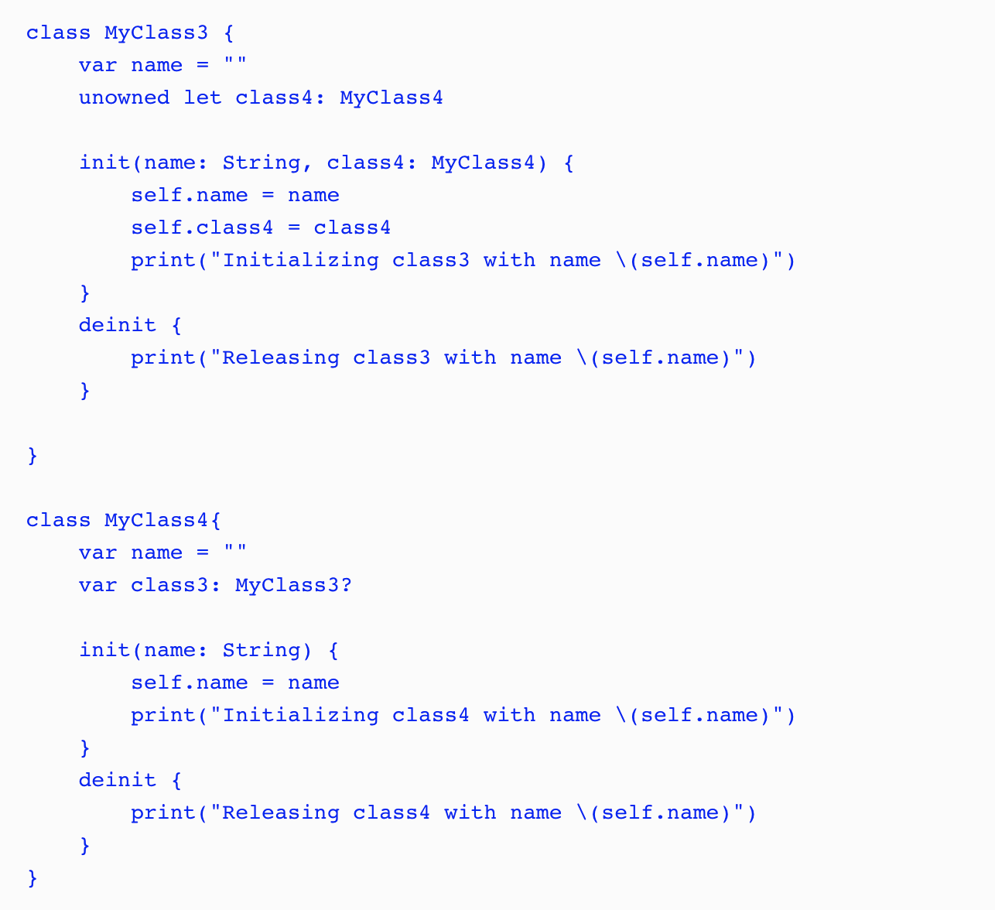
Memory management
Notes:
The MyClass4 class looks pretty similar to the MyClass1 and MyClass2 classes in the preceding example. What is different here is the MyClass3 class. In the MyClass3 class, we set the class4 property to unowned, which means it cannot be nil and it does not keep a strong reference to the MyClass4 instance that it is referring to. Since the class4property cannot be nil, we also need to set it when the class is initialized.

Slide 64
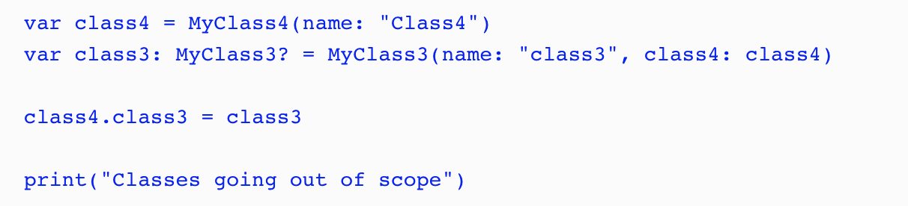
Memory management
Notes:
In the preceding code, we create an instance of the MyClass4 class and then use that instance to create an instance of the MyClass3 class. We then set the class3 property of the MyClass4 instance to the MyClass3 instance we just created. This creates a reference cycle of dependency between the two classes again, but this time, the MyClass3 instance does not keep a strong hold on the MyClass4 instance, allowing ARC to release both instances when they are no longer needed.

Slide 65
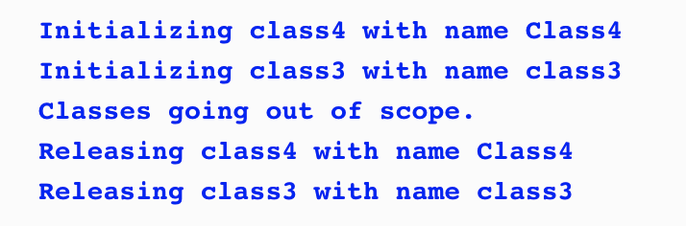
Memory management
Notes:
If we run this code, we see the following output, showing that both the MyClass3 and MyClass4 instances are released and the memory is freed:

Slide 66
Memory management
Notes:
If we run this code, we see the following output, showing that both the MyClass3 and MyClass4 instances are released and the memory is freed:

Slide 67
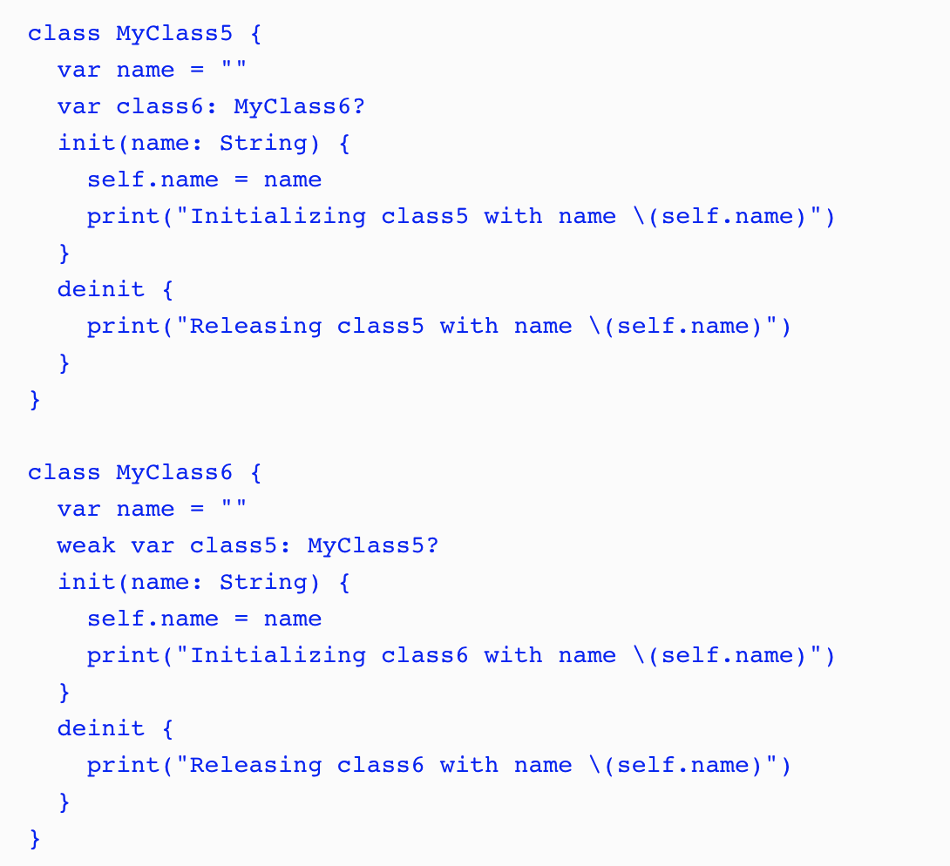
Memory management
Notes:
Now let's look at how we would use a weak reference to prevent a strong reference cycle. We begin by creating two new classes:
The MyClass5 and MyClass6 classes look very similar to the MyClass1 and MyClass2 classes we created earlier to show how a strong reference cycle works. The big difference is that we define the class5 property in the MyClass6class as a weak reference.

Slide 68
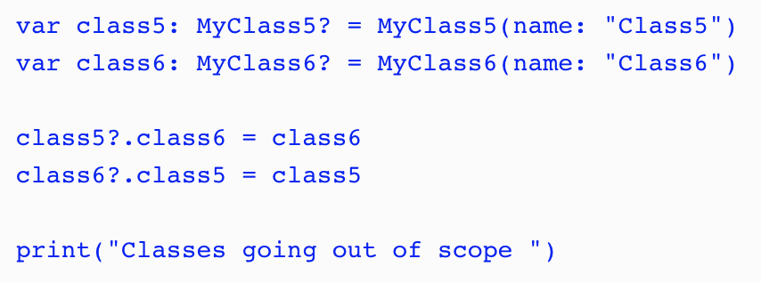
Memory management
Notes:
In the preceding code, we create instances of the MyClass5 and MyClass6 classes and then set the properties of those classes to point to the instance of the other class. Once again, this creates a cycle of dependency, but since we set the class5 property of the MyClass6 class to weak, it does not create a strong reference, allowing both instances to be released.

Slide 69
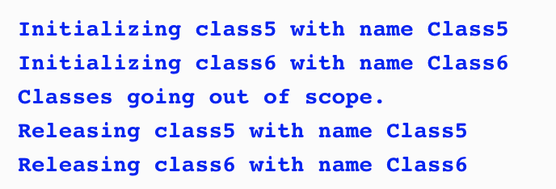
Memory management
Notes:
If we run the code, we will see the following output, showing that both the MyClass5 and MyClass6 instances are released and the memory is freed:
RUN PLAYGROUND CODE – testARC – Strong Reference Cycle – Memory Management

Slide 70
Thursday
Protocols and Extensions
No need for Xcode as yet.

Slide 71
Protocol Oriented Programming
How protocols are used as a type
How to implement polymorphism in Swift using protocols
How to use protocol extensions
Why we would want to use protocol extensions
Notes:
protocol extensions are going to be one of those defining features that set Swift programming language apart from the rest.
While protocol extensions are basically syntactic sugar they are, in my opinion, one of the most important additions to the Swift programming language. With protocol extensions, we are able to provide method and property implementations to any type that conforms to a protocol. To really understand how useful protocols and protocol extensions are, let's get a better understanding of protocols.

Slide 72
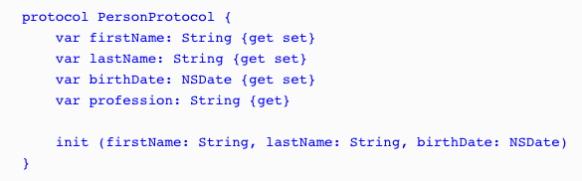
Protocol as Types
Notes:
Even though no functionality is implemented in a protocol, they are still considered a full-fledged type in the Swift programming language and can be used like any other type. What this means is we can use protocols as a parameter type or as a return type in a function. We can also use them as the type for variables, constants, and collections. Let's take a look at some examples. For these few examples, we will use the PersonProtocol protocol:

Slide 73



Protocol as Types
Notes:
In this example, the updatePerson() function accepts one parameter of the PersonProtocol protocol type and then returns a value of the PersonProtocol protocol type.
In this example, we create a variable of the PersonProtocol protocol type that is named myPerson.
In this final example, we create an array of PersonProtocol protocol types. As we can see from these three examples, even though the PersonProtocol protocol does not implement any functionality, we can still use protocols when we need to specify a type.

Slide 74
Protocol as Types
PersonProtocol protocol:var myPerson: PersonProtocol
myPerson = SwiftProgrammer(firstName: "Jon", lastName: "Hoffman", birthDate: bDateProgrammer) print("\(myPerson.firstName) \(myPerson.lastName)")
myPerson = FootballPlayer(firstName: "Dan", lastName: "Marino", birthDate: bDatePlayer) print("\(myPerson.firstName) \(myPerson.lastName)")
Notes:
let's assume that we have two types named SwiftProgrammer and FootballPlayer, which conform to the PersonProtocol protocol:
we start off by creating the myPerson variable of the PersonProtocolprotocol type. We then set the variable with an instance of the SwiftProgrammer type and print out the first and last names. Next, we set the myPerson variable to an instance of the FootballPlayer type and print out the first and last names again. One thing to note is that Swift does not care if the instance is a class or structure. It only matters that the type conforms to the PersonProtocol protocol type. Therefore, this code would be perfectly valid if the SwiftProgrammer type were a structure and the FootballPlayer type were a class.

Slide 75


Polymorphism with Protocols
Notes:
Polymorphism gives us the ability to interact with multiple types in a uniform manner. To illustrate this, we created an array of the PersonProtocol types and loop through the array. We can then access each item in the array using the properties and methods define in the PersonProtocol protocol, regardless of the actual type.
If we ran this example, the output would look similar to this:
We have mentioned a few times in this chapter that, when we define the type of a variable, constant, collection type, and so on to be a protocol type, we can then use the instance of any type that conforms to that protocol. This is a very important concept to understand and is one of the many things that make protocols and protocol extensions so powerful.
When we use a protocol to access instances, as shown in the previous example, we are limited to using only properties and methods that are defined in the protocol. If we want to use properties or methods that are specific to the individual types, we would need to cast the instance to that type.

Slide 76
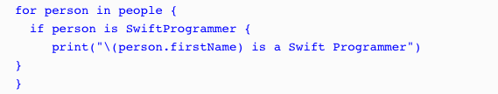
Type casting with Protocols
Notes:
Type casting is a way to check the type of an instance and/or to treat the instance as a specified type. In Swift, we use the is keyword to check if an instance is a specific type and the as keyword to treat the instance as a specific type.
In this example, we use the if conditional statement to check whether each element in the people array is an instance of the SwiftProgrammer type; if so, we print that the person is a Swift programmer to the console

Slide 77
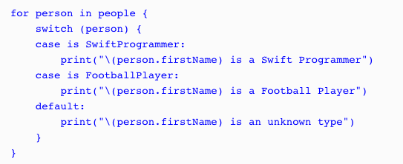
Type casting with Protocols
Notes:
It is a lot more efficient to use the switch statement, as shown in the next example:

Slide 78

Type casting with Protocols
Notes:
We can also use the where statement with the is keyword to filter the array, as shown in the following example:

Slide 79
Type casting with Protocols
as?
as!
Notes:
We can also use the where statement with the is keyword to filter the array, as shown in the following example:
Now let's look at how we can cast an instance of a class or structure to a specific type. To do this, we can use the as keyword. Since the cast can fail if the instance is not of the specified type, the as keyword comes in two forms: as? and as!. With the as? form, if the casting fails, it returns a nil; with the as! form, if the casting fails, we get a runtime error. Therefore, it is recommended we use the as? form unless we are absolutely sure of the instance type or we perform a check of the instance type prior to doing the cast.

Slide 80
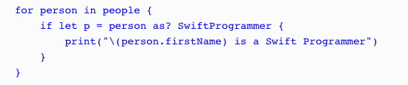

Type casting with Protocols
Notes:
Let's look at how we would use the as? keyword to cast an instance of a class or structure to a specified type:
Since the as? keyword returns an optional, we can use optional binding to perform the cast, as shown in this example. If we are sure of the instance type, we can use the as! keyword. The following example shows how to use the as! keyword when we filter the results of the array to only return instances of the SwiftProgrammer type:
If we are sure of the instance type, we can use the as! keyword.

Slide 81

Protocol Extensions
Notes:
Protocol extensions allow us to extend a protocol to provide method and property implementations to conforming types. They also allow us to provide common implementations to all confirming types, eliminating the need to provide an implementation in each individual type or the need to create a class hierarchy.
With this protocol, we are saying that any type that conforms to the DogProtocol protocol, must have the two properties of the String type, with names of: name and color.

Slide 82
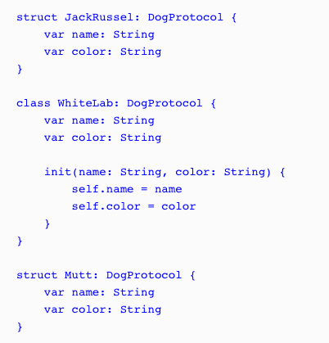
Protocol Extensions
Notes:
define the three types that conform to this protocol. We will name these types JackRussel, WhiteLab, and Mutt as follows:
Class needs an init() structures do not

Slide 83
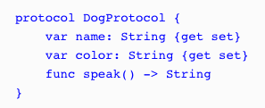
Protocol Extensions
Notes:
Now let's say that we want to provide a method named speak to each type that conforms to the DogProtocol protocol. Prior to protocol extensions, we would start off by adding the method definition to the protocol, as shown in the following code:

Slide 84
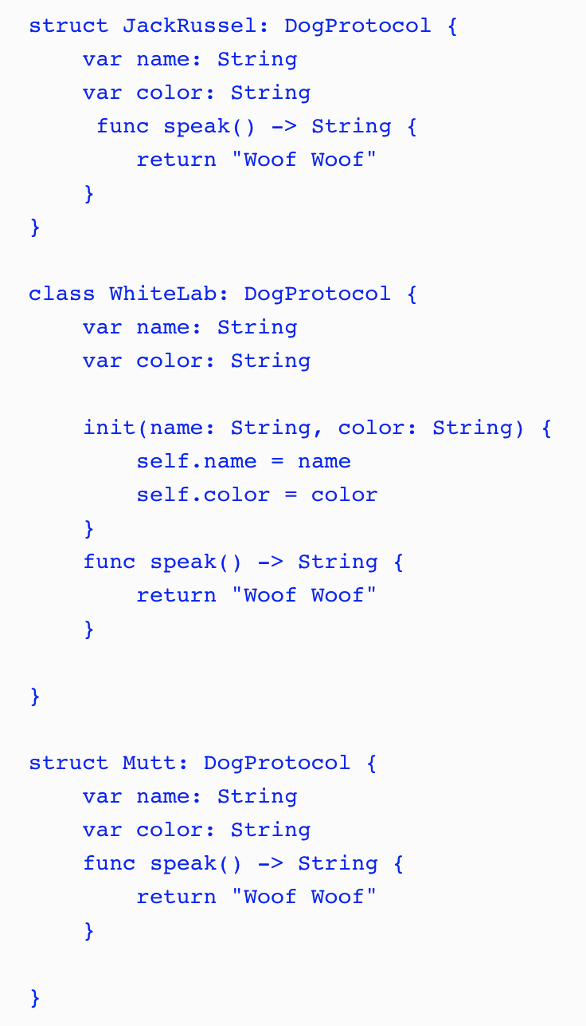
Protocol Extensions
Notes:
Once the method is defined in the protocol, we would then need to provide an implementation of the method in every type that conforms to the protocol.
While this method works, it is not very efficient because whenever we update the protocol, we would need to update all the types that conform to it and we may be duplicating a lot of code, as shown in this example. Another concern is that if we need to change the default behavior of the speak() method, we would have to go in each implementation and change the speak() method. This is where protocol extensions come in.

Slide 85
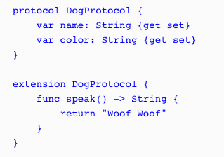
Protocol Extensions
Notes:
With protocol extensions, we could take the speak() method definition out of the protocol itself. We can then define it, with the default behavior, in protocol extension. The following code shows how we would define the protocol and the protocol extension:
We begin by defining DogProtocol with the original two properties. We then create a protocol extension that extends DogProtocol and contains the default implementation of the speak() method. With this code, there is no need to provide an implementation of the speak() method in each of the types that conform to DogProtocol because they automatically receive the implementation as part of the protocol.

Slide 86
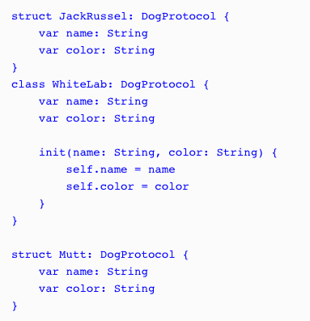
Protocol Extensions
Notes:
Let's see how this works by setting our three types that conform to DogProtocol back to their original implementations; they should receive the speak() method from the protocol extension:

Slide 87
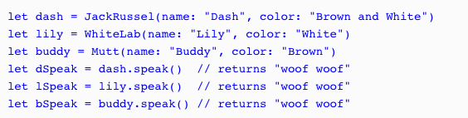
Protocol Extensions
Notes:
We can now use each of the types as shown in the following code:
As we can see in this example, by adding the speak() method to the DogProtocol protocol extension, we are automatically adding that method to all the types that conform to DogProtocol.

Slide 88
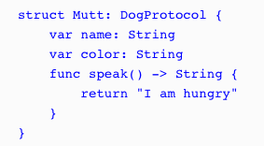
Protocol Extensions
Notes:
The speak() method in the DogProtocol protocol extension can be considered a default implementation of the speak() method because we are able to override it in the type implementations. As an example, we could override the speak() method in the Mutt structure, as shown in the following code:
When we call the speak() method for an instance of the Mutt type, it will return the string, I am hungry.

Slide 89
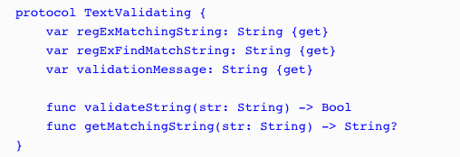
Protocol Extensions
Notes:
Text Validation example
The following code shows the TextValidating protocol, which defines the requirements for any type that we want to use for text validation:
regExMatchingString: This is a regular expression string used to verify that the input string contains only valid characters.
regExFindMatchString: This is a regular expression string used to retrieve a new string from the input string containing only valid characters. This regular expression is generally used when we need to validate the input in real time, as the user enters information, because it will find the longest matching prefix of the input string.
validationMessage: This is the error message to display if the input string contains non-valid characters.
validateString: This method will return true if the input string contains only valid characters. The regExMatchingString property will be used in this method to perform the match.
getMatchingString: This method will return a new string that contains only valid characters. This method is generally used when we need to validate the input in real time as the user enters information because it will find the longest matching prefix of the input string. We will use the regExFindMatchString property in this method to retrieve the new string.

Slide 90
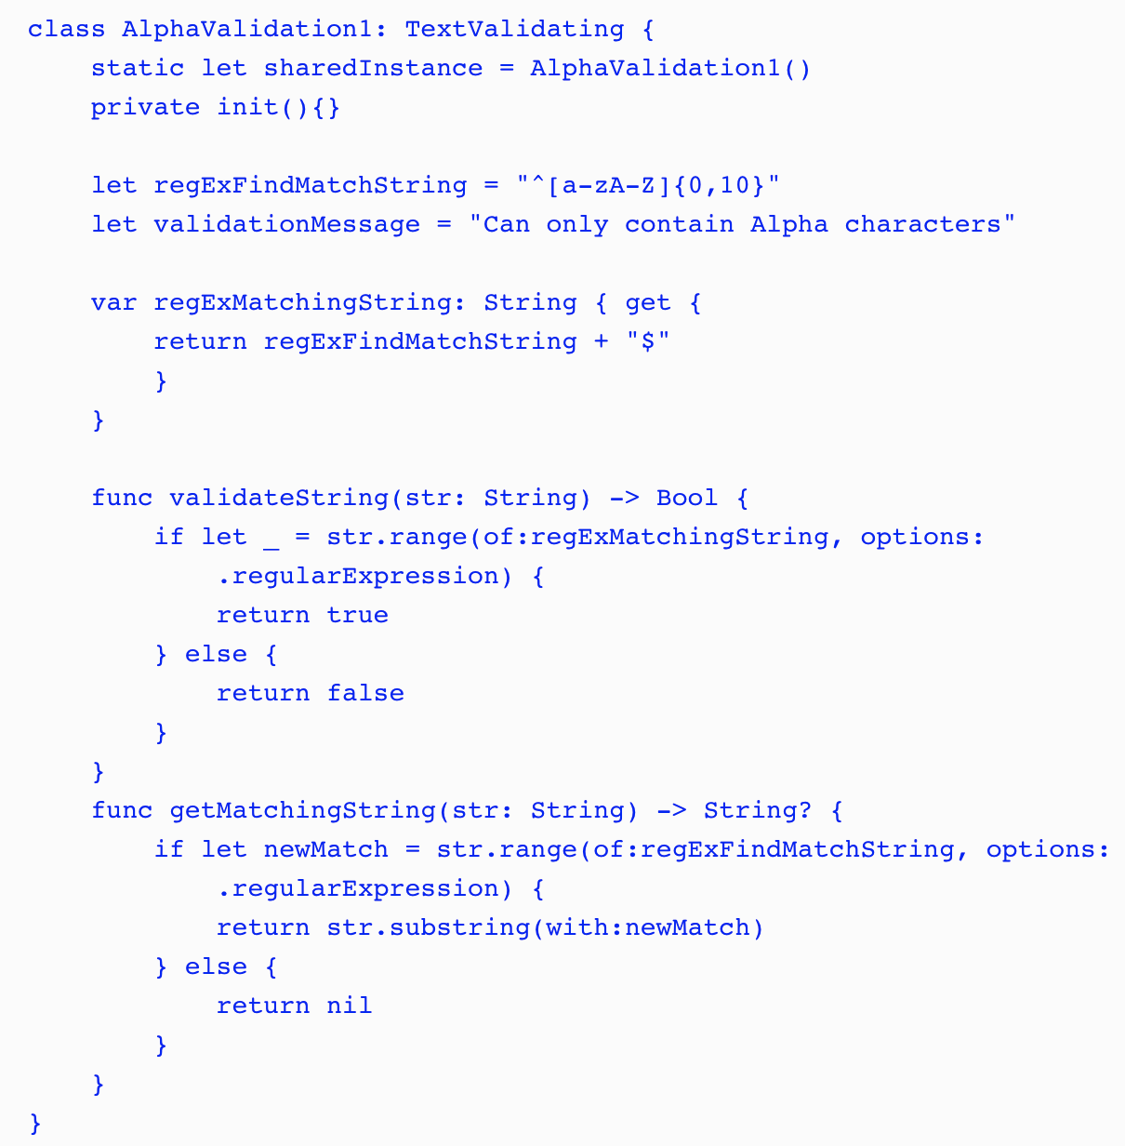
Protocol Extensions
Notes:
The following class would be used to verify that the input string contains only alpha characters:

Slide 91
Protocol Extensions
Notes:
The following class would be used to verify that the input string contains only alpha characters:
In this implementation, the regExFindMatchString and validationMessage properties are stored properties, and the regExMatchingString property is a computed property. We also implement the validateString() and getMatchingString() methods within the class.
Normally, we would have several different types that conform to TextValidating protocol where each one would validate a different type of input. As we can see from the AlphaValidation1 structure, there is a bit of code involved with each validation type. A lot of the code would also be duplicated in each type. The code for both methods (validateString() and getMatchingString()) and the regExMatchingString property would be duplicated in every validation class. This is not ideal, but if we wanted to avoid creating a class hierarchy with a super class that contains the duplicate code (I personally prefer using value types over classes), we would have no other choice.

Slide 92
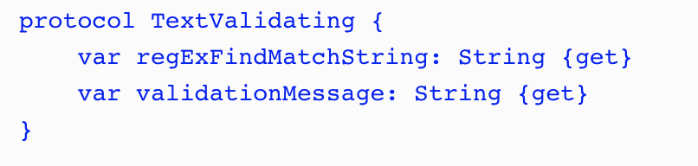
Protocol Extensions
Notes:
Now let's see how we would implement this using protocol extensions.
With protocol extensions, we need to think about the code a little differently. The big difference is, we neither need, nor want, to define everything in the protocol. With standard protocols or when we use a class hierarchy, all the methods and properties that you want to access using the generic superclass or protocol interface would have to be defined within the superclass or protocol. With protocol extensions, it is preferable for us not to define a property or method in the protocol if we are going to be defining it within the protocol extension. Therefore, when we rewrite our text validation types with protocol extensions, TextValidating would be greatly simplified and would look similar to this:
In the original TextValidating protocol, we defined three properties and two methods. As we can see in this new protocol, we are only defining two properties.

Slide 93
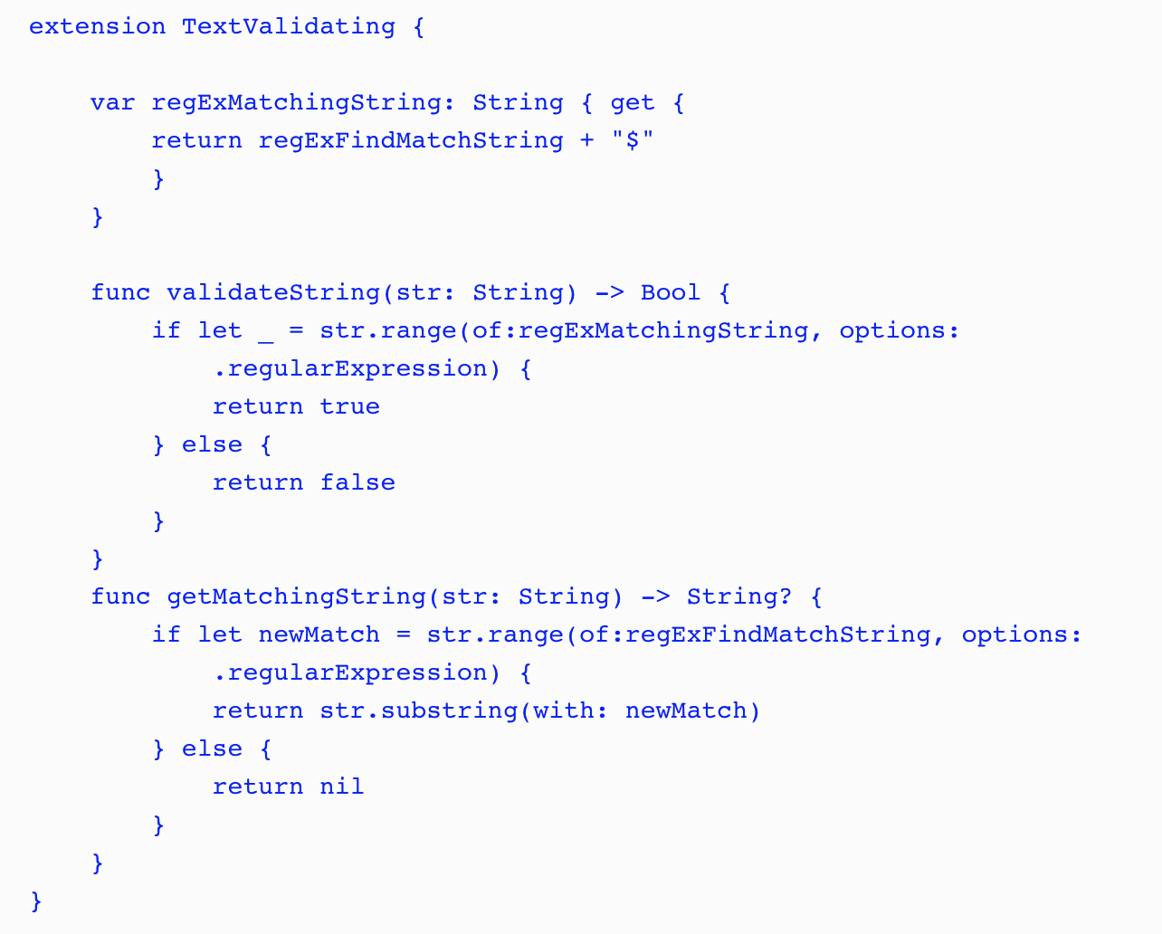
Protocol Extensions
Notes:
In the TextValidating protocol extension, we define the two methods and the third property that were defined in the original TextValidating, but were not defined in the new one. Now that we have created our protocol and protocol extension, we are able to define our text validation types.

Slide 94
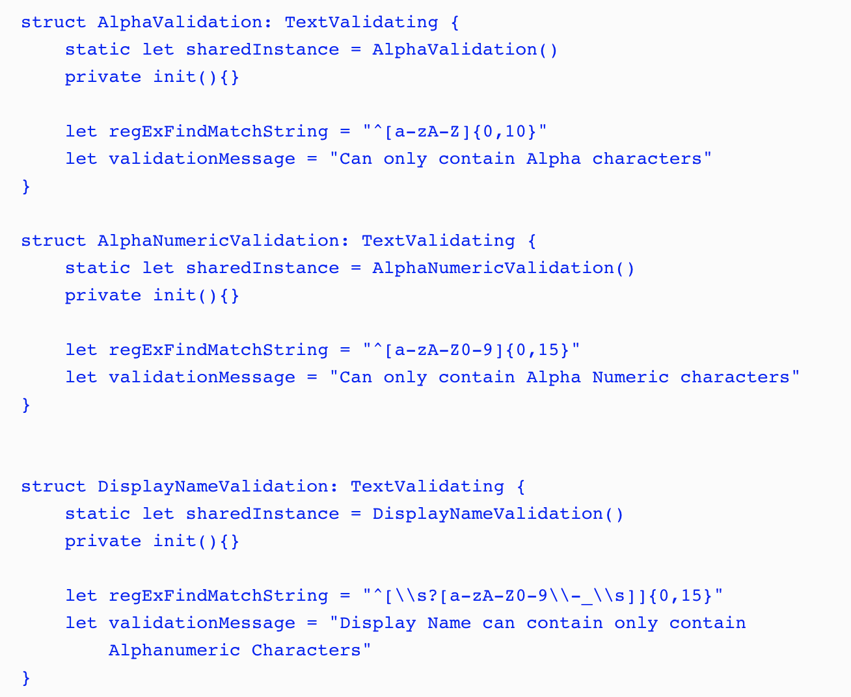
Protocol Extensions
Notes:
In the following code, we define three structures that we will use to validate text when a user types it in:
In each text validation structure, we create a static constant and a private initiator so that we can use the structure as a singleton.
After we define the singleton pattern, all we do in each type is set the values for the regExFindMatchString and validationMessage properties. Now, we have virtually no duplicate code. The only code that is duplicated is the code for the singleton pattern and that is not something we would want to put in the protocol extension because we would not want to force that pattern on all the conforming types.

Slide 95
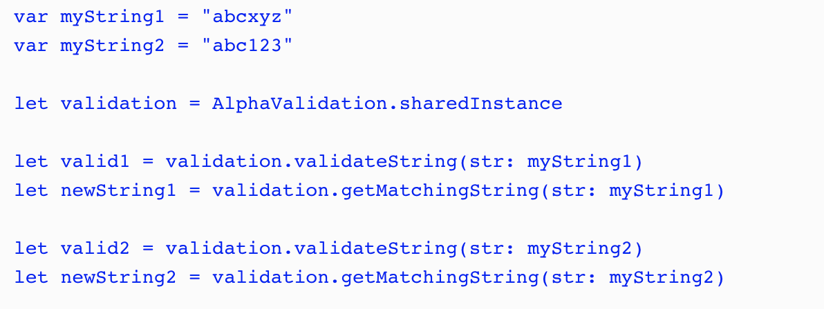
Protocol Extensions
Notes:
To use the text validation structures, we would use the validateString() method to see if a string instance matched the regular expression and the getMatchingString() method to return a new string with the invalid characters removed from the original string instance. The following example shows how we would use these methods:
In this example the valid2 constant would be true because the value of myString1 matches the regular expression defined in the AlphaValidation type while the valid2 constant would be false because the value of myString2 does not match. The newString1 constant would contain the same value as the myString1 constant because the original string matched the regular expression while newString2 would contain abc because the remainder of the characters do not match the regular expression.
RUN PLAYGROUNDS

Slide 96
Protocol Oriented Design
The difference between OOP and POP design
What is protocol-oriented design?
What is protocol composition?
What is protocol inheritance?

Slide 97
Protocol Oriented Design - Requirements
We will have three categories of animal: sea, land, and air.
Animals may be members of multiple categories. For example an alligator can be a member of both the land and sea categories.
Animals may be able to attack and/or move when they are on a tile that matches the categories they are in.
Animals will start off with a certain number of hit points and if those hit points reach 0 or less then they will die.
For our example here we will define two animals (Lion and Alligator) but we know that the number of animal types will grow as we develop the game.
Notes:
Animal types app

Slide 98
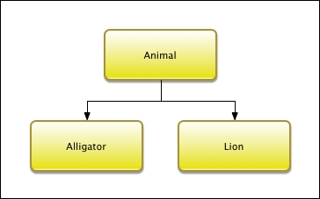
Protocol Oriented Design - OOD
Notes:
Animal types app
This diagram shows that we have one superclass named Animal and two subclasses named Alligator and Lion. We may think that, with the three categories (land, air, and sea), we would want to create a larger class hierarchy where the middle layer would contain the classes for the land, air, and sea animals. This would allow us to separate the code for each category; however it is not possible with our requirements. The reason this is not possible is that any of the animal types can be members of multiple categories and with a class hierarchy each class can have one and only one superclass. This means that our Animalsuperclass will need to contain the code required for each of the three categories. Lets take a look at the code for the Animal superclass.

Slide 99
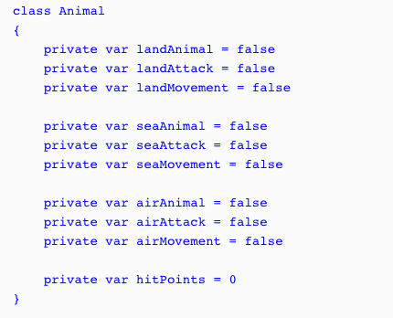
Protocol Oriented Design - OOD
Notes:
We will start the Animal superclass off by defining ten properties. These properties will define what type of animal it is and what type of attacks/movement it can do. We also define a property that will keep track of the hit points for the animal. The animal dies when its hit points reach zero.
We defined these as private variables because we need to set them in the subclass; however we do not want external entities to change them. The preference is for these to be constants; however a subclass can not set/change the value of a constant defined in a superclass. In order for this to work the subclass needs to be defined in the same physical file as the superclass

Slide 100
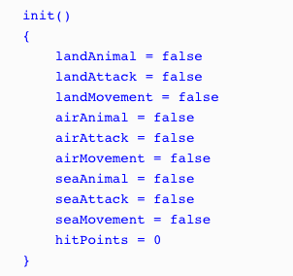
Protocol Oriented Design - OOD
Notes:
Next, we will define an initializer that will set the properties. We will set all of the properties to false by default and the hit points to 0. It will be up to the subclasses to set the appropriate properties that apply for that particular type:

Slide 101
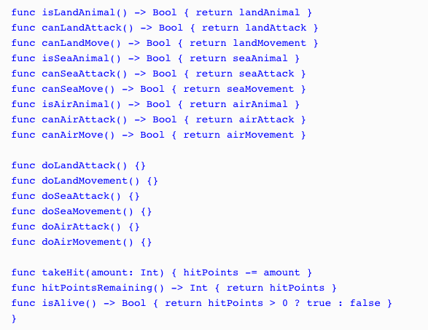
Protocol Oriented Design - OOD
Notes:
Since our properties are private we need to create some getter methods so we can retrieve the values of the properties. We will also create a couple of additional methods that will verify whether the animal is alive and also a method that will deduct hit points when the animal takes a hit:

Slide 102
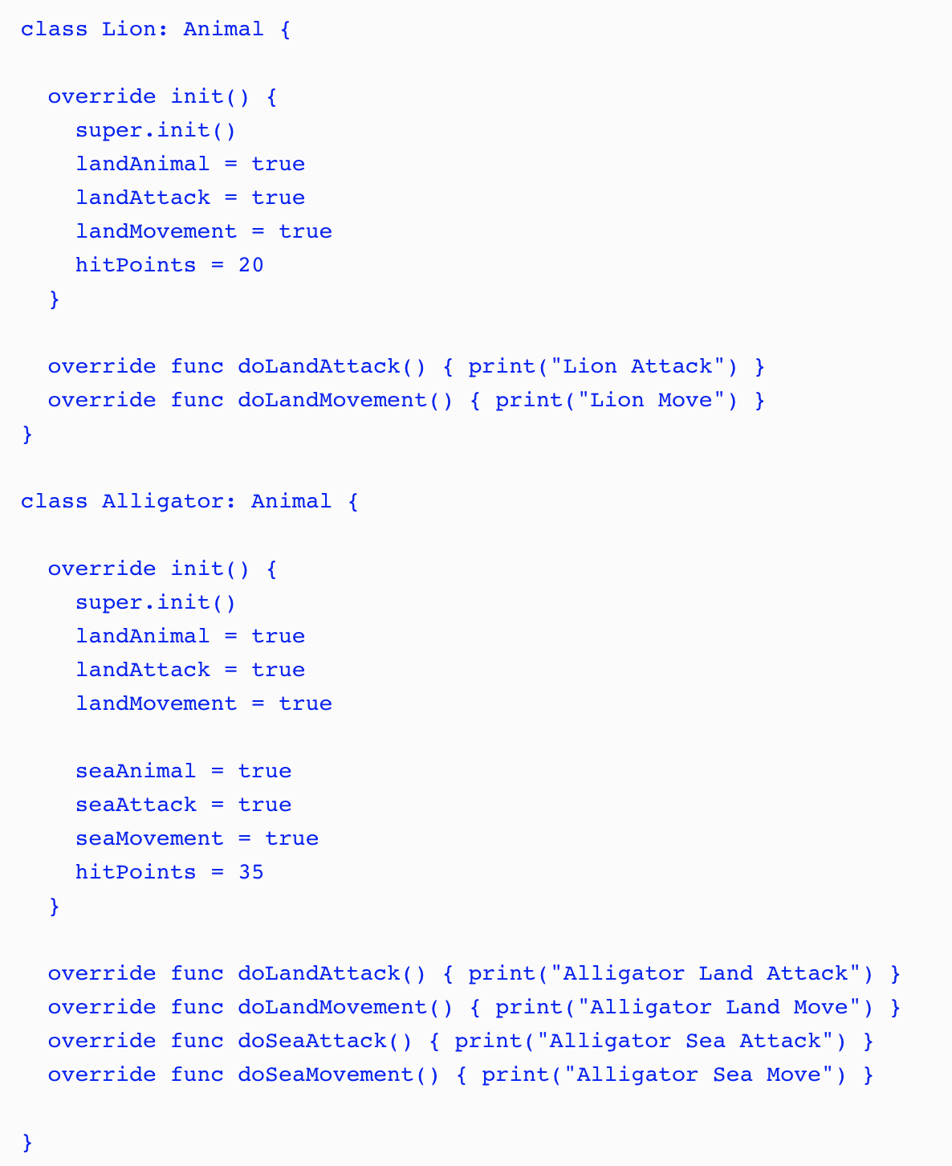
Notes:
We can now create the Alligator and Lion classes as subclasses of the Animal class:
As we can see, these classes override the functionality needed for each animal. The Lionclass contains the functionality for a land animal and the Alligator class contains the functionality for both a land and sea animal. Since both classes have the same Animal superclass we can use polymorphism to access them through the interface provided by the Animal superclass:

Slide 103
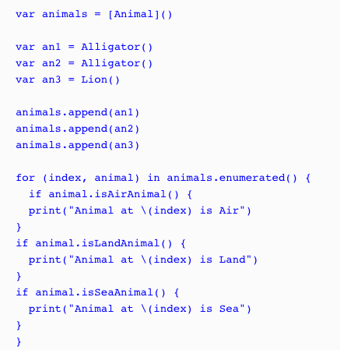
Notes:
The way we designed the animal types here would definitely work but there are several drawbacks to this design. The first drawback is the large monolithic Animal superclass. Those familiar with designing characters for video games will probably realize how much functionality is actually missing from the Animal superclass and its subclasses. This is on purpose so we can focus on the design and not all of the functionality. For those who are not familiar with designing characters for video games, trust me when I say that this class will get a lot bigger when we add all of the functionality needed.
Another drawback is not being able to define constants in the superclass that the subclasses can set. We could define various initiators for the superclass that would correctly set the constants for the different animal categories; however these initiators could become pretty complex and hard to maintain as we add additional animals. The builder pattern could help us with the initiation but, as we are about to see, a protocol-oriented design would be even better.
One final drawback that I am going to point out is the use of flags (landAnimal, seaAnimal and airAnimal properties) to define the type of animal. If we accidently set these flags wrong then the animal will not behave correctly. As an example, if we set the seaAnimalflag rather than the landAnimal flag in the Lion class then the lion would not be able to move or attack on land. Trust me, it is very easy, even for the most experienced developers, to set flags wrongly.

Slide 104
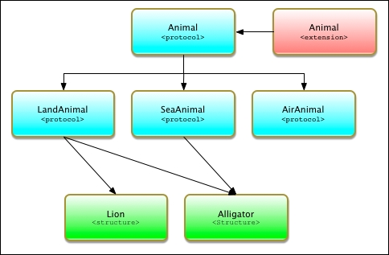
Protocol Oriented Design - POP
Notes:
As we can see, our POP design is quite a bit different from our OOP design. In this design we use three techniques that make POP significantly different from OOP. These techniques are protocol inheritance, protocol composition, and protocol extensions. It is important to understand these concepts so, before we go into our design, let's look at what protocol inheritance and protocol composition are. We looked at protocol extensions in the last chapter.

Slide 105

Protocol Oriented Design - POP
Notes:
In the Animal protocol, the only item that we are defining is the hitPoints property. This protocol would also contain any additional items that are common to all animals. To be consistent with our OOP design, we only need to add the hitPoints property to this protocol.

Slide 106
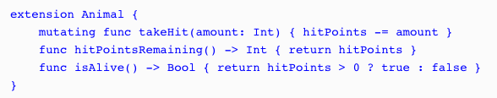
Protocol Oriented Design - POP
Notes:
Next, we need to add an Animal protocol extension that will contain the functionality that is common for all types that conform to the protocol. Our Animal protocol extension would contain the following code:
The Animal protocol extension contains the same takeHit(), hitPointsRemaining(), and isAlive() methods that we saw in the Animals superclass from the OOP example. Any type that conforms to the Animal protocol will automatically receive these three methods.

Slide 107
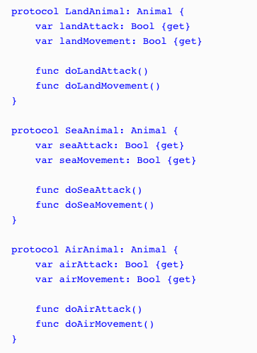
Protocol Oriented Design - POP
Notes:
Now let's define our LandAnimal, SeaAnimal, and AirAnimal protocols. These protocols will define the requirements for land, sea, and air animals respectively:
Unlike the Animal superclass in the OOP example, these three protocols only contain the functionality needed for their particular type of animal. Each of these protocols only contains four lines of code while the Animal superclass, from the OOP example, contains significantly more. This makes our protocol design much easier to read and manage. The protocol design is also much safer because the functionality for the various animal types is isolated in its own protocol rather than being embedded in a giant superclass. We also avoid the use of flags to define the animal category and instead define the category of the animal by what protocols they are conforming too.

Slide 108
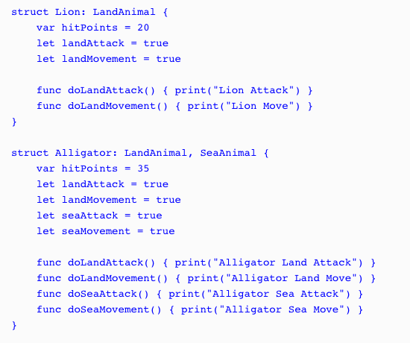
Notes:
Now let's look at how we would create our Lion and Alligator types using the protocol-oriented design:
Notice that we specify that the Lion type conforms to the LandAnimal protocol while the Alligator type conforms to both the LandAnimal and SeaAnimal protocols.
having a single type that conforms to multiple protocols is called protocol composition and is what allows us to use smaller protocols rather than one giant monolithic superclass as we did in the OOP example.

Slide 109
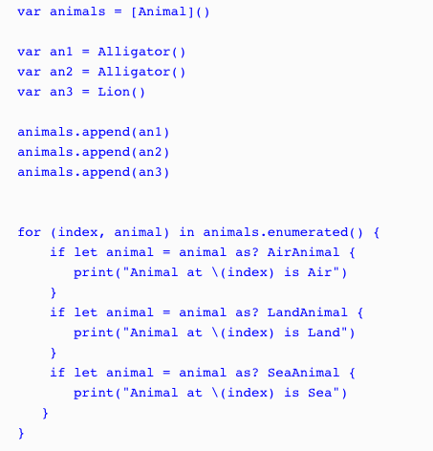
Notes:
Both the Lion and Alligator types originate from the Animal protocol; therefore we can still use polymorphism as we did in the OOP example where we use the Animal type to store instances of the Lion and Alligator types. Let's see how this works:
In this example, we create an array that will contain animal types named animals. We then create two instances of the Alligator type and one instance of the Lion type and add all three instances to the animals array. Finally, we use a for...in loop to loop through the array and print out the animal type based on the protocol that the instance conform too.

Slide 110

Protocol Oriented Design - POP
Notes:
When we use a protocol-oriented design, as we just saw, we are able to use the wherestatement to filter instances of our types. For example, if we only want to get the instances that conform to the SeaAnimal protocol we can create a for loop such as this:
This will retrieve only those animals that conform to the SeaAnimal protocol. This is a lot safer than just checking the flags because, as we pointed out earlier, it is really easy to set the wrong flag in our code, which would introduce all sorts of weird behavior.

