Slide 1
Building iOS Swift apps
5030-201720_MCS5993_M: 5030-Topics in Computer Science
5031-201720_MCS4993_M: 5031-Topics in MA/CS

Slide 2
Agenda
Protocols
Xcode Hello World
Notes:
Approach for the next few classes is to create a number of small apps to show how to use Xcode

Slide 3
Protocol Oriented Design
The difference between OOP and POP design
What is protocol-oriented design?
What is protocol composition?
What is protocol inheritance?

Slide 4
Protocol Oriented Design - Requirements
We will have three categories of animal: sea, land, and air.
Animals may be members of multiple categories. For example an alligator can be a member of both the land and sea categories.
Animals may be able to attack and/or move when they are on a tile that matches the categories they are in.
Animals will start off with a certain number of hit points and if those hit points reach 0 or less then they will die.
For our example here we will define two animals (Lion and Alligator) but we know that the number of animal types will grow as we develop the game.
Notes:
Animal types app

Slide 5
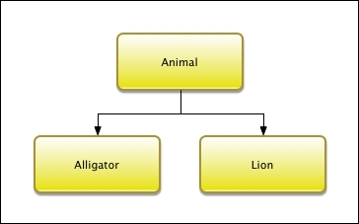
Protocol Oriented Design - OOD
Notes:
Animal types app
This diagram shows that we have one superclass named Animal and two subclasses named Alligator and Lion. We may think that, with the three categories (land, air, and sea), we would want to create a larger class hierarchy where the middle layer would contain the classes for the land, air, and sea animals. This would allow us to separate the code for each category; however it is not possible with our requirements. The reason this is not possible is that any of the animal types can be members of multiple categories and with a class hierarchy each class can have one and only one superclass. This means that our Animalsuperclass will need to contain the code required for each of the three categories. Lets take a look at the code for the Animal superclass.

Slide 6
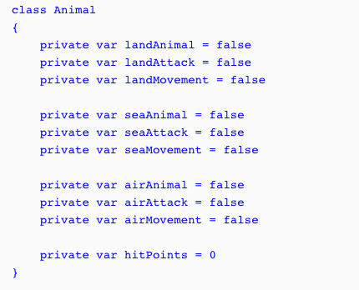
Protocol Oriented Design - OOD
Notes:
We will start the Animal superclass off by defining ten properties. These properties will define what type of animal it is and what type of attacks/movement it can do. We also define a property that will keep track of the hit points for the animal. The animal dies when its hit points reach zero.
We defined these as private variables because we need to set them in the subclass; however we do not want external entities to change them. The preference is for these to be constants; however a subclass can not set/change the value of a constant defined in a superclass. In order for this to work the subclass needs to be defined in the same physical file as the superclass

Slide 7
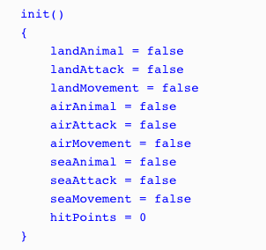
Protocol Oriented Design - OOD
Notes:
Next, we will define an initializer that will set the properties. We will set all of the properties to false by default and the hit points to 0. It will be up to the subclasses to set the appropriate properties that apply for that particular type:

Slide 8
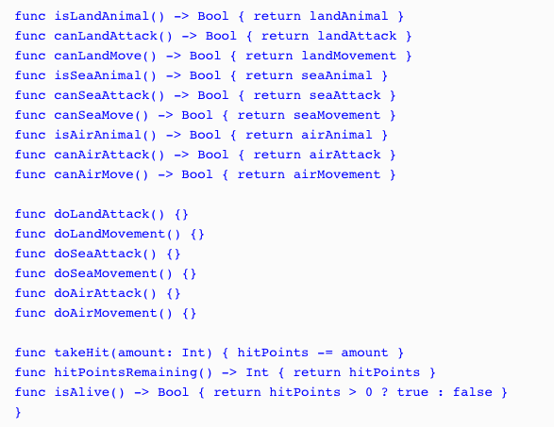
Protocol Oriented Design - OOD
Notes:
Since our properties are private we need to create some getter methods so we can retrieve the values of the properties. We will also create a couple of additional methods that will verify whether the animal is alive and also a method that will deduct hit points when the animal takes a hit:

Slide 9
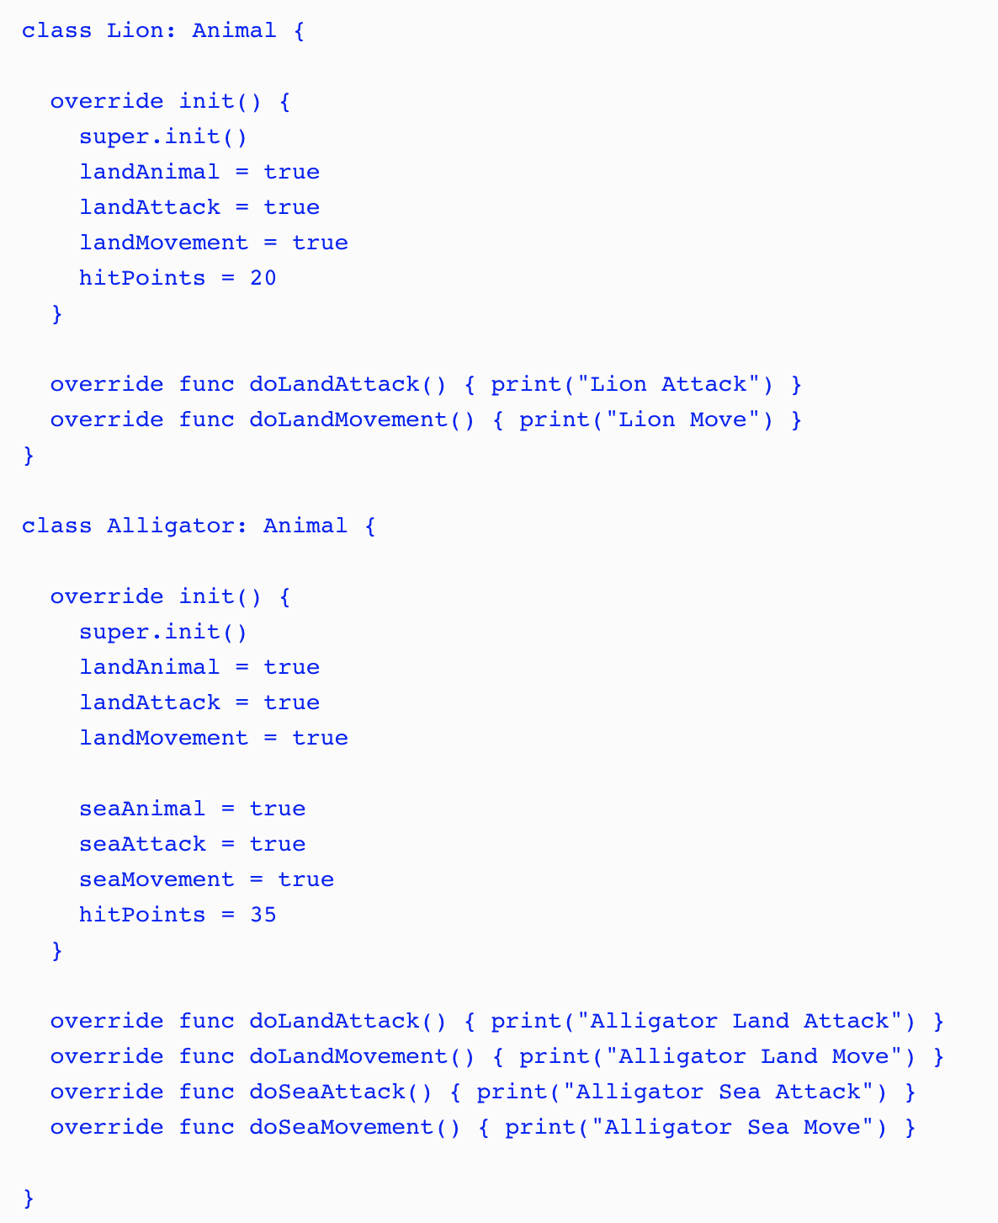
Notes:
We can now create the Alligator and Lion classes as subclasses of the Animal class:
As we can see, these classes override the functionality needed for each animal. The Lionclass contains the functionality for a land animal and the Alligator class contains the functionality for both a land and sea animal. Since both classes have the same Animal superclass we can use polymorphism to access them through the interface provided by the Animal superclass:

Slide 10
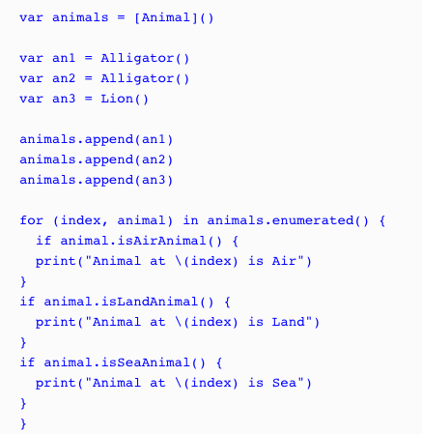
Notes:
The way we designed the animal types here would definitely work but there are several drawbacks to this design. The first drawback is the large monolithic Animal superclass. Those familiar with designing characters for video games will probably realize how much functionality is actually missing from the Animal superclass and its subclasses. This is on purpose so we can focus on the design and not all of the functionality. For those who are not familiar with designing characters for video games, trust me when I say that this class will get a lot bigger when we add all of the functionality needed.
Another drawback is not being able to define constants in the superclass that the subclasses can set. We could define various initiators for the superclass that would correctly set the constants for the different animal categories; however these initiators could become pretty complex and hard to maintain as we add additional animals. The builder pattern could help us with the initiation but, as we are about to see, a protocol-oriented design would be even better.
One final drawback that I am going to point out is the use of flags (landAnimal, seaAnimal and airAnimal properties) to define the type of animal. If we accidently set these flags wrong then the animal will not behave correctly. As an example, if we set the seaAnimalflag rather than the landAnimal flag in the Lion class then the lion would not be able to move or attack on land. Trust me, it is very easy, even for the most experienced developers, to set flags wrongly.

Slide 11
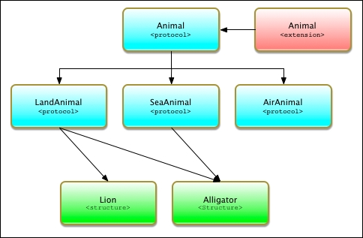
Protocol Oriented Design - POP
Notes:
As we can see, our POP design is quite a bit different from our OOP design. In this design we use three techniques that make POP significantly different from OOP. These techniques are protocol inheritance, protocol composition, and protocol extensions. It is important to understand these concepts so, before we go into our design, let's look at what protocol inheritance and protocol composition are. We looked at protocol extensions in the last chapter.

Slide 12

Protocol Oriented Design - POP
Notes:
In the Animal protocol, the only item that we are defining is the hitPoints property. This protocol would also contain any additional items that are common to all animals. To be consistent with our OOP design, we only need to add the hitPoints property to this protocol.

Slide 13
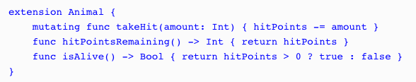
Protocol Oriented Design - POP
Notes:
Next, we need to add an Animal protocol extension that will contain the functionality that is common for all types that conform to the protocol. Our Animal protocol extension would contain the following code:
The Animal protocol extension contains the same takeHit(), hitPointsRemaining(), and isAlive() methods that we saw in the Animals superclass from the OOP example. Any type that conforms to the Animal protocol will automatically receive these three methods.

Slide 14
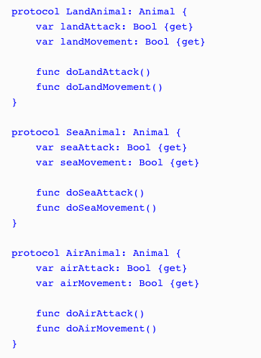
Protocol Oriented Design - POP
Notes:
Now let's define our LandAnimal, SeaAnimal, and AirAnimal protocols. These protocols will define the requirements for land, sea, and air animals respectively:
Unlike the Animal superclass in the OOP example, these three protocols only contain the functionality needed for their particular type of animal. Each of these protocols only contains four lines of code while the Animal superclass, from the OOP example, contains significantly more. This makes our protocol design much easier to read and manage. The protocol design is also much safer because the functionality for the various animal types is isolated in its own protocol rather than being embedded in a giant superclass. We also avoid the use of flags to define the animal category and instead define the category of the animal by what protocols they are conforming too.

Slide 15
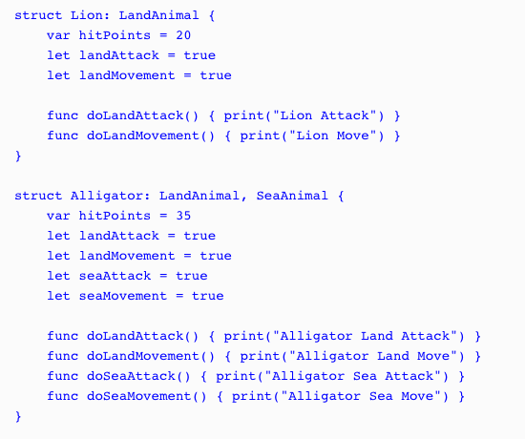
Notes:
Now let's look at how we would create our Lion and Alligator types using the protocol-oriented design:
Notice that we specify that the Lion type conforms to the LandAnimal protocol while the Alligator type conforms to both the LandAnimal and SeaAnimal protocols.
having a single type that conforms to multiple protocols is called protocol composition and is what allows us to use smaller protocols rather than one giant monolithic superclass as we did in the OOP example.

Slide 16
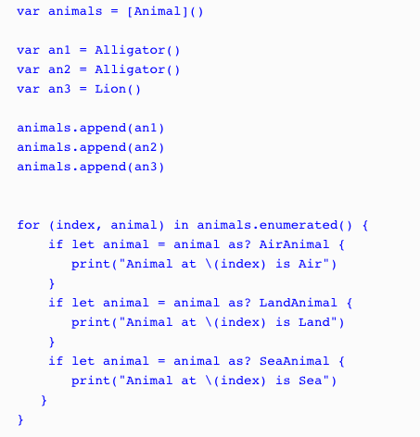
Notes:
Both the Lion and Alligator types originate from the Animal protocol; therefore we can still use polymorphism as we did in the OOP example where we use the Animal type to store instances of the Lion and Alligator types. Let's see how this works:
In this example, we create an array that will contain animal types named animals. We then create two instances of the Alligator type and one instance of the Lion type and add all three instances to the animals array. Finally, we use a for...in loop to loop through the array and print out the animal type based on the protocol that the instance conform too.

Slide 17

Protocol Oriented Design - POP
Notes:
When we use a protocol-oriented design, as we just saw, we are able to use the where statement to filter instances of our types. For example, if we only want to get the instances that conform to the SeaAnimal protocol we can create a for loop such as this:
This will retrieve only those animals that conform to the SeaAnimal protocol. This is a lot safer than just checking the flags because, as we pointed out earlier, it is really easy to set the wrong flag in our code, which would introduce all sorts of weird behavior.
DOWNLOAD CODE FROM https://www.packtpub.com/books/content/support/26824 and go through Chapter 10

Slide 18
Protocol Oriented Programming
How protocols are used as a type
How to implement polymorphism in Swift using protocols
How to use protocol extensions
Why we would want to use protocol extensions
Notes:
protocol extensions are going to be one of those defining features that set Swift programming language apart from the rest.
While protocol extensions are basically syntactic sugar they are, in my opinion, one of the most important additions to the Swift programming language. With protocol extensions, we are able to provide method and property implementations to any type that conforms to a protocol. To really understand how useful protocols and protocol extensions are, let's get a better understanding of protocols.

Slide 19
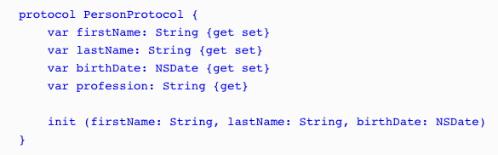
Protocol as Types
Notes:
Even though no functionality is implemented in a protocol, they are still considered a full-fledged type in the Swift programming language and can be used like any other type. What this means is we can use protocols as a parameter type or as a return type in a function. We can also use them as the type for variables, constants, and collections. Let's take a look at some examples. For these few examples, we will use the PersonProtocol protocol:

Slide 20



Protocol as Types
Notes:
In this example, the updatePerson() function accepts one parameter of the PersonProtocol protocol type and then returns a value of the PersonProtocol protocol type.
In this example, we create a variable of the PersonProtocol protocol type that is named myPerson.
In this final example, we create an array of PersonProtocol protocol types. As we can see from these three examples, even though the PersonProtocol protocol does not implement any functionality, we can still use protocols when we need to specify a type.

Slide 21
Protocol as Types
PersonProtocol protocol:var myPerson: PersonProtocol
myPerson = SwiftProgrammer(firstName: "Jon", lastName: "Hoffman", birthDate: bDateProgrammer) print("\(myPerson.firstName) \(myPerson.lastName)")
myPerson = FootballPlayer(firstName: "Dan", lastName: "Marino", birthDate: bDatePlayer) print("\(myPerson.firstName) \(myPerson.lastName)")
Notes:
let's assume that we have two types named SwiftProgrammer and FootballPlayer, which conform to the PersonProtocol protocol:
we start off by creating the myPerson variable of the PersonProtocolprotocol type. We then set the variable with an instance of the SwiftProgrammer type and print out the first and last names. Next, we set the myPerson variable to an instance of the FootballPlayer type and print out the first and last names again. One thing to note is that Swift does not care if the instance is a class or structure. It only matters that the type conforms to the PersonProtocol protocol type. Therefore, this code would be perfectly valid if the SwiftProgrammer type were a structure and the FootballPlayer type were a class.

Slide 22


Polymorphism with Protocols
Notes:
Polymorphism gives us the ability to interact with multiple types in a uniform manner. To illustrate this, we created an array of the PersonProtocol types and loop through the array. We can then access each item in the array using the properties and methods define in the PersonProtocol protocol, regardless of the actual type.
If we ran this example, the output would look similar to this:
We have mentioned a few times in this chapter that, when we define the type of a variable, constant, collection type, and so on to be a protocol type, we can then use the instance of any type that conforms to that protocol. This is a very important concept to understand and is one of the many things that make protocols and protocol extensions so powerful.
When we use a protocol to access instances, as shown in the previous example, we are limited to using only properties and methods that are defined in the protocol. If we want to use properties or methods that are specific to the individual types, we would need to cast the instance to that type.

Slide 23
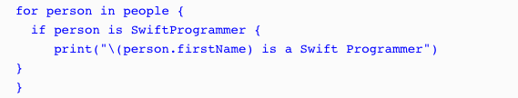
Type casting with Protocols
Notes:
Type casting is a way to check the type of an instance and/or to treat the instance as a specified type. In Swift, we use the is keyword to check if an instance is a specific type and the as keyword to treat the instance as a specific type.
In this example, we use the if conditional statement to check whether each element in the people array is an instance of the SwiftProgrammer type; if so, we print that the person is a Swift programmer to the console

Slide 24
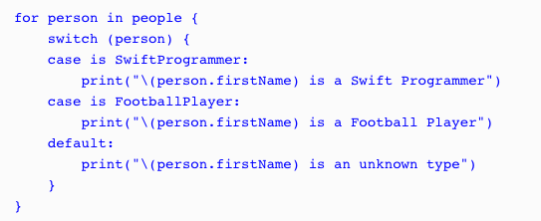
Type casting with Protocols
Notes:
It is a lot more efficient to use the switch statement, as shown in the next example:

Slide 25

Type casting with Protocols
Notes:
We can also use the where statement with the is keyword to filter the array, as shown in the following example:

Slide 26
Type casting with Protocols
as?
as!
Notes:
We can also use the where statement with the is keyword to filter the array, as shown in the following example:
Now let's look at how we can cast an instance of a class or structure to a specific type. To do this, we can use the as keyword. Since the cast can fail if the instance is not of the specified type, the as keyword comes in two forms: as? and as!. With the as? form, if the casting fails, it returns a nil; with the as! form, if the casting fails, we get a runtime error. Therefore, it is recommended we use the as? form unless we are absolutely sure of the instance type or we perform a check of the instance type prior to doing the cast.

Slide 27
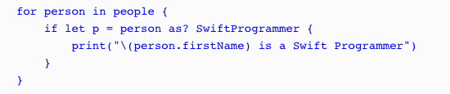

Type casting with Protocols
Notes:
Let's look at how we would use the as? keyword to cast an instance of a class or structure to a specified type:
Since the as? keyword returns an optional, we can use optional binding to perform the cast, as shown in this example. If we are sure of the instance type, we can use the as! keyword. The following example shows how to use the as! keyword when we filter the results of the array to only return instances of the SwiftProgrammer type:
If we are sure of the instance type, we can use the as! keyword.

Slide 28

Protocol Extensions
Notes:
Protocol extensions allow us to extend a protocol to provide method and property implementations to conforming types. They also allow us to provide common implementations to all confirming types, eliminating the need to provide an implementation in each individual type or the need to create a class hierarchy.
With this protocol, we are saying that any type that conforms to the DogProtocol protocol, must have the two properties of the String type, with names of: name and color.

Slide 29
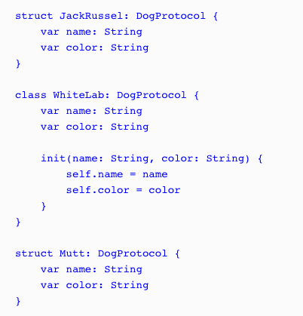
Protocol Extensions
Notes:
define the three types that conform to this protocol. We will name these types JackRussel, WhiteLab, and Mutt as follows:
Class needs an init() structures do not

Slide 30
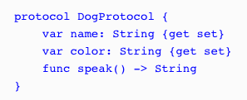
Protocol Extensions
Notes:
Now let's say that we want to provide a method named speak to each type that conforms to the DogProtocol protocol. Prior to protocol extensions, we would start off by adding the method definition to the protocol, as shown in the following code:

Slide 31
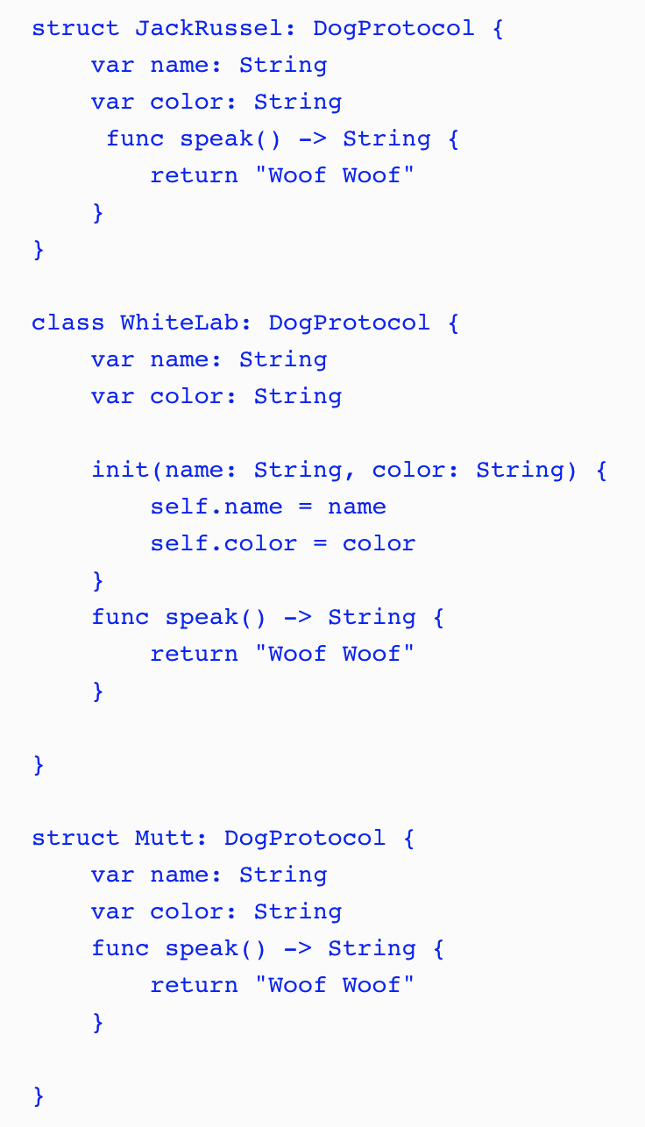
Protocol Extensions
Notes:
Once the method is defined in the protocol, we would then need to provide an implementation of the method in every type that conforms to the protocol.
While this method works, it is not very efficient because whenever we update the protocol, we would need to update all the types that conform to it and we may be duplicating a lot of code, as shown in this example. Another concern is that if we need to change the default behavior of the speak() method, we would have to go in each implementation and change the speak() method. This is where protocol extensions come in.

Slide 32
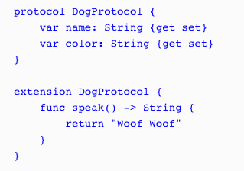
Protocol Extensions
Notes:
With protocol extensions, we could take the speak() method definition out of the protocol itself. We can then define it, with the default behavior, in protocol extension. The following code shows how we would define the protocol and the protocol extension:
We begin by defining DogProtocol with the original two properties. We then create a protocol extension that extends DogProtocol and contains the default implementation of the speak() method. With this code, there is no need to provide an implementation of the speak() method in each of the types that conform to DogProtocol because they automatically receive the implementation as part of the protocol.

Slide 33
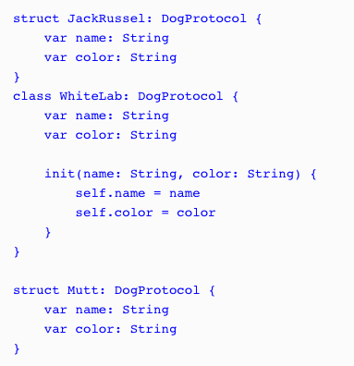
Protocol Extensions
Notes:
Let's see how this works by setting our three types that conform to DogProtocol back to their original implementations; they should receive the speak() method from the protocol extension:

Slide 34
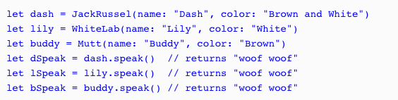
Protocol Extensions
Notes:
We can now use each of the types as shown in the following code:
As we can see in this example, by adding the speak() method to the DogProtocol protocol extension, we are automatically adding that method to all the types that conform to DogProtocol.

Slide 35
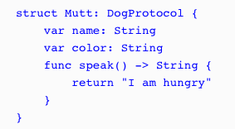
Protocol Extensions
Notes:
The speak() method in the DogProtocol protocol extension can be considered a default implementation of the speak() method because we are able to override it in the type implementations. As an example, we could override the speak() method in the Mutt structure, as shown in the following code:
When we call the speak() method for an instance of the Mutt type, it will return the string, I am hungry.

Slide 36
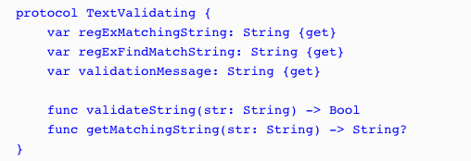
Protocol Extensions
Notes:
Text Validation example
The following code shows the TextValidating protocol, which defines the requirements for any type that we want to use for text validation:
regExMatchingString: This is a regular expression string used to verify that the input string contains only valid characters.
regExFindMatchString: This is a regular expression string used to retrieve a new string from the input string containing only valid characters. This regular expression is generally used when we need to validate the input in real time, as the user enters information, because it will find the longest matching prefix of the input string.
validationMessage: This is the error message to display if the input string contains non-valid characters.
validateString: This method will return true if the input string contains only valid characters. The regExMatchingString property will be used in this method to perform the match.
getMatchingString: This method will return a new string that contains only valid characters. This method is generally used when we need to validate the input in real time as the user enters information because it will find the longest matching prefix of the input string. We will use the regExFindMatchString property in this method to retrieve the new string.

Slide 37
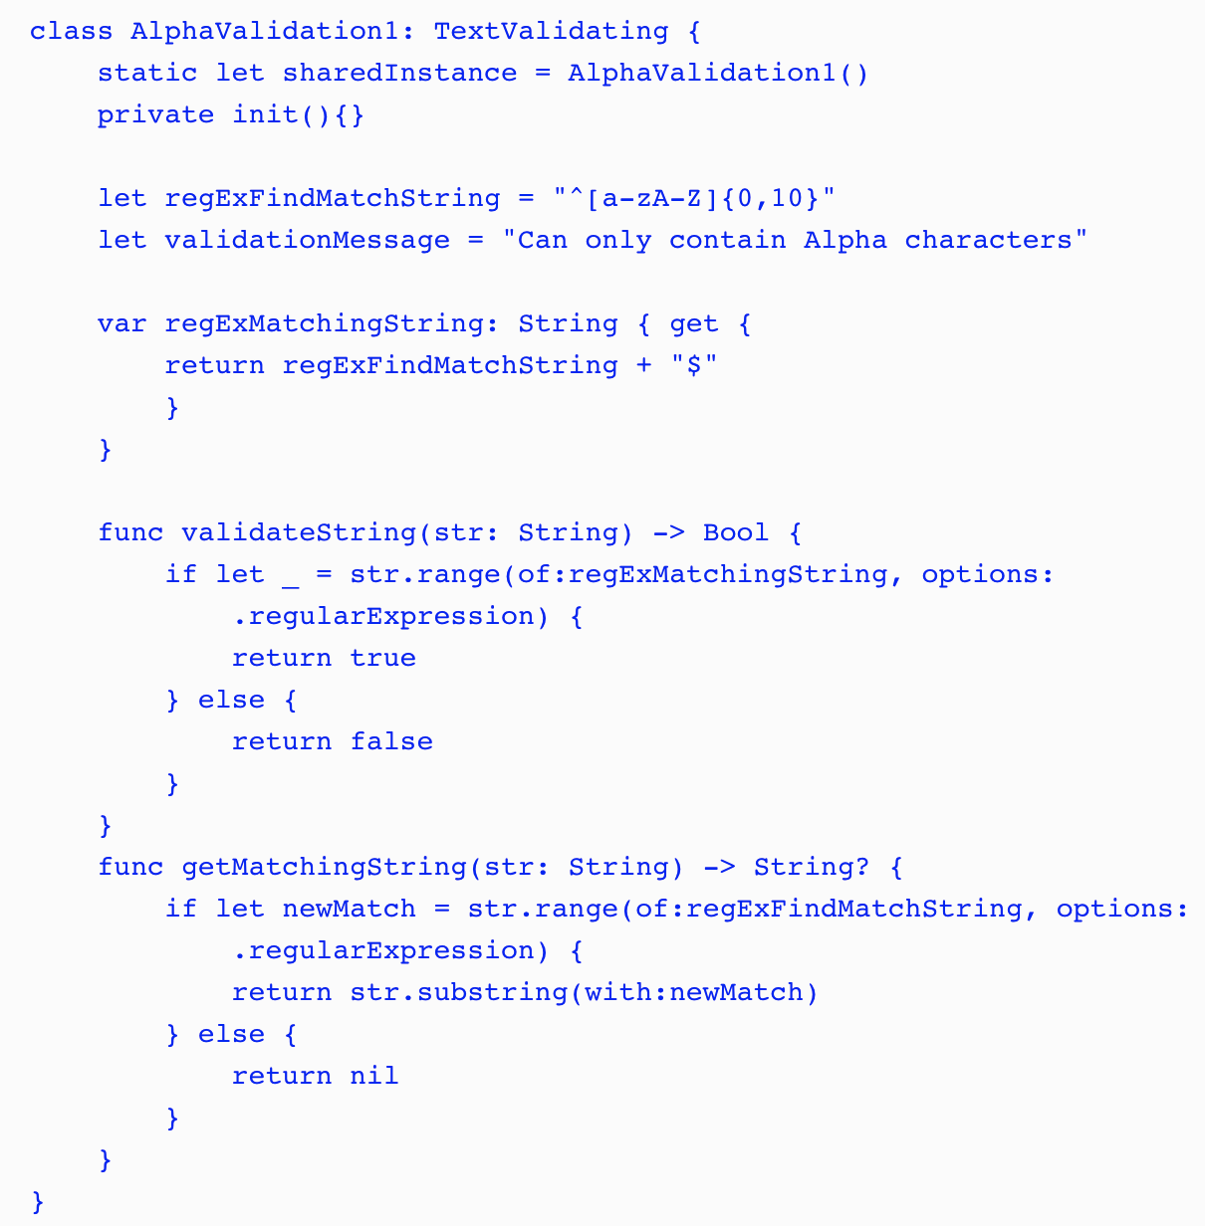
Protocol Extensions
Notes:
The following class would be used to verify that the input string contains only alpha characters:

Slide 38
Protocol Extensions
Notes:
The following class would be used to verify that the input string contains only alpha characters:
In this implementation, the regExFindMatchString and validationMessage properties are stored properties, and the regExMatchingString property is a computed property. We also implement the validateString() and getMatchingString() methods within the class.
Normally, we would have several different types that conform to TextValidating protocol where each one would validate a different type of input. As we can see from the AlphaValidation1 structure, there is a bit of code involved with each validation type. A lot of the code would also be duplicated in each type. The code for both methods (validateString() and getMatchingString()) and the regExMatchingString property would be duplicated in every validation class. This is not ideal, but if we wanted to avoid creating a class hierarchy with a super class that contains the duplicate code (I personally prefer using value types over classes), we would have no other choice.

Slide 39
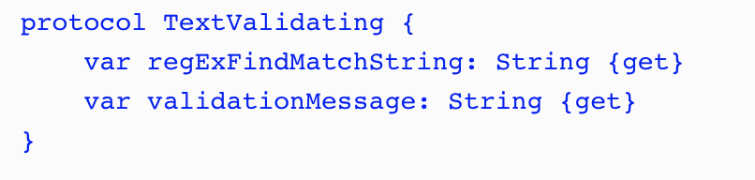
Protocol Extensions
Notes:
Now let's see how we would implement this using protocol extensions.
With protocol extensions, we need to think about the code a little differently. The big difference is, we neither need, nor want, to define everything in the protocol. With standard protocols or when we use a class hierarchy, all the methods and properties that you want to access using the generic superclass or protocol interface would have to be defined within the superclass or protocol. With protocol extensions, it is preferable for us not to define a property or method in the protocol if we are going to be defining it within the protocol extension. Therefore, when we rewrite our text validation types with protocol extensions, TextValidating would be greatly simplified and would look similar to this:
In the original TextValidating protocol, we defined three properties and two methods. As we can see in this new protocol, we are only defining two properties.

Slide 40
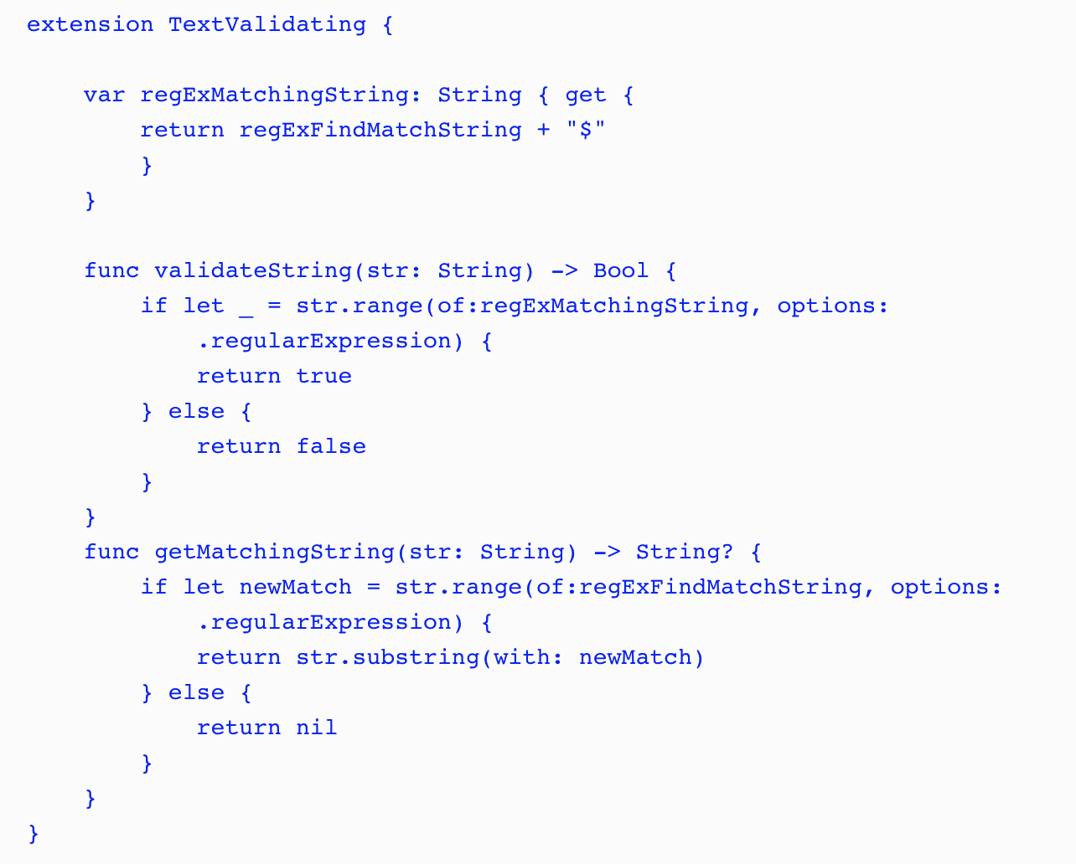
Protocol Extensions
Notes:
In the TextValidating protocol extension, we define the two methods and the third property that were defined in the original TextValidating, but were not defined in the new one. Now that we have created our protocol and protocol extension, we are able to define our text validation types.

Slide 41
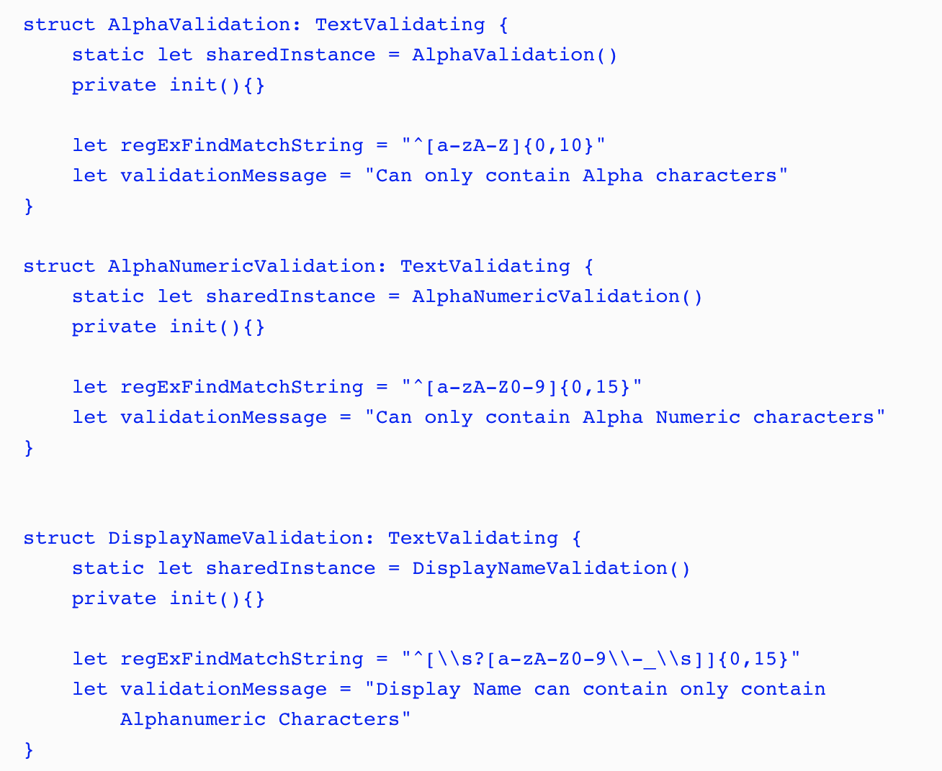
Protocol Extensions
Notes:
In the following code, we define three structures that we will use to validate text when a user types it in:
In each text validation structure, we create a static constant and a private initiator so that we can use the structure as a singleton.
After we define the singleton pattern, all we do in each type is set the values for the regExFindMatchString and validationMessage properties. Now, we have virtually no duplicate code. The only code that is duplicated is the code for the singleton pattern and that is not something we would want to put in the protocol extension because we would not want to force that pattern on all the conforming types.

Slide 42
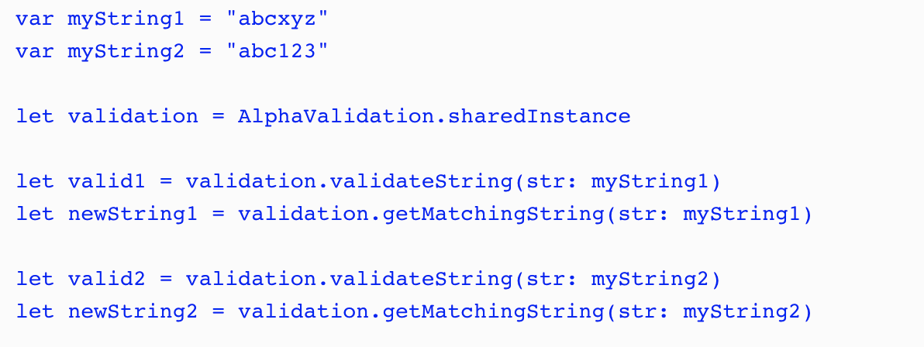
Protocol Extensions
Notes:
To use the text validation structures, we would use the validateString() method to see if a string instance matched the regular expression and the getMatchingString() method to return a new string with the invalid characters removed from the original string instance. The following example shows how we would use these methods:
In this example the valid2 constant would be true because the value of myString1 matches the regular expression defined in the AlphaValidation type while the valid2 constant would be false because the value of myString2 does not match. The newString1 constant would contain the same value as the myString1 constant because the original string matched the regular expression while newString2 would contain abc because the remainder of the characters do not match the regular expression.
RUN PLAYGROUNDS

Slide 43
Agenda
Xcode Chap2
Assignment – Exercism Word Count

