Slide 1
Hello World Swift app
Set up command line environment
Xcode Playgrounds
swift from the command line
Basic swift command
print("Hello, world!")

Slide 2
Hello World Swift app
User$ swift package init
Creating library package: HelloWorld
Creating Package.swift
Creating .gitignore
Creating Sources/
Creating Sources/HelloWorld.swift
Creating Tests/
Creating Tests/LinuxMain.swift
Creating Tests/HelloWorldTests/
Creating Tests/HelloWorldTests/HelloWorldTests.swift
User$ swift test

Slide 3
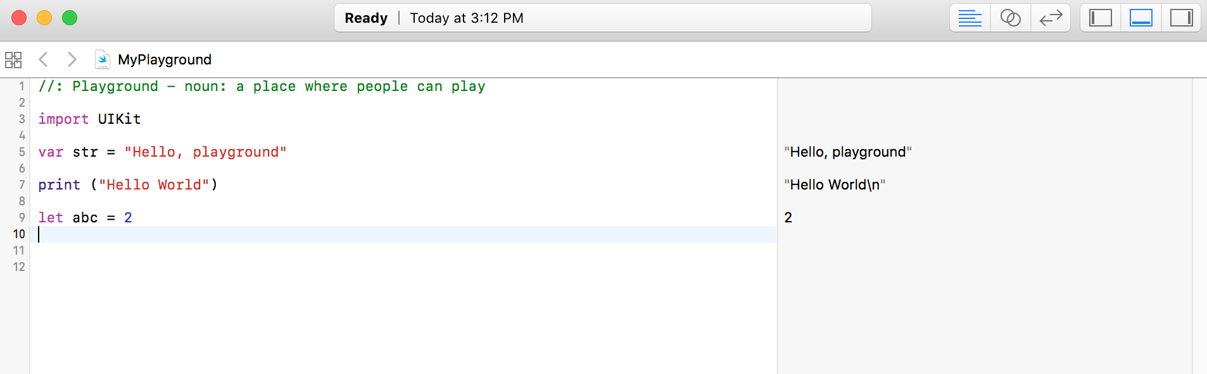
Xcode Playground
Notes:
https://developer.apple.com/go/?id=swift-tour

Slide 4
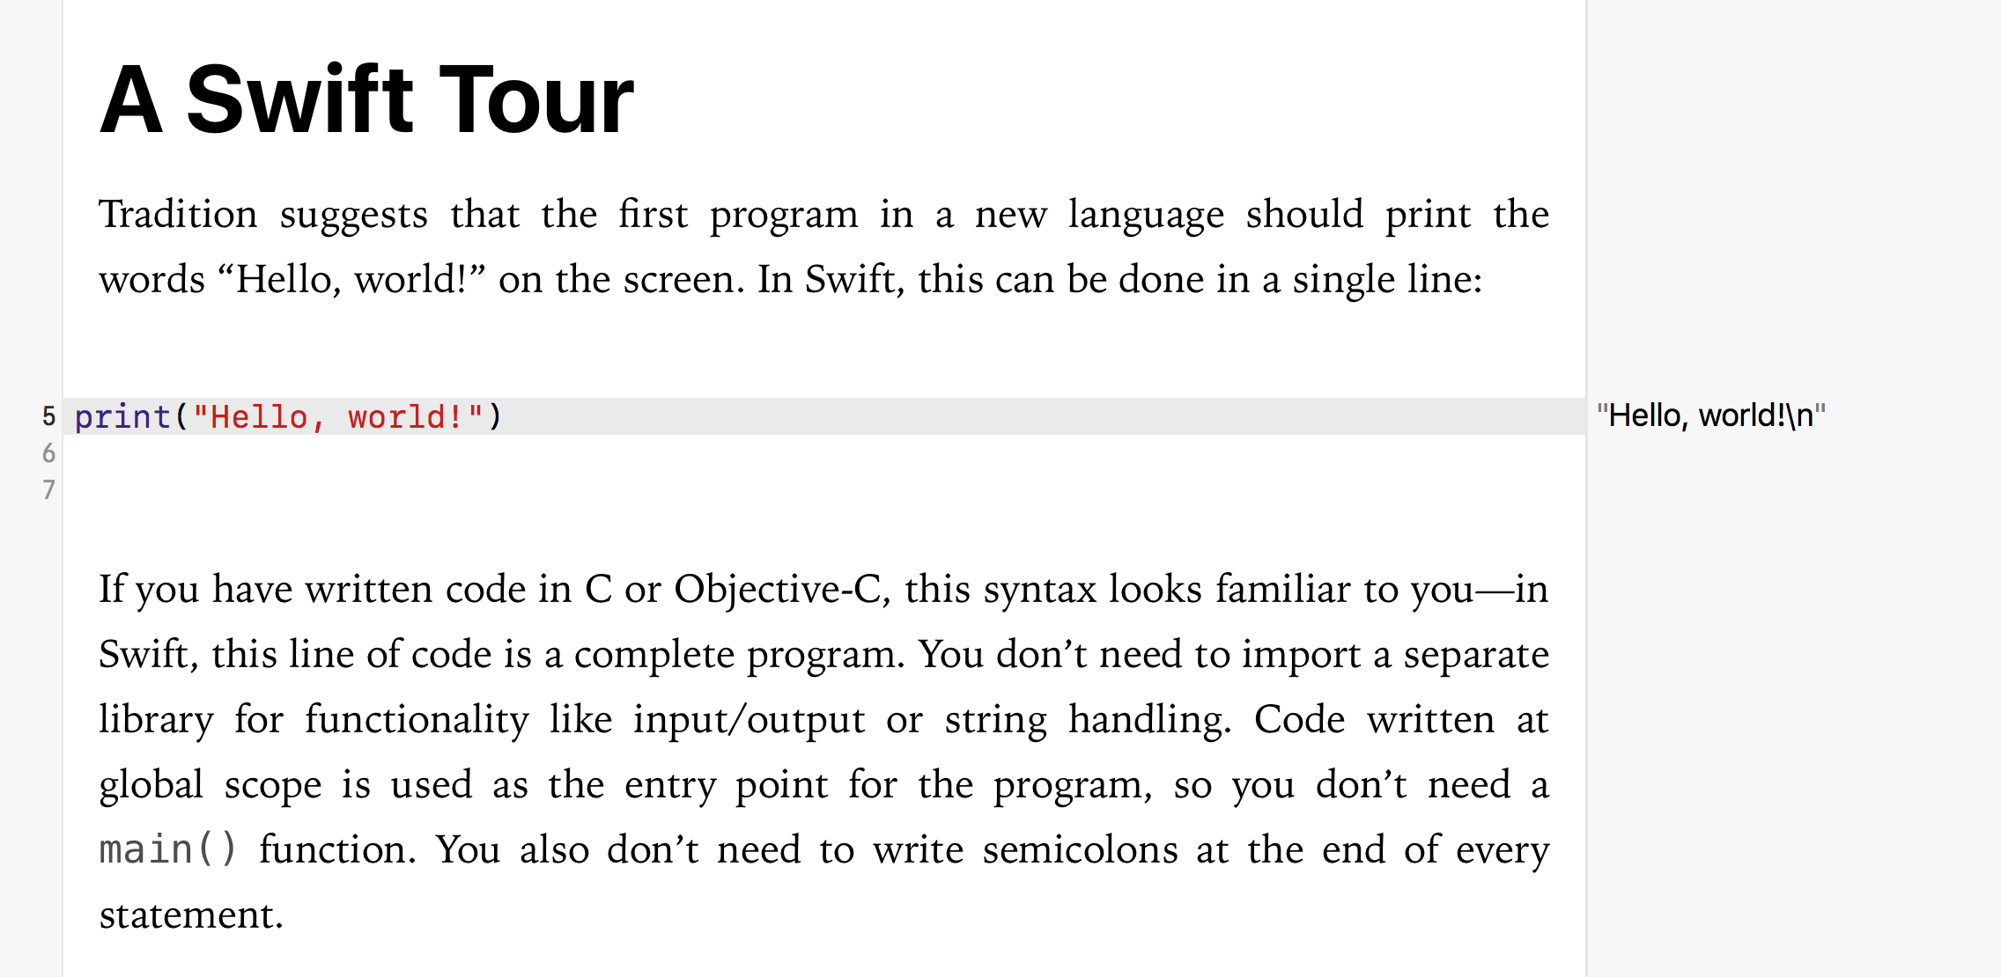
Xcode Playground - Basic tour
Notes:
https://developer.apple.com/go/?id=swift-tour

