Slide 1
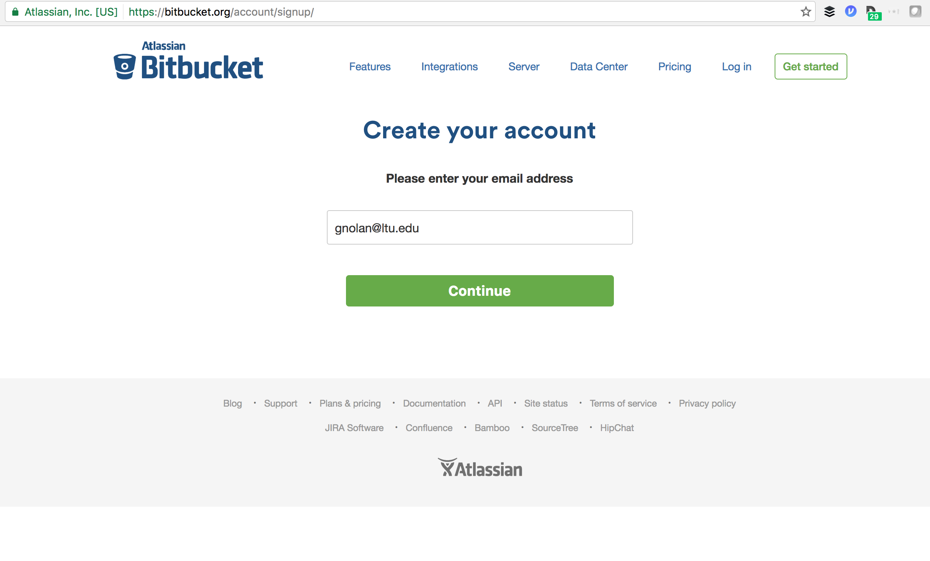

Slide 2
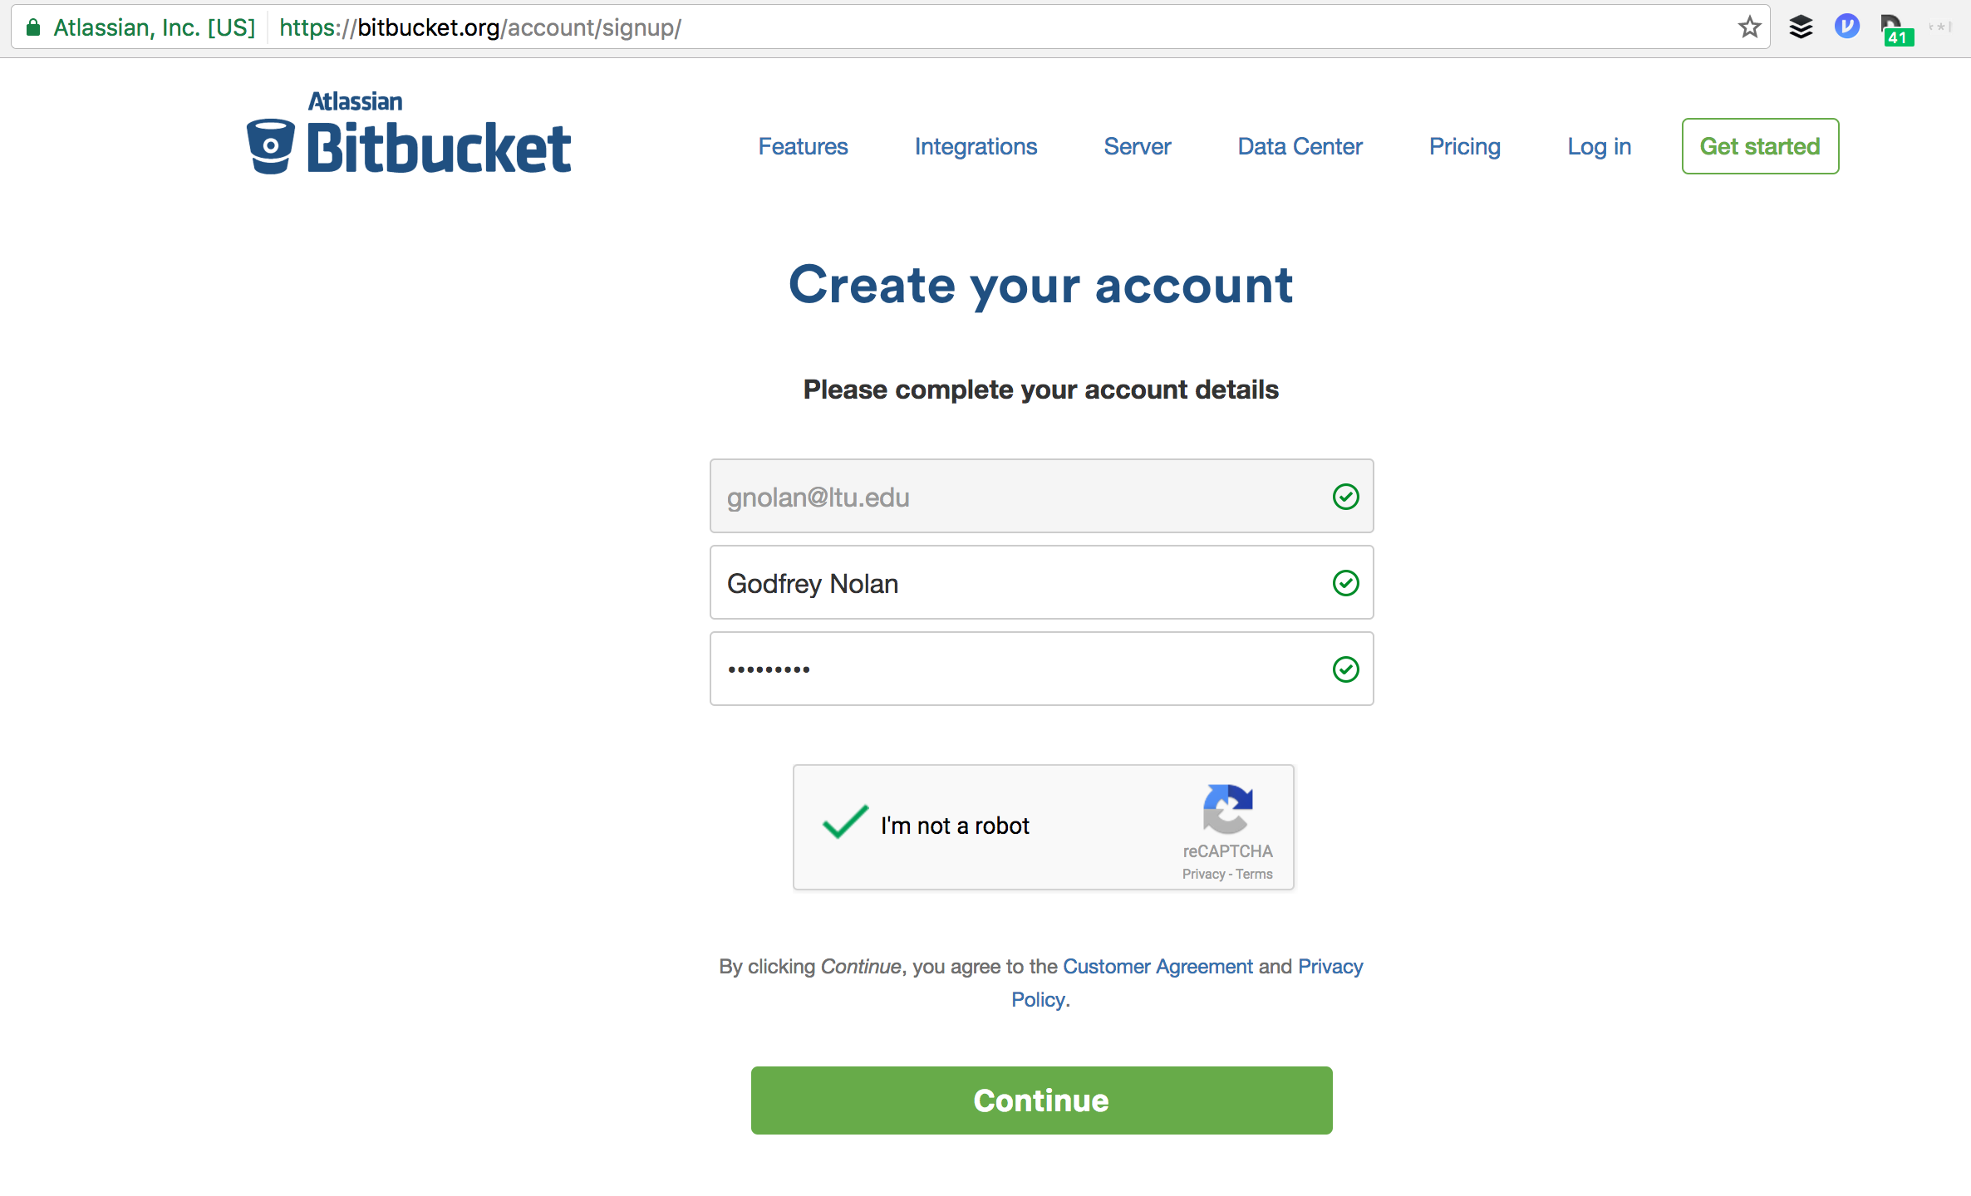

Slide 3
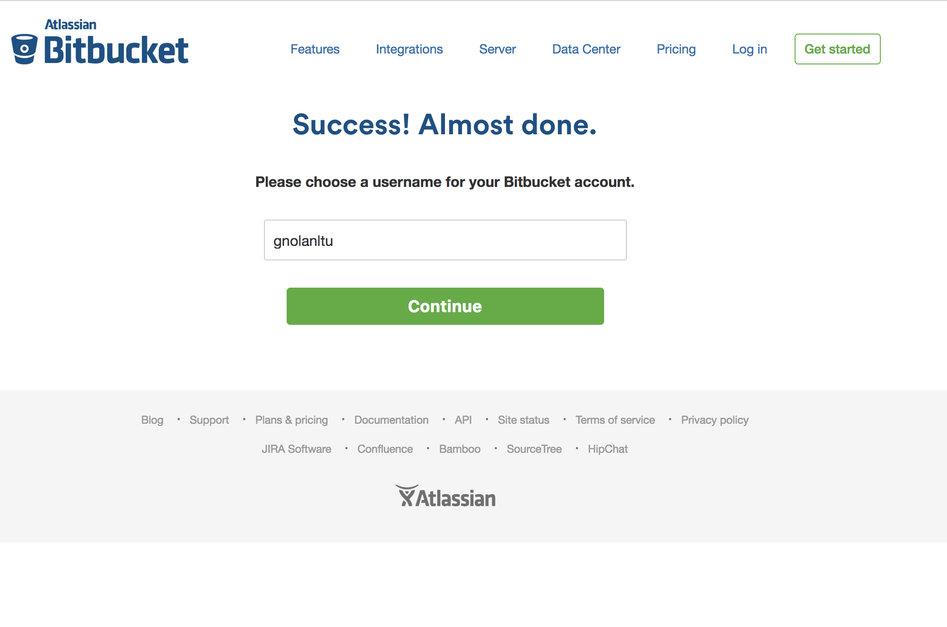

Slide 4
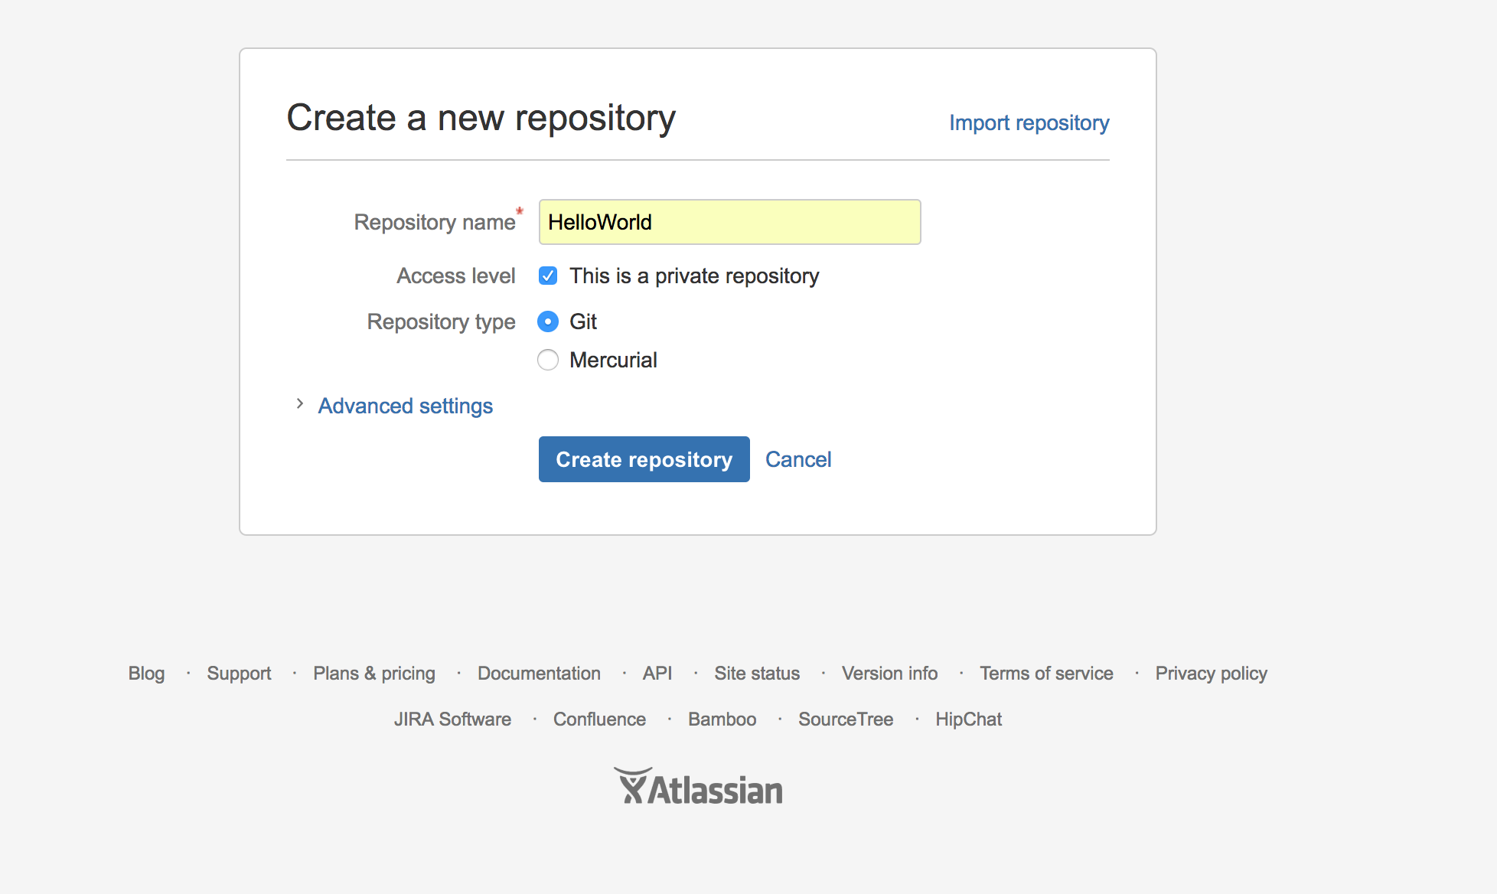

Slide 5
Git commands
git init
git add README.md
git commit -m "first commit"
git remote add origin https://bitbucket.com/godfreynolan/test.git
git push -u origin master

