Slide 1
Protocols
protocol MyProtocol { //protocol definition here }
Notes:
There are times when we would like to describe the implementation (methods, properties, and other requirements) of a class without actually providing the implementation. For this, we use protocols.
Protocols define a blueprint of methods, properties, and other requirements for a class or a structure. A class or a structure can then provide an implementation that conforms to those requirements. The class or structure that provides the implementation is said to conform to the protocol.
The syntax to define a protocol is very similar to how we define a class or a structure. The following example shows the syntax used to define a protocol:

Slide 2
Protocols
protocol MyProtocol { //protocol definition here }
class myClass: MyProtocol { //class implementation here }
Notes:
We state that a class or structure conforms to a particular protocol by placing the name of the protocol after the class or structure's name, separated by a colon. Here is an example of how we would state that a class conforms to the MyProtocol protocol:

Slide 3
Protocols
class MyClass: MyProtocol, AnotherProtocol, ThirdProtocol { // class implementation here }
Notes:
A class or a structure can conform to multiple protocols. We list the protocols that the class or structure conforms to by separating them with commas. The following example shows how we would state that our class conforms to multiple protocols:

Slide 4
Protocols
Class MyClass: MySuperClass, MyProtocol, MyProtocol2 { // Class implementation here }
Notes:
When we need a class to inherit from a superclass and implement a protocol, we list the superclass first, followed by the protocols. The following example illustrates this:

Slide 5
Protocols
Class MyClass: MySuperClass, MyProtocol, MyProtocol2 { // Class implementation here }
Notes:
When we need a class to inherit from a superclass and implement a protocol, we list the superclass first, followed by the protocols. The following example illustrates this:

Slide 6
Protocols - Properties
protocol FullName { var firstName: String {get set} var lastName: String {get set} }
Notes:
A protocol can require that the conforming class or structure provide certain properties with a specified name and type.
The protocol does not say if the property should be a stored or computed property because the implementation details are left up to the conforming class or structure.
When defining a property within a protocol, we must specify whether the property is a read-only or a read/write property by using the get and set keywords.
The FullName protocol defines two properties, which any class or structure that conforms to the protocol must implement. These are the firstName and lastName properties. Both these properties in the FullName protocol are read/write properties.

Slide 7
Protocols - Properties
protocol FullName { var firstName: String {get} var lastName: String {get set} }
Notes:
If we wanted to specify that the property is read-only, we would define it with only the get keyword, like this:

Slide 8
Protocols - Properties
class Scientist: FullName { var firstName = "" var lastName = "" }
Notes:
a Scientist class conforms to the FullName protocol:
If we had forgotten to include either the firstName or lastName property, we would have received a Scientist does not conform to protocol 'FullName' error message. We also need to make sure that the type of the property is the same. For example, if we changed the lastName definition in the Scientist class to var lastName = 42, we would also receive a Scientist does not conform to protocol 'FullName' error message because the protocol specifies that we must have a lastName property of the string type.

Slide 9
Protocols - Properties
class Scientist: FullName { var firstName = "" var lastName = "" }
Notes:
a Scientist class conforms to the FullName protocol:
If we had forgotten to include either the firstName or lastName property, we would have received a Scientist does not conform to protocol 'FullName' error message. We also need to make sure that the type of the property is the same. For example, if we changed the lastName definition in the Scientist class to var lastName = 42, we would also receive a Scientist does not conform to protocol 'FullName' error message because the protocol specifies that we must have a lastName property of the string type.

Slide 10
Protocols - Methods
protocol FullName { var firstName: String {get set} var lastName: String {get set}
func getFullName() -> String }
Notes:
A protocol can require that the conforming class or structure provide certain methods.
We define a method within a protocol exactly as we do within a normal class or structure, except without the curly braces or method body. Let's add a getFullName() method to our FullName protocol and Scientist class.
The following example shows how the FullName protocol would look with the getFullName() method added:

Slide 11
Protocols - Methods
class Scientist: FullName { var firstName = "" var lastName = "" var field = “”
func getFullName() -> String { return "\(firstName) \(lastName) studies \(field)" } }
Notes:
Now, we will need to add a getFullName() method to our Scientist class so that it will properly conform to the FullName protocol:

Slide 12
Protocols - Methods
struct FootballPlayer: FullName {
var firstName = "” var lastName = "” var number = 0
func getFullName() -> String { return "\(firstName) \(lastName) has the number \(number)” } }
Notes:
Structures can conform to Swift protocols exactly as classes do. The following example shows how we can create a FootballPlayer structure that conforms to the FullNameprotocol:
When a class or structure conforms to a Swift protocol, we can be sure that it has implemented the required properties and methods. This can be very useful when we want to ensure that certain properties or methods are implemented over various classes,
Protocols are also very useful when we want to decouple our code from requiring specific classes or structures. The following code shows how we would decouple our code using the FullName protocol, the Scientist class, and the FootballPlayer structure that we have already built:

Slide 13
Protocols - Methods
var scientist = Scientist() scientist.firstName = "Kara” scientist.lastName = "Hoffman” scientist.field = "Physics"
var player = FootballPlayer(); player.firstName = "Dan” player.lastName = "Marino” player.number = 13
var person: FullName person = scientist; print(person.getFullName()) person = player print(player.getFullName())
Notes:
In the preceding code, we begin by creating an instance of the Scientist class and the FootballPlayer structure. We then create a person variable that is of the FullName(protocol) type and set it to the scientist instance that we just created. We then call the getFullName() method to retrieve our description. This will print out the Kara Hoffman studies Physics message to the console.
We then set the person variable equal to the player instance and call the getFullName() method again. This will print out the Dan Marino has the number 13message to the console.
As we can see, the person variable does not care what the actual implementation class or structure is. Since we defined the person variable to be of the FullName type, we can set the person variable to an instance of any class or structure that conforms to the FullNameprotocol.
WHAT WILL IT PRINT??

Slide 14
var scientist = Scientist() scientist.firstName = "Kara” scientist.lastName = "Hoffman” scientist.field = "Physics"
var player = FootballPlayer(); player.firstName = "Dan” player.lastName = "Marino” player.number = 13
var person: FullName person = scientist; print(person.getFullName()) person = player print(player.getFullName())
Kara Hoffman studies Physics Dan Marino has the number 13
Notes:
RUN PROTOCOL CODE – COPY AND PASTE INTO PLAYGROUND

Slide 15
Extensions
extension String { //add new functionality here }
Notes:
With extensions, we can add new properties, methods, initializers, and subscripts, or make an existing class or structure conform to a protocol.
extensions cannot override the existing functionality.
To define an extension, we use the extension keyword, followed by the type that we are extending. The following example shows how we would create an extension that extends the string class:

Slide 16
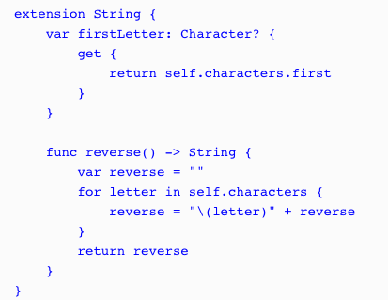
Extensions
Notes:
Let's see how extensions work by adding a reverse() method and a firstLetter property to Swift's standard string class:
When we extend an existing class or structure, we define properties, methods, initializers, and subscripts in exactly the same way as we would normally define them in a standard class or structure. In the string extension example, we see that we define the reverse()method and the firstLetter property exactly as we would define them in a normal class.

Slide 17
Extensions
var myString = "Learning Swift is fun"
print(myString.reverse())
print(myString.firstLetter)
Notes:
Extensions are very useful for adding additional functionality to classes and structures from external frameworks, even for Apple's frameworks, as demonstrated in the examples.
It is preferred to use extensions to add additional functionality to classes from external frameworks rather than subclassing because it allows us to use the classes provided by the frameworks throughout our code.
RUN EXTENSIONS CODE – CUT AND PASTE INTO PLAYGROUND

Slide 18
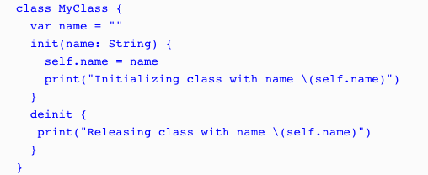
Memory management
Notes:
Let’s look at how ARC works.
This class is very similar to our previous MyClass class, except that we add a deinitializer that is called just before an instance of the class is destroyed and removed from memory.
This deinitializer prints out a message to the console that lets us know that the instance of the class is about to be removed.

Slide 19
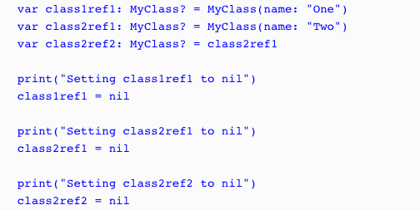
Memory management
Notes:
Now, let's look at the code that shows how ARC creates and destroys instances of a class:
In the example, we begin by creating two instances of the MyClass class named class1ref1 (which stands for class 1 reference 1) and class2ref1 (which stands for class 2 reference 1). We then create a second reference to class2ref1 named class2ref2. Now, in order to see how ARC works, we need to begin setting the references to nil. We start out by setting class1ref1 to nil. Since there is only one reference to class1ref1, the deinitializer will be called. Once the deinitializer completes its task, in our case, it prints a message to the console letting us know that the instance of the class has been destroyed and the memory has been released.
We then set the class2ref1 to nil, but a second reference to this class (class2ref2) prevents ARC from destroying the instance so that the deinitializer is not called. Finally, we set class2ref2 to nil, which allows ARC to destroy this instance of the MyClass class.

Slide 20
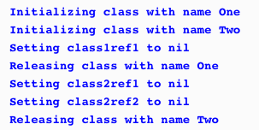
Memory management
Notes:
If we run this code, we will see the following output, which illustrates how ARC works:
From the example, it seems that ARC handles memory management very well. However, it is possible to write code that will prevent ARC from working properly.

Slide 21
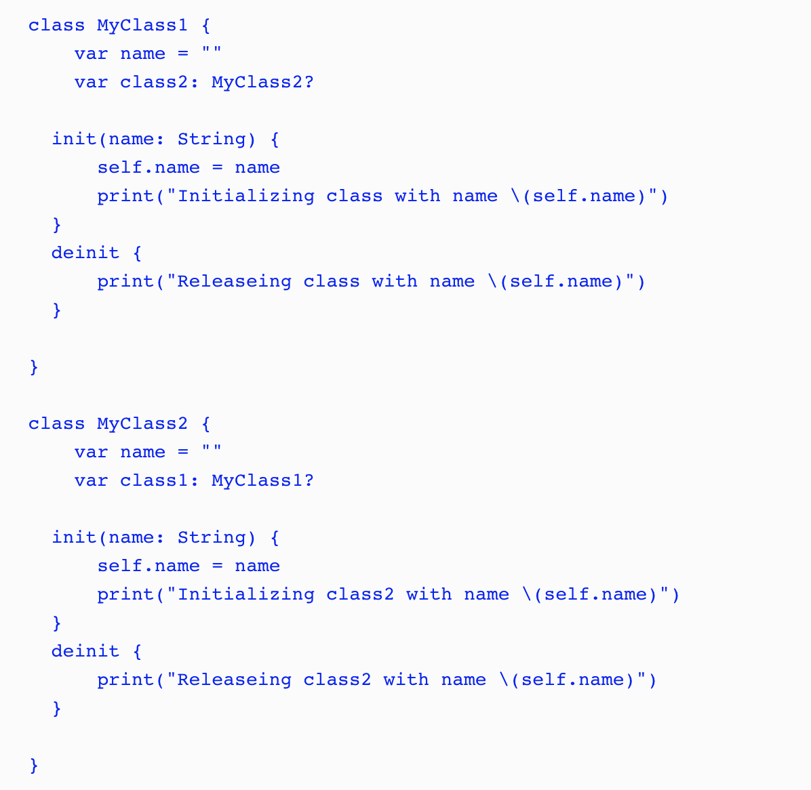
Memory management
Notes:
A strong reference cycle is where the instances of two classes hold a strong reference to each other, preventing ARC from releasing either instance. Strong reference cycles are a lot easier to understand with an example, so let's create one. In this project, we start off by creating two classes named MyClass1 and MyClass2 with the following code:

Slide 22
Memory management
Notes:
A strong reference cycle is where the instances of two classes hold a strong reference to each other, preventing ARC from releasing either instance. Strong reference cycles are a lot easier to understand with an example, so let's create one. In this project, we start off by creating two classes named MyClass1 and MyClass2 with the following code: As we can see from the code, MyClass1 contains an instance of MyClass2; therefore, the instance of MyClass2 cannot be released until MyClass1 is destroyed. We can also see from the code that MyClass2 contains an instance of MyClass1; therefore, the instance of MyClass1 cannot be released until MyClass2 is destroyed. This creates a cycle of dependency in which neither instance can be destroyed until the other one is destroyed. Let's see how this works by running the following code:

Slide 23
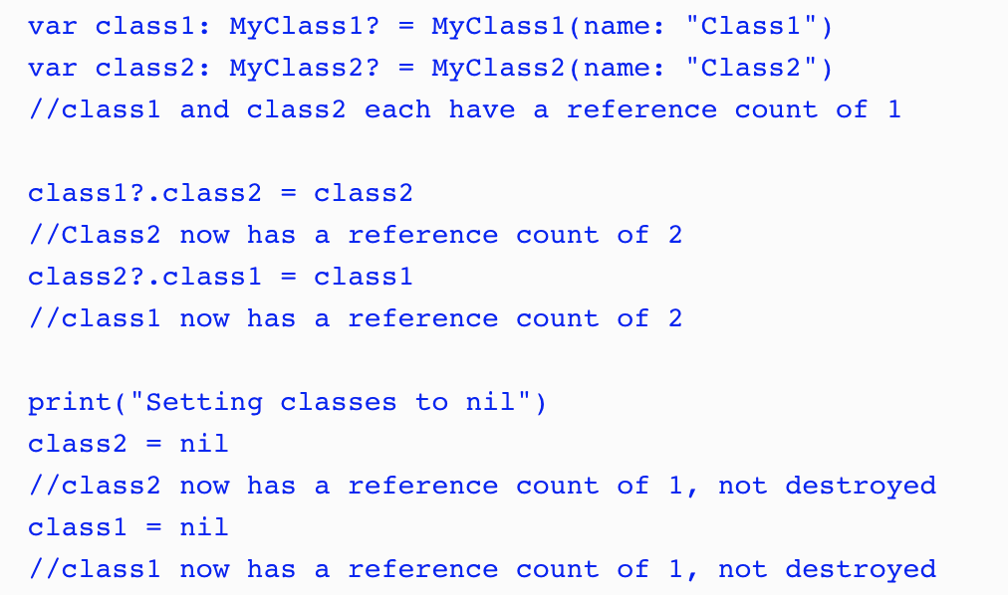
Memory management
Notes:
As we can see from the comments in the example, the reference counter for each instance never reaches zero; therefore, ARC cannot destroy the instances, thereby creating a memory leak. A memory leak is where an application continues to use memory but does not properly release it. This can eventually cause an application to crash.
To resolve a strong reference cycle, we need to prevent one of the classes from keeping a strong hold on the instance of the other class, thereby allowing ARC to destroy them both. Swift provides two ways of doing this, by letting us define the properties as either a weak reference or an unowned reference.
The difference between a weak reference and an unowned reference is that the instance which a weak reference refers to can be nil, whereas the instance that an unowned reference is referring to cannot be nil. This means that when we use a weak reference, the property must be an optional property since it can be nil. Let's see how we would use unowned and weak references to resolve a strong reference cycle. Let's start by looking at the unowned reference technique.

Slide 24
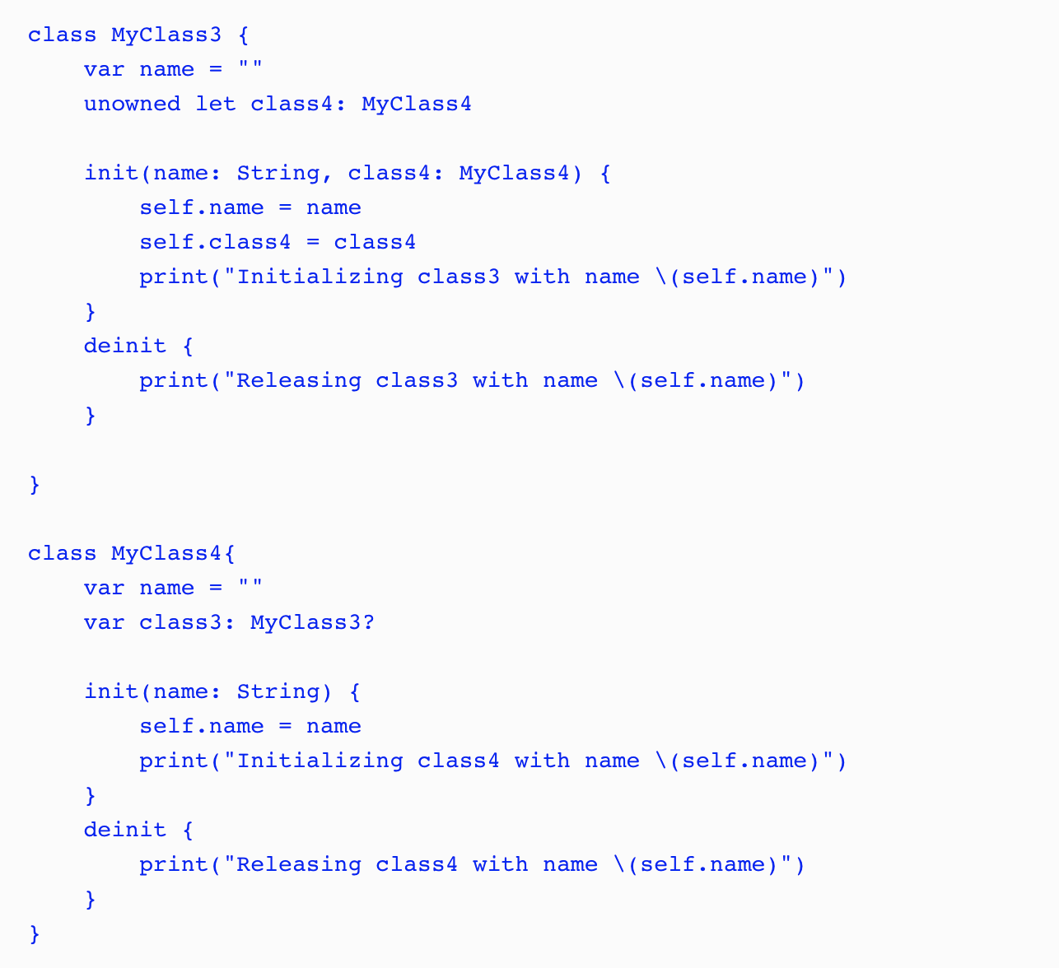
Memory management
Notes:
The MyClass4 class looks pretty similar to the MyClass1 and MyClass2 classes in the preceding example. What is different here is the MyClass3 class. In the MyClass3 class, we set the class4 property to unowned, which means it cannot be nil and it does not keep a strong reference to the MyClass4 instance that it is referring to. Since the class4property cannot be nil, we also need to set it when the class is initialized.

Slide 25
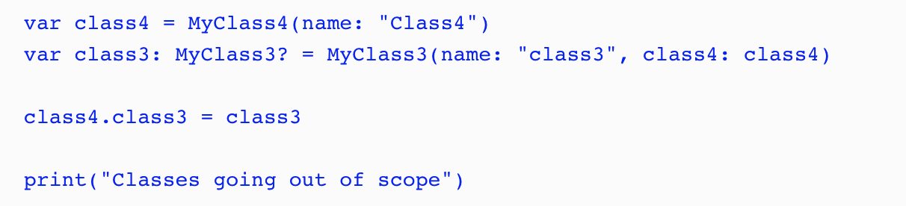
Memory management
Notes:
In the preceding code, we create an instance of the MyClass4 class and then use that instance to create an instance of the MyClass3 class. We then set the class3 property of the MyClass4 instance to the MyClass3 instance we just created. This creates a reference cycle of dependency between the two classes again, but this time, the MyClass3 instance does not keep a strong hold on the MyClass4 instance, allowing ARC to release both instances when they are no longer needed.

Slide 26
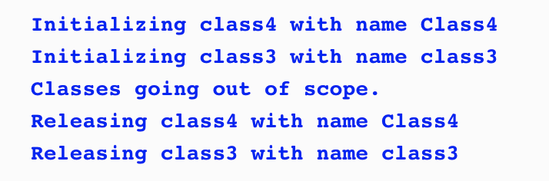
Memory management
Notes:
If we run this code, we see the following output, showing that both the MyClass3 and MyClass4 instances are released and the memory is freed:

Slide 27
Memory management
Notes:
If we run this code, we see the following output, showing that both the MyClass3 and MyClass4 instances are released and the memory is freed:

Slide 28
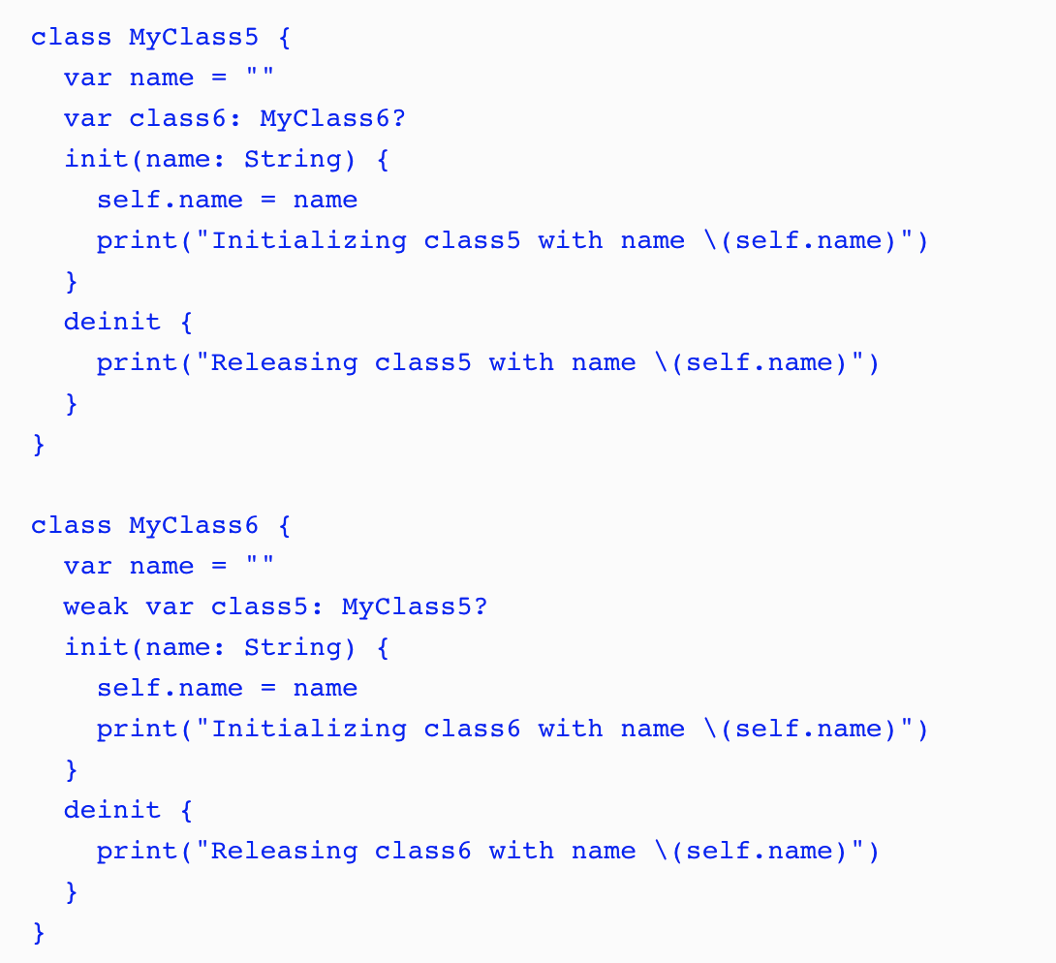
Memory management
Notes:
Now let's look at how we would use a weak reference to prevent a strong reference cycle. We begin by creating two new classes:
The MyClass5 and MyClass6 classes look very similar to the MyClass1 and MyClass2 classes we created earlier to show how a strong reference cycle works. The big difference is that we define the class5 property in the MyClass6class as a weak reference.

Slide 29
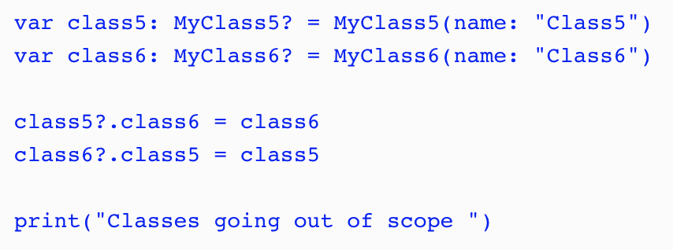
Memory management
Notes:
In the preceding code, we create instances of the MyClass5 and MyClass6 classes and then set the properties of those classes to point to the instance of the other class. Once again, this creates a cycle of dependency, but since we set the class5 property of the MyClass6 class to weak, it does not create a strong reference, allowing both instances to be released.

Slide 30
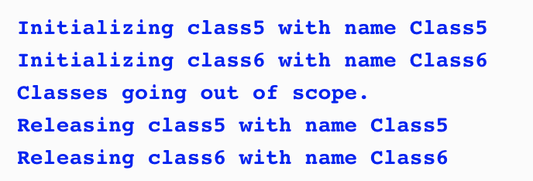
Memory management
Notes:
If we run the code, we will see the following output, showing that both the MyClass5 and MyClass6 instances are released and the memory is freed:
RUN PLAYGROUND CODE – testARC – Strong Reference Cycle – Memory Management

Slide 31
Thursday
Protocols and Extensions
No need for Xcode as yet.

Slide 32
Protocol Oriented Programming
How protocols are used as a type
How to implement polymorphism in Swift using protocols
How to use protocol extensions
Why we would want to use protocol extensions
Notes:
protocol extensions are going to be one of those defining features that set Swift programming language apart from the rest.
While protocol extensions are basically syntactic sugar they are, in my opinion, one of the most important additions to the Swift programming language. With protocol extensions, we are able to provide method and property implementations to any type that conforms to a protocol. To really understand how useful protocols and protocol extensions are, let's get a better understanding of protocols.

Slide 33
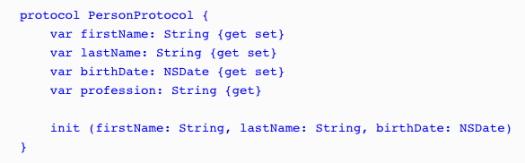
Protocol as Types
Notes:
Even though no functionality is implemented in a protocol, they are still considered a full-fledged type in the Swift programming language and can be used like any other type. What this means is we can use protocols as a parameter type or as a return type in a function. We can also use them as the type for variables, constants, and collections. Let's take a look at some examples. For these few examples, we will use the PersonProtocol protocol:

Slide 34



Protocol as Types
Notes:
In this example, the updatePerson() function accepts one parameter of the PersonProtocol protocol type and then returns a value of the PersonProtocol protocol type.
In this example, we create a variable of the PersonProtocol protocol type that is named myPerson.
In this final example, we create an array of PersonProtocol protocol types. As we can see from these three examples, even though the PersonProtocol protocol does not implement any functionality, we can still use protocols when we need to specify a type.

Slide 35
Protocol as Types
PersonProtocol protocol:var myPerson: PersonProtocol
myPerson = SwiftProgrammer(firstName: "Jon", lastName: "Hoffman", birthDate: bDateProgrammer) print("\(myPerson.firstName) \(myPerson.lastName)")
myPerson = FootballPlayer(firstName: "Dan", lastName: "Marino", birthDate: bDatePlayer) print("\(myPerson.firstName) \(myPerson.lastName)")
Notes:
let's assume that we have two types named SwiftProgrammer and FootballPlayer, which conform to the PersonProtocol protocol:
we start off by creating the myPerson variable of the PersonProtocolprotocol type. We then set the variable with an instance of the SwiftProgrammer type and print out the first and last names. Next, we set the myPerson variable to an instance of the FootballPlayer type and print out the first and last names again. One thing to note is that Swift does not care if the instance is a class or structure. It only matters that the type conforms to the PersonProtocol protocol type. Therefore, this code would be perfectly valid if the SwiftProgrammer type were a structure and the FootballPlayer type were a class.

Slide 36


Polymorphism with Protocols
Notes:
Polymorphism gives us the ability to interact with multiple types in a uniform manner. To illustrate this, we created an array of the PersonProtocol types and loop through the array. We can then access each item in the array using the properties and methods define in the PersonProtocol protocol, regardless of the actual type.
If we ran this example, the output would look similar to this:
We have mentioned a few times in this chapter that, when we define the type of a variable, constant, collection type, and so on to be a protocol type, we can then use the instance of any type that conforms to that protocol. This is a very important concept to understand and is one of the many things that make protocols and protocol extensions so powerful.
When we use a protocol to access instances, as shown in the previous example, we are limited to using only properties and methods that are defined in the protocol. If we want to use properties or methods that are specific to the individual types, we would need to cast the instance to that type.

Slide 37
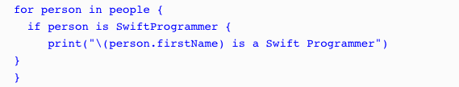
Type casting with Protocols
Notes:
Type casting is a way to check the type of an instance and/or to treat the instance as a specified type. In Swift, we use the is keyword to check if an instance is a specific type and the as keyword to treat the instance as a specific type.
In this example, we use the if conditional statement to check whether each element in the people array is an instance of the SwiftProgrammer type; if so, we print that the person is a Swift programmer to the console

Slide 38
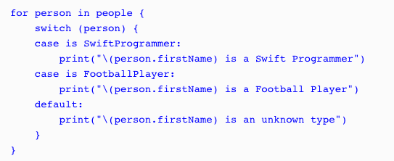
Type casting with Protocols
Notes:
It is a lot more efficient to use the switch statement, as shown in the next example:

Slide 39

Type casting with Protocols
Notes:
We can also use the where statement with the is keyword to filter the array, as shown in the following example:

Slide 40
Type casting with Protocols
as?
as!
Notes:
We can also use the where statement with the is keyword to filter the array, as shown in the following example:
Now let's look at how we can cast an instance of a class or structure to a specific type. To do this, we can use the as keyword. Since the cast can fail if the instance is not of the specified type, the as keyword comes in two forms: as? and as!. With the as? form, if the casting fails, it returns a nil; with the as! form, if the casting fails, we get a runtime error. Therefore, it is recommended we use the as? form unless we are absolutely sure of the instance type or we perform a check of the instance type prior to doing the cast.

Slide 41
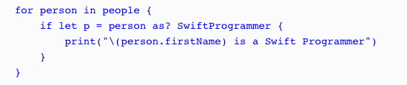

Type casting with Protocols
Notes:
Let's look at how we would use the as? keyword to cast an instance of a class or structure to a specified type:
Since the as? keyword returns an optional, we can use optional binding to perform the cast, as shown in this example. If we are sure of the instance type, we can use the as! keyword. The following example shows how to use the as! keyword when we filter the results of the array to only return instances of the SwiftProgrammer type:
If we are sure of the instance type, we can use the as! keyword.

Slide 42

Protocol Extensions
Notes:
Protocol extensions allow us to extend a protocol to provide method and property implementations to conforming types. They also allow us to provide common implementations to all confirming types, eliminating the need to provide an implementation in each individual type or the need to create a class hierarchy.
With this protocol, we are saying that any type that conforms to the DogProtocol protocol, must have the two properties of the String type, with names of: name and color.

Slide 43
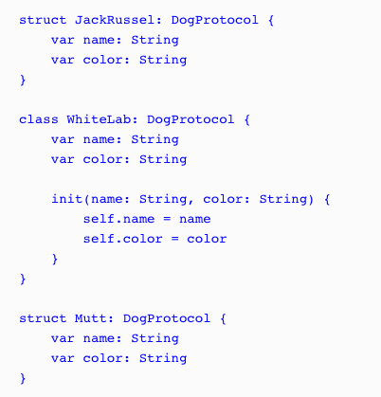
Protocol Extensions
Notes:
define the three types that conform to this protocol. We will name these types JackRussel, WhiteLab, and Mutt as follows:
Class needs an init() structures do not

Slide 44
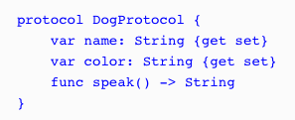
Protocol Extensions
Notes:
Now let's say that we want to provide a method named speak to each type that conforms to the DogProtocol protocol. Prior to protocol extensions, we would start off by adding the method definition to the protocol, as shown in the following code:

Slide 45
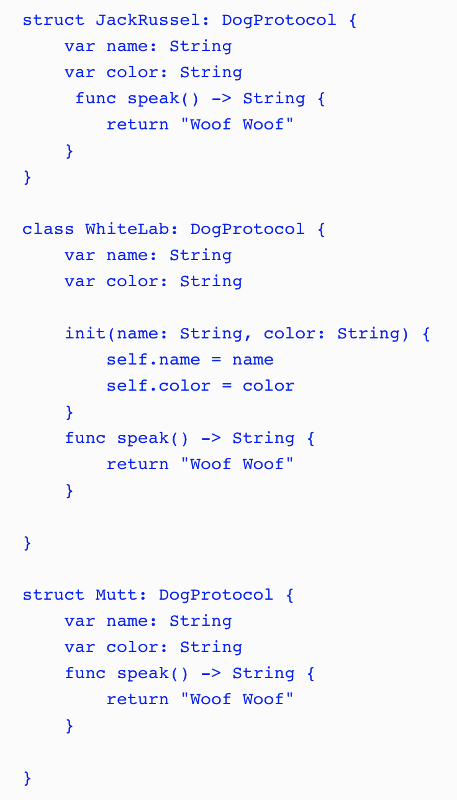
Protocol Extensions
Notes:
Once the method is defined in the protocol, we would then need to provide an implementation of the method in every type that conforms to the protocol.
While this method works, it is not very efficient because whenever we update the protocol, we would need to update all the types that conform to it and we may be duplicating a lot of code, as shown in this example. Another concern is that if we need to change the default behavior of the speak() method, we would have to go in each implementation and change the speak() method. This is where protocol extensions come in.

Slide 46
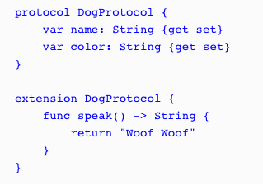
Protocol Extensions
Notes:
With protocol extensions, we could take the speak() method definition out of the protocol itself. We can then define it, with the default behavior, in protocol extension. The following code shows how we would define the protocol and the protocol extension:
We begin by defining DogProtocol with the original two properties. We then create a protocol extension that extends DogProtocol and contains the default implementation of the speak() method. With this code, there is no need to provide an implementation of the speak() method in each of the types that conform to DogProtocol because they automatically receive the implementation as part of the protocol.

Slide 47
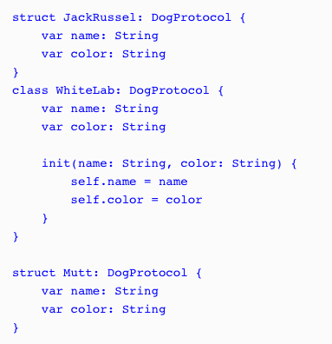
Protocol Extensions
Notes:
Let's see how this works by setting our three types that conform to DogProtocol back to their original implementations; they should receive the speak() method from the protocol extension:

Slide 48
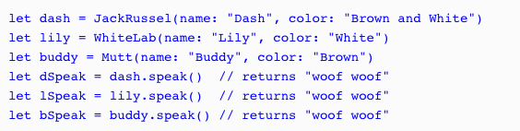
Protocol Extensions
Notes:
We can now use each of the types as shown in the following code:
As we can see in this example, by adding the speak() method to the DogProtocol protocol extension, we are automatically adding that method to all the types that conform to DogProtocol.

Slide 49
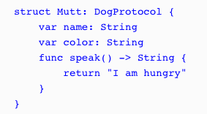
Protocol Extensions
Notes:
The speak() method in the DogProtocol protocol extension can be considered a default implementation of the speak() method because we are able to override it in the type implementations. As an example, we could override the speak() method in the Mutt structure, as shown in the following code:
When we call the speak() method for an instance of the Mutt type, it will return the string, I am hungry.

Slide 50
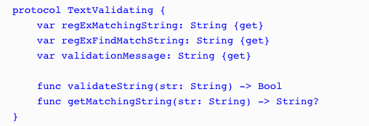
Protocol Extensions
Notes:
Text Validation example
The following code shows the TextValidating protocol, which defines the requirements for any type that we want to use for text validation:
regExMatchingString: This is a regular expression string used to verify that the input string contains only valid characters.
regExFindMatchString: This is a regular expression string used to retrieve a new string from the input string containing only valid characters. This regular expression is generally used when we need to validate the input in real time, as the user enters information, because it will find the longest matching prefix of the input string.
validationMessage: This is the error message to display if the input string contains non-valid characters.
validateString: This method will return true if the input string contains only valid characters. The regExMatchingString property will be used in this method to perform the match.
getMatchingString: This method will return a new string that contains only valid characters. This method is generally used when we need to validate the input in real time as the user enters information because it will find the longest matching prefix of the input string. We will use the regExFindMatchString property in this method to retrieve the new string.

Slide 51
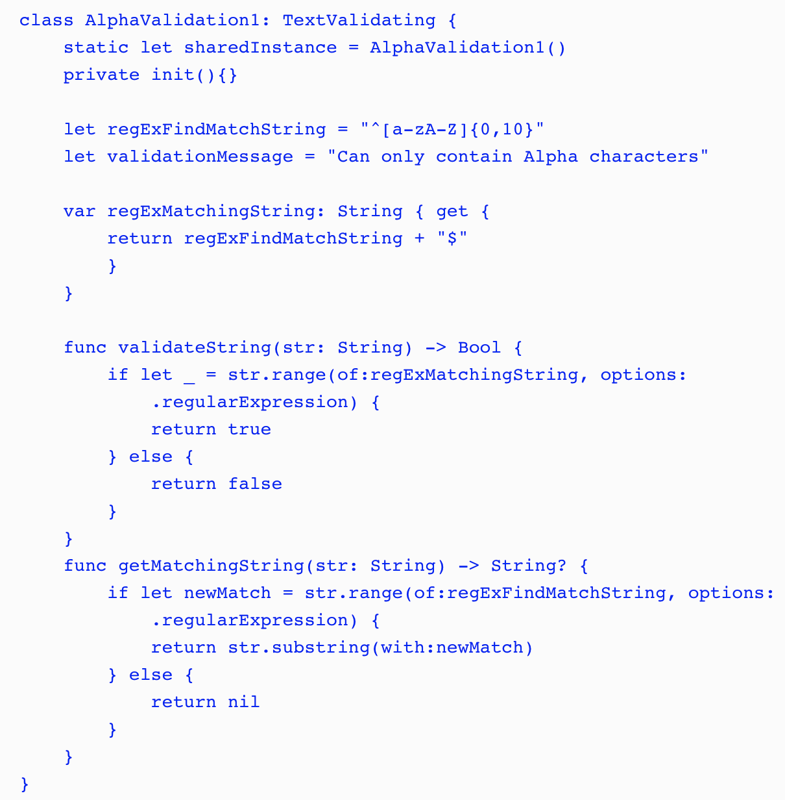
Protocol Extensions
Notes:
The following class would be used to verify that the input string contains only alpha characters:

Slide 52
Protocol Extensions
Notes:
The following class would be used to verify that the input string contains only alpha characters:
In this implementation, the regExFindMatchString and validationMessage properties are stored properties, and the regExMatchingString property is a computed property. We also implement the validateString() and getMatchingString() methods within the class.
Normally, we would have several different types that conform to TextValidating protocol where each one would validate a different type of input. As we can see from the AlphaValidation1 structure, there is a bit of code involved with each validation type. A lot of the code would also be duplicated in each type. The code for both methods (validateString() and getMatchingString()) and the regExMatchingString property would be duplicated in every validation class. This is not ideal, but if we wanted to avoid creating a class hierarchy with a super class that contains the duplicate code (I personally prefer using value types over classes), we would have no other choice.

Slide 53
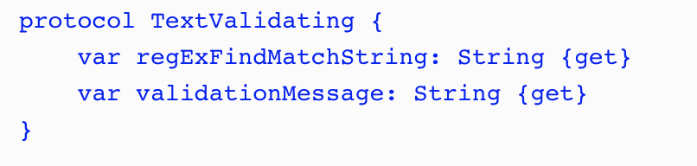
Protocol Extensions
Notes:
Now let's see how we would implement this using protocol extensions.
With protocol extensions, we need to think about the code a little differently. The big difference is, we neither need, nor want, to define everything in the protocol. With standard protocols or when we use a class hierarchy, all the methods and properties that you want to access using the generic superclass or protocol interface would have to be defined within the superclass or protocol. With protocol extensions, it is preferable for us not to define a property or method in the protocol if we are going to be defining it within the protocol extension. Therefore, when we rewrite our text validation types with protocol extensions, TextValidating would be greatly simplified and would look similar to this:
In the original TextValidating protocol, we defined three properties and two methods. As we can see in this new protocol, we are only defining two properties.

Slide 54
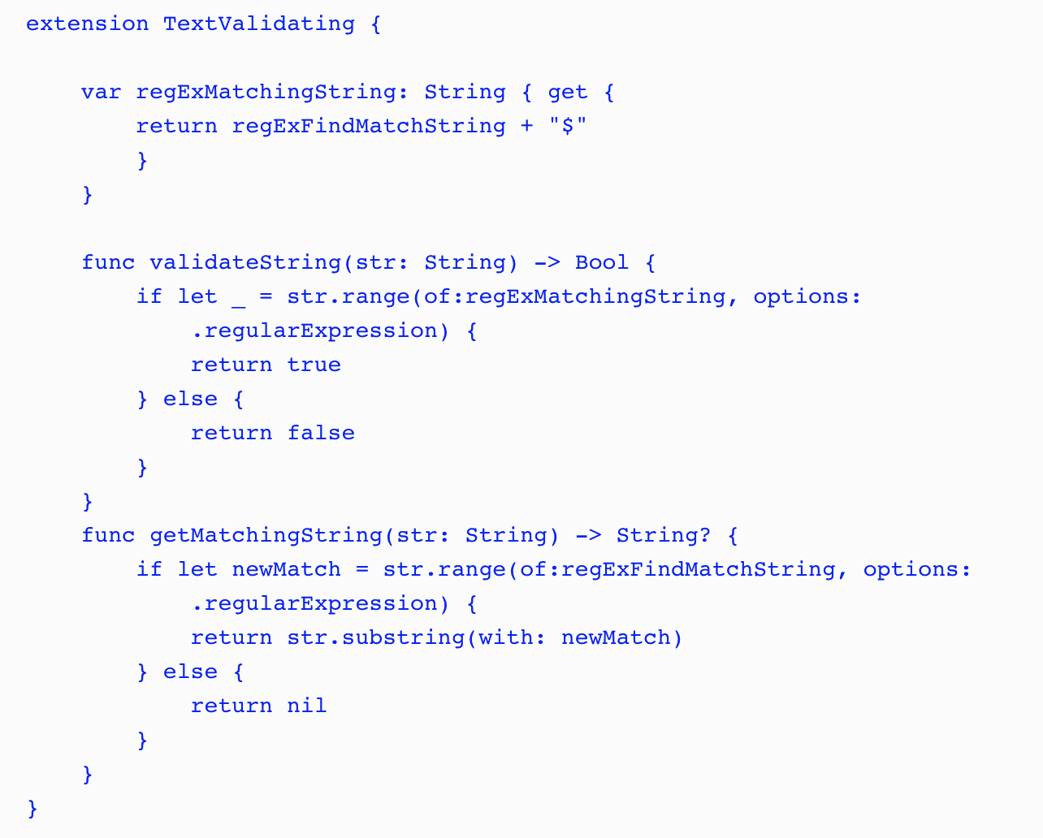
Protocol Extensions
Notes:
In the TextValidating protocol extension, we define the two methods and the third property that were defined in the original TextValidating, but were not defined in the new one. Now that we have created our protocol and protocol extension, we are able to define our text validation types.

Slide 55
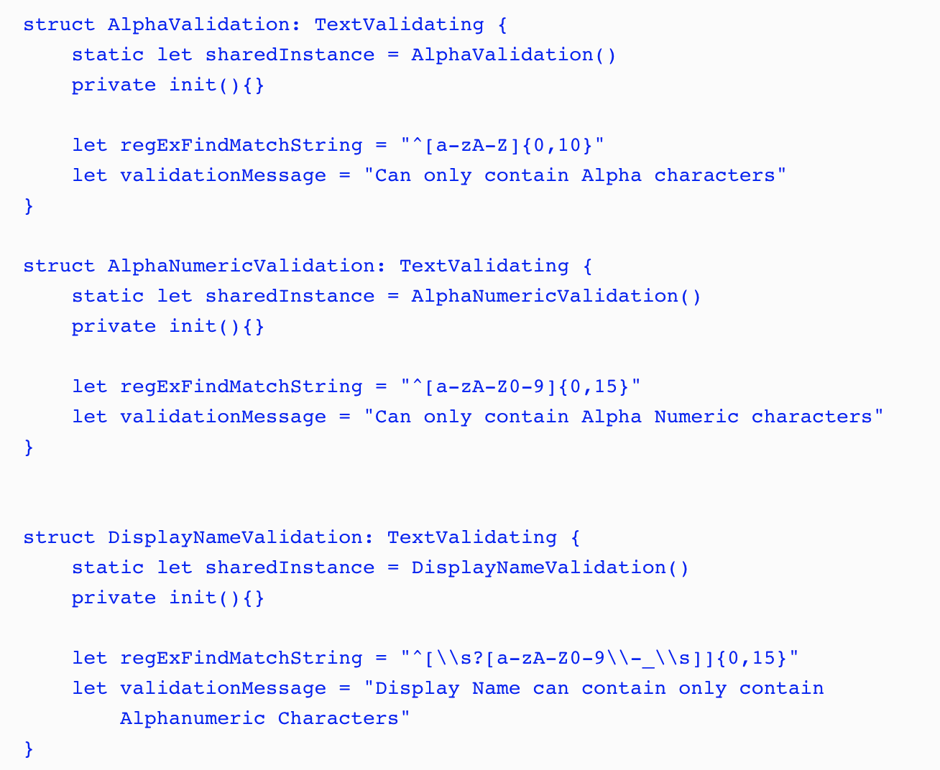
Protocol Extensions
Notes:
In the following code, we define three structures that we will use to validate text when a user types it in:
In each text validation structure, we create a static constant and a private initiator so that we can use the structure as a singleton.
After we define the singleton pattern, all we do in each type is set the values for the regExFindMatchString and validationMessage properties. Now, we have virtually no duplicate code. The only code that is duplicated is the code for the singleton pattern and that is not something we would want to put in the protocol extension because we would not want to force that pattern on all the conforming types.

Slide 56
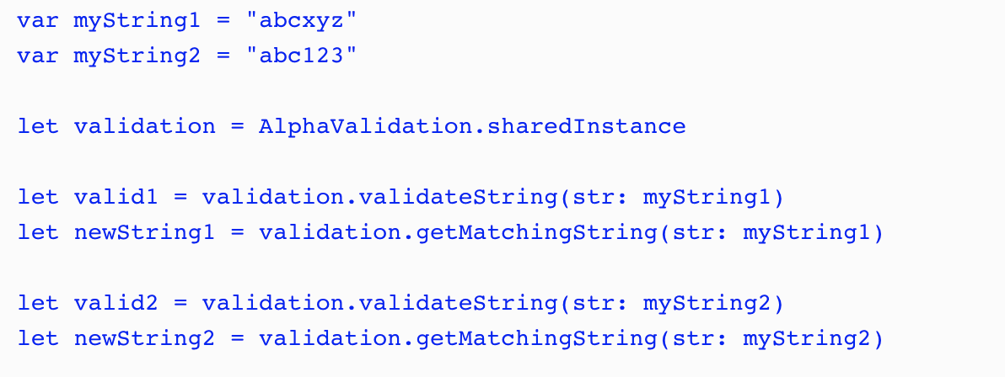
Protocol Extensions
Notes:
To use the text validation structures, we would use the validateString() method to see if a string instance matched the regular expression and the getMatchingString() method to return a new string with the invalid characters removed from the original string instance. The following example shows how we would use these methods:
In this example the valid2 constant would be true because the value of myString1 matches the regular expression defined in the AlphaValidation type while the valid2 constant would be false because the value of myString2 does not match. The newString1 constant would contain the same value as the myString1 constant because the original string matched the regular expression while newString2 would contain abc because the remainder of the characters do not match the regular expression.
RUN PLAYGROUNDS

Slide 57
Protocol Oriented Design
The difference between OOP and POP design
What is protocol-oriented design?
What is protocol composition?
What is protocol inheritance?

Slide 58
Protocol Oriented Design - Requirements
We will have three categories of animal: sea, land, and air.
Animals may be members of multiple categories. For example an alligator can be a member of both the land and sea categories.
Animals may be able to attack and/or move when they are on a tile that matches the categories they are in.
Animals will start off with a certain number of hit points and if those hit points reach 0 or less then they will die.
For our example here we will define two animals (Lion and Alligator) but we know that the number of animal types will grow as we develop the game.
Notes:
Animal types app

Slide 59
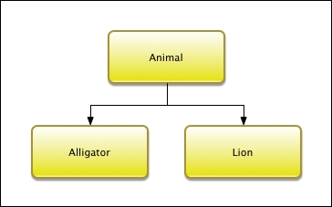
Protocol Oriented Design - OOD
Notes:
Animal types app
This diagram shows that we have one superclass named Animal and two subclasses named Alligator and Lion. We may think that, with the three categories (land, air, and sea), we would want to create a larger class hierarchy where the middle layer would contain the classes for the land, air, and sea animals. This would allow us to separate the code for each category; however it is not possible with our requirements. The reason this is not possible is that any of the animal types can be members of multiple categories and with a class hierarchy each class can have one and only one superclass. This means that our Animalsuperclass will need to contain the code required for each of the three categories. Lets take a look at the code for the Animal superclass.

Slide 60
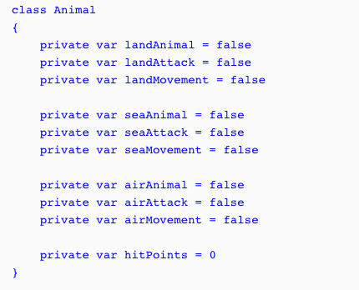
Protocol Oriented Design - OOD
Notes:
We will start the Animal superclass off by defining ten properties. These properties will define what type of animal it is and what type of attacks/movement it can do. We also define a property that will keep track of the hit points for the animal. The animal dies when its hit points reach zero.
We defined these as private variables because we need to set them in the subclass; however we do not want external entities to change them. The preference is for these to be constants; however a subclass can not set/change the value of a constant defined in a superclass. In order for this to work the subclass needs to be defined in the same physical file as the superclass

Slide 61
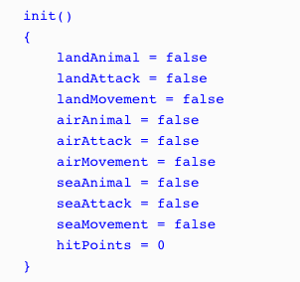
Protocol Oriented Design - OOD
Notes:
Next, we will define an initializer that will set the properties. We will set all of the properties to false by default and the hit points to 0. It will be up to the subclasses to set the appropriate properties that apply for that particular type:

Slide 62
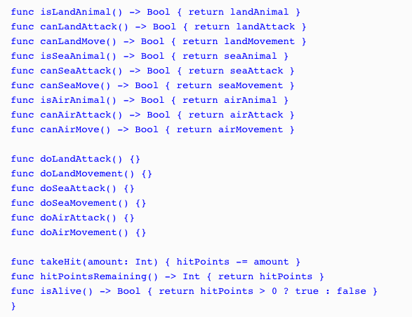
Protocol Oriented Design - OOD
Notes:
Since our properties are private we need to create some getter methods so we can retrieve the values of the properties. We will also create a couple of additional methods that will verify whether the animal is alive and also a method that will deduct hit points when the animal takes a hit:

Slide 63
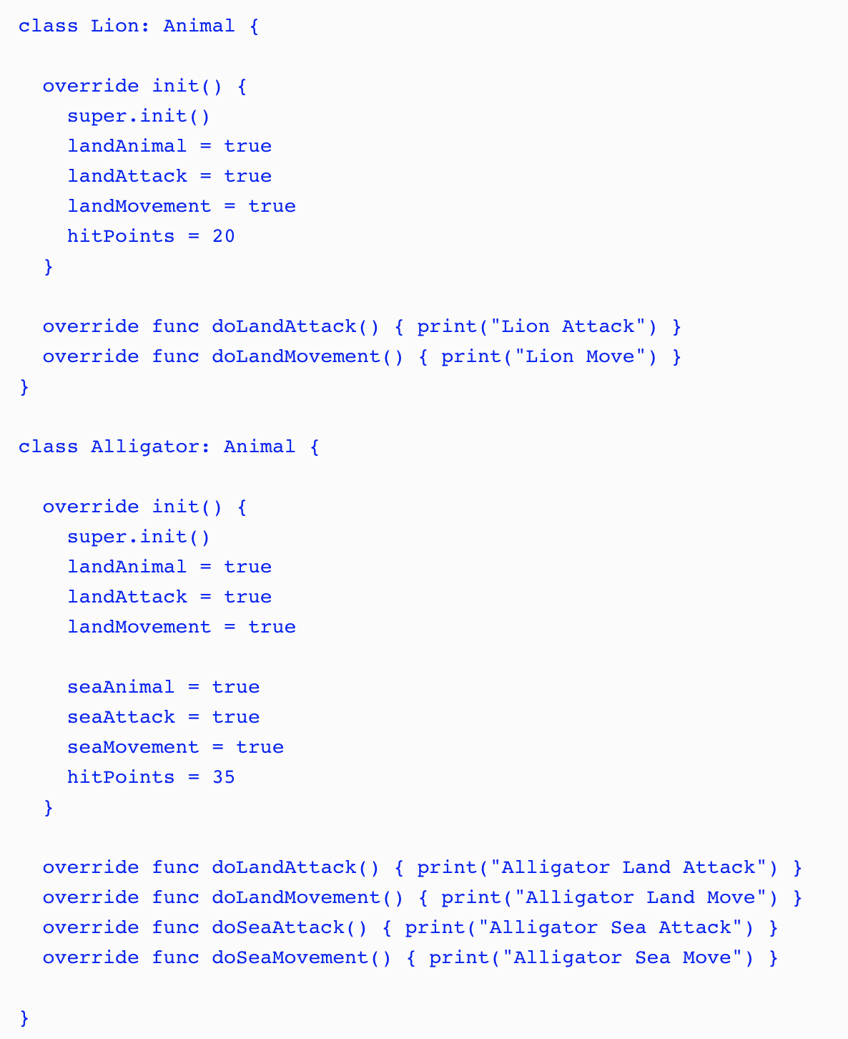
Notes:
We can now create the Alligator and Lion classes as subclasses of the Animal class:
As we can see, these classes override the functionality needed for each animal. The Lionclass contains the functionality for a land animal and the Alligator class contains the functionality for both a land and sea animal. Since both classes have the same Animal superclass we can use polymorphism to access them through the interface provided by the Animal superclass:

Slide 64
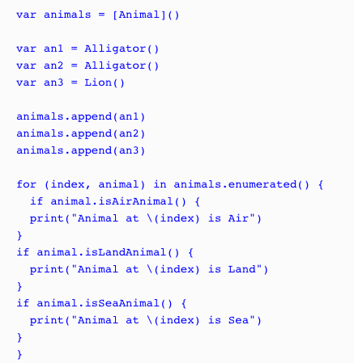
Notes:
The way we designed the animal types here would definitely work but there are several drawbacks to this design. The first drawback is the large monolithic Animal superclass. Those familiar with designing characters for video games will probably realize how much functionality is actually missing from the Animal superclass and its subclasses. This is on purpose so we can focus on the design and not all of the functionality. For those who are not familiar with designing characters for video games, trust me when I say that this class will get a lot bigger when we add all of the functionality needed.
Another drawback is not being able to define constants in the superclass that the subclasses can set. We could define various initiators for the superclass that would correctly set the constants for the different animal categories; however these initiators could become pretty complex and hard to maintain as we add additional animals. The builder pattern could help us with the initiation but, as we are about to see, a protocol-oriented design would be even better.
One final drawback that I am going to point out is the use of flags (landAnimal, seaAnimal and airAnimal properties) to define the type of animal. If we accidently set these flags wrong then the animal will not behave correctly. As an example, if we set the seaAnimalflag rather than the landAnimal flag in the Lion class then the lion would not be able to move or attack on land. Trust me, it is very easy, even for the most experienced developers, to set flags wrongly.

Slide 65
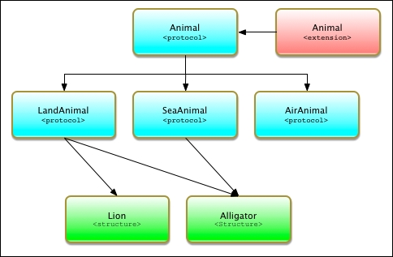
Protocol Oriented Design - POP
Notes:
As we can see, our POP design is quite a bit different from our OOP design. In this design we use three techniques that make POP significantly different from OOP. These techniques are protocol inheritance, protocol composition, and protocol extensions. It is important to understand these concepts so, before we go into our design, let's look at what protocol inheritance and protocol composition are. We looked at protocol extensions in the last chapter.

Slide 66

Protocol Oriented Design - POP
Notes:
In the Animal protocol, the only item that we are defining is the hitPoints property. This protocol would also contain any additional items that are common to all animals. To be consistent with our OOP design, we only need to add the hitPoints property to this protocol.

Slide 67
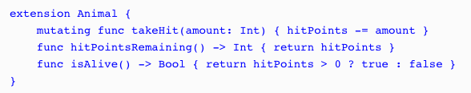
Protocol Oriented Design - POP
Notes:
Next, we need to add an Animal protocol extension that will contain the functionality that is common for all types that conform to the protocol. Our Animal protocol extension would contain the following code:
The Animal protocol extension contains the same takeHit(), hitPointsRemaining(), and isAlive() methods that we saw in the Animals superclass from the OOP example. Any type that conforms to the Animal protocol will automatically receive these three methods.

Slide 68
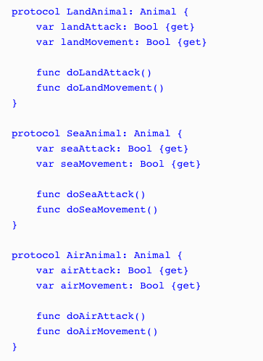
Protocol Oriented Design - POP
Notes:
Now let's define our LandAnimal, SeaAnimal, and AirAnimal protocols. These protocols will define the requirements for land, sea, and air animals respectively:
Unlike the Animal superclass in the OOP example, these three protocols only contain the functionality needed for their particular type of animal. Each of these protocols only contains four lines of code while the Animal superclass, from the OOP example, contains significantly more. This makes our protocol design much easier to read and manage. The protocol design is also much safer because the functionality for the various animal types is isolated in its own protocol rather than being embedded in a giant superclass. We also avoid the use of flags to define the animal category and instead define the category of the animal by what protocols they are conforming too.

Slide 69
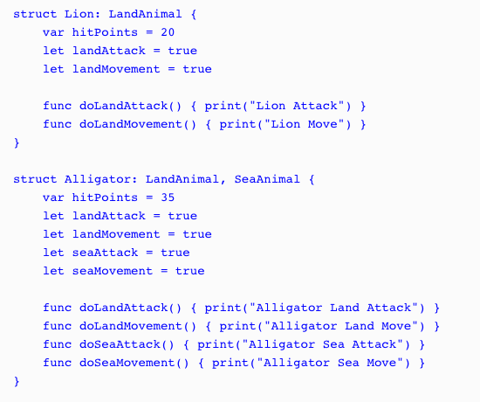
Notes:
Now let's look at how we would create our Lion and Alligator types using the protocol-oriented design:
Notice that we specify that the Lion type conforms to the LandAnimal protocol while the Alligator type conforms to both the LandAnimal and SeaAnimal protocols.
having a single type that conforms to multiple protocols is called protocol composition and is what allows us to use smaller protocols rather than one giant monolithic superclass as we did in the OOP example.

Slide 70
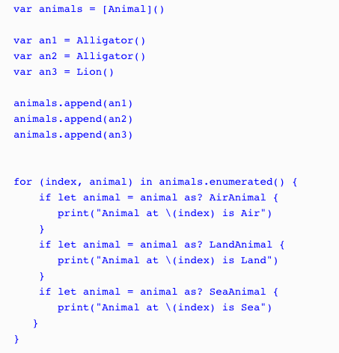
Notes:
Both the Lion and Alligator types originate from the Animal protocol; therefore we can still use polymorphism as we did in the OOP example where we use the Animal type to store instances of the Lion and Alligator types. Let's see how this works:
In this example, we create an array that will contain animal types named animals. We then create two instances of the Alligator type and one instance of the Lion type and add all three instances to the animals array. Finally, we use a for...in loop to loop through the array and print out the animal type based on the protocol that the instance conform too.

Slide 71

Protocol Oriented Design - POP
Notes:
When we use a protocol-oriented design, as we just saw, we are able to use the wherestatement to filter instances of our types. For example, if we only want to get the instances that conform to the SeaAnimal protocol we can create a for loop such as this:
This will retrieve only those animals that conform to the SeaAnimal protocol. This is a lot safer than just checking the flags because, as we pointed out earlier, it is really easy to set the wrong flag in our code, which would introduce all sorts of weird behavior.

