Slide 1
Marketing Automation
OpenAI meetup Feb ‘25

Slide 2
Agenda
News
o3-mini via the API
420 members
This month
Marketing Automation
Next month
Github Copilot
Notes:
35 new members this month - welcome

Slide 3
Marketing LinkedIn Automation
Meetup (2 x monthly)
Blog Posts (2 x monthly)
M – Meetup announcement personal
Tu – Meetup announcement company
W – Ad hoc posts (not automated)
Th – Blog posting personal
F – Blog posting company
Notes:
New Year’s resolution – automate everything with ChatGPT – here’s our marketing schedule
You could just as easily post to Facebook, or Instagram or even Hootsuite and get it to post to every marketing channel.

Slide 4
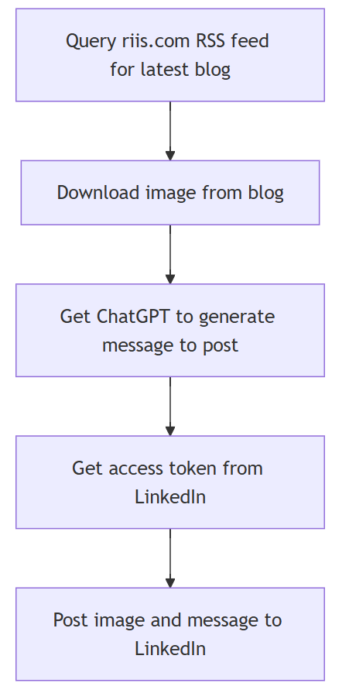
riis.com/blog to LinkedIn workflow
Notes:
Let’s start with the simpler RSS feed to LinkedIn and do the meetup.com posting later.
flowchart TD
A[Query riis.com RSS feed for latest blog]
B[Download image from blog]
C[Get ChatGPT to generate message to post]
D[Get access token from LinkedIn]
E[Post image and message to LinkedIn]
A --> B
B --> C
C --> D
D --> E

Slide 5
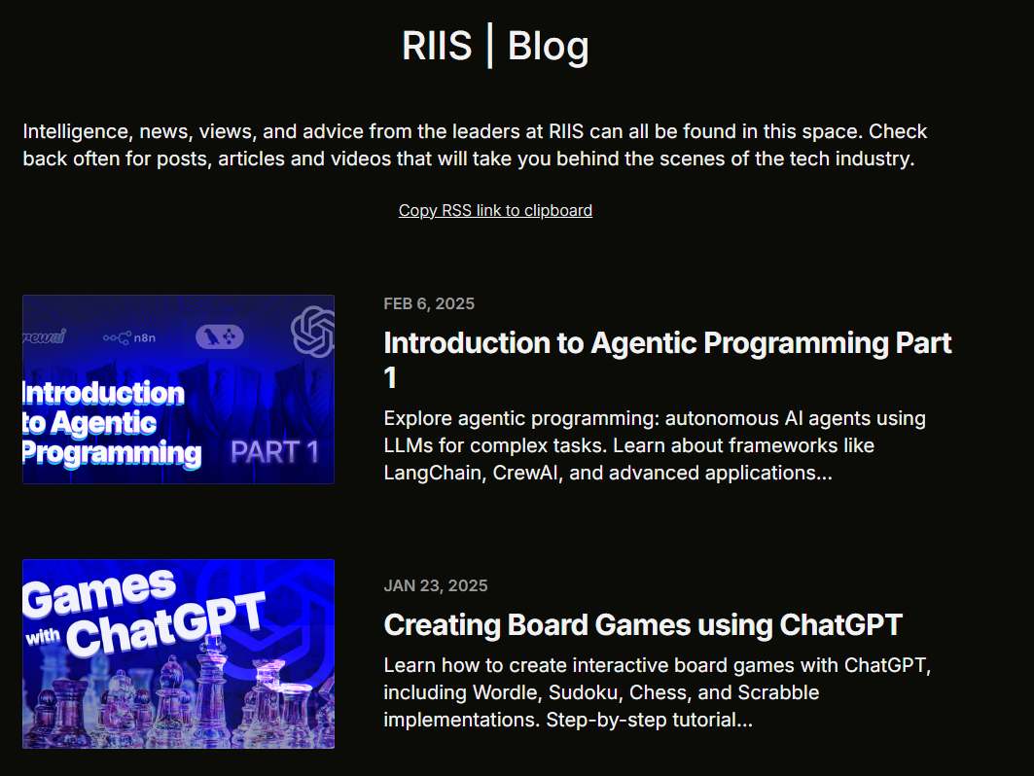
riis.com/blog to LinkedIn workflow
Notes:
As always I ask ChatGPT to generate the code to read an RSS feed, it’s using feedparser.
I just parse out the title and link of the blog as well as the URL
Download the image while you’re at it so we can post that too.

Slide 6
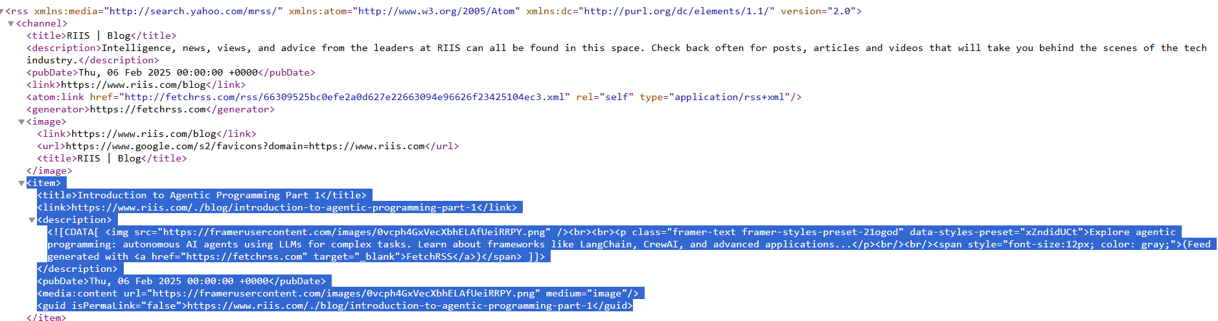
riis.com/blog to LinkedIn workflow
Notes:
It’s probably become obvious if you’ve been following our talks that these meetups are a key part of our marketing.
So twice a month we do a meetup, and each of these meetups get turned into a blog (see earlier meetup on how we do this)
Our website is developed using Framer and there’s a simple RSS plugin that lists all our blogs.
It notifies people when we have a new blog, but I’m using it to pull the important info to post it to Linkedin to increase visits to the website.
SHOW RSS FEED

Slide 7
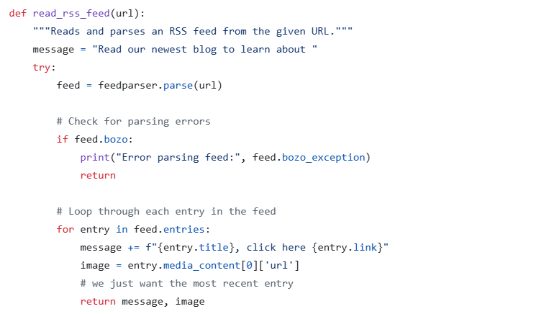
riis.com/blog to LinkedIn workflow
Notes:
As always I ask ChatGPT to generate the code to read an RSS feed, it’s using feedparser.
I just parse out the title and link of the blog as well as the URL
Download the image while you’re at it so we can post that too.

Slide 8
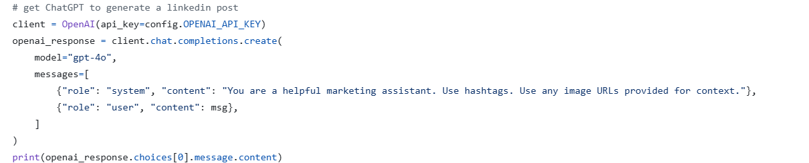
riis.com/blog to LinkedIn workflow
Notes:
It’s a simple call to OpenAI to get it to generate the message we just pass in the title and the URL of the blog
Note: you can’t use chatgpt to generate chatgpt as it was trained on the earlier version of the API

Slide 9
riis.com/blog to LinkedIn workflow
Notes:
Ok, we’re more than halfway, now we need to generate an access token for LinkedIn and then post the message.

Slide 10
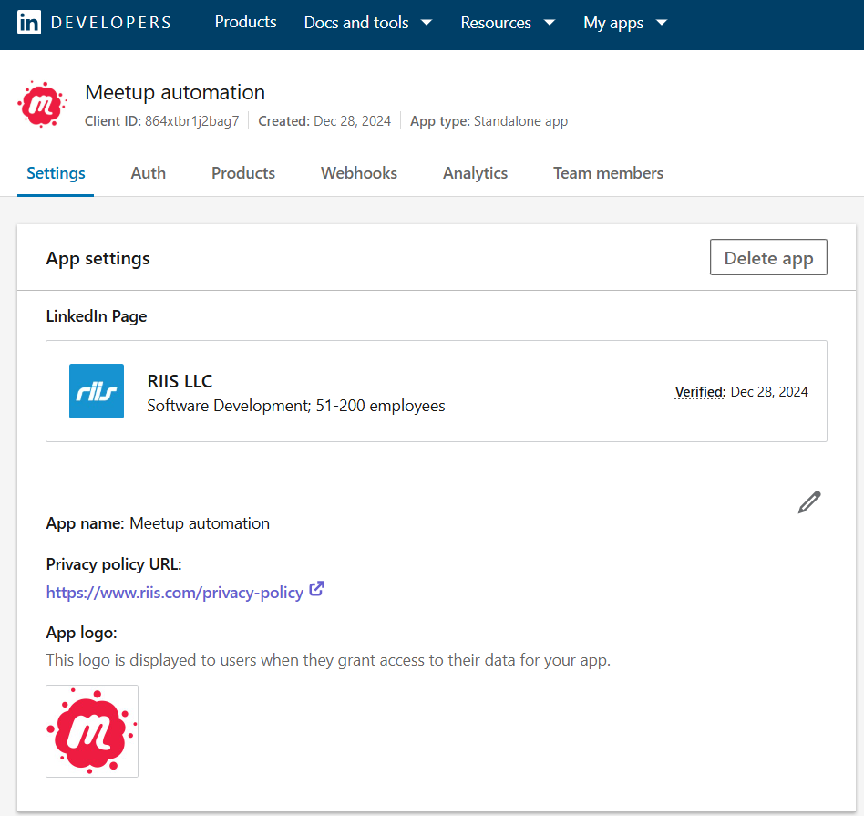
riis.com/blog to LinkedIn workflow
Notes:
Go to developer.linkedin.com and create an app, you’ll need a LinkedIn company page to be able to do this.

Slide 11
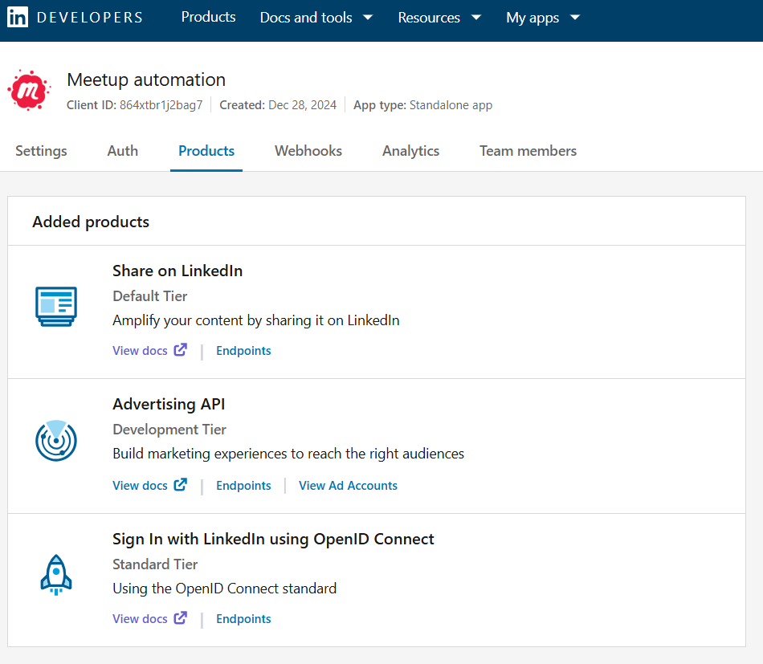
riis.com/blog to LinkedIn workflow
Notes:
You need to following products to be able to share your post on linkedin personal or company pages, signin, share and advertising

Slide 12
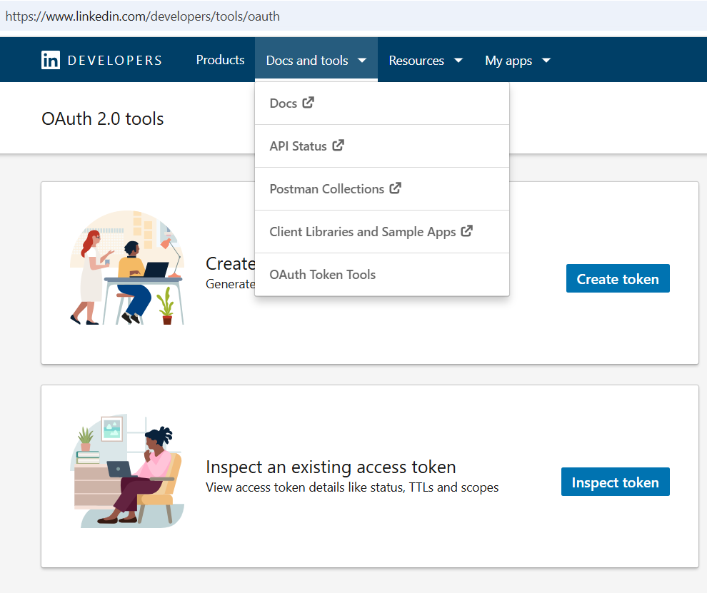
riis.com/blog to LinkedIn workflow
Notes:
Click on Docs and Tools and then click on create token. You have to do that everytime add a new app or new product.
Walk through the workflow to create a new token and you can include that in your code to get the chatgpt message and image to post.
For more detailed instructions take a look at the Jean-Christophe Chouinard’s blog, the link is in the resources

Slide 13
riis.com/blog to LinkedIn workflow
Notes:
And lastly we want to post the image and ChatGPT message to LinkedIn!

Slide 14
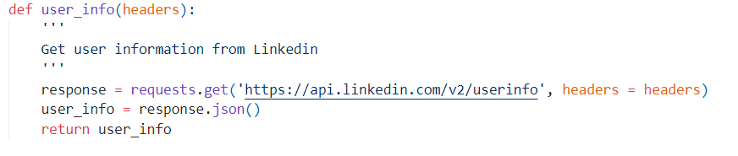
Notes:
Posting our LinkedIn message is a 4 stage process, we need our user id for our linkedin profile or organization id for our company postings
# Get user id to make a UGC post
The highlighted Sub gives us our id
This fails if you don’t have the right products, so check you have the same list as ours above

Slide 15
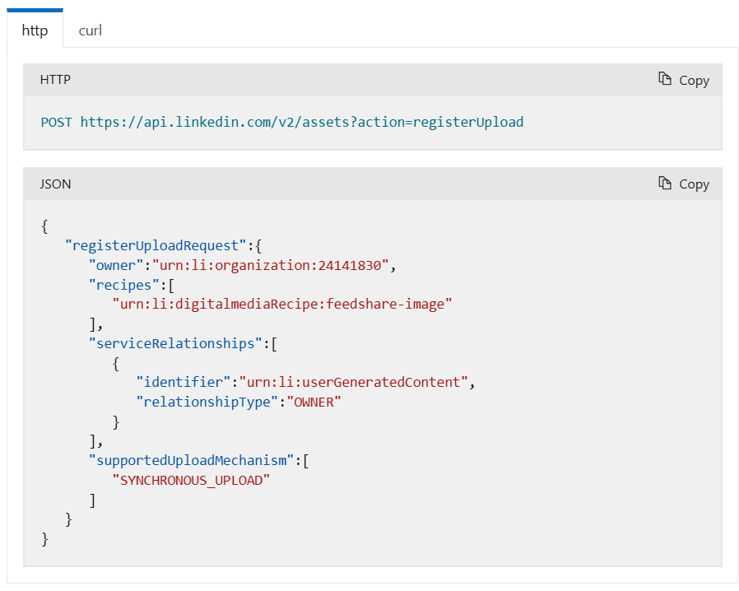
riis.com/blog to LinkedIn workflow
Notes:
We need to register the upload of our image using the Assets API, passing in your author or organization id

Slide 16
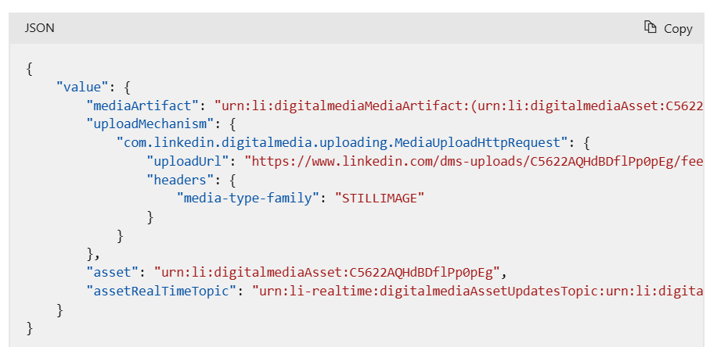
riis.com/blog to LinkedIn workflow
Notes:
This gives us an uploadUrl where we can post our image

Slide 17
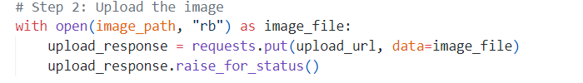
riis.com/blog to LinkedIn workflow
Notes:
Using the image we’ve downloaded from the Blog (the URL is in the RSS feed) we send a put request to the URL to upload the image

Slide 18
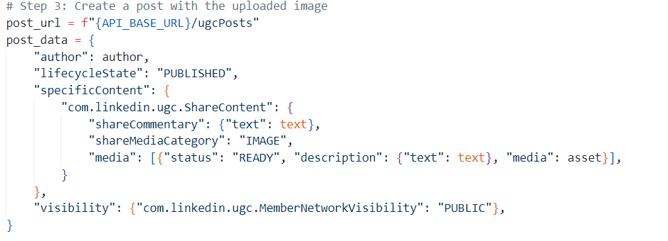
riis.com/blog to LinkedIn workflow
Notes:
And lastly we create a post with our ChatGPT text and the posted image
All this code is using the older Assets API from LinkedIn, I think that’s the only downside of using ChatGPT to generate the code, you’re always going to get the older version of the API as that’s what it was trained on.

Slide 19
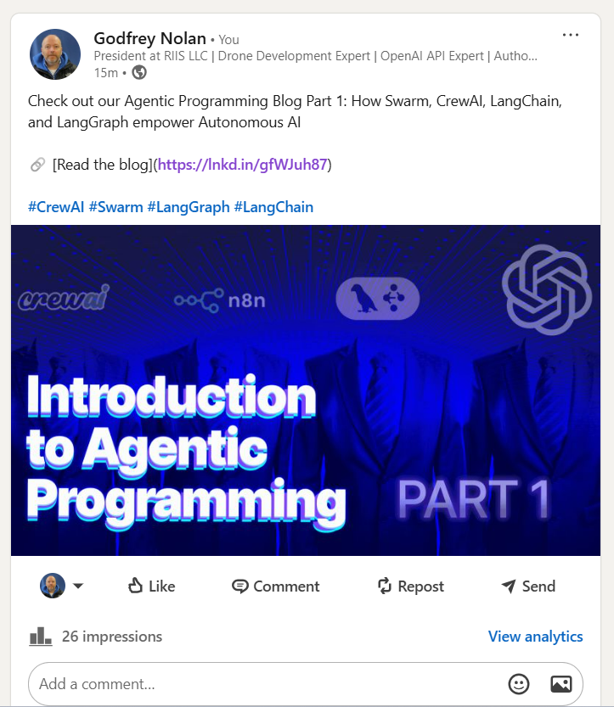
riis.com/blog to LinkedIn workflow
Notes:
And here’s the post to Linkedin

Slide 20
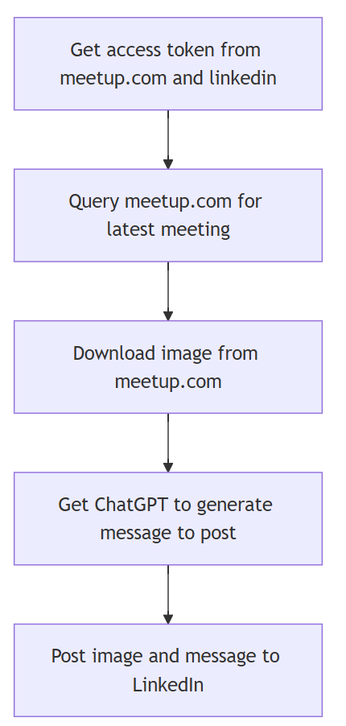
Meetup.com to LinkedIn workflow
Notes:
Let’s do one more posting

Slide 21
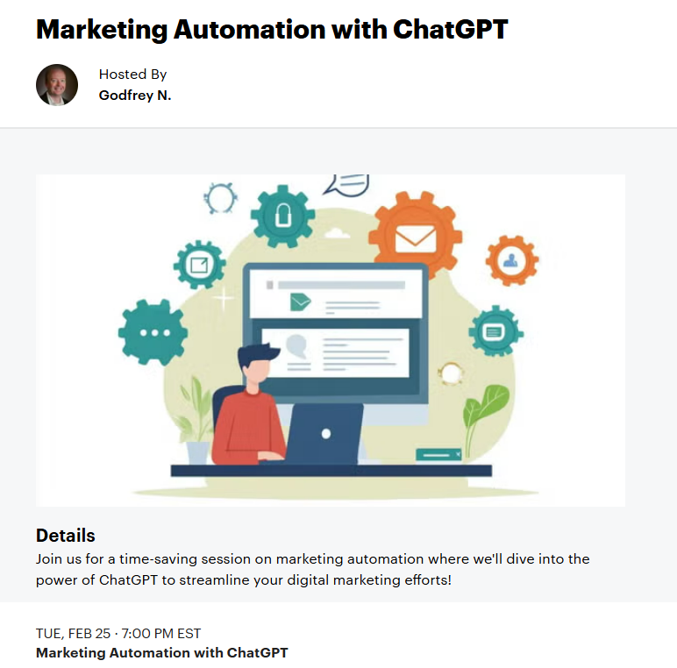
Meetup.com to LinkedIn workflow
Notes:
I have an image I created on Midjourney.com and the meeting which I got ChatGPT to generate the copy from a brief description of what I wanted to present.

Slide 22
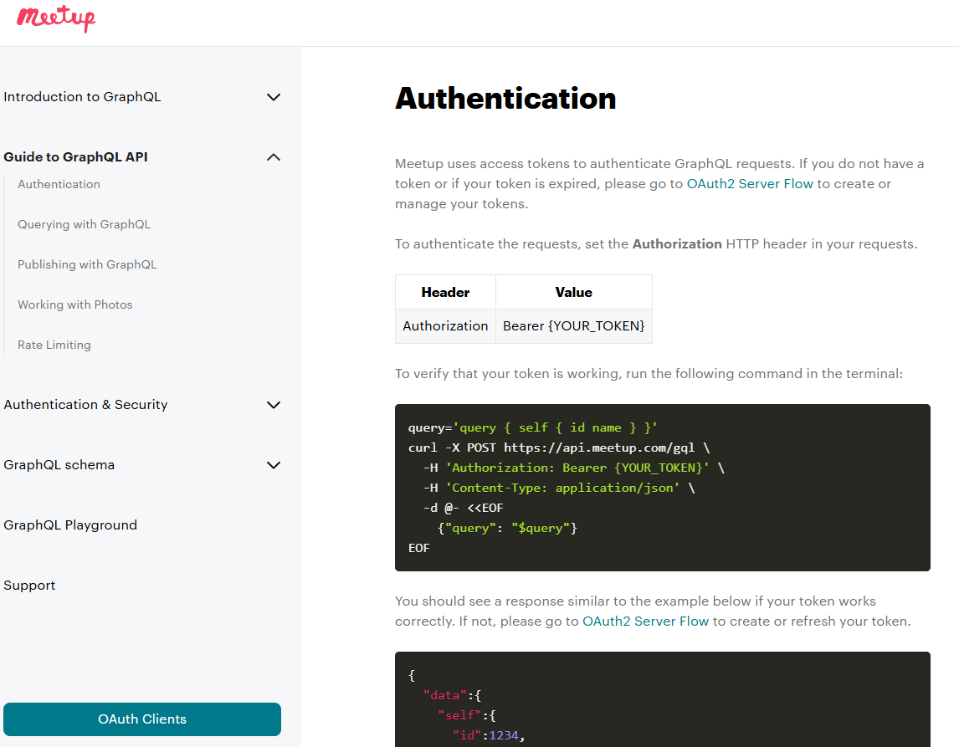
Meetup.com to LinkedIn workflow
Notes:
Meetup has a mature API spec – we need to authenticate using Oauth and then do an API query
Unfortunately meetup.com uses GraphQL which is a lot more complicated than REST API which is really simple to use

Slide 23
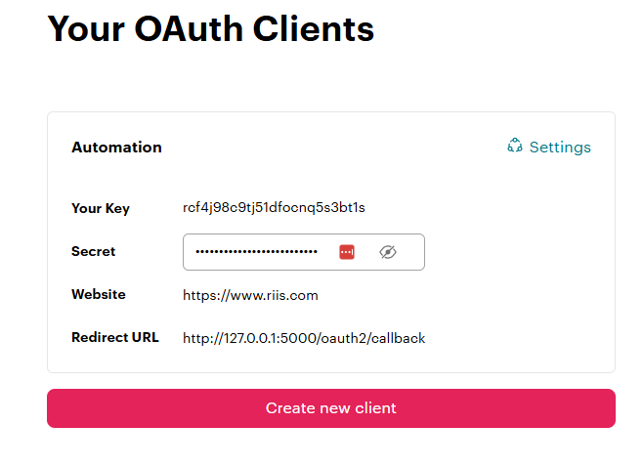
Meetup.com to LinkedIn workflow
Notes:
Click on the Auth clients to get your key and your secret which we need for authentication.

Slide 24
Meetup.com to LinkedIn workflow

Slide 25
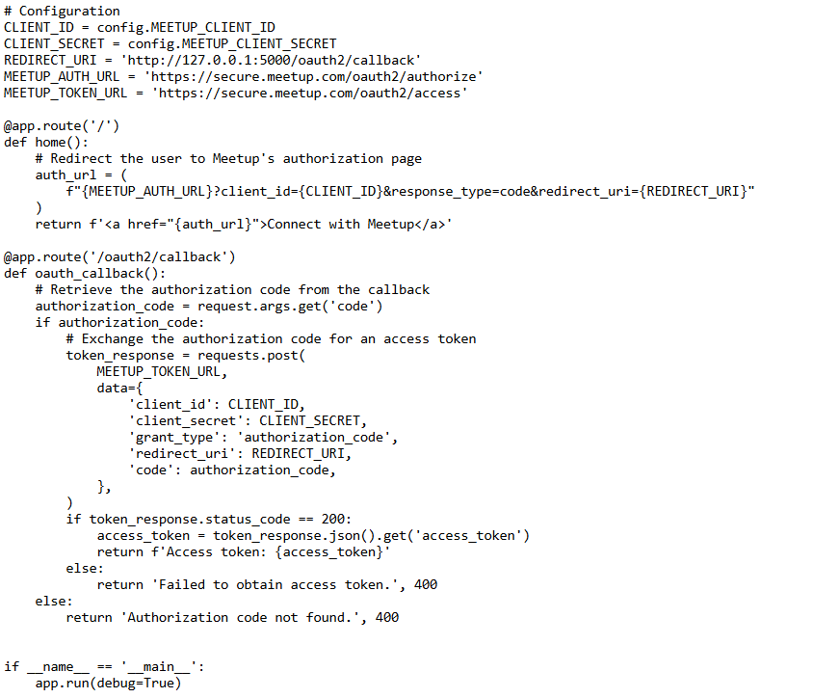
Meetup.com to LinkedIn workflow
Notes:
I asked ChatGPT to write the python to authenticate with Meetup.com – and it gave me something like this
Oauth2 has an initial call where you get an authorization_code from meetup and then we get the access token which we can use to make any database queries.
When it authenticates it’s going to send you to the REDIRECT_URI which doesn’t exist but you can pull the access token from the output

Slide 26
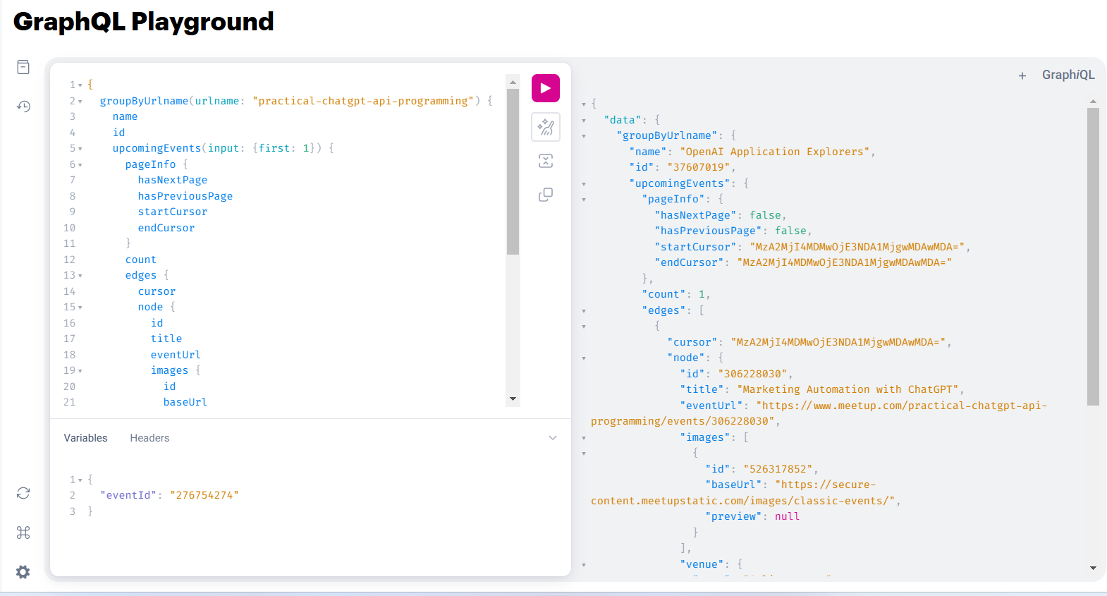
Meetup.com to LinkedIn workflow
Notes:
The meetup query uses GraphQL, here it is running in the Meetup GraphQL playground with the response. SHOW
ChatGPT got me the start of the query but this took a while as I don’t think there’s a lot of GraphQL code on github so I took a while get the query to work correctly. This gives me back the group event, time and date, short URL to the event as well as any images
SHOW code
We dump the image to the hard drive so we can post it later.

Slide 27
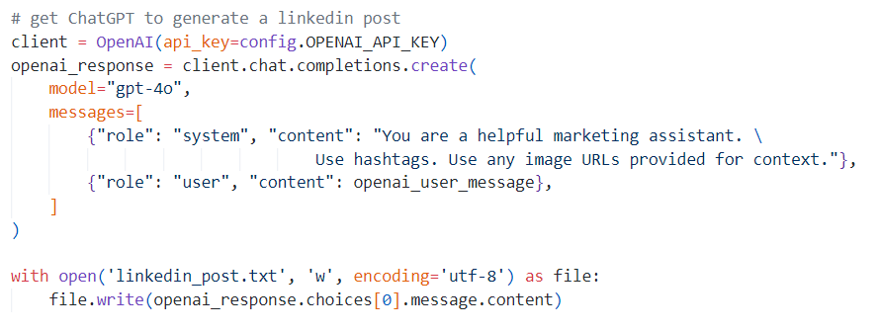
Meetup.com to LinkedIn workflow
Notes:
Get chatgpt to come up with the text for the linkedin posts – it’s great at emojis and is by default super enthusiastic
You might want to give it several examples of your previous posts to get it find your voice.

Slide 28
Meetup.com to LinkedIn workflow
Notes:
Ok so now we have to post to linkedin – again we have to do the 2 factor authentication with linkedin – although linkedin does make this easier

Slide 29
Meetup.com to LinkedIn workflow
Notes:
Go to developer.linkedin.com and create an app, you’ll need a LinkedIn company page to be able to do this.

Slide 30
Meetup.com to LinkedIn workflow
Notes:
You need to following products to be able to share your post on linkedin personal or company pages, signin, share and advertising

Slide 31
Meetup.com to LinkedIn workflow
Notes:
Click on Docs and Tools and then click on create token. You have to do that everytime add a new app or new product.
Walk through the workflow to create a new token and you can include that in your code to get the chatgpt message and image to post.

Slide 32
Meetup.com to LinkedIn workflow
Notes:
Ok, last step – let’s post to Linkedin same as we did with the Blog posting

Slide 33
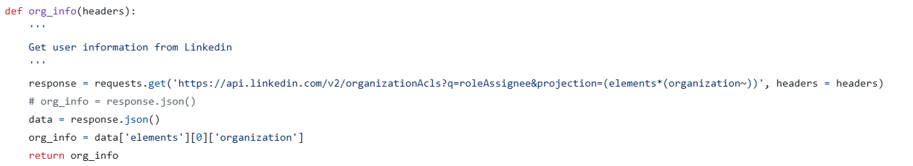
Meetup.com to LinkedIn workflow
Notes:
In this example we’re looking not for the personal userid but the companyid, but everything else is the same as with the rss blog.

Slide 34
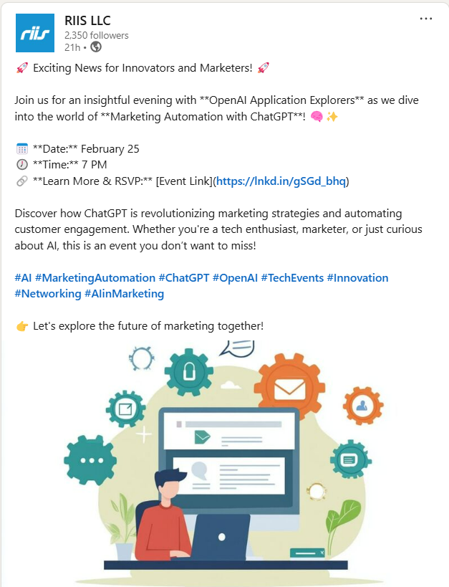
Meetup.com to LinkedIn workflow
Notes:
Here’s the final image posted to our company page, I really like how chatgpt adds lots of emojis and hashtags. I think it pops a lot more than what we were doing in the past.

Slide 35
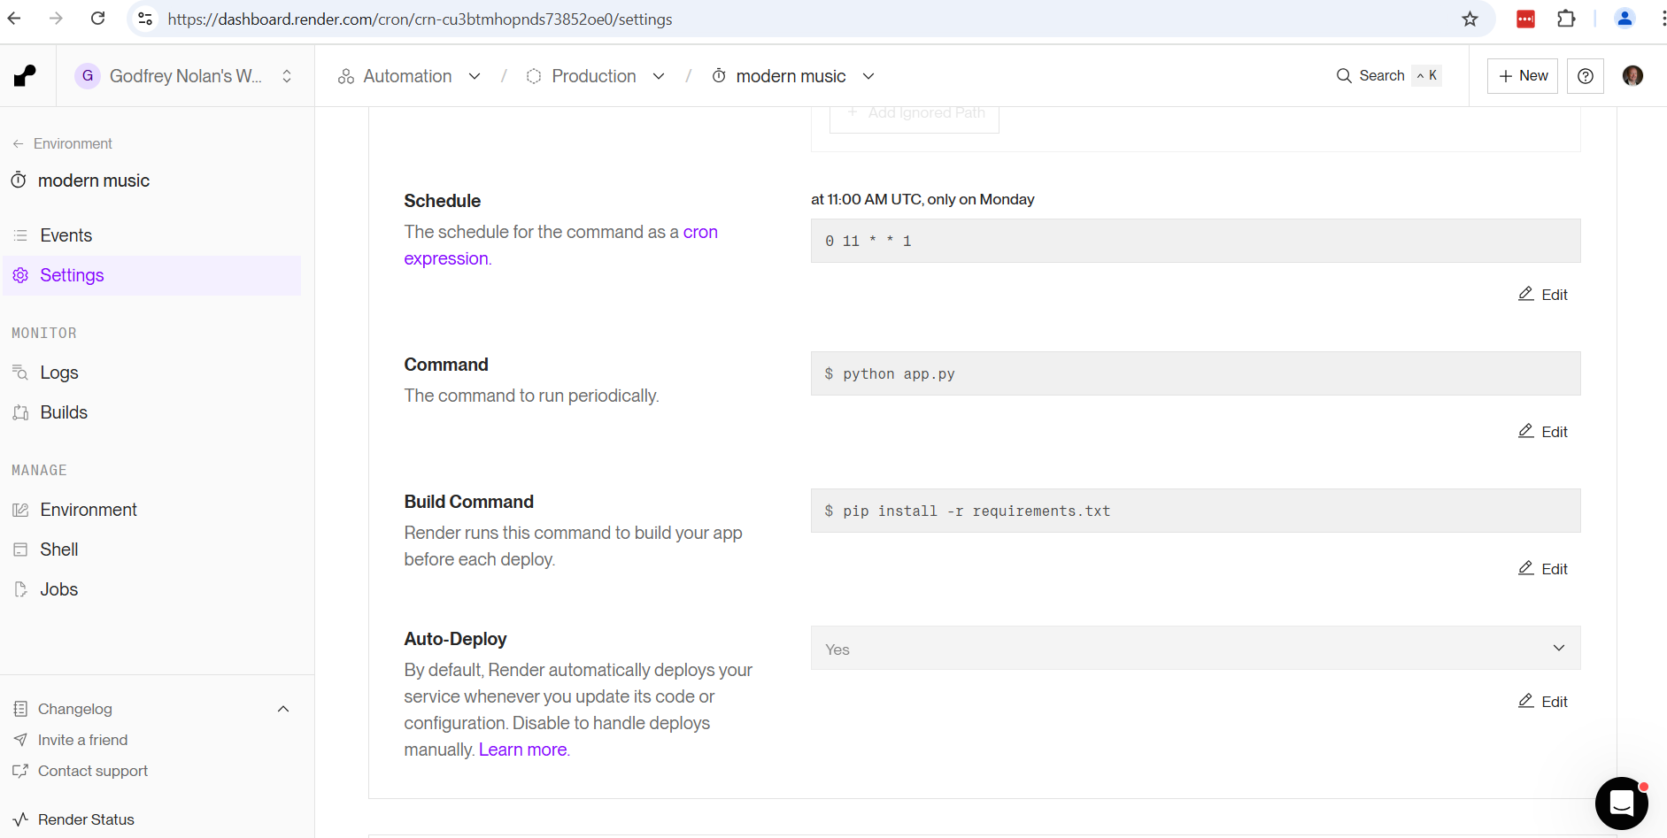
Notes:
New Year’s resolution is to automate everything, so we can do that on render.com and probably lots of other websites.
Ask ChatGPT for the right format for the schedule, this is what is known as a cron job or cron expression.

Slide 36
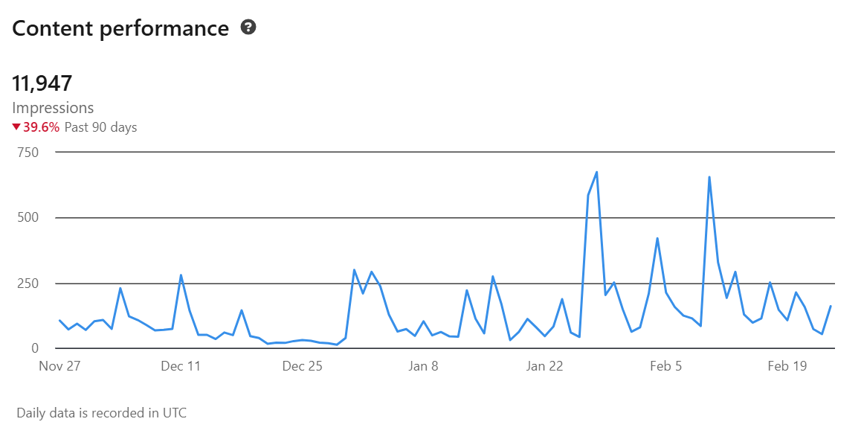
riis.com/blog to LinkedIn workflow
Notes:
I started doing this automation project early January as I thought we were really tapering off with our content last year.
So there are a couple takeaways – yes the general trend is up since the start of the year. But we’re still way down on the previous 90 days as Nov/Dec was so bad.
As with all marketing I feel it’s like throwing spaghetti at the wall and seeing what works – but you always have to check what you’re doing is working or not and adjust if necessary.
I think I need to change the voice of our posts before this goes on much longer. And I think I should be able to add some video soon, which we’ll be looking at in a future meetup

Slide 37
Resources
https://www.riis.com/blog/turn-your-videos-into-articles-with-openai-and-langchain
https://developer.linkedin.com
https://www.jcchouinard.com/linkedin-api-authentication/
https://learn.microsoft.com/en-us/linkedin/compliance/integrations/shares/ugc-post-api
https://www.meetup.com/api/schema/#graphQl-schema

Slide 38
Next month
Github Copilot

