Slide 1
JOBCONNECT
JOB’S FIND YOU

Slide 2
INTRODUCTION
Welcome to the Future of Job Search and Recruitment!
In an ever-evolving job market, where technology shapes the way we live and work, we proudly introduce "JobConnect" - a revolutionary job portal designed to bridge the gap between job seekers and employers. This presentation will walk you through the essence of JobConnect, its objectives, and the transformative impact it promises to bring to the world of employment.

Slide 3
Challenges in Traditional Job Search
01
03
02
04
Limited Personalization
Navigating Time Wastage
Scattered Communication
Geographical
Barriers

Slide 4
SCOPE & OBJECTIVES
Security and Privacy
Job Seeker Experience
Employer Interface

Slide 5
KEY OBJECTIVES INCLUDE
Personalized Job Matching
Seamless Communication
User-Centric
Design
Continuous Improvement

Slide 6
PROJECT CATAGORY
A Platform for Modern Recruitment
IT IS A WEB-BASED APPLICATION.
UNLKE TRADITIONAL APPLICATION, IT IS ACCESSIBLE ANYTIME, ANYWHERE , VIA A BROWSER WITH AN INTERNET CONNECTION.
IT IS LOWER REQUIREMENTS ON THE END USER SYSTEM AND SIMPLIFIED ARCHITECTURE.

Slide 7
TABLE OF CONTENTS
01
TECH STACK
02
MODULES
03
MODEL
04
DFD

Slide 8
01
TECH STACK

Slide 9
TECHNOLOGIES USED
01
02
03
04
FROUNT-END
RESPONSIVE
SERVER-SIDE
DATABASE
HTML CSS JS
BOOTSTRAP
PHP
MYSQL

Slide 10
02
MODULES

Slide 11
LOGIN & LOGOUT
SECURE AUTHENTICATION
ACCESS CONTROL
CONFIDENTIALITY
ENHANCES EFFICIENCY

Slide 12
HOME PAGE
ENGAGING CONTENT
INTUTIVE NAVIGATION
IMPORTANT
JOBS
ENHANCED USER EXPERIENCE

Slide 13
JOB SEARCH AND LISTINGS
JOBS
INTERNSHIPS

Slide 14
APPLICATION SUBMISSION
APPLY
FOR
DESIRED POSITIONS
FILLUP
APPLY
FORM

Slide 15
03
MODEL USED

Slide 16
WATERFALL MODEL
WE ADOPTED THE WAATERFALL MODEL , A STRUCTURED AND SEQUENTIAL SOFTWARE DEVLOPMENT APPROACH , ENSURING THOROUGH COMPLETION OF EACH PHASE BEFOR PROHRESSING TO THE NEXT STAGE. THIS LED TO A STABLE AND WELL-TESTED SYSTEM FOR OUR CLIENTS.

Slide 17
WATERFALL
ANALYSIS
GATHERING DATA
DESIGN
USER INTERFACE
DATABASE SCHEMA
DEVLOPMENT
IMPLEMENTES OF MODULES
TESTING
SYSTEM TESTING

Slide 18

04
DFD

Slide 19
DATA FLOW DIAGRAM

Slide 20

05
Data
DICTIONARY

Slide 21

USER TABLE
Field Name | Data Type | Field Length | Cortstraint | Description
id | int | 11 | 🔑Primary Key | Auto Increment id
User_name | varchar | 50 | Not null | Name of User
password | varchar | 50 | Not null | Strong Password
Phone_ Number | int | 11 | Not null | Valid Number
Email | varchar | 50 | Not null | Valid Email of User
country | varchar | 50 | Not null | country of User
User_img | varchar | 50 | Not null | image of User
Your_self | longtext | 50 | Not null | About User

Slide 22

COMPANY TABLE
Field Name | Data Type | Field Length | Cortstraint | Description
id | int | 11 | 🔑Primary Key | Auto Increment id
Job_catagory | varchar | 50 | Not null | Catagory of Job
Company_ name | varchar | 50 | Not null | Name of Company
location | varchar | 50 | Not null | Location of Job
salary | varchar | 50 | Not null | Salary Range
Job_time | int | 11 | Not null | Time of Job
job_ description | varchar | 50 | Not null | Description of Job Role
Company_ logo | varchar | 50 | Not null | Logo of Company

Slide 23

USER_APPLY
TABLE
Field Name | Data Type | Field Length | Cortstraint | Description
id | int | 11 | 🔑Primary Key | Auto Increment id
Company_id | int | 11 | Not null | Id from company table
name | varchar | 50 | Not null | Name of Company
logo | varchar | 50 | Not null | Logo of Company
User_ name | varchar | 50 | Not null | Name of User
User_email | varchar | 50 | Not null | Email of User
User_phone | int | 11 | Not null | Valid Number
User_location | varchar | 50 | Not null | Location of Job
User_cover_ letter | varchar | 50 | Not null | Cover Letter from User
User_resume | varchar | 50 | Not null | Resume of User
time | varchar | 50 | Not null | Apply Time of User

Slide 24
QUERY TABLE
Field Name | Data Type | Field Length | Cortstraint | Description
id | int | 11 | 🔑Primary Key | Auto Increment id
user_name | varchar | 50 | Not null | Name of User
user_email | varchar | 50 | Not null | Valid Email of User
subject | varchar | 50 | Not null | Subject of Query
comment | varchar | 50 | Not null | Comment of Query

Slide 25
06
Data
Layout

Slide 26
DATA LAYOUT
Sign up.php
otp.php
login.php
job_details up.php
home.php
Jobs_info.php
Job_form.php
your_applys.php
Contact us.php
User_profile.php
User_update.php
User_delete.php

Slide 27
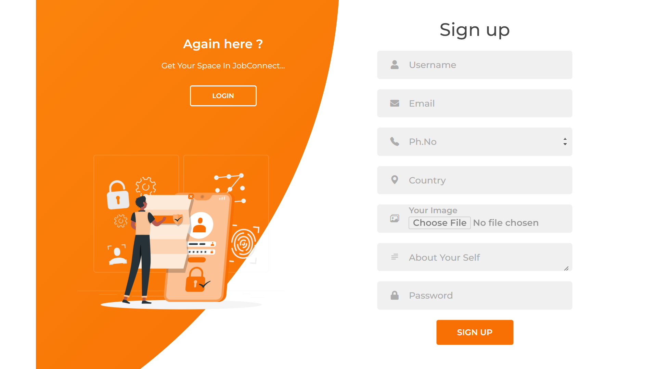
Sign up.php

Slide 28
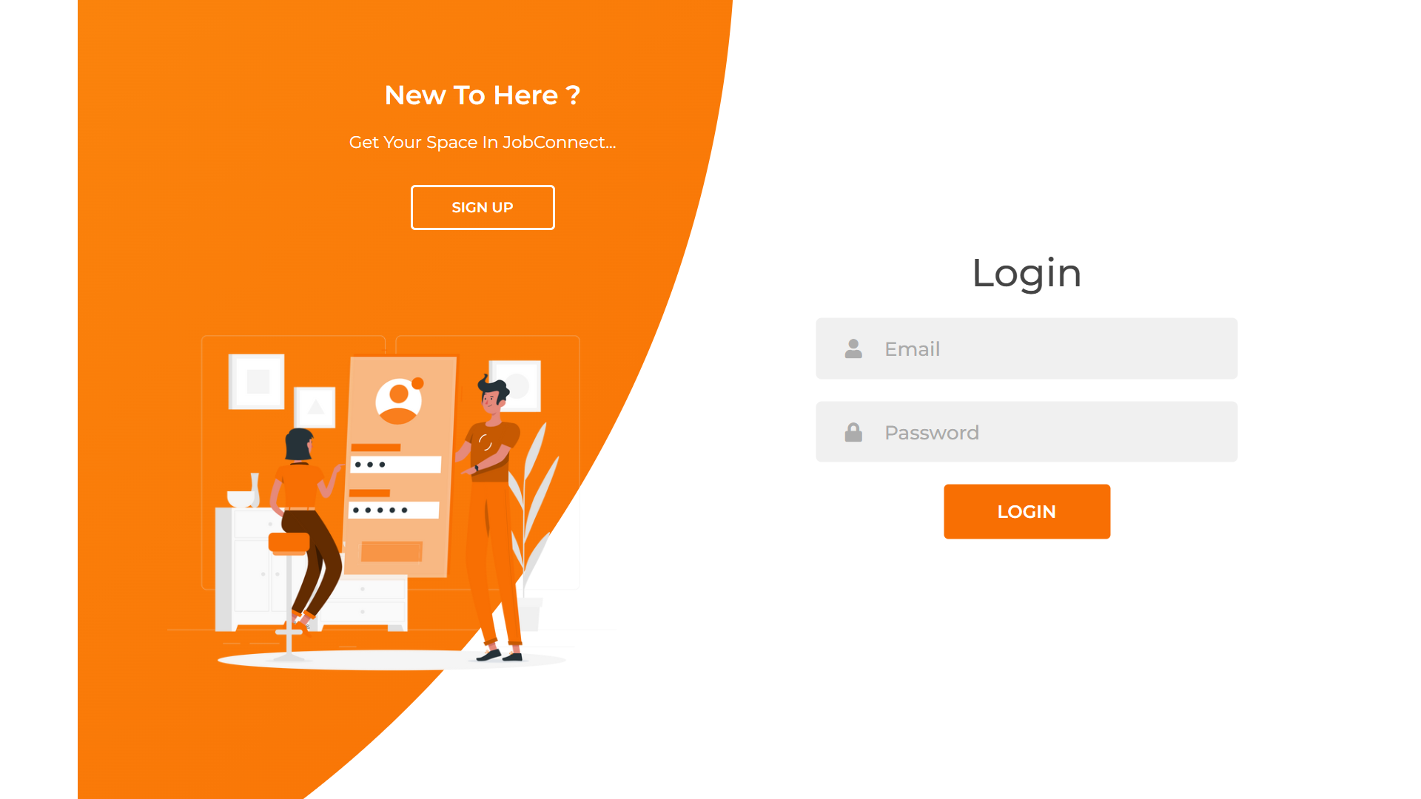
login.php

Slide 29
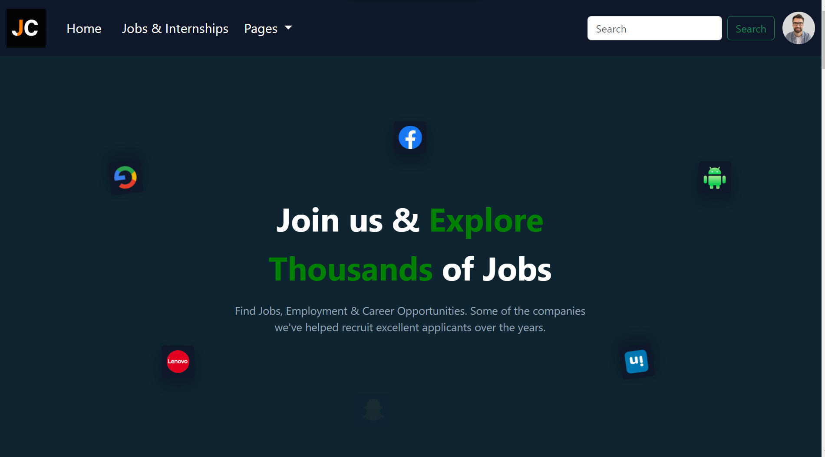
home.php

Slide 30


Slide 31
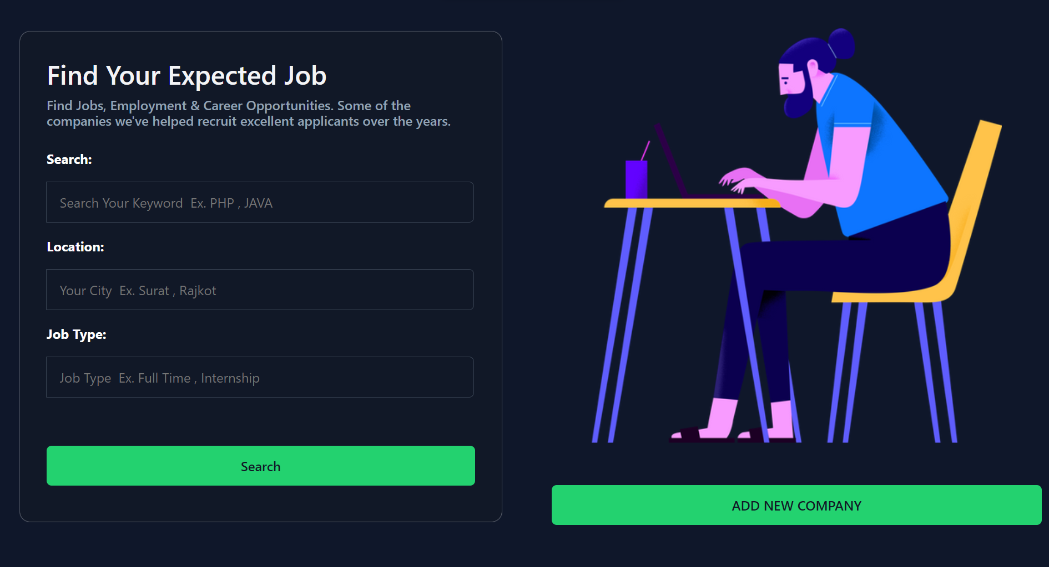
Jobs_info.php

Slide 32
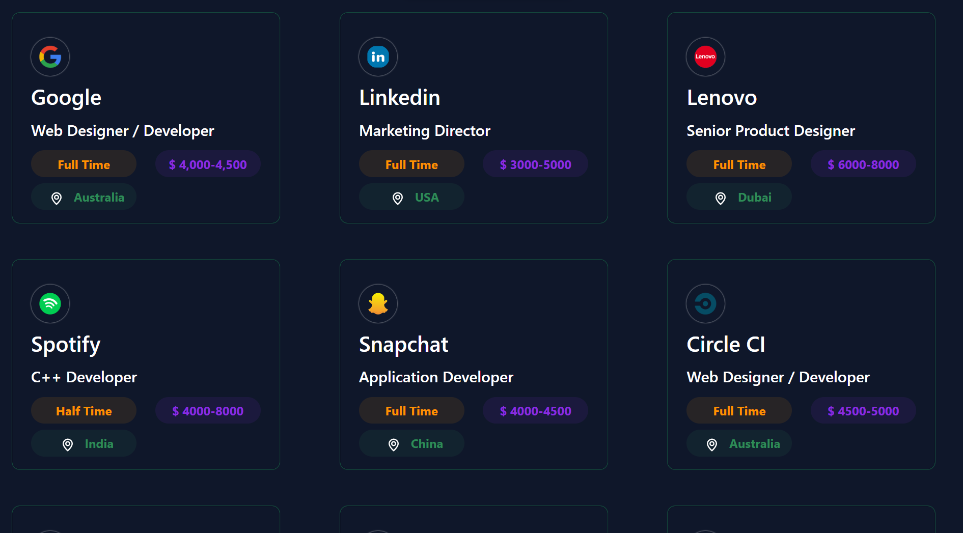

Slide 33
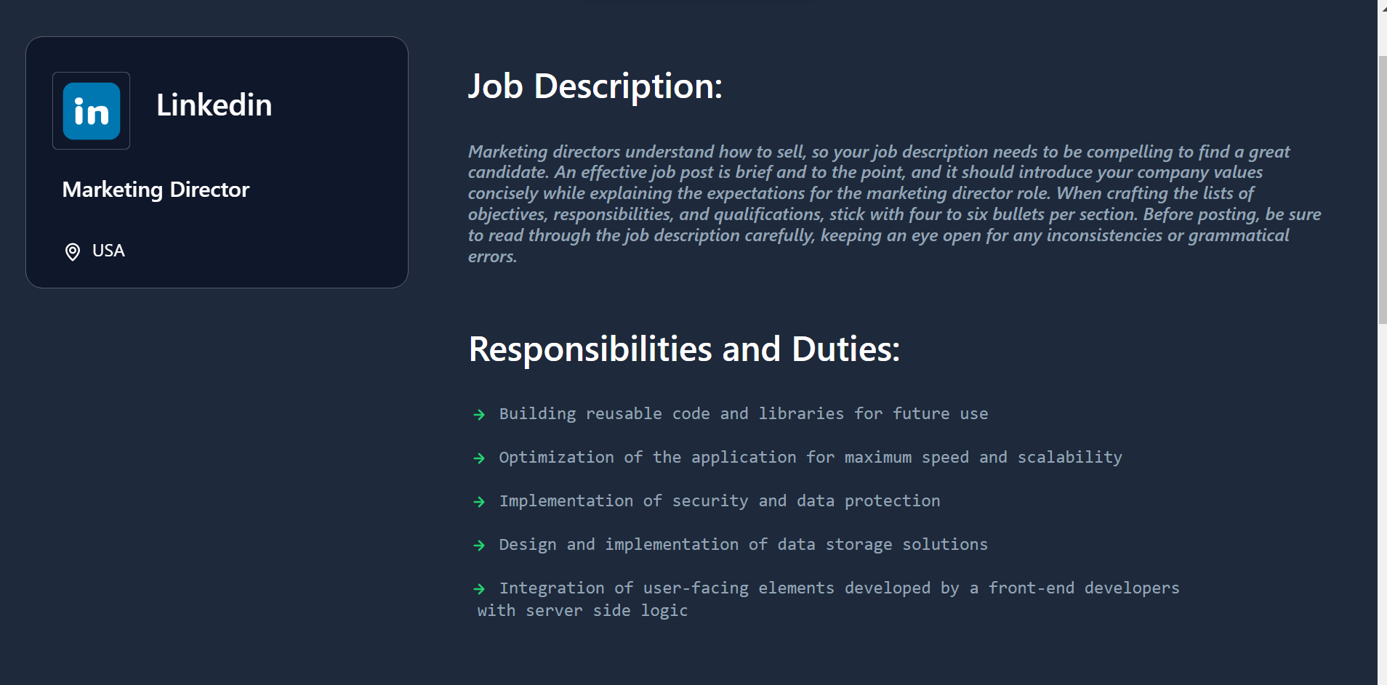
Job_detailes.php

Slide 34
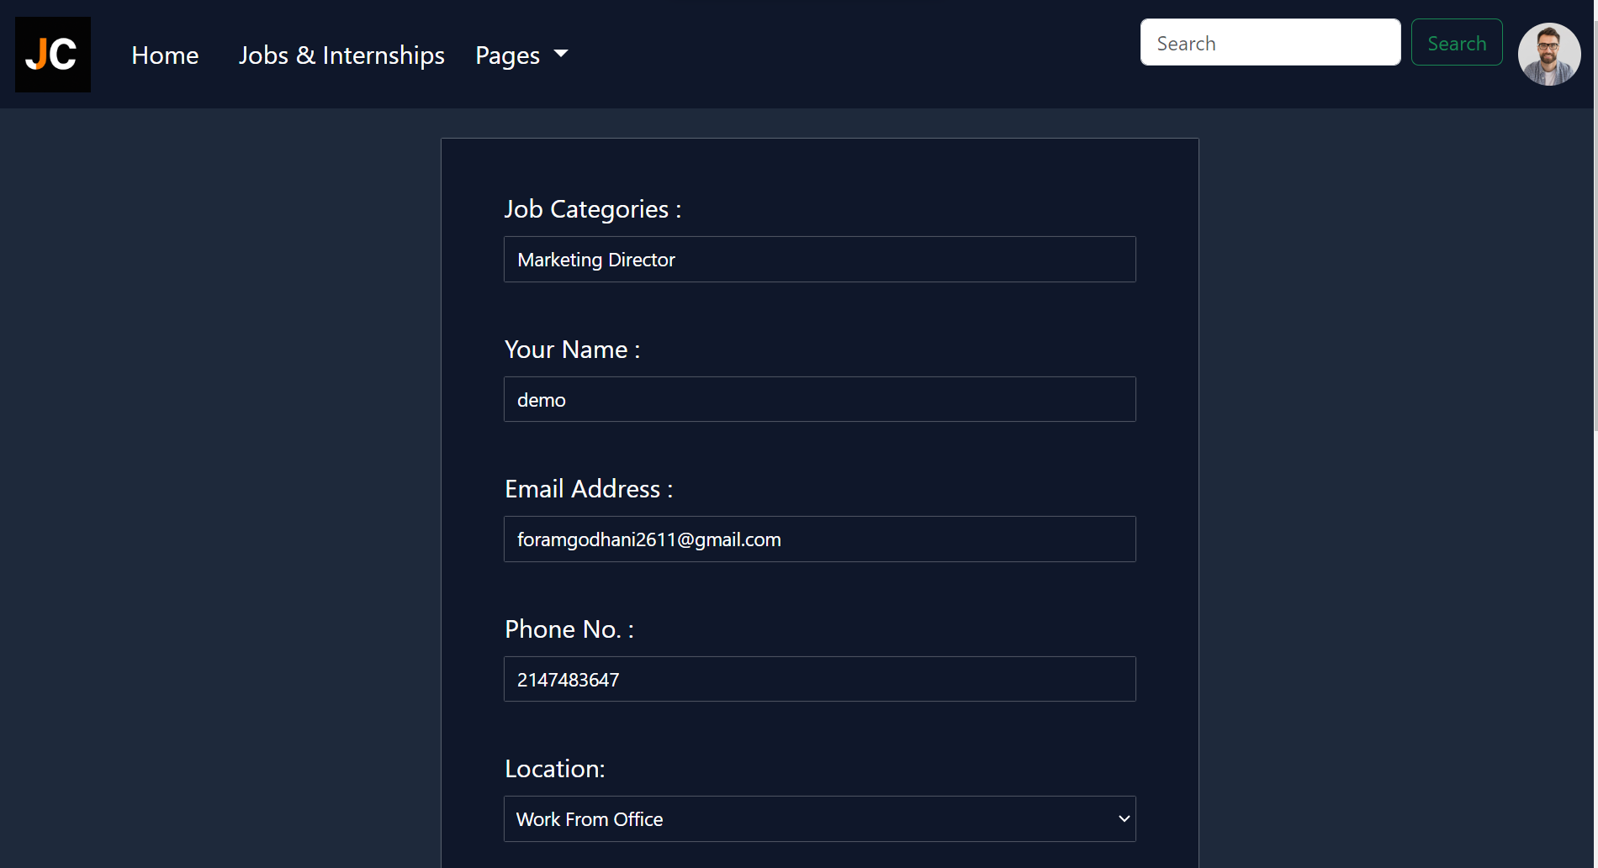
Job_form.php

Slide 35
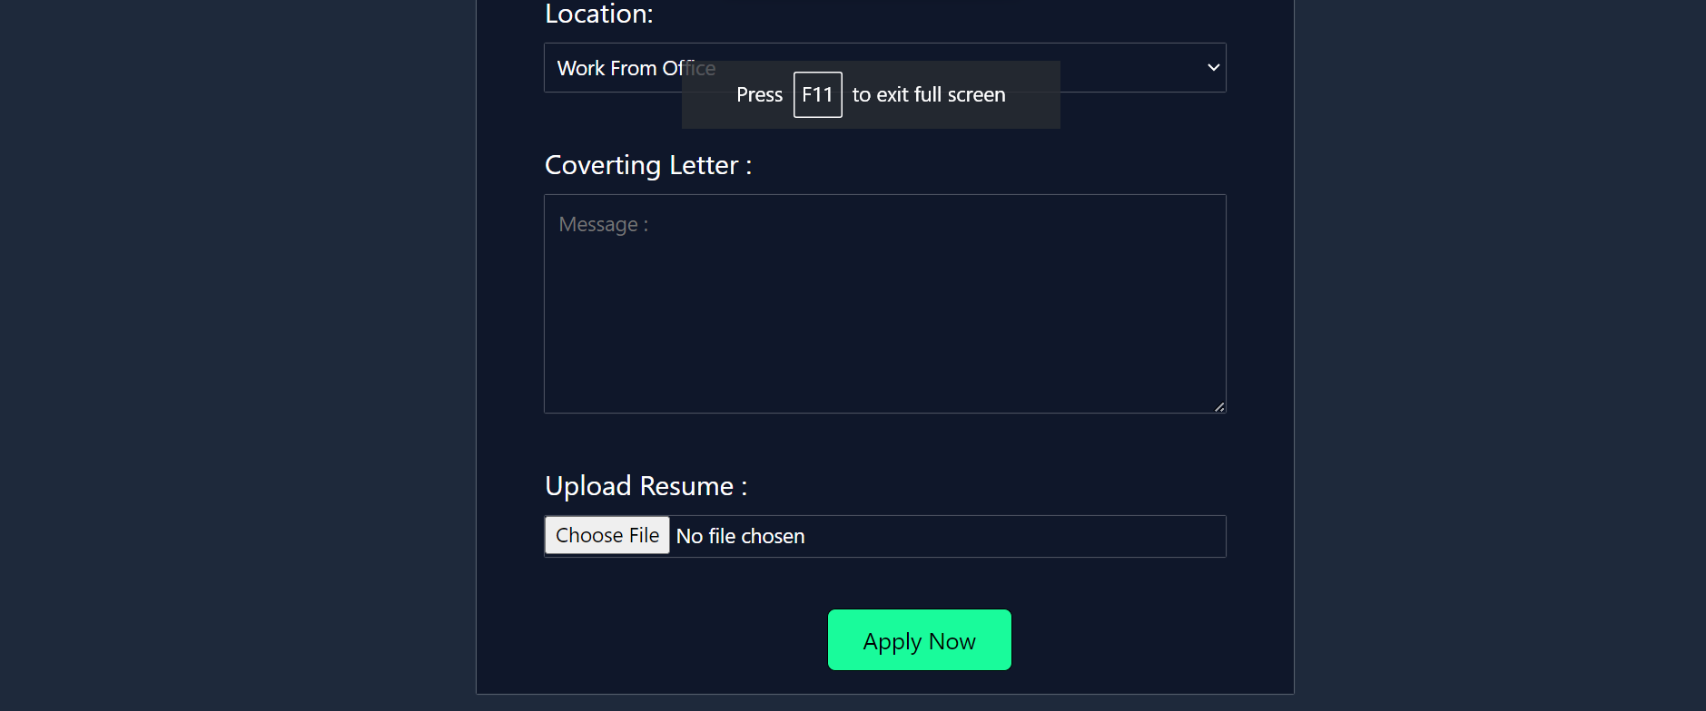

Slide 36
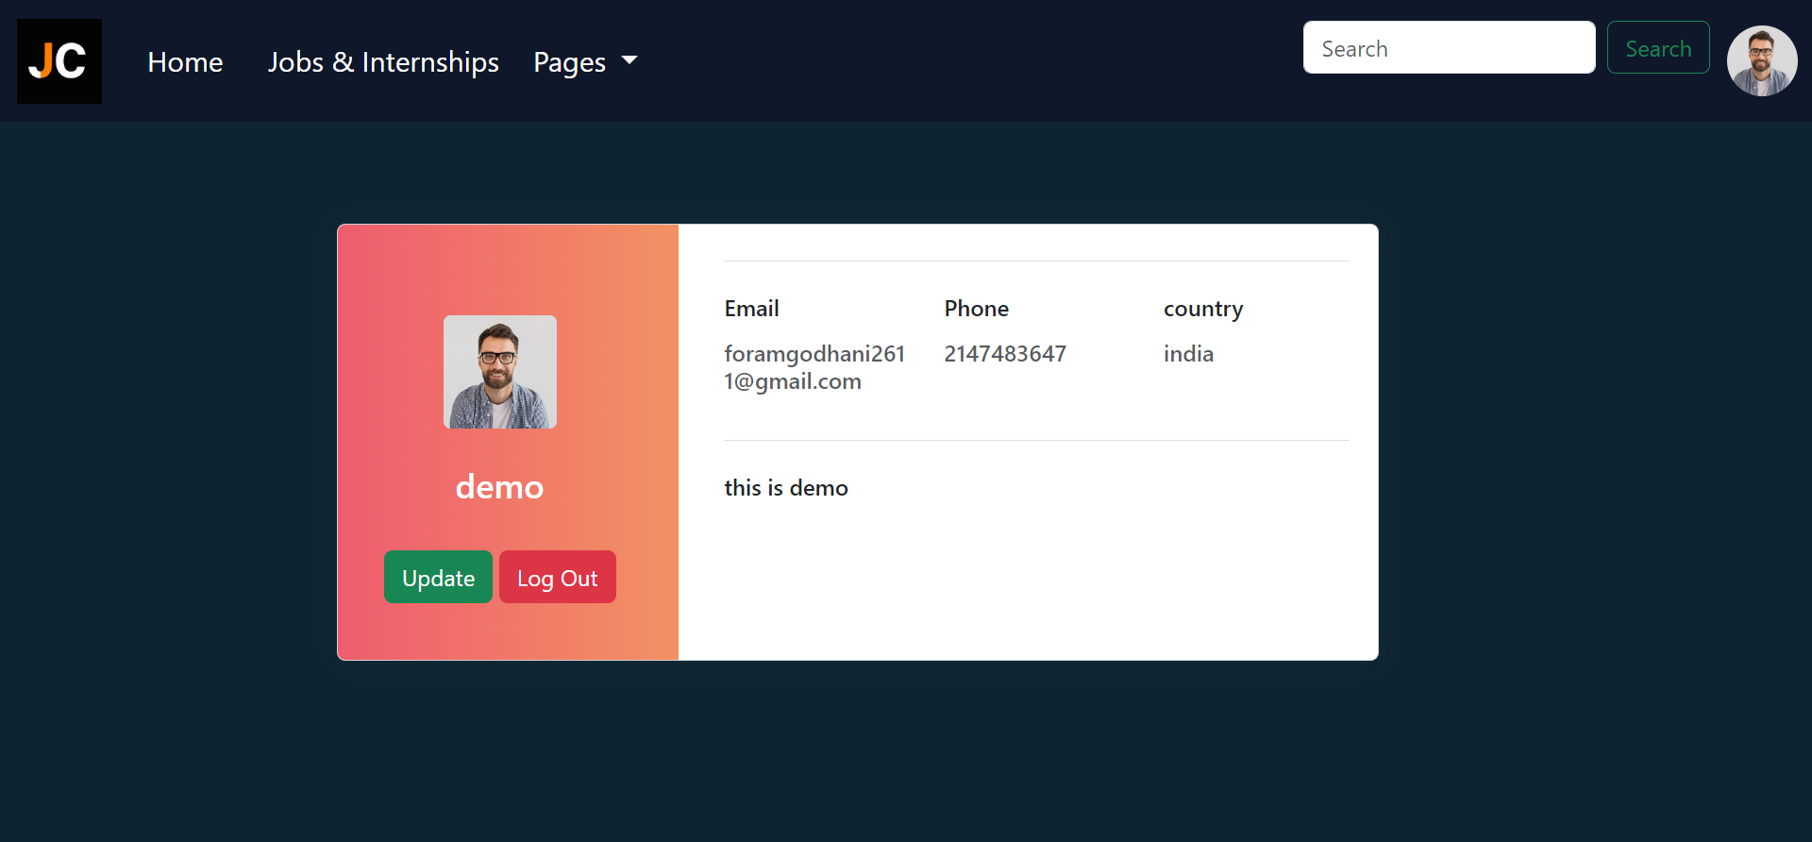
User_profile.php

Slide 37
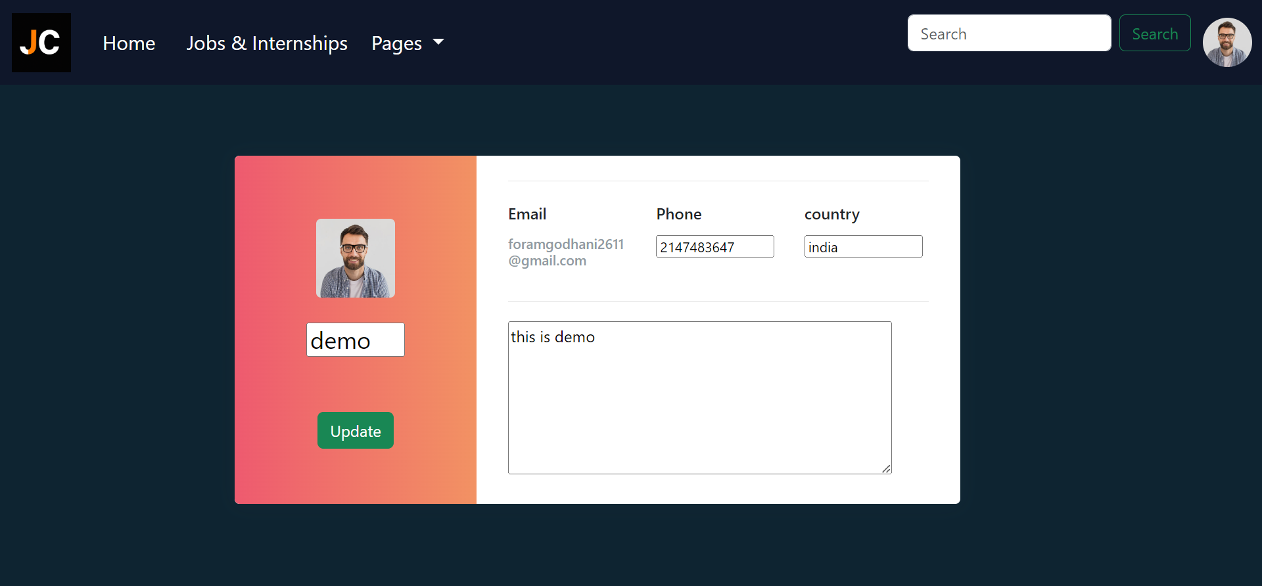
User_update.php

Slide 38
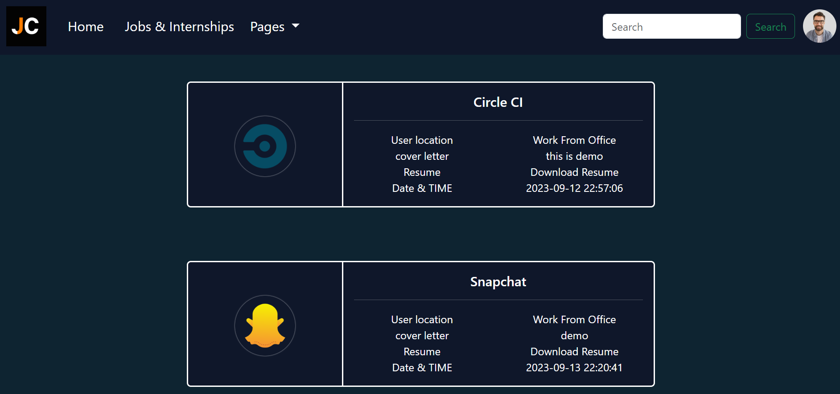
Your_applys.php

Slide 39

Contact_us.php

Slide 40
07
BIBLIOGRAPHY

Slide 41
WEBSITES
LIBRARIES
Bootstrap
ChatGPT
Canva
Slides go
Bootstrap
jQuery
PHPMailer
OTHER
Vscode
Figma
PHPMailer

Slide 42
Proper Validation: Enhancements in form validations across various pages.
Chat by Profile : we can Provide Chat System By Profile To Profile.
Security: Provide More Security Feature.
08
Future Enhancement

Slide 43
THANKS!
WITH JOBCONNECT, WE ARE COMMITTED TO REDEFINIG THE JOB SEARCH AND RECRUITMENT MANAGEMENT EXPERIENCE. MAKE FASTER AND MORE SECURE WAY TO GROW EMPLOYEE AND COMPANIES FUTURE…

